Slide 1

State

Slide 2
Why use Redux?
state
Lifting state
Lifting state
Lifting state
Lifting state
ADD
Counter

Slide 3
Why use Redux?
state
Lifting state
Lifting state
Lifting state
Lifting state

Slide 4
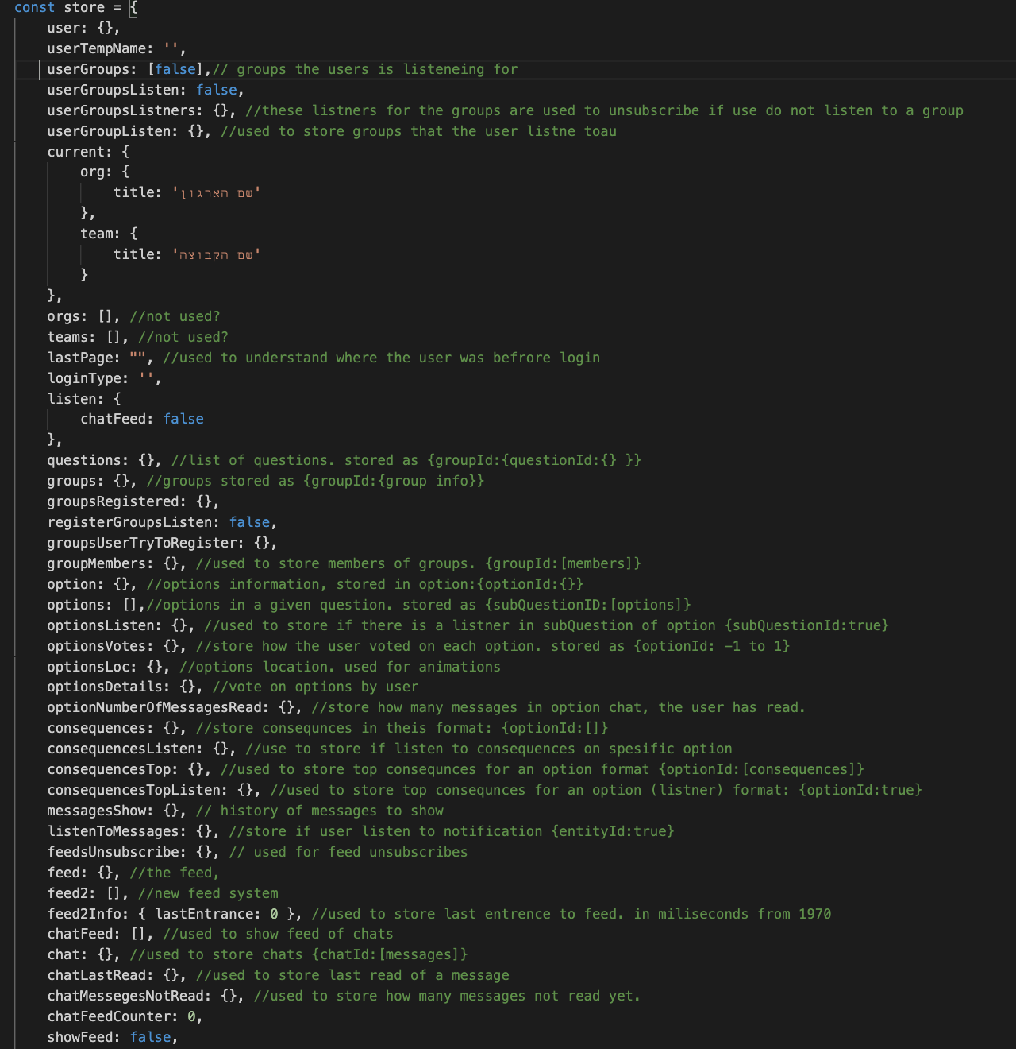
Why use Redux?

Slide 5
Why use Redux?
Actions (type, payload)

Slide 6
Why use Redux?
Reducer (the way to change)
Actions (type, payload)

Slide 7
Why use Redux?
Reducer (the way to change)
Actions (type, payload)
immutable
Virtual DOM
Time travel

Slide 8
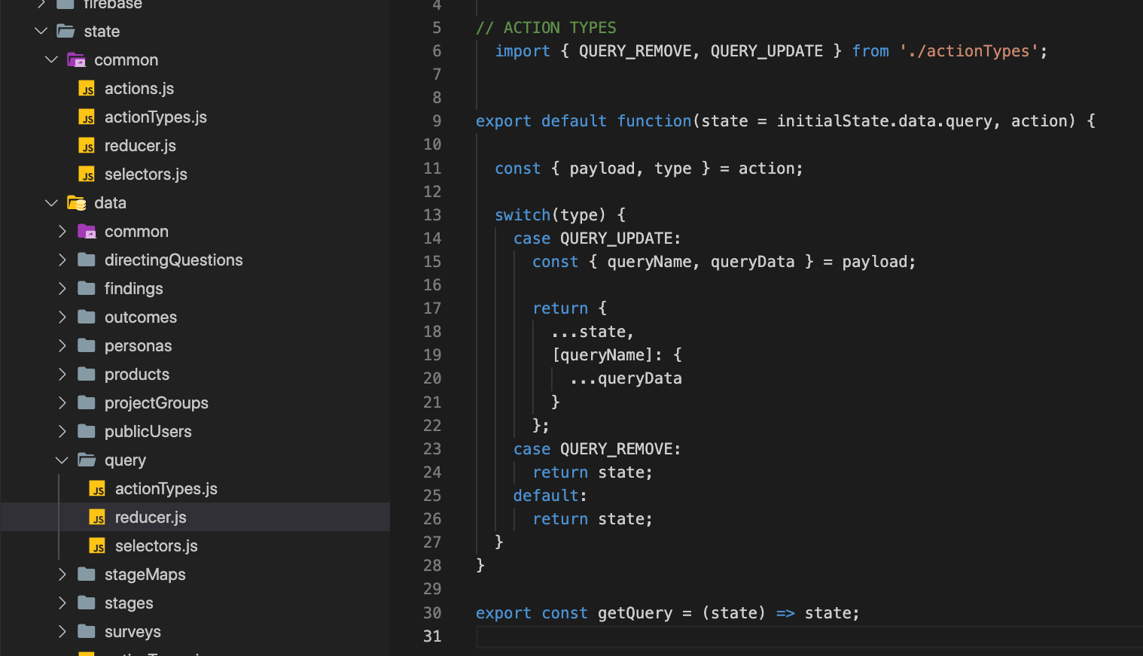
Why use Redux?

Slide 9
Why use Redux?
state
Lifting state
Lifting state
Lifting state
Lifting state

Slide 10
Why use Redux?
state
useSelector
useSelector
dispatch
dispatch

Slide 11
Why use Redux (speed)?
RealTime
state
Lifting state
Lifting state
Lifting state
Lifting state

Slide 12
Why use Redux (speed)?
RealTime
state
useSelector
useSelector

Slide 13
Why use Redux (speed)?
RealTime
RealTime
state
useSelector
useSelector

Slide 14

Dispatch(action)
Send it to the store
Action
Object that describes what happened
reducer(state, action)
functions that calculate a new state based on the old state and the action
Store
One state tree for all the app

Slide 15
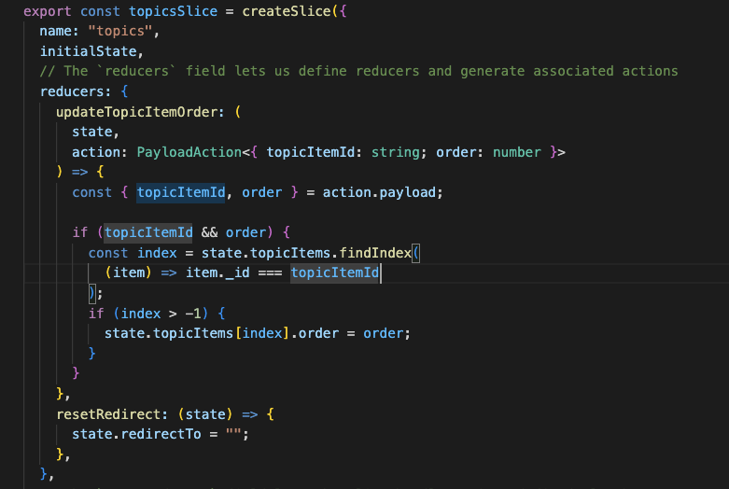
Dispatch(action)
Send it to the store
Action
Object that describes what happened
reducer(state, action)
functions that calculate a new state based on the old state and the action
Store
One state tree for all the app
dispatch
action
reducer

Slide 16
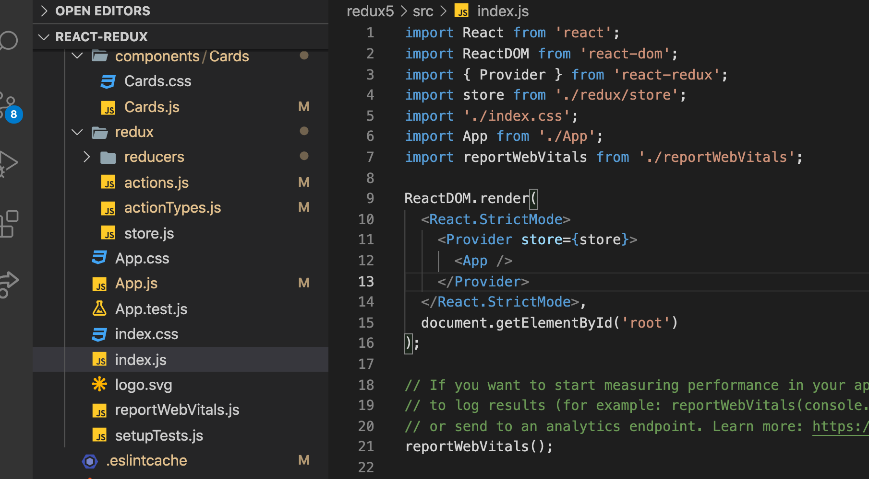

Slide 17
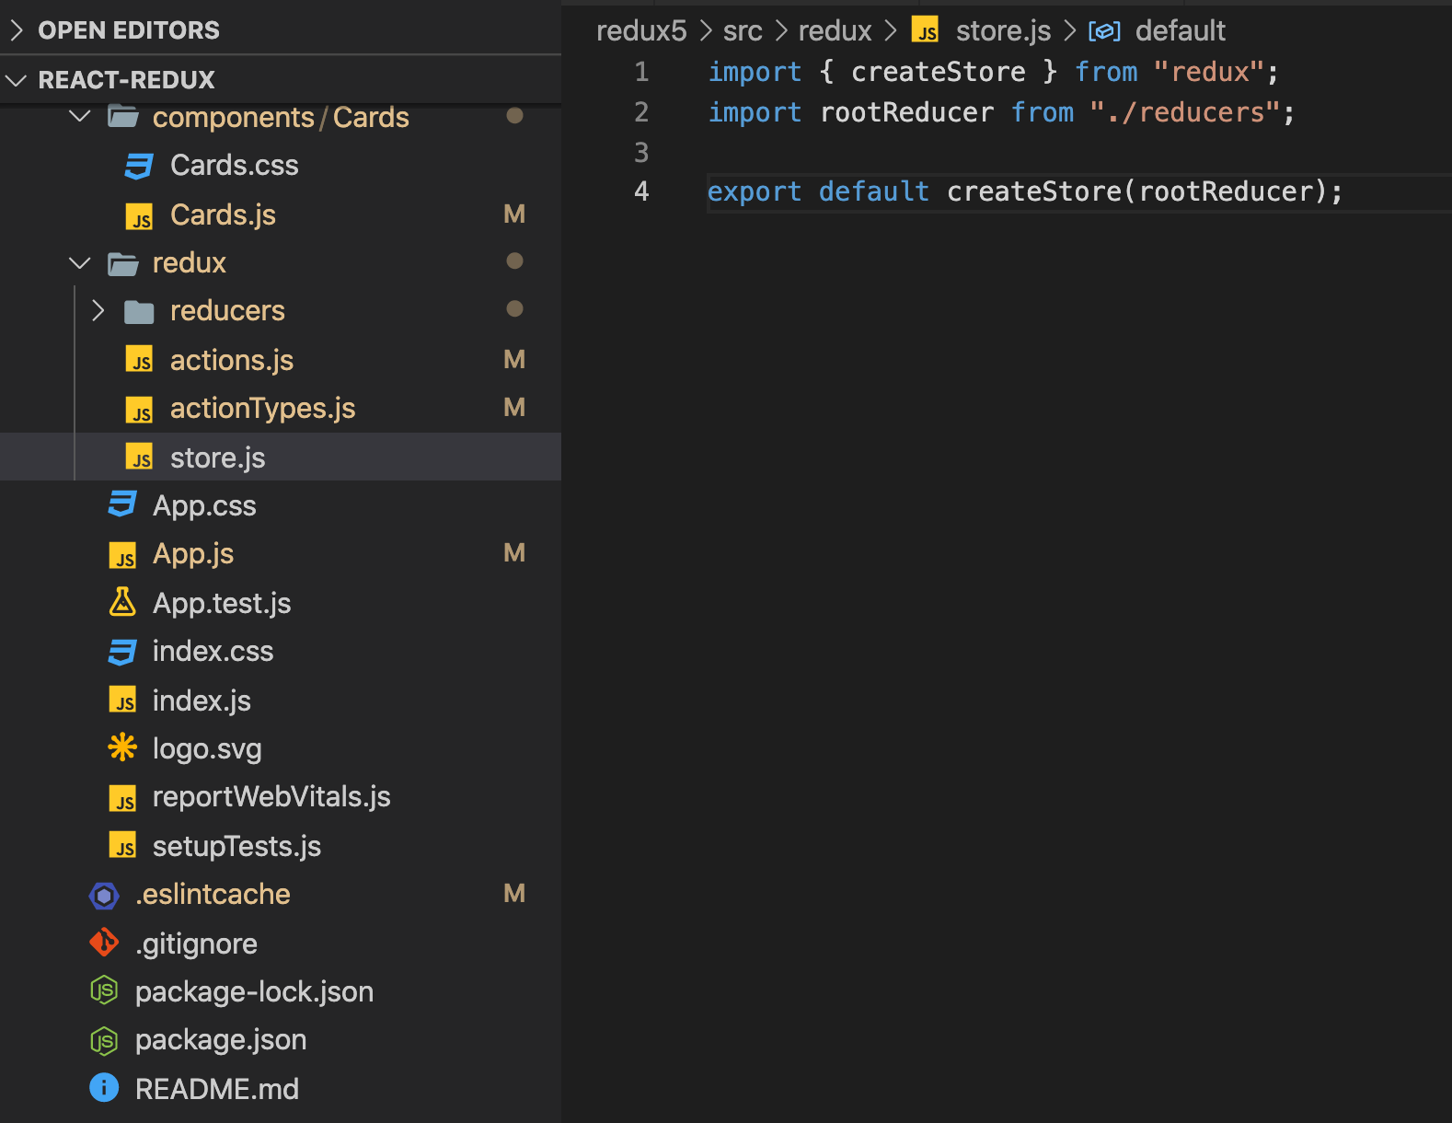
Reducer (how to change)
Actions (type, payload)

Slide 18
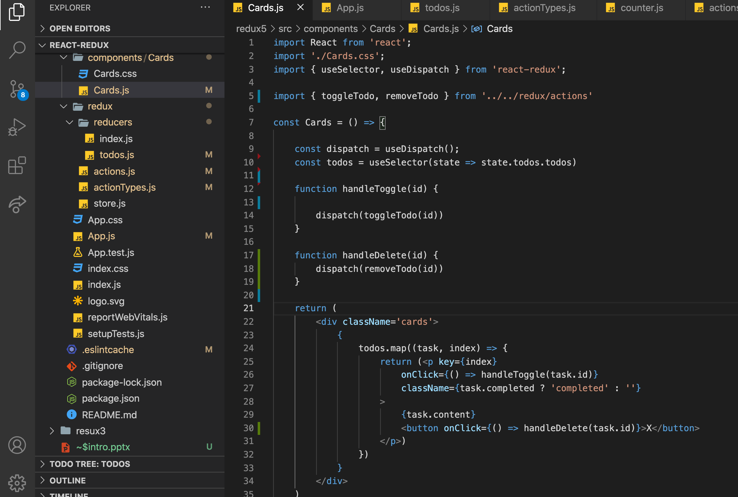

Slide 19
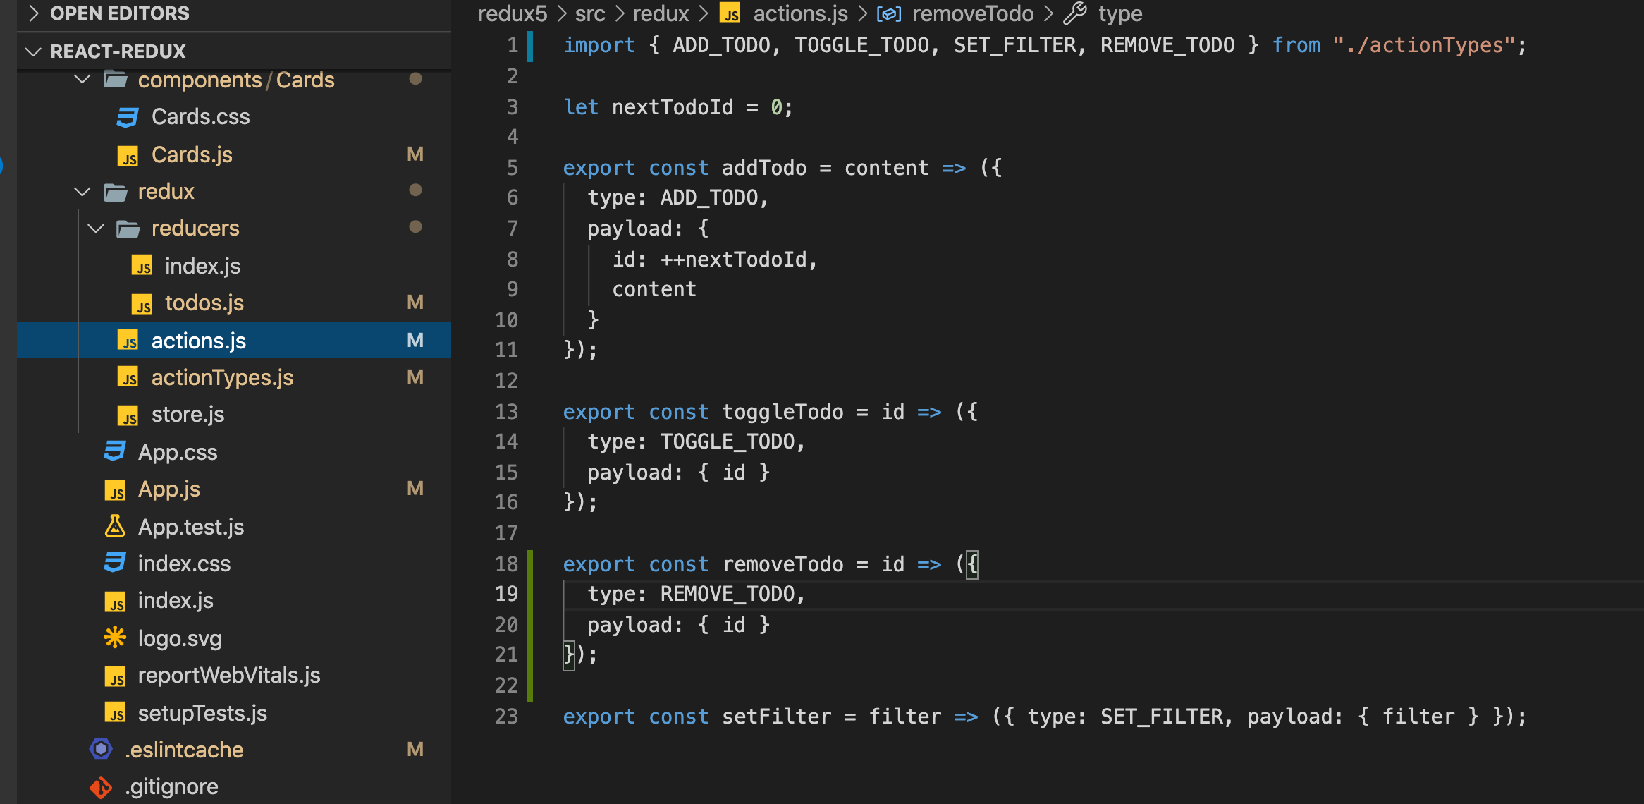

Slide 20
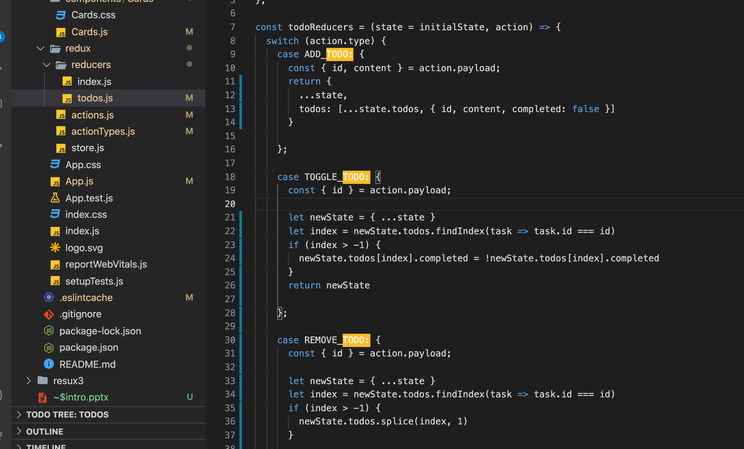

Slide 21
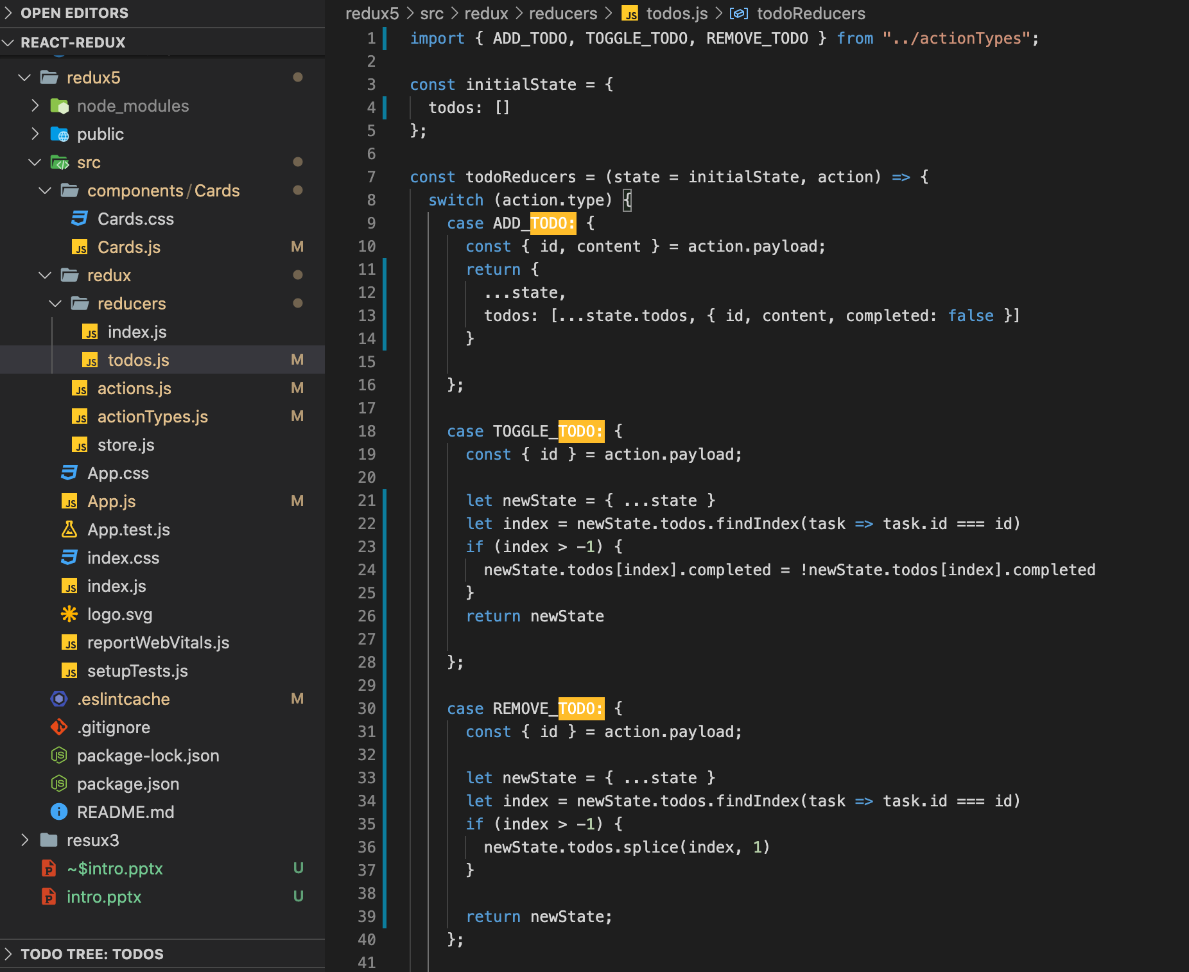

Slide 23
The Redux Cycle
state
Reducer (the way to change)
Reducer (the way to change)
Actions (type, payload)
Actions (type, payload)
useSelector
useSelector
dispatch
dispatch

