Slide 1
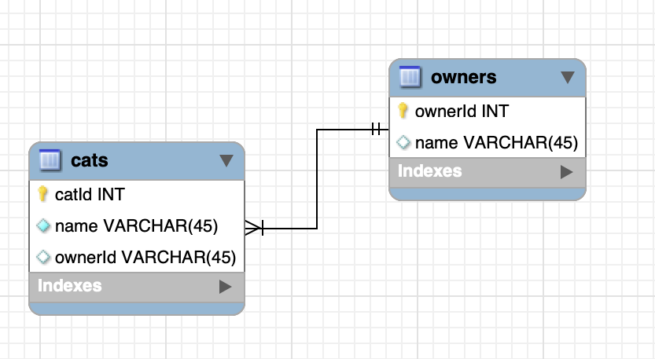

SQL
cats
Id Name ownerId
owners
Id Name city
Cats-Owners
cat-id Cat.name Owner.Name city
Introduction

Slide 2
SQL
Introduction

