Slide 1
JSX
נערך על ידי: גילי מנחם

Slide 2
AGENDA
Introduction​
Rules of JSX
​

Slide 3
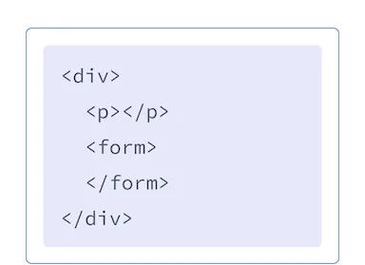
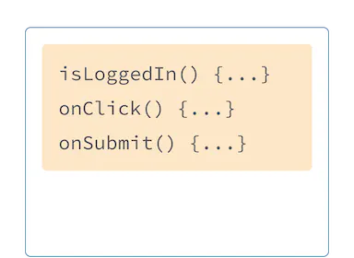
Introduction
JSX is a syntax extension for JavaScript that lets you write HTML-like markup inside a JavaScript file. Although there are other ways to write components, most React developers prefer the conciseness of JSX, and most codebases use it.

Slide 4
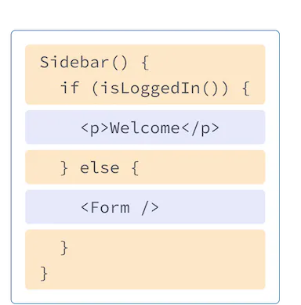
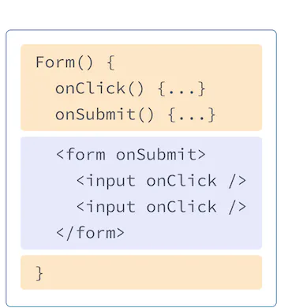
But as the Web became more interactive, logic increasingly determined content. JavaScript was in charge of the HTML! This is why in React, rendering logic and markup live together in the same place—components.

Slide 5



The Rules of JSX
Return a single root element
Close all the tags
camelCase all most of the things!
JSX looks like HTML, but under the hood it is transformed into plain JavaScript objects. You can’t return two objects from a function without wrapping them into an array. This explains why you also can’t return two JSX tags without wrapping them into another tag or a Fragment.
JSX requires tags to be explicitly closed: self-closing tags like <img> must become <img />, and wrapping tags like <li>oranges must be written as <li>oranges</li>.
JSX turns into JavaScript and attributes written in JSX become keys of JavaScript objects. In your own components, you will often want to read those attributes into variables. But JavaScript has limitations on variable names. For example, their names can’t contain dashes or be reserved words like class.

Slide 6
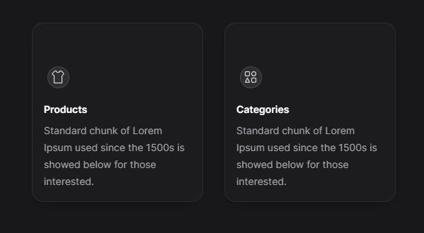
task

