Slide 1
NODEJS - EXPRESS
Express
Fast, unopinionated, minimalist web framework for Node.js

Slide 2
Simple server

Slide 3
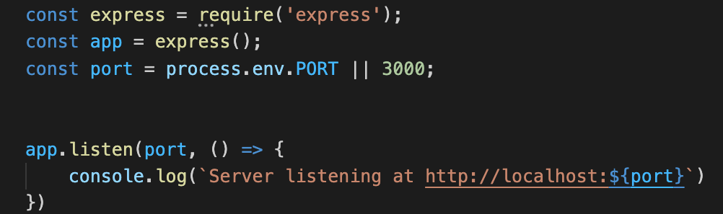
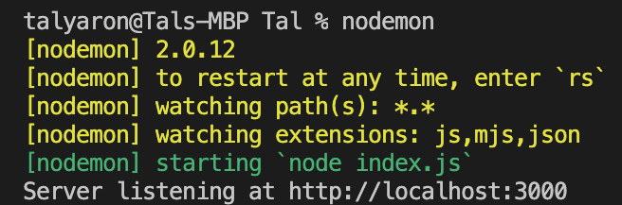
Simple server
Terminal

Slide 4
Simple server
Importing express from node_modules
Terminal

Slide 5
Simple server
Setting an instance of the server
Terminal

Slide 6
Simple server
Getting the port from the host (if on remote host) or setting it to 3000 in local host
Terminal

Slide 7
Simple server
The server now listen to requests from clients on the specific port
Terminal

Slide 8
Serving static files
HTML, CSS, JS, IMG

Slide 9
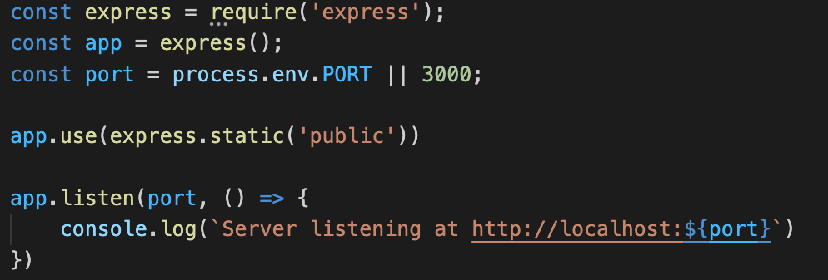
Static files
Static files can be served from public folder

Slide 10
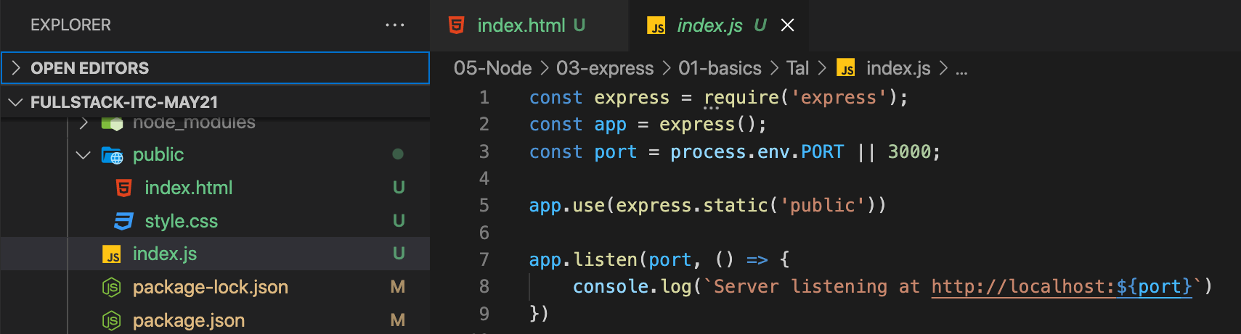
Static files
Static files can be served from public folder
Static files can be served from public folder

Slide 11
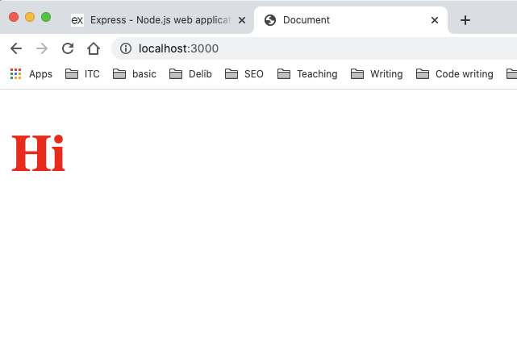
Static files
This is the static file index.html with a link to style.css

Slide 12
Simple routes

Slide 14
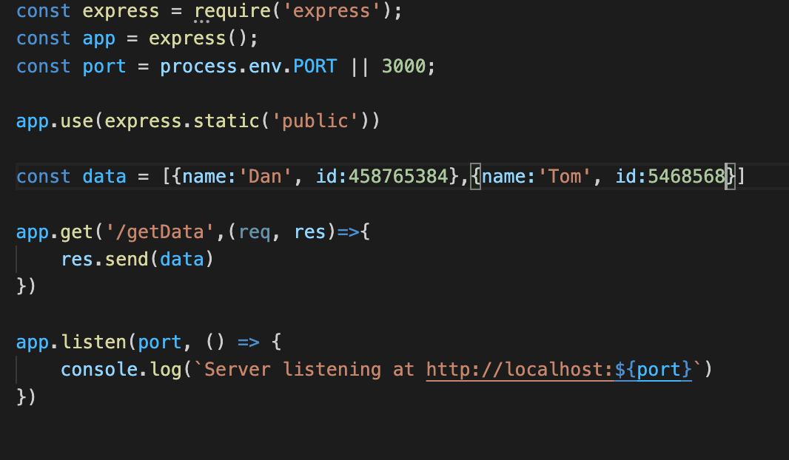
Simple route
A client can request or send a data in a route

Slide 15
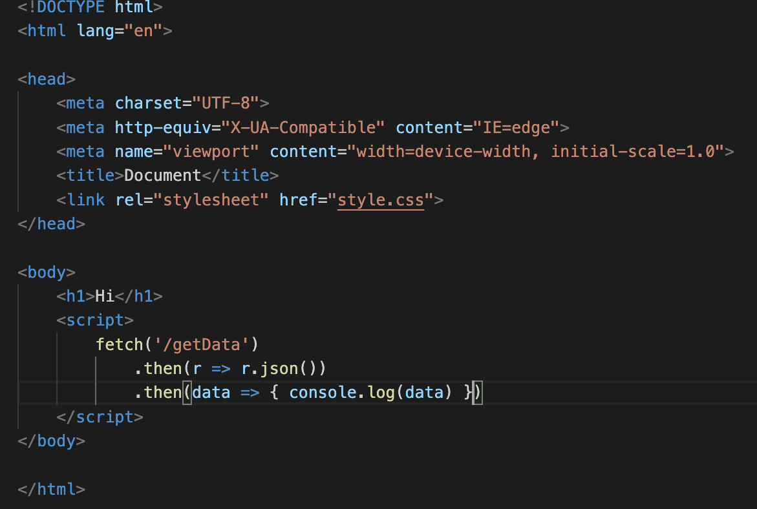
Simple route
A client can request or send a data in a route

Slide 16
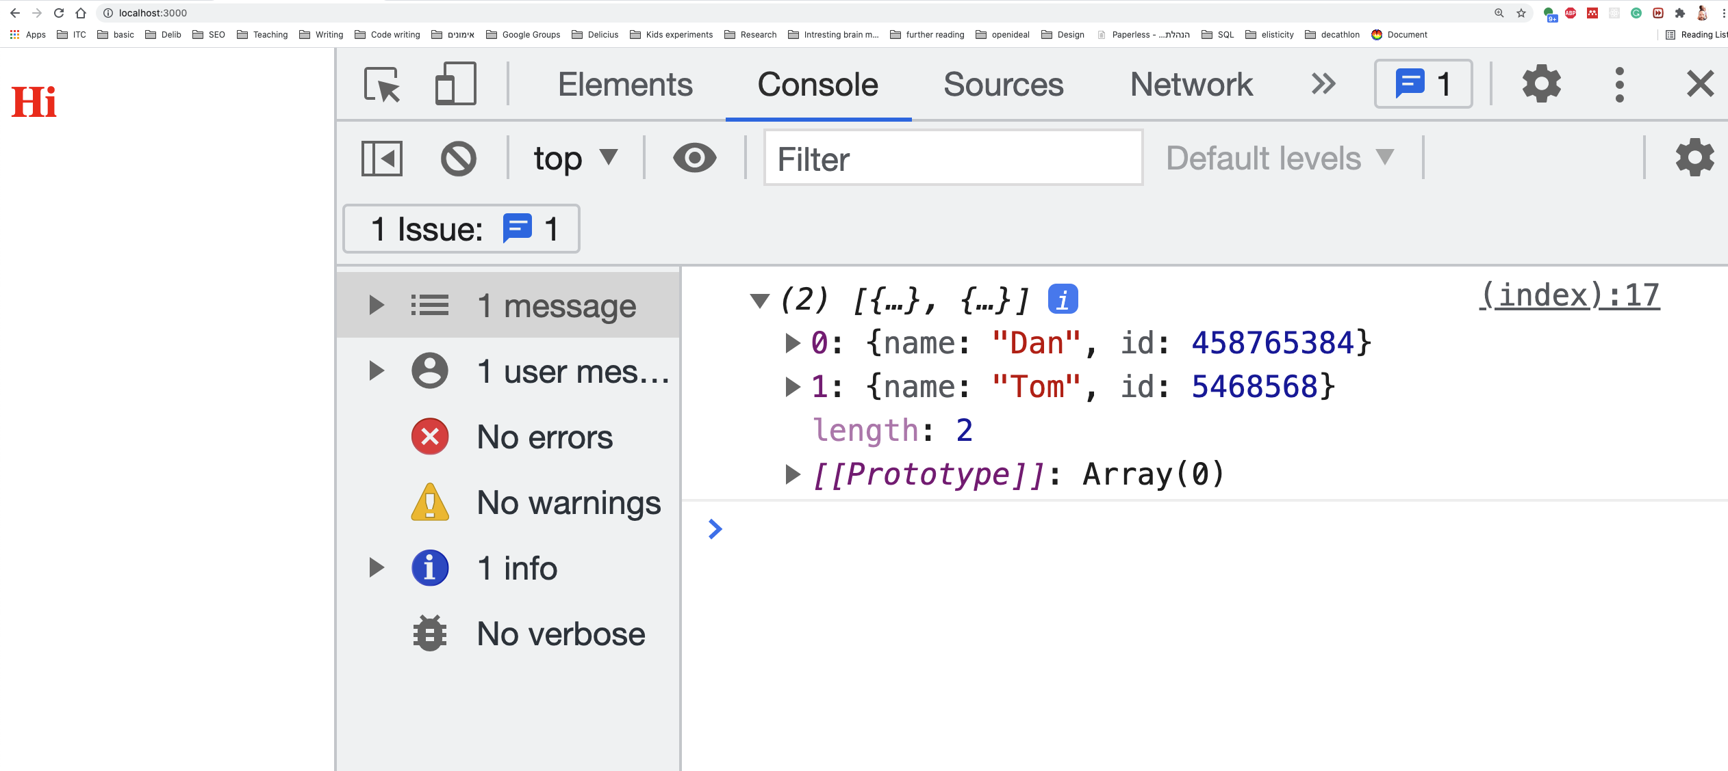
Simple route
A client can request or send a data in a route

Slide 17
Crud

Slide 19
AXIOS
Promise based HTTP client for the browser and node.js

Slide 20
Axios

Slide 21
Axios
Axios is an easy-to-use liberary for sending request to the server.
It can send request from the client to the server and from server to another server

Slide 22
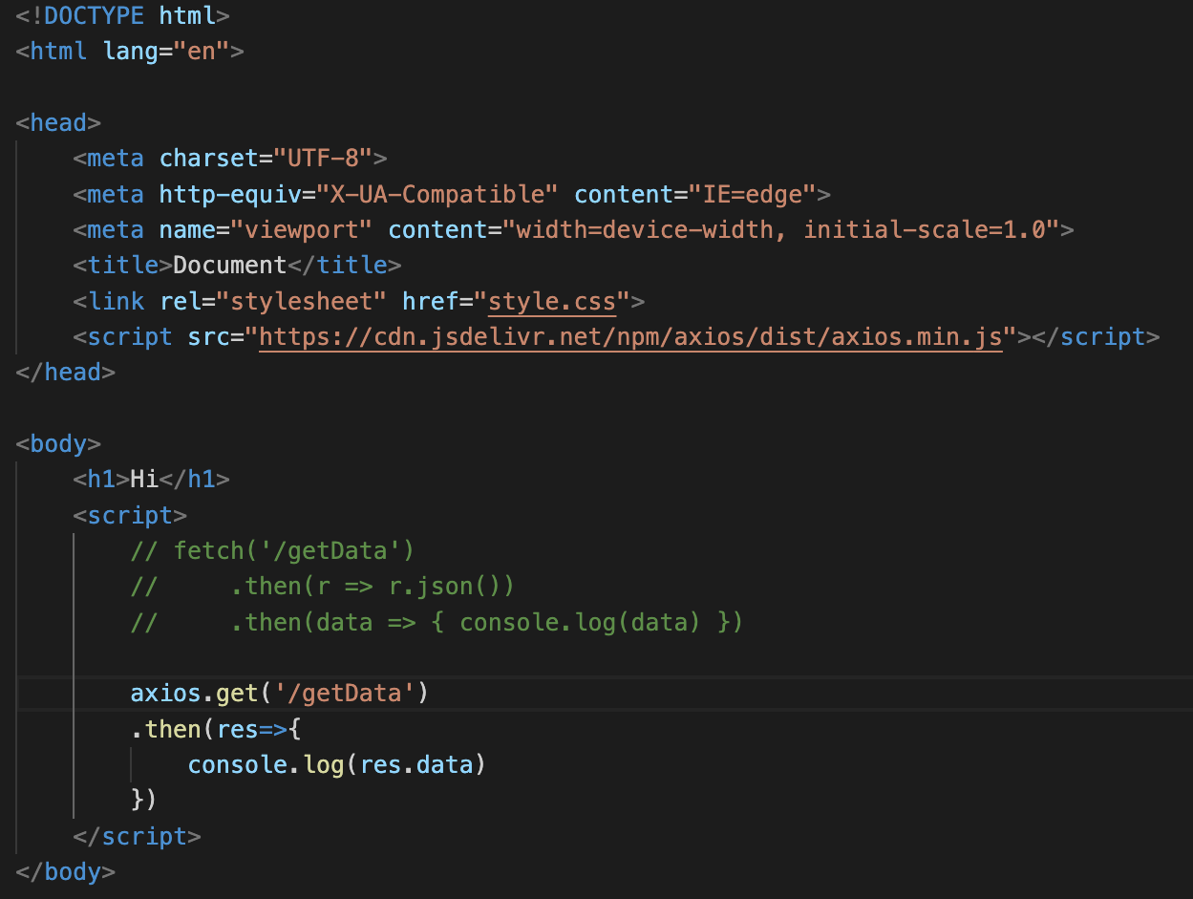
Set the CDN
(Content delivery network)
A get request using cdn

Slide 23

CRUD
Create - post
Read – get
Update – put
Delete - delete

Slide 24
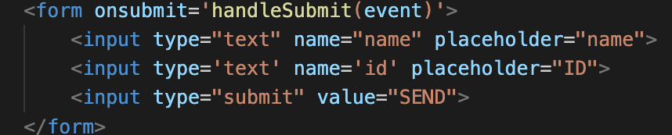
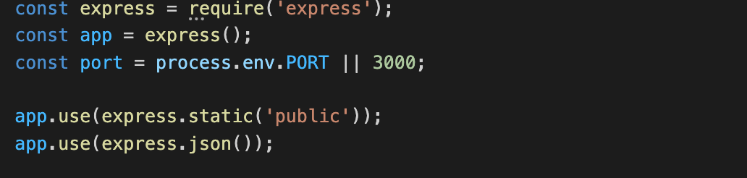
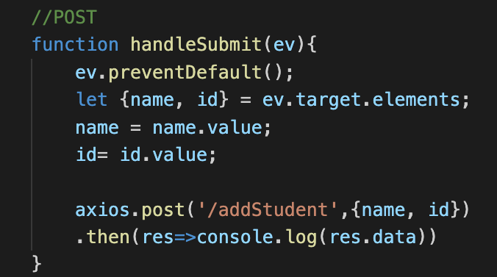
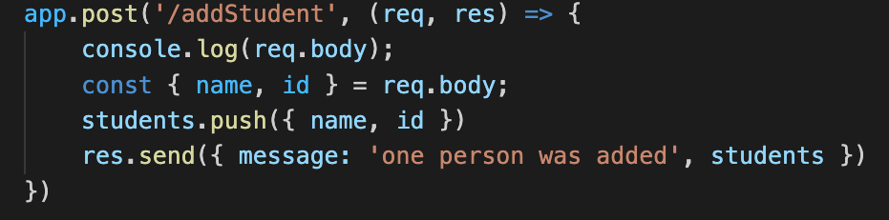
POST
Client
Server

Slide 25
POST
To be able to read the data (‘Body’), you must add this line
Client
Server

Slide 26
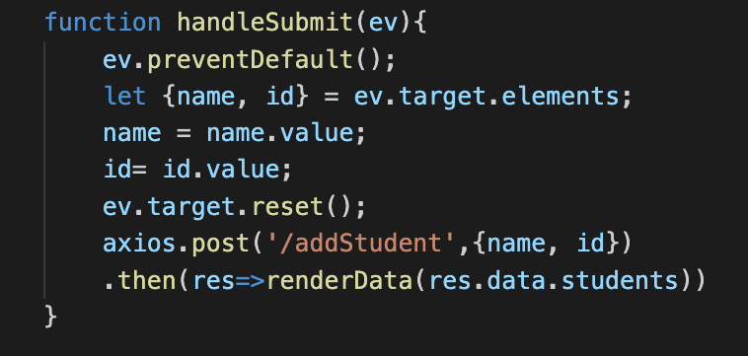
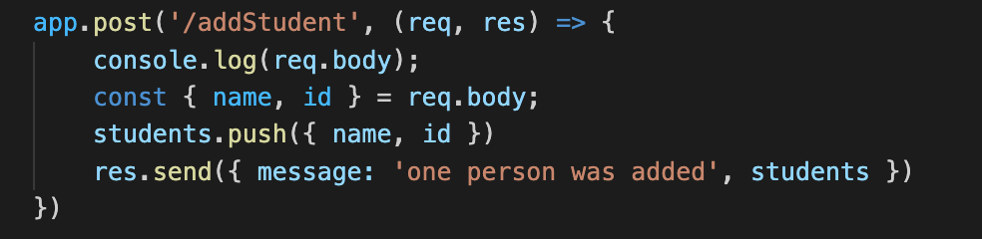
POST
Client
Server
A post route, which takes data from the body, and add it to a data array

Slide 27
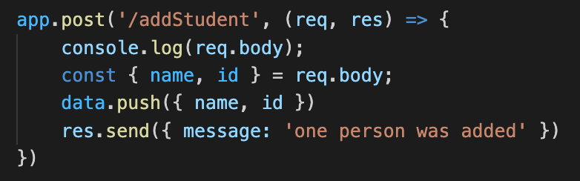
POST
Client
Server
This is the “body” sent from the client

Slide 28
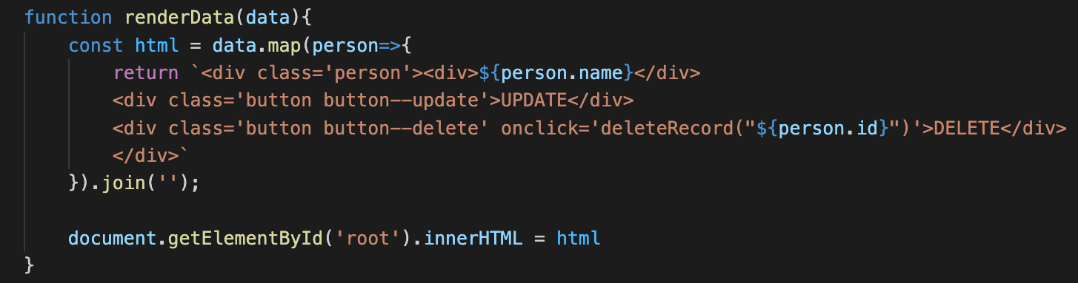
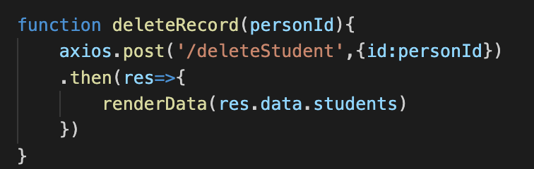
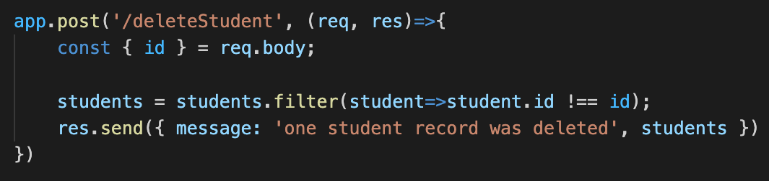
DELETE
Client
Server

Slide 29
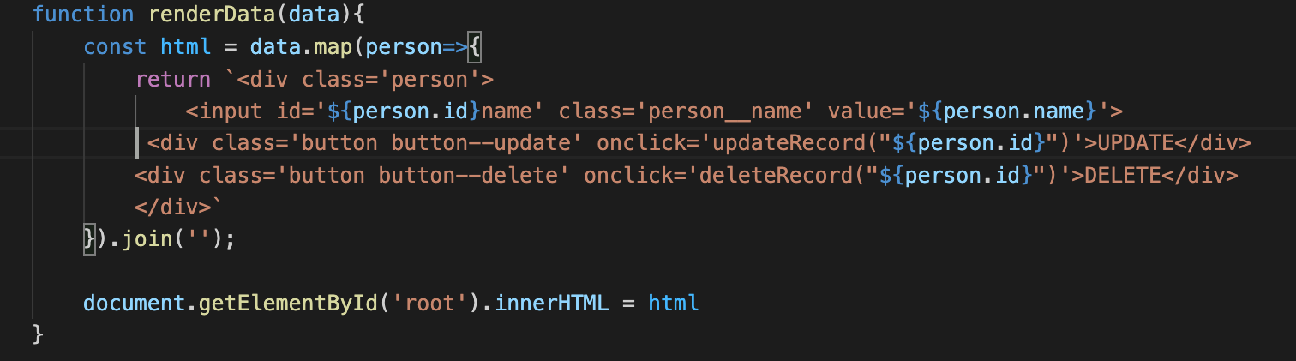
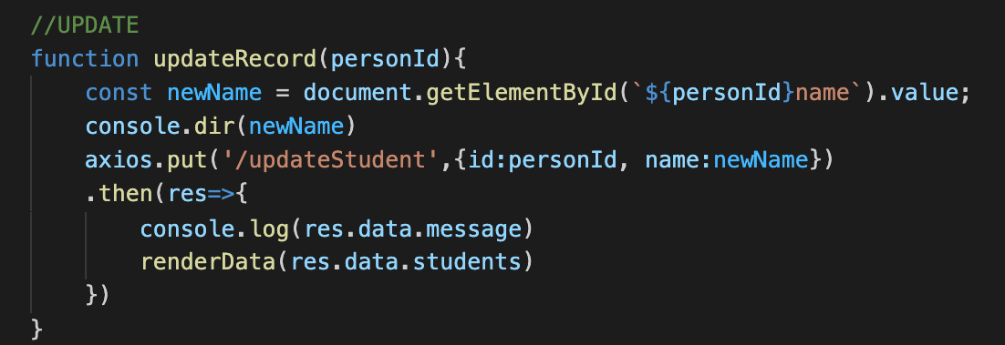
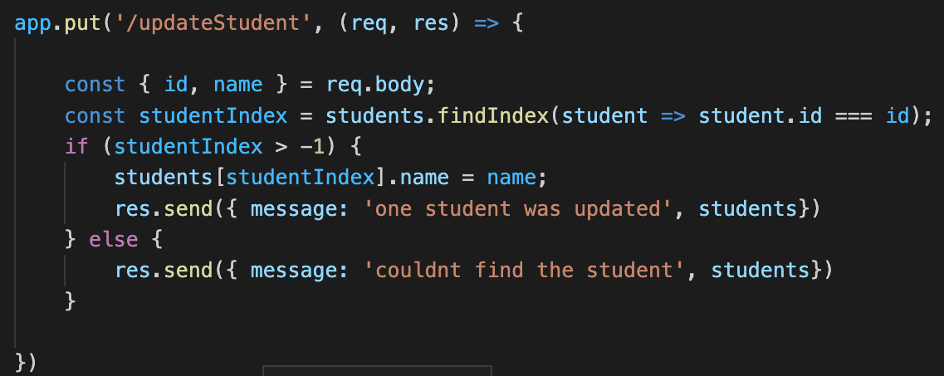
UPDATE
Client
Server

Slide 30
Routes and controlers

Slide 31
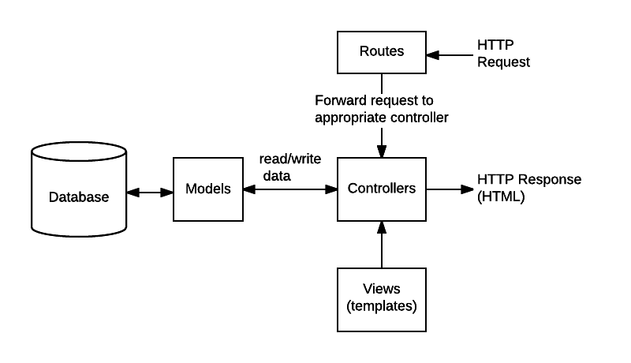

Slide 32
In our case these are the static files
https://developer.mozilla.org/en-US/docs/Learn/Server-side/Express_Nodejs/routes

Slide 33
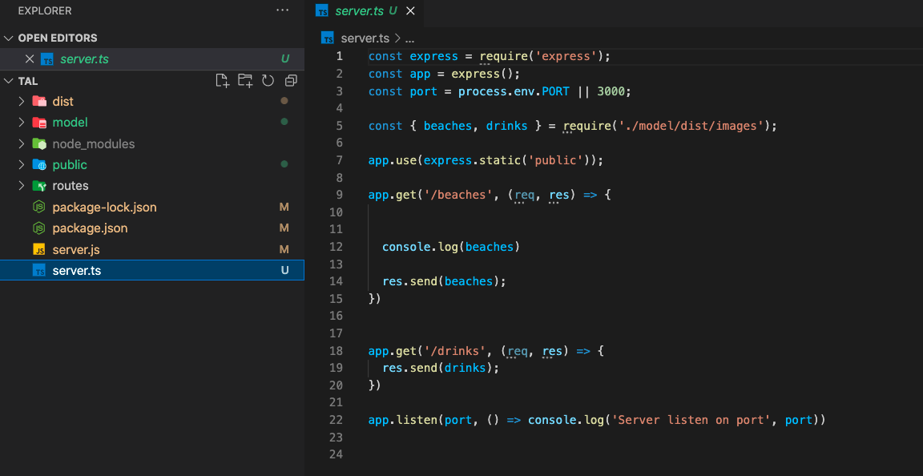

Slide 34
We can store here our interfaces classes and data

Slide 35
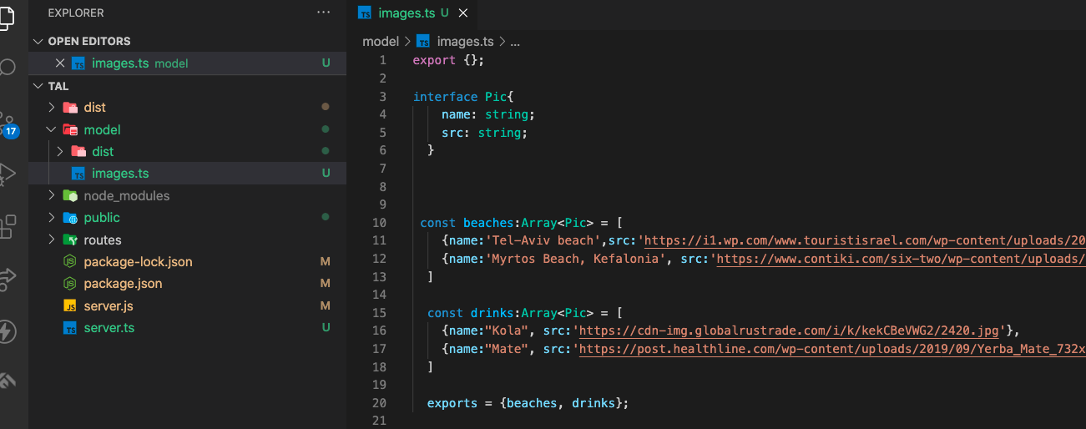
Model (data)

Slide 36
We can put the routes in a specific folder

Slide 37
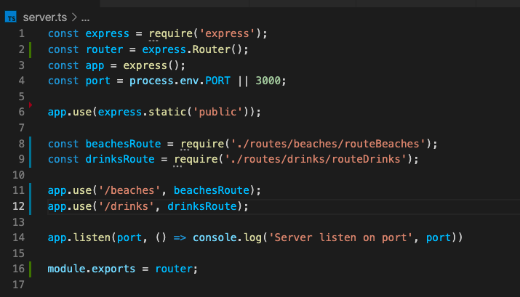

Slide 38
We import the routes

Slide 39
And we use them

Slide 40
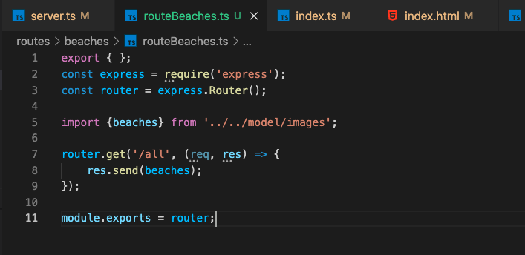

Slide 41
We import the data (model)
We export the router
We export the router

Slide 42
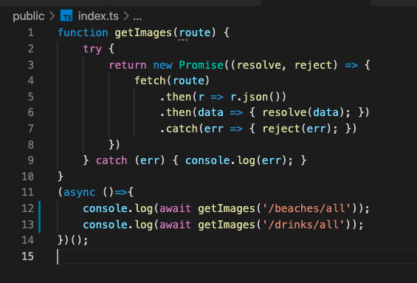


The route is composed from two pieces
The route in the server.js
The route in the routeBeaches.js

Slide 43
Cookies

Slide 44
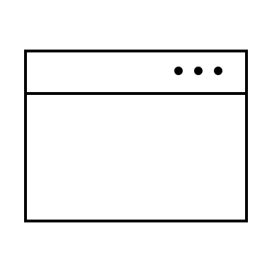

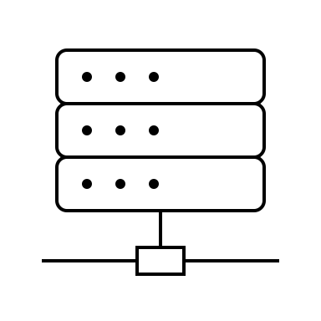

Slide 45

Login data other data
Login data other data
sessionTime (maxAge)
Data (about the user)

Slide 46
Login data other data
Login data other data

Slide 47
sessionTime (maxAge)
Data (about the user)

Slide 48
sessionTime (maxAge)
Data (about the user)
sessionTime (maxAge)
Data (about the user)

Slide 49
sessionTime (maxAge)
Data (about the user)

Slide 50
sessionTime (maxAge)
Data (about the user)

Slide 51
sessionTime (maxAge)
Data (about the user)
sessionTime (maxAge)
Data (about the user)

Slide 52
Middlewares

Slide 53
middlware
App.use(bodyParser)
middlware
App.use(cookie-parser)
middlware
App.use(isTheUserAllowedInThisRoute)

Slide 54
Middleware
Middlware are like functions inside express
They are functions which usualy get the request, extract some info, and set new info to req or res objects
They can also be used for authrization. They can check if the user is authorized. If it is false, they can return 401

Slide 55
usage
Authurization
Getting info from cookies
Getting body
Getting headers
Responding to headers
Etc…

Slide 56

req, res
getName
Req.name = req.cookie.name
next
401
res
req, res
isAdmin
Req.role = req.cookie.role
If not admin
next

Slide 57
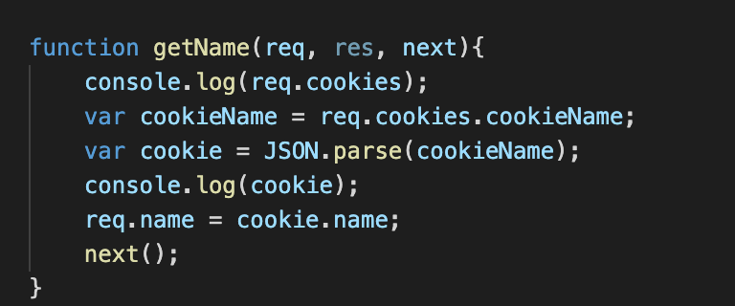
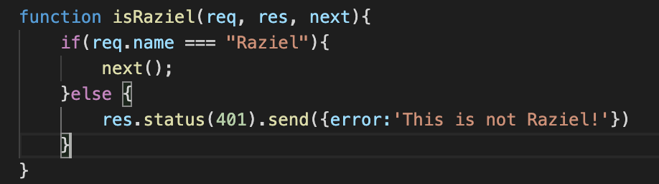
Get the name from the cookie and proceed
Check if the user is Raziel. If no, return 401 error. If it is Raziel, proceed (next)

Slide 58

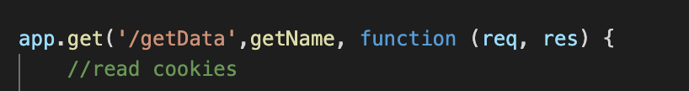
Use on all routes (under the invocation)
Use on specific route

