Slide 1
Animations

Slide 2
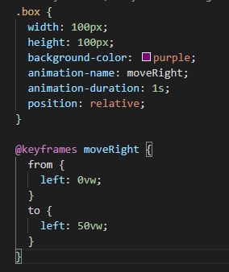
Basic animations
Animations: the setting of the animation
Keyframes: from → to

Slide 3
Animation settings
animation-name: the name of the animation to be used inside the class

Slide 4

Animation settings
animation-duration: the duration of the animation in ms (1/1000 of a second) or in s (seconds)

Slide 5
Animation settings
animation-delay: the duration before the start of the animation in ms (1/1000 of a second) or in s (seconds)

