Slide 1
Functions

Slide 2

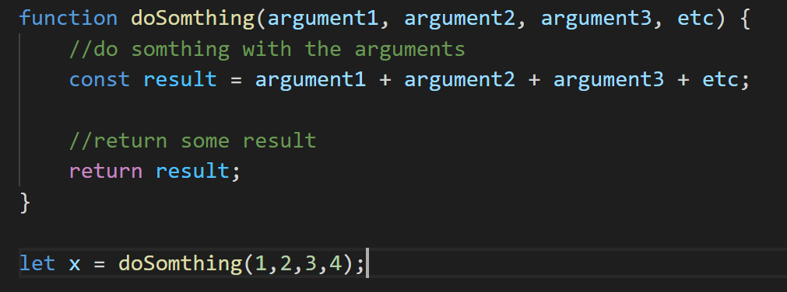

Function

Slide 3
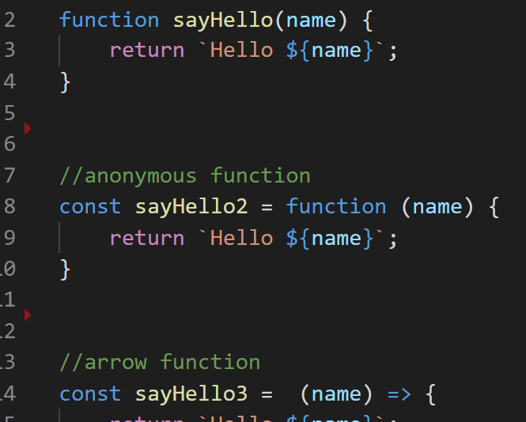
3 ways to write a function

