Slide 1
Functions

Slide 2

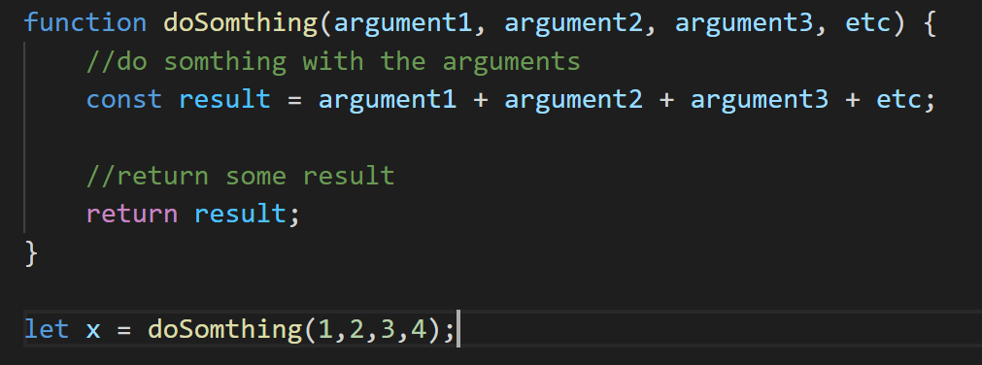

Function

