Slide 1
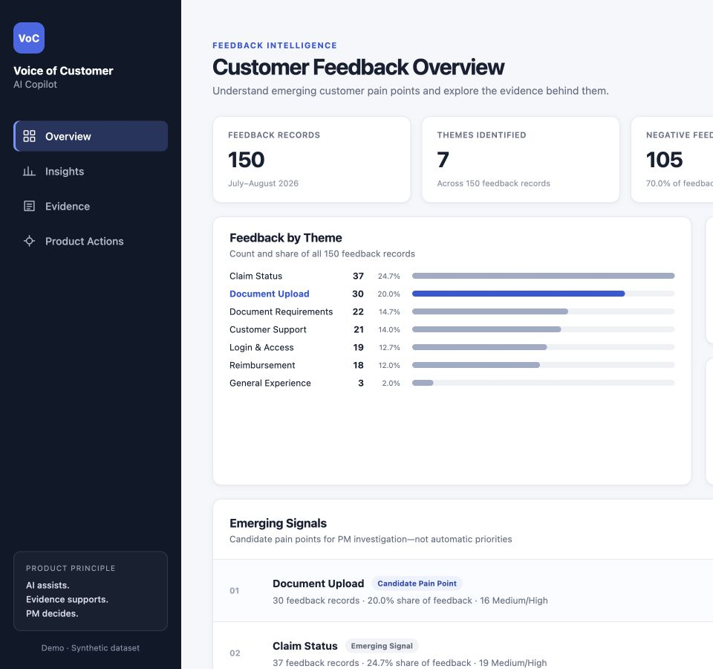
AI PRODUCT MANAGEMENT CASE STUDY
Voice of Customer
AI Copilot
Turning unstructured insurance feedback into traceable product signals
SYNTHETIC DATASET
Product strategy · Prototype · AI evaluation
Notes:
WHAT TO SAY
Introduce this as a Product Management case study. The system helps a PM move from raw feedback to a candidate pain point, supporting evidence, and an investigation decision.
WHY THIS SLIDE EXISTS
Set the product and audience before discussing implementation.
TAKEAWAY
Evaluation shaped the product boundaries.
DO NOT OVERCLAIM
Do not imply deployment, real insurer data, or measured business impact.
LIKELY FOLLOW-UP
What did you personally do? Explain the problem framing, taxonomy, prototype, human references, experiments, and final evaluation.
SOURCES
web-prototype; evaluation_final_holdout_report.md

Slide 2
CASE STUDY
Product Managers receive feedback as text, not decisions
Feedback arrives across channels with different wording and levels of detail.
01
Which product area is involved?
RAW FEEDBACK
“Did the file arrive?”
02
What kind of feedback is this?
“Why did my status move back?”
03
How much impact does the text describe?
“Which receipt do I need?”
“Please add separate profiles.”
04
Which records support the pattern?
The opportunity is faster evidence review, not automated prioritization.
VOICE OF CUSTOMER AI COPILOT
02
Notes:
WHAT TO SAY
Start with the PM problem. Free text contains useful evidence but resists comparison and verification at scale.
WHY THIS SLIDE EXISTS
Prevent the story from becoming an API implementation demo.
TAKEAWAY
The product should accelerate evidence review while preserving PM judgment.
DO NOT OVERCLAIM
No time-to-insight reduction or market-volume claim was measured.
LIKELY FOLLOW-UP
Why not automate prioritization? Severity reliability and ambiguity make human review necessary.
SOURCES
web-prototype/src/App.jsx; project brief

Slide 3
CASE STUDY
Product opportunity and value hypothesis
PRODUCT HYPOTHESIS
If PMs can identify recurring friction and trace it back to customer evidence faster, they can spend less time organizing feedback and more time investigating the problems that deserve attention.
Faster synthesis
Earlier visibility
Evidence-backed investigation
Less manual effort organizing feedback before analysis.
Recurring friction becomes easier to spot across many records.
Patterns remain linked to customer feedback before a PM acts.
VALUE HYPOTHESIS
To be validated with real PM workflows and production data
VOICE OF CUSTOMER AI COPILOT
03
Notes:
WHAT TO SAY
I added this product hypothesis to make the company rationale explicit. The opportunity is to reduce the manual setup around feedback analysis so a Product Manager can spend more time investigating evidence and less time organizing comments.
WHY THIS SLIDE EXISTS
Connect the PM problem to potential organizational value before showing the solution.
TAKEAWAY
The proposed value is faster synthesis, earlier visibility into recurring friction, and more traceable investigation.
DO NOT OVERCLAIM
These are hypotheses. I did not measure time saved, customer outcomes, cost reduction, or revenue impact.
LIKELY FOLLOW-UP
How would you validate the value? Observe real PM workflows and measure time to a defensible insight, evidence usage, and correction effort.
SOURCES
Product hypothesis derived from the prototype workflow and project problem statement. No measured business outcome.

Slide 4
CASE STUDY
Primary user and job to be done
PRIMARY USER
JOB TO BE DONE
Product
Manager
When reviewing a large feedback set, help me find recurring friction and inspect the evidence so I can decide what needs deeper investigation.
Owns the product decision and the investigation that follows.
AI organizes the evidence
PM owns the decision
Customer Service Manager remains a possible future user, not part of the focused MVP story.
VOICE OF CUSTOMER AI COPILOT
04
Notes:
WHAT TO SAY
Keep one primary user: the Product Manager. The job is to reach a defensible investigation question from a large feedback set.
WHY THIS SLIDE EXISTS
A focused persona clarifies the MVP and decision owner.
TAKEAWAY
The PM owns interpretation and priority.
DO NOT OVERCLAIM
Do not claim the AI discovers root cause.
LIKELY FOLLOW-UP
Who else could use it? Research, support, or operations teams could be later users after PM workflow validation.
SOURCES
web-prototype/src/App.jsx

Slide 5
CASE STUDY
Product workflow
01
02
03
04
05
06
Customer
feedback
AI
classification
Structured
signals
Candidate
pain point
Customer
evidence
PM
investigation
AI structures and surfaces signals
The Product Manager decides what deserves action
VOICE OF CUSTOMER AI COPILOT
05
Notes:
WHAT TO SAY
Walk through the system from feedback to investigation. Classification enables aggregation, and evidence remains attached to every insight.
WHY THIS SLIDE EXISTS
Show the complete product logic in one view.
TAKEAWAY
AI produces decision support rather than a roadmap decision.
DO NOT OVERCLAIM
The AI summary is a candidate frame, not a proven root cause.
LIKELY FOLLOW-UP
Where does AI end? At classification and synthesis. The PM reviews evidence and decides status.
SOURCES
web-prototype/src/App.jsx; evaluation_taxonomy_v2.md

Slide 6
CASE STUDY
The prototype makes every insight traceable
01
Overview
Ranks candidate signals
02
Insight
Separates volume and share
03
Evidence
Returns to original records
04
Product action
Keeps the PM responsible
WORKFLOW PROTOTYPE
Earlier seven-theme UI taxonomy
VOICE OF CUSTOMER AI COPILOT
06
Notes:
WHAT TO SAY
Demonstrate the local prototype and its evidence path. Be explicit that the UI uses an earlier seven-theme classified dataset and omits Feedback Type.
WHY THIS SLIDE EXISTS
Show real product work without overstating taxonomy alignment.
TAKEAWAY
Traceability is the strongest product capability.
DO NOT OVERCLAIM
Do not imply the final V2 taxonomy is already implemented in the UI.
LIKELY FOLLOW-UP
Would you update it? Yes: align eight themes, add Feedback Type, and add review states.
SOURCES
web-prototype; customer_feedback_classified.csv

Slide 7
CASE STUDY
Four dimensions create more useful product signals
Theme
Feedback Type
Sentiment
Severity
What product area is involved?
What is the customer trying to communicate?
What attitude is expressed?
What impact is described?
Document Upload
Technical Issue
Negative
Medium
Separating subject, intent, attitude, and impact prevents one label from carrying four meanings.
VOICE OF CUSTOMER AI COPILOT
07
Notes:
WHAT TO SAY
Explain the behavioral contract. Each dimension answers a different question, and the model must choose exactly one primary label per dimension.
WHY THIS SLIDE EXISTS
Show why taxonomy design is product work.
TAKEAWAY
Sentiment and Severity remain independent from Theme and Feedback Type.
DO NOT OVERCLAIM
Emotional wording alone must not increase Severity.
LIKELY FOLLOW-UP
How handle mixed feedback? Choose the primary problem and flag genuinely plausible alternatives as Ambiguous.
SOURCES
evaluation_taxonomy_v2.md

Slide 8
CASE STUDY
Development and holdout served different purposes
DEVELOPMENT LANE
FINAL HOLDOUT
150
synthetic records
24
40
human-reviewed development records
locked records
Selected candidate evaluated once on unseen examples
V1 · V2 · V3
prompt experiments
V1
final candidate lock
NO POST-HOLDOUT TUNING
VOICE OF CUSTOMER AI COPILOT
08
Notes:
WHAT TO SAY
Explain that the 40 records became development data once prompt iterations used their results. The 24-record holdout remained untouched until final evaluation.
WHY THIS SLIDE EXISTS
Establish responsible evaluation and experiment integrity.
TAKEAWAY
Development supports iteration; holdout supports the final unseen test.
DO NOT OVERCLAIM
The holdout is small and coverage-focused, not representative of production prevalence.
LIKELY FOLLOW-UP
Why only 24? Portfolio scope; it provides disciplined evidence but limited statistical confidence.
SOURCES
evaluation_holdout_lock.md; evaluation_final_candidate_lock.md; evaluation reports

Slide 9
CASE STUDY
More prompt detail did not improve overall performance
Development set · n = 40
Prompt | Theme | Type | Sentiment | Severity | Exact
V1 | 97.5% | 85.0% | 82.5% | 92.5% | 67.5%
V2 | 95.0% | 90.0% | 52.5% | 82.5% | 37.5%
V3 | 95.0% | 87.5% | 85.0% | 85.0% | 62.5%
V2 improved Feedback Type but caused major regressions. V3 recovered much of the loss, yet V1 retained the strongest overall balance.
FINAL CANDIDATE: BASELINE V1
VOICE OF CUSTOMER AI COPILOT
09
Notes:
WHAT TO SAY
I compared three prompt versions on the same 40-record development set. V2 improved Feedback Type but caused major regressions. V3 recovered much of that loss, but V1 still had the strongest overall trade-off, so I selected V1 before touching the holdout.
WHY THIS SLIDE EXISTS
Show that prompt changes were treated as product experiments rather than assumed improvements.
TAKEAWAY
More prompt detail did not automatically create better product behavior.
DO NOT OVERCLAIM
These are development results. They supported selection but do not estimate final generalization.
LIKELY FOLLOW-UP
Why not choose the newest prompt? Because the product uses all four dimensions, and V1 performed better across the combined behavior.
SOURCES
evaluation_prompt_v1_v2_v3_comparison.md; evaluation_final_candidate_lock.md

Slide 10
CASE STUDY
The unseen holdout revealed uneven reliability
Final holdout · n = 24
Accuracy (%)
11 / 24
45.8% all-fields exact match
A record counts as exact only when all four fields agree.
45.8% is not a single overall ‘AI accuracy.’
Theme 100.0% Feedback Type 83.3% Sentiment 87.5% Severity 58.3%
VOICE OF CUSTOMER AI COPILOT
10
Notes:
WHAT TO SAY
Show every dimension rather than averaging away the weak one. Theme was perfect on this small balanced holdout; Severity was materially weaker.
WHY THIS SLIDE EXISTS
Present final unseen evidence honestly.
TAKEAWAY
Reliability varies by product signal.
DO NOT OVERCLAIM
Do not call exact match the general accuracy or claim production readiness.
LIKELY FOLLOW-UP
Why did holdout differ? It exposed different boundaries, especially No Issue versus Low.
SOURCES
evaluation_final_holdout_report.md

Slide 11
CASE STUDY
Severity was the weakest signal on unseen data
Human label
Gemini prediction
No Issue
Low
Medium
High
7 of 10
No Issue
3
7
0
0
No Issue records predicted Low
The largest failure pattern
Low
1
3
2
0
Medium: 6 of 6 correct
Medium
0
0
6
0
High: 2 of 2 correct
High
0
0
0
2
The main boundary problem was no stated impact versus limited impact.
VOICE OF CUSTOMER AI COPILOT
11
Notes:
WHAT TO SAY
Seven of ten No Issue records became Low, and two Low records became Medium. Medium and High were correct in this small holdout.
WHY THIS SLIDE EXISTS
Turn weak performance into a product-risk insight.
TAKEAWAY
The model often created false urgency when impact was not stated.
DO NOT OVERCLAIM
The sample is too small to claim perfect detection of serious impact generally.
LIKELY FOLLOW-UP
Why calibration? The model threshold for adverse impact appears too low.
SOURCES
evaluation_final_holdout_report.md; evaluation_final_holdout_errors.csv

Slide 12
CASE STUDY
Evaluation changed what I would let the AI decide
Theme
Organize and filter feedback
USE
Sentiment
Add supporting context
SUPPORT
Feedback Type
Review known boundary cases
REVIEW
Severity
Never act as an autonomous priority score
REVIEW
Product recommendation: expose evidence and require PM review when impact affects prioritization.
VOICE OF CUSTOMER AI COPILOT
12
Notes:
WHAT TO SAY
The holdout changed my product recommendation. I would use Theme for organization, keep Sentiment as supporting context, review known Feedback Type boundaries, and never use Severity as an autonomous priority score.
WHY THIS SLIDE EXISTS
Translate model evidence into concrete product permissions.
TAKEAWAY
Different outputs earned different levels of trust.
DO NOT OVERCLAIM
The holdout is small and synthetic. These permissions are a conservative MVP decision, not proof of production readiness.
LIKELY FOLLOW-UP
Why keep Severity at all? It can help reviewers notice potential impact, but the evidence must remain visible and the PM must confirm it.
SOURCES
evaluation_final_holdout_report.md; evaluation_final_holdout_errors.csv

Slide 13
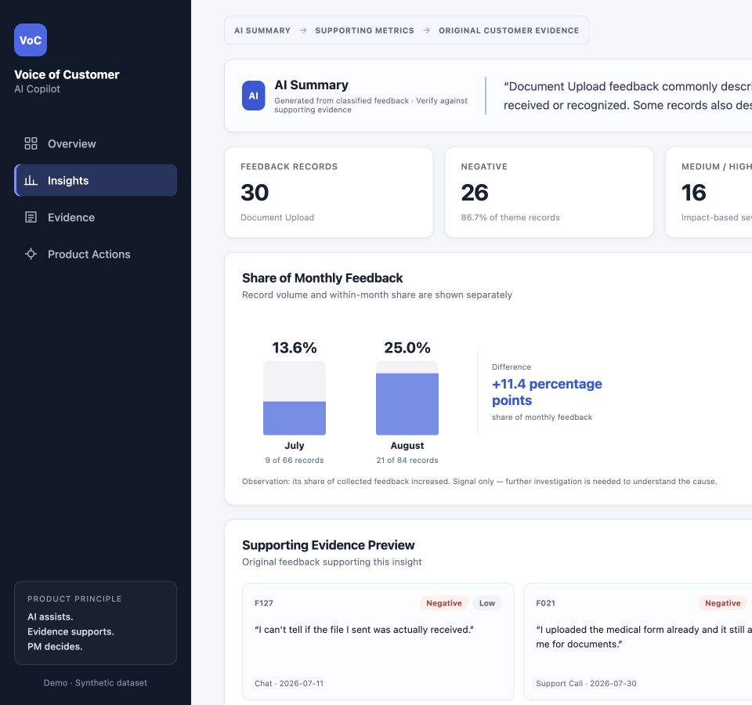
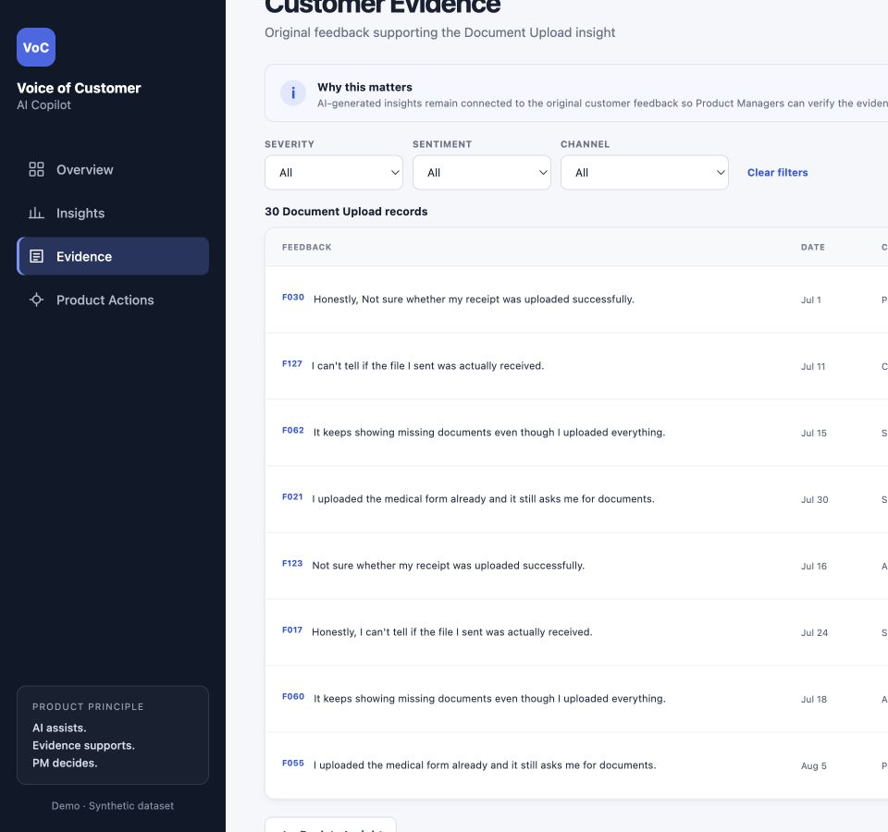
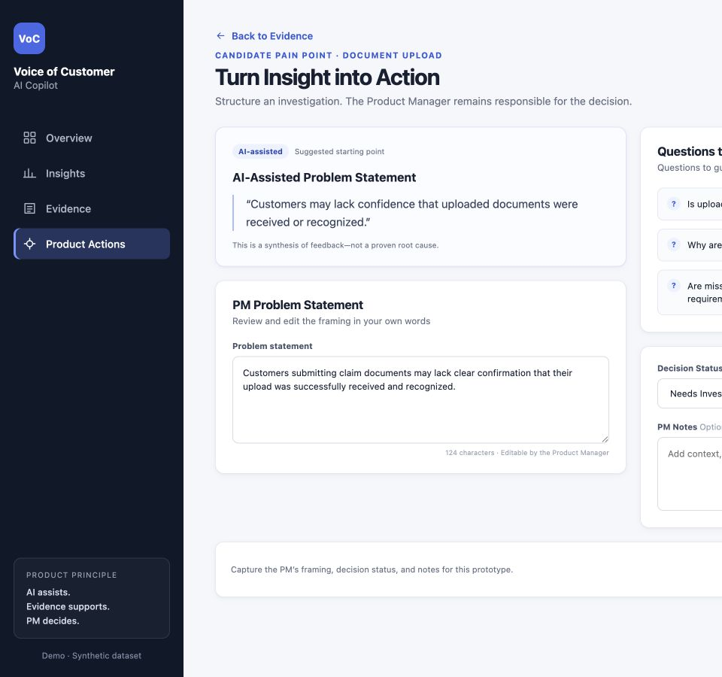
CASE STUDY
Evidence stays attached to the product decision
CANDIDATE INSIGHT
TRACEABLE EVIDENCE
PM ACTION
The AI proposes a frame. The PM decides whether the evidence supports it.
VOICE OF CUSTOMER AI COPILOT
13
Notes:
WHAT TO SAY
Show the real insight, evidence, and action screens. The AI summary is labeled as a starting point and the PM edits the problem statement.
WHY THIS SLIDE EXISTS
Demonstrate human oversight in the product experience.
TAKEAWAY
Traceability connects aggregate signals to customer evidence and PM action.
DO NOT OVERCLAIM
The local prototype does not persist decisions in a production database.
LIKELY FOLLOW-UP
What makes it more than a dashboard? It connects patterns, records, and an explicit investigation decision.
SOURCES
web-prototype/src/App.jsx; local prototype screenshots

Slide 14
CASE STUDY
What I would validate next
CURRENT LIMITS
NEXT VALIDATION
01
Synthetic feedback, not real customer data
01
Test anonymized real feedback under governance controls
02
24-record coverage-focused holdout
02
Expand and stratify the evaluation set
03
Human labels include judgment
03
Investigate Severity thresholds and review states
04
Prototype taxonomy predates V2
04
Test the workflow with Product Managers
05
No PM usability or outcome study
05
Define pilot success metrics before deployment
VOICE OF CUSTOMER AI COPILOT
14
Notes:
WHAT TO SAY
The current evidence is useful but limited. My next step would be to test the workflow with real Product Managers, use governed anonymized feedback, expand the human-reviewed evaluation set, and investigate the Severity boundary with a new locked test set.
WHY THIS SLIDE EXISTS
End the case study with a realistic validation plan rather than a production claim.
TAKEAWAY
The next work is product and data validation, not another round of tuning on the same holdout.
DO NOT OVERCLAIM
I have not run a real customer-data pilot, usability study, privacy review, or business-impact measurement.
LIKELY FOLLOW-UP
What would you measure first? PM time to a defensible insight, correction rate by dimension, evidence usage, and decision usefulness.
SOURCES
portfolio_project_defense_guide.md; portfolio_claim_evidence_register.md

Slide 15
KEY LEARNING
The harder decision
was what to trust
AI
assists
01
Trust Theme for organization
evidence
Treat Severity as a review signal
supports
02
03
Keep evidence and PM judgment in the loop
PM
decides
Building the classifier produced outputs. Evaluation produced the product decision.
Notes:
WHAT TO SAY
Close on the product decision, not the technology. The work defined behavior, accepted regressions, protected a holdout, and translated failures into constraints.
WHY THIS SLIDE EXISTS
Leave the audience with the strongest Product Management lesson.
TAKEAWAY
Evaluation determines what the AI should be trusted to do.
DO NOT OVERCLAIM
Do not call the system production-ready.
LIKELY FOLLOW-UP
What are you most proud of? Resisting the newest prompt and narrowing AI permissions based on evidence.
SOURCES
Final comparison; final candidate lock; final holdout report

Slide 16
APPENDIX
Full Theme taxonomy
Document Requirements
Document Upload
Which documents or paperwork are required
Whether a submitted file was received or recognized
Claim Submission & Form
Claim Status
Entering, editing, saving, or submitting the form
Progress or state of the claim
Reimbursement
Login & Account
Payment timing, amount, or receipt of money
Login, authentication, password, or profile access
Customer Support
General Experience
Support itself is the primary problem
Fallback when no specific Theme applies
APPENDIX
16

Slide 17
APPENDIX
Feedback Type, Sentiment, and Severity
FEEDBACK TYPE
SENTIMENT
Process Friction
Technical Issue
Improvement Request
Positive
Neutral
Negative
Information Need
Compliment
General Feedback
SEVERITY
No Issue
Low
Medium
High
No adverse impact described
Limited inconvenience or uncertainty
Meaningful delay, repeated effort, or intervention
Important action blocked or material failure
Severity reflects explicit impact. Emotional wording alone must not increase it.
APPENDIX
17

Slide 18
APPENDIX
Dataset and prototype scope
150
5
7
0
synthetic feedback records
raw source fields
themes in prototype dataset
production integrations
July and August 2026
ID, date, channel, stage, text
Earlier taxonomy
Local interactive demo
Prototype scope caveat
The UI uses the earlier seven-theme labels, including Login & Access and Severity None. It does not display the later Feedback Type dimension. The deck treats it as workflow evidence, not final taxonomy implementation.
APPENDIX
18

Slide 19
APPENDIX
Full development comparison
Metric | V1 | V2 | V3
Theme accuracy | 97.5% | 95.0% | 95.0%
Feedback Type accuracy | 85.0% | 90.0% | 87.5%
Sentiment accuracy | 82.5% | 52.5% | 85.0%
Severity accuracy | 92.5% | 82.5% | 85.0%
Exact match | 67.5% | 37.5% | 62.5%
Theme macro F1 | 86.5% | 84.3% | 84.3%
Type macro F1 | 80.5% | 85.0% | 83.3%
APPENDIX
19

Slide 20
APPENDIX
Holdout confusion matrices
FEEDBACK TYPE
SEVERITY
Process
Technical
Request
Info
Compliment
General
No Issue
Low
Medium
High
Process
3
2
0
0
0
0
No Issue
3
7
0
0
Technical
0
5
0
0
0
0
Low
1
3
2
0
Request
0
0
6
0
0
0
Info
0
0
0
3
0
0
Medium
0
0
6
0
Compliment
0
0
0
0
3
0
High
0
0
0
2
General
1
0
0
0
1
0
Rows: human reference · Columns: Gemini prediction
APPENDIX
20

Slide 21
APPENDIX
Representative holdout errors
HOLD003
Request for evidence-category examples
Severity: No Issue / Low
Request language triggered impact
HOLD011
Claim status moved backward after waiting
Type: Process Friction / Technical
System-state wording outweighed process
HOLD015
Payment arrived; bank description was cryptic
Type / Sentiment / Severity
Mixed factual feedback became praise
HOLD021
Chat disconnected; user returned to queue end
Type: Process Friction / Technical
Technical event outweighed primary setback
APPENDIX
21

Slide 22
APPENDIX
Experiment integrity safeguards
✓
Human-reviewed development and holdout references
✓
Predictions saved before label comparison
✓
SHA-256 locks for frozen artifacts
✓
Final candidate selected before holdout
✓
Four-field allowlist for model input
✓
No post-holdout prompt rerun
✓
Structured JSON schema plus local validation
The holdout can inform future work, but it cannot remain an unseen test after that work.
APPENDIX
22

Slide 23
APPENDIX
Metrics and technical implementation
Accuracy
Share of records correct for one dimension
Precision
When a label is predicted, how often it is correct
Recall
How many true examples of a label the model finds
F1
Balance of precision and recall
Macro F1
Average F1 across classes with equal class weight
Exact match
All four fields correct for one record
Python + pandas
Gemini Developer API
Structured JSON output
Local React prototype
APPENDIX
23

