Slide 1


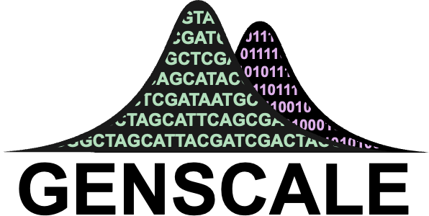

Optimization Framework For Phylogenetic Compression
Comité de Suivi Individuelle (1st year)
25 June 2025
Tam Truong
Dominique Lavenier, Thesis Director
Karel Břinda, Principal Scientific Supervisor
Pierre Peterlongo, Scientific Supervisor
Notes:
Good afternoon everyone, thank you for being here and today I would like to welcome everybody and present to you what I have been working on, it is about

Slide 2
Presentation Outline:
Background
Formation
PhD Research Presentation
Introduction
The Optimization Problem Formulation
Track 1: Pre-ordering
Track 2: Partitioning
Conclusion
Outcome and Next Steps

Slide 3
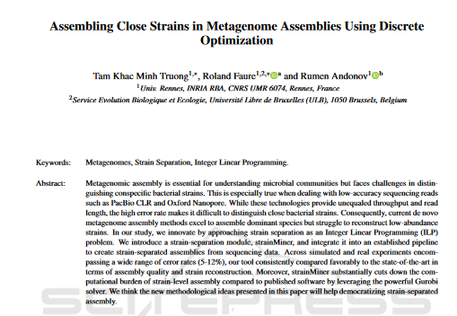
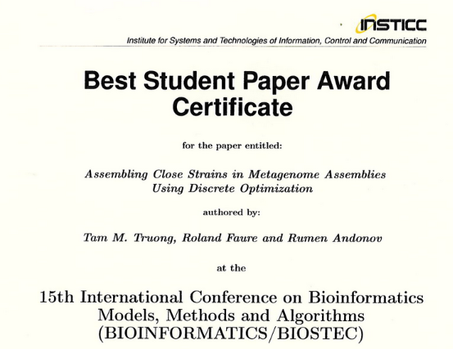
Backround: International & Multidisciplinary
2018-2021: Bachelor deg MIAGE – Rennes University
Multidisciplinary competences
Big data
Method development & researching
Master’s internships in bioinformatics
2021: Full-stack developer – Enedis, Paris
2021-2023: Double Master deg Data Science & Business:
Rennes & Aalto Univ (Finland)
2022 & 2023: 2 Internships at INRIA:
Optimization for Strains Seperation - Supervisor: R. Andonov
Start: Nov. 2024
PhD: Optimization for Phylogenetic Compression

Slide 4
Formation
First Year (at 7 month)
General training (51h)
Starthèse: Entrepreneurship
French language B1
Scientific training (Validation pending)
Conference attendance: SeqBim (2 days)
Various programmation training: Git, Good practices, Mooc Deep learning (~15h)
Plan: Second Year
General training
Ethic for Science
Scientific training (focus)
Scientific writing
Coferences
Teaching

Slide 5
PhD Research Presentation

Slide 6
Introduction

Slide 7
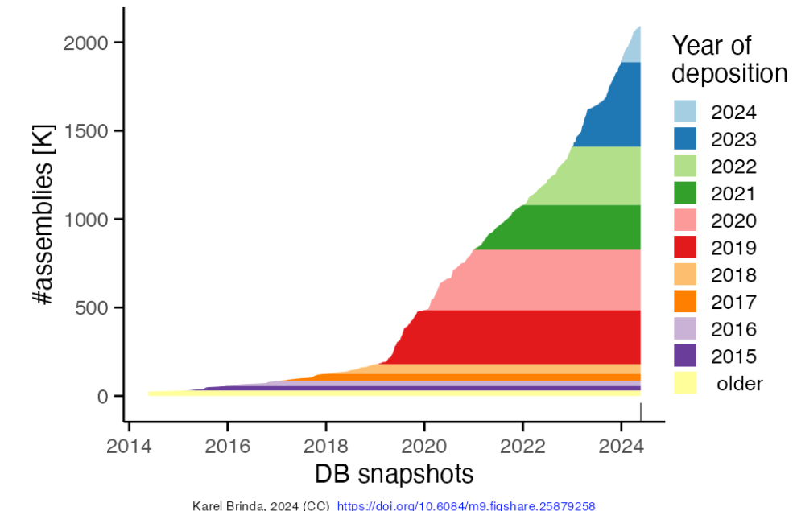
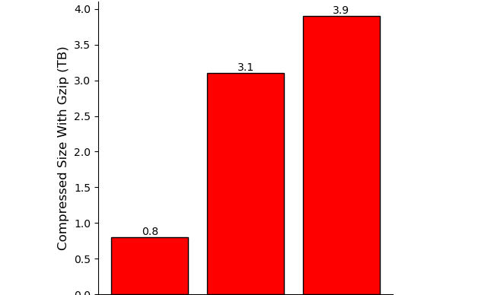
Motivation: Rapidly Growing Bacteria Genome Collections
Fast Growth Of Bacterial Genomes Data¹ (NCBI)
As of 2025: Multi-Terabytes Microbial Genome Collections
661k [2]
Nov. 2021
n = 661,405
AllThe Bacteria v0.2 [3]
Mar. 2024
n = 1,932,812 [3]
AllTheBacteria v0.3 [3]
Nov. 2024
n = 2,440,377 [3]
18 Jun 2025: ATB v0.4 with 330k new genomes
Next decade: Even larger collections (n = ~10⁷), higher diversity, …
Challenging: Efficient storage & analysis (indexing, searching)
Standard compression protocols based on gzip are not sufficient
Notes:
Bacterial genome databases are expanding rapidly, as shown in the snapshot on the right. Beyond individual genomes, we now have growing collections of genomes, which are becoming increasingly available and serve as a valuable resource for bacterial research. These collections are curated to ensure uniform processing of genomes, making them particularly useful for large-scale studies.
They are also growing at an impressive rate. For example, in the 661k collection, we have… All the bacterial…

Slide 8
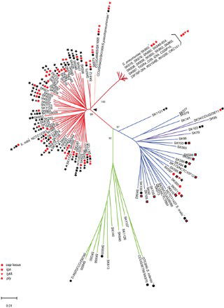
Phylogenetic Compression: New Method For Microbial Genomes Compression
Problem:
Compression is a widely studied problem but existing methods do not scale for modern genomes collection
Difficulty: Million-genome scale and complex redundancy structure of the collection.
Phylogenetic compression:
Key Idea: guiding of compression using evolutionary history to enhances local compressibility
Result: 1-2 order of magnitude improvement in compression size of genome collections
Notes:
And so we have a recent innovation, like it has been mentioned here a lot of time before, by Karel Brinda
Challenge: Compressing genomes efficiently is difficult/not easy because the data contains a lot of redundancy spread across different regions.
Key Idea: If we reorder genomes based on their evolutionary relationships, we can group similar sequences together, making compression more effective.

Slide 9
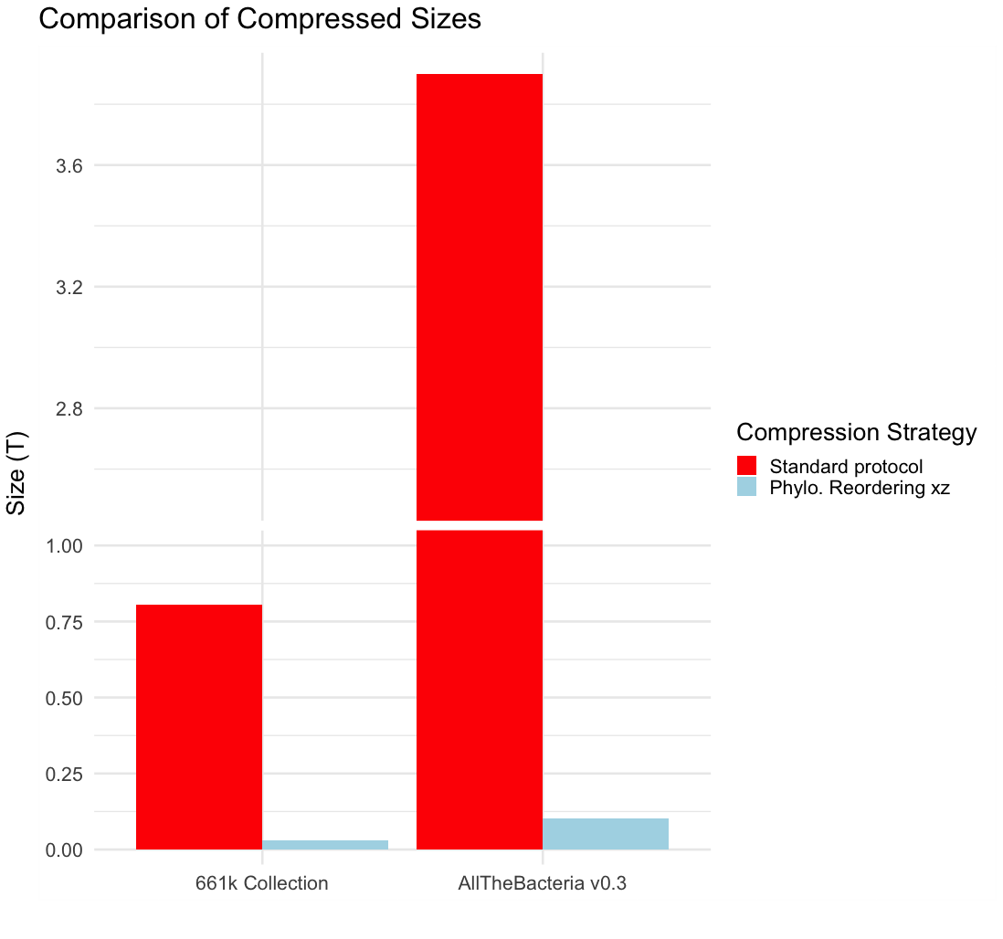
Phylogenetic Compression: Applications On Large Genomes Collections – 1-2 Orders Of Magnitude Reduction In Size
3,9T
Compression Size (T)
- Gzip
- MiniPhy
805G
29G
102G
661k [2]
AllTheBacteria v0.3 [3]
➔ Core compression technique for AllTheBacteria, currently the largest microbial genomes collection
Notes:
Phylogenetic comp reduced it down to respectively
The resulting improvement with the use of phylogenetic compression, specifically MiniPhy, shows a significant advancement in data compression. This method achieves lossless compression that improves by one to three orders of magnitude compared to the standard protocol, offering a more efficient way to handle large genomic datasets while maintaining data integrity.

Slide 10
Phylogenetic compression intrinsics: Two steps of reordering in Phylogetic Compression
Level 1 : Preordering via Species-based batching
Level 2 : Within-batch tree-based ordering
(left to right according to a phylogeny)
Collection of genomes
Species clustering
Followed by compression using a low-level tool using xz
Implemented in MiniPhy (github.com/karel-brinda/miniphy)
Notes:
In practice, phylogenetic compression involves two main steps. Step one is phylogenetic batching, which serves as the starting point of my PhD. In this step, genomes are grouped based on their phylogenetic relationships to improve the efficiency of compression. Step two is phylogenetic reordering, where genomes within each batch are reordered to further enhance the compression process.

Slide 11



Level 1 : Batching (current state of the art via species & accessions)
MiniPhy’s default strategy: sort by submission time (accession number)
INPUT:
Collection of genomes
Species cluster 1
S1
S1
S1
Species clustering
Batching
S2
S2
S3
Dustbin:
Group genomes from small cluster
Sort the genomes lexicographically
Split big clusters into batches
$≈$4000 genomes/batch
S2
S3
Species form clusters in public databases
Split dustbin into batches
Sequencing data is typically uploaded together
i.e. genomes with nearby accession numbers are likely related.
$≈$1000 genomes/batch
1 – SAM029385
2 – SAM029386
3 – SAM029387
…
3999 – SAM033384
4000 – SAM033385
4001 – SAM033386
…
Parameters (Constraints):
Max batch size
Max dustbin size
Dustbin threshold (clusters go to dustbin)

Slide 12
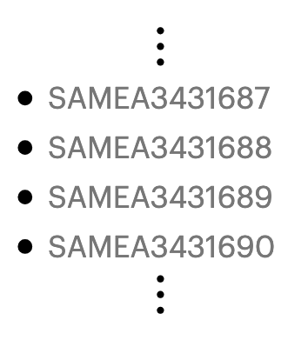
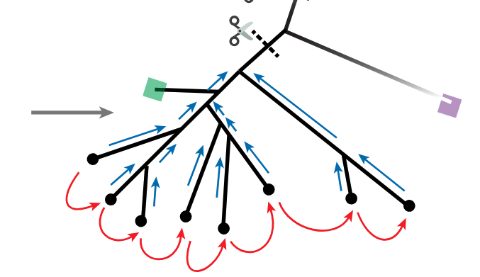
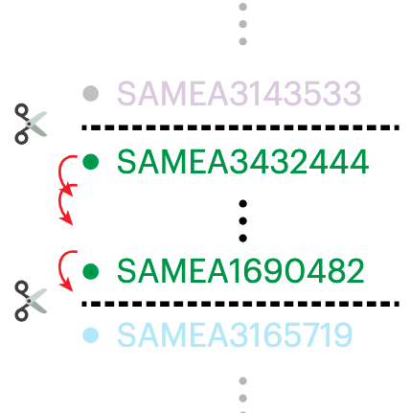
Level 2 : Within-batch tree based ordering (current state of the art, in MiniPhy via Attotree)
Attotree (github.com/karel-brinda/attotree) is used for Phylogenetic Inference
Highly efficient but scalable only to small to mid-size batches

Slide 13
Limitation: Phylogenetic batching currently unable to adjust to target applications
No formalization of batching as an optimization problem.
Batching are not suitable for hardware specific target application.
Heavily dependent on metadata for an approximative input order
We want
Constraints on:
Uncompressed sizes
Compressed sizes
Number of genomes
We want
Search on GPUs or for processing-in-memory (PIM) architectures
We want
Independence on metadata (accession numbers, species labels)

Slide 14
My Work

Slide 15
The Optimization Problem Formulation
For Phylogenetic Compression Batching

Slide 16
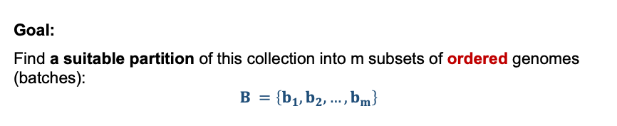
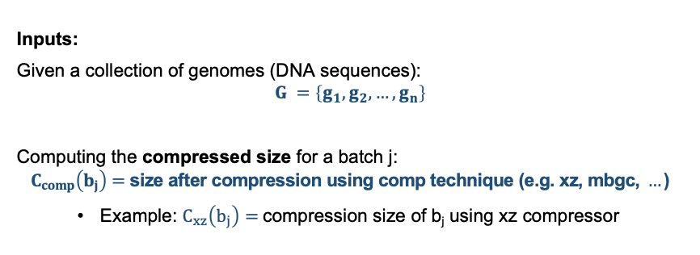
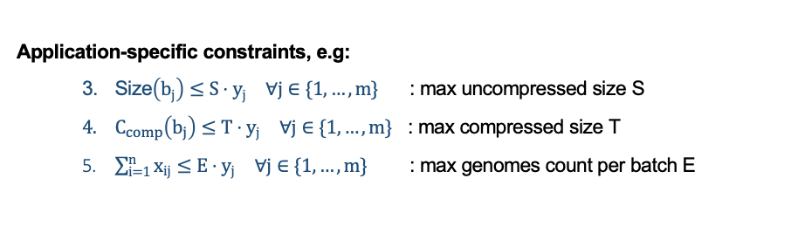
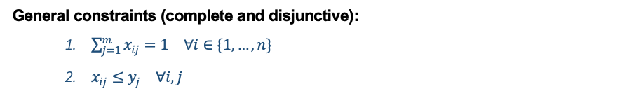

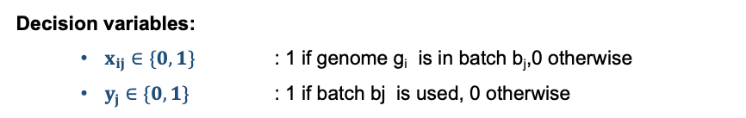
Formulation of the batching optimization problem for phylogenetic compression
Inputs:
Given a collection of genomes (DNA sequences):
$$G =\left\{g_{1},g_{2},…,g_{n}\right\}$$
Computing the compressed size for a batch j:
$$C_{comp}\left(b_{j}\right)=\text{siz}\text{e} \text{after} \text{compression} \text{using} \text{comp} \text{technique}\text{ (}\text{e}\text{.}\text{g}\text{. }\text{xz}\text{, }\text{mbgc}\text{, }…\text{)}$$
Example: $C_{xz}\left(b_{j}\right)=$compression size of b_{j} using xz compressor
Objective function:
$$\min\left(α\sum_{j=1}^{m}{C_{comp}\left(b_{j}\right)}⋅y_{j}+β\sum_{j=1}^{m}{y_{j}}\right)$$
Minimize total compressed batch sizes
Minimize the number of batches
Goal:
Find a suitable partition of this collection into m subsets of ordered genomes (batches):
$$B =\left\{b_{1},b_{2},…,b_{m}\right\}$$
General constraints (complete and disjunctive):
$\sum_{j=1}^{m}{x_{ij}}=1 ∀i∈\{1,…,n\}$
$x_{ij}≤y_{j} ∀i,j$
Application-specific constraints, e.g:
Size$\left(b_{j}\right)≤S⋅y_{j} ∀j∈\{1,…,m\}$ : max uncompressed size S
$C_{comp}\left(b_{j}\right)≤T⋅y_{j} ∀j∈\{1,…,m\}$ : max compressed size T
$\sum_{i=1}^{n}{x_{ij}}≤E⋅y_{j} ∀j∈\{1,…,m\}$ : max genomes count per batch E
Decision variables:
$x_{ij}∈\{0,1\}$ : 1 if genome g_{i} is in batch b_{j},0 otherwise
$y_{j}∈\{0,1\}$ : 1 if batch bj is used, 0 otherwise

Slide 17
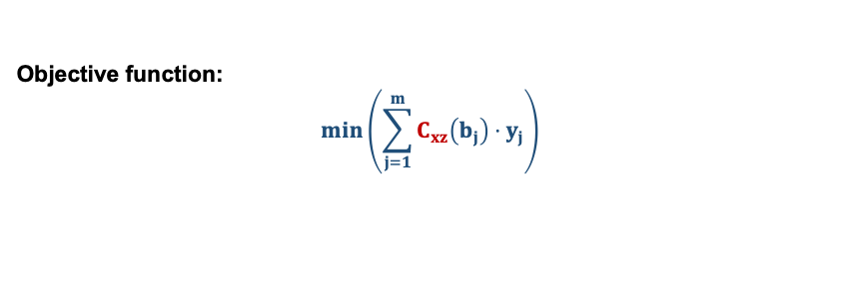
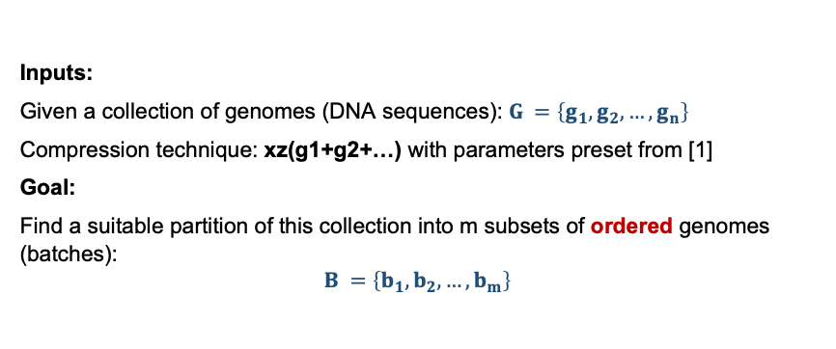
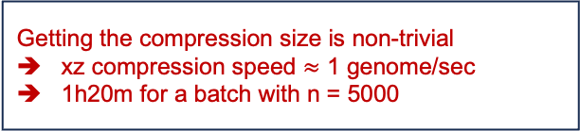
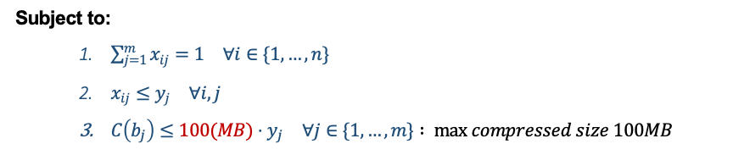
Scenario: max bound on per batch compressed size (motivated by internet transmission)
Inputs:
Given a collection of genomes (DNA sequences): $G =\left\{g_{1},g_{2},…,g_{n}\right\}$
Compression technique: xz(g1+g2+…) with parameters preset from [1]
Goal:
Find a suitable partition of this collection into m subsets of ordered genomes (batches):
$$B =\left\{b_{1},b_{2},…,b_{m}\right\}$$
Non linear objective function
Different genome order leads to different compression size
Objective function:
$$\min\left(\sum_{j=1}^{m}{C_{xz}\left(b_{j}\right)}⋅y_{j}\right)$$
Getting the compression size is non-trivial
xz compression speed $≈$ 1 genome/sec
1h20m for a batch with n = 5000
Subject to:
$\sum_{j=1}^{m}{x_{ij}}=1 ∀i∈\{1,…,n\}$
$x_{ij}≤y_{j} ∀i,j$
$C\left(b_{j}\right)≤100(MB)⋅y_{j} ∀j∈\{1,…,m\}$ $: max compressed size 100MB$

Slide 18
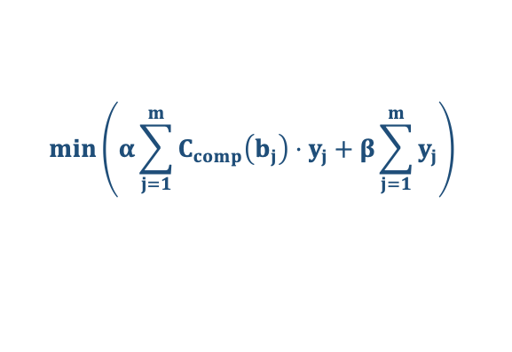
The Two Tracks Of My Work: Preordering & Partitionning
$$\min\left(α\sum_{j=1}^{m}{C_{comp}\left(b_{j}\right)}⋅y_{j}+β\sum_{j=1}^{m}{y_{j}}\right)$$
Difficult to solve in full generality
The goal of my PhD: develop a heuristic approaches
1. Phylogenetic Pre-ordering Of Genomes
2. Order-based Genome Batching

Slide 19
Axis 1: Phylogenetic Pre-ordering Of Genomes

Slide 20
Problem: Per species phylogenetic preordering without using accession number
INPUT:
Collection of genomes
Species 1
S2
OUTPUT (For each cluster):
An ordered set of genomes
Given:
Species clusters
Species clustering
S3
To achieve this: we use 2 different methods depending on cluster size
Small to mid-size clusters: Attotree
Large clusters: Skeleton-based-tree

Slide 21
Method 1: Standard phylogenetic tree inference with Attotree
INPUT:
Collection of genomes
Species 1
S2
Infere phylogenetic tree with Attotree [1]:
Distance estimation (Mash) + Neighbor joining algorithm (Quicktree)
Species clustering
S3
Attotree
Challenging for large clusters due to Quicktree - O(n³)
In modern collection, species cluster with > 100k genomes would requires days of computation

Slide 22
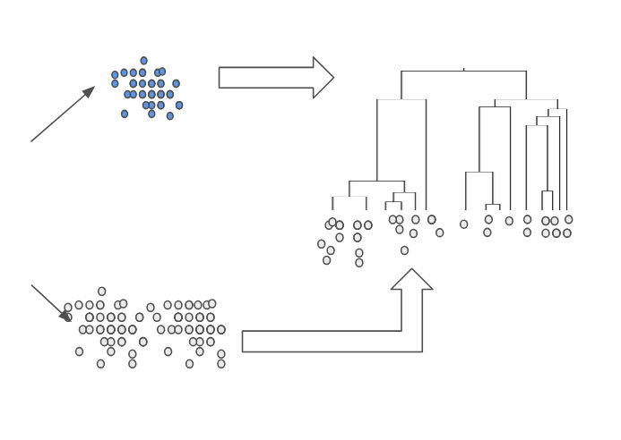
Method 2: Skeleton-tree Based Pre-ordering
Reference genomes
(fraction of the cluster)
Skeleton tree
Attotree
Large cluster
Ordered set of genomes
Nearest-neighbor placement with Mash
Remaining genomes

Slide 23
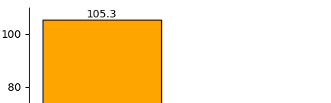
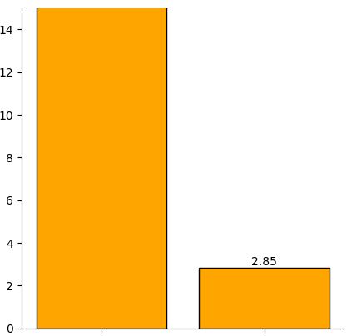
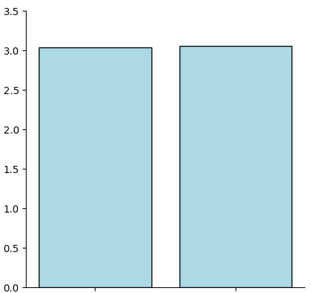
Example: Benchmark with E. coli from 661k collection
Setup:
Dataset: E. Coli cluster from 661k
Number of genomes: 90k
Methods compared:
Attotree (default setting)
Skeleton-tree based with 10% reference genomes
Run on Mac M4 with 10 cores
Significantly faster while having similar compression result
3.03
3.05
Mash finished (12.5h)
Size (G)
Runtime (h)
Mash + Quicktree finished (20m)
Phylo. Inference
Skeleton-tree-based
Phylo. Inference
Skeleton-tree-based
Compression size comparison
Runtime comparison

Slide 24
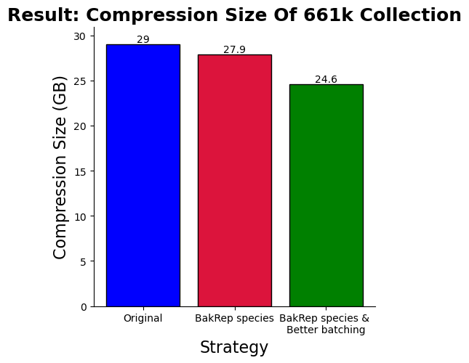
Experiment: Application to the whole 661k collection
Setup:
Dataset: 661k [1]
One large cluster:
S. enterica (180k genomes)
Compression results compared:
Original MiniPhy (Accession)
Original MiniPhy with new MetaData [2]
New strategy with new MetaData
 | Original | New
S. enterica | 4.6 | 3.8
E. coli | 4.3 | 3.0
S. pneumoniae | 0.7 | 0.5
Dustbin | 10.9 | 10.6
Compression size of
3 most highly sampled species & dustbin [GB]
Original Miniphy
Orig Miniphy
+
New metadata
New Strategy
+
New metadata
15% reduction in compression size compared to using accession number

Slide 25
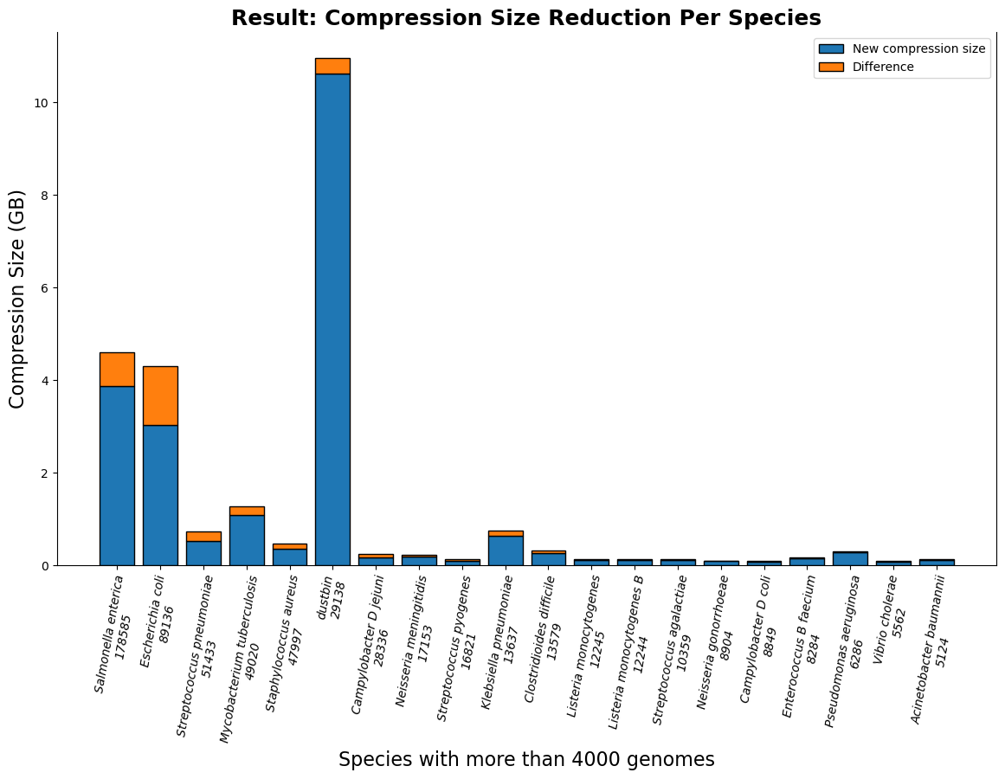
Result (661k) species-wise: per species absolute compressed size reduction
Clusters with more than 4000 genomes

Slide 26
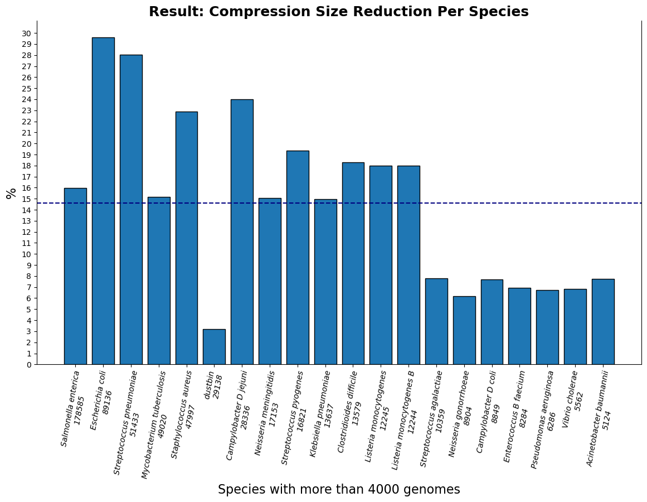
Result (661k) species-wise: per species relative compressed size reduction
Clusters with more than 4000 genomes

Slide 27
Axis summary:
Skeleton-tree-based method is significantly faster and achieves comparable result.
Most of the compression improvement comes from dominant cluster.
The dustbin group shows the least relative size reduction.

Slide 28
Axis 2: Order-based Genome Batching

Slide 29
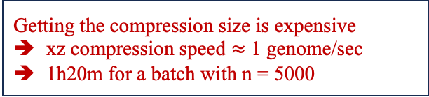
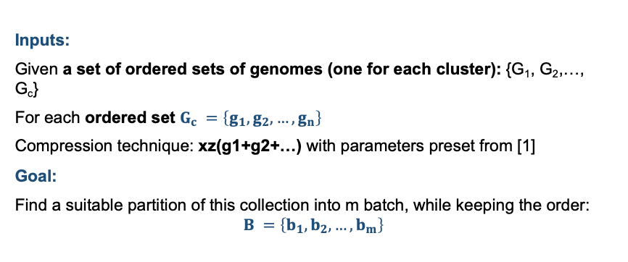
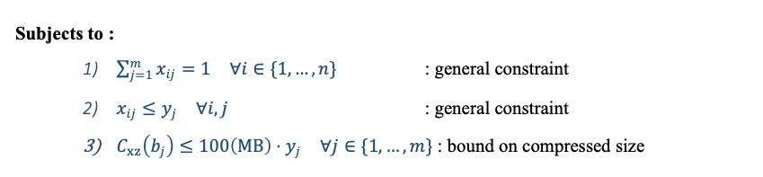
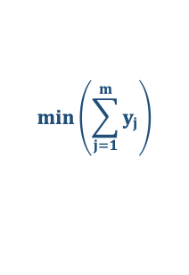

Back to a scenario: Max bound on compression size – with ordered input
Inputs:
Given a set of ordered sets of genomes (one for each cluster): {G₁, G₂,…, G_{c}}
For each ordered set $G_{c} =\left\{g_{1},g_{2},…,g_{n}\right\}$
Compression technique: xz(g1+g2+…) with parameters preset from [1]
Goal:
Find a suitable partition of this collection into m batch, while keeping the order:
$$B =\left\{b_{1},b_{2},…,b_{m}\right\}$$
Bin Packing Problem
Decision variables: $x_{ij}∈\{0,1\}, y_{j}∈\{0,1\}$
Objective function:
$$\min\left(\sum_{j=1}^{m}{y_{j}}\right)$$
$$\min\left(\sum_{j=1}^{m}{C_{xz}\left(b_{j}\right)}⋅y_{j}\right)$$
Getting the compression size is expensive
xz compression speed $≈$ 1 genome/sec
1h20m for a batch with n = 5000
Subjects to :
$\sum_{j=1}^{m}{x_{ij}}=1 ∀i∈\{1,…,n\}$ : general constraint
$x_{ij}≤y_{j} ∀i,j$ : general constraint
$C_{xz}\left(b_{j}\right)≤100\left(MB\right)⋅y_{j} ∀j∈\{1,…,m\}$ : bound on compressed size

Slide 30
Bin packing: Classic optimization problem
Definition:
Given a list of items i = 1, . . . , n, each having a size ci ∈ Z+, and an integer value CAPACITY. Find the minimum number of bin to pack all items in such a way that the sum of the item sizes in one bin is always smaller than CAPACITY.
Items
Bins
For genomes collection:
Bin and batch are equivalent in this case
Put items (genomes) into bins
Bin capacity is the batch max compression size
First-fit Bin Packing heuristic:
Put items in the first available bin
Preserve the order of the input items

Slide 31
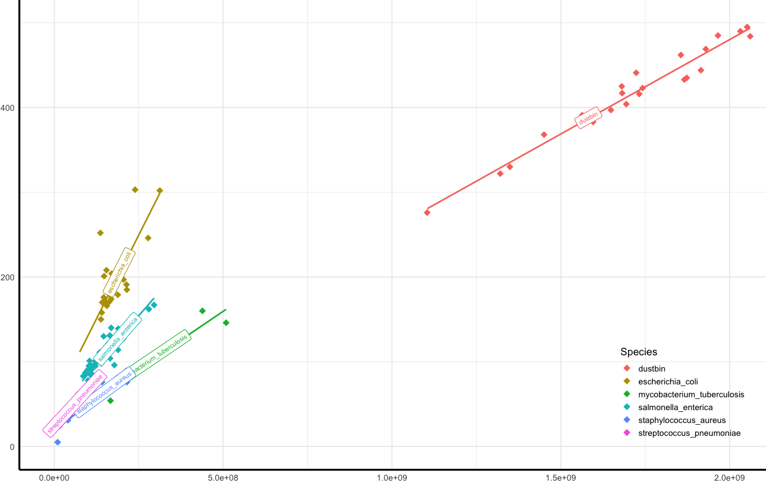
Trick: Post compression size approximation using distinct k-mers count at the species level.
Compression Size Vs Distinct Kmers Count – 661k Collections – Top 5 Highly Sampled Species & Dustbin
r = 0.98
r = 0.775
K-mers : length k substring of a genomes
We have to count the number of distinct kmers
K-mers estimation using HyperLogLog sketching
Compression Size (MB)
r = 0.88
r = 0.97
y = 0.269x + 24.481
r = 0.89
r = 0.96
Distinct Kmers Count

Slide 32
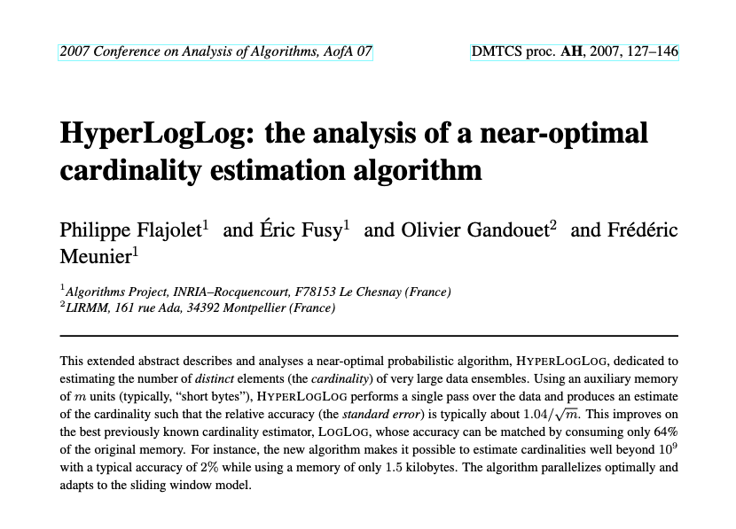
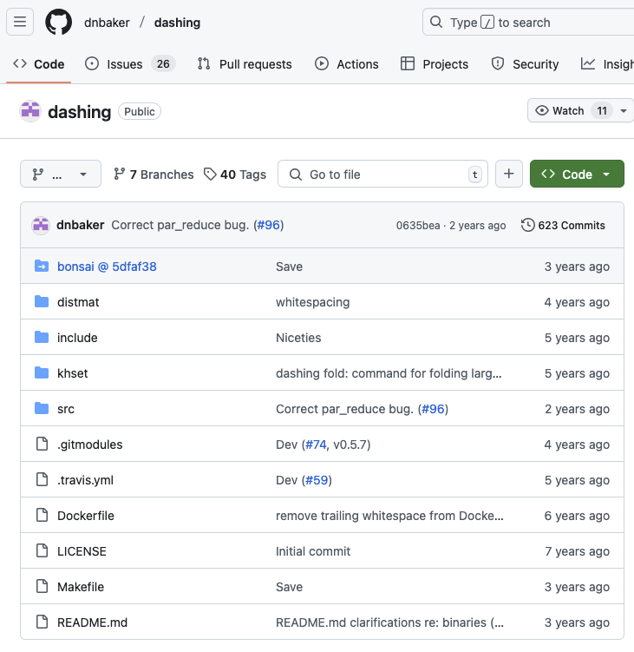
Fast Distinct Kmers Counting using sketches
Sketches : approximate data structures
HyperLogLog is used for counting distinct problem
Fast and efficient UNION operation for sketches.

Slide 33
Preliminary experiment: Mycobacterium tuberculosis from 661k collection
Dataset: Mycobacterium tuberculosis from 661k collection
Number of Genomes: 49k – 13 MiniPhy batches
We want the compression size to be approximately 100MB
Using the equation: y = 0.269x + 24.481
Capacity (distinct kmers count) of batches: 279,000,000

Slide 34
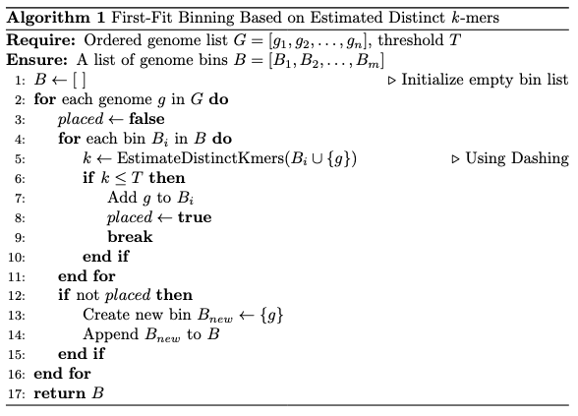
Approach: Fist-fit bin packing with distinct kmers count estimation
Input:
A genome order (e.g., accession order, used for comparison to Miniphy).
Steps:
Start with an empty bin.
Iteratively add genomes to the first bin that can accommodate them (based on k-mer threshold).
Estimate distinct k-mer count using Dashing at each step.
Create a new bin if no existing bin can hold the genome.
Implemented at HLL-binning github.com/tam-km-truong/HLL-Binning

Slide 35
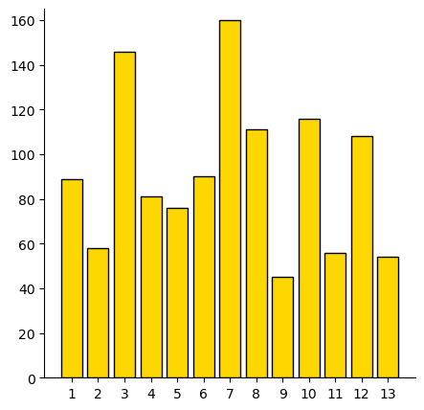
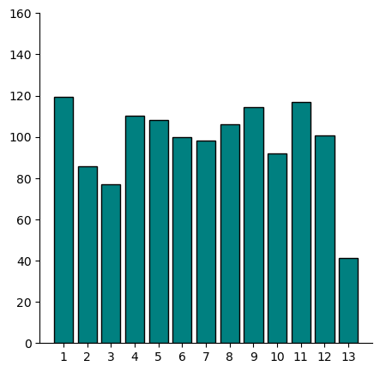
Preliminary experiment - Compression size per batch: Binning vs Fixed-Number of genomes (4000)
Size(MB)
Similar total compression size:
1.27GB & 1.24GB
More balanced, but accuracy could be improved
First fit binning
(number of genomes p. batch varies)
Fixed 4000 p. batch

Slide 36
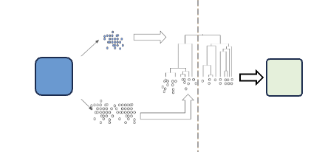
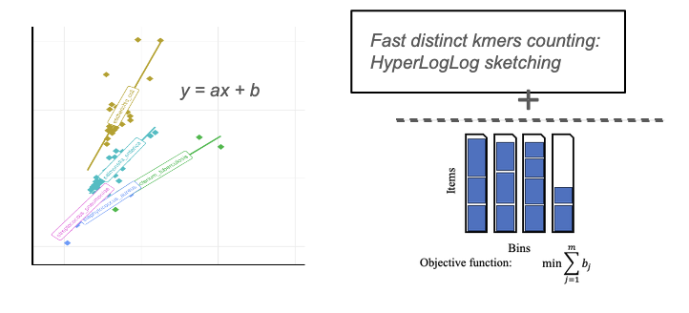
Conclusions
Formulated an optimization problem for Phylogenetic batching
Nextstep:
Both axis: Scale up to AllTheBacteria
Axis 1:
Species-oblivious strategy
Experiments for different parameters (percentage, sketch size)
Axis 2:
Study other estimators of compression size
Other applications: (different constraints, different representation of genomes)

Slide 37
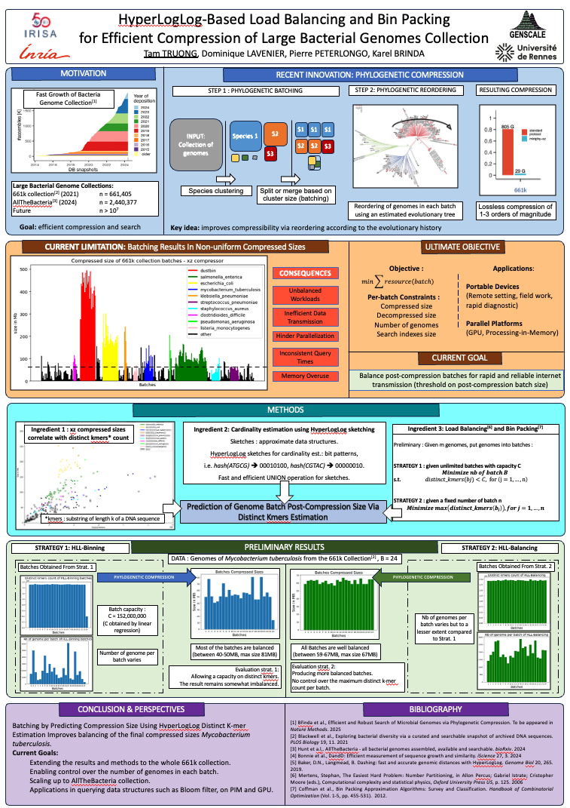
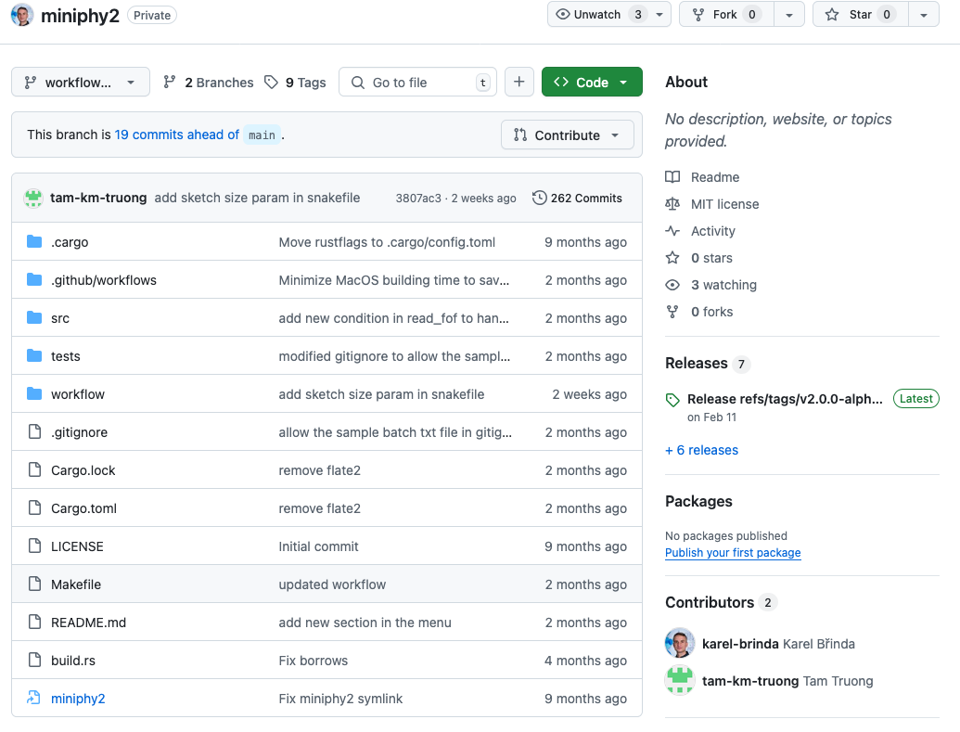
Current outcomes
Poster at the DKM department seminar
Presentation in an internal GenScale meeting
Co-developing MiniPhy2 – released soon
Collaboration: incorporated into the next incremental release of AllTheBacteria

Slide 38



Plans:
Presentation at upcoming SeqBim and DSB conferences
Submit to conferences such as RECOMB and ISMB/ECCB
Eventual Publication in bioinformatics journals e.g. Bioinformatics, Genome Research

