Slide 1




Computational methods for phylogenetic compression of bacteria genomes
Comité de Suivi Individuelle Metting (1st year)
Tam Truong, Dominique Lavenier, Pierre Peterlongo, Karel Břinda

Slide 2
Outline

Slide 3
background

Slide 4
formation
Entrepreneur ship training
French language training
Planing to teach next year
Seqbim
Other small training:
Genouest cluster
Git
Presenting

Slide 5
Introduction

Slide 6
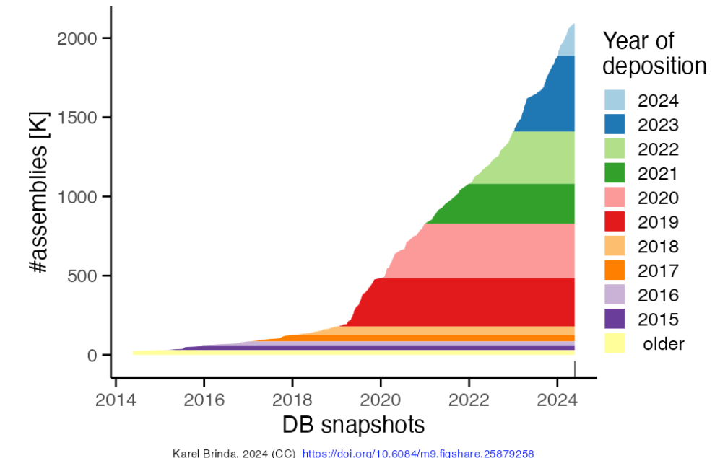
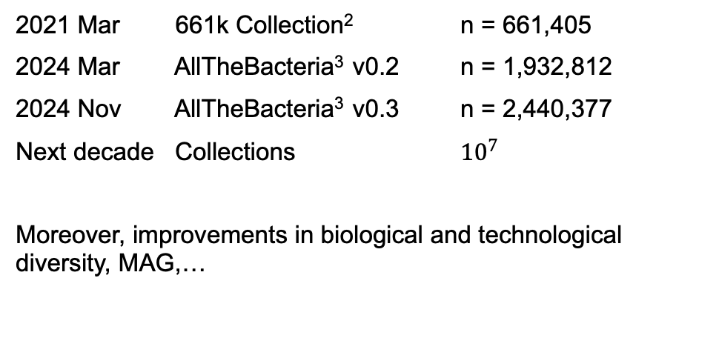
Motivation: Rapidly Growing Bacteria Genome Data & collection of genomes is big
Fast Growth Of Bacterial Genomes Data¹
Increasing Availability of Larger Bacterial Genome Collections
2021 Mar 661k Collection² n = 661,405
2024 Mar AllTheBacteria³ v0.2 n = 1,932,812
2024 Nov AllTheBacteria³ v0.3 n = 2,440,377
Next decade Collections ${10}^{7}$
Moreover, improvements in biological and technological diversity, MAG,…
Challenging: Efficient storage & analysis (indexing, searching)

Slide 7
Storage is insufficient, standard protocol is not good enough

Slide 8
Phylogenetic compression

Slide 9
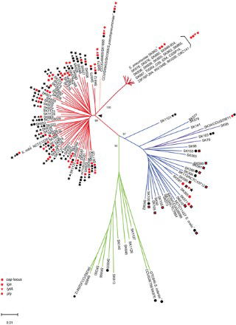
Recent Innovation: Phylogenetic Compression
Difficulty: Compression of genomes is challenging due to the widespread redundancy in the data.
Key Idea: Reordering genomes based on evolutionary history enhances local compressibility¹
Here I have to explain the difficulty of compression of bacteria genomes then explain the main principle of phylo comp

Slide 10
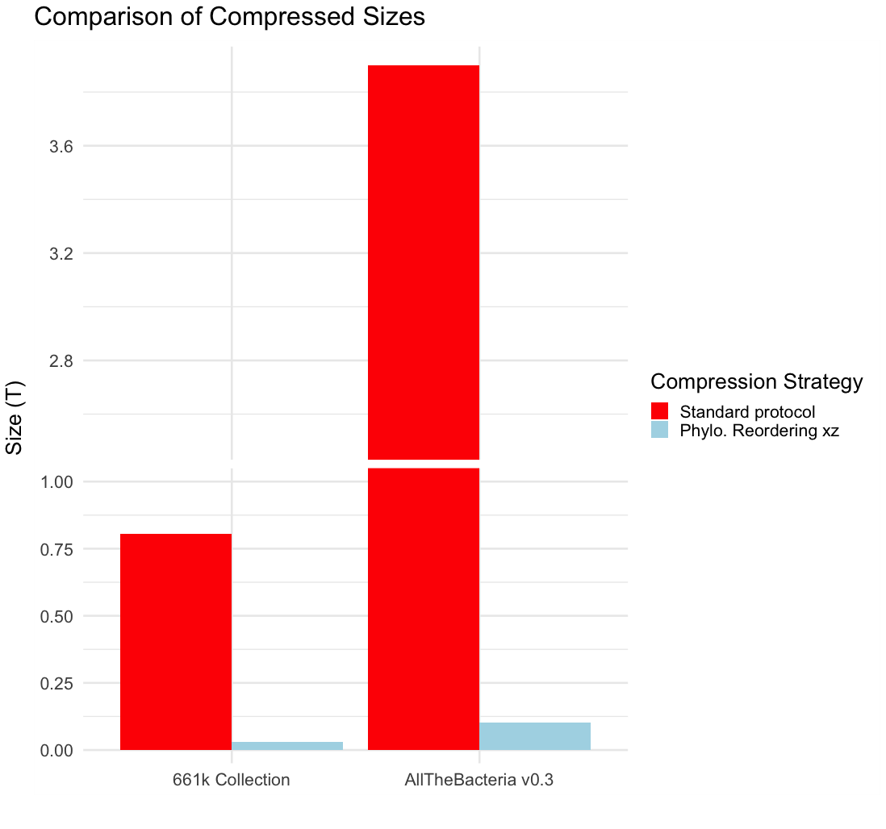

Recent Innovation: Lossless Compression Of 1-3 Orders Of Magnitude
3,9T
805G
29G
102G
Improvement Using Phylogenetic Compression Workflow (MiniPhy¹)

Slide 11

Recent Innovation: MiniPhy, the current implementation
Collection of genomes
Step 1 : Phylogenetic Species-based
Pre-Batching
Step 2 : Phylogenetic Reordering Per Batch

Slide 12
Application: where it has been used
It is the core compression technique, is now used by All the bacteria

Slide 13
Key concepts

Slide 14
Concept of order: my PhD
Optimizing the initial order
Optimize the cut
Conceptlize the prob
We have sth sth
We want order
In miniphy 1 it was done like this and now I’m doing this like this

Slide 15



Concept of genomes order
Given a collection of genomes
The way we order them heavily affect how compressible they are:
Random order
Accession order
Phylogenetic order

Slide 16


Batching: Key Step In Phylogenetic Compression
Current strategy: sort by sequencing time (accession number)
$≈$4000 genomes/batch
INPUT:
Collection of genomes
Species 1
S2
S1
S1
S1
1 – SAM029385
2 – SAM029386
3 – SAM029387
…
4000 – SAM033385
4001 – SAM033386
…
Species clustering
Batching
S2
S2
S3
S3
Species form clusters in public databases
$≈$1000 genomes/dustbin
dustbin
dustbin
Sequencing data is typically uploaded together.
I.e. genomes with nearby accession numbers are likely related.
Split big clusters into smaller batches
Merge small clusters together into dustbins

Slide 17
Why do we need batching
Scaling is the biggest argument: not able to do phylogenetic reordering for genomes collections
Batching improve compression time (parralleilization)
Batching help to

Slide 18
Start of Phd

Slide 19
Lack of formulization for batching

Slide 20
Limitation: Dependent on Species & Accession Metadata
INPUT:
Collection of genomes
Species 1
S2
S1
S1
S1
1 – SAM029385
2 – SAM029386
3 – SAM029387
…
4000 – SAM033385
4001 – SAM033386
…
Species clustering
Batching
S2
S2
S3
S3
Metadata that are often missing, inconsistent, or unreliable
Accession number order doesn’t always improve compressibility

Slide 21
Limitation of miniphy batching current

Slide 22
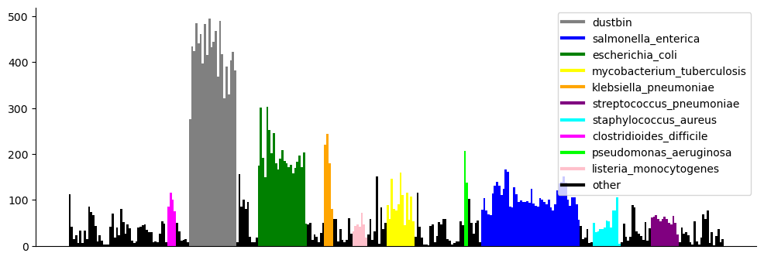
Limitation: Not Efficiently Optimized Batches For Scalable Downstream Processing
Reminder: After batching (step 1), batches are reordered (step 2) then compressed
Separate the messages
Compression result of 661k Batches
Non-uniform post-compression sizes
Size(MB)
Consequences of Non-uniformity
Unbalanced Workloads
Inefficient Transmission
Hinder Parallelization
Memory Overuse
Inconsistent Query Time
Application for balance batches: Portable Devives (remote setting, field work, rapid diagnostic), Parallel Platforms (GPU, Processing-in-Memory)

Slide 23
Objectives
Present it more like a vision not an engineering challenges

Slide 24
Optimization framwork for Phylogenetic compression
A general optimization formulation
Given a genome collection C: maximize Compression_ratio(C)
Robust compression without metadata
Without accesssion number
Without species label

Slide 25
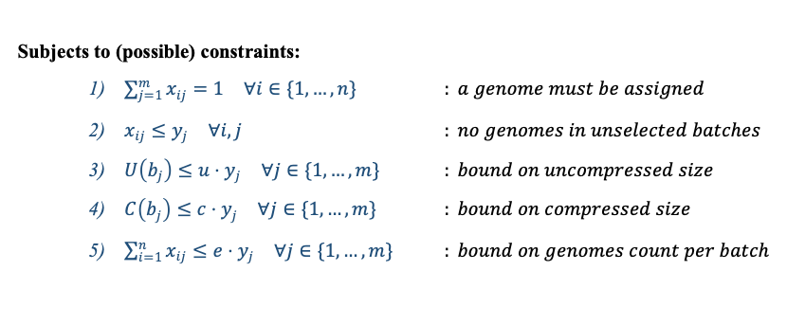
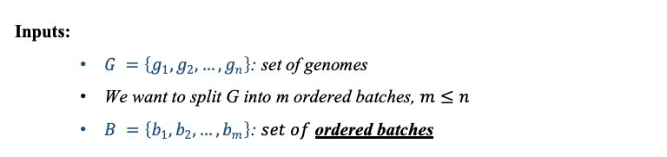
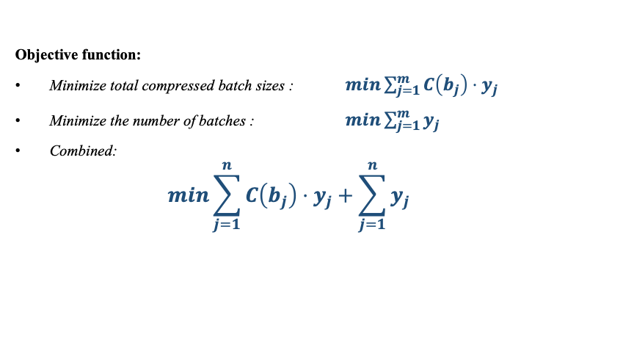
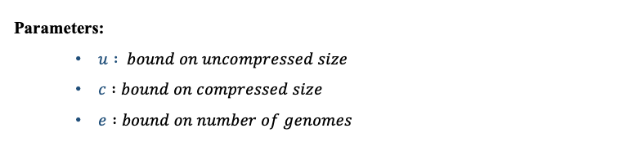
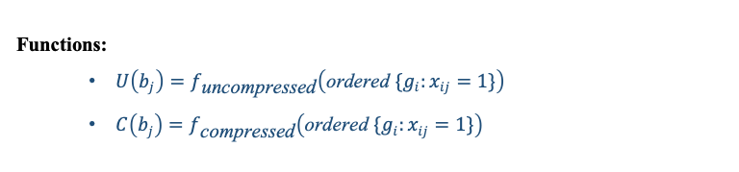
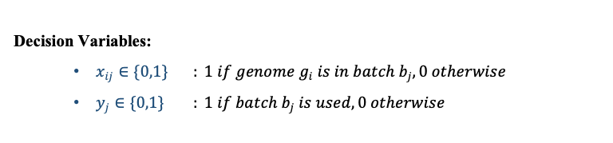
Optimization Problem Formulation For Phylogenetic Compression
Objective function:
Minimize total compressed batch sizes : $\min{\sum_{j=1}^{m}{C\left(b_{j}\right)}}⋅y_{j}$
Minimize the number of batches : $\min{\sum_{j=1}^{m}{y_{j}}}$
Combined:
$$\min{\sum_{j=1}^{n}{C\left(b_{j}\right)}}⋅y_{j}+\sum_{j=1}^{n}{y_{j}}$$
Inputs:
$G =\left\{g_{1},g_{2},…,g_{n}\right\}\text{: }\text{set} \text{of} \text{genomes}$
We want to split G into m ordered batches, $m≤n$
$B =\left\{b_{1},b_{2},…,b_{m}\right\}\text{: }set of$ ordered batches
Parameters:
$u : bound on uncompressed size$
$c :bound on compressed size$
$e :bound on number of genomes$
Decision Variables:
$x_{ij}∈\{0,1\}$ $: 1 if genome g_{i} is in batch b_{j},0 otherwise$
$y_{j}∈\{0,1\}$ $: 1 if batch b_{j} is used, 0 otherwise$
Subjects to (possible) constraints:
$\sum_{j=1}^{m}{x_{ij}}=1 ∀i∈\{1,…,n\}$ $: a genome must be assigned$
$x_{ij}≤y_{j} ∀i,j$ $: no genomes in unselected batches$
$U\left(b_{j}\right)≤u⋅y_{j} ∀j∈\{1,…,m\}$ $: bound on uncompressed size$
$C\left(b_{j}\right)≤c⋅y_{j} ∀j∈\{1,…,m\}$ $: bound on compressed size$
$\sum_{i=1}^{n}{x_{ij}}≤e⋅y_{j} ∀j∈\{1,…,m\}$ $: bound on genomes count per batch$
Functions:
$U\left(b_{j}\right)=f_{\text{uncompressed}}\left(\text{ordered} \{g_{i}:x_{ij}=1\}\right)$
$C\left(b_{j}\right)=f_{\text{compressed}}\left(\text{ordered} \{g_{i}:x_{ij}=1\}\right)$

Slide 26
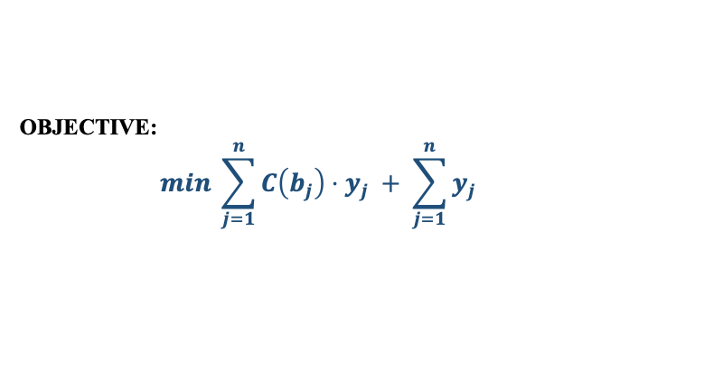
The Two Tracks Of My Work: Preordering & Partitionning
OBJECTIVE:
$$\min{\sum_{j=1}^{n}{C\left(b_{j}\right)}}⋅y_{j} + \sum_{j=1}^{n}{y_{j}}$$
1. Phylogenetic Pre-ordering Of Genomes
2. Order-based Genome Batching

Slide 27
Examples

Slide 28
Objective: Robust Compression With Or Without Species Metadata
With metadata: Species-wise
INPUT:
Collection of genomes
GOAL: Species-wise pre-ordering
S1
S1
S1
Species 1
S2
Species clustering
Batching
S2
S2
S3
S3
Without metadata: Species-independent
INPUT:
Collection of genomes
GOAL: species-independent pre-ordering
S1
S1
S1
Pre-ordering
Batching
S2
S2
S3

Slide 29
Objective: Overview Of New Workflow
With metadata
Species-wise pre-ordering
INPUT:
Collection of genomes
GOAL: Optimized Batching
+ xz
Species-independent pre-ordering
Without metadata

Slide 30
Method
Need to conceptually separate the axis

Slide 31
Axis 1: Metadata-independence – Species-wise (Without Accession Number)
INPUT:
Collection of genomes
Mash distances + Neighbor joining tree (implemented in attotree)
S1
S1
S1
Species 1
S2
Species clustering
Batching
S2
S2
S3
S3
Infere phylogenetic tree for each species
Challenging for highly sampled species

Slide 32
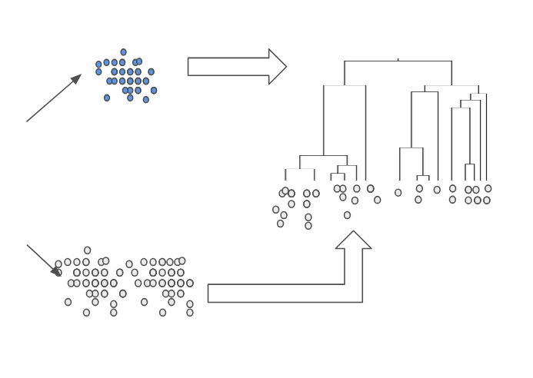
Axis 1: Skeleton-tree Based Preordering – For Highly Sampled Species
Reference genomes
Skeleton tree
Infere
Highly sampled species
Nearest-neighbor placement
Query genomes

Slide 33
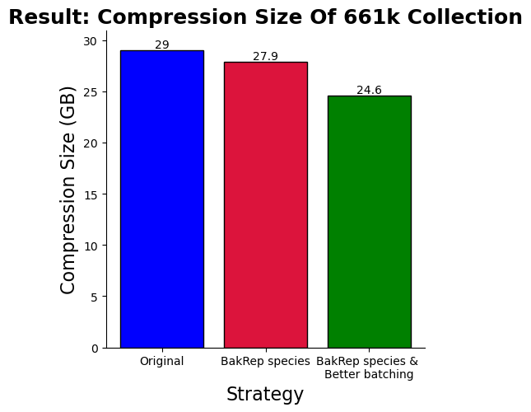
Axis 1 Result (661k) Species-Wise: 18% size reduction
Compression size of
3 most highly sampled species & dustbin [GB]
 | Original | New
S. enterica | 4.6 | 3.8
E. coli | 4.3 | 3.0
S. pneumoniae | 0.7 | 0.5
Dustbin | 10.9 | 10.6

Slide 34
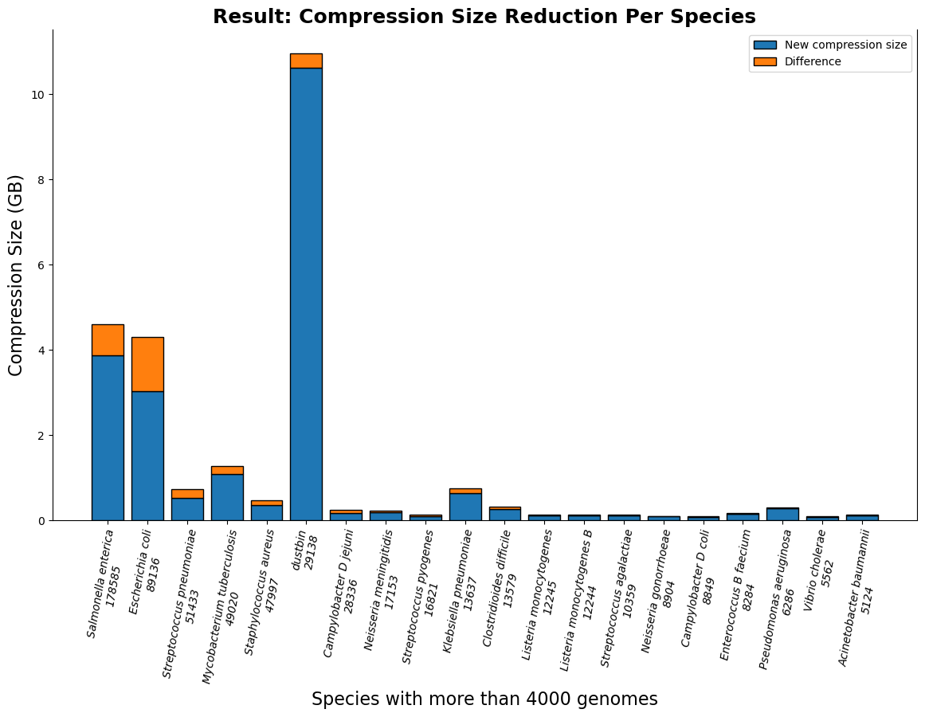
Axis 1 Result (661k) Species-Wise: Absolute compressed size reduction p. species

Slide 35
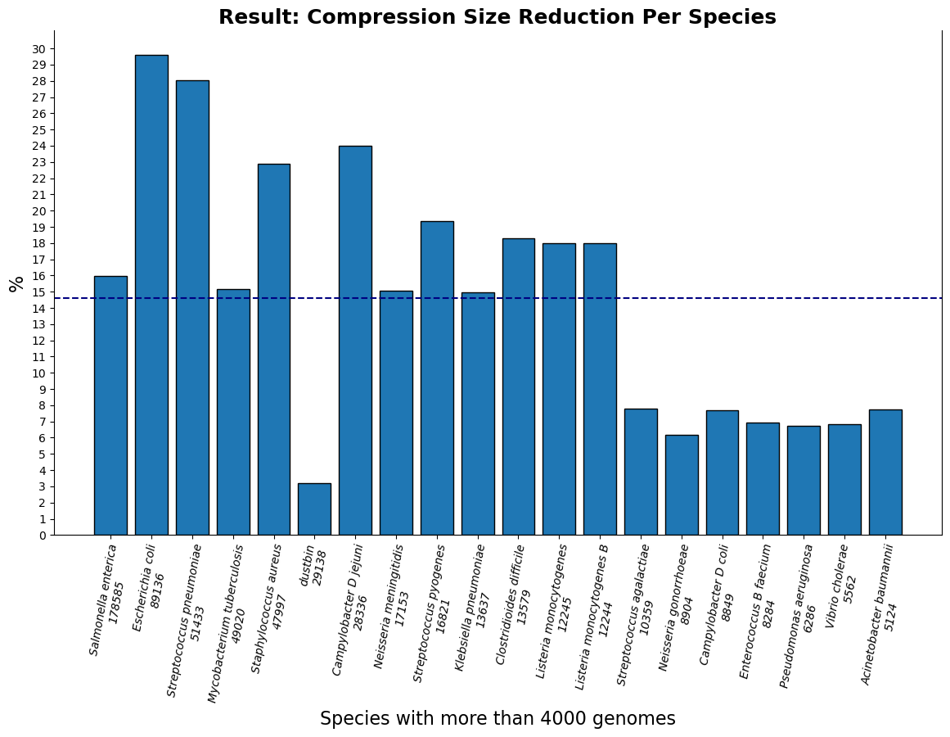
Axis 1 Result (661k) Species-Wise: Relative compressed size reduction per species

Slide 36
Axis 1 Result (661k) Species-Wise: Selection percentage - E. coli case
 | Compression size (byte) | Reduction %
Species-wise mash tree | 3027293636 | 29.6
Skeleton tree with 10% dataset | 3043772372 | 29.2
Skeleton tree with 8% | 3049647152 | 29.1
5% | 3053279092 | 29.0
3% | 3059981920 | 28.8
1% | 3094261844 | 28.0
Original accession order | 4301631272 | X
A skeleton tree with just 1% of the species has a 28% reduction in compression size

Slide 37
Axis 1: Species-Independence
INPUT:
Collection of genomes
Skeleton-based reordering
S1
S1
S1
Pre-ordering
Batching
S2
S2
S3
Apply the skeleton-based approach on the entiere collection

Slide 38
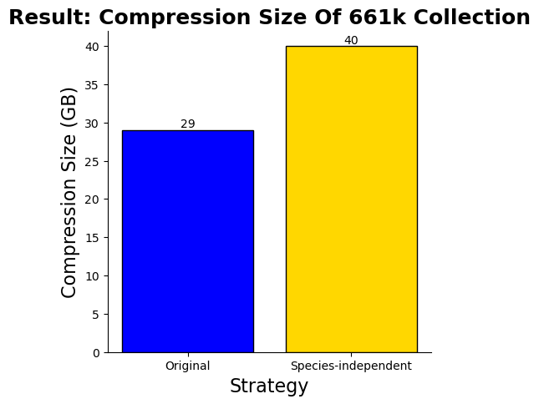
Axis 1 Result (661k) Species-independent: Currently No Improvement
Observed limitation
References genomes set comprises of only 40% species
Future improvement of the strategy
Selection strategy for better diversity of reference genomes set

Slide 39
Axis 1 Result Summary
New workflow: species-wise preordering
15-20% compression size reduction.
Will be included along with the new version of phylogenetic compression: MiniPhy2
Species-independent (on-going)
Future improvement: selection strategy that ensure a good diversity

Slide 40
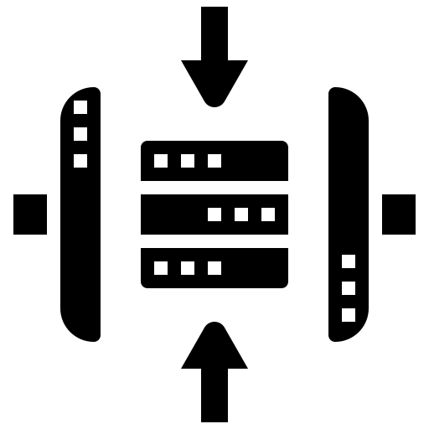

Axis 2 Constraints-aware Batching: Quick Recap – Current Workflow & Our Goal
Clusters of genomes: genomes from the same species, uneven in size
We want to group them into batches while ensuring:
Requirements on batches: number of genomes, uncompressed size, …
Post-compression batch sizes must fit within a memory constraint (balance)
To ensure good compression ratio: maximize number of genomes per single batches.
➔ Corresponds to minimize the number of batches used.
Minimize
Notes:
We are working with clusters of genomes that come from the same species but vary significantly in size. The goal is to group these genomes into batches while meeting several key requirements. First, we must consider the number of genomes and the uncompressed size of the batches. Additionally, post-compression batch sizes must fit within a defined memory constraint to maintain balance across the system.
To achieve an optimal compression ratio, we aim to maximize the number of genomes in each batch. This will help minimize the total number of batches used, which in turn improves both efficiency and the effectiveness of the compression process. The challenge is to find the right balance that meets all these constraints while still ensuring a high-quality compression outcome.

Slide 41
Axis 2: Toward the first optimization model
We have a set of genomes
Need: group the into batches with constraints
Minimize the number of batches
➔ Optimization Problem: Bin Packing

Slide 42
Axis 2: Bin packing problem
Bin and batch are equivalent in this case
Put items into bins
Each bin has a capacity
Generalized algorithm:
Initially, an empty bin is created.
At each step, the next item is selected and packed in a bin.
A new bin may be created at each step.
Items
Bins

Slide 43
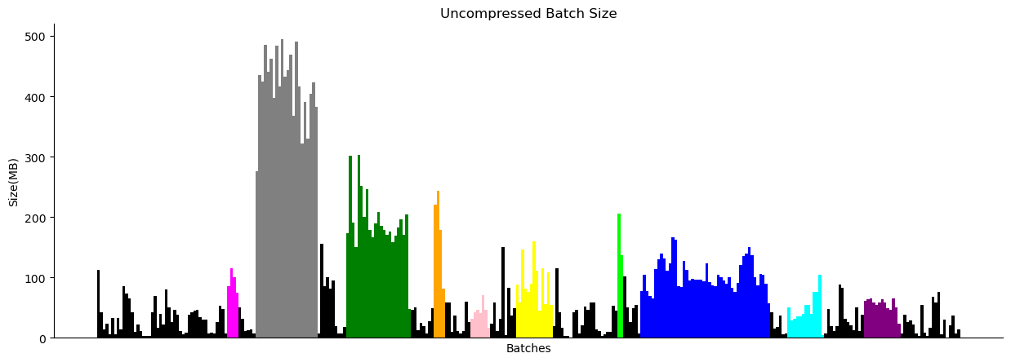
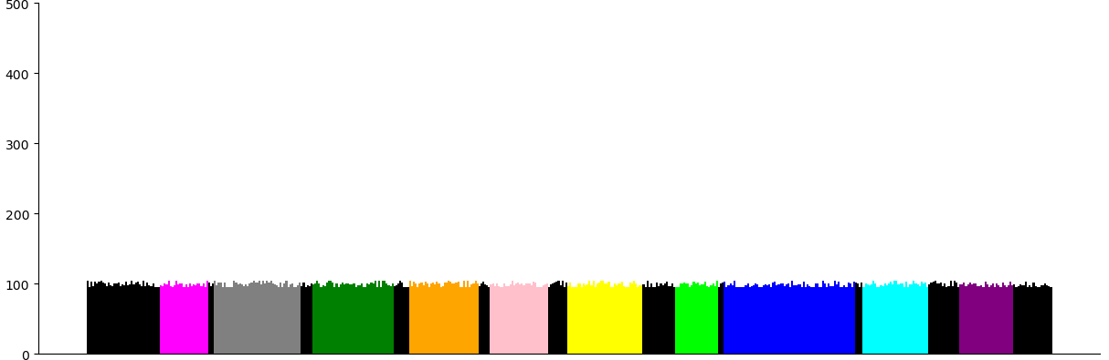
Objective: Constraints-aware batching strategy
Current:
+ xz
GOAL: Optimized Batching
Objective:
+ xz
Notes:
Our goal is to design a balancing batching strategy that addresses the challenges associated with non-uniformity in genomic data compression.

Slide 44
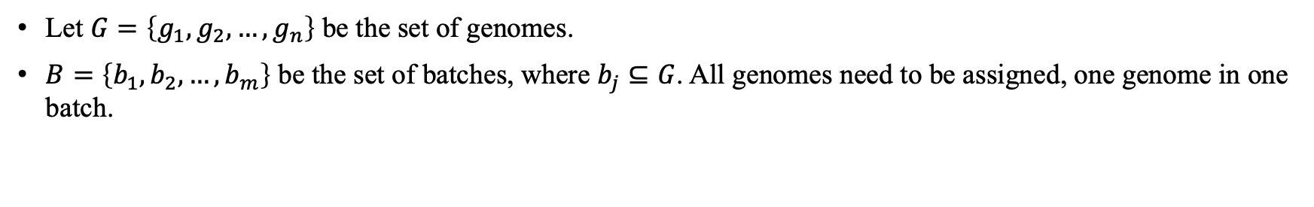
Axis 2: The First Optimaztion Model For Balancing Batching
Let $G=\left\{g_{1},g_{2},…,g_{n}\right\}$ be the set of genomes.
$B=\left\{b_{1},b_{2},…,b_{m}\right\}$ be the set of batches, where $b_{j}⊆G$. All genomes need to be assigned, one genome in one batch.

Slide 45
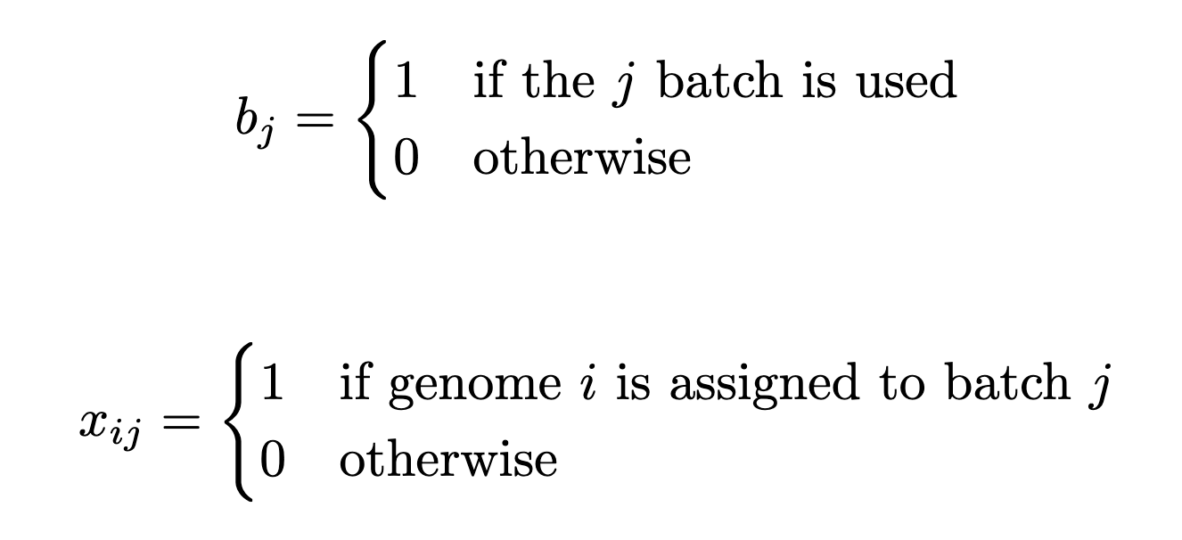
Axis 2: The First Optimaztion Model For Balancing Batching
Let $G=\left\{g_{1},g_{2},…,g_{n}\right\}$ be the set of genomes.
$B=\left\{b_{1},b_{2},…,b_{m}\right\}$ be the set of batches, where $b_{j}⊆G$. All genomes need to be assigned, one genome in one batch.

Slide 46
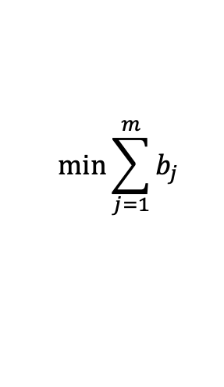
Axis 2: The First Optimaztion Model For Balancing Batching
Let $G=\left\{g_{1},g_{2},…,g_{n}\right\}$ be the set of genomes.
$B=\left\{b_{1},b_{2},…,b_{m}\right\}$ be the set of batches, where $b_{j}⊆G$. All genomes need to be assigned, one genome in one batch.
The compression size of each batch must be less than or equal to A MB:
$|post_compression_size(b_{j})|≤A$, $∀j∈\{1,…,m\}$
$$\min{\sum_{j=1}^{m}{b_{j}}}$$
Objective function:

Slide 47
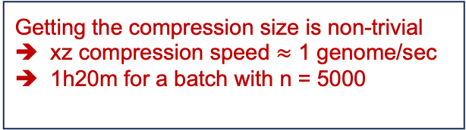
Axis 2: The First Optimaztion Model For Balancing Batching
Let $G=\left\{g_{1},g_{2},…,g_{n}\right\}$ be the set of genomes.
$B=\left\{b_{1},b_{2},…,b_{m}\right\}$ be the set of batches, where $b_{j}⊆G$. All genomes need to be assigned, one genome in one batch.
The compression size of each batch must be less than or equal to A MB:
$|post_compression_size(b_{j})|≤A$, $∀j∈\{1,…,m\}$
Getting the compression size is non-trivial
xz compression speed $≈$ 1 genome/sec
1h20m for a batch with n = 5000
$$\min{\sum_{j=1}^{m}{b_{j}}}$$
Objective function:

Slide 48
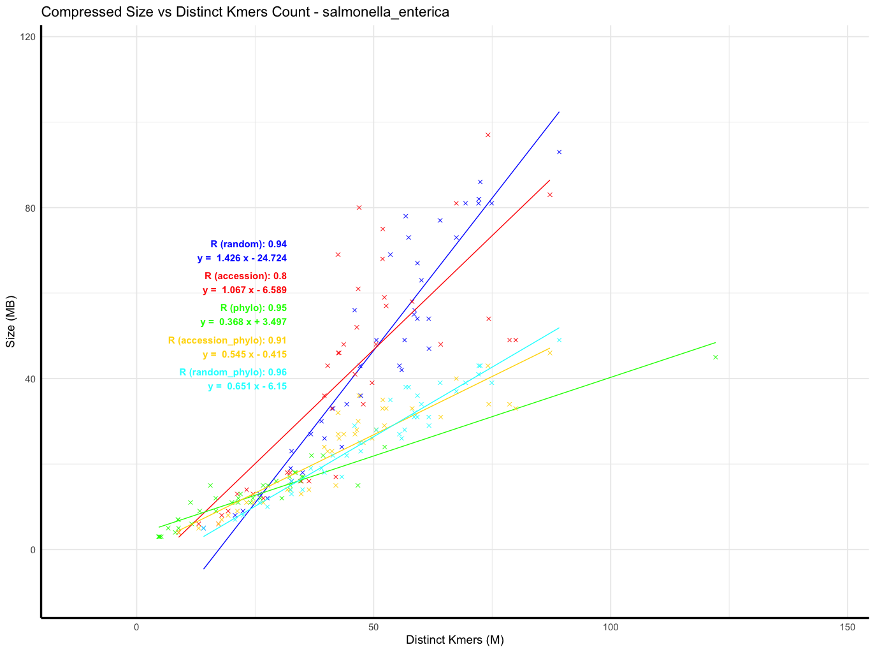
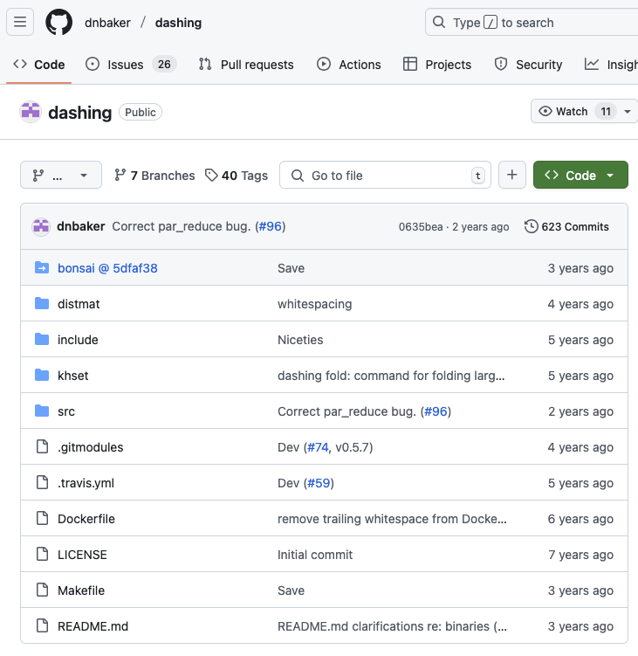
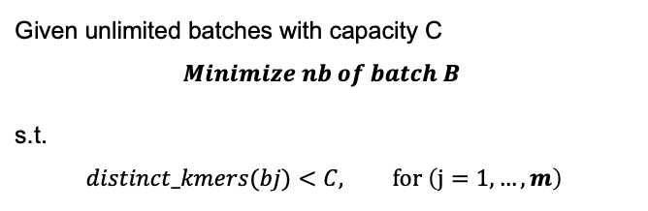
Axis 2: Implementation
Ingredient 1: Post-compression Sizes Correlates With Distinct Kmers Count In Genomes Collections
Ingredient 3: First-fit Bin Packing Algorithms
Given unlimited batches with capacity C
$$Minimize nb of batch B$$
s.t.
$$distinct_kmers(bj)<C, for \left(j=1,…,m\right)$$
Sort the genomes by acession number.
Initially, an empty bin is created.
At each step, the next genomes is selected and packed in the first available bin.
Distinct kmers count in each step is calculated using Dashing
Create new bin as needed.
Ingredient 2: Fast Distinct Kmers Counting via HyperLogLog - Implemented in Dashing

Slide 49
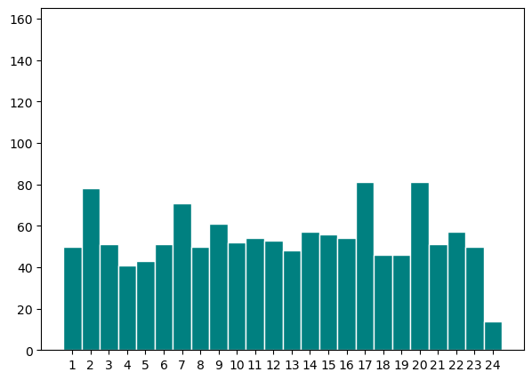
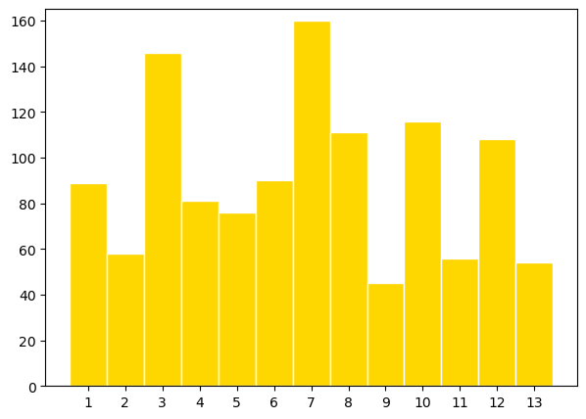
Axis 2 result: M. tuberculosis case (updating new result)

Slide 50
Axis 2 661k result: NA (I’m running the result)

Slide 51
Summary And Perspectives
2 main axis:
Metadata-independent: species-wise and species-independent
Constraints-aware batching
Side projects: recompression of genomes collections and tools development
Perspectives:
Combine the 2 axis
Improve reference genomes selections for axis 1
Extend axis 2 to more use cases (constraints)

