Slide 1
Bin Packing For Genomic Data
01/09/2025

Slide 2
Introduction & motivation

Slide 3
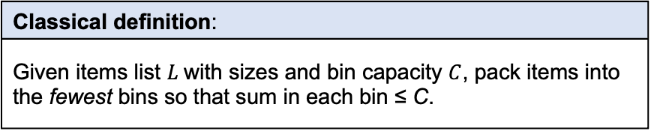



Bin packing: a classical and historically relevant optimization problem
Items of sizes $L_{i}$, $i=1,…,n$
Classical definition:
Given items list $L$with sizes and bin capacity $C$, pack items into the fewest bins so that sum in each bin ≤ C.
Bin capacity $C$
Historical contexts & applications
NP-hard, decision version NP-complete. Research began early 1970s: Ullman (1971), Johnson (1973–74), Garey et al. (1972–76). Recent surveys: Coffman et al. (1997), Coffman et al. (2013) Applications: logistics, computer systems, scheduling, Virtual Machine resource allocation
Pack
Pack into minimum bins $B$.

Slide 4
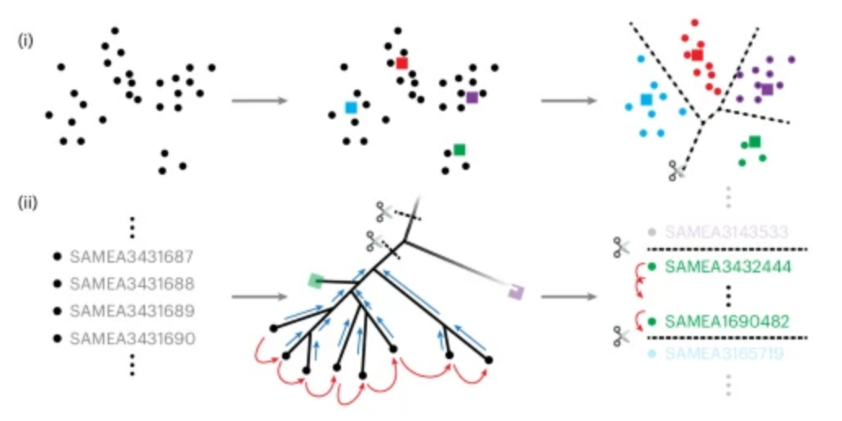
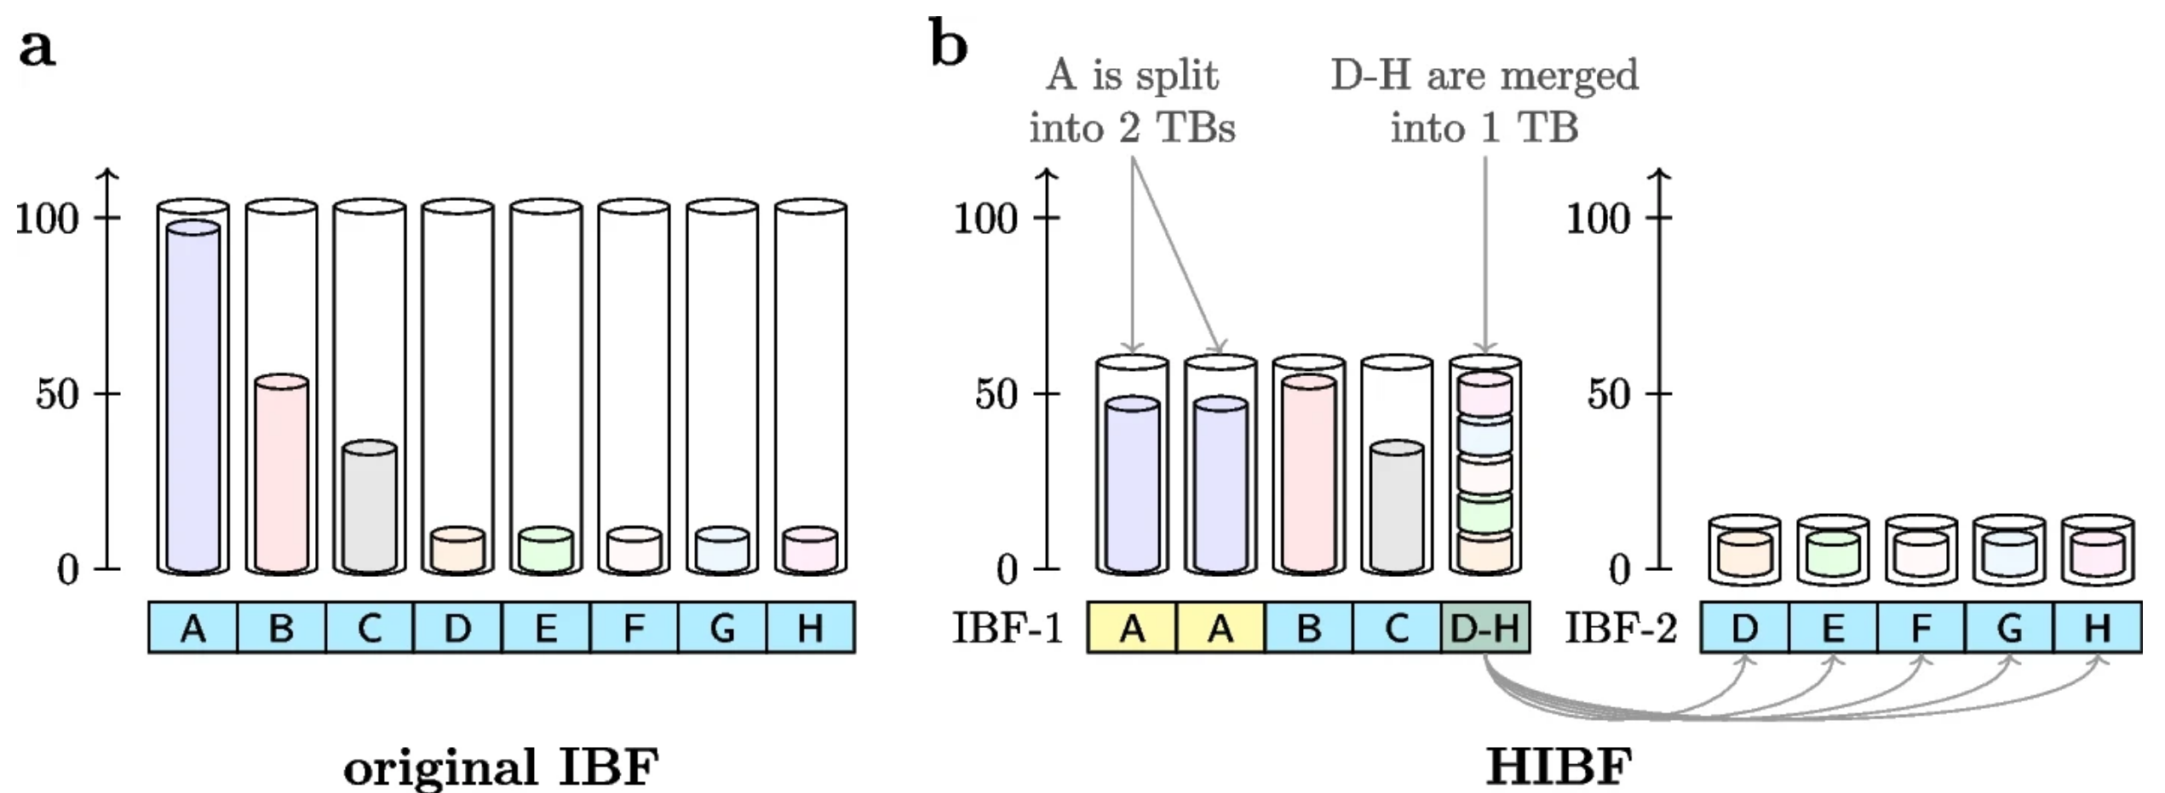
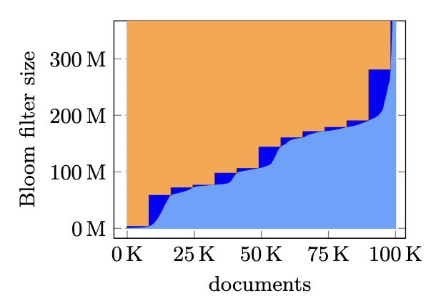
Bin packing and its variants in bioinformatics applications (overview)
Phylogenetic Compression:
Groups phylogenetically similar genomes into batches (bins) of equal cardinality.
Hierarchically Structured Bin Packing (DREAM-Yara):
Uses hierarchical taxonomy to group genomes into bins.
Bloom Filter Bin Packing (HIBF):
Groups genomes into a fixed number of Bloom filters of roughly equal size.
Optimizes memory usage and query efficiency
Bin Packing in COBS:
Capacity constraint: fixed maximum false positive rate per bin of equal cardinality.

Slide 5
Bin packing in phylogenetic compression
Data (genomes) split into size-constrained batches (bins).
2 types of bins:
Single-species bins
Multi-species bins i.e. dustbin
2 capacity constraints C
based on bin cardinality (each genome = size 1)
C_{single-species} = 4000
C_{multi-species} = 1000
Collection of genomes
Species clustering/packing
dustbin
First level of phylogenetic compression:
Species-based packing
Followed by within each batch:
phylogenetically reordering + compression using a low-level compressor.

Slide 6
Packing used in genomes collection indexing
COBS
HIBF
Dream-yara

Slide 7
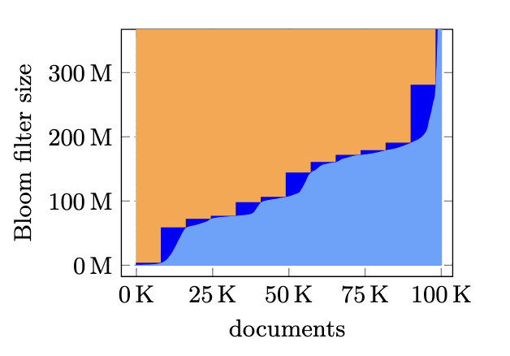
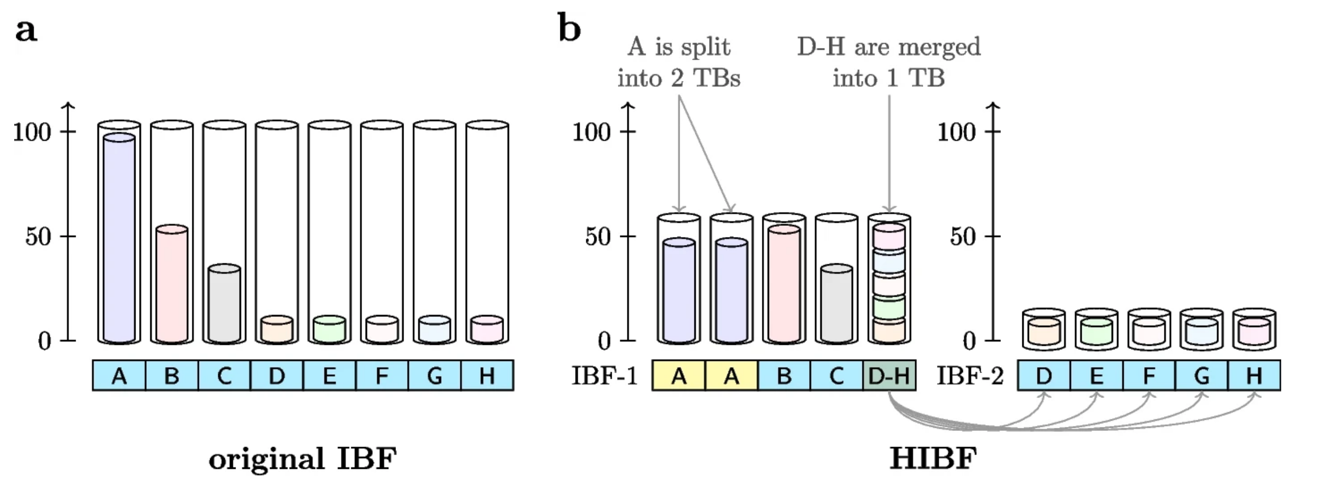
Bin packing in genomes indexes
Key Ideas: Bin packing is used to split data into groups before indexing
HIBF example:
Instead of packing genomes, HIBF packing strategy based on the contents (kmers) of a set of genomes (set A, B, … , H)
Instead of capacity, HIBF uses a limited number of bins (max number of bin allowed)
Packing schemes:
Split the content of a set into several bin
Store the entire content of a set in 1 bin
Store the content of multiple sets, i.e. merging, in 1 bin
COBS example: 100k genomes (documents)
Light blues slope: genomes sorted according to the index sizes (Bloom filter sizes with false positive rate 0.3)
Dark blue staircase: group into bins of 8192 genomes

Slide 8
Bin packing with taxonomy metadata: hierarchically structured bin packing
Input: Tree T with leaves L_{T} (with sizes/weights) and internal nodes N_{T} Bin capacity C
Output: a partion of L_{T} that minimizes overall scatterness.
Scatterness Measure:
Node dispersal number of node v: number of bins intersecting with leaves under v.
Example:
Internal nodes: n1, n2, n3
Leaves: l1 to l9
Leaf size = 1, bin capacity = 3
Partition A:
Dispersal numbers → n1 = 1, n2 = 1, n3 = 1, root = 3
Total scatterness = 6 (optimal)
Partition B:
Dispersal numbers → n1 = 3, n2 = 3, n3 = 3, root = 3
Total scatterness = 9
3/3
r
1/3
n₁
n₂
1/3
n₃
1/3
l₁
l₂
l₃
l₄
l₅
l₇
l₈
l₉
l₆
P_{A: optimal}
P_{B: not optimal}

Slide 9
Bin packing for genomic data recap: generalities and usages
What are the items to pack?
Whole genomes
Genomic contents (k-mers = substrings of length k)
What are some of the capacity thresholds and constraints?
Bin cardinality (number of genomes per bin)
Size of the indexing data structure
Total genomic content (number of distinct k-mers)
Taxonomy or phylogenetic information
What are the applications?
Optimize index space usage (HIBF, COBS)
Group related genomes together (DREAM-Yara, phylogenetic compression)
Enable parallelization (phylogenetic compression)
Improve search efficiency (HIBF, COBS)

Slide 10
Challenge 1: genomes and their contents overlap
In practice, genomic data is highly redundant.
Overlap of contents:
K-mer indexes (e.g. Bloom filters) of multiple genomes can merge its contents
Redundancies can be leveraged:
Phylogenetic compression uses evolutionary history
Improves local redundancy → achieves better compression
Genome 1
ATC
TCG
CTG
TCA
Genome 2
TCA
TGA
CAG
AAA
AAT
Genome 3
AAT
ATC
CCT
AGG

Slide 11
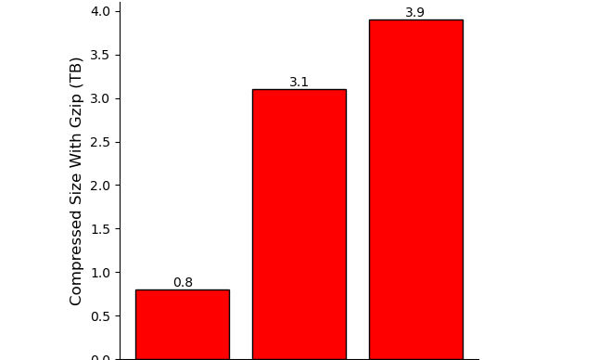
Challenge 2: genomic data is growing extremely fast
As of 2025: Multi-Terabytes Microbial Genome Collections
Computing hardware is not scaling fast enough to keep up
Horizontal scaling through parallelization is necessary
➔ Efficient bin packing is critical to manage and process the data
661k [2]
Nov. 2021
n = 661,405
AllThe Bacteria v0.2 [3]
Mar. 2024
n = 1,932,812 [3]
AllTheBacteria v0.3 [3]
Nov. 2024
n = 2,440,377 [3]
18 Jun 2025: ATB v0.4 with 330k new genomes
Next decade: Even larger collections (n = ~10⁷), higher diversity, …

Slide 12
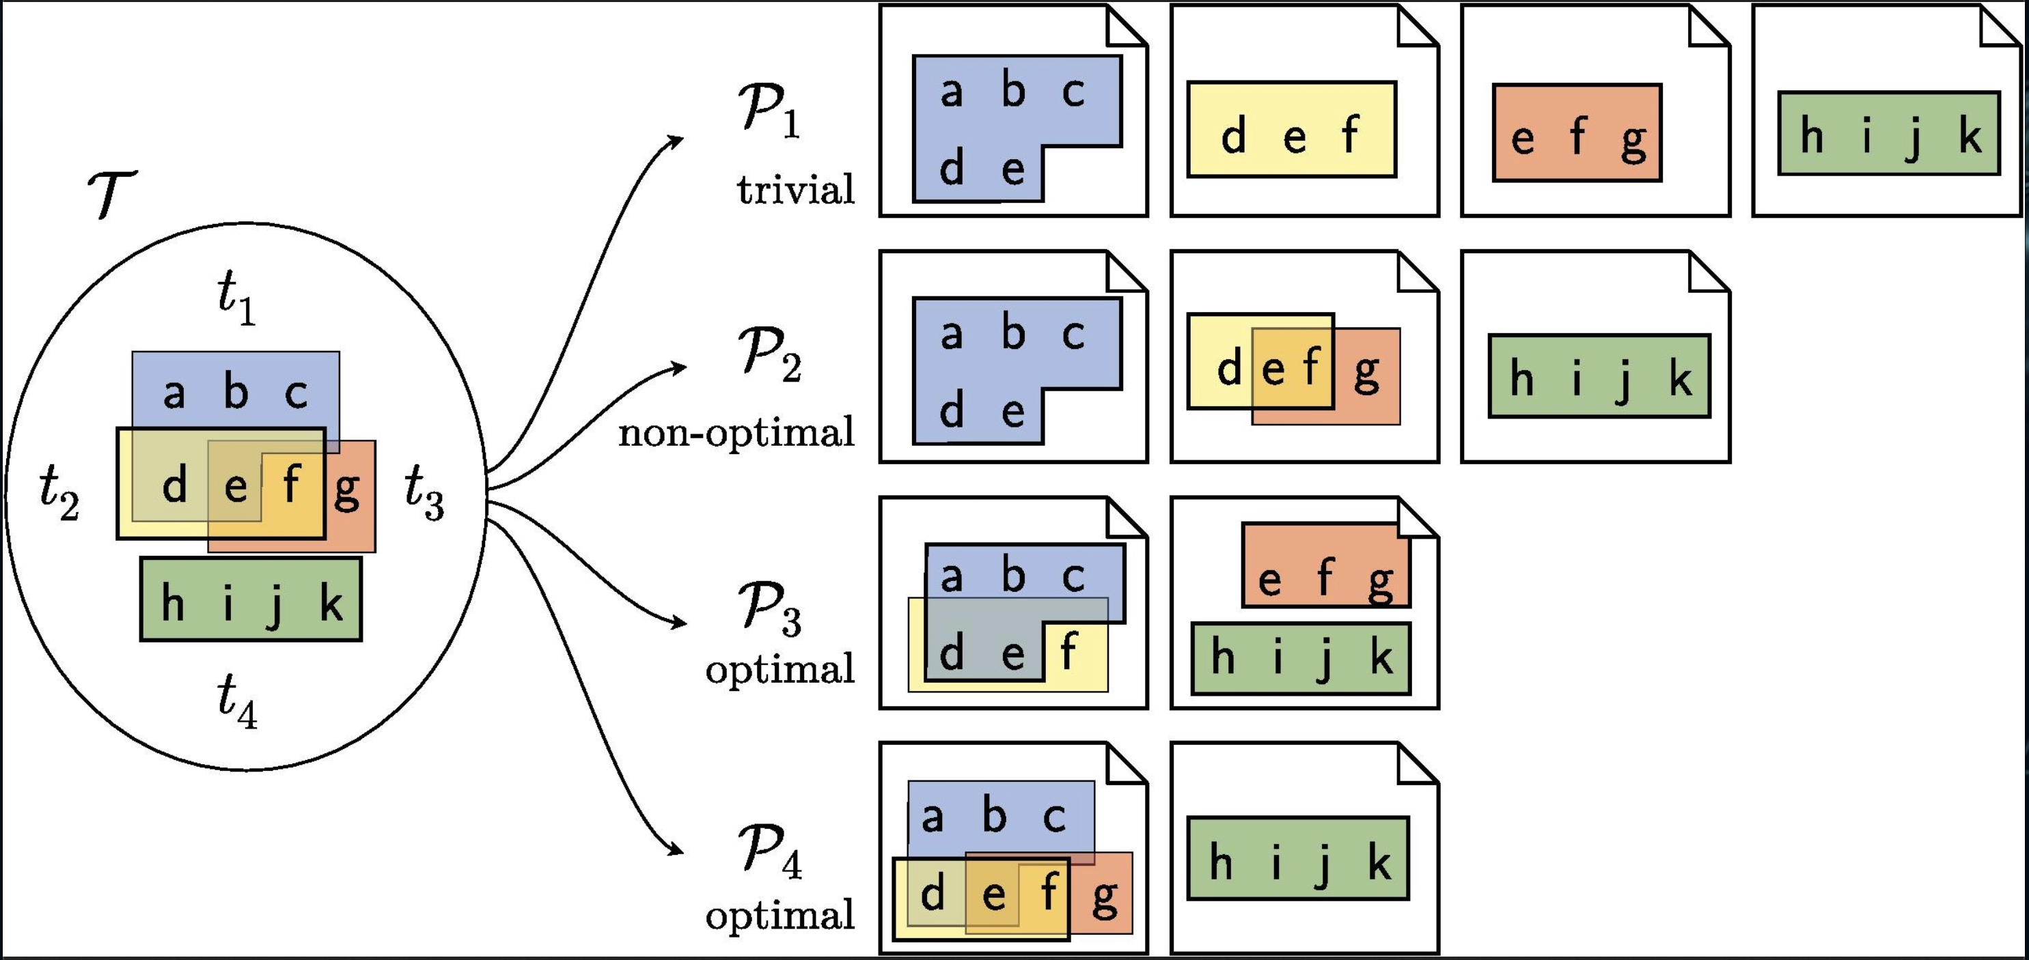
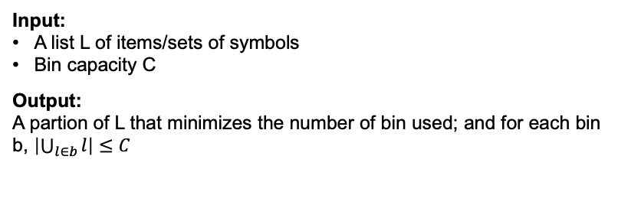
Finding: Packing genomic data can be formulized as a bin packing with overlapping items problem
Input: A list L of items/sets of symbols Bin capacity C
Output: A partion of L that minimizes the number of bin used; and for each bin b, $\left|\bigcup_{l∈b}{l}\right|≤C$
An extension of the classical bin packing
First proposed in 2011 to used for Virtual Maching Packing
Formalized and some heuristics proposed in 2018
Example (Grange et al., 2018): partitioning with items with overlapping contents
Items: {t1, t2, t3, t4}
Contents: {{a,b,c,d,e}, {d,e,f}, {e,f,g}, {h,i,j,k,}}

Slide 13
Optimization problem model

Slide 14
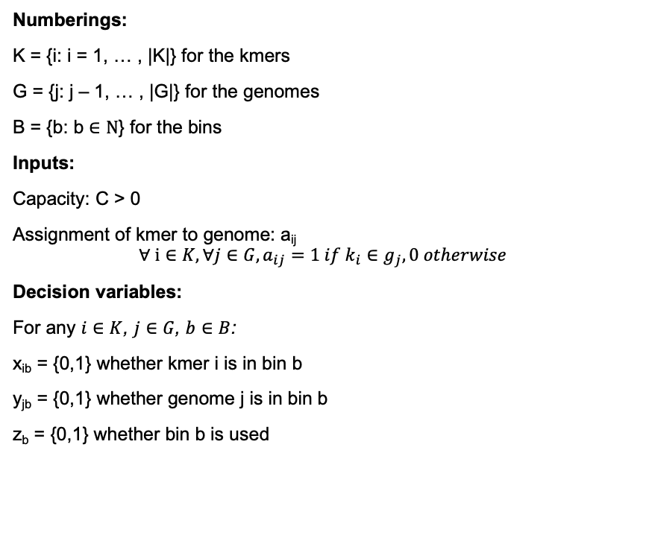
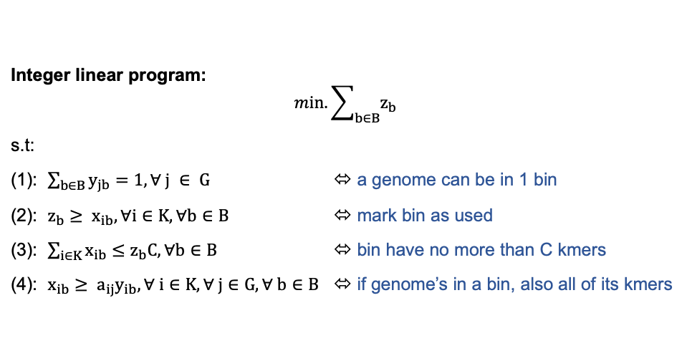
Interger linear model for genomes bin packing with overlapping contents (kmers)
Numberings:
K = {i: i = 1, … , |K|} for the kmers
G = {j: j – 1, … , |G|} for the genomes
B = {b: b $∈Ν$} for the bins
Inputs:
Capacity: C > 0
Assignment of kmer to genome: a_{ij}
$$∀ i∈K, ∀j∈G, a_{ij}=1 if k_{i}∈g_{j}, 0 otherwise$$
Decision variables:
For any $i∈K$, $j∈G$, $b∈B$:
x_{ib} = {0,1} whether kmer i is in bin b
y_{jb} = {0,1} whether genome j is in bin b
z_{b} = {0,1} whether bin b is used
Integer linear program:
$$min. \sum_{b∈B}{z_{b}}$$
s.t:
(1): $\sum_{b∈B}{y_{jb}}=1, ∀ j ∈ G$ ⬄ a genome can be in 1 bin
(2): $z_{b}≥ x_{ib}, ∀i∈K, ∀b∈B$ ⬄ mark bin as used
(3): $\sum_{i∈K}{x_{ib}≤z_{b}C, ∀b∈B}$ ⬄ bin have no more than C kmers
(4): $x_{ib}≥ a_{ij}y_{ib}, ∀ i∈K, ∀ j∈G, ∀ b∈B$ ⬄ if genome’s in a bin, also all of its kmers
Exact solution: Can be solved exact using solver
Impractical in practice due to the scale of data
➔ Heuristic solution needed

Slide 15
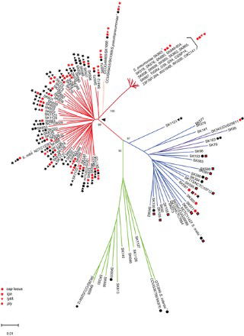
Proposition: First fit bin packing with preordering
The Any-Fit (AF) heuristic family (Next-Fit, First-Fit, Best-Fit, …) is well-studied in classical bin packing
In classical bin packing, preordering by item size improves results
Not applicable for genomes → contents may overlap or merge
Proposed approach:
Reorder genomes phylogenetically to optimize for local redundancies (Břinda et al., 2025)
Apply AF heuristics (e.g., First-Fit) on the reordered input
AF
Applications:
Grouping genomes along with its kmers contents for indexing
Grouping genomes for compression

Slide 16
Secondary proposition: the case of phylogenetic compression’s Dustbin
Recap:
Hierarchically Structured Bin Packing keep take into accounts a tree structure
Phylogenetic compression packs genomes into multi-species bins (dustbin)
Proposition:
➔ Apply HSBP to the case of dustbin.
Collection of genomes
Species clustering/packing
dustbin

Slide 17
Takeaways:
Bin packing is highly relevant in bioinformatics
Optimizes space usage
Facilitates parallelization
Genomes and its contents as items
Packing genomes can be modeled as a bin packing problem
Challenge: items (genomes) may overlap in content
Research proposition
Investigate Any-Fit heuristics (First-Fit, Best-Fit, …) with phylogenetic ordering to exploit local redundancy

