Slide 1
Distinct K-mers Count and Compression Size:
Correlations Across Genome Orders
31 Mars 2025

Slide 2
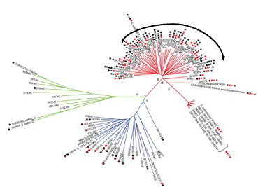
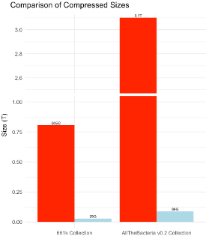
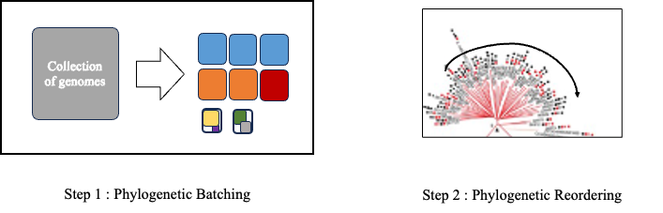

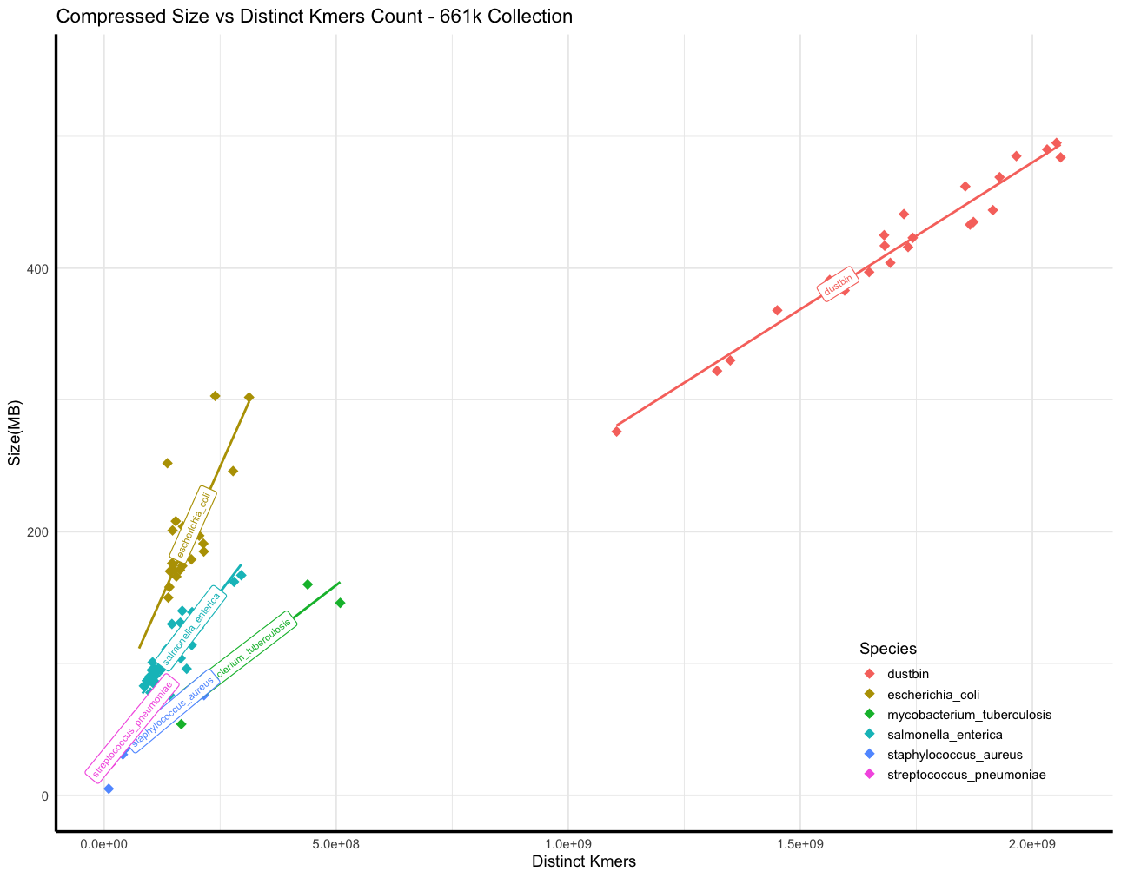
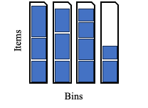

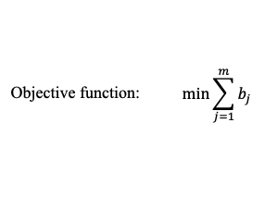
Phylogenetic compression and 3 ingredients for balancing batches
1: Innovation for compressing steadily growing bacteria database
2: Key steps of phylogenetic compression
3: Current limitation and out objective
4: First approach using distinct kmers count
Fast distinct kmers counting:
HyperLogLog sketching
Current batches compressed size: non-uniform
y = ax + b
Threshold
GOAL: balancing batches

Slide 3
Phylogenetic compression and 3 ingredients for balancing batches
1: Innovation for compressing steadily growing bacteria database
2: Key steps of phylogenetic compression
Reordering genomes based on evolutionary history
3: Current limitation and out objective
4: First approach using distinct kmers count
Fast distinct kmers counting:
HyperLogLog sketching
Current batches compressed size: non-uniform
y = ax + b
Threshold
GOAL: balancing batches
A deeper look into this ingredient

Slide 4
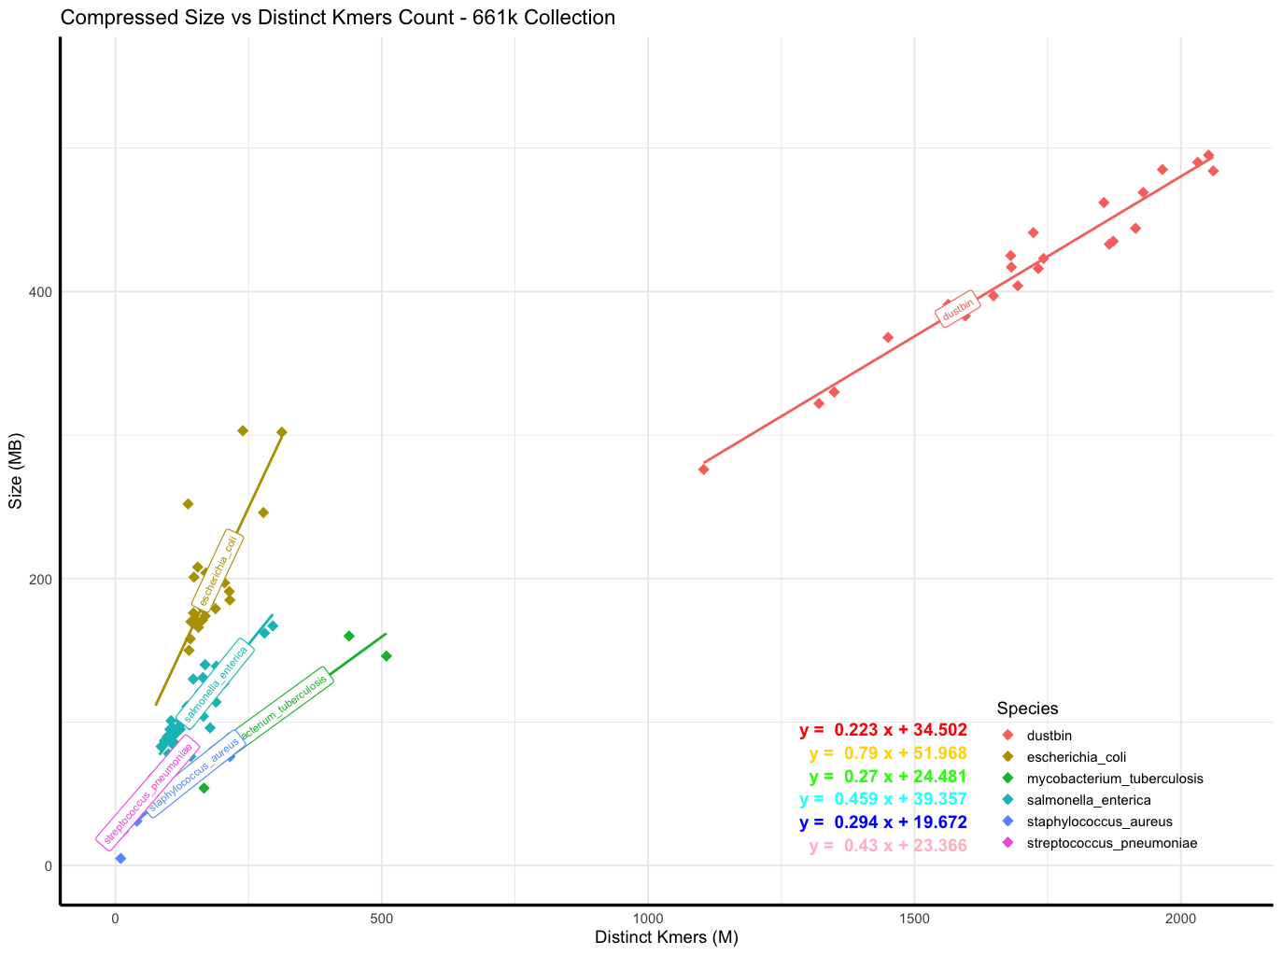
Evaluating post compression sizes prediction using 661k batches
Test data: 10 randomly sampled batches from a single species, each with a varying number of genomes (100 => 1000).
Root Mean Squared Error is used in this presentation for ease of interpretation

Slide 5
Evaluating post compression sizes prediction using 661k batches
Test data: 10 randomly sampled batches from a single species, each with a varying number of genomes (100 => 1000).
Salmonella enterica:
Root Mean Squared Error (RMSE): 34.850 MB
Escherichia coli:
Root Mean Squared Error (RMSE): 53.911 MB
Mycobacterium tuberculosis:
Root Mean Squared Error (RMSE): 26.651 MB
Not particularly good prediction
⇒ Possible reason: The batches in the 661k dataset are not random; they have a specific ordering.

Slide 6
Does accounting for genome orderings improve the approximation of post-compression sizes?
Experiment setup - Dataset:
From the 661k genome collection, select 6 species (gtdbtk classification) with over 20,000 genomes.
Sample randomly 20,000 genomes from each species.
The 6 selected species comprise 444,507 genomes, or 67% of the collection. We sampled 120,000 genomes (20,000 per species), representing 18% of the total collection.
Species: Campylobacter_D jejuni, Escherichia coli, Mycobacterium tuberculosis , Salmonella enterica, Staphylococcus aureus, Streptococcus pneumoniae

Slide 7

Orders: Random, Accession, Phylogenetic, Accession+Phylo, Random+Phylo
genome_1
genome_2
genome_3
genome_4
…
genome_20000
random_subset_1
accession_subset_1
phylo_subset_1
random_subset_2
accession_subset_2
phylo_subset_2
…
…
…
shuffle
sort
phylo
Reorder 1 more time with phylo tree
genome_113
genome_192
genome_4512
genome_6789
…
genome_19091
SAMN1
SAMN11
SAMN13
SAMN30
…
SAMN20000
genome_2
genome_1
genome_4
genome_3
…
genome_20000
Cut each of the 3 sets into smaller subsets
random_phylo
subset_1
accession_phylo
subset_1
…
…
Random+Phylo
Accession+Phylo
Random:
bash function shuf
Sorted by Accession number:
bash function sort
Reordering with Phylo tree (mash+quicktree)

Slide 8
Split the genomes into different size groups
The set genomes are then cut into subsets, starting with a small number of genomes and gradually increasing the number.
Example: with 20 genomes, and 4 groups:
Subset 1: 2 genomes
Subset 2: 4 genomes
Subset 3: 6 genomes
Subset 4: 8 genomes
We cut the set of 20,000 genomes of single species into 40 disjunctive subsets.
The smallest one has 24, the largest has 976 genomes
Then we estimate the distinct kmers and compress all of them.
Subset 1
Set of genomes
Subset 2
Subset 3
Subset 4
Subset 5

Slide 9
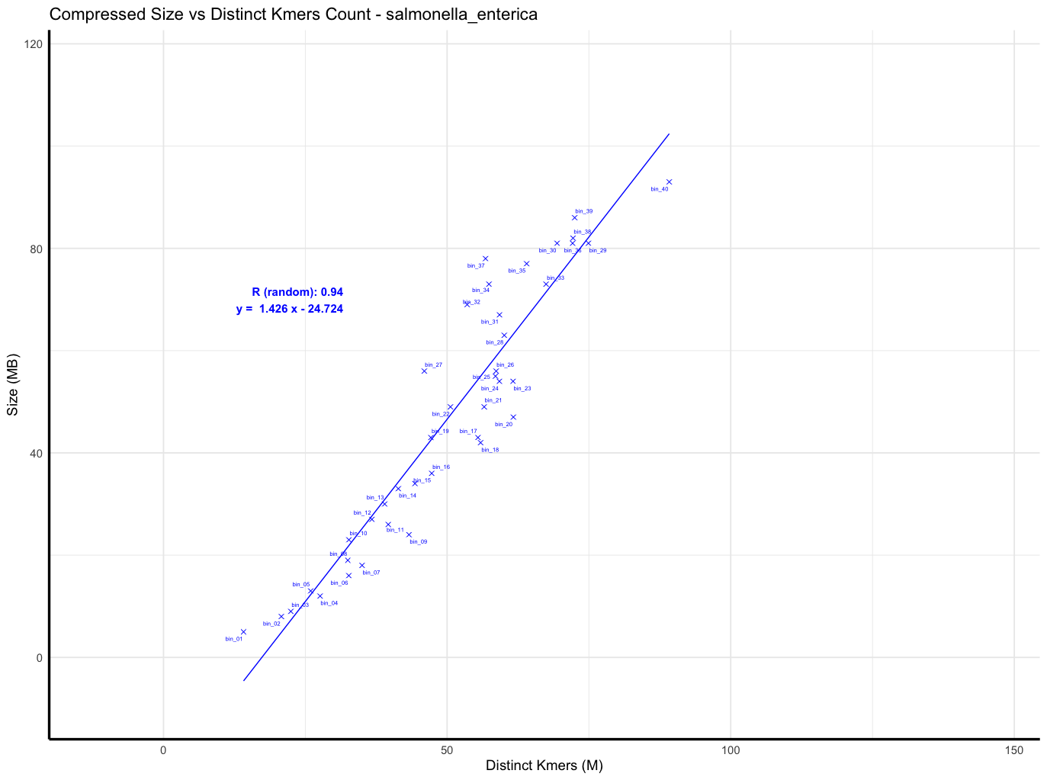
Linear regression result: Salmonella enterica - random order

Slide 10
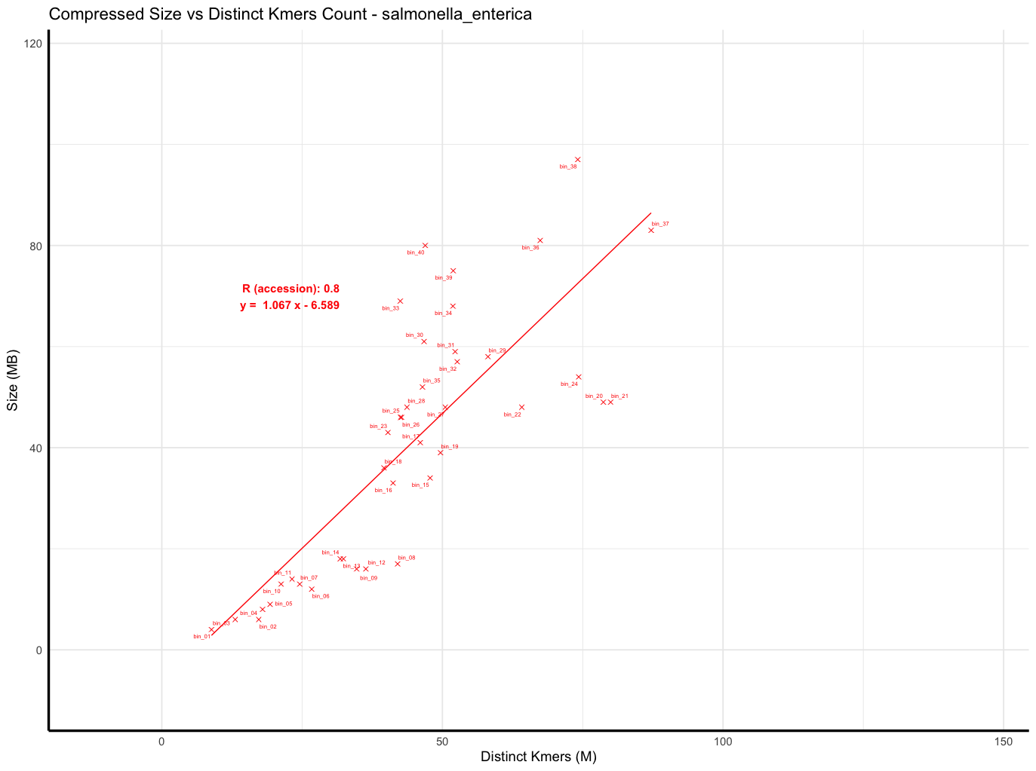
Linear regression result: Salmonella enterica - accession order

Slide 11
Linear regression result: Salmonella enterica - accession order
S. enterica in 661k: 178,585 genomes
Sampled: 20,000 (11% of the total)
This sampling broke the accession order.

Slide 12
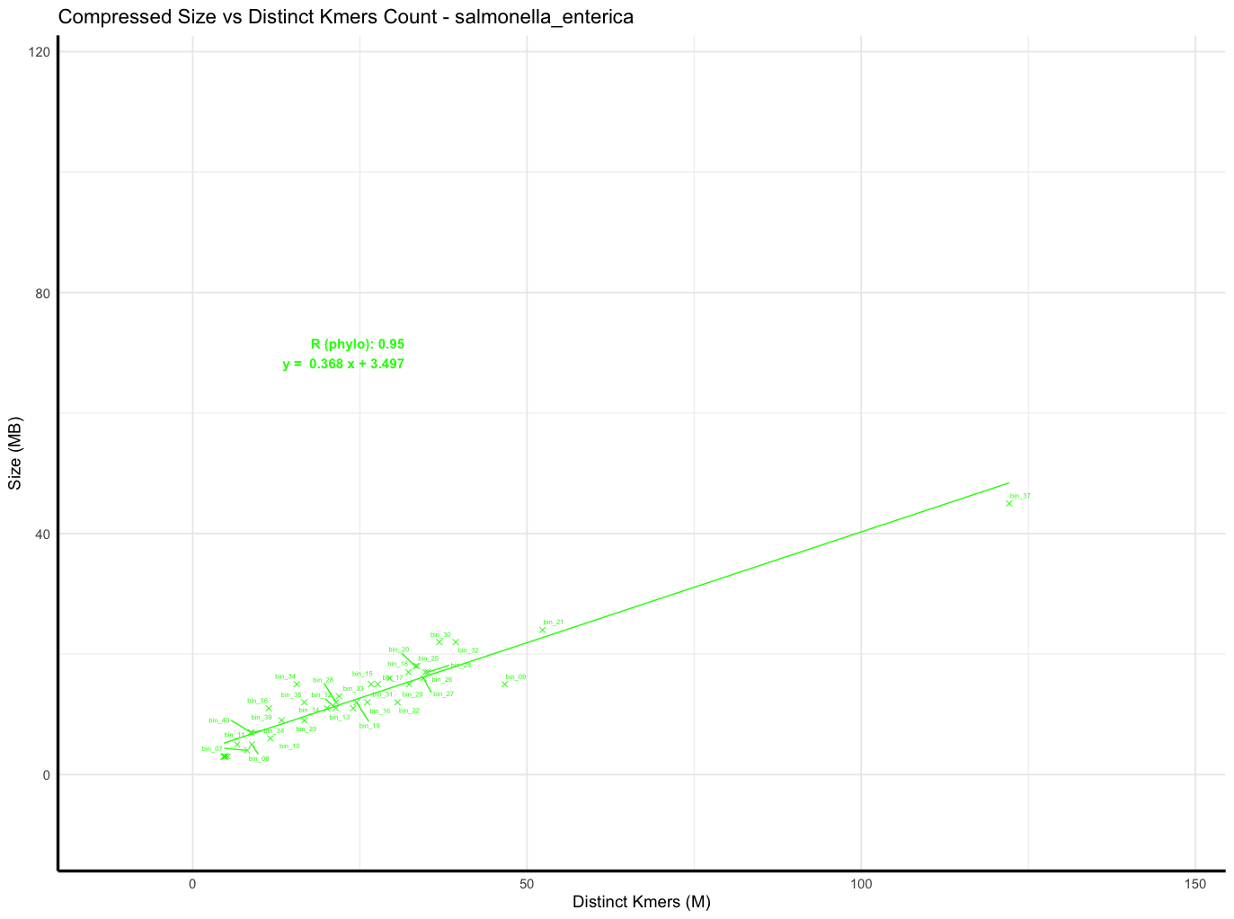
Linear regression result: Salmonella enterica - phylo order
Outlier
Hypothesis: low-quality genomes

Slide 13
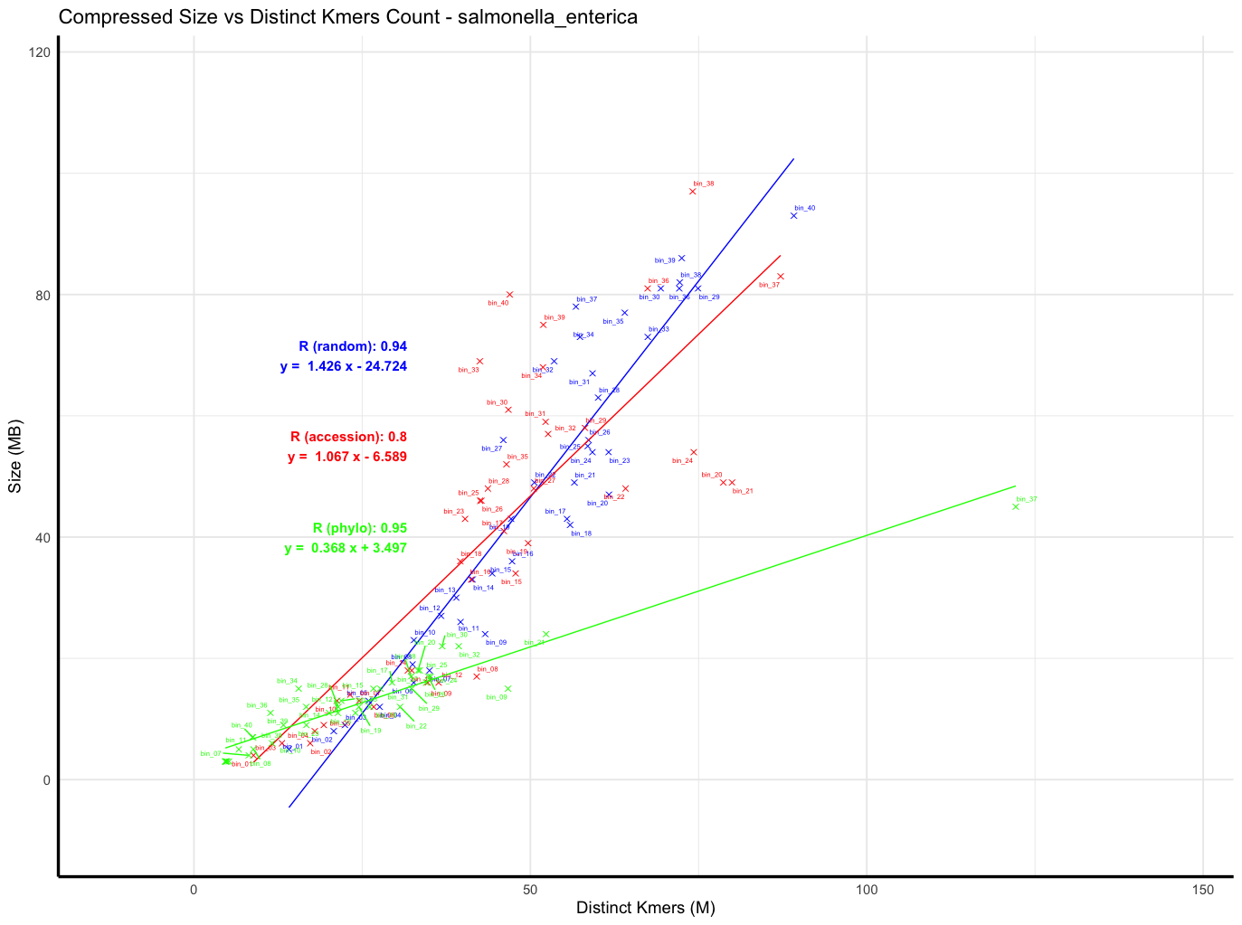
Linear regression result: Salmonella enterica - random, accession, phylo

Slide 14
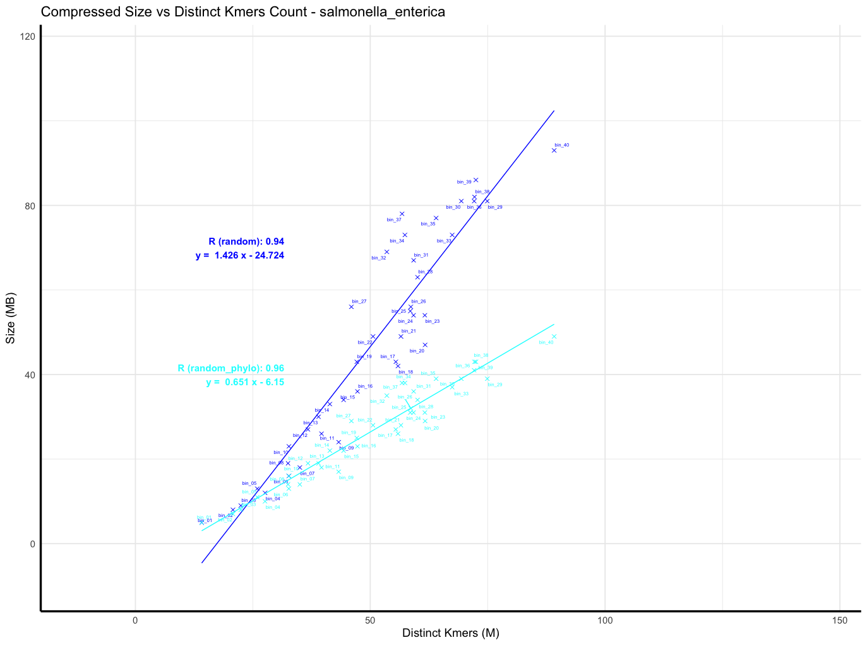
Linear regression result: Salmonella enterica - random, random + phylo

Slide 15
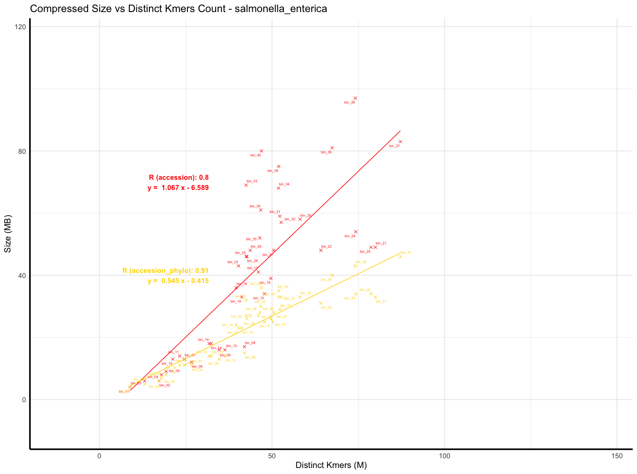
Linear regression result: Salmonella enterica - accession, accession + phylo

Slide 16
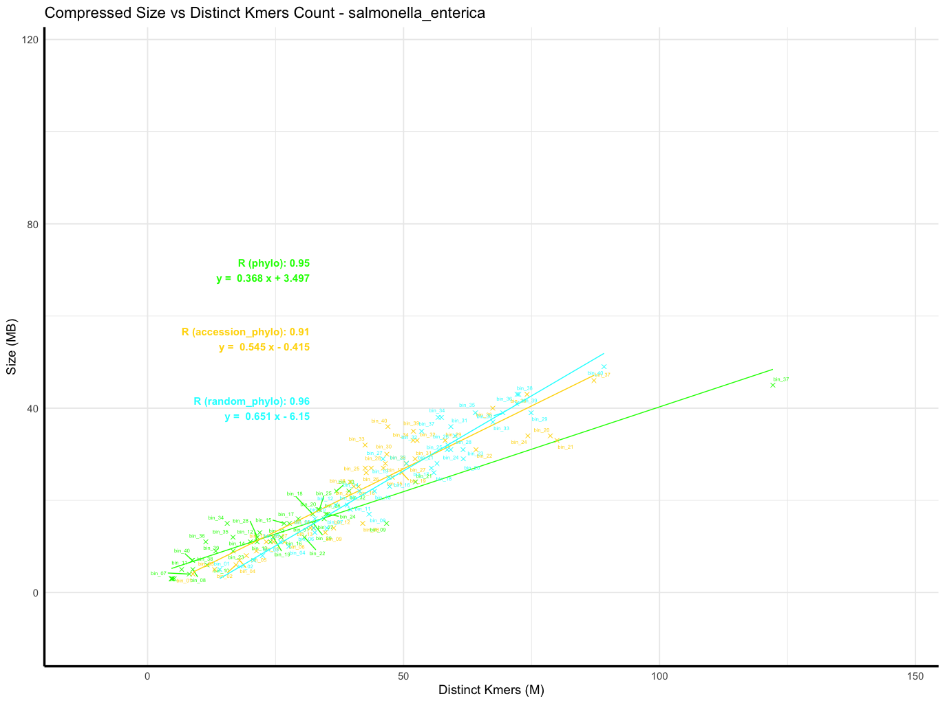
Linear regression result: Salmonella enterica - phylo, accession+phylo, random+phylo

Slide 17
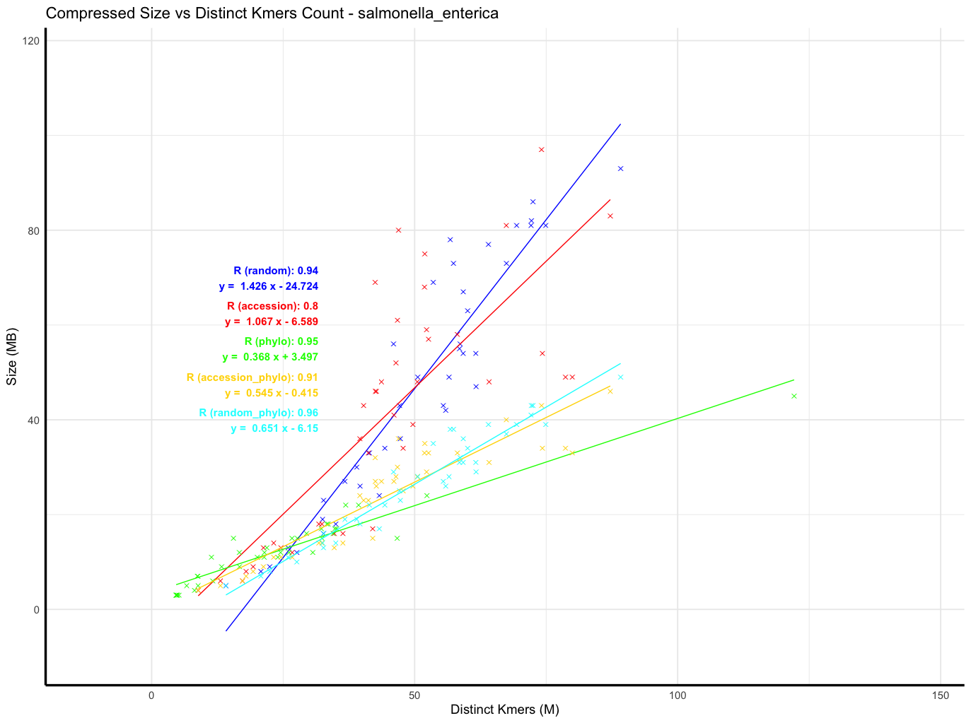
Linear regression result: Salmonella enterica - all orders
 | RMSE (MB)
Random | 45.623
Accession | 36.236
Phylo | 17.533
A+Phylo | 14.345
R+Phylo | 17.205

Slide 18
Summary: RMSE (MB) of 6 species investigated, how well can we predict?
 | S.enterica | E.coli | M.tuberculosis | S.aureus | C.D.jejuni | S.pneumoniae
Random | 45.623 | 53.375 | 20.590 | Still compressing
Accession | 36.236 | 43.26 | 26.810
Phylo | 17.533 | 32.325 | 39.635
A+Phylo | 14.345 | 21.464 | 17.702
R+Phylo | 17.205 | 23.332 | 13.761

Slide 19
Discussion and perspectives
Improved Approximation (3 of the most highly sampled species for now): Considering species and genome ordering improves post-compression size approximation. Phylogenetic Compression: Its impact grows as batch size increases.
Scalability: Estimating a phylogenetic tree for 20,000 genomes is feasible—can we scale to 100,000 genomes or more?
Challenge: Outliers negatively impact results. (explain the outlier behaviors in phylogenetic orders)
Future Improvement: Incorporate genome quality to handle outliers effectively. ⇒ additional strategy needed for lq genomes in collections + experiments for low quality genomes

Slide 20
Supplementary

Slide 21
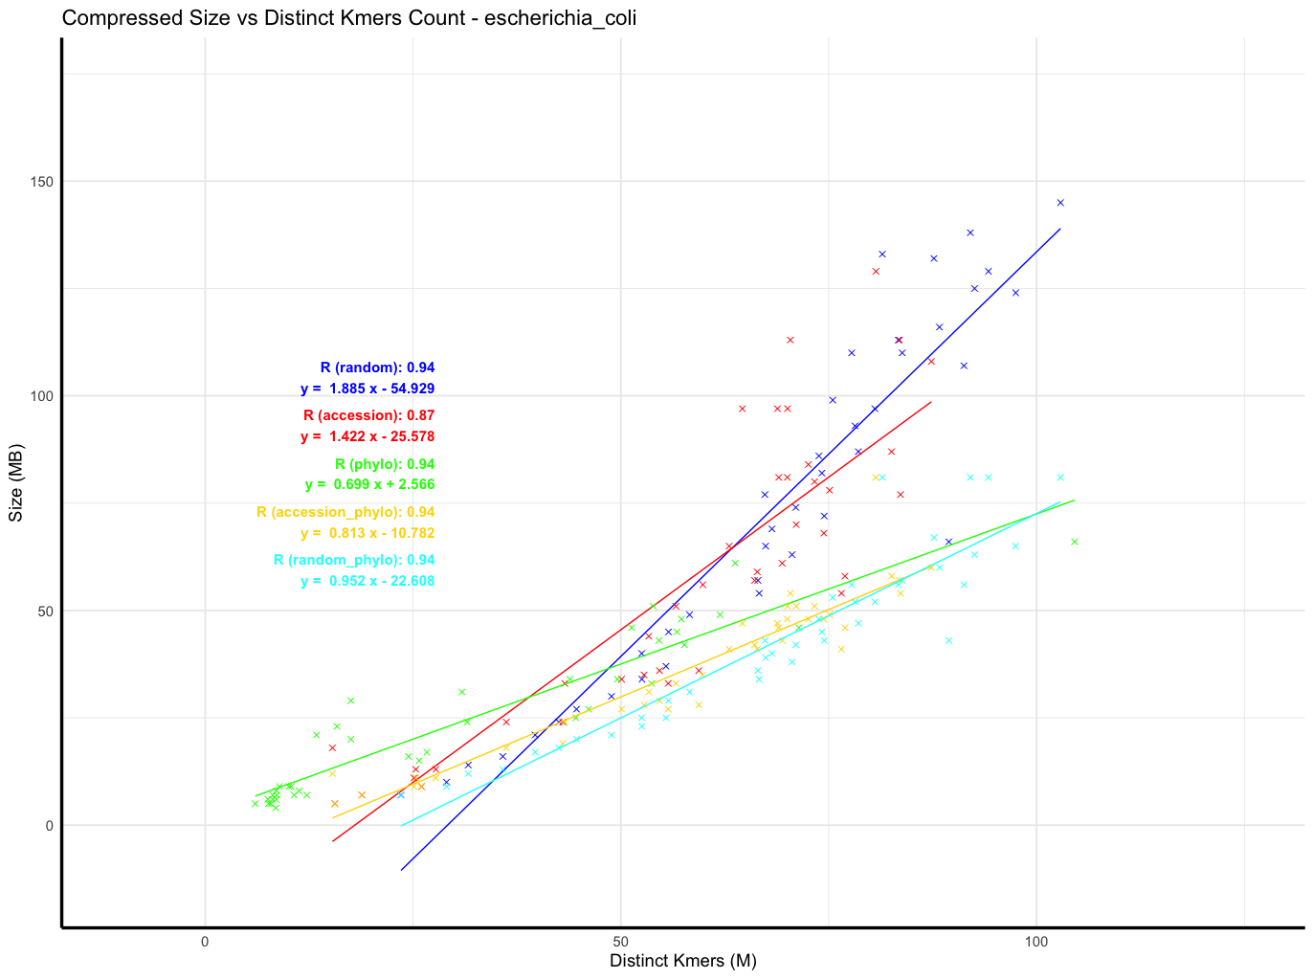
escherichia_coli

Slide 22
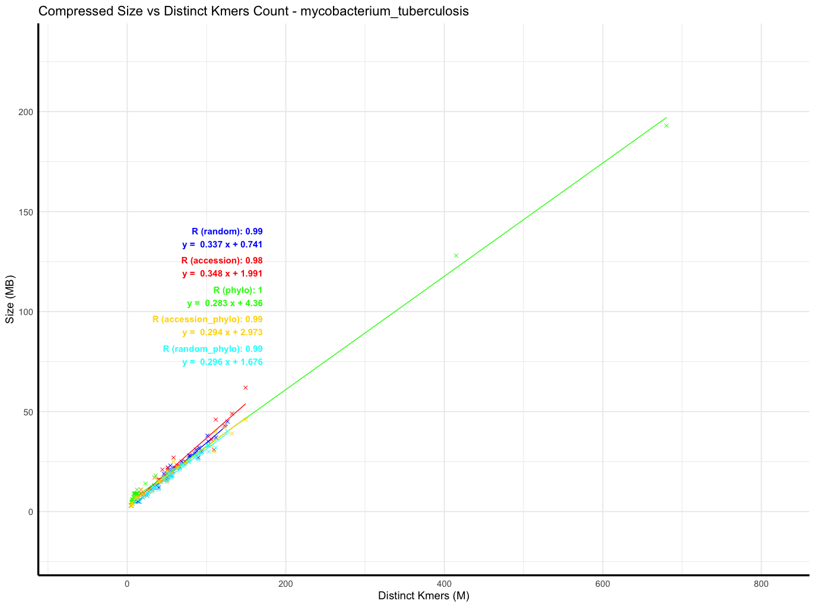
mycobacterium_tuberculosis

Slide 23
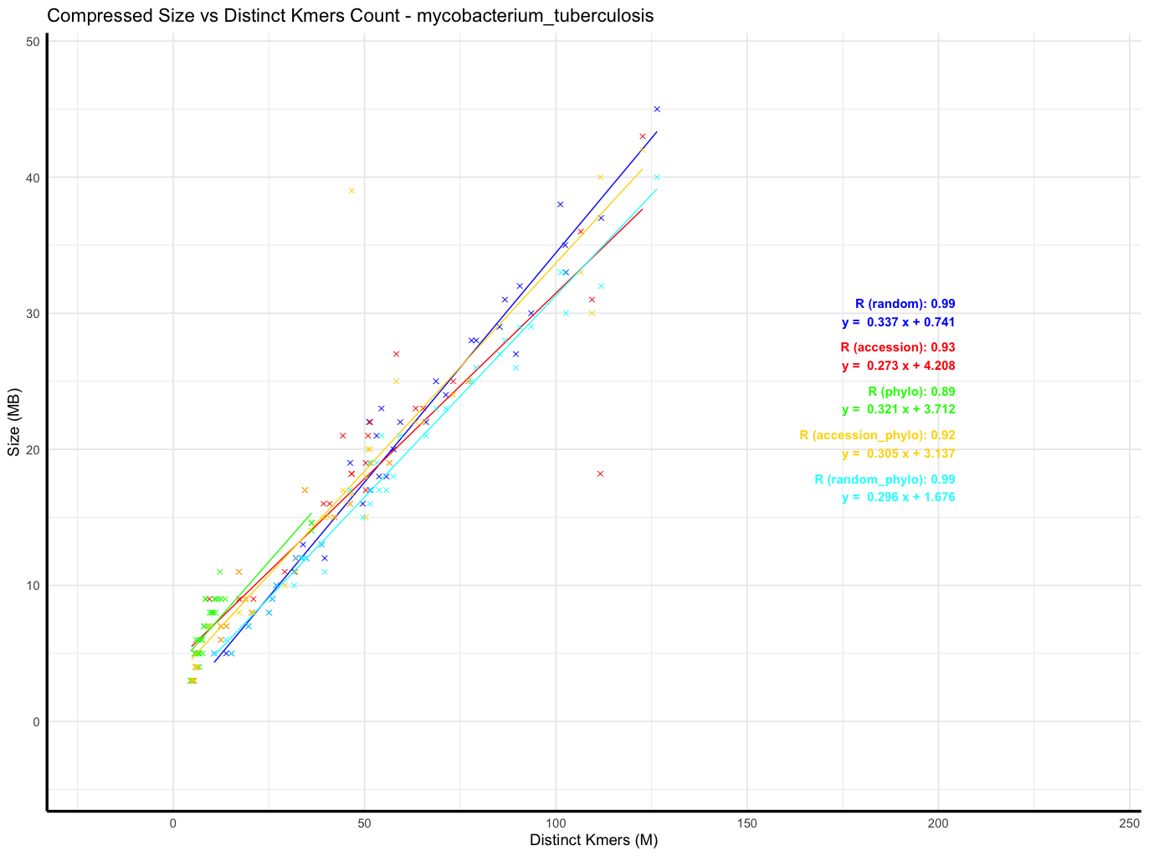
mycobacterium_tuberculosis; replaced outliers with means

Slide 24
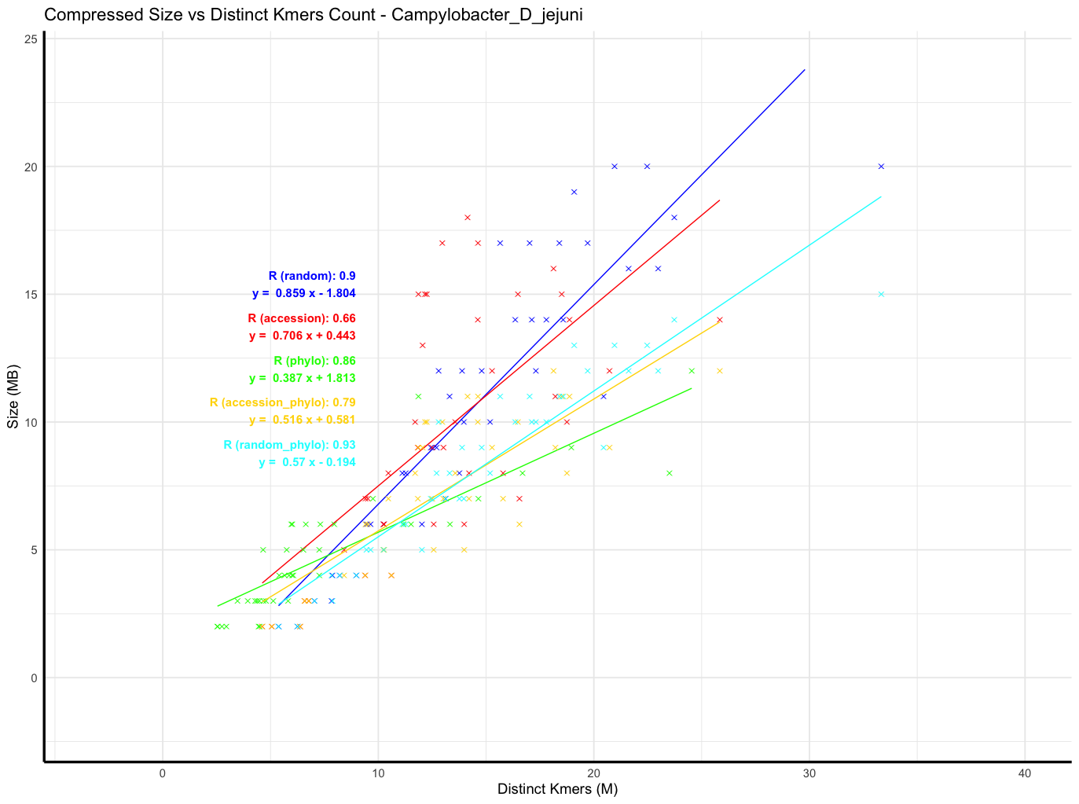
Campylobacter_D_jejuni

Slide 25
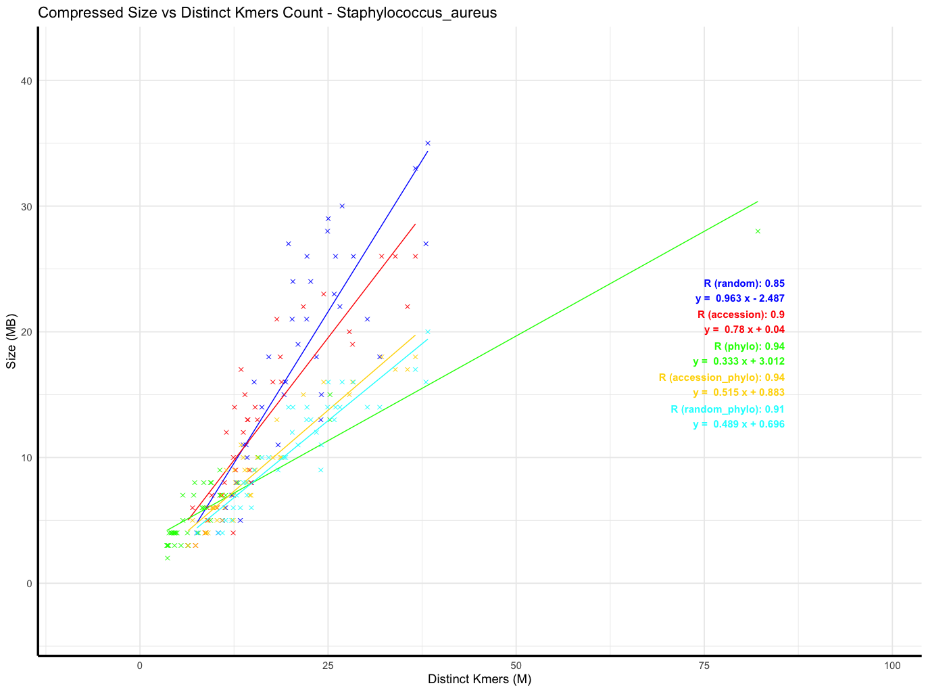
Staphylococcus_aureus

Slide 26
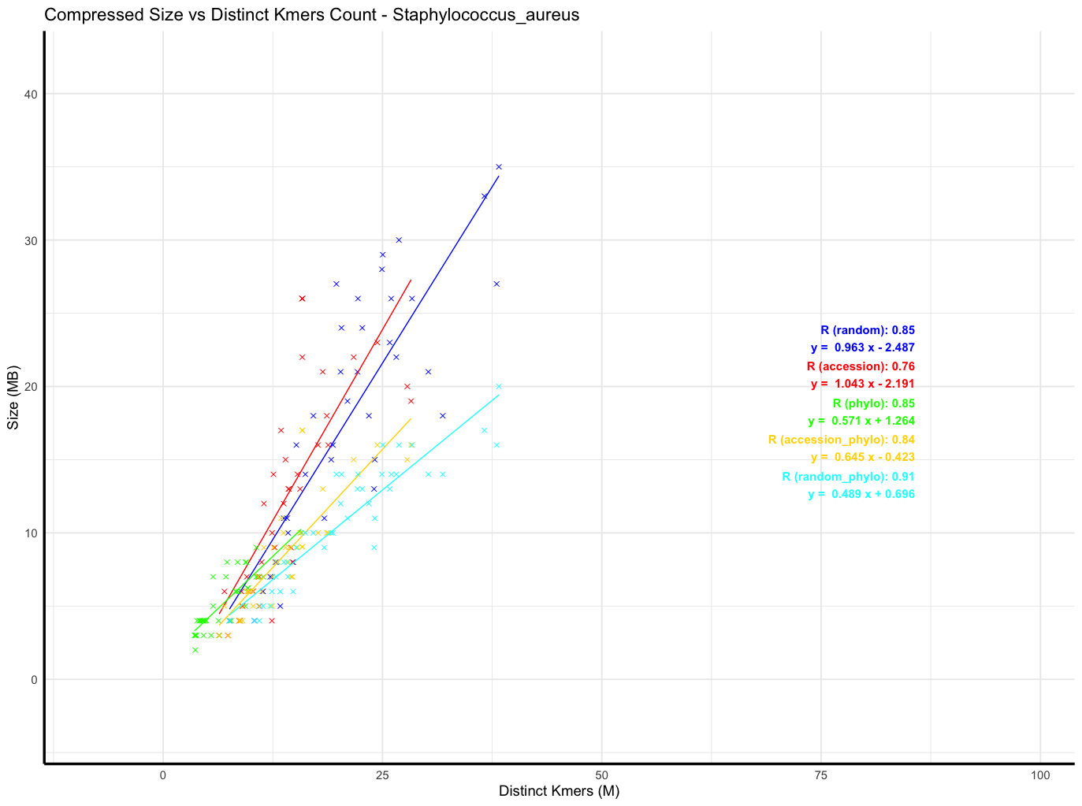
Staphylococcus_aureus; replaced outliers with means

Slide 27
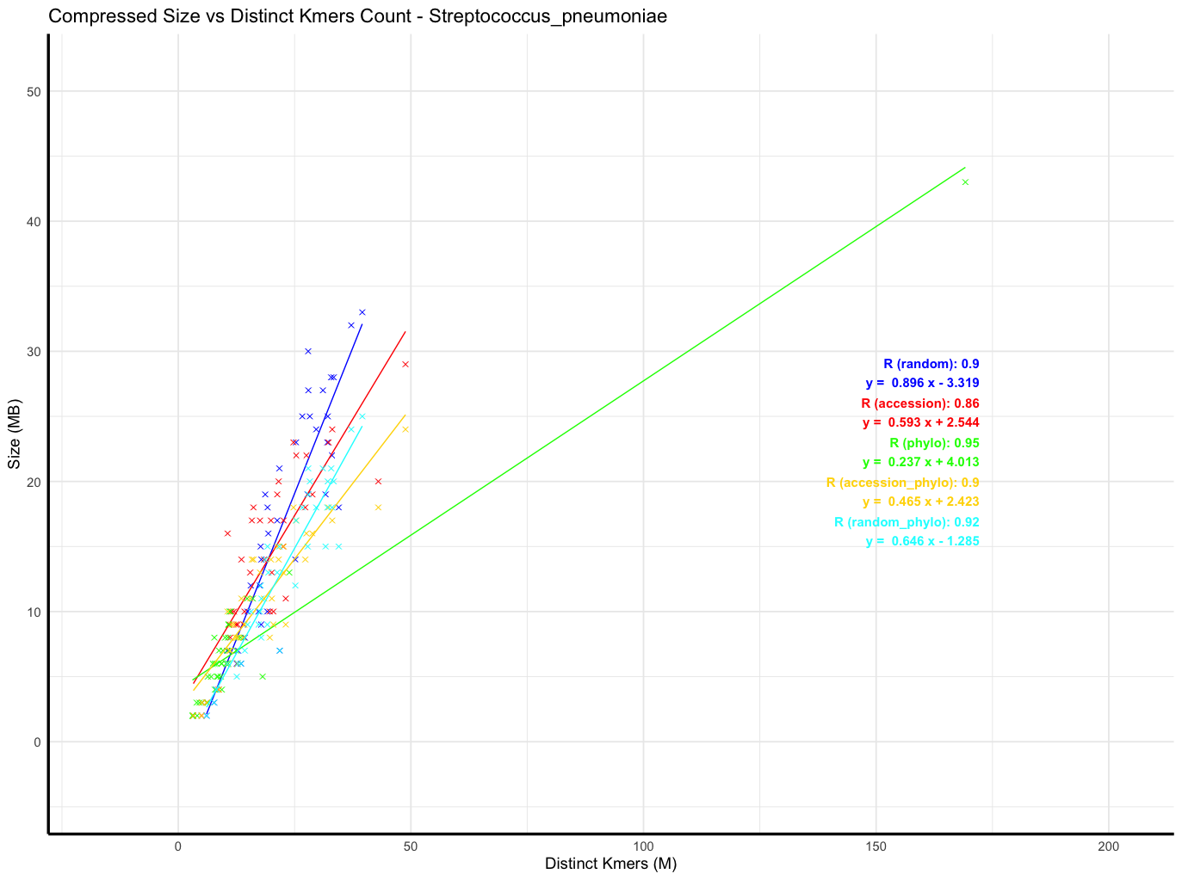
Streptococcus_pneumoniae

Slide 28
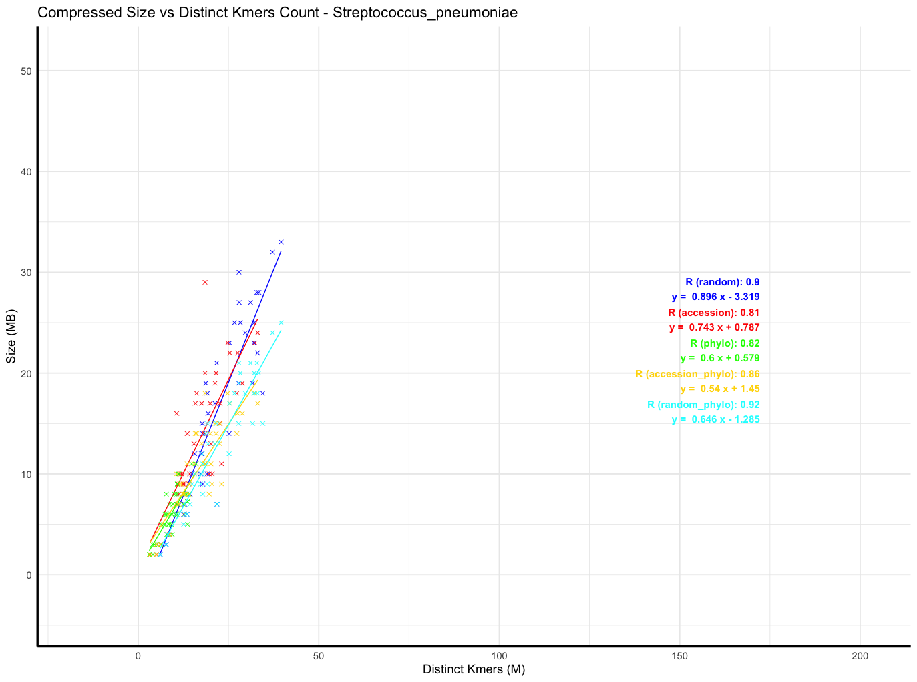
Streptococcus_pneumoniae; replaced outliers with means

