Slide 1

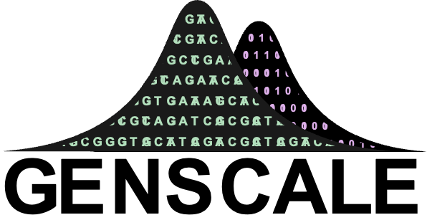


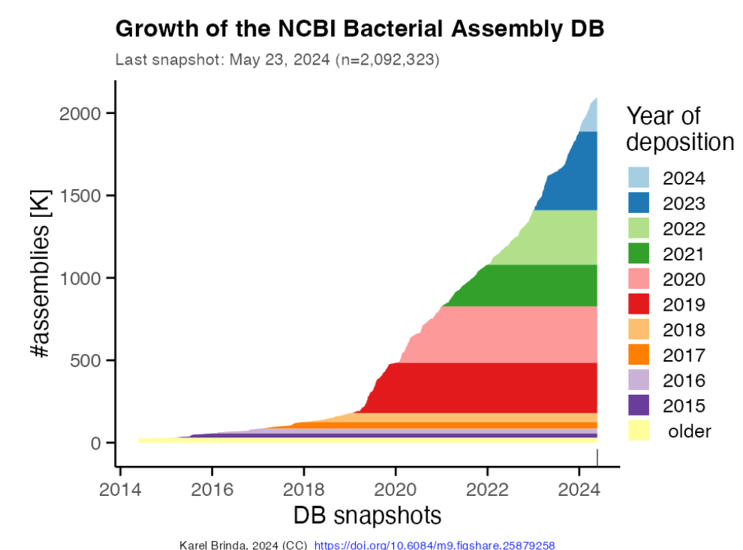
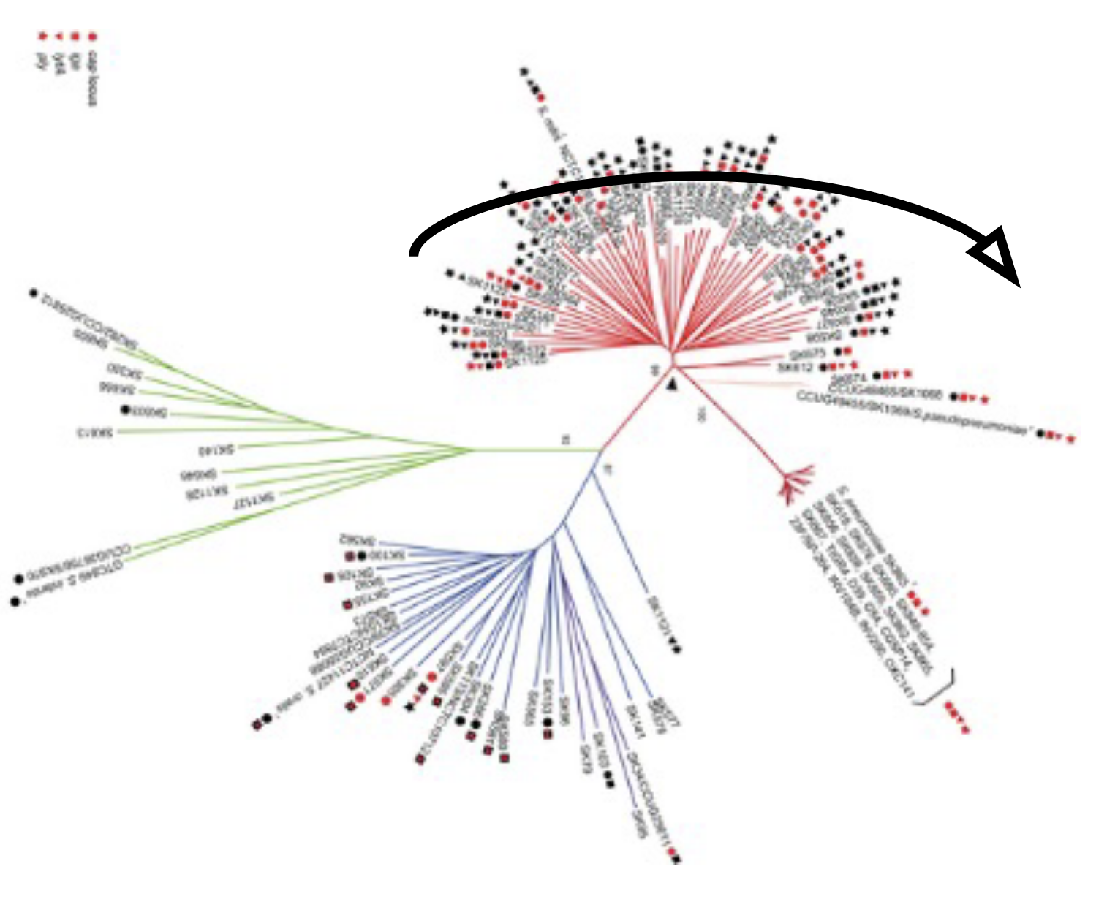
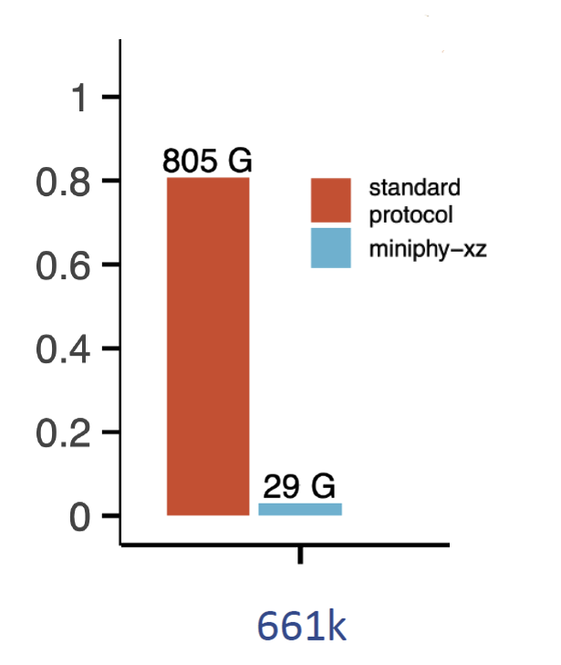
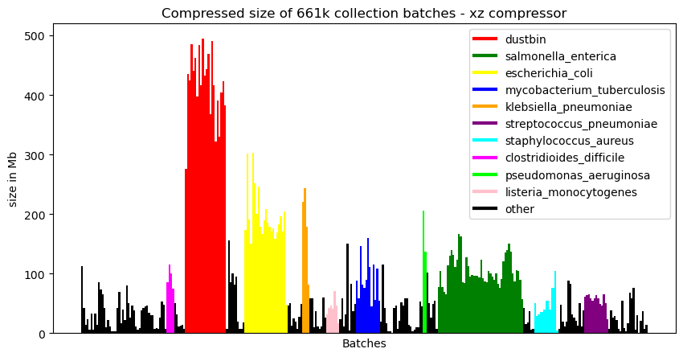
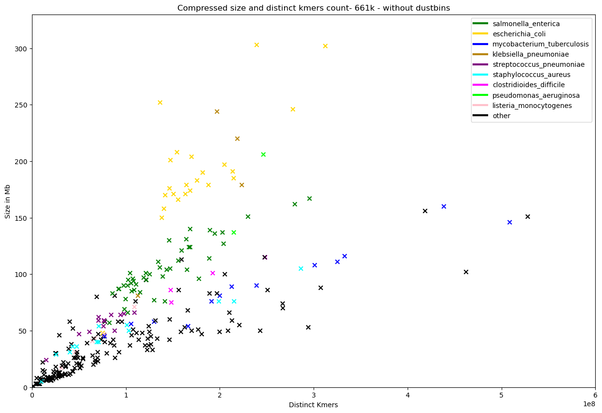
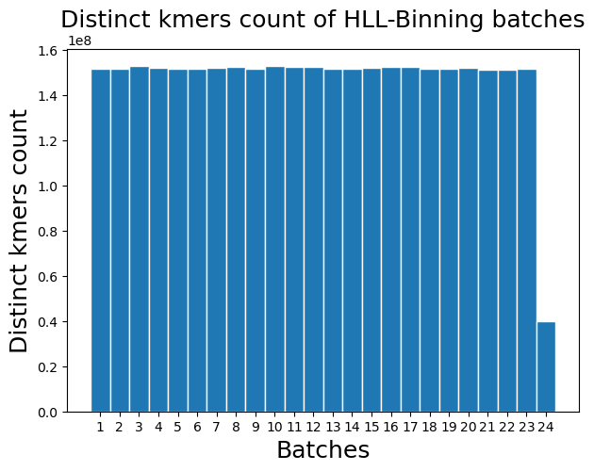
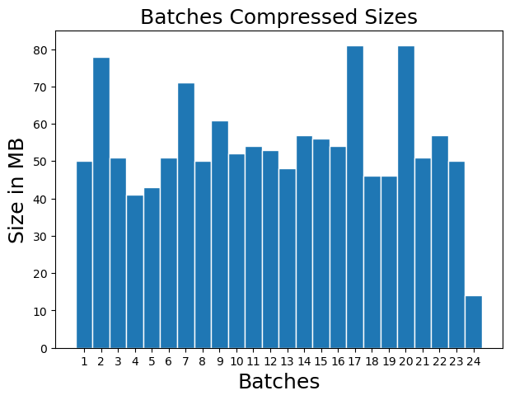
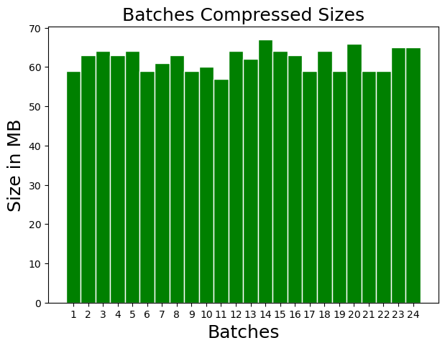
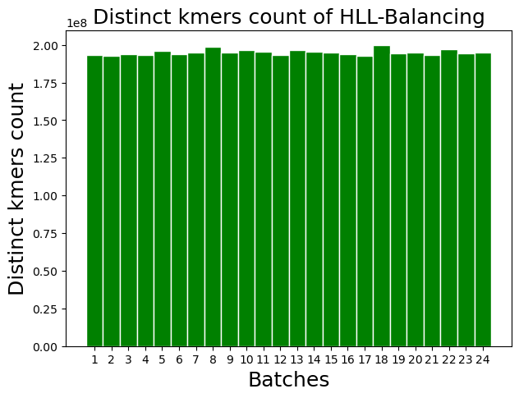
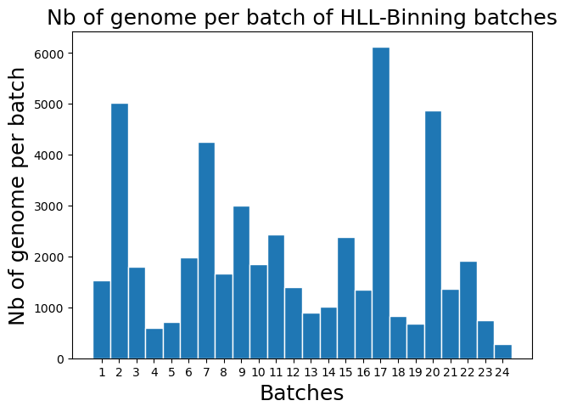
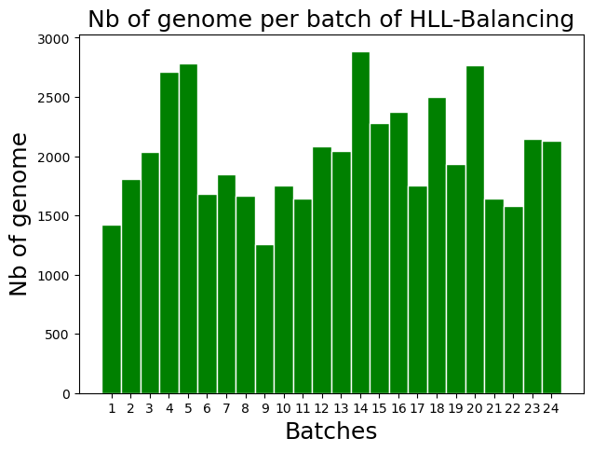

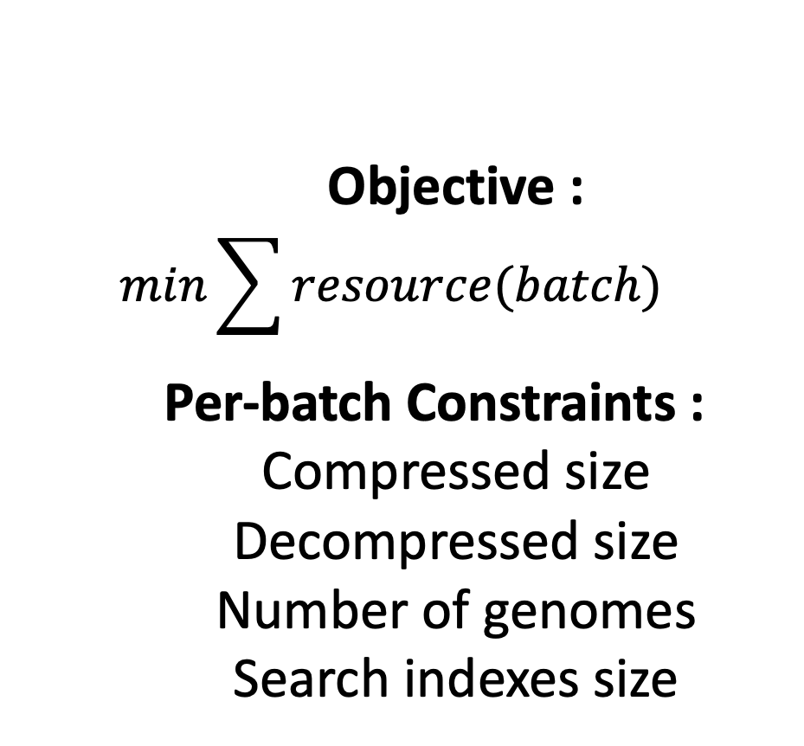
HyperLogLog-Based Load Balancing and Bin Packing
for Efficient Compression of Large Bacterial Genomes Collection
Tam TRUONG, Dominique LAVENIER, Pierre PETERLONGO, Karel BRINDA
Efficient Compression and Querying of Bacterial Genomes
MOTIVATION
RECENT INNOVATION: PHYLOGENETIC COMPRESSION
Fast Growth of Bacteria Genome Collection^{[1]}
STEP 1 : PHYLOGENETIC BATCHING
STEP 2: PHYLOGENETIC REORDERING
RESULTING COMPRESSION
INPUT:
Collection of genomes
Species 1
S2
S1
S1
S1
S3
S2
S2
S3
Large Bacterial Genome Collections: 661k collection^{[2]} (2021) n = 661,405
AllTheBacteria^{[3]} (2024) n = 2,440,377
Future n > 10⁷
Species clustering
Split or merge based on cluster size (batching)
Reordering of genomes in each batch using an estimated evolutionary tree
Lossless compression of 1-3 orders of magnitude
Goal: efficient compression and search
Key idea: improves compressibility via reordering according to the evolutionary history
CURRENT LIMITATION: Batching Results In Non-uniform Compressed Sizes
ULTIMATE OBJECTIVE
CONSEQUENCES
Objective :
$$min\sum{resource(batch)}$$
Per-batch Constraints :
Compressed size
Decompressed size
Number of genomes
Search indexes size
Applications:
Portable Devices
(Remote setting, field work, rapid diagnostic)
Parallel Platforms
(GPU, Processing-in-Memory)
Unbalanced Workloads
Inefficient Data Transmission
Hinder Parallelization
Inconsistent Query Times
CURRENT GOAL
Memory Overuse
Balance post-compression batches for rapid and reliable internet transmission (threshold on post-compression batch size)
METHODS
Ingredient 1 : xz compressed sizes correlate with distinct kmers* count
Ingredient 2: Cardinality estimation using HyperLogLog sketching
Sketches : approximate data structures.
HyperLogLog sketches for cardinality est.: bit patterns,
i.e. hash(ATGCG) ➔ 00010100, hash(CGTAC) ➔ 00000010.
Fast and efficient UNION operation for sketches.
Ingredient 3: Load Balancing^{[6]} and Bin Packing^{[7]}
Preliminary : Given m genomes, put genomes into batches :
STRATEGY 1 : given unlimited batches with capacity C
$$Minimize nb of batch B$$
s.t. $distinct_kmers(bj)<C, for \left(j=1,…,n\right)$
STRATEGY 2 : given a fixed number of batch n
$$Minimize max\left(distinct_kmers\left(bj\right)\right), for j=1,…,n$$
*kmers : substring of length k of a DNA sequence
Prediction of Genome Batch Post-Compression Size Via Distinct Kmers Estimation
STRATEGY 1: HLL-Binning
PRELIMINARY RESULTS
STRATEGY 2: HLL-Balancing
Batches Obtained From Strat. 1
PHYLOGENETIC COMPRESSION
DATA : Genomes of Mycobacterium tuberculosis from the 661k Collection^{[2]} , B = 24
PHYLOGENETIC COMPRESSION
Batches Obtained From Strat. 2
Batch capacity :
C = 152,000,000
(C obtained by linear regression)
Nb of genomes per batch varies but to a lesser extent compared to Strat. 1
Number of genome per batch varies
Most of the batches are balanced (between 40-50MB, max size 81MB)
All Batches are well balanced
(between 59-67MB, max size 67MB)
Evaluation strat. 1:
Allowing a capacity on distinct kmers.
The result remains somewhat imbalanced.
Evaluation strat. 2:
Producing more balanced batches.
No control over the maximum distinct k-mer count per batch.
CONCLUSION & PERSPECTIVES
BIBLIOGRAPHY
Batching by Predicting Compression Size Using HyperLogLog Distinct K-mer Estimation Improves balancing of the final compressed sizes Mycobacterium tuberculosis.
Current Goals:
Extending the results and methods to the whole 661k collection.
Enabling control over the number of genomes in each batch.
Scaling up to AllTheBacteria collection.
Applications in querying data structures such as Bloom filter, on PIM and GPU.
[1] Břinda et al., Efficient and Robust Search of Microbial Genomes via Phylogenetic Compression. To be appeared in Nature Methods. 2025
[2] Blackwell et al., Exploring bacterial diversity via a curated and searchable snapshot of archived DNA sequences. PLOS Biology 19, 11. 2021
[3] Hunt et a.l,. AllTheBacteria - all bacterial genomes assembled, available and searchable. bioRxiv. 2024
[4] Bonnie et al., DandD: Efficient measurement of sequence growth and similarity. iScience 27, 3. 2024
[5] Baker, D.N., Langmead, B. Dashing: fast and accurate genomic distances with HyperLogLog. Genome Biol 20, 265. 2019.
[6] Mertens, Stephan, The Easiest Hard Problem: Number Partitioning, in Allon Percus; Gabriel Istrate; Cristopher Moore (eds.), Computational complexity and statistical physics, Oxford University Press US, p. 125. 2006
[7] Coffman et al., Bin Packing Approximation Algorithms: Survey and Classification. Handbook of Combinatorial Optimization (Vol. 1-5, pp. 455-531). 2012.
Notes:
FINAL VERSION FOR DKM 2025

Slide 2
Motivation
Fast Growth of Bacteria Genome Collection^{[1]}
Large Bacterial Genome Collections: 661k collection^{[2]} (2021) n = 661,405
AllTheBacteria^{[3]} (2024) n = 2,440,377
Future n > 10⁷
Goal: efficient compression and search within those collections

Slide 3
Recent Innovation: Phylogenetic Compression
STEP 1 : PHYLOGENETIC BATCHING
INPUT:
Collection of genomes
Species 1
S2
S1
S1
S1
S2
S2
S3
S3
Species clustering
Split or merge based on cluster size (batching)
STEP 2: PHYLOGENETIC REORDERING
RESULTING COMPRESSION
Reordering of genomes in each batch using an estimated evolutionary tree
Lossless compression of 1-3 orders of magnitude

Slide 4
Current limitation: Batching Results In Non-uniform Compressed Sizes
Unbalanced Workloads
Hinder Parallelization
CONSEQUENCES
Inconsistent Query Times
Memory Overuse
Inefficient Transmission

Slide 5
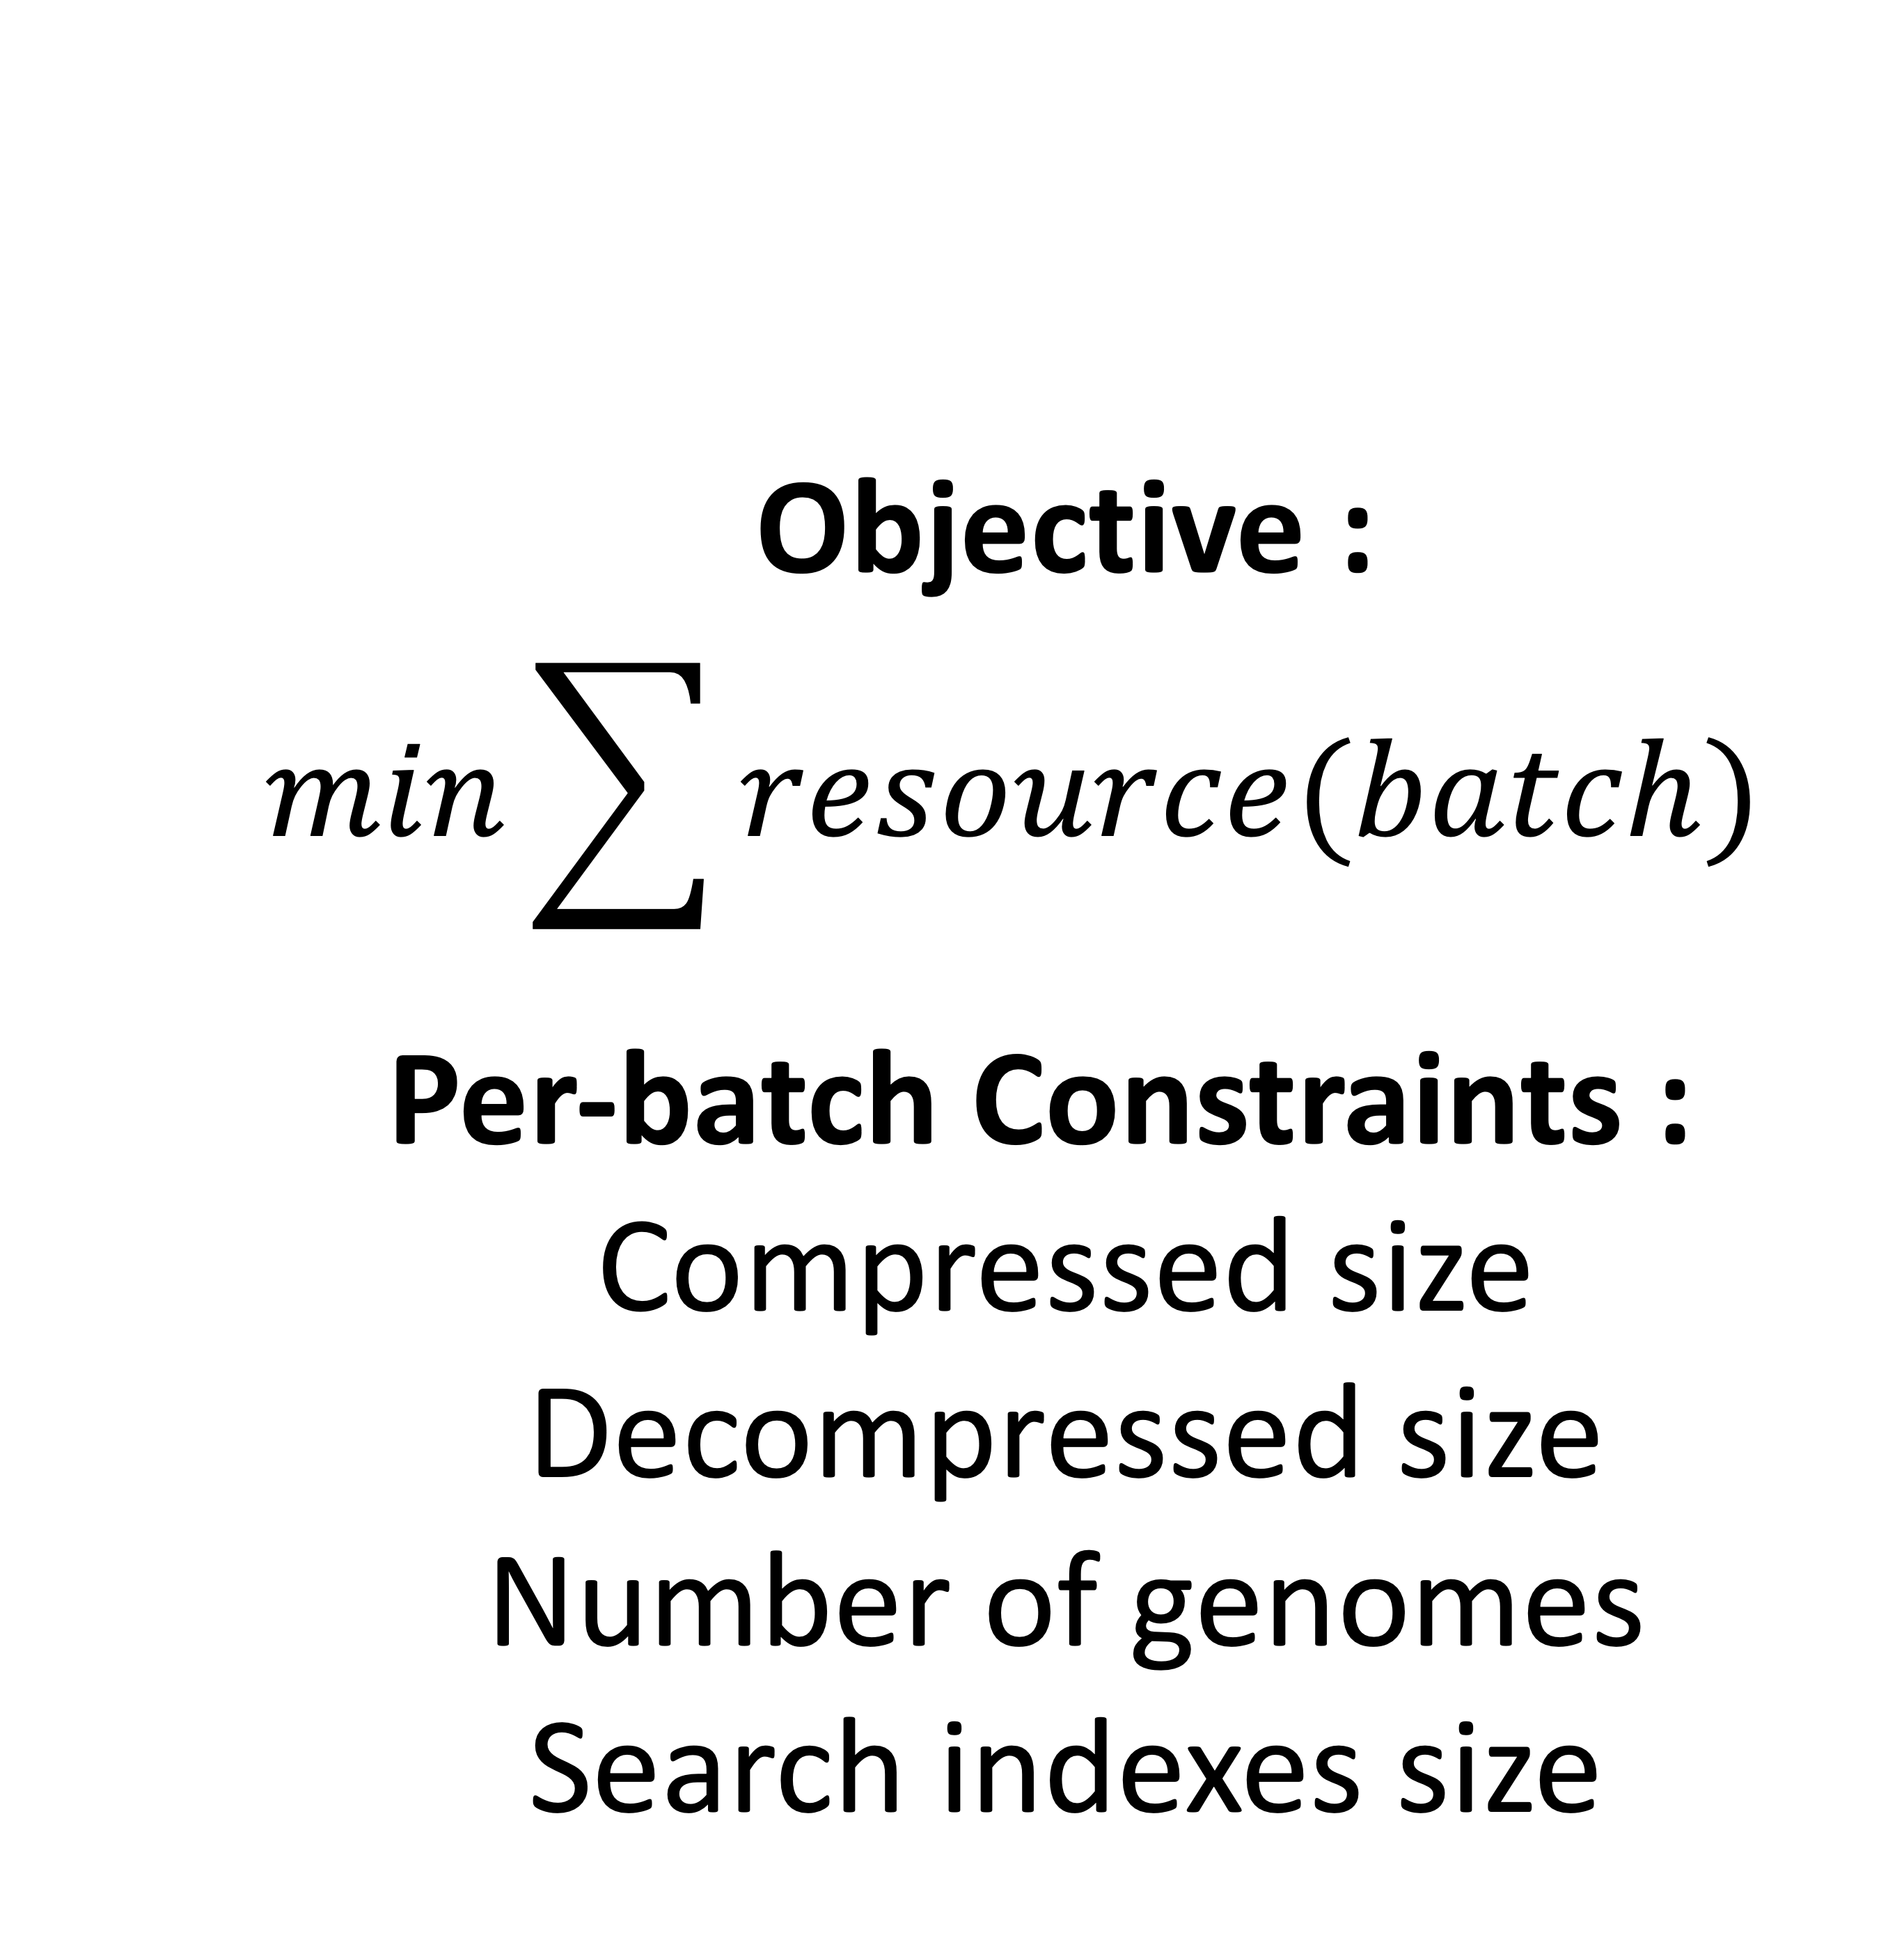
Ultimate Objective
Objective :
$$min\sum{resource(batch)}$$
Per-batch Constraints :
Compressed size
Decompressed size
Number of genomes
Search indexes size
Applications:
Portable Devices
(Remote setting, field work, rapid diagnostic)
Parallel Platforms
(GPU, Processing-in-Memory)
CURRENT GOAL
Balance post-compression batches for rapid and reliable internet transmission (threshold on post-compression batch size)

Slide 6
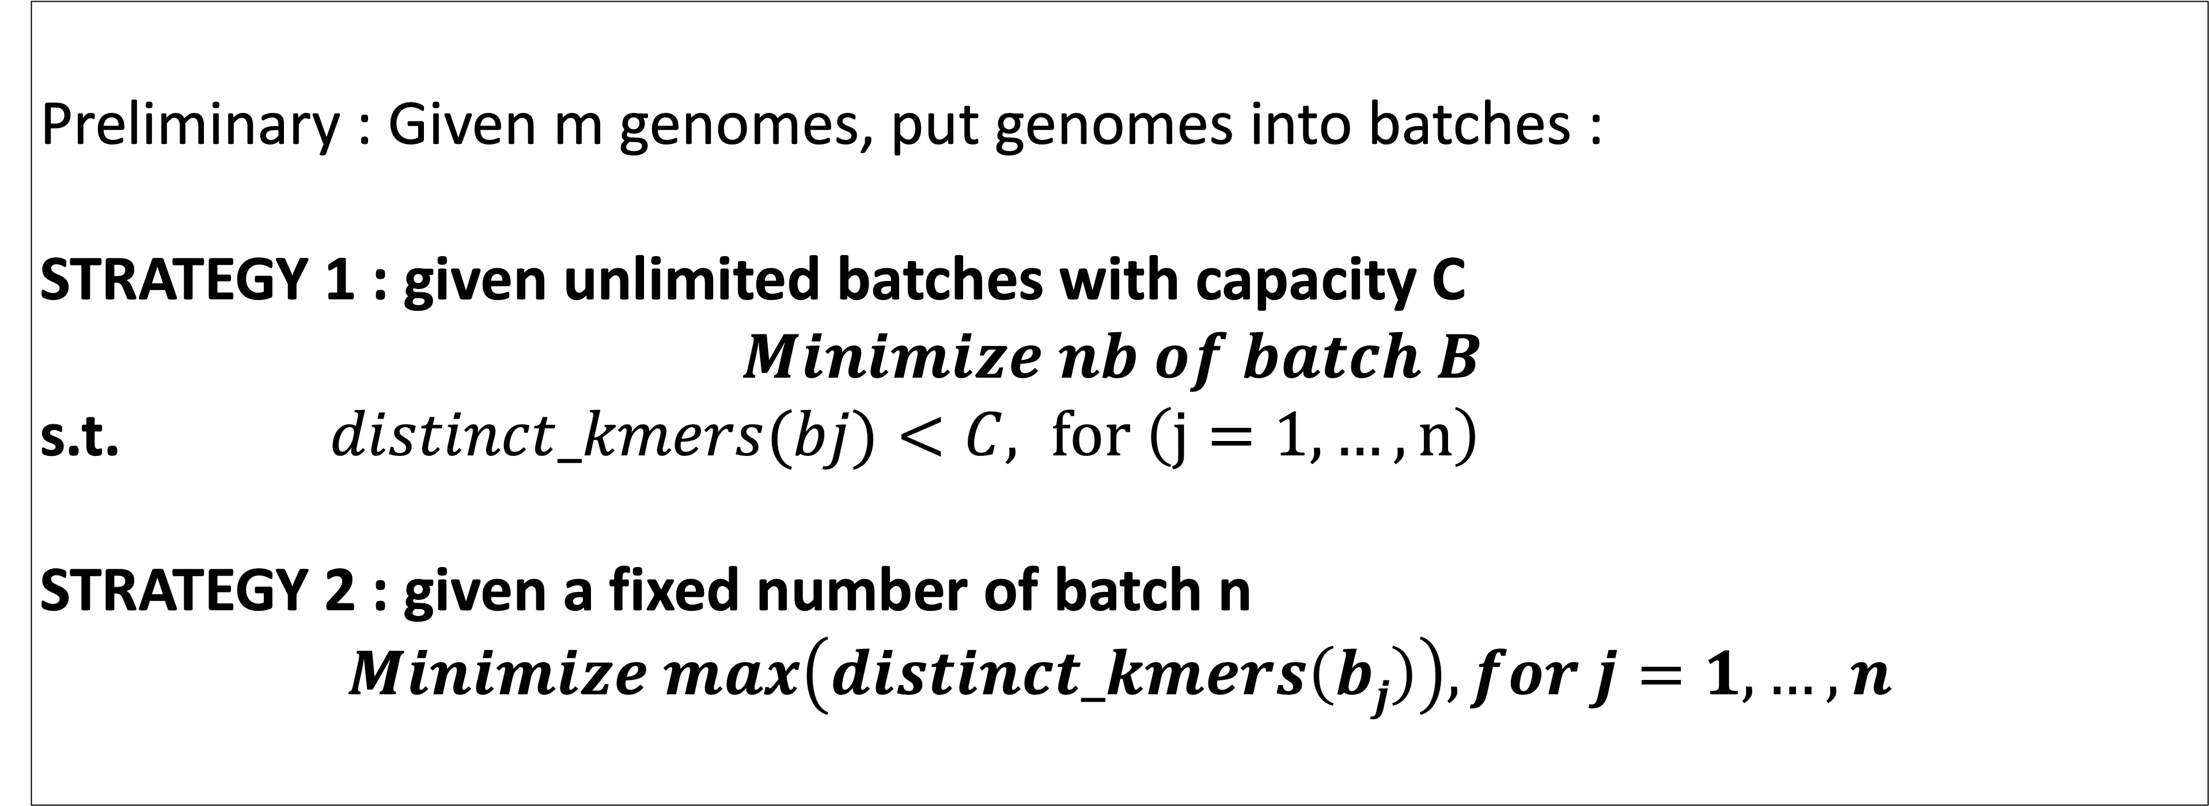
Methods
Ingredient 1 : xz compressed sizes correlate with distinct kmers* count
*kmers : substring of length k of a DNA sequence
Ingredient 2: Cardinality estimation using HyperLogLog sketching
Sketches : approximate data structures.
HyperLogLog sketches for cardinality est.: bit patterns,
i.e. hash(ATGCG) ➔ 00010100, hash(CGTAC) ➔ 00000010.
Fast and efficient UNION operation for sketches.
Preliminary : Given m genomes, put genomes into batches :
STRATEGY 1 : given unlimited batches with capacity C
$$Minimize nb of batch B$$
s.t. $distinct_kmers(bj)<C, for \left(j=1,…,n\right)$
STRATEGY 2 : given a fixed number of batch n
$$Minimize max\left(distinct_kmers\left(bj\right)\right), for j=1,…,n$$
Prediction of Genome Batch Post-Compression Size Via Distinct Kmers Estimation

Slide 7
Preliminary results
DATA : Genomes of Mycobacterium tuberculosis from the 661k Collection^{[2]} , B = 24
STRATEGY 1: HLL-Binning
STRATEGY 2: HLL-Balancing
Batches Obtained From Strat. 1
Batches Obtained From Strat. 2
Batch capacity :
C = 152,000,000
(C obtained by linear regression)
Nb of genomes per batch varies but to a lesser extent compared to Strat. 1
Number of genome per batch varies
PHYLOGENETIC COMPRESSION
PHYLOGENETIC COMPRESSION
Most of the batches are balanced (between 40-50MB, max size 81MB)
All Batches are well balanced
(between 59-67MB, max size 67MB)
Evaluation strat. 1:
Allowing a capacity on distinct kmers.
The result remains somewhat imbalanced.
Evaluation strat. 2:
Producing more balanced batches.
No control over the maximum distinct k-mer count per batch.

Slide 8
Conclusion and Perspectives
Batching by Predicting Compression Size Using HyperLogLog Distinct K-mer Estimation Improves balancing of the final compressed sizes Mycobacterium tuberculosis.
Current Goals:
Extending the results and methods to the whole 661k collection.
Enabling control over the number of genomes in each batch.
Scaling up to AllTheBacteria collection.
Applications in querying data structures such as Bloom filter, on PIM and GPU.
BIBLIOGRAPHY
[1] Břinda et al., Efficient and Robust Search of Microbial Genomes via Phylogenetic Compression. To be appeared in Nature Methods. 2025
[2] Blackwell et al., Exploring bacterial diversity via a curated and searchable snapshot of archived DNA sequences. PLOS Biology 19, 11. 2021
[3] Hunt et a.l,. AllTheBacteria - all bacterial genomes assembled, available and searchable. bioRxiv. 2024
[4] Bonnie et al., DandD: Efficient measurement of sequence growth and similarity. iScience 27, 3. 2024
[5] Baker, D.N., Langmead, B. Dashing: fast and accurate genomic distances with HyperLogLog. Genome Biol 20, 265. 2019.
[6] Mertens, Stephan, The Easiest Hard Problem: Number Partitioning, in Allon Percus; Gabriel Istrate; Cristopher Moore (eds.), Computational complexity and statistical physics, Oxford University Press US, p. 125. 2006
[7] Coffman et al., Bin Packing Approximation Algorithms: Survey and Classification. Handbook of Combinatorial Optimization (Vol. 1-5, pp. 455-531). 2012.

