Slide 1




Bin Packing for Efficient Compression of Large Bacterial Genomes Collection
Tam Truong, Dominique Lavenier, Pierre Peterlongo, Karel Břinda
Notes:
Good afternoon everyone, thank you for being here and today I would like to present to you what I have been working on, it is about bin packing for …

Slide 2
Introduction & State Of The Art

Slide 3
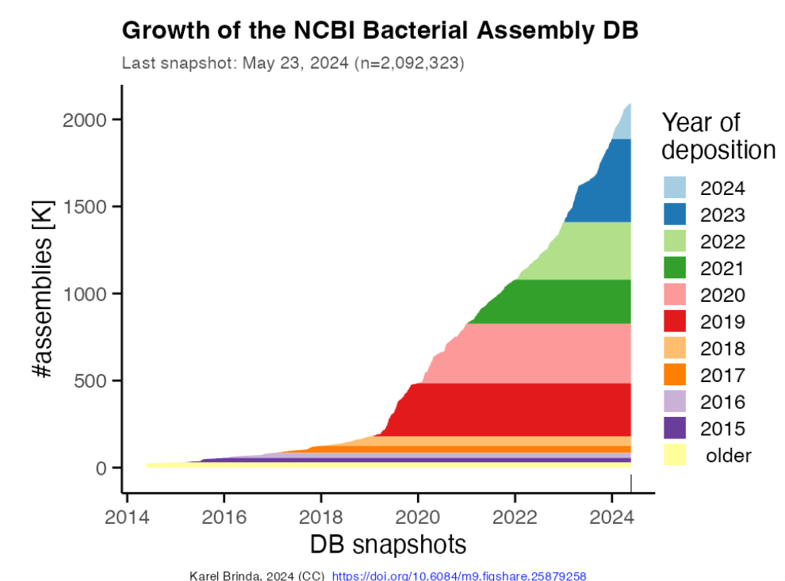
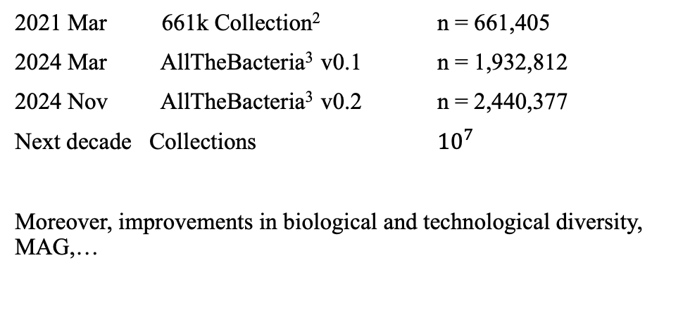
Motivation: Rapidly Growing Bacteria Genome Data
Fast Growth Of Bacterial Genomes Data¹
Increasing Availability of Larger Bacterial Genome Collections
2021 Mar 661k Collection² n = 661,405
2024 Mar AllTheBacteria³ v0.1 n = 1,932,812
2024 Nov AllTheBacteria³ v0.2 n = 2,440,377
Next decade Collections ${10}^{7}$
Moreover, improvements in biological and technological diversity, MAG,…
NCBI Database
[1] Břinda et al., Efficient and Robust Search of Microbial Genomes via Phylogenetic Compression. To appear in Nature Methods. 2025
[2] Blackwell et al., Exploring bacterial diversity via a curated and searchable snapshot of archived DNA sequences. PLOS Biology 19, 11. 2021
[3] Hunt et a.l,. AllTheBacteria - all bacterial genomes assembled, available and searchable. bioRxiv. 2024
Notes:
I personally enjoy working with and exploring data, and in bioinformatics, we have an abundance of it. Bacterial genome databases are expanding rapidly, as shown in the snapshot on the right. Beyond individual genomes, we now have growing collections of genomes, which are becoming increasingly available and serve as a valuable resource for bacterial research. These collections are curated to ensure uniform processing of genomes, making them particularly useful for large-scale studies.
They are also growing at an impressive rate. For example, in the 661k collection, we have… All the bacterial…

Slide 4
Motivation: Rapidly Growing Bacteria Genome Data
Fast Growth Of Bacterial Genomes Data¹
Increasing Availability of Larger Bacterial Genome Collections
2021 Mar 661k Collection² n = 661,405
2024 Mar AllTheBacteria³ v0.1 n = 1,932,812
2024 Nov AllTheBacteria³ v0.2 n = 2,440,377
Next decade Collections ${10}^{7}$
Moreover, improvements in biological and technological diversity, MAG,…
NCBI Database
Challenging: efficient compression and search within those collections
[1] Břinda et al., Efficient and Robust Search of Microbial Genomes via Phylogenetic Compression. To appear in Nature Methods. 2025
[2] Blackwell et al., Exploring bacterial diversity via a curated and searchable snapshot of archived DNA sequences. PLOS Biology 19, 11. 2021
[3] Hunt et a.l,. AllTheBacteria - all bacterial genomes assembled, available and searchable. bioRxiv. 2024
Notes:
A key challenge is make sure to have efficient compression and fast search within these growing genome collections.

Slide 5
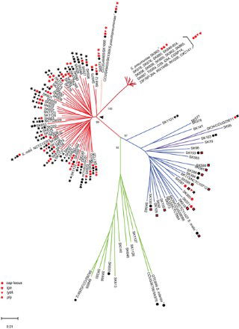
Recent Innovation: Phylogenetic Compression
Difficulty: Compression of genomes is challenging due to the widespread redundancy in the data.
Key Idea: Reordering genomes based on evolutionary history enhances local compressibility¹
[1] Břinda et al., Efficient and Robust Search of Microbial Genomes via Phylogenetic Compression. To be appeared in Nature Methods. 2025
Notes:
And so we have a recent innovation, like it has been mentioned here a lot of time before, by Karel Brinda
Challenge: Compressing genomes efficiently is difficult/not easy because the data contains a lot of redundancy spread across different regions.
Key Idea: If we reorder genomes based on their evolutionary relationships, we can group similar sequences together, making compression more effective.

Slide 6
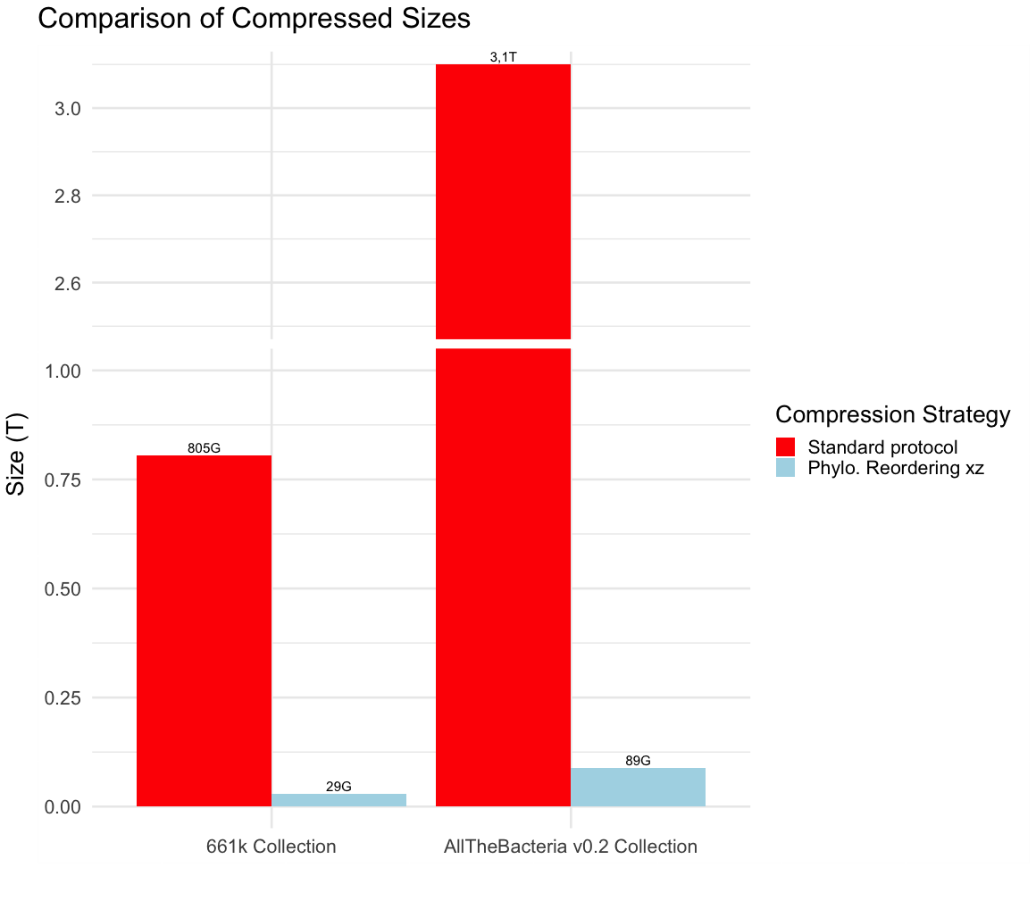
Resulting Improvement Using Phylogenetic Compression (MiniPhy¹)
3,1T
Standard Protocol
MiniPhy-xz
805G
29G
89G
661k
AllTheBacteria v0.2
Lossless compression of 1-3 orders of magnitude over standard protocol
[1] https://github.com/karel-brinda/miniphy
Notes:
The resulting improvement with the use of phylogenetic compression, specifically MiniPhy, shows a significant advancement in data compression. This method achieves lossless compression that improves by one to three orders of magnitude compared to the standard protocol, offering a more efficient way to handle large genomic datasets while maintaining data integrity.

Slide 7
In Practice: Phylogenetic compression involves two steps:
Collection of genomes
Step 1 : Phylogenetic Batching
Step 2 : Phylogenetic Reordering
Starting point of my PhD
Notes:
In practice, phylogenetic compression involves two main steps. Step one is phylogenetic batching, which serves as the starting point of my PhD. In this step, genomes are grouped based on their phylogenetic relationships to improve the efficiency of compression. Step two is phylogenetic reordering, where genomes within each batch are reordered to further enhance the compression process.

Slide 8
Key Step In Phylogenetic Compression: Genomes Batching
INPUT:
Collection of genomes

Slide 9
Key Step In Phylogenetic Compression: Genomes Batching
INPUT:
Collection of genomes
Species form clusters in public databases

Slide 10
Key Step In Phylogenetic Compression: Genomes Batching
INPUT:
Collection of genomes
Species 1
S2
Species clustering
S3

Slide 11
Key Step In Phylogenetic Compression: Genomes Batching
INPUT:
Collection of genomes
Species 1
S2
Species clustering
S3
Advantage:
Highly sampled and sparsely sampled

Slide 12
Key Step In Phylogenetic Compression: Genomes Batching
Current strategy:
1 – SAM029385
2 – SAM029386
3 – SAM029387
…
4000 – SAM033385
4001 – SAM033386
…
Within each cluster, sort by sequencing time (accession number)
INPUT:
Collection of genomes
Species 1
S2
Species clustering
S3
Advantage:
Highly sampled and sparsely sampled

Slide 13
Key Step In Phylogenetic Compression: Genomes Batching
Current strategy:
1 – SAM029385
2 – SAM029386
3 – SAM029387
…
4000 – SAM033385
4001 – SAM033386
…
Within each cluster, sort by sequencing time (accession number)
INPUT:
Collection of genomes
Species 1
S2
Species clustering
Sequencing data is typically uploaded together.
I.e. genomes with nearby accession numbers are likely related.
S3
Advantage:
Highly sampled and sparsely sampled

Slide 14

Key Step In Phylogenetic Compression: Genomes Batching
INPUT:
Collection of genomes
Species 1
S2
S1
S1
S1
$≈$ 4000 genomes in each batches
Species clustering
Batching
S2
S2
S3
S3
1000 genomes in each dustbin
dustbin
dustbin
Split big clusters into smaller batches
Merge small clusters together into dustbins

Slide 15
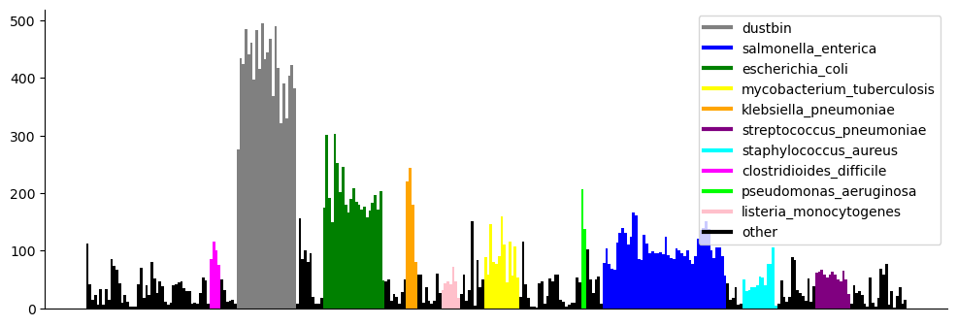
Current Limitation: Non-uniform post-compression sizes
Batches are then reordered and compressed
Size(MB)
Consequences of Non-uniformity
Compressed 661k Batches
Unbalanced Workloads
Inefficient Transmission
Hinder Parallelization
Memory Overuse
Inconsistent Query Time
Notes:
he consequences of non-uniformity in genomic data compression can be quite significant. One major issue is unbalanced workloads, where certain batches may require more processing power or time than others, leading to inefficiencies. Another consequence is inefficient transmission, as the non-uniform distribution of data can result in uneven compression rates, ultimately affecting the speed and effectiveness of data transfer. These challenges highlight the importance of optimizing the batching and reordering processes in phylogenetic compression to ensure a more balanced and efficient system.”
Additionally, non-uniformity in genomic data compression can hinder parallelization, as unevenly distributed data makes it difficult to efficiently divide tasks across multiple processors. This leads to suboptimal use of computational resources. Another issue is memory overuse, where certain data batches may require more memory than others, potentially causing bottlenecks or even system failures. Finally, non-uniformity can result in inconsistent query times, as some batches may take longer to process or retrieve, reducing the overall efficiency of data querying and analysis. Addressing these challenges is crucial for improving the scalability and performance of genomic data compression systems.

Slide 16
Current Limitation: Non-uniform post-compression sizes
We than proceed to reorder and compress all batches individually
Size(MB)
Consequences of Non-uniformity
Compressed 661k Batches
Unbalanced Workloads
Inefficient Transmission
Hinder Parallelization
Memory Overuse
Inconsistent Query Time
Application for balance batches: Portable Devives (remote setting, field work, rapid diagnostic), Parallel Platforms (GPU, Processing-in-Memory)
Notes:
Balanced batches have several important applications in various contexts. For instance, in portable devices, such as those used in remote settings or fieldwork, balanced batches ensure efficient data processing in environments with limited computational resources. This is particularly valuable for rapid diagnostics, where quick and accurate results are crucial. Additionally, balanced batches are highly beneficial for parallel platforms, such as GPUs or processing-in-memory systems. In these cases, the even distribution of data allows for optimal parallel processing, significantly improving the speed and efficiency of computations. These applications highlight the versatility and importance of balanced data batching in modern computational environments.

Slide 17
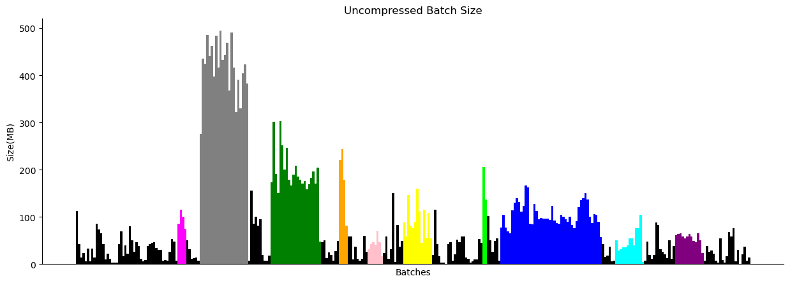
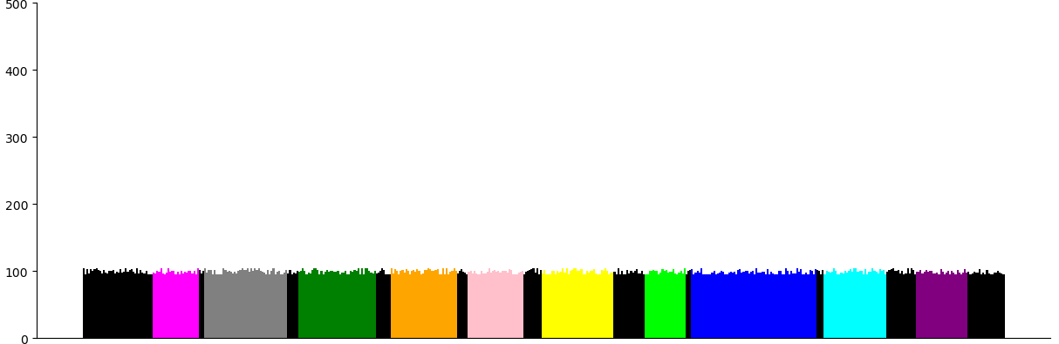
Our Goal: Design A Balancing Batching Strategy
Current:
+ xz
Optimized Batching
Objective:
+ xz
Notes:
Our goal is to design a balancing batching strategy that addresses the challenges associated with non-uniformity in genomic data compression.

Slide 18
Toward The First Optimization Problem

Slide 19
Quick Recap: What We Have So Far & Our Next Goal
Clusters of genomes: genomes from the same species, uneven in size

Slide 20
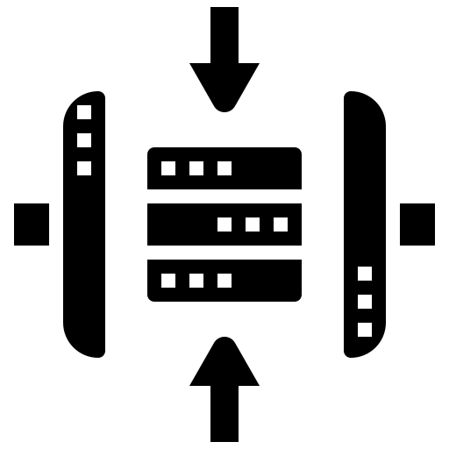

Quick Recap: What We Have So Far & Our Next Goal
Clusters of genomes: genomes from the same species, uneven in size
We want to group them into batches while ensuring:
Requirements on batches: number of genomes, uncompressed size, …
Post-compression batch sizes must fit within a memory constraint (balance)
Notes:
We are working with clusters of genomes that come from the same species but vary significantly in size. The goal is to group these genomes into batches while meeting several key requirements. First, we must consider the number of genomes and the uncompressed size of the batches. Additionally, post-compression batch sizes must fit within a defined memory constraint to maintain balance across the system.
To achieve an optimal compression ratio, we aim to maximize the number of genomes in each batch. This will help minimize the total number of batches used, which in turn improves both efficiency and the effectiveness of the compression process. The challenge is to find the right balance that meets all these constraints while still ensuring a high-quality compression outcome.

Slide 21
Quick Recap: What We Have So Far & Our Next Goal
Clusters of genomes: genomes from the same species, uneven in size
We want to group them into batches while ensuring:
Requirements on batches: number of genomes, uncompressed size, …
Post-compression batch sizes must fit within a memory constraint (balance)
To ensure good compression ratio: maximize number of genomes per single batches.
➔ Corresponds to minimize the number of batches used.
Minimize
Notes:
We are working with clusters of genomes that come from the same species but vary significantly in size. The goal is to group these genomes into batches while meeting several key requirements. First, we must consider the number of genomes and the uncompressed size of the batches. Additionally, post-compression batch sizes must fit within a defined memory constraint to maintain balance across the system.
To achieve an optimal compression ratio, we aim to maximize the number of genomes in each batch. This will help minimize the total number of batches used, which in turn improves both efficiency and the effectiveness of the compression process. The challenge is to find the right balance that meets all these constraints while still ensuring a high-quality compression outcome.

Slide 22
Quick Recap: What We Have So Far & Our Next Goal
Clusters of genomes: genomes from the same species, uneven in size
We want to group them into batches while ensuring:
Requirements on batches: number of genomes, uncompressed size, …
Post-compression batch sizes must fit within a memory constraint (balance)
To ensure good compression ratio: maximize number of genomes per single batches.
➔ Corresponds to minimize the number of batches used.
Minimize
➔ Optimization Problem: Bin Packing
Notes:
We are working with clusters of genomes that come from the same species but vary significantly in size. The goal is to group these genomes into batches while meeting several key requirements. First, we must consider the number of genomes and the uncompressed size of the batches. Additionally, post-compression batch sizes must fit within a defined memory constraint to maintain balance across the system.
To achieve an optimal compression ratio, we aim to maximize the number of genomes in each batch. This will help minimize the total number of batches used, which in turn improves both efficiency and the effectiveness of the compression process. The challenge is to find the right balance that meets all these constraints while still ensuring a high-quality compression outcome.

Slide 23

Bin Packing Problem: Definition
Bin Packing Problem:
Given a list of items i = 1, . . . , n, each having a size ci ∈ Z+, and an integer value CAPACITY. Find the minimum number of bin to pack all items in such a way that the sum of the item sizes in one bin is always smaller than CAPACITY.
A classic combinatorial optimization problem.
The problem is NP-complete
Classical heuristics are ordered-based algorithms.
Initially, an empty bin is created. At each step, the next item is selected and packed in a bin. A new bin may be created at each step.
First-fit: choose the first possible bin
Best-fit: choose largest remaining CAPACITY bin
Worst-fit: choose smallest remaining CAPACITY bin
Items
Still a trending research topics (presentation at ROADEF 2024)
Bins
Notes:
The bin packing problem is a classic combinatorial optimization problem and is known to be NP-complete, meaning there is no known efficient algorithm that guarantees an optimal solution in polynomial time.
As you mentioned, classical heuristics for solving the bin packing problem are typically order-based algorithms, which iteratively select items and place them into bins, either creating new bins or using existing ones, depending on certain criteria.

Slide 24
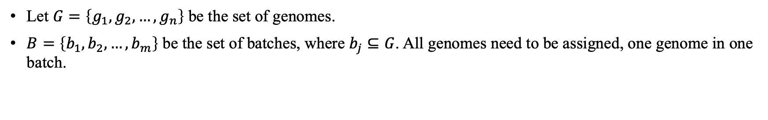
The First Optimaztion Model For Balancing Batching
Let $G=\left\{g_{1},g_{2},…,g_{n}\right\}$ be the set of genomes.
$B=\left\{b_{1},b_{2},…,b_{m}\right\}$ be the set of batches, where $b_{j}⊆G$. All genomes need to be assigned, one genome in one batch.

Slide 25
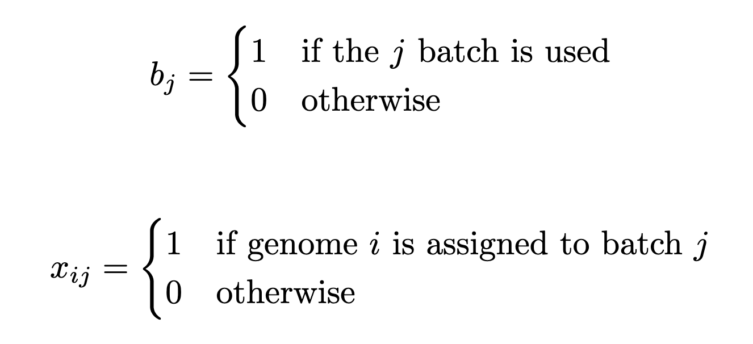
The First Optimaztion Model For Balancing Batching
Let $G=\left\{g_{1},g_{2},…,g_{n}\right\}$ be the set of genomes.
$B=\left\{b_{1},b_{2},…,b_{m}\right\}$ be the set of batches, where $b_{j}⊆G$. All genomes need to be assigned, one genome in one batch.

Slide 26
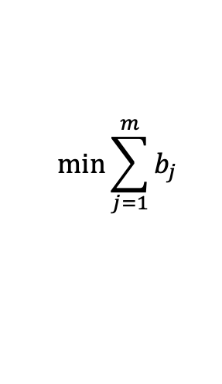
The First Optimaztion Model For Balancing Batching
Let $G=\left\{g_{1},g_{2},…,g_{n}\right\}$ be the set of genomes.
$B=\left\{b_{1},b_{2},…,b_{m}\right\}$ be the set of batches, where $b_{j}⊆G$. All genomes need to be assigned, one genome in one batch.
The compression size of each batch must be less than or equal to A MB:
$|post_compression_size(b_{j})|≤A$, $∀j∈\{1,…,m\}$
$$\min{\sum_{j=1}^{m}{b_{j}}}$$
Objective function:

Slide 27
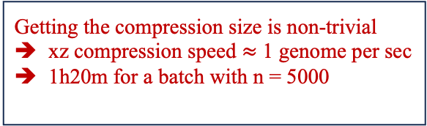
The First Optimaztion Model For Balancing Batching
Let $G=\left\{g_{1},g_{2},…,g_{n}\right\}$ be the set of genomes.
$B=\left\{b_{1},b_{2},…,b_{m}\right\}$ be the set of batches, where $b_{j}⊆G$. All genomes need to be assigned, one genome in one batch.
The compression size of each batch must be less than or equal to A MB:
$|post_compression_size(b_{j})|≤A$, $∀j∈\{1,…,m\}$
Getting the compression size is non-trivial
xz compression speed $≈$ 1 genome per sec
1h20m for a batch with n = 5000
$$\min{\sum_{j=1}^{m}{b_{j}}}$$
Objective function:

Slide 28
Implementation Of The Balancing Batching Model

Slide 29
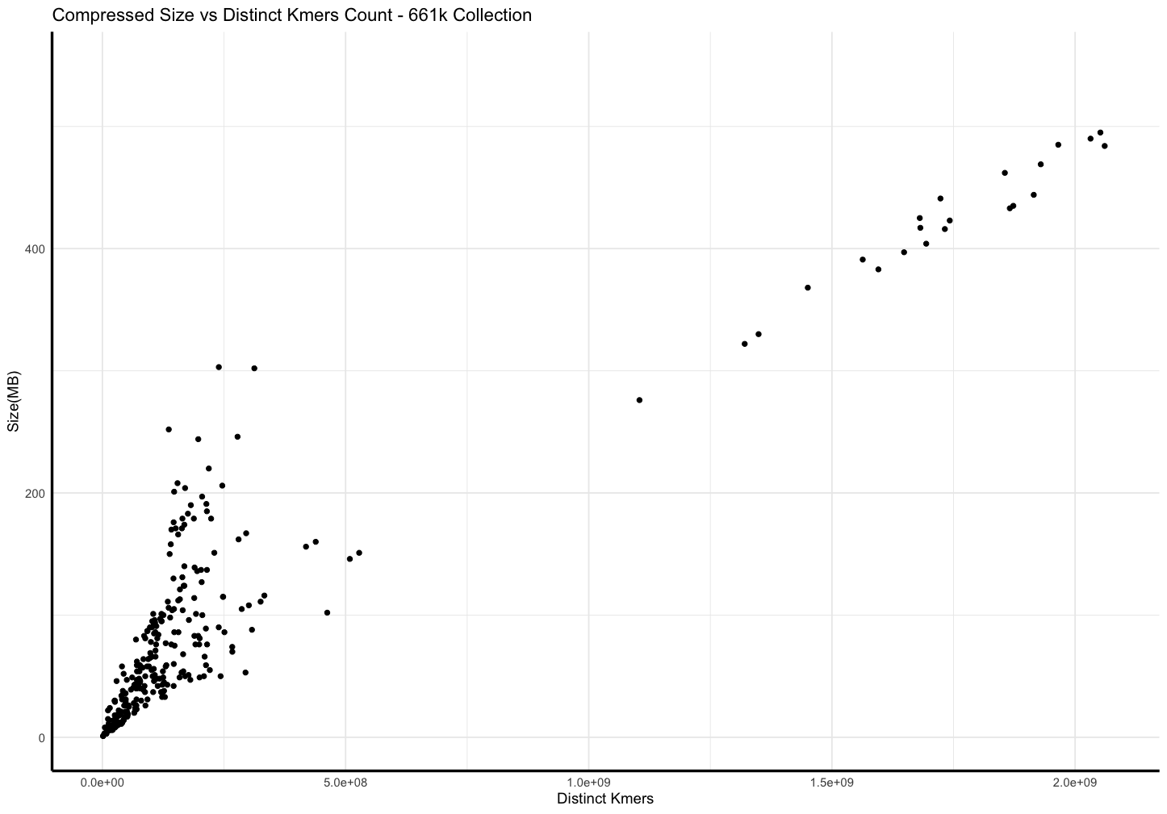
Ingredient 1: Post-compression Sizes Correlates With Distinct Kmers Count In Genomes Collections
Notes:
Ingredient 1 examines the relationship between post-compression sizes and the distinct k-mers count in genome collections. Genomes with more distinct k-mers tend to compress less effectively due to higher data diversity. Understanding this correlation helps in predicting compression efficiency and optimizing genome batching strategies, ensuring that post-compression sizes stay within memory constraints while minimizing the number of batches

Slide 30
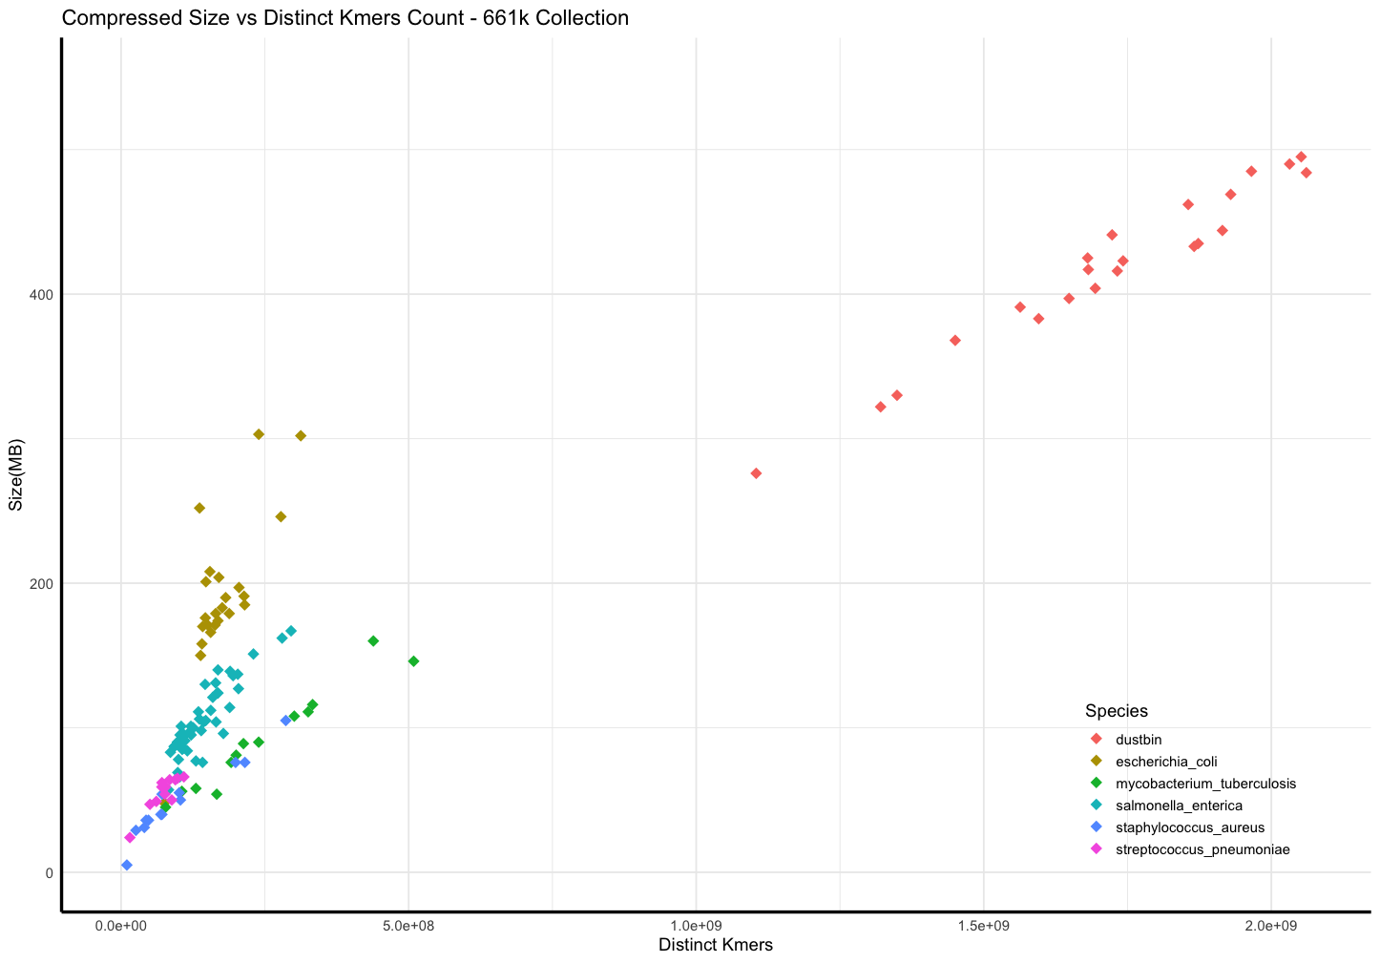
Ingredient 1: Post-compression Sizes Correlates With Distinct Kmers Count In Genomes Collections

Slide 31
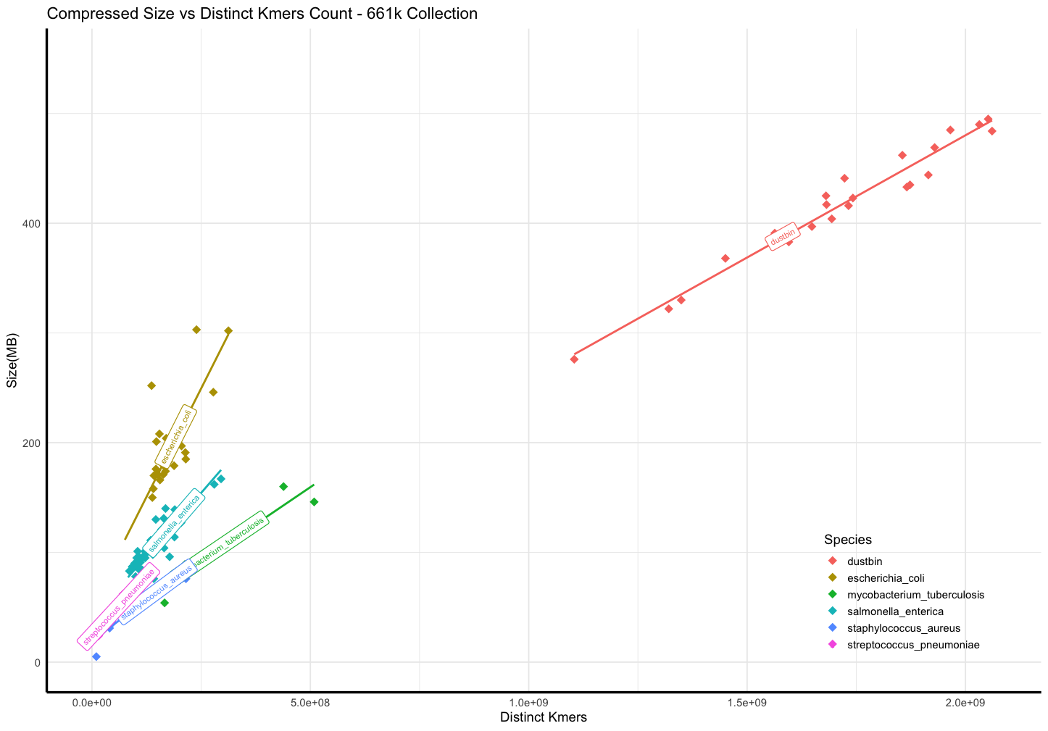
Ingredient 1: Post-compression Sizes Correlates With Distinct Kmers Count In Genomes Collections
r = 0.98
r = 0.775
r = 0.88
r = 0.97
r = 0.89
r = 0.96

Slide 32
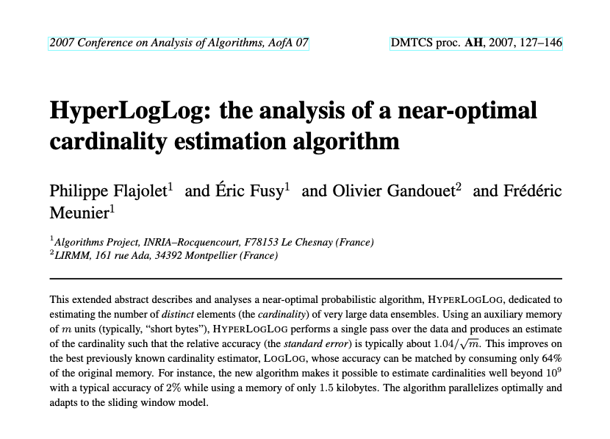
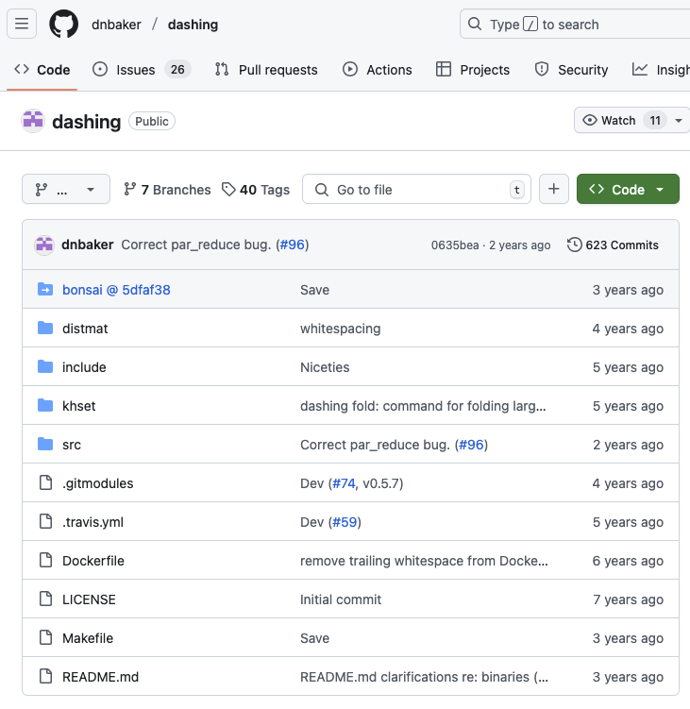
Ingredient 2: Fast Distinct Kmers Counting via HyperLogLog
HyperLogLog Cardinality Estimation¹
Implemented in Dashing^{2,3}
[1] Philippe Flajolet, Éric Fusy, Olivier Gandouet, Frédéric Meunier. HyperLogLog: the analysis of a near-optimal cardinality estimation algorithm. AofA: Analysis of Algorithms, Jun 2007
[2] Baker, D.N., Langmead, B. Dashing: fast and accurate genomic distances with HyperLogLog. Genome Biol 20, 265. 2019
[3] https://github.com/dnbaker/dashing

Slide 33


Ingredient 3: Bin Packing Greedy Algorithms – 2 Variations
STRATEGY 1 : given unlimited batches with capacity C
$$Minimize nb of batch B$$
s.t.
$$distinct_kmers(bj)<C, for \left(j=1,…,m\right)$$
STRATEGY 2 : given a fixed number of batch n
$$T≥distinct_kmers\left(b_{j}\right), for j=1,…,m$$
$$Minimize T$$
Sort the genomes by acession number.
Initially, an empty bin is created.
At each step, the next genomes is selected and packed in the first available bin.
Distinct kmers count in each step is calculated using Dashing
Create new bin as needed.
Sort the genomes by acession number.
Create n bins.
At each step, the next genomes is selected and packed in the bin with the smallest CAPACITY.
Distinct kmers count in each step is calculated using Dashing

Slide 34
First Results

Slide 35
Dataset:
Assemblies of Mycobacterium tuberculosis from 661k collection
Number of Genomes: around 49,000
Uncompressed Size: 218 GB
CAPACITY of batches: 152,000,000

Slide 36
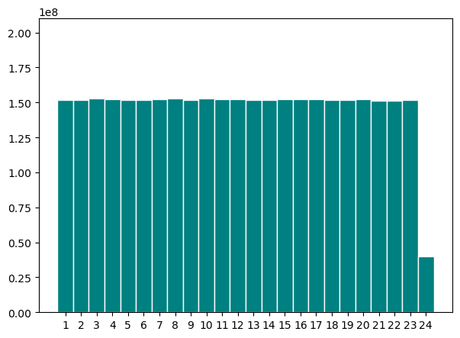
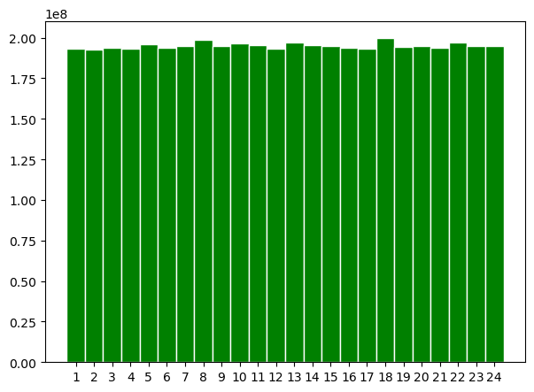
Batching Results Comparison: Distinct Kmers Count
Distinct Kmers Count
Strat.1
Strat.2

Slide 37
Batching Results Comparison: Distinct Kmers Count
Distinct Kmers Count
Strat.1
Outlier
Strat.2
Strat.1 keep the order of accession number
➔ Lower number of distinct kmers count per batch
➔ Distinct Kmers Counts is balanced

Slide 38
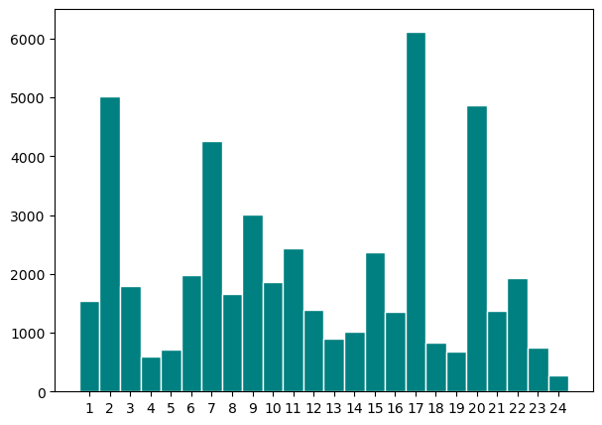
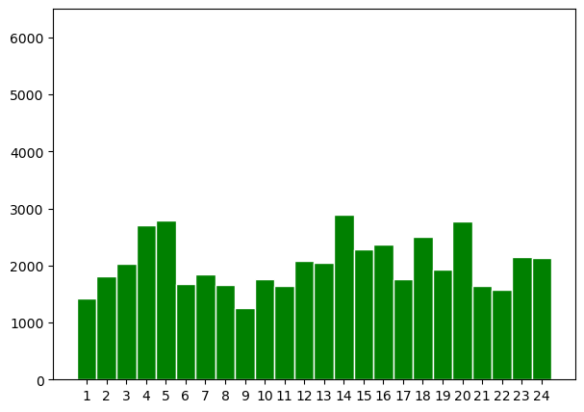
Batching Results Comparison: Number Of Genomes
Number of Genomes
Strat.1
Strat.2
Number of genomes per batch varies, strat.2 to a lesser extent compared to strat.1

Slide 39
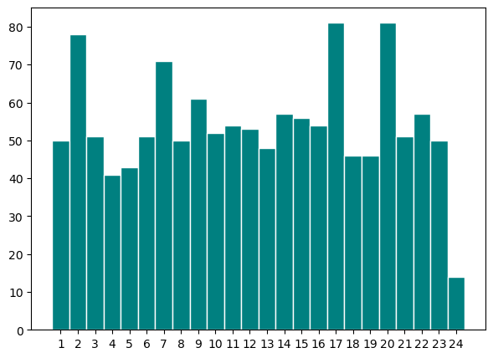
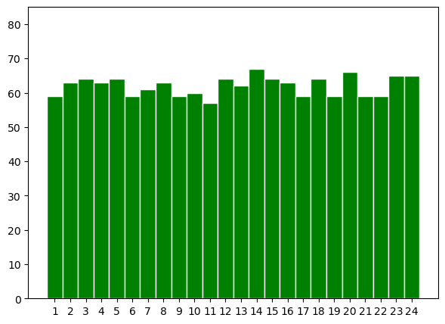
Batching Results Comparison: After Compression
Size(MB)
Strat.1
Strat.2

Slide 40
Batching Results Comparison: After Compression
Size(MB)
Strat.1
Strat.2
Post-compression size: 1,3G
Post-compression size: 1,6G
Most of the batches are balanced (between 40-50MB, max size 81MB)
All Batches are well balanced
(between 59-67MB, max size 67MB)

Slide 41
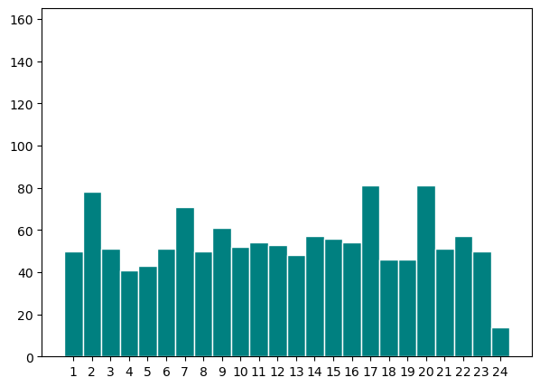
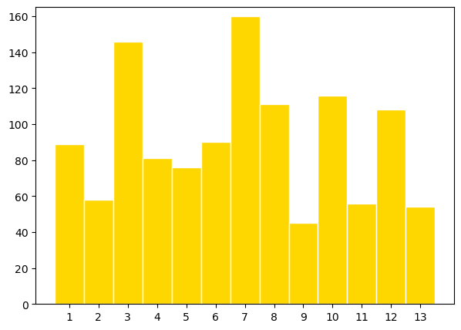
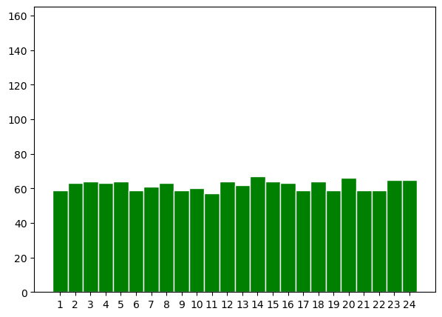
Batching Results Comparison: Compare With the Original Batching
Size(MB)
Post-compression size: 1,2G
Highly imbalance

Slide 42
Conclusion & Perspectives
Batching is a crucial step in Phylogenetic Compression.
Batching by estimating compression size via HyperLogLog and Distinct K-mer counts improves balancing of the final compressed sizes Mycobacterium tuberculosis.
First results:
First model for Optimization Batching as a Bin Packing Problem.
Workflows of the bin packing batching strategies:
https://github.com/tam-km-truong/HLL-Binning
https://github.com/tam-km-truong/HLL-Balancing
Perspectives:
Currently scaling up the results and methods to the 661k and the AllTheBacteria Collections
Introducing new constraints such as Max Number of genomes per batch
Application in other data structure such as Bloom filter, on PIM and GPU

Slide 43
Thank You

Slide 44
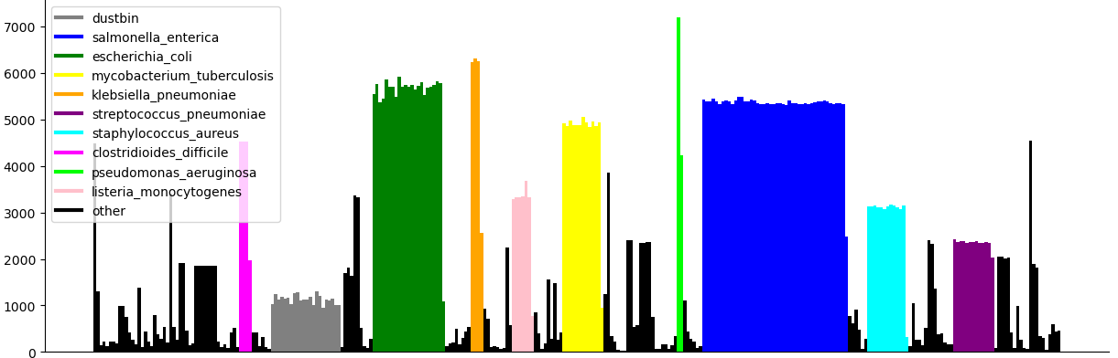
Current Limitation: Non-uniform post-compression sizes
Uncompressed 661k Batches
Size(MB)
Before compression: Batches size are balanced by species
Batches

Slide 45
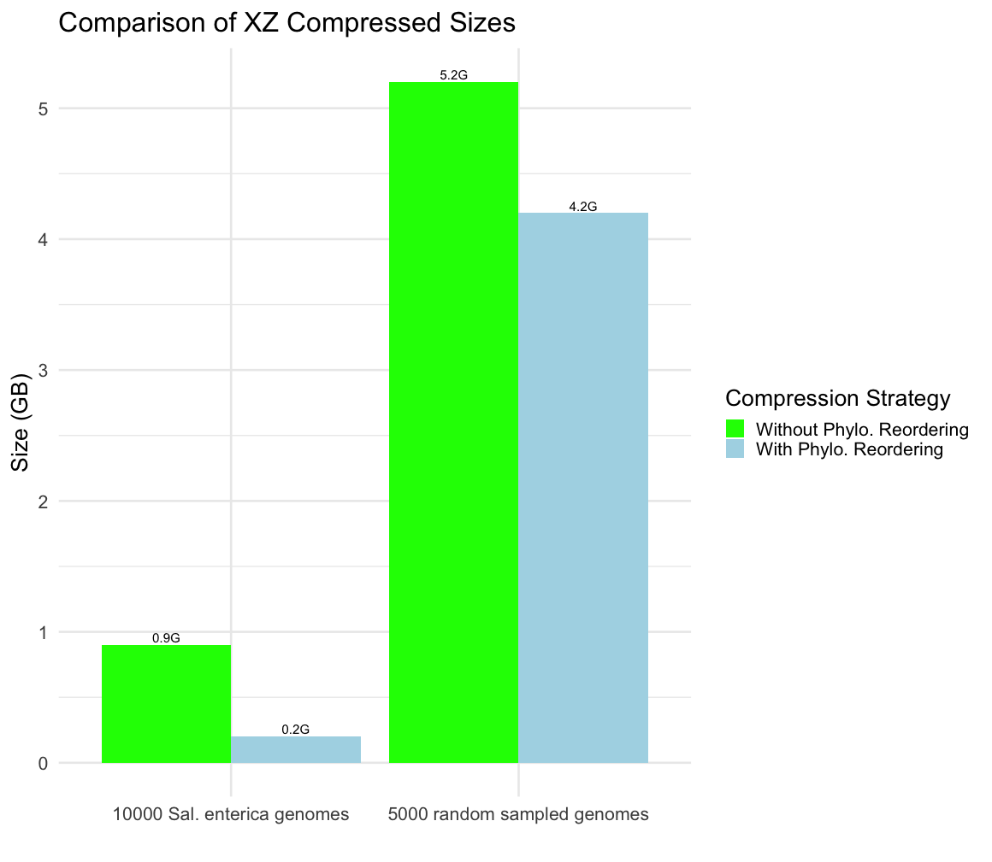
Resulting compression
10000 Sal. enterica genomes (45G gzipped): 4x improvement
5000 randomly sampled genomes (20G gzipped): 1.2x improvement

