Slide 1
Optimizations For Efficient Compression Of Large Bacterial Genome Collections

Slide 2
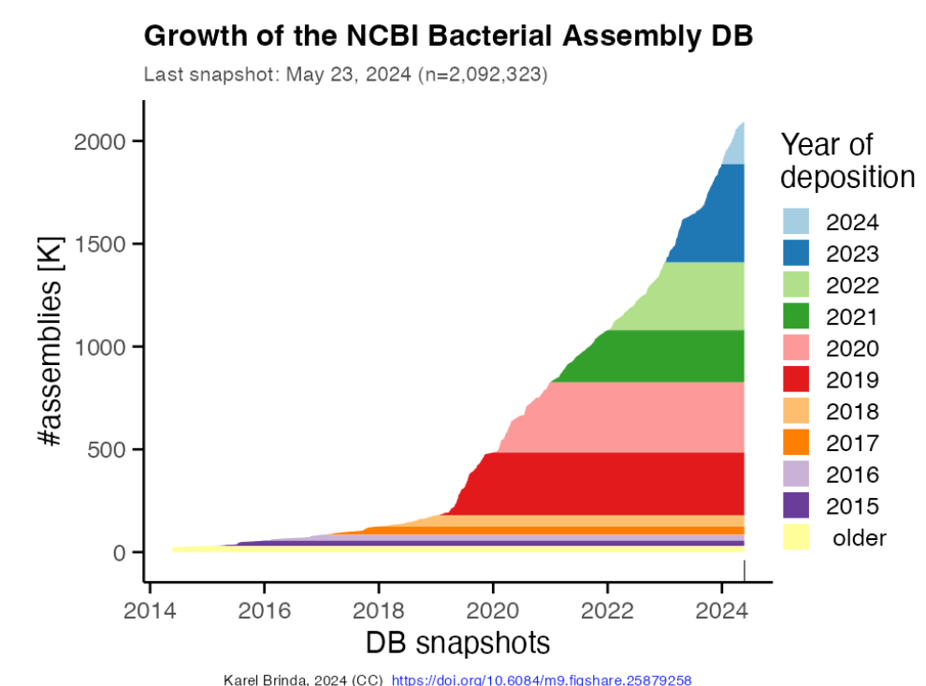
MOTIVATION: Larger And Higher Diversity Genome Collections Are Growing Rapidly
Fast Growth of Bacteria Genome Collection^{[1]}
Large Bacterial Genome Collections: 661kcollection^{[2]}(2021) nb_of_genomes = 661,405
AllTheBacteria^{[3]} (2024) n = 2,440,377
Future n > 10⁷
Make big line here about bacterial genomes collection, then make the graph bigger
Goal: efficient compression and search within those collections

Slide 3

RECENT INNOVATION Phylogenetic Compression^{[1]} Improves Compressibility Via Reordering According To The Evolutionary History (MiniPhy protocol)
Step 1: Phylogenetic clustering & batching
Step 2: Phylogenetic reordering
Resulting compression
INPUT:
Collection of genomes
Size: 100GB
B1
B2
: 1GB
AGCTTTTCAGAT…
: 1.5GB
Species clustering
: 0.5GB
SPECIES 2
SPECIES 3
SPECIES 1
: 1.5GB
10GB
BATCH 1 SPECIES1
BATCH 2
SPECIES1
BATCH 3
SPECIES1
: 1GB
Split highly sampled clusters
: 0.5GB
BATCH 1
SPECIES2
BATCH 2
SPECIES2
BATCH 1
SPECIES3
Infer evolutionary trees
: 4GB
Merge sparsly sampled clusters
DUST-BIN

Slide 4
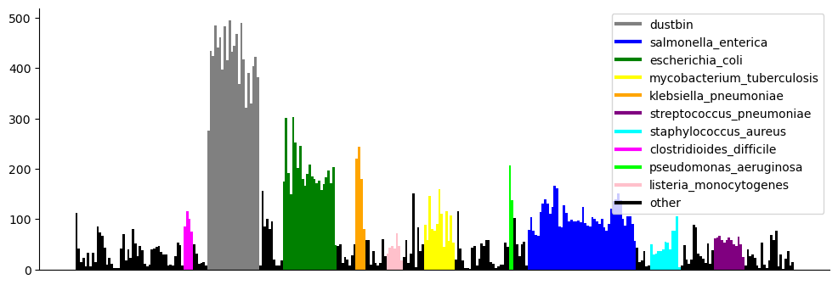
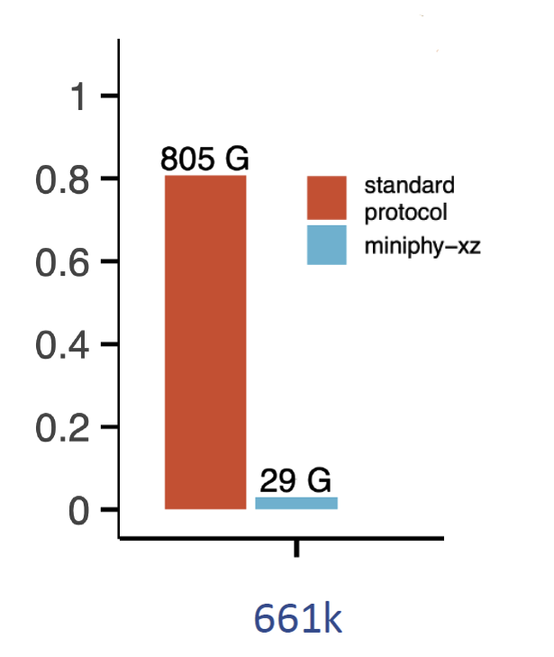
This Strategy Allows Lossless Compression Of 1-3 Orders Of Magnitude Across Different Genome Collections
GB
AllTheBacteria - TBA
RESULTING COMPRESSION

Slide 5
Current Limitation: Batching Results In Non-uniform Post-compression Sizes
Size (MB)
Batches of the 661k Collection

Slide 6
Current Limitation: Batching Results In Non-uniform Post-compression Sizes
AllTheBacteria Batches here
Size (MB)
Batches of the 661k Collection

Slide 7
Consequences: Negative Impact on Downstream Analysis
Consequences: Negative Impact on Downstream Analysis
Unbalanced Workloads
Unbalanced Workloads
Hinder Parallelization
Hinder Parallelization
Inconsistent Query Times
Inconsistent Query Times
Memory Overuse
Memory Overuse
Inefficient Transmission
Inefficient Transmission

Slide 8


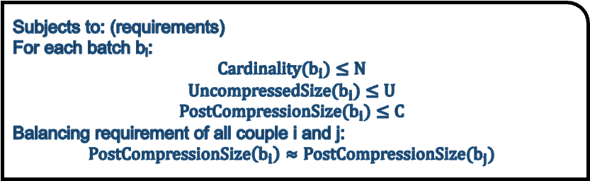
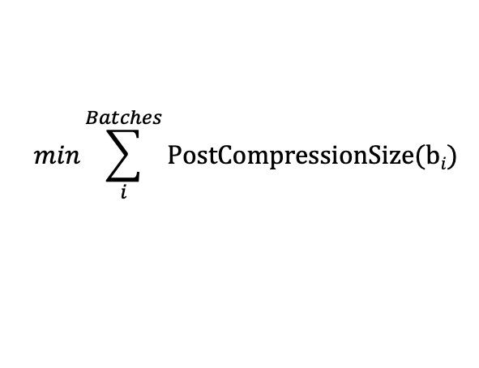
Ultimate Objective: Design An Optimized Batching Strategy For Multiple Applications
Batching Problem:
Given a set of genomes.
Partition it into a set of batches.
User-input parameters for each batch i.e. nb_genomes N, uncompressed size U, post-compression size C.
Minimize the total compression size of the batches and in such a way that the constraints are satisfied.
SPECIES 1
B1
B4
B3
B2
OBJECTIVE:
$$min\sum_{i}^{Batches}{PostCompressionSize(bi)}$$
Requirements for uncompressed batch
Subjects to: (requirements)
For each batch b_{i}:
$$Cardinality(b_{i})≤N$$
$$UncompressedSize(b_{i})≤U$$
$$PostCompressionSize(b_{i})≤C$$
Balancing requirement of all couple i and j:
$$PostCompressionSize\left(b_{i}\right)≈PostCompressionSize(b_{j})$$
Requirements on balancing batches
Requirements on post-compression size
Different Requirements

Slide 9
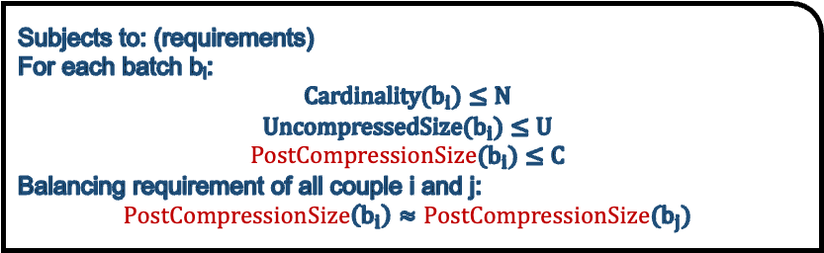
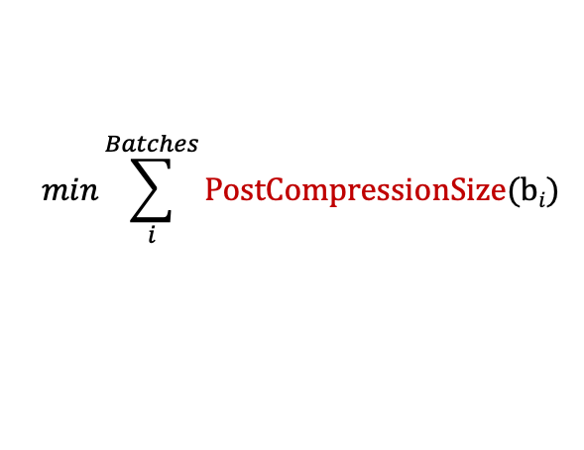
Ultimate Objective: Design An Optimized Batching Strategy For Multiple Applications
Batching Problem:
Given a set of genomes.
Partition it into a set of batches.
User-input parameters for each batch i.e. nb_genomes N, uncompressed size U, post-compression size C.
Minimize the total compression size of the batches and in such a way that the constraints are satisfied.
SPECIES 1
B1
B4
B3
B2
OBJECTIVE:
$$min\sum_{i}^{Batches}{PostCompressionSize(bi)}$$
Requirements for uncompressed batch
Subjects to: (requirements)
For each batch b_{i}:
$$Cardinality(b_{i})≤N$$
$$UncompressedSize(b_{i})≤U$$
$$PostCompressionSize(b_{i})≤C$$
Balancing requirement of all couple i and j:
$$PostCompressionSize\left(b_{i}\right)≈PostCompressionSize(b_{j})$$
Requirements on balancing batches
Requirements on post-compression size
Different Requirements
Predicting Post-compression Size Is Non-trivial

Slide 10
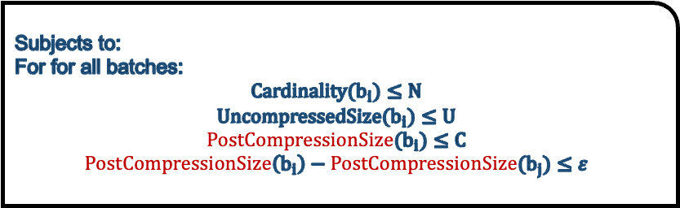
Challenge: Find Develop An Optimized Batching Strategy For Various Use Cases
Batching Problem:
Given a set of genomes.
Partition it into a set of batches.
User-input parameters for each batch i.e. number of genomes N, uncompressed size U, post-compression size C.
Maximize the compression ratio of the set and in such a way that some constraints are satisfied.
SPECIES 1
B3
OBJECTIVE:
B1
B2
B4
$$min\sum_{i}^{Batches}{PostCompressionSize(bi)}$$
Constraint on uncompressed batch
Subjects to:
For for all batches:
$$Cardinality(b_{i})≤N$$
$$UncompressedSize(b_{i})≤U$$
$$PostCompressionSize(b_{i})≤C$$
$$PostCompressionSize\left(b_{i}\right)−PostCompressionSize(b_{j})≤ε$$
Constraint on balanced batches
Constraint post-compression size

Slide 11
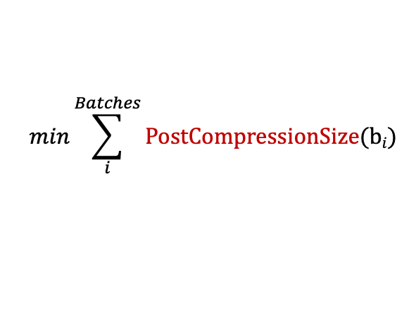

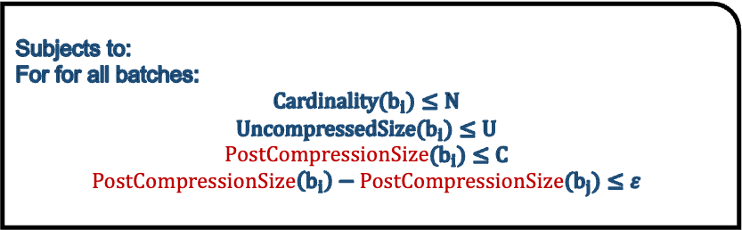
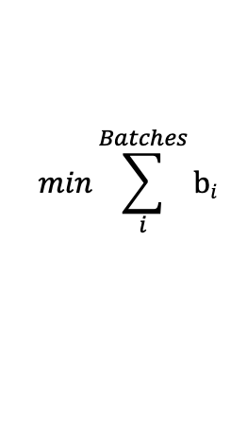
First approach: without considering compression
Assumption: For simplicity, we stop considering genome compression
OBJECTIVE:
OBJECTIVE:
$$min\sum_{i}^{Batches}{PostCompressionSize(bi)}$$
$$min\sum_{i}^{Batches}{bi}$$
Subjects to:
For for all batches:
$$Cardinality(b_{i})≤N$$
$$UncompressedSize(b_{i})≤U$$
$$PostCompressionSize(b_{i})≤C$$
$$PostCompressionSize\left(b_{i}\right)−PostCompressionSize(b_{j})≤ε$$
Subjects to:
For for all batches:
$$Cardinality(b_{i})≤N$$
$$UncompressedSize(b_{i})≤U$$
This becomes an instance of the classical optimization problem: Bin Packing

Slide 12

Bin Packing Problem Is One Of The First Studied Combinatorial Optimization Problem
Bin Packing Problem:
Given a list of items i = 1, . . . , n, each having a size ci ∈ Z+, and an integer value CAPACITY, find the minimum number of bin to pack all items in such a way that the sum of the item sizes in one bin is always smaller than CAPACITY.
The problem is NP-complete
Classical heuristics are ordered-based algorithms
Initially, an empty bin is created.
At each step, the next item is selected and packed in a bin.
A new bin may be created at each step.
Next-fit: choose the current bin
First-fit: choose the first possible bin
Best-fit: choose largest remaining CAPACITY bin
Worst-fit: choose smallest remaining CAPACITY bin
Items
Bins
Studied in Combinatorial Optimization at ISTIC
Continue to be a really hot research topics (presentation at ROADEF 2024)

Slide 13
Bin Packing Problem Is One Of The First Studied Combinatorial Optimization Problem
Bin Packing Problem:
Given a list of item i = 1, . . . , n, each having a size ci ∈ R+, and an integer value CAPACITY, find the minimum number of bin to pack all items in such a way that the sum of the item sizes in one bin is always smaller than CAPACITY.
The problem is NP-complete
Classical heuristics are ordered-based algorithms
Initially, an empty bin is created.
At each step, the next item is selected and packed in a bin.
A new bin may be created at each step.
Next-fit: choose the current bin
First-fit: choose the first possible bin
Best-fit: choose largest remaining CAPACITY bin
Worst-fit: choose smallest remaining CAPACITY bin
Now that we have a strategy to dynamically pack bins based on different parameters,
can we estimate the post-compression size without actually compressing the data?

Slide 14
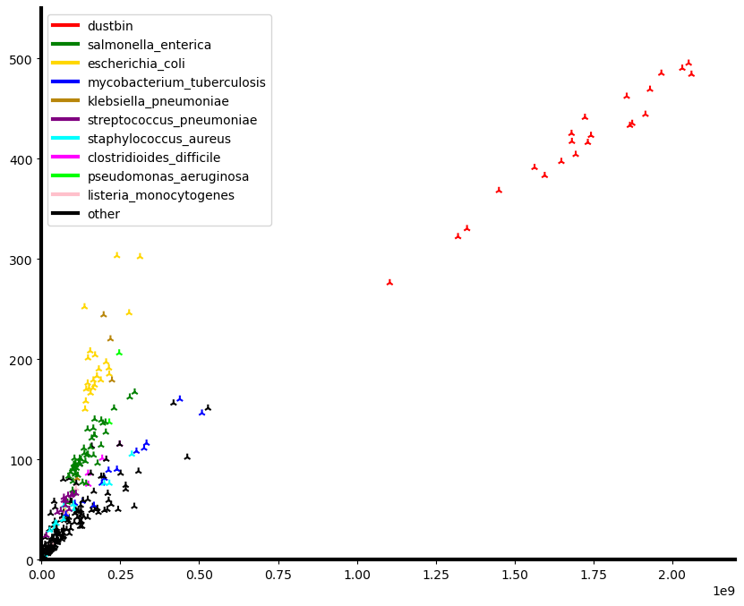
Observation: xz Post-compression 661k Batch Sizes Correlate With Their Distinct Kmers Count

Slide 15
From without compression to compression

Slide 16
Ingredient 2: Cardinality estimation using HyperLogLog sketching
Sketches : approximate data structures.
HyperLogLog sketches for cardinality est.: bit patterns,
i.e. hash(ATGCG) ➔ 00010100, hash(CGTAC) ➔ 00000010.
Fast and efficient UNION operation for sketches.

Slide 17
Bin Packing with distinct kmers Strategy For Genomes Batching
Pseudocode of Strategy 1

Slide 18
Another approach Load Balancing with distinct kmers Strategy For Genomes Batching
We have a fixed number of bin B
T >= #_unique_kmers(bi) for each bi in B
Objective function:
Min T

Slide 19
Recap of the Three Batching Strategies

Slide 20
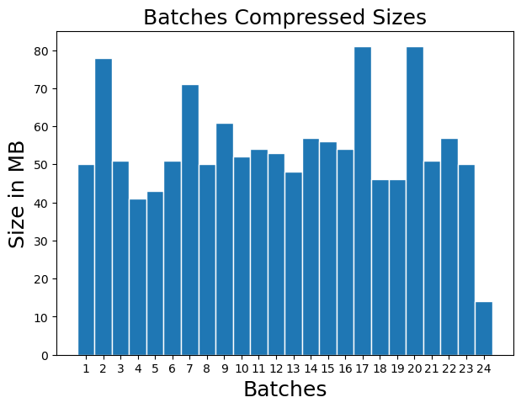
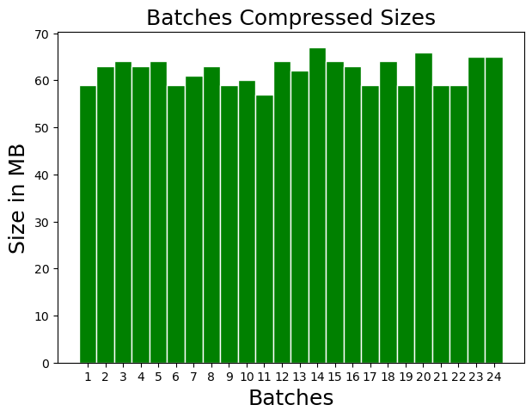
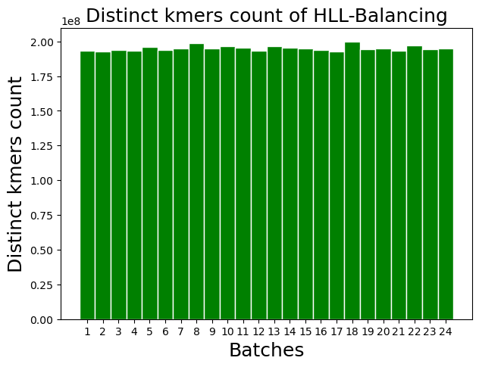
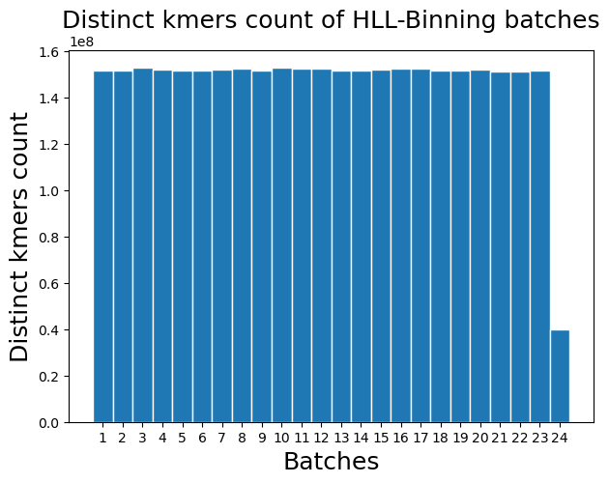
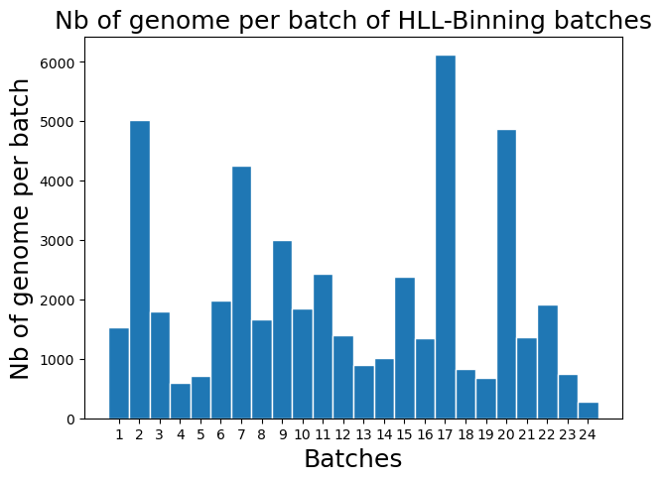
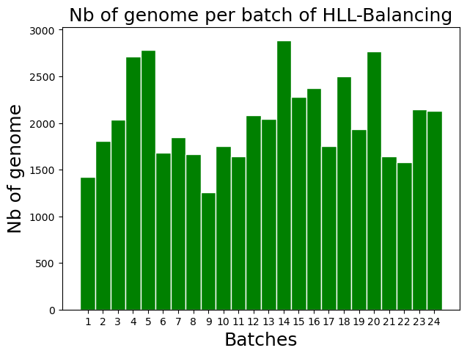
Comparisons of the batching strategíe
STRATEGY 1: HLL-Binning
STRATEGY 2: HLL-Balancing
DATA : Genomes of Mycobacterium tuberculosis from the 661k Collection^{[2]} , B = 24
Batches Obtained From Strat. 1
PHYLOGENETIC COMPRESSION
PHYLOGENETIC COMPRESSION
Batches Obtained From Strat. 2
Batch capacity :
C = 152,000,000
(C obtained by linear regression)
Nb of genomes per batch varies but to a lesser extent compared to Strat. 1
Number of genome per batch varies
Most of the batches are balanced (between 40-50MB, max size 81MB)
All Batches are well balanced
(between 59-67MB, max size 67MB)
Evaluation strat. 1:
Allowing a capacity on distinct kmers.
The result remains somewhat imbalanced.
Evaluation strat. 2:
Producing more balanced batches.
No control over the maximum distinct k-mer count per batch.

Slide 21
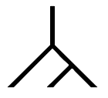
Species 1
Species 1
Species 1
Species 2
Species 3
Species 1
AGCTTTTCATTCTGACTGCAACGGGCAATATGTCTCTGTGTGGAT…
Species 2
Species 2
Species 3
Species clusterting
Batching into equal group
Estimating evolutionary tree
compress

