Slide 1




Bin Packing for Efficient Compression of Large Bacterial Genomes Collection
Tam TRUONG, Dominique LAVENIER, Pierre PETERLONGO, Karel BRINDA

Slide 2
Introduction & State Of The Art

Slide 3
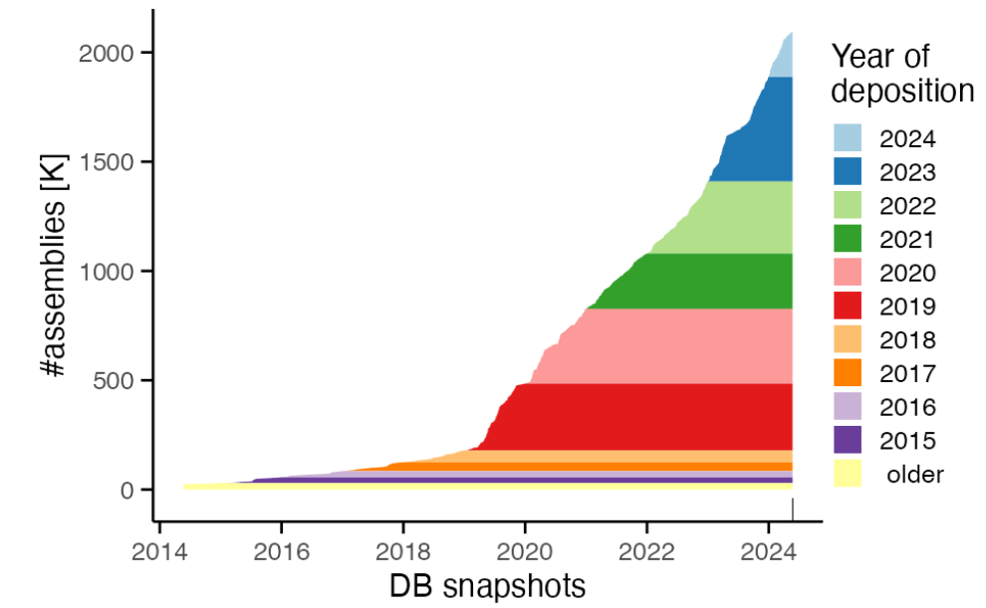
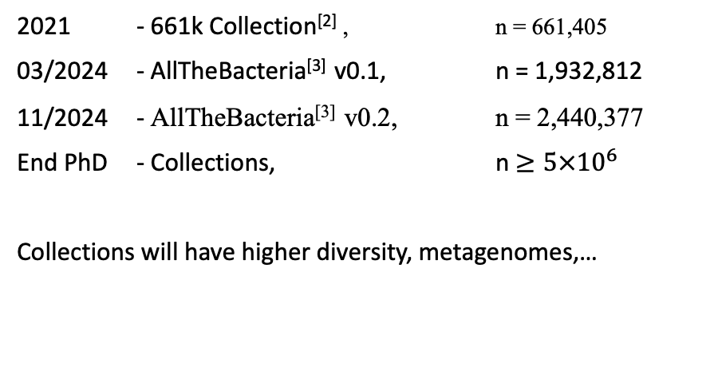
Motivation: Rapidly Growing Bacteria Genome Data
Fast growth of bacterial genomes data^{[1]}
Increasing Availability of Larger Bacterial Genome Collections
2021 - 661k Collection^{[2]} , n = 661,405
03/2024 - AllTheBacteria^{[3]} v0.1, n = 1,932,812
11/2024 - AllTheBacteria^{[3]} v0.2, n = 2,440,377
End PhD - Collections, n $≥5×{10}^{6}$
Collections will have higher diversity, metagenomes,…
➔ Enable research on bacterial adaptation, drug resistant,…
➔ Challenge: efficient compression and search within those collections
[1] Břinda et al., Efficient and Robust Search of Microbial Genomes via Phylogenetic Compression. To be appeared in Nature Methods. 2025
[2] Blackwell et al., Exploring bacterial diversity via a curated and searchable snapshot of archived DNA sequences. PLOS Biology 19, 11. 2021
[3] Hunt et a.l,. AllTheBacteria - all bacterial genomes assembled, available and searchable. bioRxiv. 2024

Slide 4
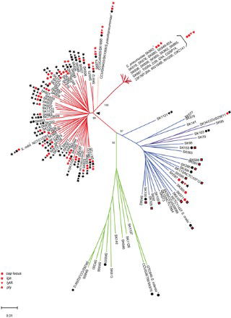
Recent Innovation: Phylogenetic Compression
Individual genomes are not highly compressible but collections of related genomes are extremely compressible^{[4]}.
Key Idea: improves compressibility via reordering according to the evolutionary history^{[1]}
[1] Břinda et al., Efficient and Robust Search of Microbial Genomes via Phylogenetic Compression. To be appeared in Nature Methods. 2025
[4] Loh, PR., Baym, M. & Berger, B. Compressive genomics. Nat Biotechnol. 2012

Slide 5
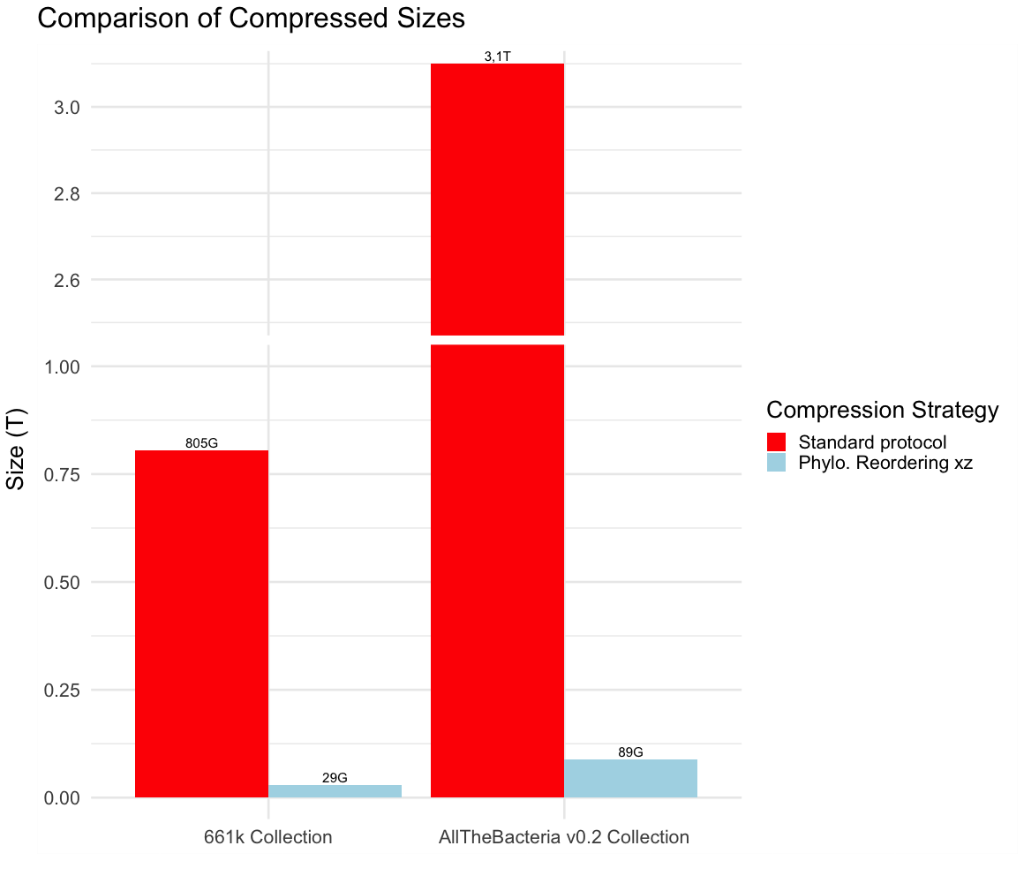
Resulting compression
Lossless compression of 1-3 orders of magnitude over standard protocol

Slide 6

Key Step In Phylogenetic Compression: Genomes Batching
$𝒪\left(n^{3}\right) time$^{[5]}
Infer a phylogenetic tree on an entire collection is infeasible
➔ Partition the collections into manageble subsets
[5] Kevin Howe, Alex Bateman, Richard Durbin, QuickTree: building huge Neighbour-Joining trees of protein sequences, Bioinformatics, 2002

Slide 7
Key Step In Phylogenetic Compression: Genomes Batching
INPUT:
Collection of genomes
Species form clusters in public databases

Slide 8
Key Step In Phylogenetic Compression: Genomes Batching
1 – SAM029385
2 – SAM029386
3 – SAM029387
…
4000 – SAM033385
4001 – SAM033386
…
Sequencing data are uploaded per individual projects
INPUT:
Collection of genomes
Species 1
S2
Species clustering
Similar genomes are more likely to be uploaded together
S3
Within each cluster, sort by sequencing time (accession number)
Sampling bias: popular vs sparse

Slide 9

Key Step In Phylogenetic Compression: Genomes Batching
INPUT:
Collection of genomes
Species 1
S2
S1
S1
S1
$≈$ 4000 genomes in each batches
Species clustering
Batching
S2
S2
S3
S3
1000 genomes in each dustbin
dustbin
dustbin
Split big clusters into smaller batches
Merge small clusters together into dustbins

Slide 10

Key Step In Phylogenetic Compression: Genomes Batching
Infer evolutionary trees & reorder genomes in each batch

Slide 11
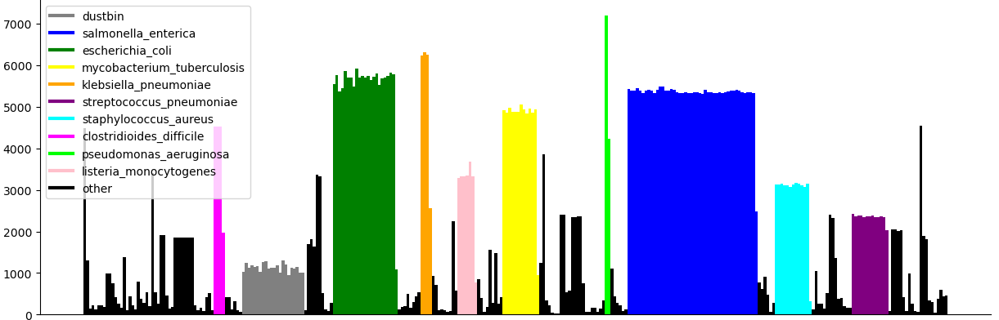
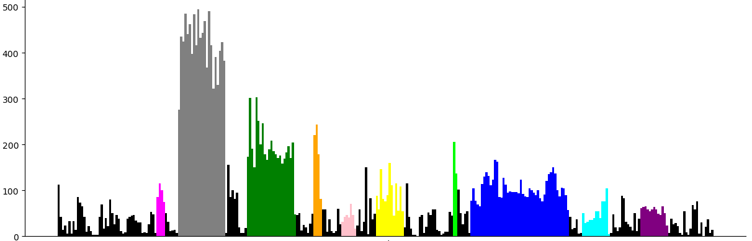
Current Limitation: Non-uniform post-compression sizes
Uncompressed 661k Batches
Size(MB)
Consequences of Non-uniformity
Unbalanced Workloads
Hinder Parallelization
*zoom in
Compressed 661k Batches
Inconsistent Query Time
Memory Overuse
Size(MB)
Inefficient Transmission
Batches

Slide 12
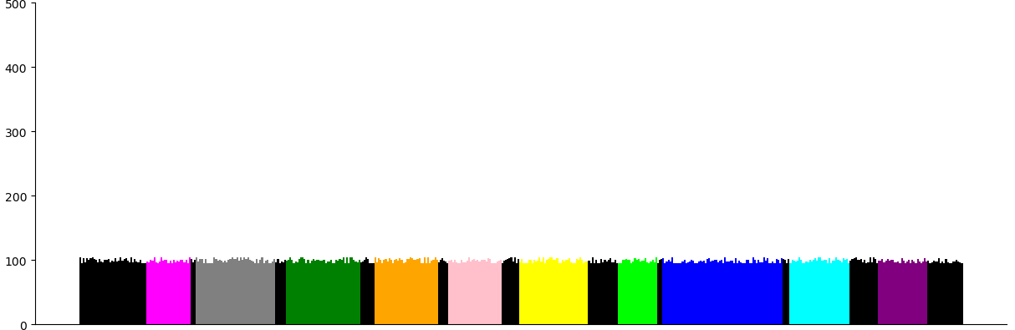
Our Goal: Design A Balancing Batching Strategy
Optimized Batching
APPLICATION: Portable Devives (remote setting, field work, rapid diagnostic), Parallel Platforms (GPU, Processing-in-Memory)

Slide 13
Toward The First Optimization Problem

Slide 14

Quick Recap: What We Have So Far
Cluster of genomes: genomes from the same species
Put them into Batches
Requirements on batches: number of genomes, uncompressed size, …
Post-compression batch sizes must fit within a memory constraint (balance)
Put as many genomes into the batches as possible
Minimize the number of batches used
Minimize
➔ Optimization Problem: Bin Packing

Slide 15

Bin Packing Problem: Definition
Bin Packing Problem:
Given a list of items i = 1, . . . , n, each having a size ci ∈ Z+, and an integer value CAPACITY. Find the minimum number of bin to pack all items in such a way that the sum of the item sizes in one bin is always smaller than CAPACITY.
A classic combinatorial optimization problem.
The problem is NP-complete
Classical heuristics are ordered-based algorithms.
Initially, an empty bin is created. At each step, the next item is selected and packed in a bin. A new bin may be created at each step.
First-fit: choose the first possible bin
Best-fit: choose largest remaining CAPACITY bin
Worst-fit: choose smallest remaining CAPACITY bin
Items
Still a trending research topics (presentation at ROADEF 2024)
Bins

Slide 16
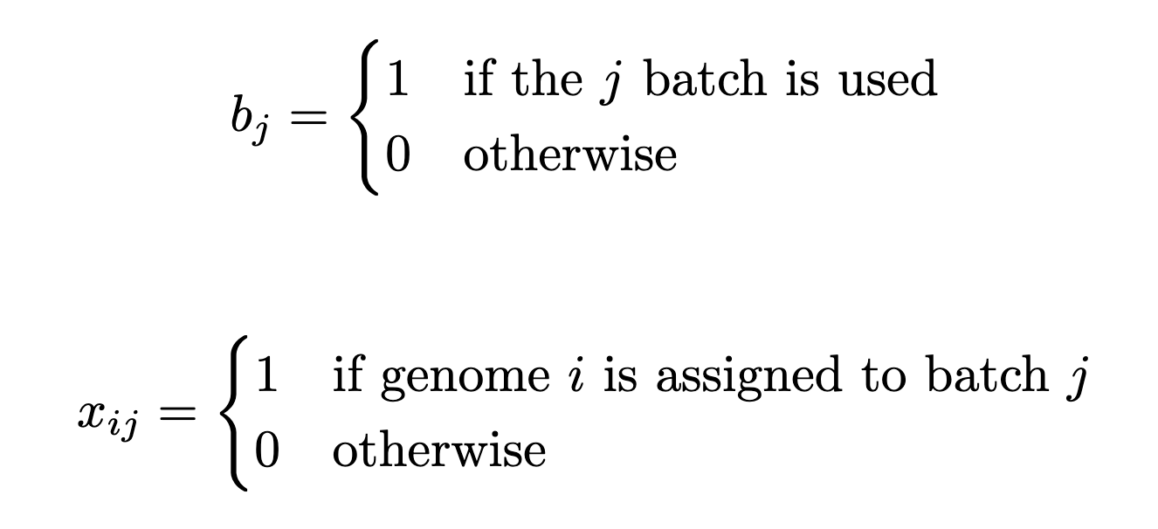
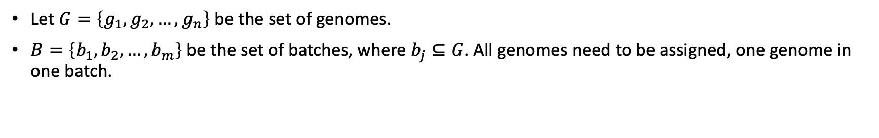
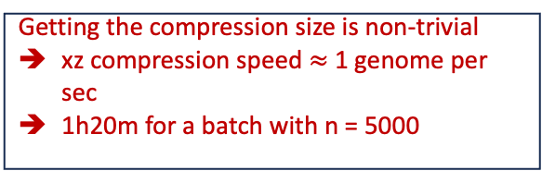
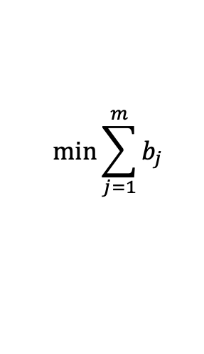
The First Optimaztion Model For Batching
Let $G=\left\{g_{1},g_{2},…,g_{n}\right\}$ be the set of genomes.
$B=\left\{b_{1},b_{2},…,b_{m}\right\}$ be the set of batches, where $b_{j}⊆G$. All genomes need to be assigned, one genome in one batch.
The compression size of each batch must be less than or equal to A MB:
$|post_compression_size(b_{j})|≤A$, $∀j∈\{1,…,m\}$
Getting the compression size is non-trivial
xz compression speed $≈$ 1 genome per sec
1h20m for a batch with n = 5000
$$\min{\sum_{j=1}^{m}{b_{j}}}$$
Objective function:

Slide 17
Implementation Of The Balancing Model
Approximation Of Post Compression Size Using Distinct Kmers Count
Fast Distinct Kmers Count Via Hyperloglog Sketching
Bin Packing Greedy Algorithms

Slide 18
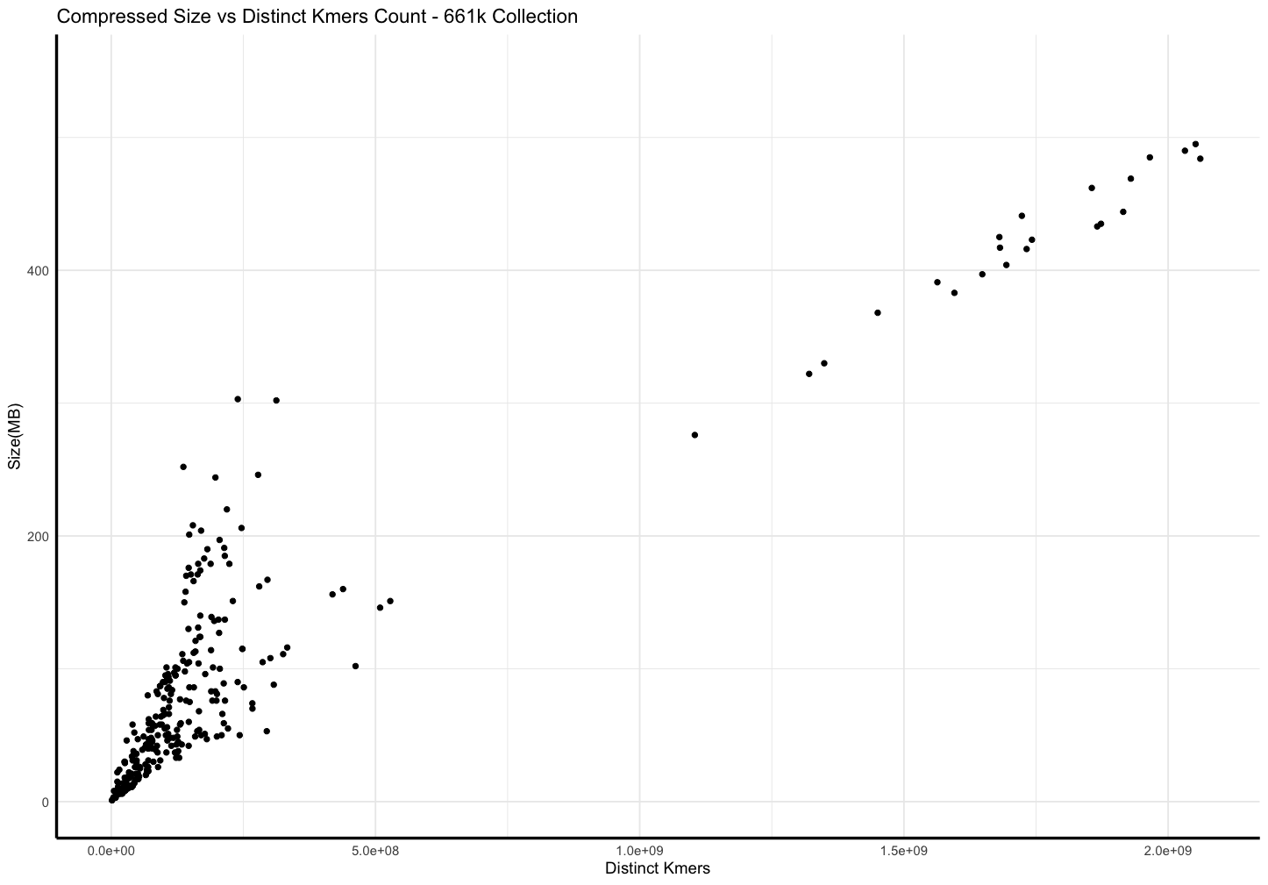
Ingredient 1: Post-compression Sizes Vs Distinct Kmers Count In Assemblies Collections

Slide 19
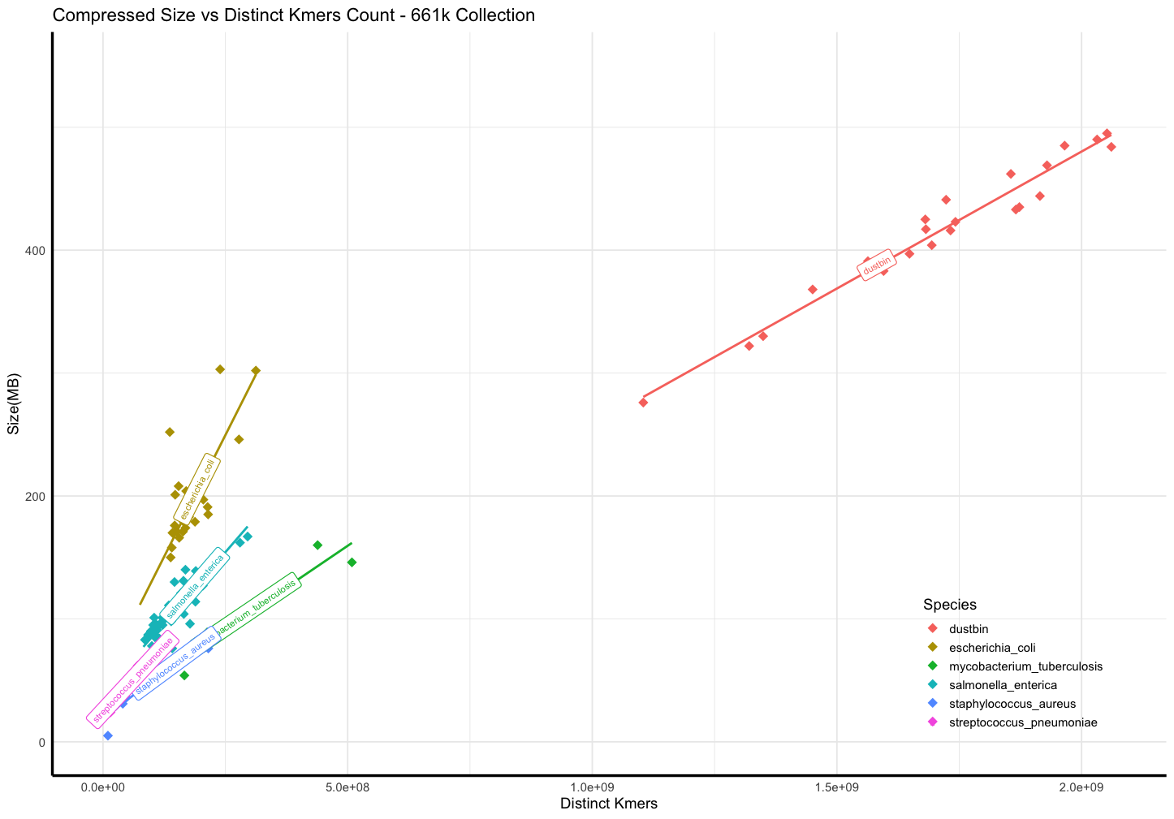
Ingredient 1: Post-compression Sizes Vs Distinct Kmers Count In Assemblies Collections
r = 0.98
r = 0.775
r = 0.88
r = 0.97
r = 0.89
r = 0.96

Slide 20
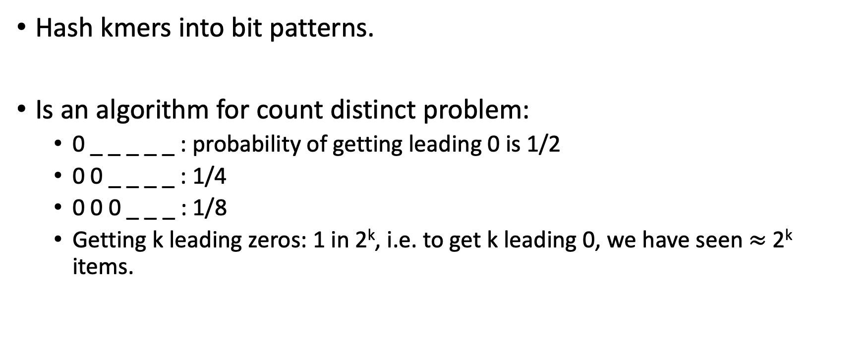
Ingredient 2: Fast Distinct Kmers Counting via HyperLogLog
Hash kmers into bit patterns.
Is an algorithm for count distinct problem:
0 _ _ _ _ _ : probability of getting leading 0 is 1/2
0 0 _ _ _ _ : 1/4
0 0 0 _ _ _ : 1/8
Getting k leading zeros: 1 in 2^{k}, i.e. to get k leading 0, we have seen $≈$ 2^{k} items.

Slide 21
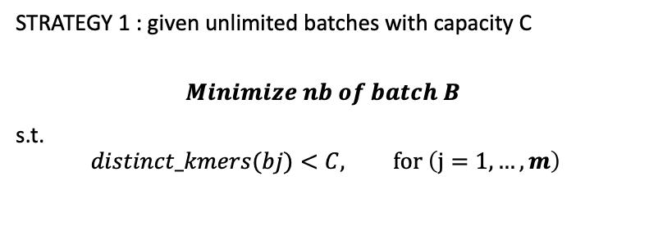
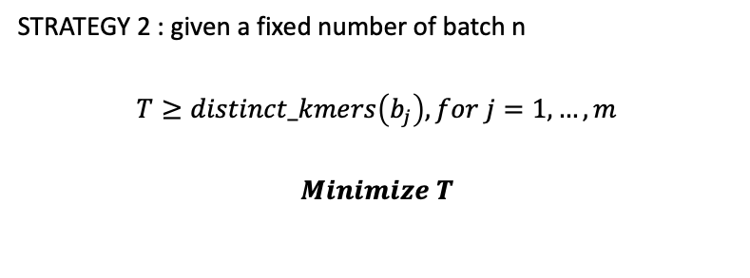
Ingredient 3: Bin Packing greedy algorithms – 2 variations
STRATEGY 1 : given unlimited batches with capacity C
$$Minimize nb of batch B$$
s.t.
$$distinct_kmers(bj)<C, for \left(j=1,…,m\right)$$
STRATEGY 2 : given a fixed number of batch n
$$T≥distinct_kmers\left(b_{j}\right), for j=1,…,m$$
$$Minimize T$$
Sort the genomes by acession number.
Initially, an empty bin is created.
At each step, the next genomes is selected and packed in the first available bin.
Create new bin as needed.
Sort the genomes by acession number.
Create n bins.
At each step, the next genomes is selected and packed in the bin with the smallest CAPACITY.

Slide 22
Results

Slide 23
Dataset:
Asemblies of Mycobacterium tuberculosis from 661k
Number of Genomes: 49000
Uncompressed Size: 218 GB
CAPACITY of batches: 152,000,000

Slide 24
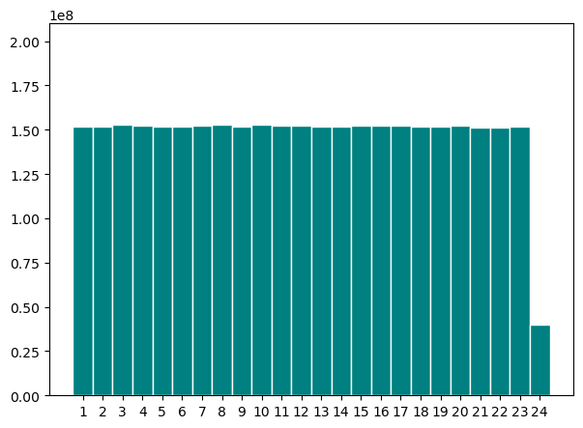
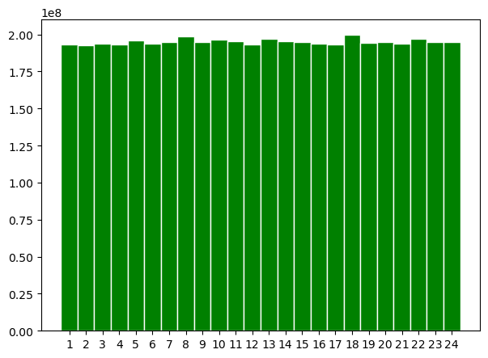
Batching Results Comparison: Distinct Kmers Count
Distinct Kmers Count
Strat.1
Outlier
Strat.2
Strat.1 keep the order of accession number
➔ Better compression
➔ Distinct Kmers Counts is balanced

Slide 25
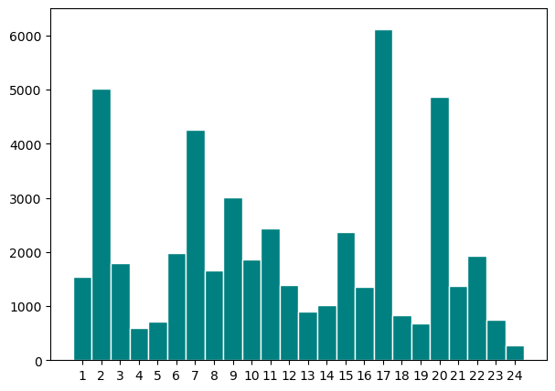
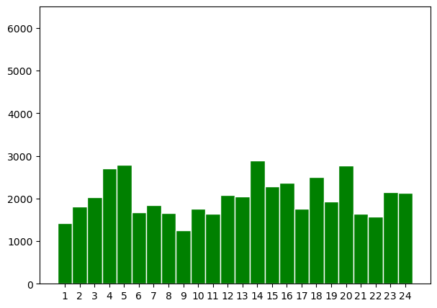
Batching Results Comparison: Number Of Genomes
Number of Genomes
Strat.1
Strat.2
Number of genomes per batch varies, strat.2 to a lesser extent compared to strat.

Slide 26
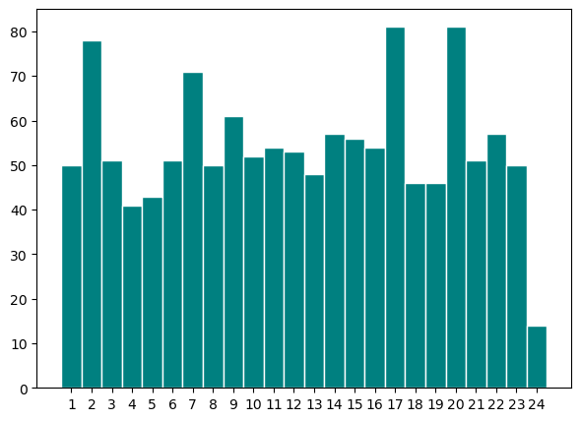
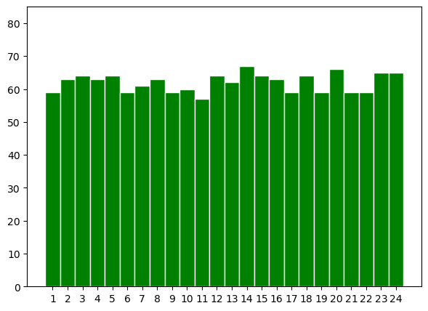
Batching Results Comparison: After Compression
Size(MB)
Strat.1
Strat.2
Post-compression size: 1,3G
Post-compression size: 1,6G
Most of the batches are balanced (between 40-50MB, max size 81MB)
All Batches are well balanced
(between 59-67MB, max size 67MB)

Slide 27
Conclusion & Perspectives
Batching is a crucial step in Phylogenetic Compression
Batching by estimating compression size via HyperLogLog and Distinct K-mer counts improves balancing of the final compressed sizes Mycobacterium tuberculosis.
First results:
First model of the Optimization Batching as a Bin Packing Problem
Workflows of the bin packing batching strategies:
https://github.com/tam-km-truong/HLL-Binning
https://github.com/tam-km-truong/HLL-Balancing
Perspectives:
Currently scaling up the results and methods to the 661k and the AllTheBacteria Collections
Introducing new constraints such as Max Number of genomes per batch
Application in other data structures such as Bloom filter, on PIM and GPU

Slide 28
Thank You

