Slide 1
Optimized ordering and batching of microbial genomic data for compression
08/09/2025

Slide 2
Introduction & motivation

Slide 3
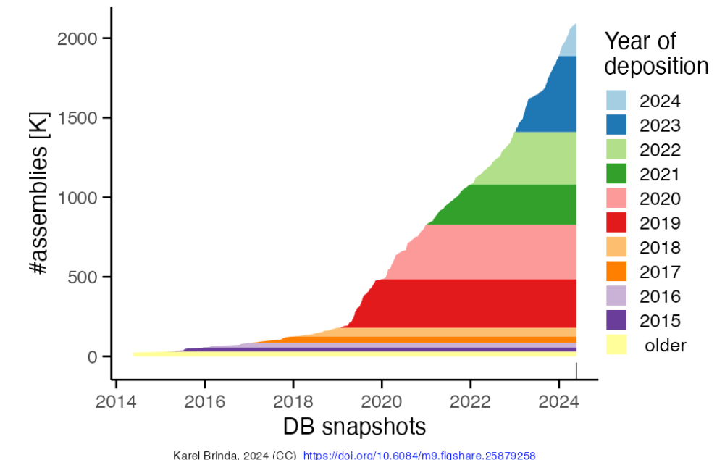
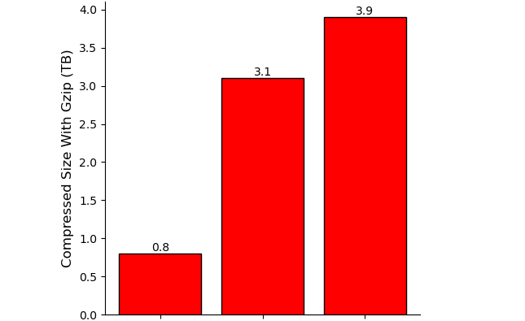
Traditional data storages techniques are insufficent for the explosion of microbial data
Fast Growth Of Bacterial Genomes Data¹ (NCBI)
661k [2]
Nov. 2021
n = 661,405
AllThe Bacteria v0.2 [3]
Mar. 2024
n = 1,932,812 [3]
AllTheBacteria v0.3 [3]
Nov. 2024
n = 2,440,377 [3]
18 Jun 2025: ATB v0.4 with 330k new genomes
Next decade: Even larger collections (n = ~10⁷), higher diversity, …
Challenging: Bacterial genomes are highly diverse
Challenging: Efficient storage & analysis (indexing, searching)
Challenging: Standard compression protocols based on gzip are not keeping up with data

Slide 4
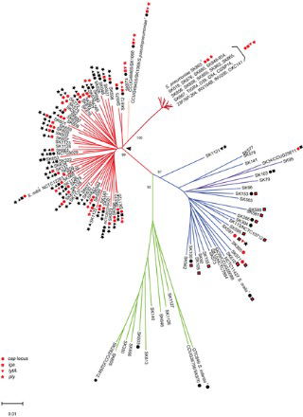
Phylogenetic order is a compression facilitator for bacterial genome collections
Problem:
Compression is a widely studied problem but existing methods do not scale for modern genomes collection
Difficulty: Million-genome scale and complex redundancy structure of bacterial collections.
Phylogenetic compression:
Key Idea: guiding of compression using evolutionary history to enhances local compressibility
Result: 1-2 order of magnitude improvement in compression size of genome collections

Slide 5
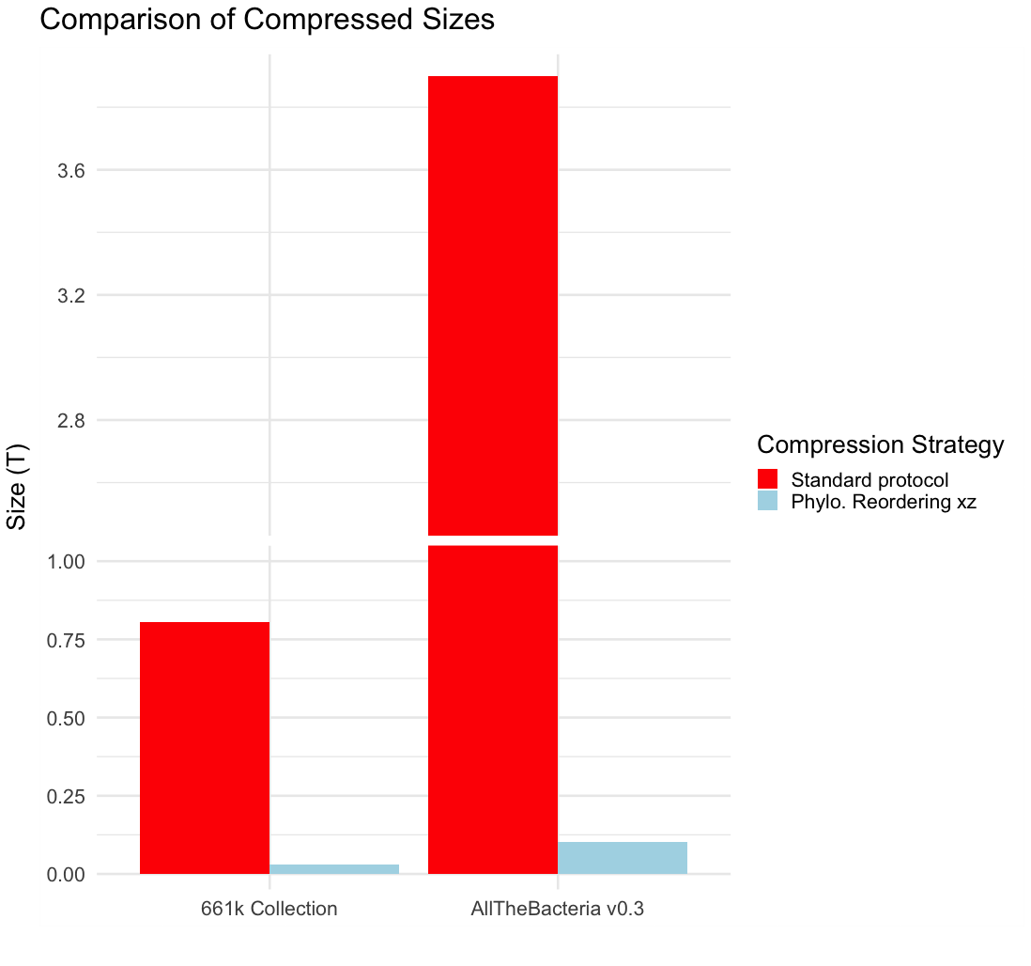
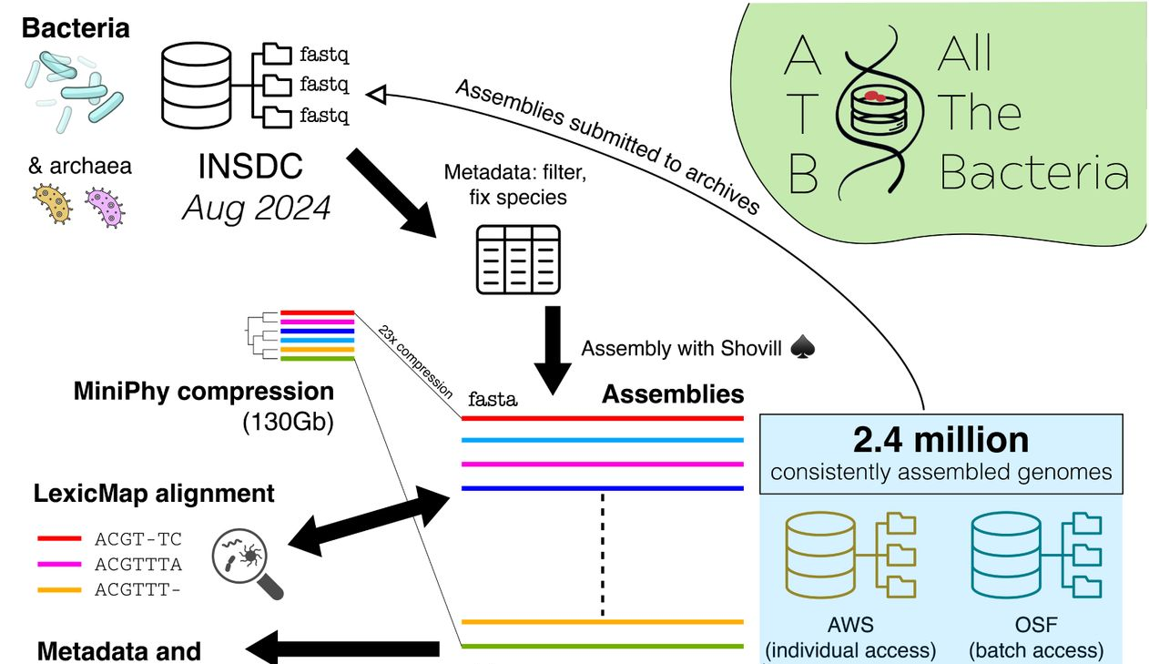
Applications On Large Genomes Collections – 1-2 Orders Of Magnitude Reduction In Size
3,9T
- Gzip
- MiniPhy
805G
29G
103G
661k [2]
AllTheBacteria v0.3 [3]
➔ Core compression technique for AllTheBacteria, currently the largest microbial genomes collection
MiniPhy: Implemetation of phylogenetic compression workflow

Slide 6
Phylogenetic compression intrinsics: Two steps of reordering in Phylogetic Compression
Level 1 GLOBAL : Preordering via Species-based batching
Level 2 LOCAL: Within-batch tree-based ordering
(left to right according to a phylogeny)
Collection of genomes
Species clustering
Followed by compression using a low-level compressors:
General technique: XZ
Specialized techniques:
For microbial data: MBGC
With random access to compressed genome: AGC
Neural network: GeCo3

Slide 7
Batching step is needed for efficient uses of tools & computational ressources
Collection of genomes
Species clustering
Global phylogenetic inference: Computationally impractical at millions genomes scale.
Some existing tools fail to run at collection-scale
(MBGC for 661k with no batching)
Per-batch analysis:
Facilitate parallelization
Easily shareable
Economize computational resources

Slide 8



Batching in phylogenetic compression (current state of the art via species & accessions)
MiniPhy’s default strategy: sort by submission time (accession number)
INPUT:
Collection of genomes
Species cluster 1
S1
S1
S1
Species clustering
Batching
S2
S2
S3
Dustbin:
Group genomes from small cluster
Sort the genomes lexicographically
Split big clusters into batches
$≈$4000 genomes/batch
S2
S3
Species form clusters in public databases
Split dustbin into batches
Sequencing data is typically uploaded together
i.e. genomes with nearby accession numbers are likely related.
$≈$1000 genomes/batch
1 – SAM029385
2 – SAM029386
3 – SAM029387
…
3999 – SAM033384
4000 – SAM033385
4001 – SAM033386
…
Parameters (Constraints):
Max batch size
Max dustbin size
Dustbin threshold (clusters go to dustbin)

Slide 9
Limitation: Phylogenetic batching currently unable to adjust to target applications
No formalization of batching as an optimization problem.
Batching are not suitable for hardware specific target application.
Heavily dependent on metadata for an approximative input order
We want
Constraints on:
Uncompressed sizes
Compressed sizes
Number of genomes
We want
Search on GPUs or for processing-in-memory (PIM) architectures
We want
Independence on metadata (accession numbers, species labels)

Slide 10
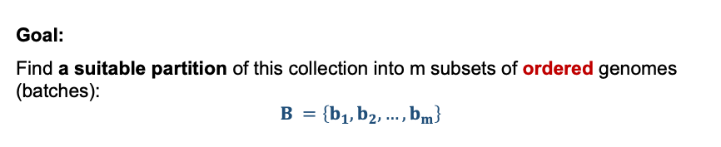
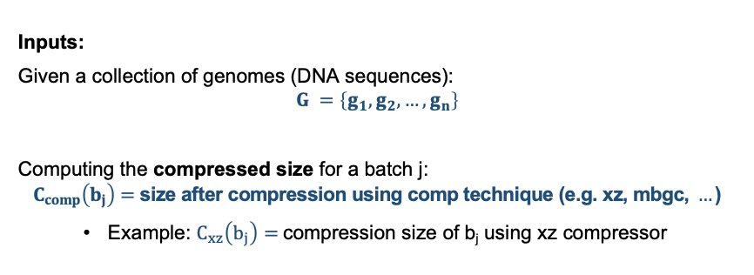
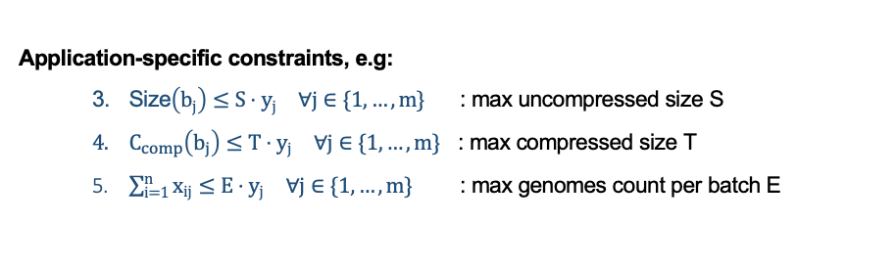
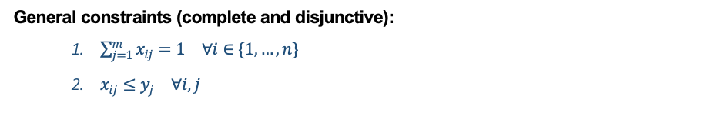

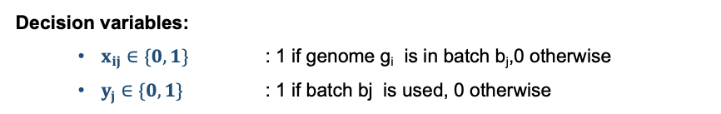
Formulation of the batching optimization problem for phylogenetic compression
Inputs:
Given a collection of genomes (DNA sequences):
$$G =\left\{g_{1},g_{2},…,g_{n}\right\}$$
Computing the compressed size for a batch j:
$$C_{comp}\left(b_{j}\right)=\text{siz}\text{e} \text{after} \text{compression} \text{using} \text{comp} \text{technique}\text{ (}\text{e}\text{.}\text{g}\text{. }\text{xz}\text{, }\text{mbgc}\text{, }…\text{)}$$
Example: $C_{xz}\left(b_{j}\right)=$compression size of b_{j} using xz compressor
Objective function:
$$\min\left(α\sum_{j=1}^{m}{C_{comp}\left(b_{j}\right)}⋅y_{j}+β\sum_{j=1}^{m}{y_{j}}\right)$$
Minimize total compressed batch sizes
Minimize the number of batches
Goal:
Find a suitable partition of this collection into m subsets of ordered genomes (batches):
$$B =\left\{b_{1},b_{2},…,b_{m}\right\}$$
General constraints (complete and disjunctive):
$\sum_{j=1}^{m}{x_{ij}}=1 ∀i∈\{1,…,n\}$
$x_{ij}≤y_{j} ∀i,j$
Application-specific constraints, e.g:
Size$\left(b_{j}\right)≤S⋅y_{j} ∀j∈\{1,…,m\}$ : max uncompressed size S
$C_{comp}\left(b_{j}\right)≤T⋅y_{j} ∀j∈\{1,…,m\}$ : max compressed size T
$\sum_{i=1}^{n}{x_{ij}}≤E⋅y_{j} ∀j∈\{1,…,m\}$ : max genomes count per batch E
Decision variables:
$x_{ij}∈\{0,1\}$ : 1 if genome g_{i} is in batch b_{j},0 otherwise
$y_{j}∈\{0,1\}$ : 1 if batch bj is used, 0 otherwise

Slide 11
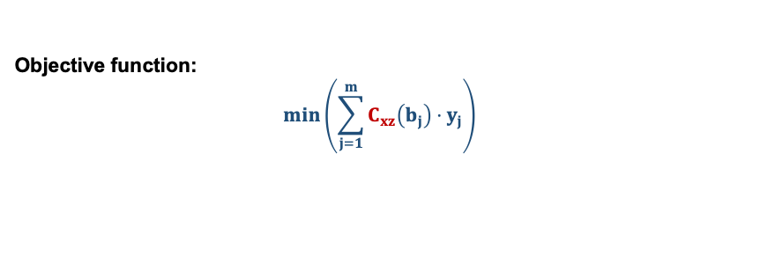
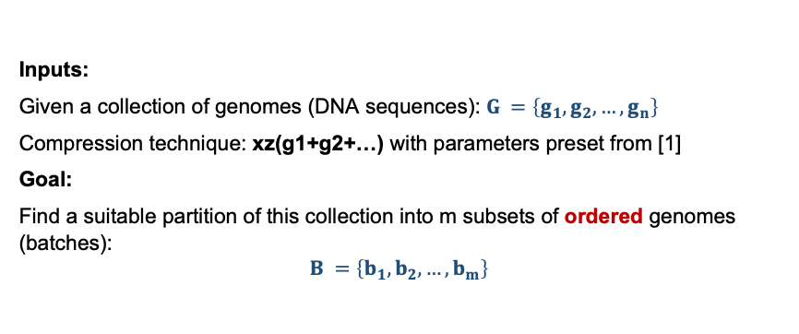
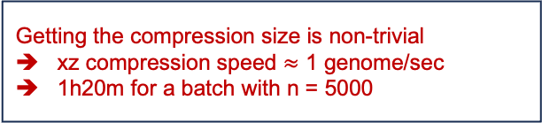
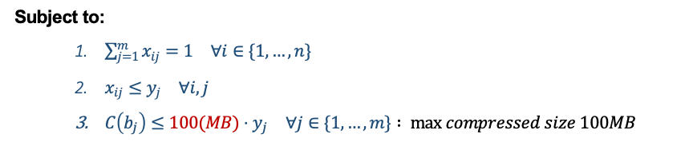
Scenario: max bound on per batch compressed size (motivated by internet transmission)
Inputs:
Given a collection of genomes (DNA sequences): $G =\left\{g_{1},g_{2},…,g_{n}\right\}$
Compression technique: xz(g1+g2+…) with parameters preset from [1]
Goal:
Find a suitable partition of this collection into m subsets of ordered genomes (batches):
$$B =\left\{b_{1},b_{2},…,b_{m}\right\}$$
Non linear objective function
Different genome order leads to different compression size
Objective function:
$$\min\left(\sum_{j=1}^{m}{C_{xz}\left(b_{j}\right)}⋅y_{j}\right)$$
Getting the compression size is non-trivial
xz compression speed $≈$ 1 genome/sec
1h20m for a batch with n = 5000
Subject to:
$\sum_{j=1}^{m}{x_{ij}}=1 ∀i∈\{1,…,n\}$
$x_{ij}≤y_{j} ∀i,j$
$C\left(b_{j}\right)≤100(MB)⋅y_{j} ∀j∈\{1,…,m\}$ $: max compressed size 100MB$

Slide 12
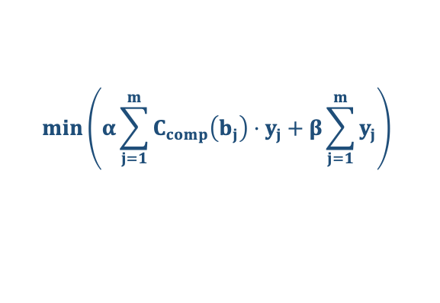
The Two Tracks Of My Work: Preordering & Partitionning
$$\min\left(α\sum_{j=1}^{m}{C_{comp}\left(b_{j}\right)}⋅y_{j}+β\sum_{j=1}^{m}{y_{j}}\right)$$
Difficult to solve in full generality
The goal of my PhD: develop a heuristic approaches
1. Phylogenetic Pre-ordering Of Genomes
2. Order-based Genome Batching

Slide 13
Methods

Slide 14








Overview: Phylogenetic batching for million of genomes
INPUT
REM
(c)
REF
(a)
REM
Dist.
Cal.
Nearest
neighbor
REF
REM
$$≤4 genomes$$
$$≤4 genomes$$
$$≤4 genomes$$
REF
$$≤100k kmers$$
$$≤100k kmers$$
Phylo. Infr
(d)
(b)
$$≤50MB$$
$$≤50MB$$
$$≤50MB$$
(a): Splitting the input genomes into 2 sets: reference genomes (REF) and remaining genomes (REM)
(b): Phylogenetics tree inference of REF.
(c): Placing the remaining genomes according to the leaf-order of the REF tree and the resulting order
(d): Cut the order into batches satisfying a given threshold, here 3 examples are shown: cardinality, number of kmers, compressed size,…

Slide 15
Ordering

Slide 16
Scalability of neighbor-joining:
Theoretically: complexity O(n3)
Experimentally:
Mash + quicktree
Ecoli:
Parameteres:

Slide 17
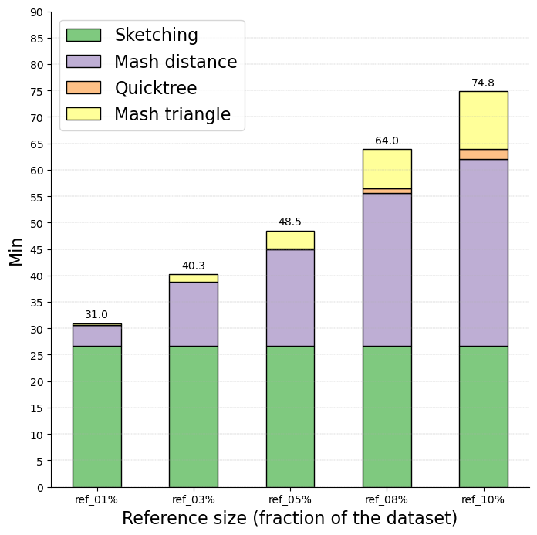
Key Idea: reduce the number of required calculations for phylogenetic ordering
Example: Benchmark with E. coli – different reference genomes percentage, runtime by individual step
Dataset: 90k E.coli genomes from 661k collection
Parameter:
Attotree with sketch size 10000
NN placement with sketch size 1000
Attotree
The higher the number of reference genomes, the more impactful the runtime of phylogenetic tree inference on the total runtime
Number of required calculations:
1%: 819² + 80 x 10⁶ ~ 80 x 10⁶
3%: 2674² + 231 x 10⁶
5%: 4457² + 377 x 10⁶
…
100%: 90k² ~ 8100 x 10⁶
Not yet taken into account neighbor joining’s O(n³) complexity
We want to keep the number of refence genomes low
NN placement
1%
(891 genomes)
3%
(2674 genomes)
5%
(4457 genomes)
8%
(7131 genomes)
10%
(8914 genomes)

Slide 18
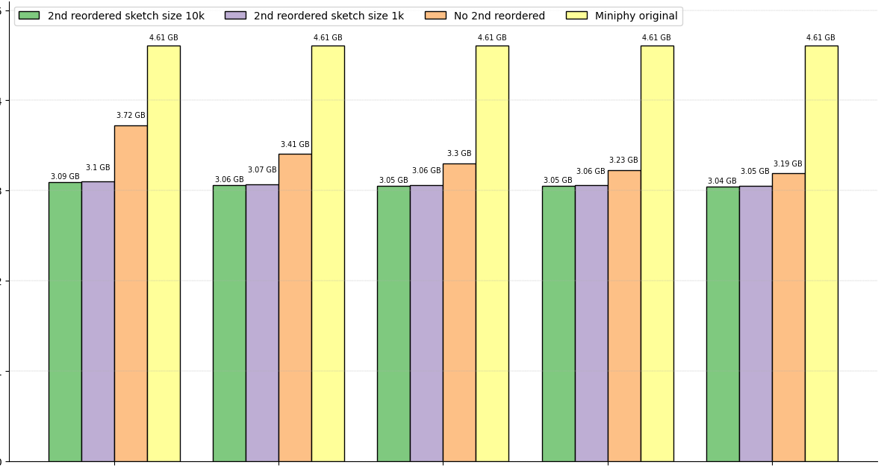
Example: Benchmark with E. coli – different reference genomes percentage, compression size, different within batch reordering method
Within batch reordering (2nd reordering) improve compression size
Sketch size has minimal effect on improving compression
Size (GB)
The higher the percentage of selection for reference genomes, the lower the improvement impact of 2nd reordering
Diminishing return on fraction selection.
1%
(891 genomes)
3%
(2674 genomes)
5%
(4457 genomes)
8%
(7131 genomes)
10%
(8914 genomes)

Slide 19
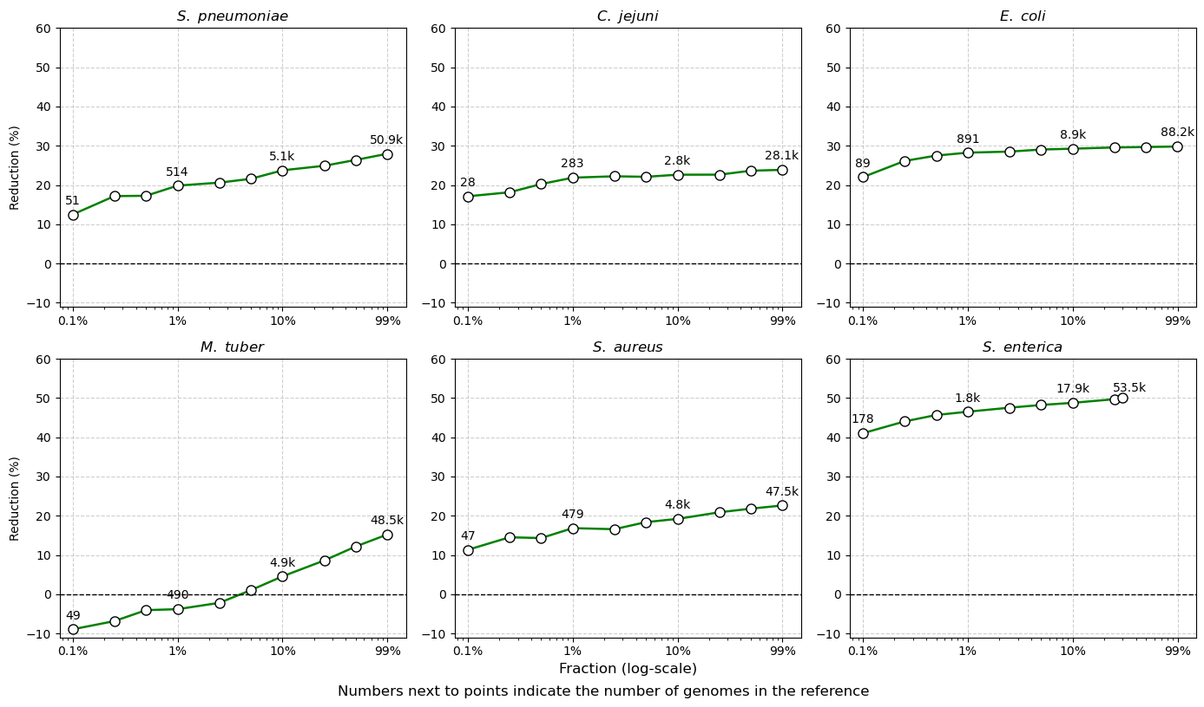
Top 6 species of 661k: 15-40% improvement with reference genomes using fewer than 10% of the input
(51433)
(28336)
(89136)
Noticeable improvement using just 0.1% fraction
(49020)
(47997)
(178585)
Independence of reference genomes size and input cluster size ?
M. tuberculosis only shows improvement with REF at more than 5% fraction

Slide 20
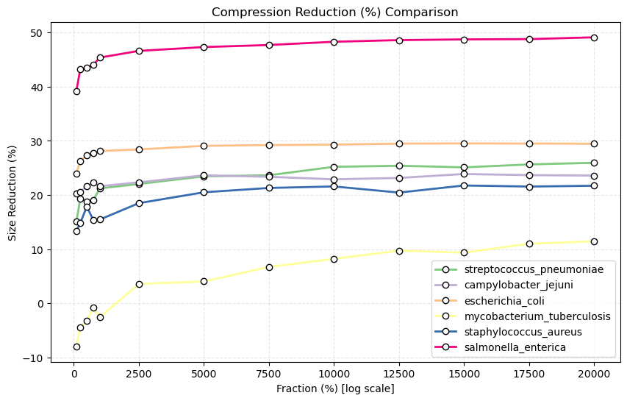
Consistent improvement using a fixed number of genomes instead of a fraction of a collection
The ”sweet spot” is around 2500 genomes.
Improvement rises slowly after that.
Nb of genomes for references

Slide 21
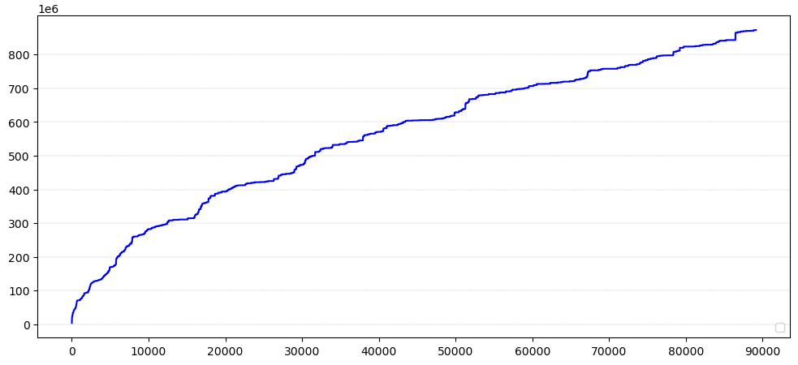
Question: What is the smallest possible genomes selection for reference tree that ensures a good compression size?
Hypothesis: Set of reference genomes with higher diversity would lead to better compression result
Cumulative distinct kmers estimation – E.coli 661k – accession order
Number of genomes

Slide 22
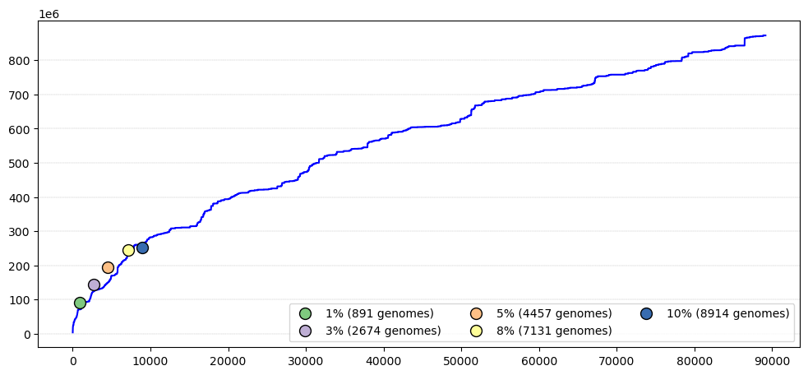
Question: What is the smallest possible genomes selection for reference tree that ensures a good compression size?
Hypothesis: Set of reference genomes with higher diversity would lead to better compression result
Cumulative distinct kmers estimation – E.coli 661k – accession order
Number of genomes

Slide 23
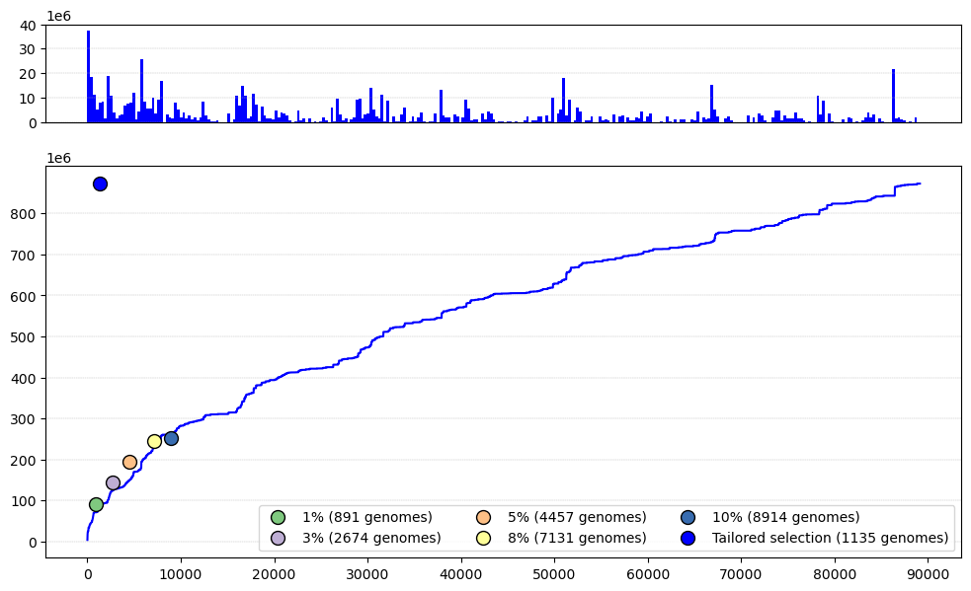
Question: What is the smallest possible genomes selection for reference tree that ensures a good compression size?
Increases in distinct kmers count of each genomes
Select only genomes that increase the distinct kmers count
Kmers maxing based selection: 1135 genomes with distinct kmer count equals the totality
Number of genomes

Slide 24
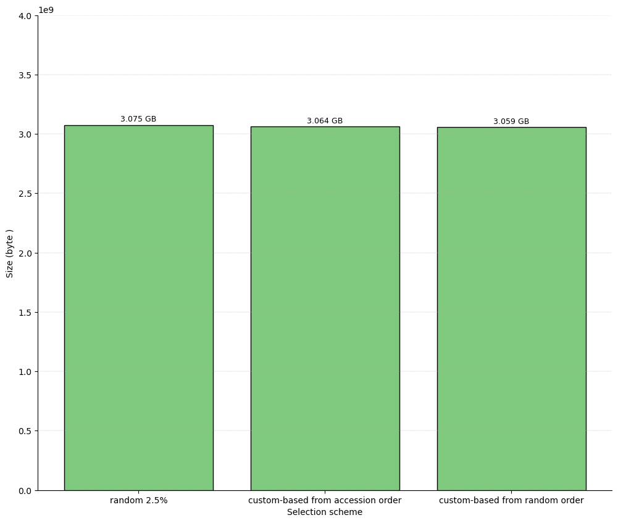
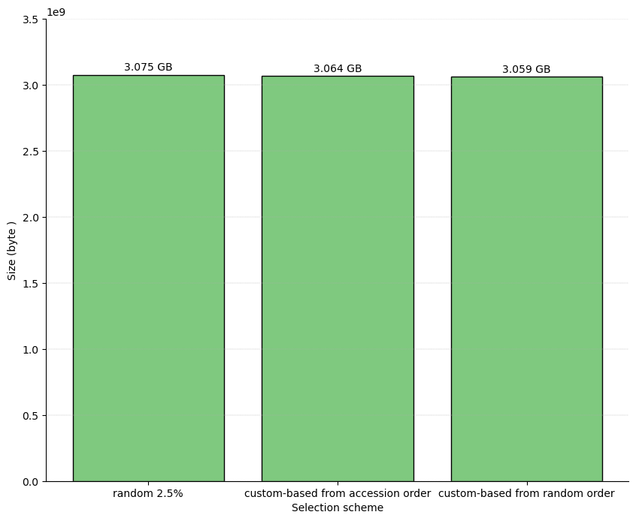
Question: What is the smallest possible genomes selection for reference tree that ensures a good compression size?
We have:
Random selection 2.5%
Kmers maxing based selection from accession
Kmers maxing based selection from random (the same as (2) but initially using random order)
➔ Custom selections give slightly better compression results with a fewer number of reference genomes, but require an extra step of estimating kmers.
(2228)
(1135)
(1136)

Slide 25
Batching

Slide 26
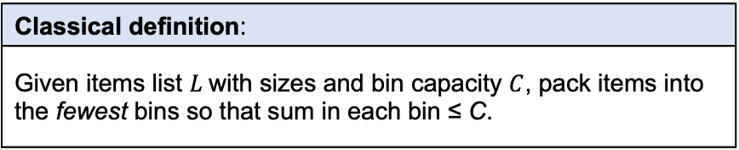



The easy case of batching: cardinality and uncompressed size
➔ Classic one-dimensional bin packing
Bin packing: quick recap
Items of sizes $L_{i}$, $i=1,…,n$
Classical definition:
Given items list $L$with sizes and bin capacity $C$, pack items into the fewest bins so that sum in each bin ≤ C.
Bin capacity $C$
Contexts & applications
NP-hard, decision version NP-complete. Research began early 1970s: Ullman (1971), Johnson (1973–74), Garey et al. (1972–76). Recent surveys: Coffman et al. (1997), Coffman et al. (2013) Applications: logistics, computer systems, scheduling, Virtual Machine resource allocation
Pack
Pack into minimum bins $B$.

Slide 27
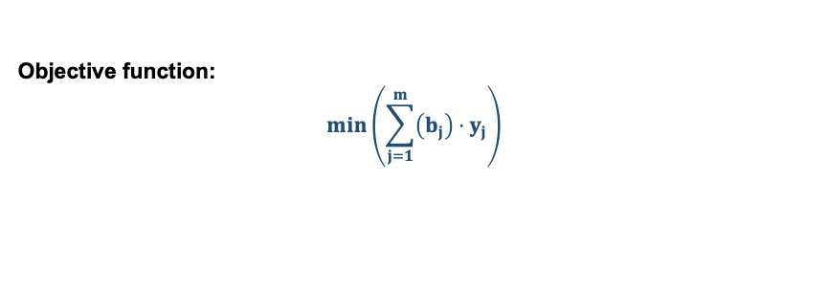
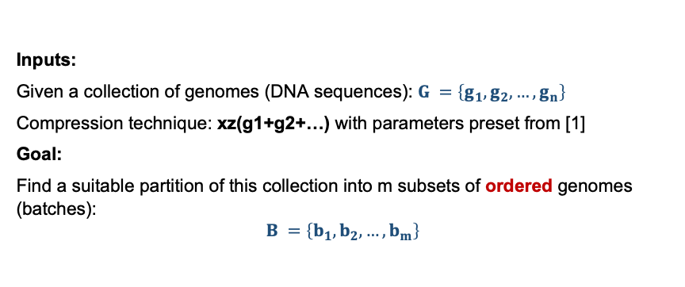
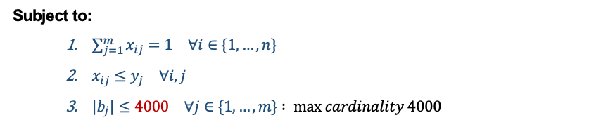
The easy case of batching: cardinality and uncompressed size
Inputs:
Given a collection of genomes (DNA sequences): $G =\left\{g_{1},g_{2},…,g_{n}\right\}$
Compression technique: xz(g1+g2+…) with parameters preset from [1]
Goal:
Find a suitable partition of this collection into m subsets of ordered genomes (batches):
$$B =\left\{b_{1},b_{2},…,b_{m}\right\}$$
Objective function:
$$\min\left(\sum_{j=1}^{m}{\left(b_{j}\right)}⋅y_{j}\right)$$
Subject to:
$\sum_{j=1}^{m}{x_{ij}}=1 ∀i∈\{1,…,n\}$
$x_{ij}≤y_{j} ∀i,j$
$|b_{j}|≤4000 ∀j∈\{1,…,m\}$ $: max cardinality 4000$
➔ Trivial: iterate through the ordered list of genomes and put separators

Slide 28
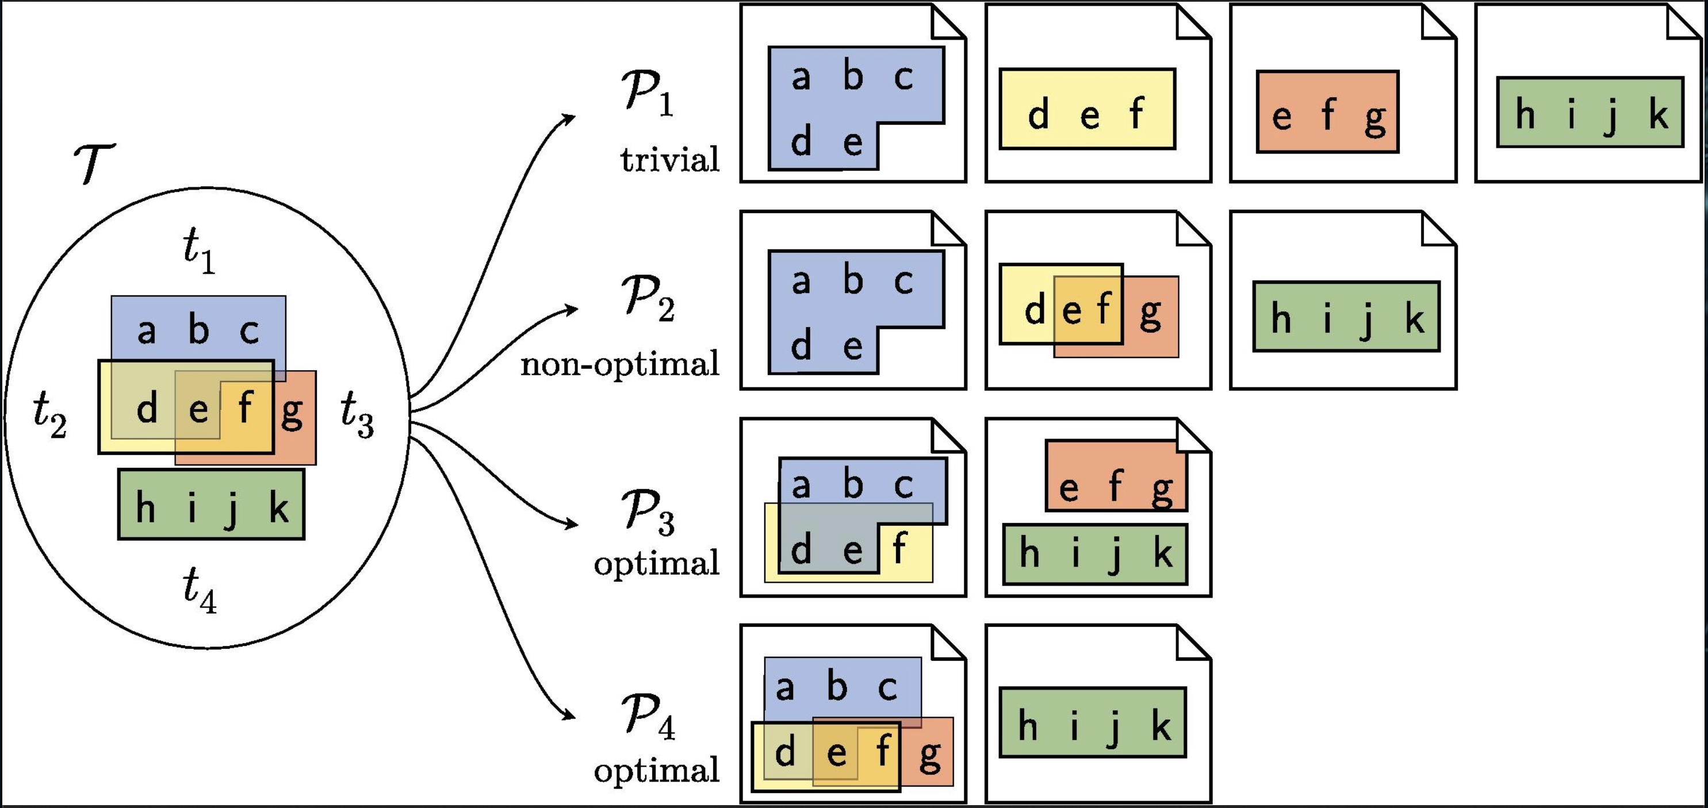
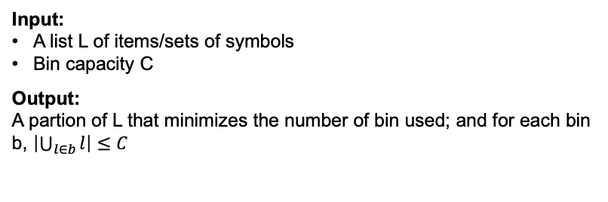
The complex case of batching: thresholding with kmers
Input: A list L of items/sets of symbols Bin capacity C
Output: A partion of L that minimizes the number of bin used; and for each bin b, $\left|\bigcup_{l∈b}{l}\right|≤C$
Classic bin packing ➔ Bin packing with overlapping items
An extension of the classical bin packing
First proposed in 2011 to used for Virtual Maching Packing
Formalized and some heuristics proposed in 2018
Genomes and their contents overlap (kmers)
Genome 1
ATC
TCG
CTG
TCA
Genome 2
TCA
TGA
CAG
AAA
AAT
Genome 3
AAT
ATC
CCT
AGG
Example (Grange et al., 2018): partitioning with items with overlapping contents
Items: {t1, t2, t3, t4}
Contents: {{a,b,c,d,e}, {d,e,f}, {e,f,g}, {h,i,j,k,}}

Slide 29
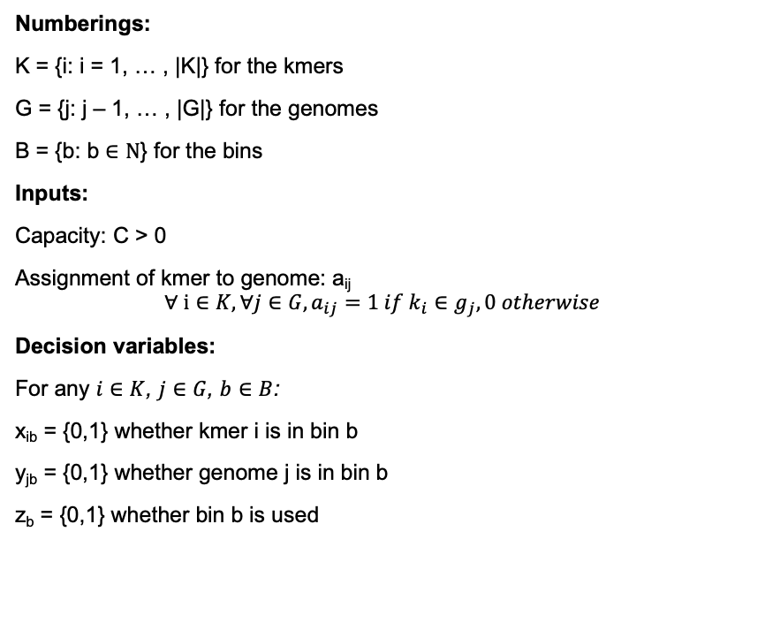
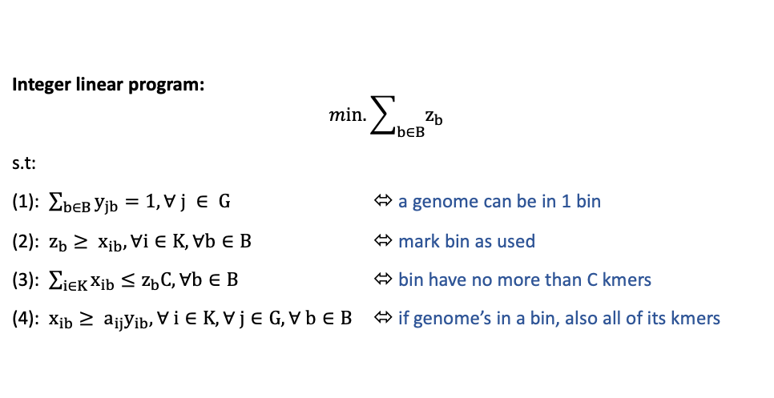
Interger linear model for genomes bin packing with overlapping contents (kmers)
Numberings:
K = {i: i = 1, … , |K|} for the kmers
G = {j: j – 1, … , |G|} for the genomes
B = {b: b $∈Ν$} for the bins
Inputs:
Capacity: C > 0
Assignment of kmer to genome: a_{ij}
$$∀ i∈K, ∀j∈G, a_{ij}=1 if k_{i}∈g_{j}, 0 otherwise$$
Decision variables:
For any $i∈K$, $j∈G$, $b∈B$:
x_{ib} = {0,1} whether kmer i is in bin b
y_{jb} = {0,1} whether genome j is in bin b
z_{b} = {0,1} whether bin b is used
Integer linear program:
$$min. \sum_{b∈B}{z_{b}}$$
s.t:
(1): $\sum_{b∈B}{y_{jb}}=1, ∀ j ∈ G$ ⬄ a genome can be in 1 bin
(2): $z_{b}≥ x_{ib}, ∀i∈K, ∀b∈B$ ⬄ mark bin as used
(3): $\sum_{i∈K}{x_{ib}≤z_{b}C, ∀b∈B}$ ⬄ bin have no more than C kmers
(4): $x_{ib}≥ a_{ij}y_{ib}, ∀ i∈K, ∀ j∈G, ∀ b∈B$ ⬄ if genome’s in a bin, also all of its kmers
Exact solution: Can be solved exactly using solver
NOT SCALABLE: Impractical in practice due to the scale of the data
➔ Heuristic solution needed

Slide 30
Counting kmers is computationally expensive
Intuition:
Instead of solving exactly, we need
Make sure that overlapping genomes stay close together ➔ phylogenetical order
A way to estimate kmers quickly ➔ approximative data structure (sketches)

Slide 31
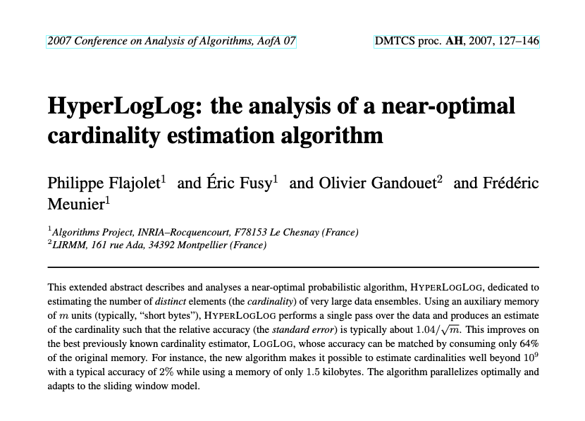
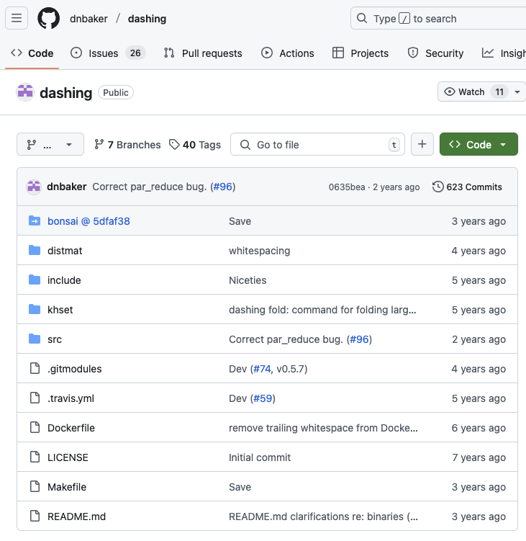
Fast distinct kmers counting using sketches
Sketches : approximate data structures
HyperLogLog is used for counting distinct problem
Fast and efficient UNION operation for sketches.

Slide 32
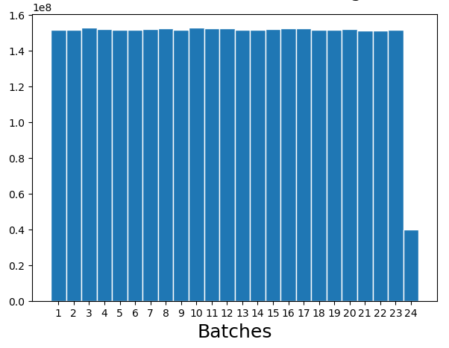
Example: M. tuberculosis from the 661k Collection
Trivial: Similar scheme to bin packing
Iterate through the ordered list of genomes
Estimate the cumulative kmers count
When the threshold is reached, put separator and reset the count
Distinct kmers count
Kmers per batch: 152,000,000

Slide 33
The even more complex case of batching: compressed size
Bin packing with overlapping items for genomes (we have a solution for this)
Compression sizes depends on the compressor used
XZ
MBGC
ACG
Unability to pre-estimate compression size:
xz compression speed ≈ 1 genome/sec
1h20m for a batch with n = 5000
Question: How to estimate compression sizes?

Slide 34
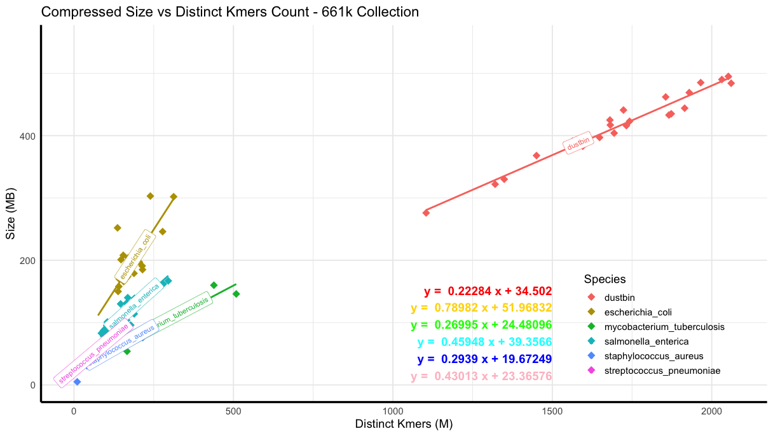
Linear correlation between compression size and distinct kmers count - xz compressor – top 6 species
r = 0.98
r = 0.775
r = 0.88
r = 0.97
r = 0.89
r = 0.96

Slide 35
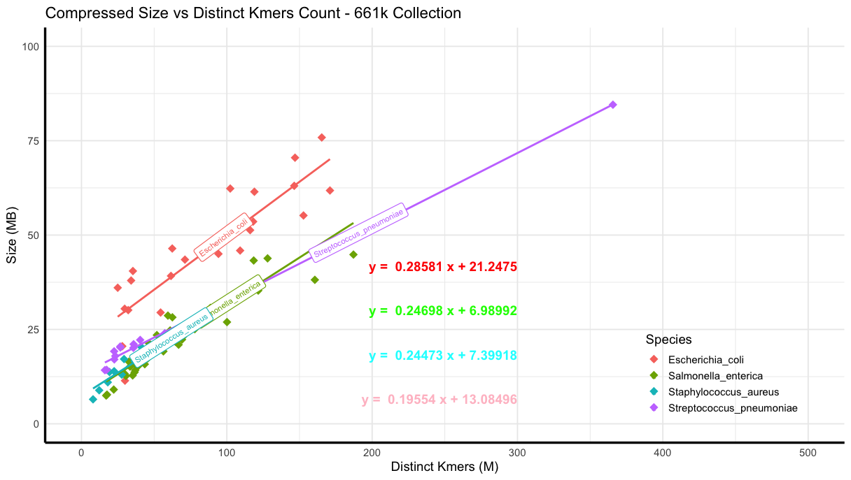
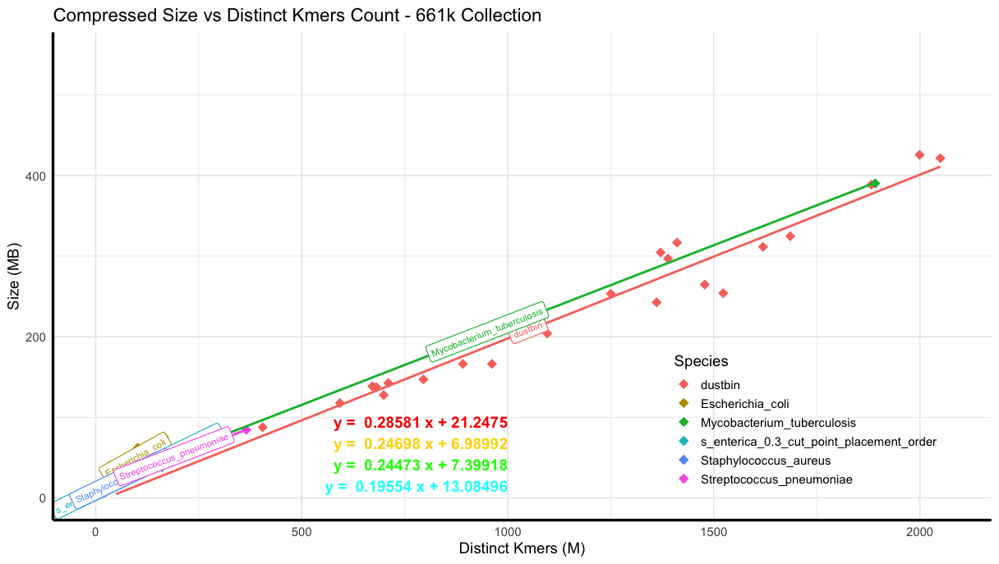
Linear correlation between compression size and distinct kmers count - MBGC compressor - top 6 species
r = 0.88
r = 0.99
r = 0.906
r = 0.972

Slide 36
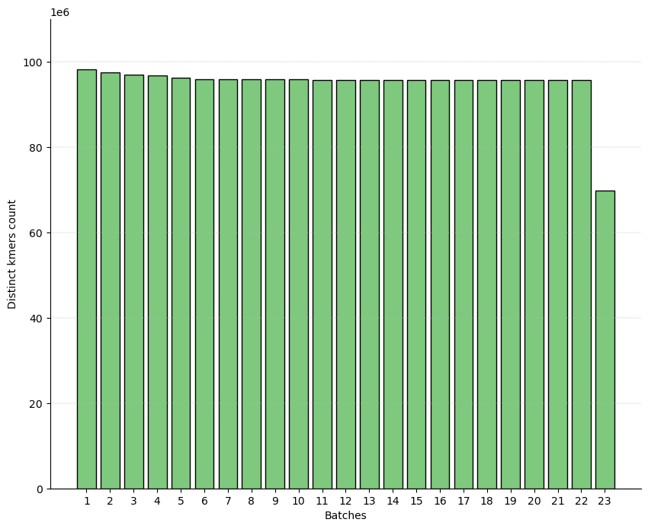
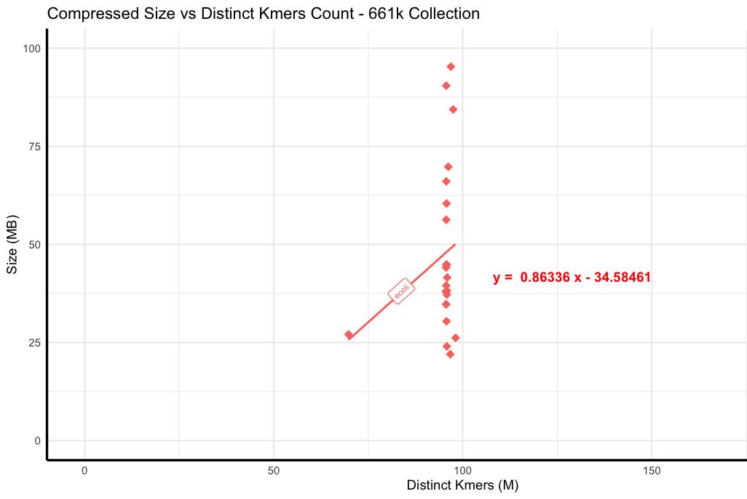
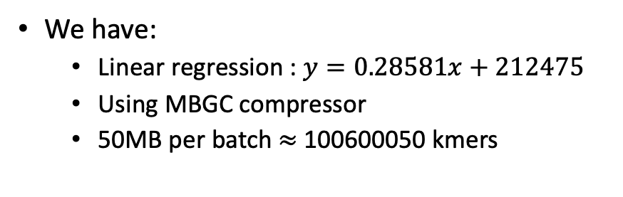
Benchmark: E.coli, MBGC compressor, 50MB per compressed batch
We have:
Linear regression : $y=0.28581x+212475$
Using MBGC compressor
50MB per batch $≈$100600050 kmers
Bad results:
With MBGC, linear regression with kmers doesn’t work
r = 0.23

Slide 37
Global Results

Slide 38
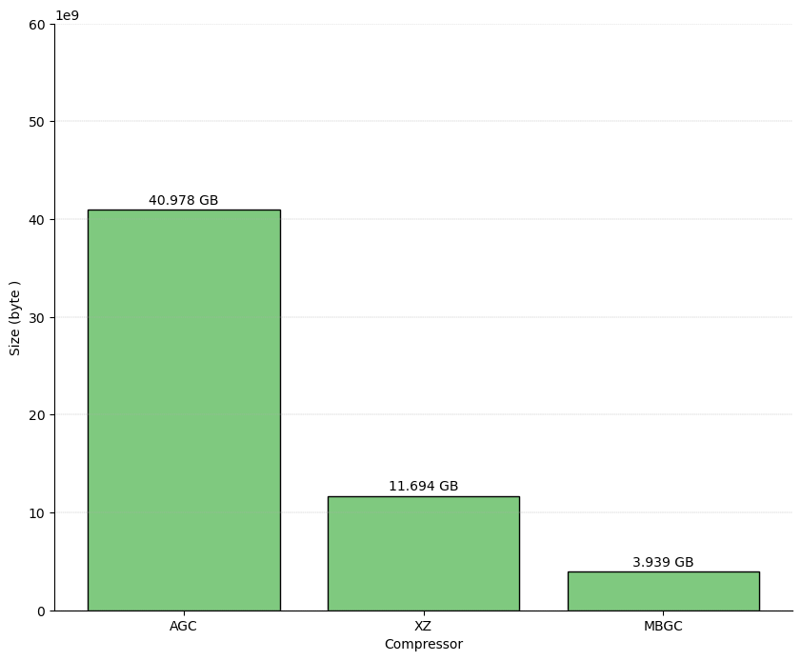
Compressors comparison: XZ for general usages, MBGC for the best results, AGC for accessing compressed genomes
Dataset: ATB E.coli
Recompression with skeleton-tree 5%
AGC is not suitable for bacterial data (outperformed by XZ)
In AGC’s paper, benchmark of 661k is unavailable.

Slide 39
Batching vs no batching – AGC 661k
28GB vs 27GB

Slide 40
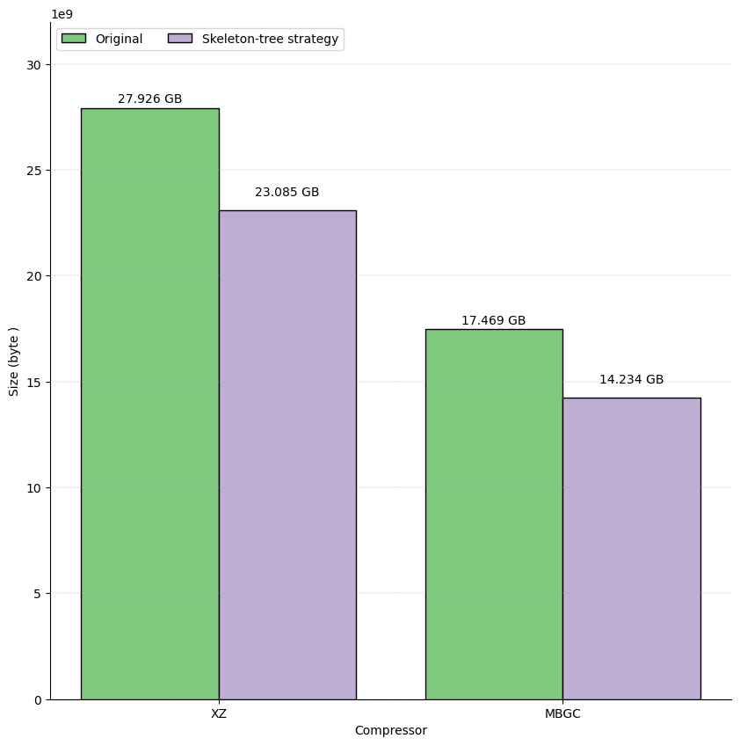
661k: Further reduction in compression size
For 661k S.enterica: Skeleton-tree 30% strategy
For other species clusters: phylogenetic tree inference on all genomes.

Slide 41
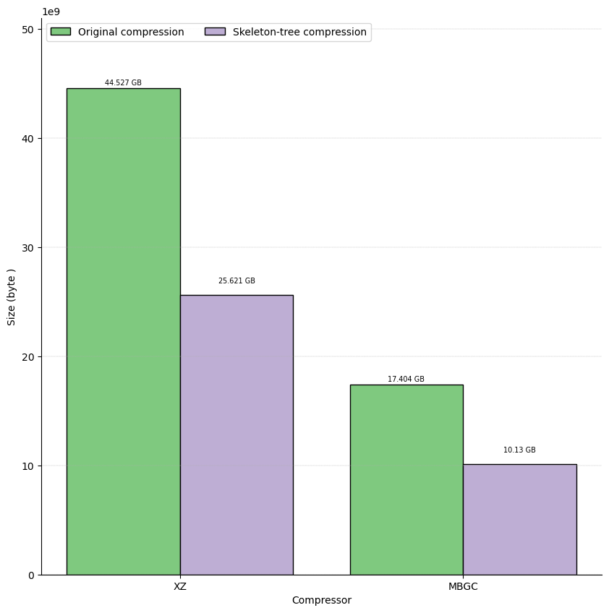
AllTheBacteria top 7 – recompression with 5% reference genomes
Recompression of ATB’s top 7 species by compression sizes
Skeleton-tree 5% strategy

Slide 42
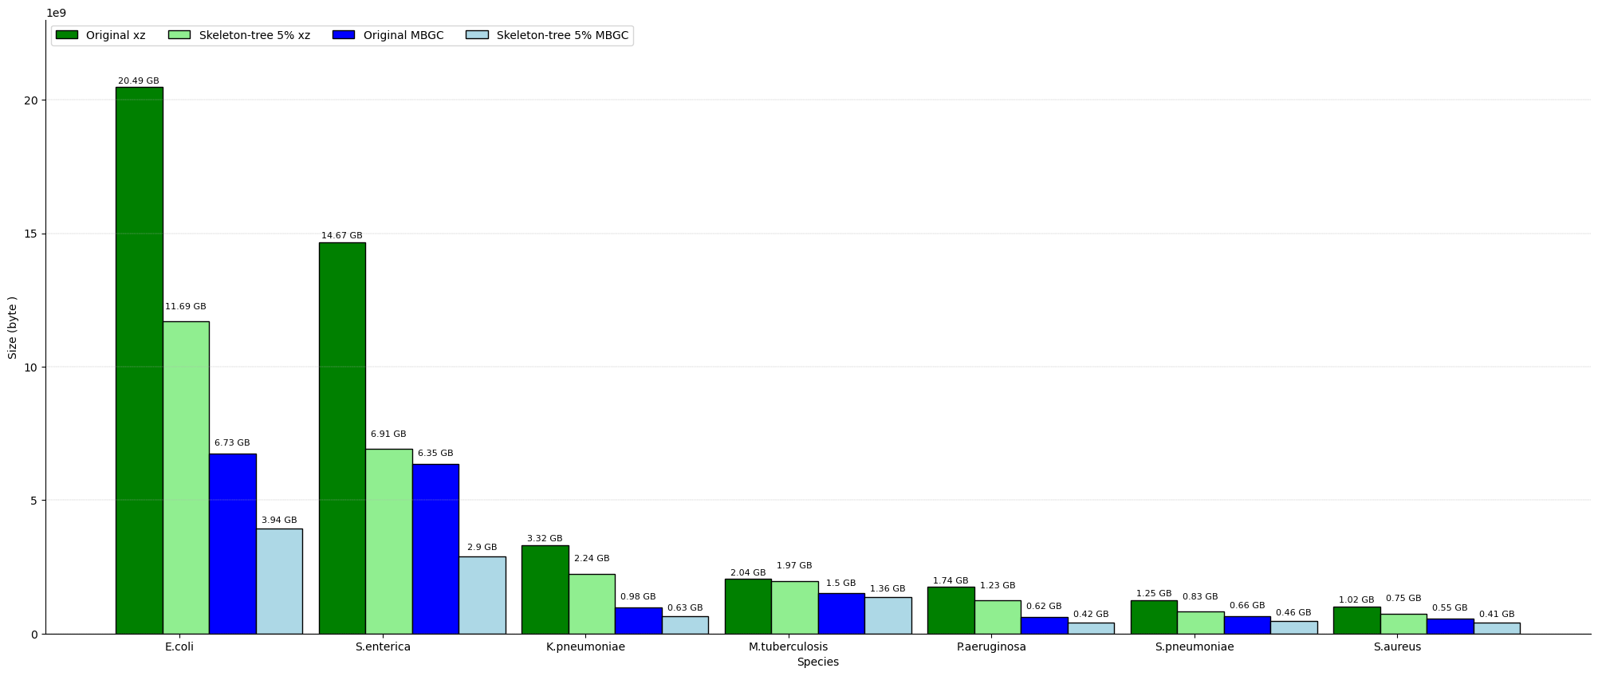
AllTheBacteria: Top 7 species by compression sizes
(399844)
(644699)
(72963)
(180094)
(43160)
(121034)
(121427)
Species

Slide 43
Implemetation, data availability and reproducibility
The current workflow is provided at:
https://github.com/tam-km-truong/PhyloPack
All current results and the batches used are available on the cluster at:
/projects/reall/tam/RESULTS

Slide 44
Conclusion and discussion
Ordering:
Improvement over the state of the art
2 splitting modes: fractional & fixed
2 selection schemes: random & kmers-based
Random gives good result and need more reference genomes
Kmers-based gives slightly better results, requires fewer reference genomes, but needs an extra step of counting kmers
Batching:
3 cases: classic bin packing (BP), BP with overlaping kmers, BP with overlapping contents and compression size estimation.
More work needed to efficiently estimate compression size using different compressor

