Slide 1
Optimized ordering and batching of microbial genomic data for compression
15/09/2025

Slide 2
Methods overview and recap

Slide 3
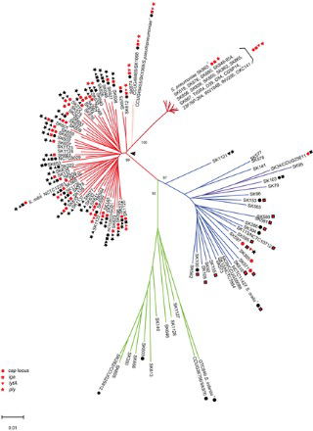
Phylogenetic compression methods overview (SOTA):
Two steps of reordering in Phylogetic Compression
Level 1 GLOBAL : Preordering via Species-based batching
Level 2 LOCAL: Within-batch tree-based ordering
(left to right according to a phylogeny)
Collection of genomes
Species clustering
Followed by compression using a low-level compressors:
General technique: XZ
Specialized techniques:
For microbial data: MBGC
With random access to compressed genome: AGC
Neural network: GeCo3

Slide 4








Proposed methods overview: Global preordering and batching (replace level 1 from MiniPhy)
INPUT
REM
(c)
REF
(a)
REM
Dist.
Cal.
Nearest
neighbor
REF
REM
$$≤4 genomes$$
$$≤4 genomes$$
$$≤4 genomes$$
REF
Phylo. Infr.
(d)
$$≤100k kmers$$
$$≤100k kmers$$
(b)
$$≤50MB$$
$$≤50MB$$
$$≤50MB$$
(a): Splitting the input genomes into 2 sets: reference genomes (REF) and remaining genomes (REM)
(b): Phylogenetics tree inference of REF.
(c): Placing the remaining genomes according to the leaf-order of the REF tree and the resulting order
(d): Cut the order into batches satisfying a given threshold, here 3 examples are shown: cardinality, number of kmers, compressed size,…

Slide 5
Proposed methods overview: Global preordering and batching (replace level 1 from MiniPhy)
INPUT
REM
(c)
REF
(a)
REM
Dist.
Cal.
Nearest
neighbor
REF
REM
$$≤4 genomes$$
$$≤4 genomes$$
$$≤4 genomes$$
REF
Phylo. Infr.
(d)
$$≤100k kmers$$
$$≤100k kmers$$
(b)
$$≤50MB$$
$$≤50MB$$
$$≤50MB$$
(a): Splitting the input genomes into 2 sets: reference genomes (REF) and remaining genomes (REM)
(b): Phylogenetics tree inference of REF.
(c): Placing the remaining genomes according to the leaf-order of the REF tree and the resulting order
(d): Cut the order into batches satisfying a given threshold, here 3 examples are shown: cardinality, number of kmers, compressed size,…

Slide 7
Global updated results
15/10/2025

Slide 8
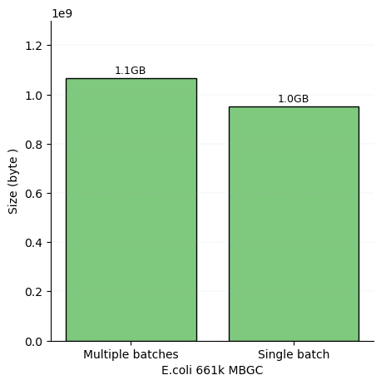
Baches vs no-batch (single batch): ~10% different in compression size
Experiment setup:
Dataset: E.coli 661k
Multiple batches: Split into 23 batches of 4000 genomes
Single batches: Compressed everything into 1 file
Compressor: MBGC
Parameters:
MBGC: max compression (-m 3)
Reordering scheme:
Phylogeneticcally reordered using all genomes (90k), solely for this experiment, not recommend in practice
Threads: 25

Slide 9
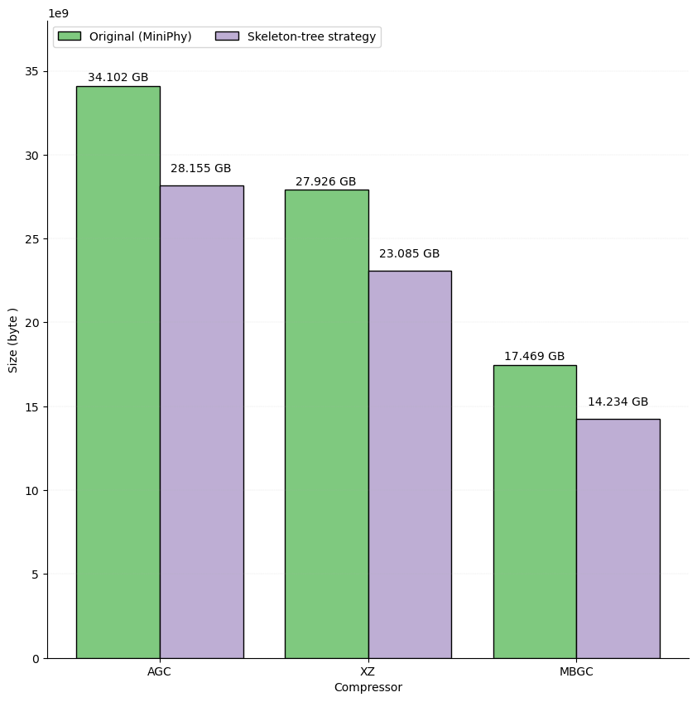
XZ, AGC, MBGC are all benefitted from Phylogenetic Compression
Specific paramaters for bacterial data help AGC to achieve comparable results with XZ
15-20% improvement in general
Parameters:
AGC: segment size = 1500, group size = 500, adaptive mode
MBGC: max compression (-m 3)
XZ: Default MiniPhy parameter
Threads: 25

Slide 10
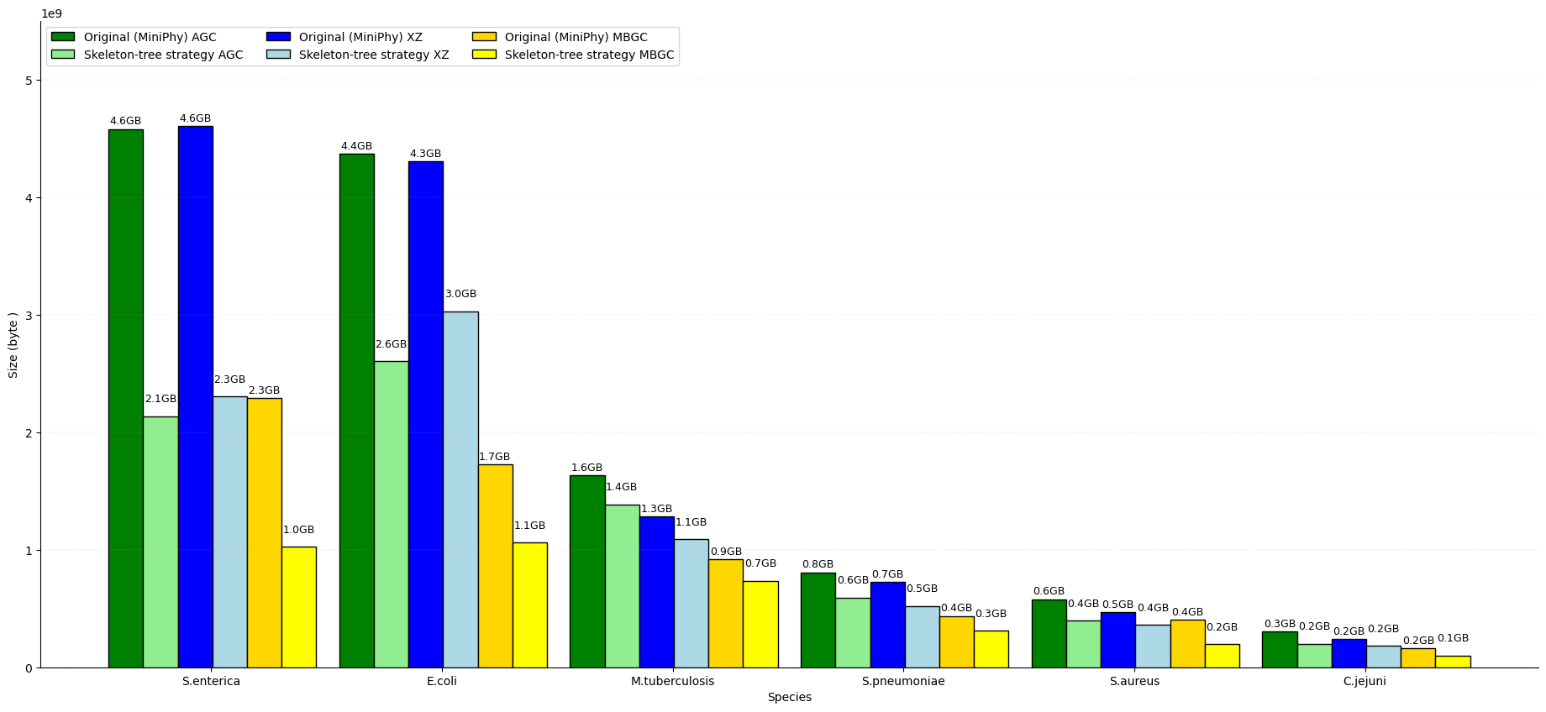
Top 6 species 661k compression size differences- MBGC, AGC, XZ
Parameters:
AGC: segment size = 1500, group size = 500, adaptive mode
MBGC: max compression (-m 3)
XZ: Default MiniPhy parameter
Threads: 25
Reordering scheme: Fully phylogenetic inference except for S.enterica

Slide 11
Discussions

Slide 12
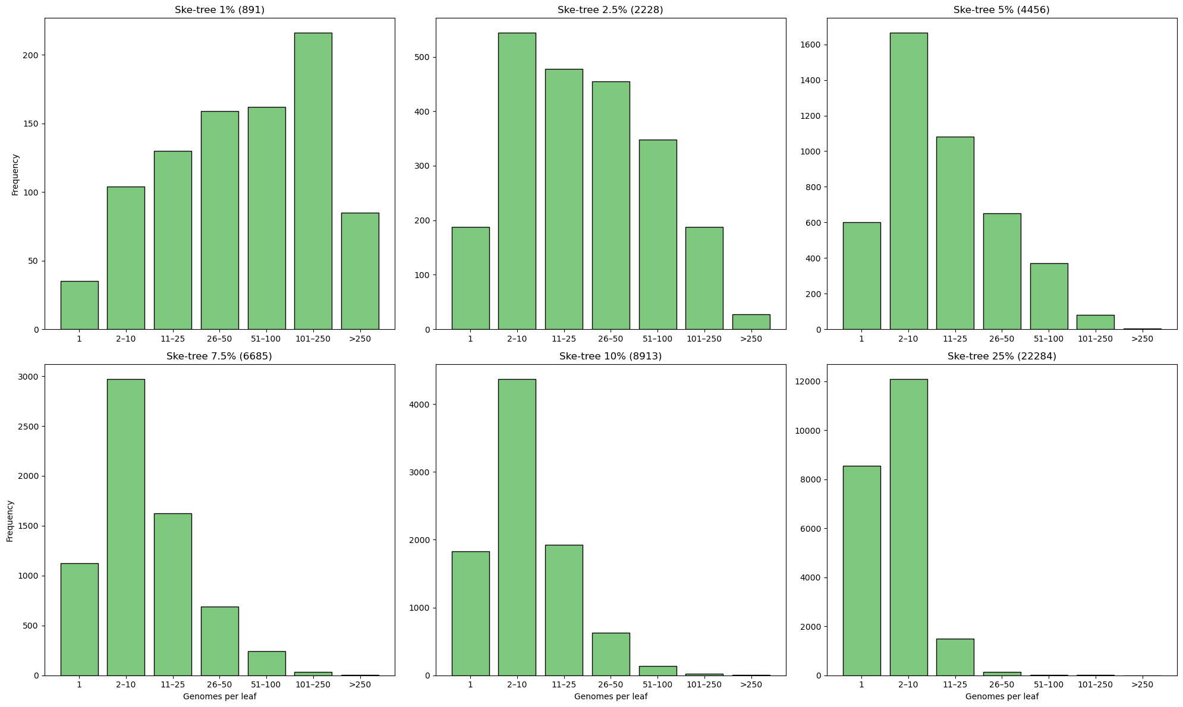
Distribution of remanining genomes in the skeleton tree are not uniform
The more genomes in the skeleton tree, the sparser the distribution of remaining genomes
The ratio of empty leaves:
1% ske-tree: 0.039
2.5% ske-tree : 0.084
5% ske-tree : 0.135
7.5% ske-tree : 0.168
10% ske-tree : 0.205
25% ske-tree : 0.384

Slide 13
Multilayers of similar parameters leads to confusion
Genome sketch size: 2 distance calculation steps
Reference genomes: 10000
Remaining genomes: 1000
2 kinds of sketch: Minhash and Hyperloglog
2 ordering steps:
Preordering i.e. skeleton tree scheme
Within batch preordering
Kmers: multiple steps require kmers
Phylogenetic inference: default k = 21
Hyperloglog: default k = 31
➔ Need to systematize the different parameters with better naming.
➔ Using the same value for different parameter (10000 for both sketch sizes) could reduce the number of parameter but can result in inflexibility

