Slide 1
Optimized ordering and batching of microbial genomic data for compression
24/09/2025

Slide 2
New results

Slide 3
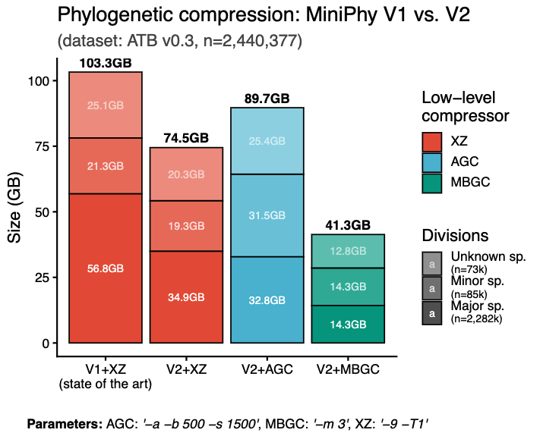
Recompression of ATB: 30% reduction in size with XZ
New vocabularies for clusters division:
Major species: regular batches
Minor species: dustbin
Unknown species: species without taxo metadata
Different compressors all benefit from phylogenetic compression:
XZ for general usage
AGC for rapid sample extraction
MBGC for best compression (2,3 millions genomes compressed down to just over 14GB)

Slide 4
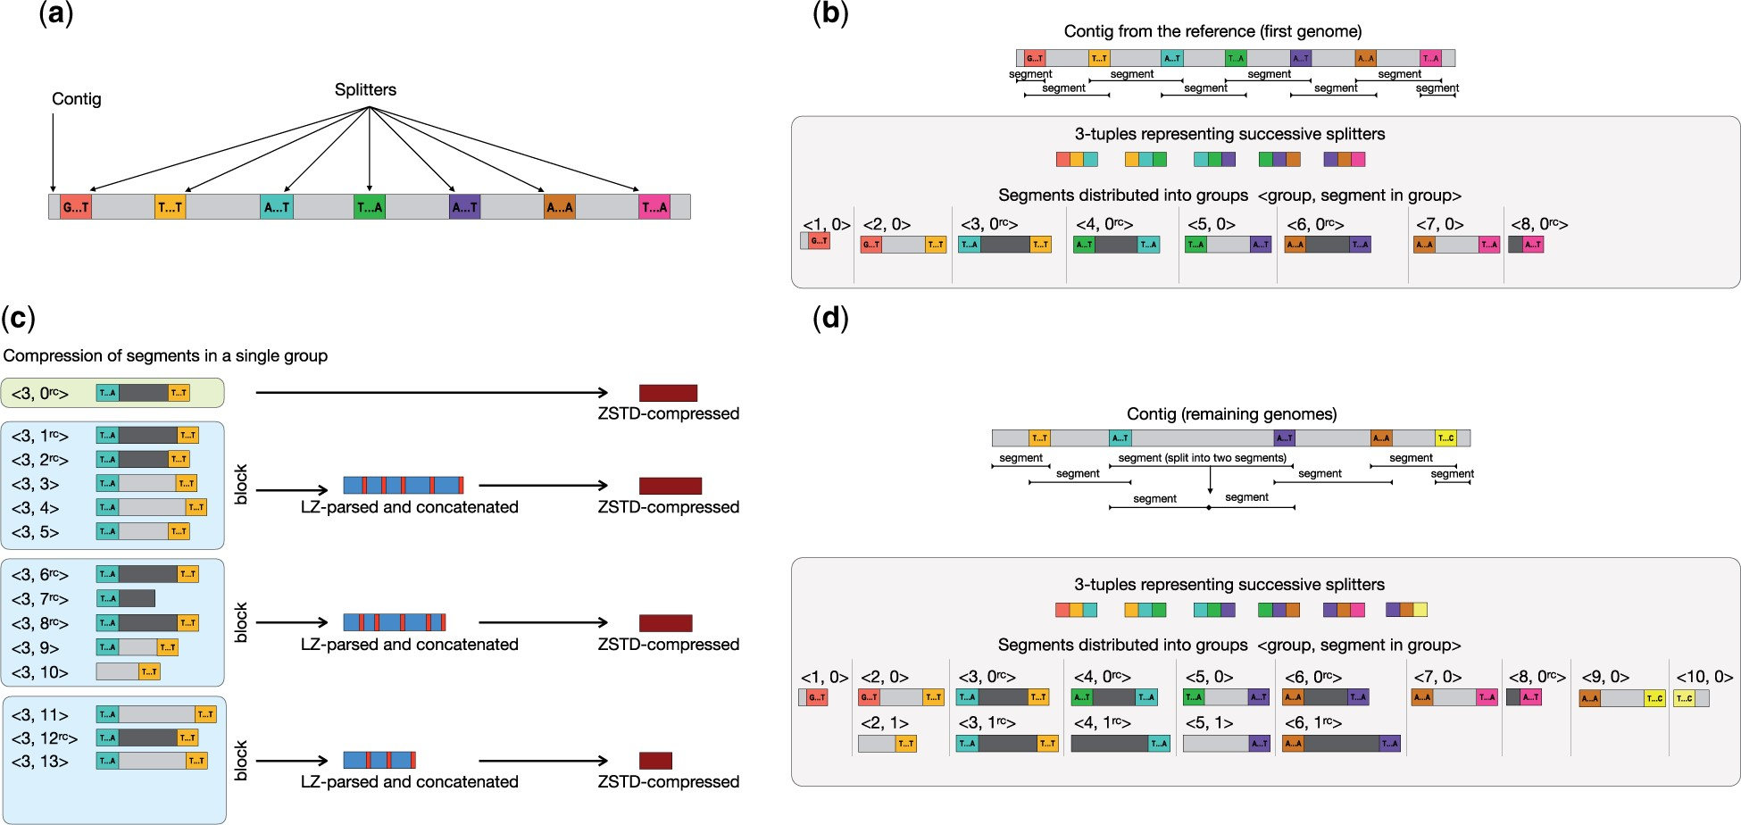
AGC minor species clusters: the choice of reference genomes
AGC requires that a reference genomes is picked.
(a): Pick single appearance kmers as splitter
(b): Split the reference genomes into segment (parameter -s)
(c): Split the remaining genomes into segments and then grouping (parameter -b)
(d): Compression of each segment groups by first LZSS parsing agst the reference and zstd compressing

Slide 5
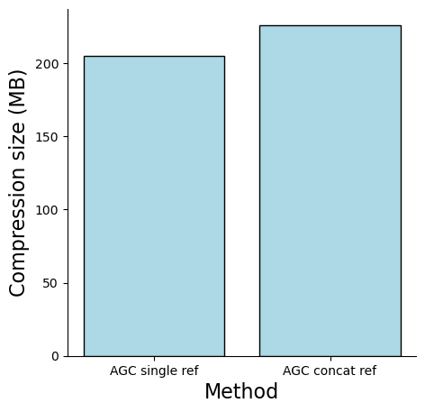
AGC minor species clusters: the choice of reference genomes
Our choice of reference genomes: the first genome of each batch.
Question:
This works with batch from the same species clusters (evidently agc compress better than xz for major spc batches).
But is it a bad choice with batches containing genomes from multiple species (minor batches)?
Testing with 1 batch:
Dataset: batch atb.assembly.r0.2.batch.97 from original ATB batch
Batch metadata:
Number of species: 33
Number of genomes: 1000
Reference genome choices:
The first genome
Randomly select 1 genome from each species, then concatenate them
Parameter: AGC –a –b 500 –s 1500

Slide 6
Single sample extraction: AGC compressor is the most suitable
Setup:
Extract randomly 20 genomes from each batch with AGC, MBGC and XZ
Tools | Sample extraction (n = 17,440)
 | Average (s) | Total (s)
AGC | 0.29 | 5056
MBGC | 8.18 | 142738
XZ | - | (still running)

Slide 7
Prediction of compression size

Slide 8
Small experiment: compressibility measure z as a predictor of compression size
GOAL: Gain first intuition for the impact of cmp measure z on compression sizes using 3 compressors (xz, mbgc, agc)
Hypothesis: Since all 3 compressors in many aspects share the same compression principle of dictionary compression ➔ z could be a good predictor

Slide 9
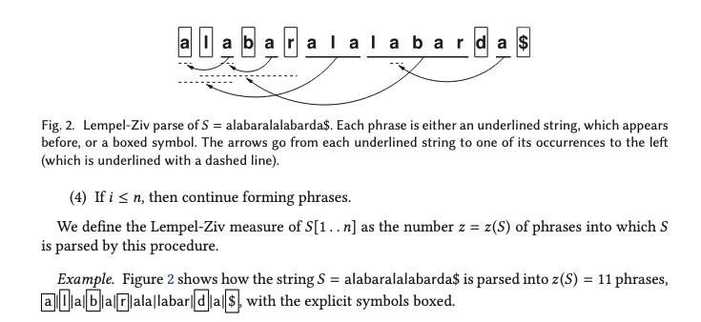
Lempel-Ziv compression: repetitive measure z

Slide 10
Conceptual explaination
Studying various characteristic of the batches (repetitive measures, distinct kmers count) and the outcome as a compression size with different compressors
Mult linear regression

Slide 11
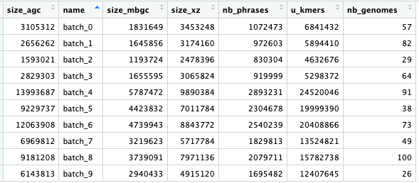
Setup:
Dataset: 10 small batches of E. coli, number of genomes ranging from 25-100 genomes.
Predictors: number of distinct kmers, number of genomes, number of phrase z (using PFP)
~

Slide 12
Multi-linear regression results
Outcome | Significant Predictors | Direction | Notes
size_mbgc | u_kmers (+, p = 0.03) nb_genomes (+, p = 0.079, borderline) | Positive | nb_phrases not significant.
size_agc | nb_phrases (+, p = 0.017) nb_genomes (+, p = 0.040) | Positive | u_kmers not significant.
size_xz | nb_phrases (+, p = 0.016) nb_genomes (+, p = 0.0068) | Positive | u_kmers not significant.
Model fit (all compressor):
Currently overfitting with R² > 0.99, adjusted R² > 0.98.
Residual SE varies from ~100kb to ~400kb
Exploratory signals pointing to possible predictors (nb_genomes, nb_phrases)
Distinct kmers count not so good, to be further tested using delta measures.

