Slide 1
Quasi-phylogenetic ordering
with minimum mapping
28/04/2025

Slide 2
Motivation & Recap of Previous Experiments

Slide 3
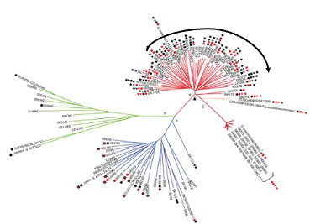
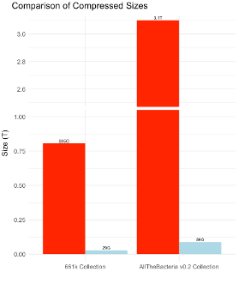
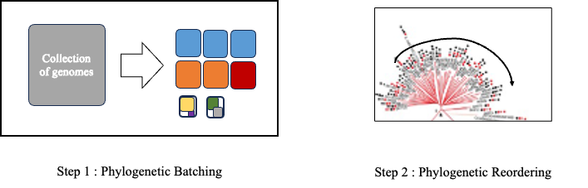
Phylogenetic compression improves compressibility via reordering according to the evolutionary history
Innovation for compressing steadily growing bacteria database
Key steps of phylogenetic compression

Slide 4
Phylogenetic compression improves compressibility via reordering according to the evolutionary history
Innovation for compressing steadily growing bacteria database
Current reordering strategy:
Sort by accession number
Split into batches
Reorder with phylogenetic tree on each batch
Key steps of phylogenetic compression
⇒ Is this ordering strategy the best? How good is it compared to other orders?

Slide 5
Orders: Random, Accession, Phylogenetic, Accession+Phylo, Random+Phylo
Random
Accession
Phylo
genome_1
genome_2
genome_3
genome_4
…
genome_20000
genome_113
genome_192
genome_4512
genome_6789
…
genome_19091
SAMN00001
SAMN00011
SAMN00013
SAMN00300
…
SAMN20000
genome_2
genome_1
genome_4
genome_3
…
genome_20000
Cut each of the 3 sets into N disjunctive and different size subsets.
random_subset_1
accession_subset_1
phylo_subset_1
random_subset_2
accession_subset_2
phylo_subset_2
…
…
…
Random+Phylo
Accession+Phylo

Slide 6
Orders: Random, Accession, Phylogenetic, Accession+Phylo, Random+Phylo
Random
Accession
Phylo
Cutting how?
genome_1
genome_2
genome_3
genome_4
…
genome_20000
genome_113
genome_192
genome_4512
genome_6789
…
genome_19091
SAMN00001
SAMN00011
SAMN00013
SAMN00300
…
SAMN20000
genome_2
genome_1
genome_4
genome_3
…
genome_20000
Subset 1
Set of genomes
Subset 2
Subset 3
Cut each of the 3 sets into N disjunctive and different size subsets.
Subset 4
random_subset_1
accession_subset_1
phylo_subset_1
random_subset_2
accession_subset_2
phylo_subset_2
Subset 5
…
…
…
Random+Phylo
Accession+Phylo

Slide 7
Orders: Random, Accession, Phylogenetic, Accession+Phylo, Random+Phylo
Random
Accession
Phylo
Cutting how?
genome_1
genome_2
genome_3
genome_4
…
genome_20000
genome_113
genome_192
genome_4512
genome_6789
…
genome_19091
SAMN00001
SAMN00011
SAMN00013
SAMN00300
…
SAMN20000
genome_2
genome_1
genome_4
genome_3
…
genome_20000
Subset 1
Set of genomes
Subset 2
Subset 3
Cut each of the 3 sets into N disjunctive and different size subsets.
Subset 4
random_subset_1
accession_subset_1
phylo_subset_1
random_subset_2
accession_subset_2
phylo_subset_2
Subset 5
…
…
…
Reorder 1 more time on individual subset with phylo tree
random_phylo
subset_1
accession_phylo
subset_1
…
…
Random+Phylo
Accession+Phylo

Slide 8
Orders: Random, Accession, Phylogenetic, Accession+Phylo, Random+Phylo
Random
Accession
Phylo
Cutting how?
genome_1
genome_2
genome_3
genome_4
…
genome_20000
genome_113
genome_192
genome_4512
genome_6789
…
genome_19091
SAMN00001
SAMN00011
SAMN00013
SAMN00300
…
SAMN20000
genome_2
genome_1
genome_4
genome_3
…
genome_20000
Subset 1
Set of genomes
Subset 2
Subset 3
Cut each of the 3 sets into N disjunctive and different size subsets.
Subset 4
random_subset_1
accession_subset_1
phylo_subset_1
random_subset_2
accession_subset_2
phylo_subset_2
Subset 5
…
…
…
Reorder 1 more time with phylo tree
5 methods of ordering genome to evaluate
random_phylo
subset_1
accession_phylo
subset_1
…
…
Random+Phylo
Accession+Phylo

Slide 9
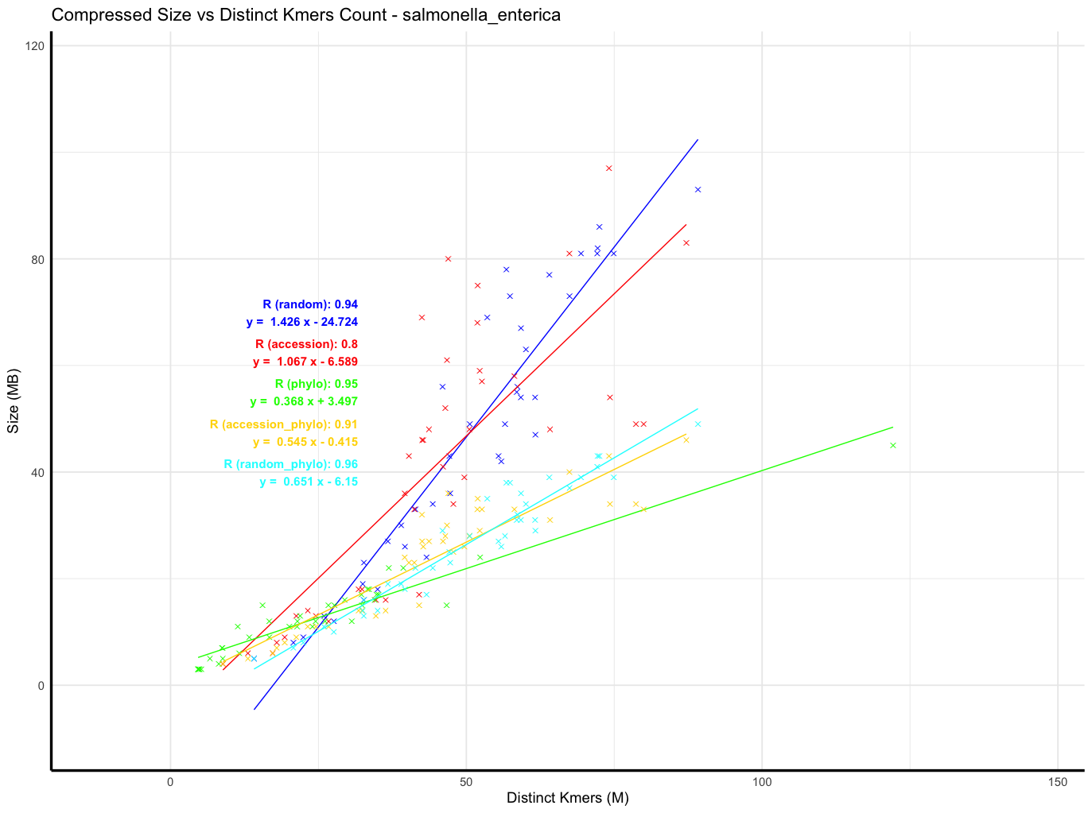
Evaluate Ordering Compressibility using Distinct Kmers Counts as an approximation of compression sizes
5 orders, 40 batches (subsets) per order.
Using a linear regression:
y = Ax + B
Smaller A → less space per distinct k-mer → higher compression efficiency

Slide 10
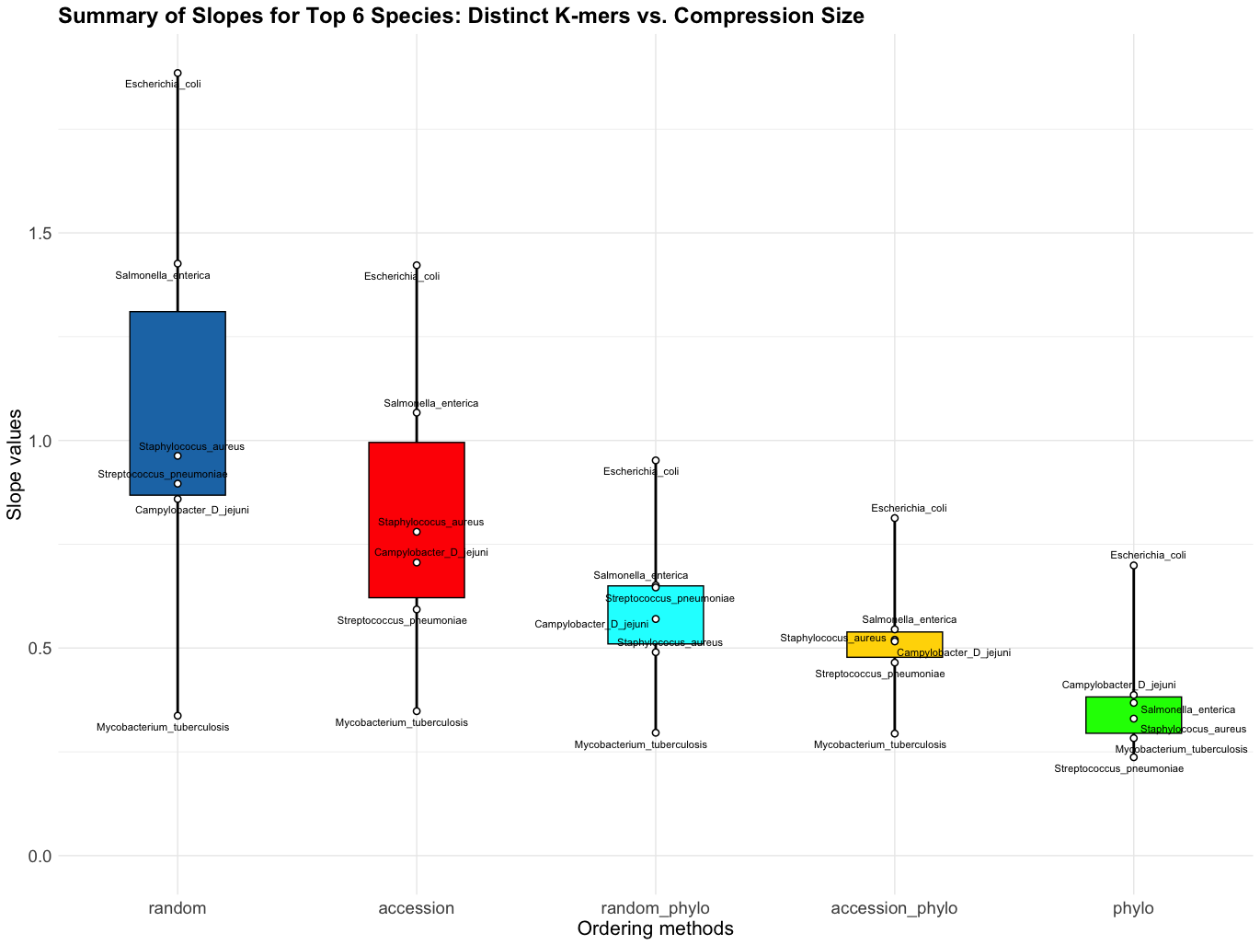
Phylogenetic Ordering Strategy Achieves The Best Compressibility
Experiment:
661k collection, select 6 species (gtdbtk classification) with over 20,000 genomes.
Sample randomly 20,000 genomes from each species.
Compress the genomes using the 5 ordering methods.
Accession + phylo is equivalent to the current strategy.

Slide 11
Challenge: neighbor joining tree scaling up is impractical O(n³)
Scaling up to 100k genomes (Salmonella enterica) using the following strategy:
Phylogenetic order with sketch size 10000 (default attotree)
Result:
Mash triangle: ~14h
Quicktree: ~4 days
⇒ Challenge: not scalable
⇒ Goal: a faster way of estimating phylogenetic order at scale (100k, 1 million)

Slide 12
Quasi-phylogenetic order

Slide 13
Quasi-phylogenetic ordering with minimum mapping
Idea:
10k reference genomes tree order
Infer subtree
Remaining genomes

Slide 14
Quasi-phylogenetic ordering with minimum mapping - Implementation
Input: A set of genomes
Split the set of genomes into 2 groups (randomly): reference genomes and query genomes
Build a reference tree from reference genomes.
Calculate the distance between each query genome to all the reference genomes in the tree
Map the query genome to the branch with the minimum distance (min-mapping)
Infer phylogenetic tree for each min-mapping sub-groups.
Output: Quasi-phylogenetic order of the entire set

Slide 15
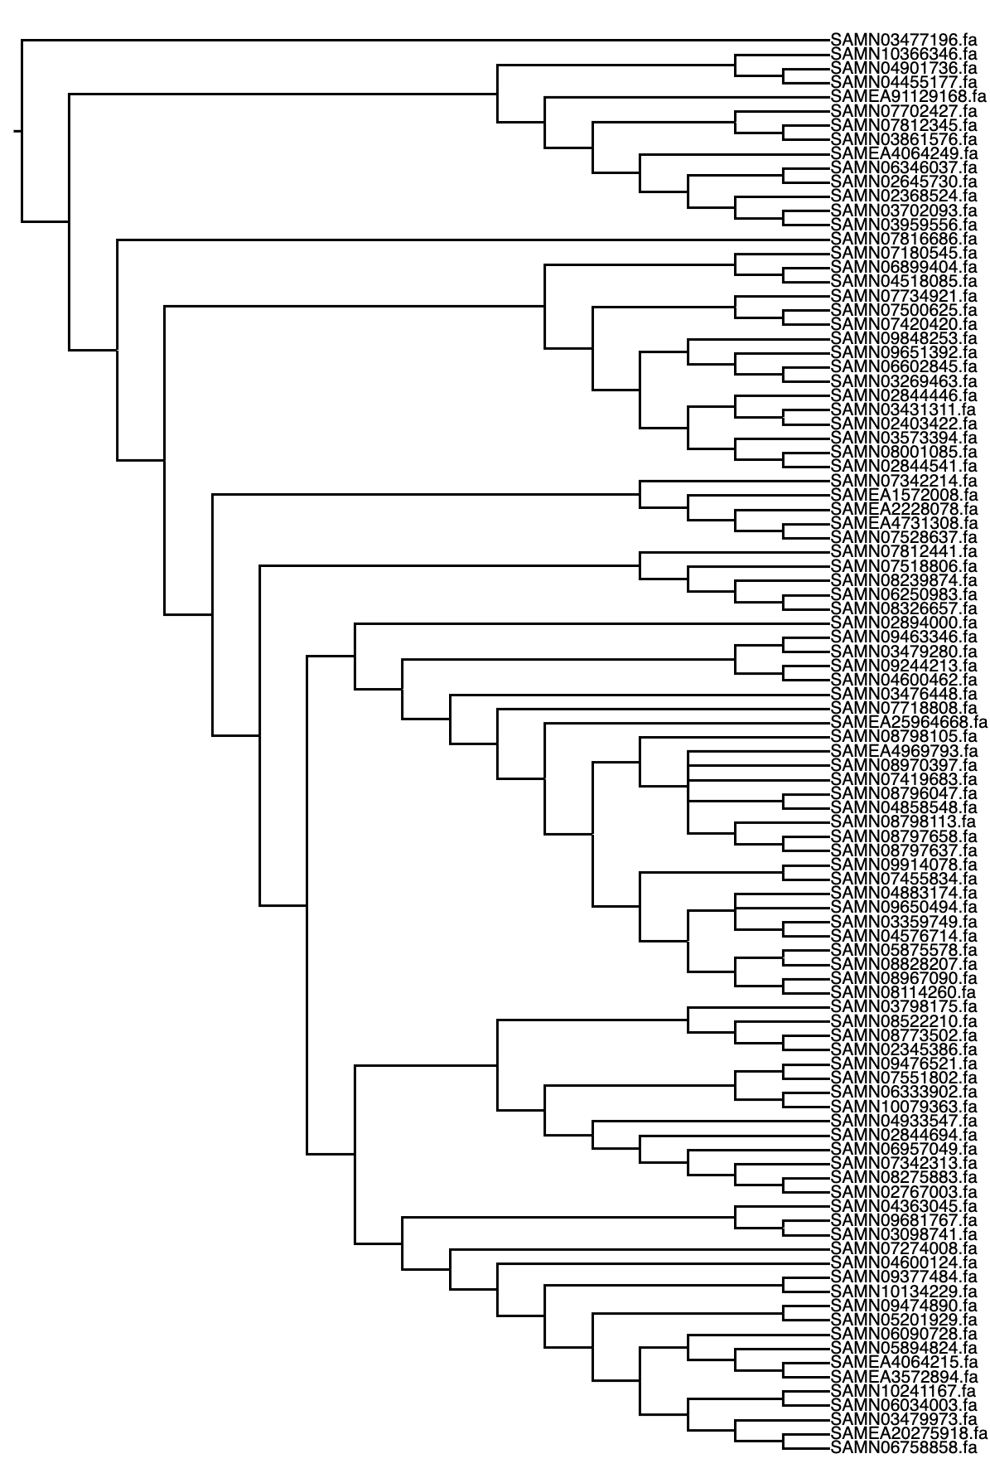
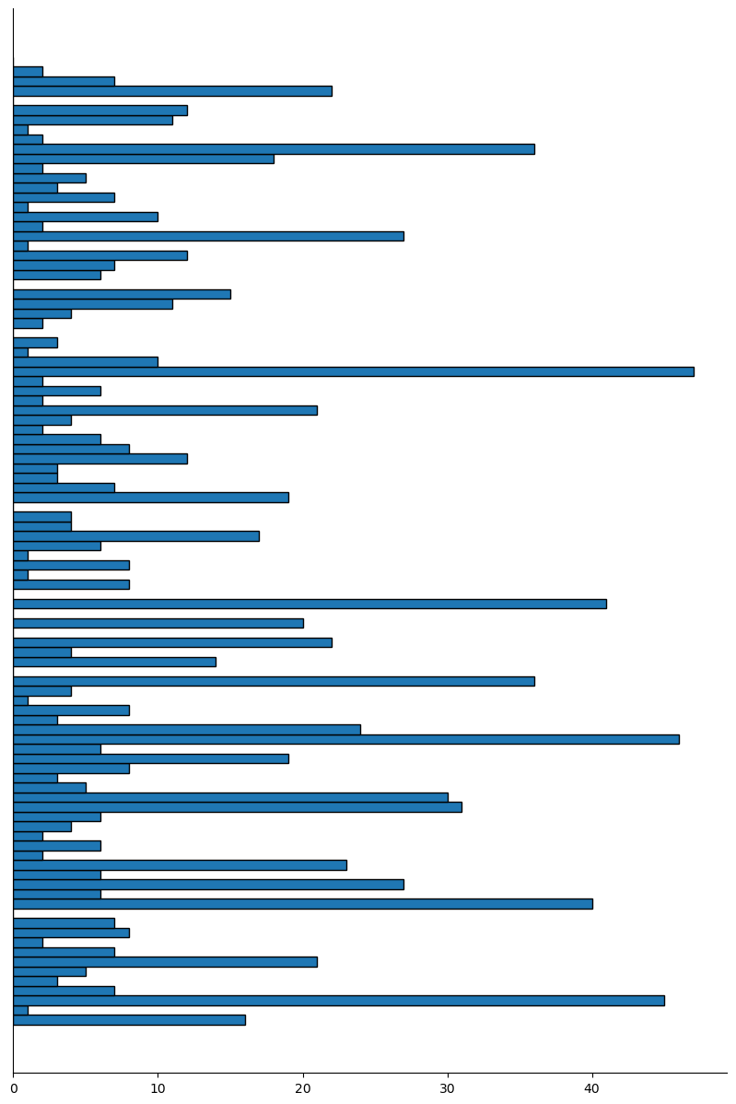
Quasi-phylogenetic ordering with minimum mapping - visualization
Step 1: build the reference tree
Step 2: min-mapping the query genomes
Step 3: infer tree for each min-map subgroup
Step 4: concat the subgroups ⇒ quasi-phylogenetic order
Number of genomes

Slide 16
Experiment: 89136 genome of Escherichia coli from the 661k collection
Set-up:
All the genomes of Escherichia coli using gtbdk classification from BakRep.
3 ordering strategy:
Batch size 4000, 23 batches
Original (accession + phylo), phylogenetic, quasi-phylogenetic (10k genomes references tree)

Slide 17
Experiment: 89136 genome of Escherichia coli from the 661k collection
Set-up:
All the genomes of Escherichia coli using gtbdk classification from BakRep.
3 ordering strategy:
Batch size 4000, 23 batches
Original (accession + phylo), phylogenetic, quasi-phylogenetic (10k genomes references tree)
Compression size:
Original strategy: 4.302 GB
Quasi-phylogenetic: 3.184 GB
Phylogenetic: 3.027 GB
Runtime (Ordering):
Original: Negligible
Quasi-phylogenetic (M4 10 cores):
Reference tree (10k genomes): ~4h
Computing distance (79k*10k): ~3h
Phylogenetics (M4 10 cores): > 3.5 days
Similar compression runtime.
⇒ IMPROVEMENT: Comparable compressibility with phylogenetic order while being significantly faster

Slide 18
Experiment: 89136 genome of Escherichia coli from the 661k collection
Set-up:
All the genomes of Escherichia coli using gtbdk classification from BakRep.
3 ordering strategy:
Batch size 4000, 23 batches
Original (accession + phylo), phylogenetic, quasi-phylogenetic (10k genomes references tree)
Compression size:
Original strategy: 4.302 GB
Quasi-phylogenetic: 3.184 GB
Phylogenetic: 3.027 GB
Runtime (Ordering):
Original: Negligible
Quasi-phylogenetic (M4 10 cores):
Reference tree (10k genomes): ~4h
Computing distance (79k*10k): ~3h
Phylogenetics (M4 10 cores): > 3.5 days
Similar compression runtime.
⇒ IMPROVEMENT: Comparable compressibility with phylogenetic order while being significantly faster
⇒ QUESTION: Are there other mapping strategies?

Slide 19
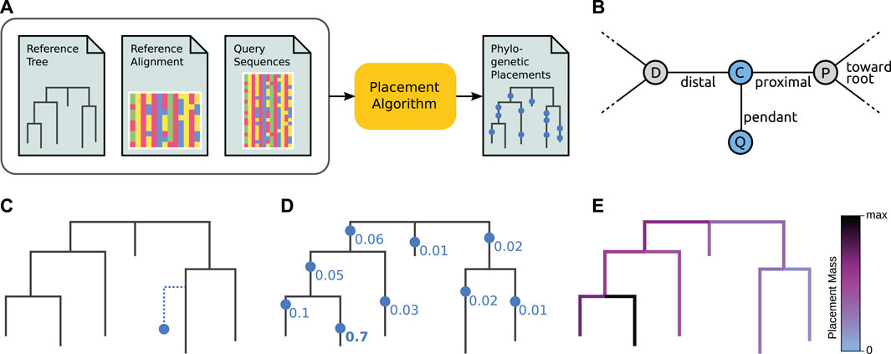
Adding New Genome to a Reference Tree: a Well Established Research Topic
Czech, L. & al. Frontiers in Bioinformatics, 2022
Overview of Phylogenetic Placement:
mapping a query to an existing tree onto its branch (Maximum likelihood based placement)

Slide 20
Adding New Genome to a Reference Tree: a Well Established Research Topic
Czech, L. & al. Frontiers in Bioinformatics, 2022
Overview of Phylogenetic Placement:
mapping a query to an existing tree onto its branch (Maximum likelihood based placement)
Questionable applicability: Mash distance vs ML based, Maximum likelihood tree are preferred in the literature, single vs multiple species...

Slide 21
Roadmap

Slide 22
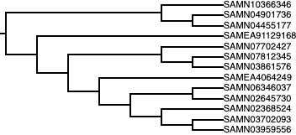
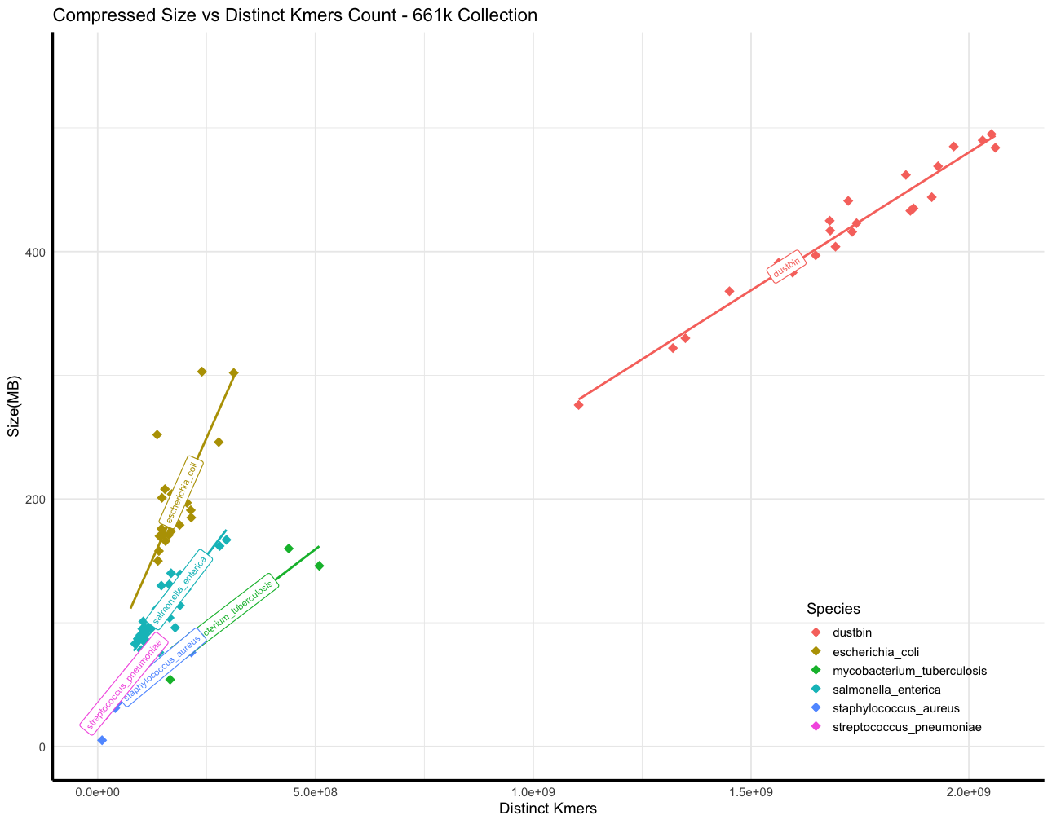

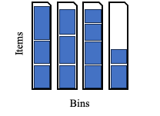
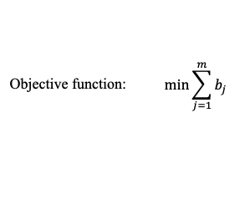
The New Batching Comprehensive Pipeline
References
y = ax + b
input
mapping
batching
Balanced, optimized
ref
Queries
query
distance matrix
bin packing

Slide 23
The New Batching Comprehensive Pipeline - Questions & Perspectives
Size of tree? (Delta (δ)?)
Linear regression for quasi-phylogenetic
Selection strategies?
References
y = ax + b
input
mapping
batching
Phylogenetic placement?
Balanced, optimized
ref
Queries
query
distance matrix
bin packing
Different sketch sizes?
Instead of mapping to a leave, mapping to a branch?
bin repacking: redistribute the subgroups into balanced batches
Directly using the subgroups as batches?
Can we optimize for number of batches here?

