Slide 1
Phylogenetics grouping as an optimization problem
Feb 10 2025

Slide 2
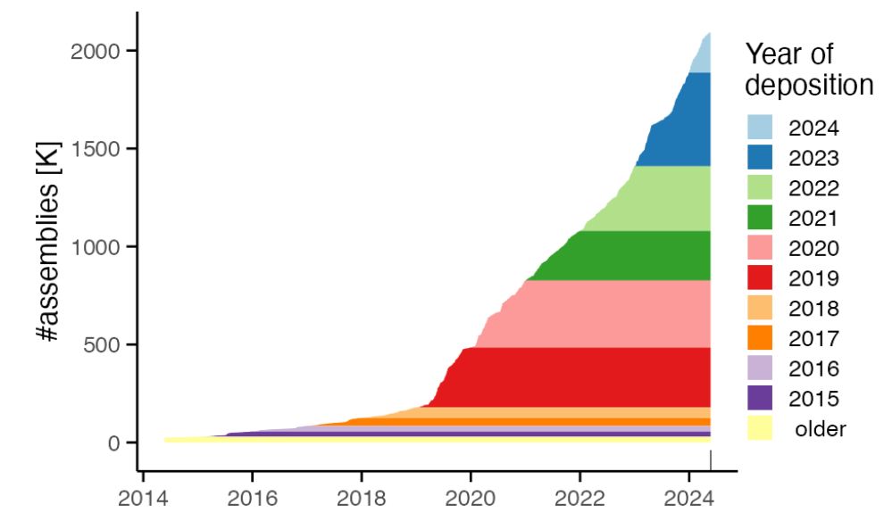
Motivation - Rapidly Growing Bacterial Genome Data
Fast growth of bacterial genomes data
Increasing Availability of Larger Bacterial Genome Collections
AllTheBacteria (Hunt et al., bioRxiv, 2024)
v0.2 release 2024-08 n = 2,440,377
v0.1 data release n = 1,932,812
661k (Blackwell et al., PLOS Biology, 2021) n = 661,405
BIGSIdata (Bradley et al.,Nature biotech, 2019) n = 469,654
FUTURE : collection of ten of millions bacteria genomes, higher diversity, metagenomes,...
[Brinda et al.,bioRxiv, 2024]

Slide 3
Motivation - Rapidly Growing Bacterial Genome Data
Fast growth of bacterial genomes data
Increasing Availability of Larger Bacterial Genome Collections
AllTheBacteria (Hunt et al., bioRxiv, 2024)
Release 2024-08 n = 2,440,377
v0.1 data release n = 1,932,812
661k (Blackwell et al., PLOS Biology, 2021) n = 661,405
BIGSIdata (Bradley et al.,Nature biotech, 2019) n = 469,654
FUTURE : collection of ten of millions bacteria genomes, higher diversity, metagenomes,...
[Brinda et al.,bioRxiv, 2024]

Slide 4
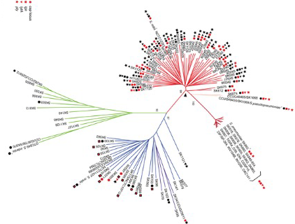
Phylogenetic compression: Utilizes evolutionary relationships to guide compression and search
Genomes that are closer to each other on the phylogenetic tree are more compressible
Individual genomes are not highly compressible.
Collections of related genomes are extremely compressible.
Loh, PR., Baym, M. & Berger, B. Compressive genomics. Nat Biotechnol 30, 627–630 (2012). https://doi.org/10.1038/nbt.2241
[Brinda et al.,bioRxiv, 2024]

Slide 5
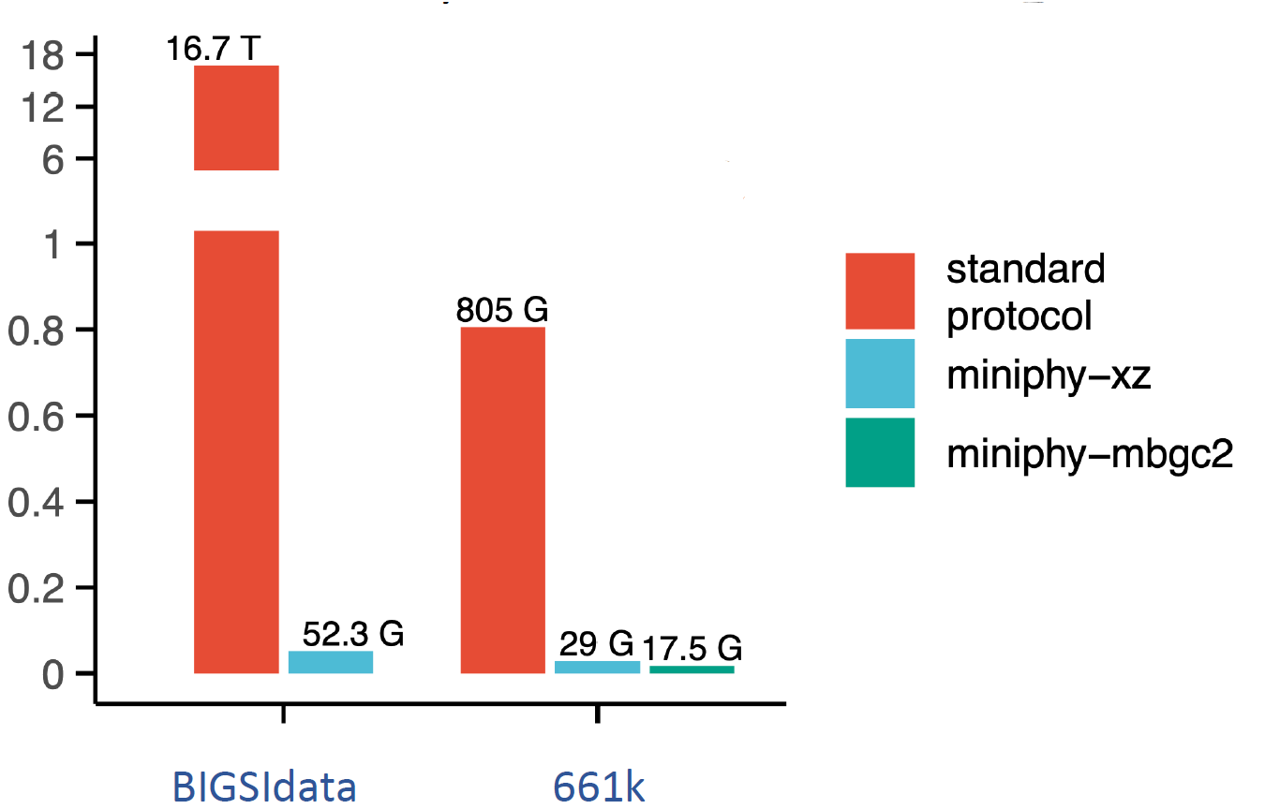
Lossless compression of 1-3 order of magnitude
Compression improvement
[Brinda et al.,bioRxiv, 2024]

Slide 6
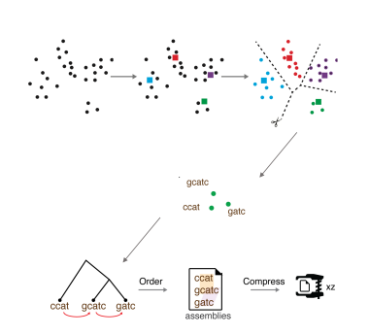
Phylogenetic compression involves evolutionary reordering the genomes in the collection
On real bacteria collections, phylogenetic compression involves:
Clustering them by species, then partitioning the genomes into batches
Building a phylogenetic tree, then compress each batch with a compressor
[Brinda et al.,bioRxiv, 2024]

Slide 7
Batching is advantageous for different use cases and tools
Batching the collection into manageable partition for:
Reliable Internet transmission ⇒ reasonable compressed size
Parallelizable processing of batches
Searchable ⇒ search within the compressed batch (using PhyLign)
https://github.com/karel-brinda/Phylign

Slide 8
661k clustering and batching as an example using Miniphy tools
S1 into smaller batches of n genomes
Split genomes into clusters of species
S2
S1
S1
INPUT: COLLECTION OF GENOMES
S3
Species 1
S2
S1
S1
S3
Sparsely sampled species
=> merged(dustbin)
Species form clusters in public repositories
Sampling bias: popular vs sparse
sequencing data uploaded per individual projects
Clustering by species
split popular species, merge sparse species
Sort genome within each cluster by sequencing time (accession number)
Notes:
Constrained genome size range. For bacteria, their genome size can be assumed to fit within a range of one order of magnitude, typically 1 Mbp to 10 Mbp (see the principles behind BIGSI ¹⁷).
Relatedness within bioprojects. In public repositories such as ENA, sequencing data are usually uploaded per individual projects, and ENA accession ranges often contain highly phylogenetically related genomes.
Species clusters. Individual microbial species form clusters in public repositories such as ENA ³⁵.
Sampling biases. Public repositories exhibit prevalent sampling biases, enabling a rough classification of bacterial species into two categories: highly sampled and sparsely sampled

Slide 9
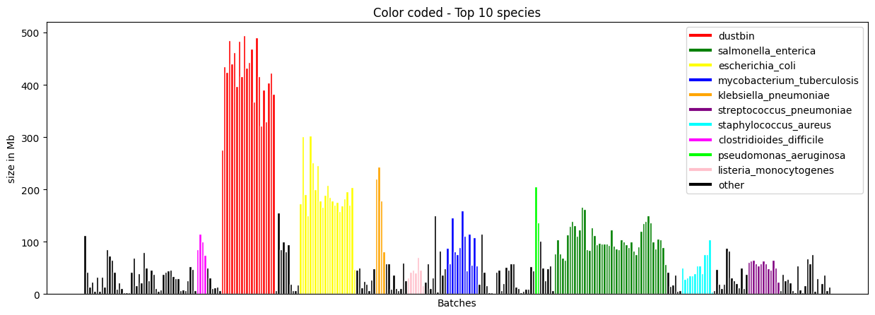
Result: Current 661k batching strategy results in imbalance
Compressed size for each batch, using xz compressor

Slide 10
Challenge: Current batching is imbalance, hindering downstream analysis
Large batches (dustbins) are difficult to transmit over unreliable networks.
Inefficiently make use of computational resources (e.g. for parallelization)
⇒ Optimization needed to minimize ressources requirement for different use cases.

Slide 11
Toward the first optimization model

Slide 12

Many optimization problems for different use cases
Given:
• Clusters of genomes
• Hardware platform
• Search algorithm
Objective function:
Variables:
Number of batches: n
Assignments of genomes to batches: a_{ij}
- binary variable for whether a genome j is in batch i
Challenge: resource(batch_{i}) cannot be easily evaluated, but can be estimated through bacteria’s biological properties (eg diversity of a given species)
Per-batch constraints:
• Bounds on compressed size
• Bounds on decompressed size
• Bounds on number of genomes
• Bounds on size of the used search indexes
Notes:
Ressource can be different thing

Slide 13

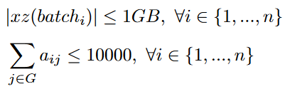
An optimization problem for internet transmission
Examples of scenarios:
• Internet transmission:
Objective function:
Minimize the total compression size of all batches
Capacity of a batches : the size of the batch after compression
Number of genomes in each batch less < 10000
Subject to:
THIS CAN BE FORMULATED AS A BIN PACKING OPTIMIZATION PROBLEM
Notes:
Ressource can be different thing

Slide 14
Bin packing Formal Statement
Instance:
Finite set I of items, a size s ( i ) ∈ Z + for each i ∈ I
A positive integer bin capacity C.
Question:
Is there a partition of I into disjoint sets B_1 , … , B_K such that the sum of the sizes of the items in each B_j is C or less?
Garey, M. R.; Johnson, D. S. (1979). Victor Klee (ed.). Computers and Intractability: A Guide to the Theory of NP-Completeness.

Slide 15
Bin packing for cluster of genomes : preliminary
Biological properties p:
P1
P2
P3
…
Pg
Set of items : set of genomes
Capacity of a batches : the size of the batch after compression
The capacity of each batch is generally the the sum of the properties of the genomes in that batch.
Genome 1
Genome 2
Genome 3
…
Genome g
Sorted
Threshold (size)
…
Partitioning
Batches

Slide 16




First simplified bin packing problem for batching
Let:
G={g1,g2,g3,…,gn} be the set of genomes.
B={b1,b2,b3,…,bm} be the set of batches, where bi⊆G. All genomes need to be assigned, one gen in one batch
The decision variables are:
and
The compression size of each batch must be less than or equal to A MB:
Challenge : What biological property can be use to determine compressed size ?
Minimize the number of batches:

Slide 17
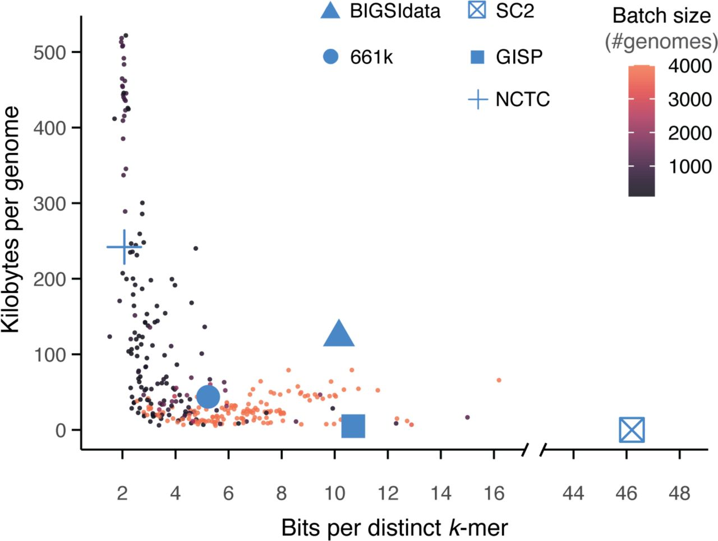
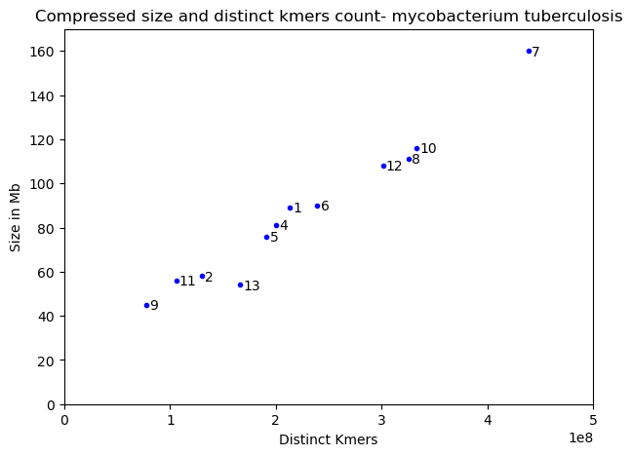
Observation: The compressed size of batches is related to its distinct kmers count
[Brinda et al.,bioRxiv, 2024]

Slide 18
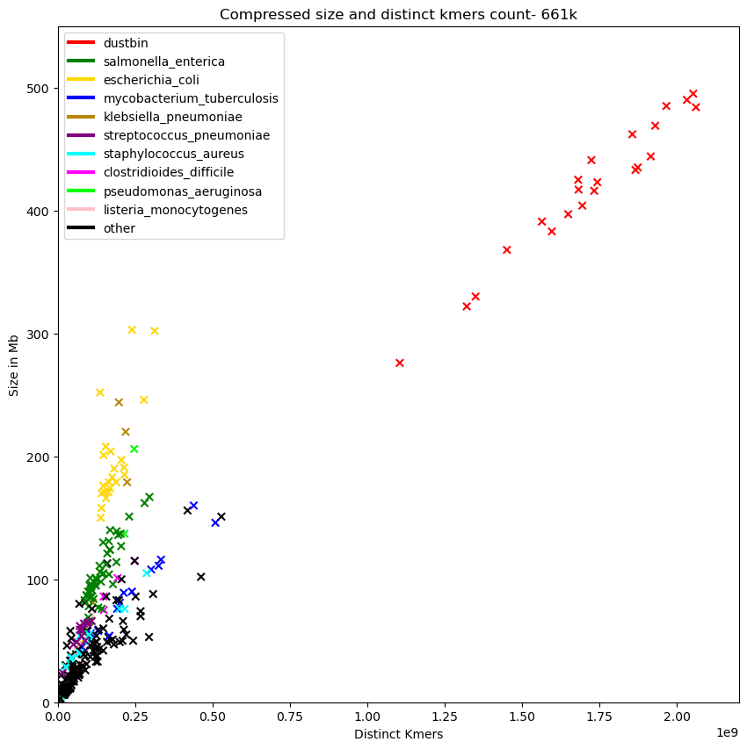
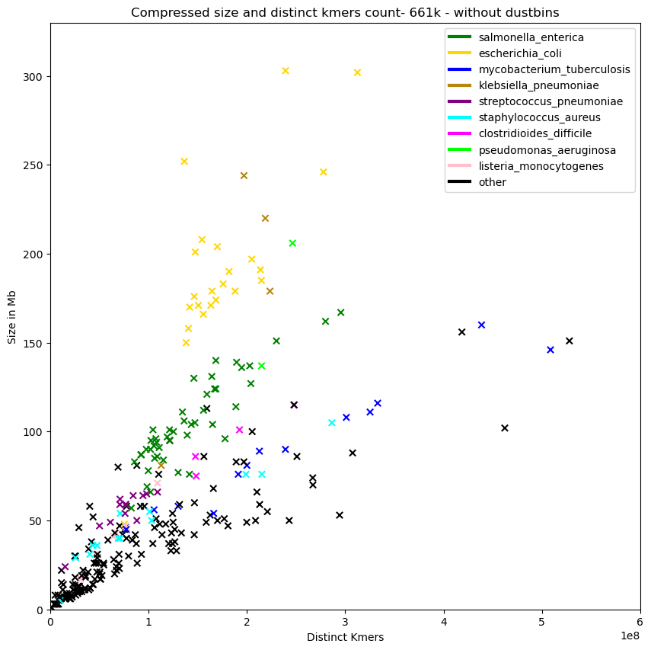
Observation: The compressed size of batches is related to its distinct kmers count

Slide 19
Observations:
Different species has different correlation coefficient.
HyperLogLog sketches for approximating distinct kmers
Distinct kmers can be overlapped between genomes:
⇒ So card(g1+g2) = card(g1) U card(g2)
⇒ Virtual Machine Bin Packing
Need to pre-compute the card(genomes) for all combinations for batching

Slide 20
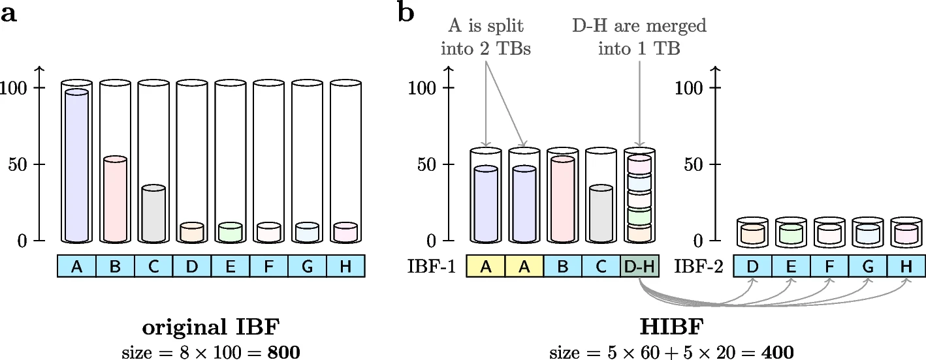
Greedy approach inspired by Mehringer, S., Seiler, E., Droop, F. et al.
Assumption:
Presorted the genomes by its number of distinct kmers
Compute the UNION size of a batch using Hyperloglog sketching (implemented in dashing)
(Mehringer et al., Genome Biology, 2023)
Mehringer, S., Seiler, E., Droop, F. et al. Hierarchical Interleaved Bloom Filter: enabling ultrafast, approximate sequence queries. Genome Biol 24, 131 (2023). https://doi.org/10.1186/s13059-023-02971-4

Slide 21
Experiment - Snakemake
1. Given a list of genomes from the same species.
2. Estimate the number of distinct k-mers for each genome using Dashing.
3. Sort the genomes in descending order based on their distinct k-mer counts.
4. Create an empty list of bins and mark them as available.
5. For each genome in the sorted list:
Try to add it to the first available bin.
i. Before adding, estimate the total distinct k-mers with the genome in the bin using Dashing.
ii. If the total remains within the allowed max size, add the genome to the bin.
iii. If adding the genome exceeds the max size, mark the bin as unavailable and use a new bin for this genome.
6. Once all genomes are assigned, compress each bin using Miniphy2.
7. Return the list of bins.

Slide 22
Bin packing variable and its equivalence in bactching problem
Set of items : set of genomes
Capacity of a bin : max number of distinct kmers per batches
⇒ the capacity of a bin could also be how compressible is the genomes in that batch

Slide 23
First simplified bin packing problem
Let:
G={g1,g2,g3,…,gn} be the set of genomes.
B={b1,b2,b3,…,bm} be the set of batches, where bi⊆G. All genomes need to be assigned, one gen in one batch
The decision variables are:
and
The compression size of each batch must be less than or equal to A MB:
Minimize the number of batches:

Slide 24

First simplified bin packing problem
Let:
G={g1,g2,g3,…,gn} be the set of genomes.
B={b1,b2,b3,…,bm} be the set of batches, where bi⊆G. All genomes need to be assigned, one gen in one batch
The decision variables are:
and
(1) The number of distinct k-mers in each batch must be similar:
(2) The compression size of each batch must be less than or equal to A MB:
Minimize the number of batches:

Slide 25
Distinct kmers as a predictor for compressed size
[Brinda et al.,bioRxiv, 2024]

Slide 26
Observation: The compressed size of batches is related to its distinct kmers count

Slide 27
HyperLogLog estimates for approximating distinct kmers
Distinct kmers can be overlapped between genomes:
So card(g1+g2) = card(g1) U card(g2)
Need to pre-compute the card(genomes) for all combinations.

Slide 28
Heuristic inspired by Mehringer, S., Seiler, E., Droop, F. et al.
Assumption:
Presorted the genomes by its number of distinct kmers
Compute the UNION size of a batch using Hyperloglog sketch (implemented in dashing)
(Mehringer et al., Genome Biology, 2023)

Slide 29
Perspectives -what I have been working on week 4 Jan
String attractors, delta measures for compression
Recompressing all the batches of 661k locally
Worked on a small improvement of MiniPhy2

Slide 30
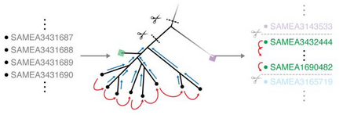
NExt step Reordering with compressive phylogeny
Process each batch individually due to the high computational cost of a full phylogenetic tree.
Difficult to build an exact phylogenetic tree
⇒ approximating with Mashtree algorithm
(Attotree reimplementation)
⇒ reordering from left to right
[Brinda et al.,bioRxiv, 2024]

Slide 31
Outline
Motivation and Phylogenetic Compression
Compression size optimization
Bin packing problem
Measuring compressibility DandD
HIBP - balancing distinct kmers bloom filter
Side project:
MiniPhy2 in Rust, New metadata for 661k from BakRep

Slide 32
Essential Properties for Batches - Different Use Cases
Compressed size
Upper-bounded : Ensures smooth internet transmission.
Lower-bounded: Prevents unbalanced batches, ensuring compatibility with workflow managers.
Decompressed size
Upper-bounded: Limits memory usage, enabling parallel processing.
Upper-bounded genomes per batch: Sets time limits for analysis.

Slide 33
Imbalances cause many issues
Compressed size imbalanced:
Large batches (dustbins) are difficult to transmit over unreliable networks.
Inefficiently make use of computational resources (e.g. for parallelization)
⇒ Need for optimization for balancing batches

Slide 34
MiniPhy - workflow of phylogenetic compression
Step 1 : Divide the genomes into roughly equal-sized batches, usually based on species.
Step 2 : Process each batch individually
an approximate phylogenetic tree is created
genomes are then reordered based on the tree
Step 3 : Compress with a low-level compressor
⇒ My focus: Step 1
MiniPhy : https://github.com/karel-brinda/miniphy

Slide 35
Our specific bin packing problem formulation for batch design in internet transmission.
Preliminary:
A set of genomes from the same species (a cluster of genomes)
Goal: Group them into batches
The number of distinct kmers in individual batches should be similar
The compressed size of each batch must be below a certain size

Slide 36
Key observations:
Constrained genome size range:
Bacterial genome size typically falls within 1 Mbp to 10 Mbp (one order of magnitude). BIGSI
Relatedness within bioprojects:
Sequencing data in ENA are uploaded per project.
ENA accession ranges often include phylogenetically related genomes.
Species clusters:
Microbial species form clusters in public repositories like ENA.
Sampling biases:
Public repositories show sampling biases.
Bacterial species can be classified into two categories:
Highly sampled.
Sparsely sampled.

Slide 37
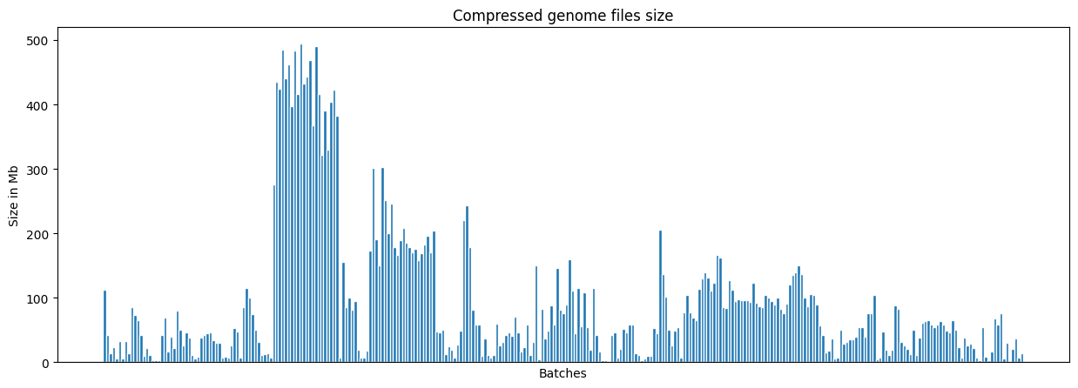
Limitation of current 661k batching: Current batches extremely unbalanced

Slide 38
How to count/estimate constraints?
Counting the distinct kmers for balancing batch
Kmers is shared between genomes ⇒ Virtual Machine packing problem [1] ⇒ higher complexity than bin packing
Counting kmers is costly
Determining the relationship (more explanation) between number of distinct kmers and compressed size for each species.

Slide 39
Hypothesis: Correlation between the number of distinct kmers and the compressed size at the single batch level.
Observation:
Dustbin: Genomes from different species exhibit lower compressibility.
Within the same species: The final batch contains fewer genomes.
Uncompressed genome file sizes remain similar.
Accession numbers do not fully account for the relatedness of bacterial genomes.
Correlation between number of distinct kmers of each bach and its compressed size
Not possible to infer everything using phylo tree

Slide 40
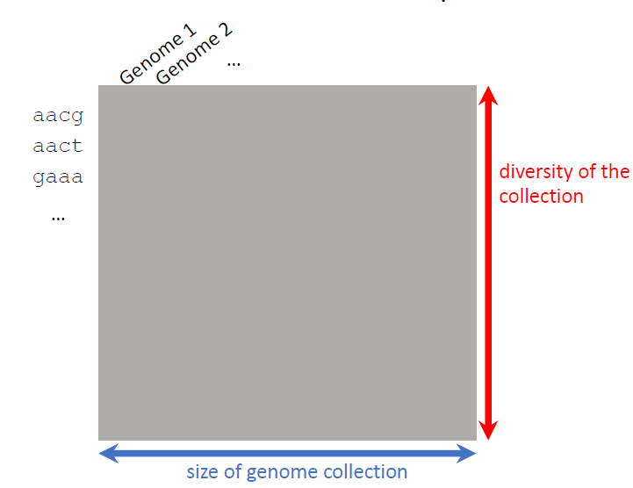
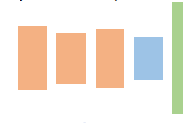

How batching is implemented in MiniPhy
Other genomes
Splitted into balanced batches
S. enterica
clustering
batching
Genomes are sorted according to their accession number.
Thresholding at 4000 genomes per batches (1000 genomes for dustbin)
Dustbin are batches of sparsely sampled species.

Slide 41
Goal
Developing computational methods for
Designing balanced batches
Different use cases – first for Internet transmission, later other use cases

Slide 42
batching for Internet transmission is an instance of a Bin packing problem
Explain the title

Slide 43
DandD: Efficient measurement of sequence growth and similarity
Bonnie, J. K., Ahmed, O. & Langmead, B. DandD: efficient measurement of sequence growth and similarity. iScience 109054 (2024).

Slide 44
Paper overview
Propose DandD and k-independent Jaccard measure
For: measuring how much new genetic information each additional genome sequence contributes to a growing collection
How: estimating delta measure using sketches

Slide 45
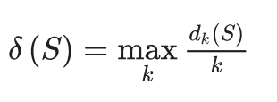
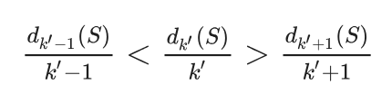
Delta Measure Estimation
Choosing the k that maximizes d_k(S)/k identifies this point of diminishing returns.
Estimating delta measure find 3 consecutive k

Slide 46
Estimation cardinality using dashing
Compares exact and approximate modes of DandD
Evaluates computational performance on different genome datasets
Demonstrates the efficiency and accuracy of the sketch-based approximation method
The maximum observed relative error was 1.32 x 10^-3

Slide 47
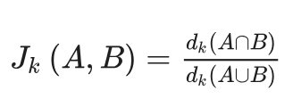
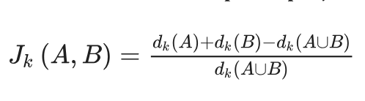
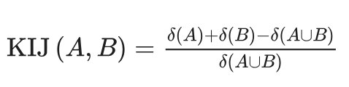
K-independent jaccard measure

Slide 48

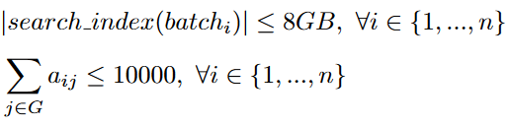
Formalizing batching as an optimization problem
Given:
• Clusters of genomes
• Hardware platform
• Search algorithm
Examples of scenarios:
• Internet transmission:
Objective function:
Objective function:
Subject to:
Variables:
Number of batches: n
Assignments of genomes to batches: a_{ij}
- binary variable for whether a genome j is in batch i
• Computation on many CPUs with shared memory
Objective function:
Per-batch constraints:
• Bounds on compressed size
• Bounds on decompressed size
• Bounds on number of genomes
• Bounds on size of the used search indexes
Subject to:
Challenge: resource(batch_{i}) cannot be easily evaluated, but can be estimated through bacteria’s biological properties (eg diversity of a given species)
Notes:
Ressource can be different thing

Slide 49
Tools and techniques studied/ to be further studied
Kmers counting:
KMC3, Jellyfish
Dashing - distinct kmers estimation using Hyperloglog algorithm
Minhash and Mash
Miniphy and Miniphy2:
Goal: Documentation for Miniphy 2

Slide 50
Balancing using distinct kmer counts is not straightforward
Objective:
Compute a 'weight' or ‘size’ for each genome within a species, i.e. the ratio of the genome's distinct kmers to the species' total distinct kmers.
My first intuition:
The weight w(g1​) of genome g1​ can be estimated: w(g1)=card(g1) / card(G)
⇒ WRONG.
⇒ Distinct kmers of genomes can overlap with each other.

Slide 51
Similar problem in Hierarchical Interleaved Bloom Filter: enabling ultrafast, approximate sequence queries

Slide 52
Paper overview - a new data structure
Propose a new data structure: Hierarchical Interleaved Bloom Filter (HIBF)
Improved on Interleaved Bloom Filter, faster and more space efficient
Mehringer, S., Seiler, E., Droop, F. et al. Hierarchical Interleaved Bloom Filter: enabling ultrafast, approximate sequence queries. Genome Biol 24, 131 (2023). https://doi.org/10.1186/s13059-023-02971-4

Slide 53
Interleaved Bloom Filter - Preliminary
Input data : a set/cluster of sequences from a species (or other semantic meaning)
Technical bin: BFs from IBF
Data structure based on combining Bloom Filters.

Slide 54
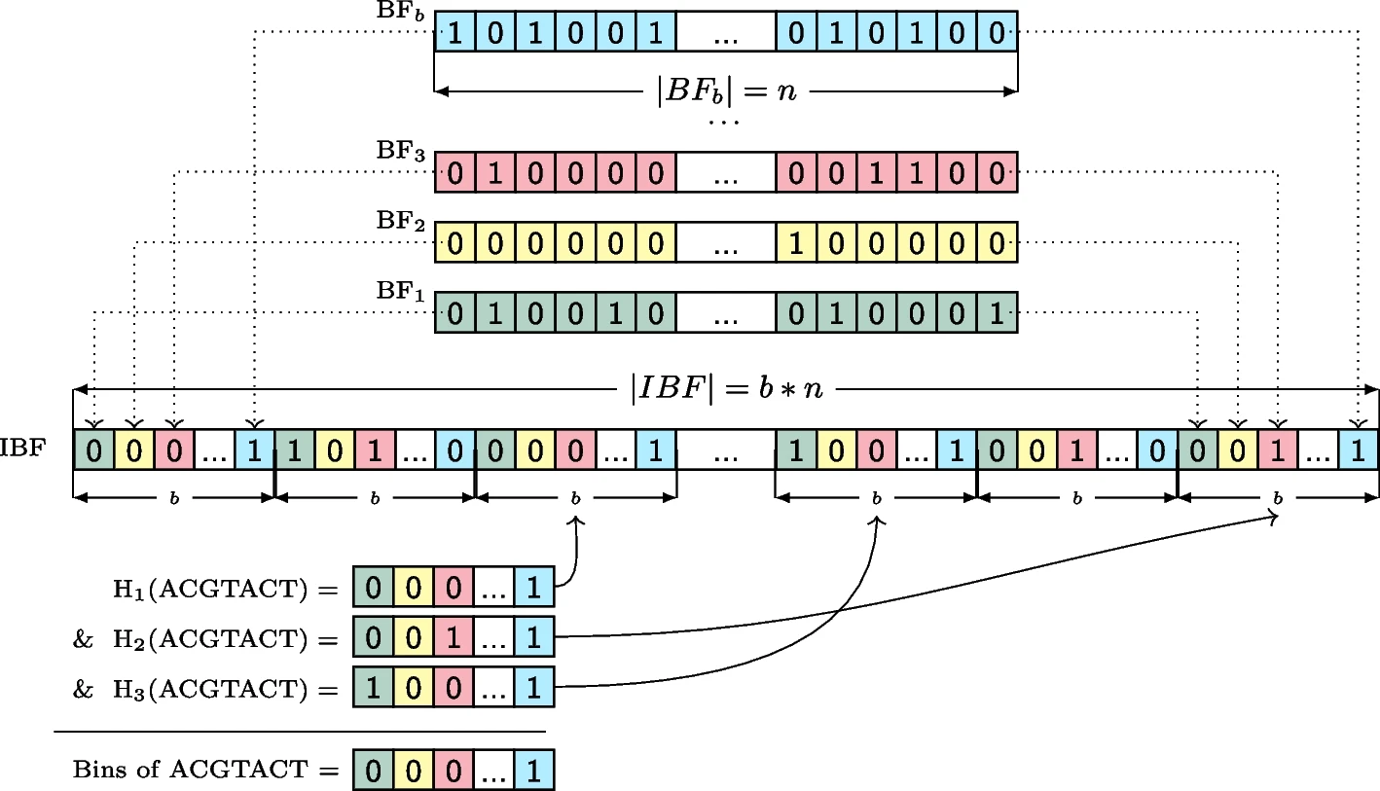
Interleaved Bloom Filter
Bloom Filter b (BFb) for genomes from species b
BF3 for species 3
BF2 for species 2
BF1 for species 1
Combined BFs into 1 (interleaved BF)
Querying kmers
(Mehringer et al., Genome Biology, 2023)

Slide 55
Limitations of IBF
Bin size: Based on the largest species cluster ⇒ smaller one still requires bins of the same size.
Impact of species diversity:
Greater number of species increases the number of bins needed.
Higher species diversity leads to longer query times.
IBF layout of 8 species clusters (A–H) and their respective BFs, with all BFs standardized to the size of the largest species cluster (100).
(Mehringer et al., Genome Biology, 2023)

Slide 56
Why is IBF relevant to our problem of phylogenetic grouping?
IBF bins contents shows significant imbalance ⇒ wasted space.
⇒ Need for an approach to reorganize the bin contents toward a more balanced and optimized distribution.

Slide 57
HIBF strategy to balance the size of the BFs (Technical bins)
(Mehringer et al., Genome Biology, 2023)
PARAMETER t_max = 5, i.e. max number of TBs allowed:
⇒ Split contents of big species clusters into multiple smaller TBs
⇒ Put all the content of of a species cluster into a single smaller TBs
⇒ Merge all small species clusters into 1 TB, this TB is now also a lower level IBF

Slide 58
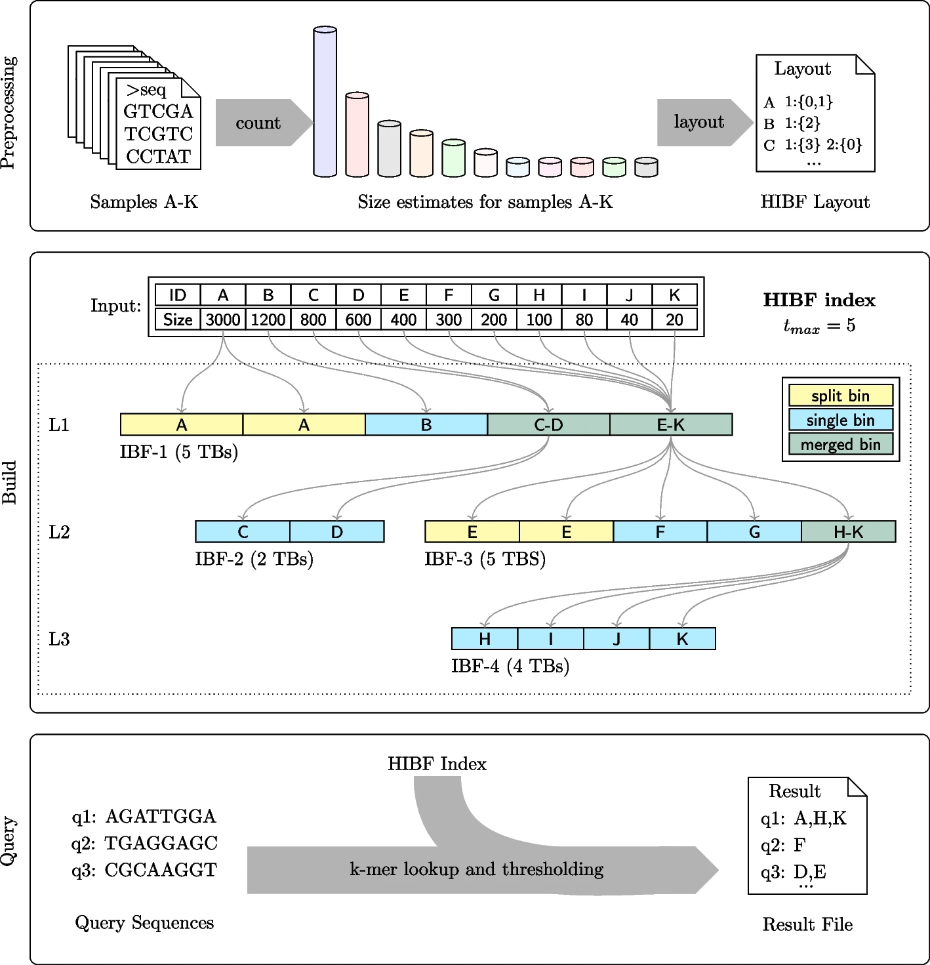
Workflow of HIBF
Preprocessing :
Estimating the size of the input clusters using Hyperloglog sketches.
then compute the layout of the HIBF using Dynamic Programing.
Building : From the given layout, build the HIBF index
Query : The HIBF index can subsequently be utilized to query the membership of sequences within the input samples.
(Mehringer et al., Genome Biology, 2023)

Slide 59
Building the layout of HIBF - general
Dynamic Programming (DP) Matrices:
Rows: Represent technical bins (TB0, …, TBt−1).
Columns: Represent user bins (UB0, …, UBb−1).
Movement in the DP matrix:
Horizontally: Consume multiple user bins for a single technical bin (merged bin).
Vertically: Consume multiple technical bins for single user bin (isplit bin).
No diagonal movement.
A single bin (for clarity) is treated as a split bin of size 1.
Matrices:.
Mi,j:
Tracks the maximum technical bin size
Li,j:
Tracks the space consumption estimate for all lower-level IBFs created for each merged bin

Slide 60
Building the layout of HIBF - general
Recurrence:
2 cases: splitting and merging
DP Matrix Updates:
The values of Mi,jM_{i,j}Mi,j​ (maximum bin size) and Li,jL_{i,j}Li,j​ (lower-level IBF costs) are updated by comparing the costs of splitting vs. merging.
Traceback to construct the layout

Slide 61
Building the layout of HIBF - Obstacle
The tools provided by the paper can only be installed on Linux
The lowest tmax possible by default in the tool is 64 technical bins

Slide 62
Building the layout of HIBF - example simplified
Assumptions:
We have 5 user bins, denoted UB0,UB1,...,UB4​.
We have 3 technical bins, denoted TB0,TB1,TB3​.
Let’s assume the sizes of the user bins as follows:
∣UB0∣=100
∣UB1∣=90
∣UB2∣=80
∣UB3∣=70
∣UB4∣=60
Mij | U0 | U1 | U2 | U3 | U4
T1
T2
T3
Lij | U0 | U1 | U2 | U3 | U4
T1
T2
T3

Slide 63
Building the layout of HIBF - example simplified
Initialize j = 0
Mij | U0 | U1 | U2 | U3 | U4
T1 | 100
T2 | 50
T3 | 25
Lij | U0 | U1 | U2 | U3 | U4
T1 | 0
T2 | 0
T3 | 0

Slide 64
Building the layout of HIBF - example simplified
Initialize j = 0,
Initialize i = 0, j !=0 : the space consumption is
Mij | U0 | U1 | U2 | U3 | U4
T1 | 100 | 90 | 80 | 70 | 60
T2 | 50
T3 | 25
Lij | U0 | U1 | U2 | U3 | U4
T1 | 0 | 190 | 270 | 340 | 400
T2 | 0
T3 | 0

Slide 65
Building the layout of HIBF - example simplified
Initialize j = 0,
Initialize i = 0, j !=0
Recursion:
Mij | U0 | U1 | U2 | U3 | U4
T1 | 100 | 90 | 80 | 70 | 60
T2 | 50
T3 | 25
Lij | U0 | U1 | U2 | U3 | U4
T1 | 0 | 190 | 270 | 340 | 400
T2 | 0
T3 | 0

Slide 66
Workflow of HIBF

Slide 67
Implementation

Slide 68
Create batch
Parameters:
Current implementation in Python
can be found at

Slide 69
BakRep - new metadata
Total species:
create batches how many

Slide 70
Side challenge: recompressing 661k in Rust with new metadata

Slide 71
MiniPhy2 - Overview
Miniphy2 is the second version of the Miniphy workflow, designed for phylogenetic compression of genome data (bacteria).
It is written in Rust, better optimized and more efficient
Currently in development.
New metadata for 661k from BakRep

Slide 72
MiniPhy2 - Input preparation
Steps:
Prepare Input:
find <path_to_genome_files>/*.fa > <input_file>
The input (input.txt) contains a list of genome file names.
Build Tree: Run attotree to generate a tree:
attotree -L <input_file> -o <output_tree_file>
-L: Specifies the input file containing the list of genome files.
-o: Defines the output tree file.
Post-process Tree: Use postprocess_tree.py in MiniPhy to get tree leaves in order:
./postprocess_tree.py --standardize --midpoint-outgroup --name-internals --ladderize -n <output_nodes_file> -l <leaves_order_file> <input_tree_file> <output_tree_file>
<output_nodes_file>: File to save tree node data.
<leaves_order_file>: File to save the order of tree leaves.
<input_tree_file>: Input tree file (e.g., from attotree).
<output_tree_file>: Processed tree file.
Generate Ordered Genome Paths: Create paths with prefixes and suffixes for genome files:
awk '{print "/path/to/file/" $0 ".fa"}' leaves_order.txt > input_genomes_order.txt
Output: input_genomes_order.txt, an ordered list of paths for genome files for MiniPhy.
Finalized Input:
input_genomes_order.txt: Paths to genome files, ready for further processing.

Slide 73
MiniPhy2
./miniphy2 compress input_genomes_order.txt -l -c -o ./output/output_xz
Explanation:
./miniphy2: Runs the miniphy2 program from the current directory.
compress: Specifies the operation to compress input data.
-l: Indicates the input is a list of files
-c: Specifies compression using the xz algorithm at maximum level (level 9).
-o ./output/output_xz: Indicates the compressed output file will be saved as output_xz in the ./output/ directory.
Unexpected differences in compressed file sizes for
Tuberculosis batch 01
Downloaded from Zenodo: File size: 93.1 MB.
Recompressed version using Miniphy2: File size: 77.2 MB.
Tuberculosis batch 02
Downloaded from Zenodo: File size: 60.5 MB.
Recompressed version using Miniphy2: File size: 49.9 MB.

Slide 74
MiniPhy2
Decompress the same genome file from Miniphy2 and the corresponding file from Zenodo, then compare them:
diff -q miniphy2/tuber_02/SAMEA1101627.fa zenodo/mycobacterium_tuberculosis_02/SAMEA1101627.fa
MiniPhy2
>SAMEA1101627.contig00001
MiniPhy
>SAMEA1101627.contig00001 len=261652 cov=28.0 corr=0 origname=NODE_1_length_261652_cov_27.971079_pilon sw=shovill-spades/1.0.4 date=20190103
}
⇒ This is fixed

Slide 75
Build a snakemake pipeline
Build a snakemake pipeline for miniphy to from preparing input data to compression

Slide 76
A closer examination of the relationship between the xz compression sizes of the batches and their properties.

Slide 77
Preliminary results suggest that post-compression batch sizes are more balanced when batches have a similar distinct k-mer count.

Slide 78
Balancing distinct k-mers across batches requires fast estimation via HyperLogLog sketching.

