Slide 1
Distinct Kmers Count, Compression size and Compression Ratio Across Genome Orders
04 Apr 2025

Slide 2
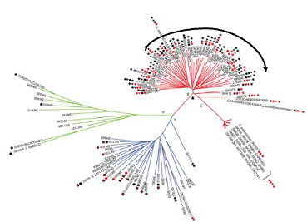
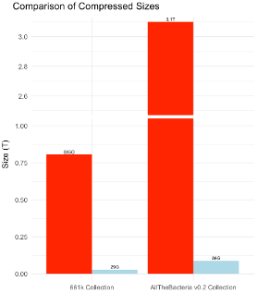
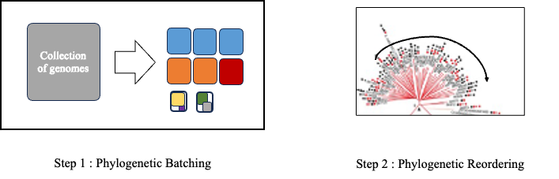

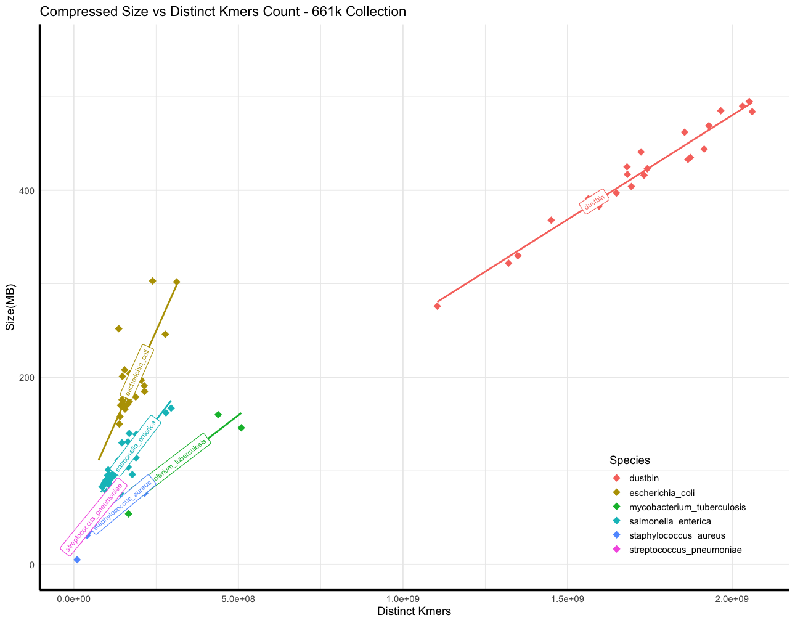
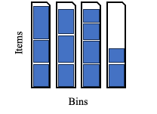

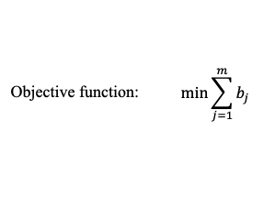
Phylogenetic compression and 3 ingredients for balancing batches
1: Innovation for compressing steadily growing bacteria database
2: Key steps of phylogenetic compression
Reordering genomes based on evolutionary history
3: Current limitation and out objective
4: First approach using distinct kmers count
Fast distinct kmers counting:
HyperLogLog sketching
Current batches compressed size: non-uniform
y = ax + b
Threshold
GOAL: balancing batches
A deeper look into this ingredient

Slide 3
Does accounting for genome orderings improve the approximation of post-compression sizes?
Experiment setup - Dataset:
From the 661k genome collection, select 6 species (gtdbtk classification) with over 20,000 genomes.
Sample randomly 20,000 genomes from each species.
The 6 selected species comprise 444,507 genomes, or 67% of the collection. We sampled 120,000 genomes (20,000 per species), representing 18% of the total collection.
Species: Campylobacter_D jejuni, Escherichia coli, Mycobacterium tuberculosis , Salmonella enterica, Staphylococcus aureus, Streptococcus pneumoniae
Side note: the same experiment is also done with 13 species with over 10k genomes

Slide 4

Orders: Random, Accession, Phylogenetic, Accession+Phylo, Random+Phylo
genome_1
genome_2
genome_3
genome_4
…
genome_20000
shuffle
sort
phylo
genome_113
genome_192
genome_4512
genome_6789
…
genome_19091
SAMN00001
SAMN00011
SAMN00013
SAMN00300
…
SAMN20000
genome_2
genome_1
genome_4
genome_3
…
genome_20000
Random:
bash function shuf
Sorted by Accession number:
bash function sort
Reordering with Phylo tree (mash+quicktree)

Slide 5
Orders: Random, Accession, Phylogenetic, Accession+Phylo, Random+Phylo
Random
Accession
Phylo
genome_1
genome_2
genome_3
genome_4
…
genome_20000
genome_113
genome_192
genome_4512
genome_6789
…
genome_19091
SAMN00001
SAMN00011
SAMN00013
SAMN00300
…
SAMN20000
genome_2
genome_1
genome_4
genome_3
…
genome_20000
Cut each of the 3 sets into 40 disjunctive and different size subsets.
random_subset_1
accession_subset_1
phylo_subset_1
random_subset_2
accession_subset_2
phylo_subset_2
…
…
…
Random+Phylo
Accession+Phylo

Slide 6
Orders: Random, Accession, Phylogenetic, Accession+Phylo, Random+Phylo
Random
Accession
Phylo
Cutting how?
genome_1
genome_2
genome_3
genome_4
…
genome_20000
genome_113
genome_192
genome_4512
genome_6789
…
genome_19091
SAMN00001
SAMN00011
SAMN00013
SAMN00300
…
SAMN20000
genome_2
genome_1
genome_4
genome_3
…
genome_20000
Subset 1
Set of genomes
Subset 2
Subset 3
Cut each of the 3 sets into 40 disjunctive and different size subsets.
Subset 4
random_subset_1
accession_subset_1
phylo_subset_1
random_subset_2
accession_subset_2
phylo_subset_2
Subset 5
…
…
…
Random+Phylo
Accession+Phylo

Slide 7
Orders: Random, Accession, Phylogenetic, Accession+Phylo, Random+Phylo
Random
Accession
Phylo
Cutting how?
genome_1
genome_2
genome_3
genome_4
…
genome_20000
genome_113
genome_192
genome_4512
genome_6789
…
genome_19091
SAMN00001
SAMN00011
SAMN00013
SAMN00300
…
SAMN20000
genome_2
genome_1
genome_4
genome_3
…
genome_20000
Subset 1
Set of genomes
Subset 2
Subset 3
Cut each of the 3 sets into 40 disjunctive and different size subsets.
Subset 4
random_subset_1
accession_subset_1
phylo_subset_1
random_subset_2
accession_subset_2
phylo_subset_2
Subset 5
…
…
…
…
…
…
Reorder 1 more time on individual subset with phylo tree
random_phylo
subset_1
accession_phylo
subset_1
…
…
Random+Phylo
Accession+Phylo

Slide 8
Orders: Random, Accession, Phylogenetic, Accession+Phylo, Random+Phylo
Random
Accession
Phylo
Cutting how?
genome_1
genome_2
genome_3
genome_4
…
genome_20000
genome_113
genome_192
genome_4512
genome_6789
…
genome_19091
SAMN00001
SAMN00011
SAMN00013
SAMN00300
…
SAMN20000
genome_2
genome_1
genome_4
genome_3
…
genome_20000
Subset 1
Set of genomes
Subset 2
Subset 3
Cut each of the 3 sets into 40 disjunctive and different size subsets.
Subset 4
random_subset_1
accession_subset_1
phylo_subset_1
Final:
40 subsets for each order.
random_subset_2
accession_subset_2
phylo_subset_2
Subset 5
…
…
…
…
…
…
Reorder 1 more time with phylo tree
random_phylo
subset_1
accession_phylo
subset_1
…
…
Random+Phylo
Accession+Phylo

Slide 9
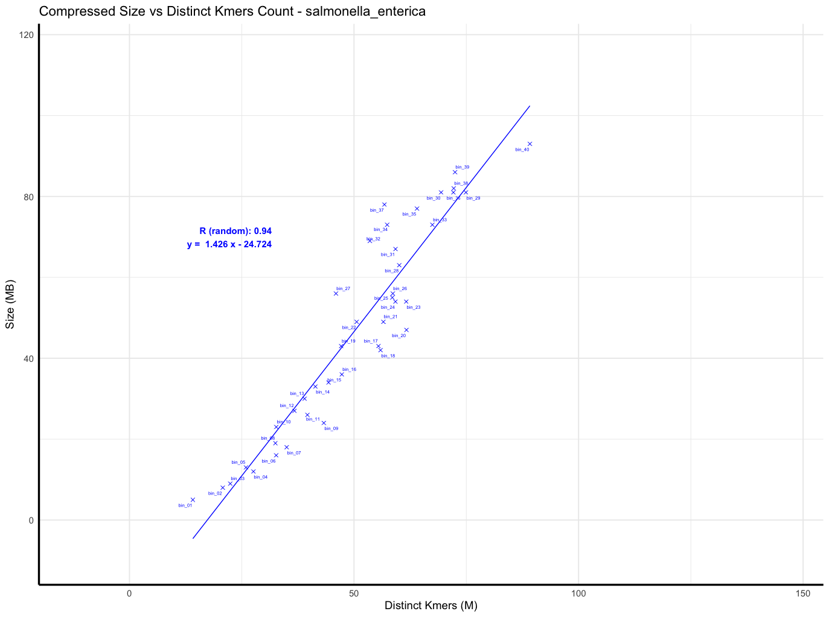
Linear regression result: Salmonella enterica - random order

Slide 10
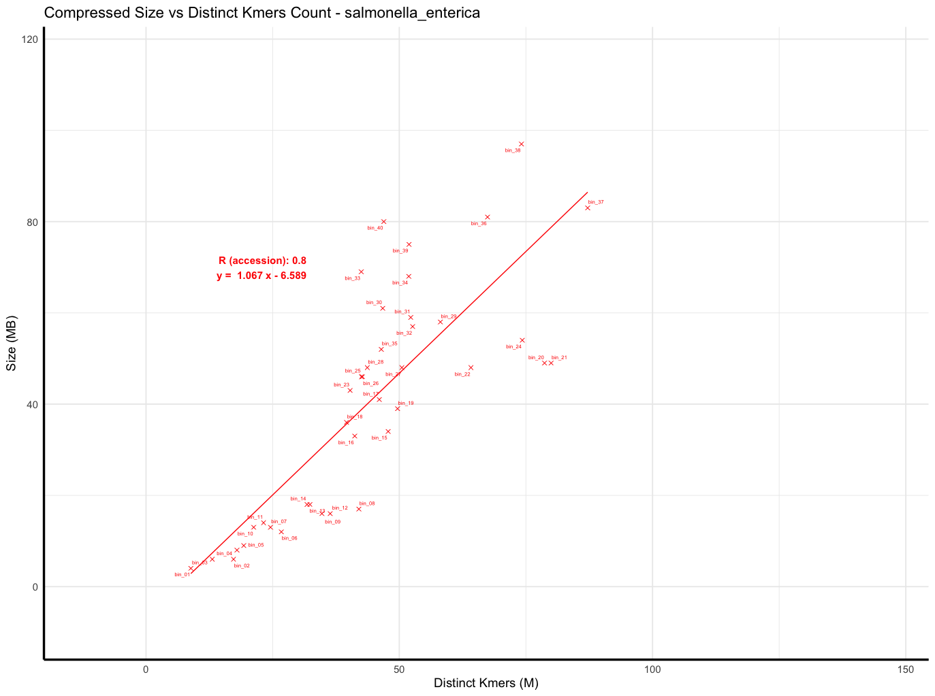
Linear regression result: Salmonella enterica - accession order

Slide 11
Linear regression result: Salmonella enterica - accession order
S. enterica in 661k: 178,585 genomes
Sampled: 20,000 (11% of the total)
This sampling broke the accession order.

Slide 12
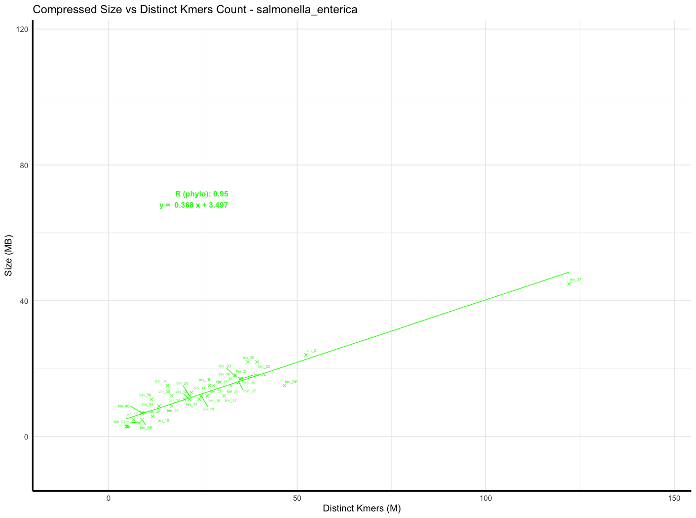
Linear regression result: Salmonella enterica - phylo order
Outlier
Hypothesis: low-quality genomes?

Slide 13
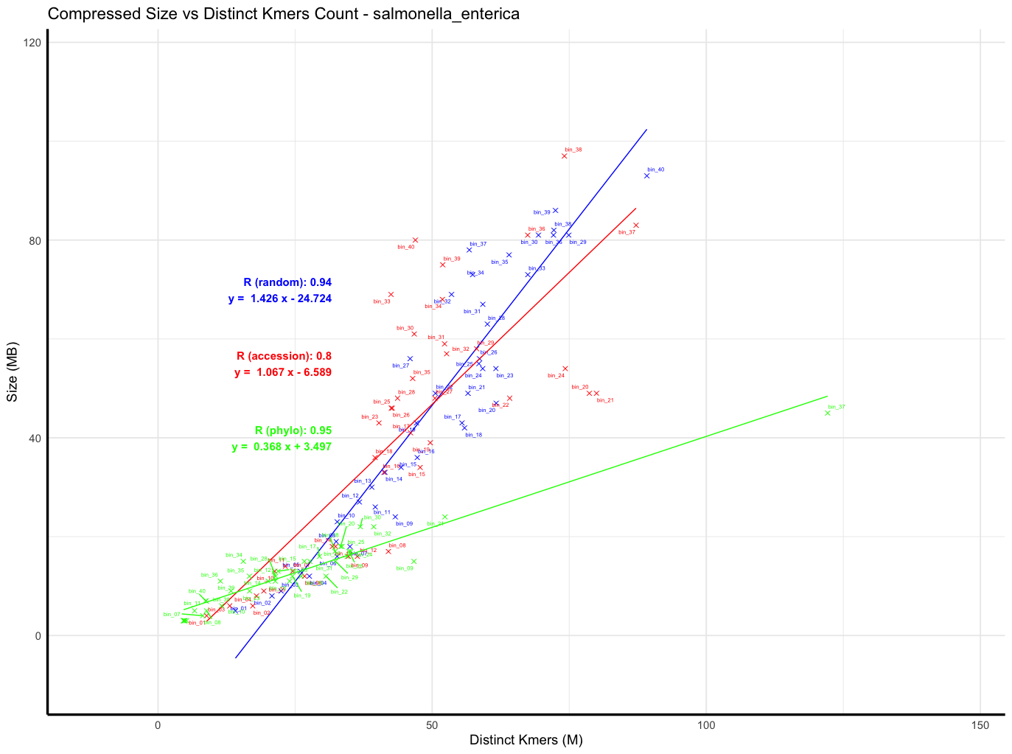
Result: Salmonella enterica - random, accession, phylo

Slide 14
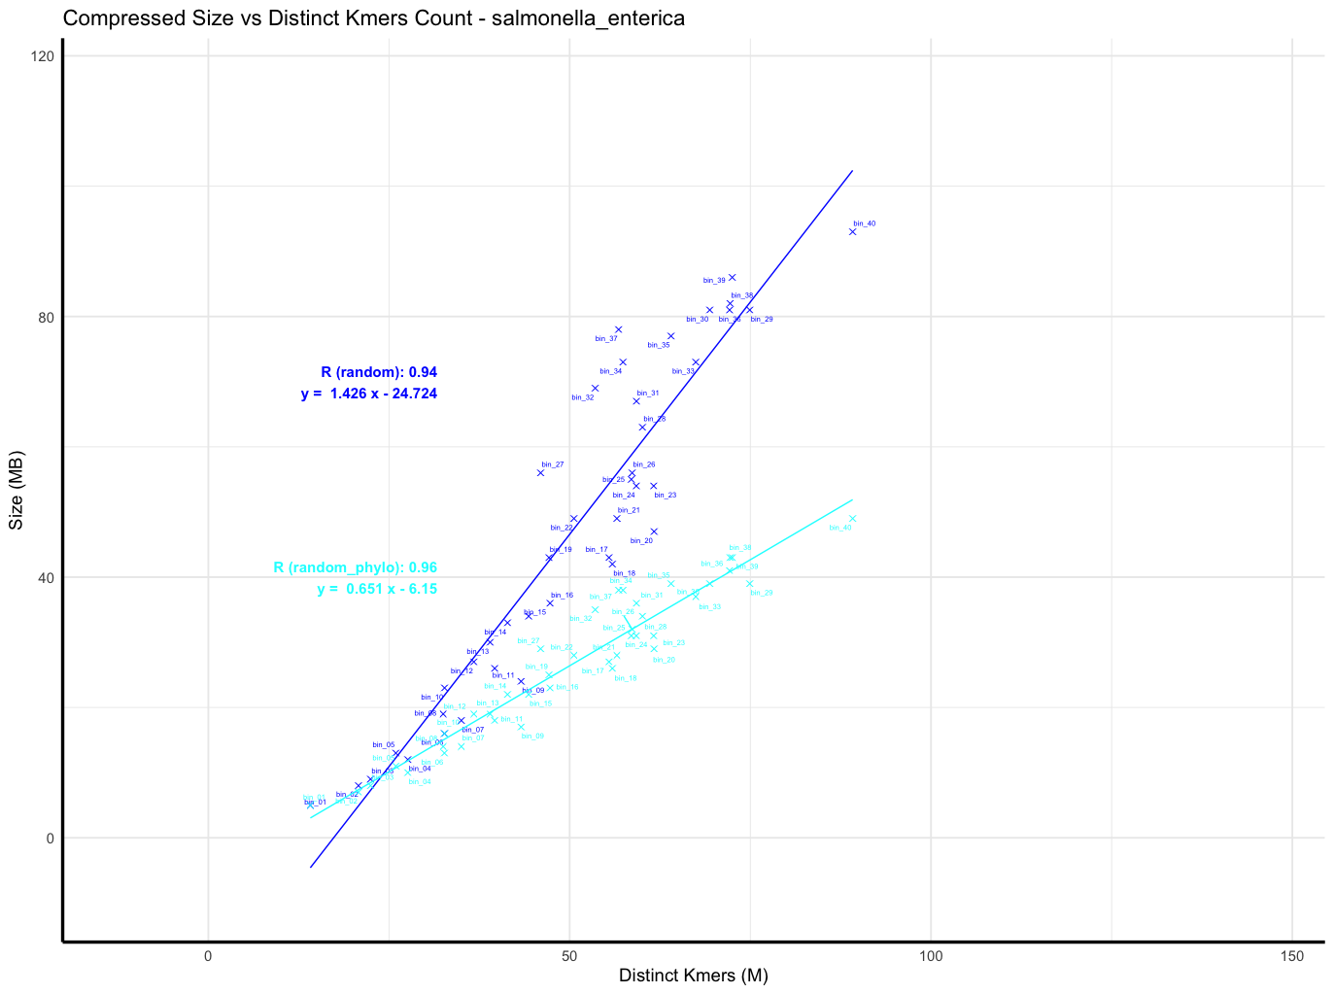
Result: Salmonella enterica - random, random + phylo

Slide 15
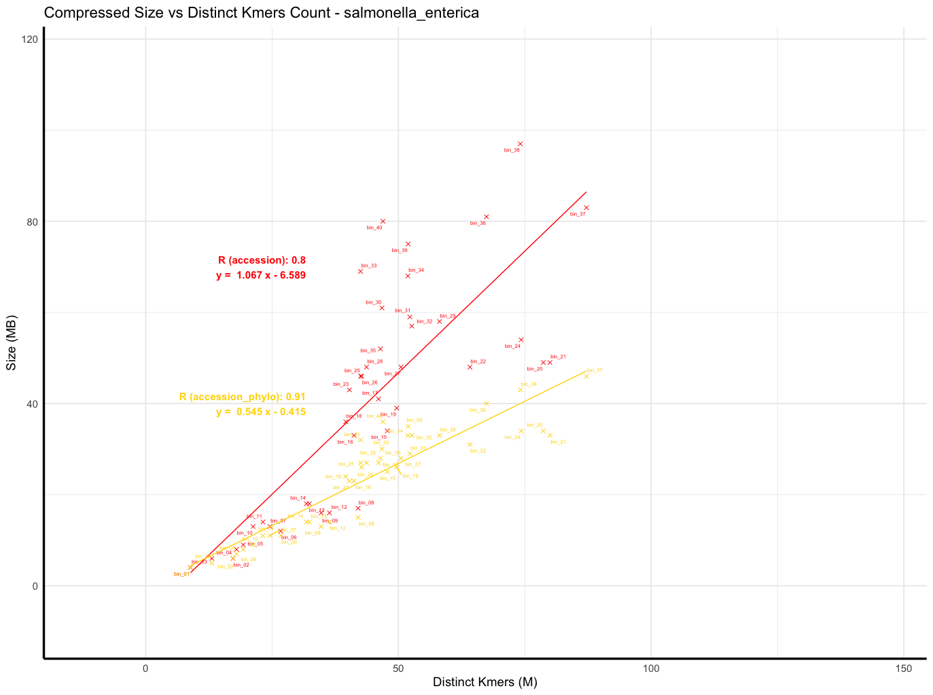
Result: Salmonella enterica - accession, accession + phylo

Slide 16
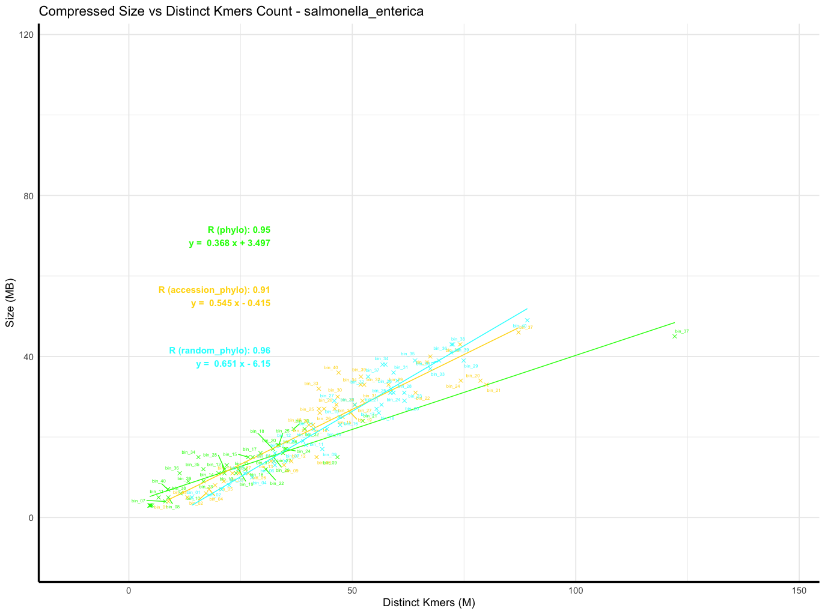
Result: Salmonella enterica - phylo, accession+phylo, random+phylo

Slide 17
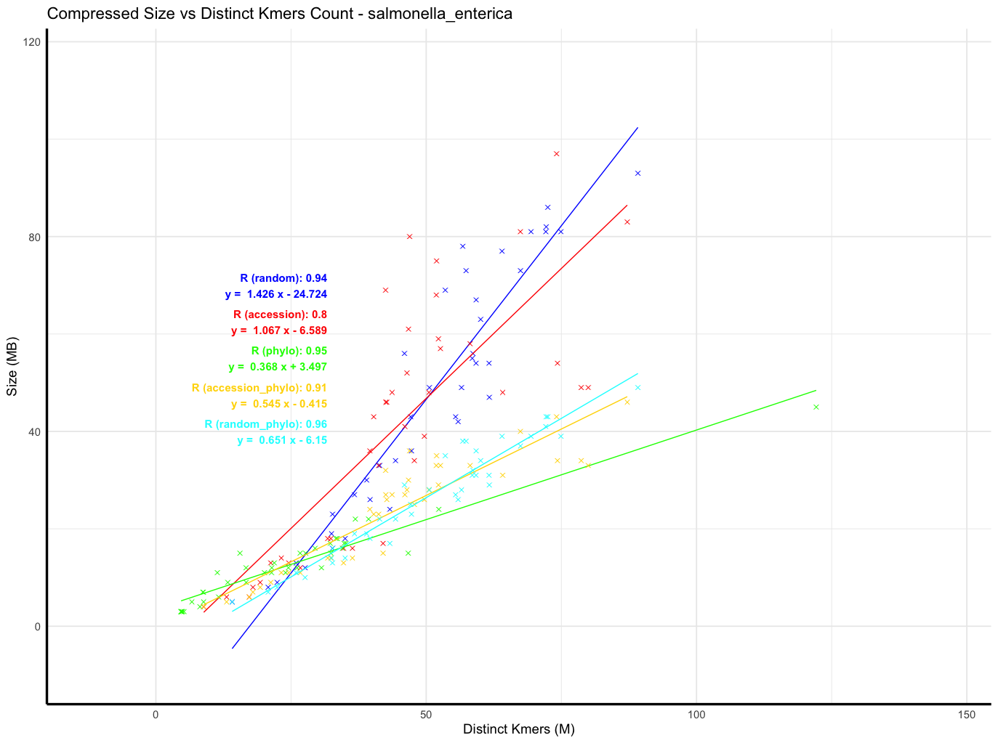
Result: Salmonella enterica - all orders

Slide 18
Observations and Preliminary Analysis

Slide 19
How well can you compress on different genomes orders
Initial orders is important

Slide 20
How well can you predict the compression sizes
Root Mean Squared Error is used in this presentation for ease of interpretation
Test data: 10 randomly sampled batches from a single species, each with a varying number of genomes (100 => 1000).
 | S.enterica | E.coli | M.tuberculosis | S.aureus | C.D.jejuni | S.pneumoniae
Random | 45.623 | 53.375 | 20.590 | Still compressing
Accession | 36.236 | 43.26 | 26.810
Phylo | 17.533 | 32.325 | 39.635
A+Phylo | 14.345 | 21.464 | 17.702
R+Phylo | 17.205 | 23.332 | 13.761

Slide 21
Phylogenetic trees last batch behaviors
Outlier
Hypothesis: low-quality genomes

Slide 22
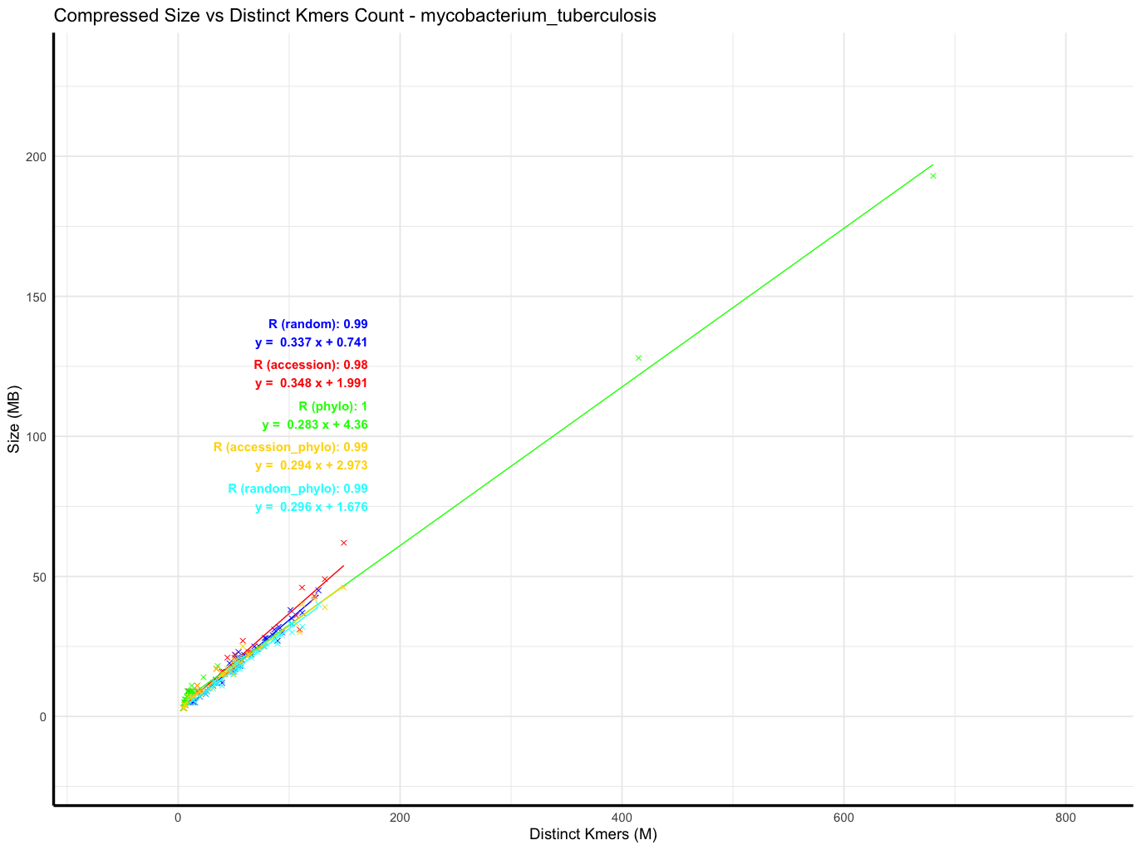
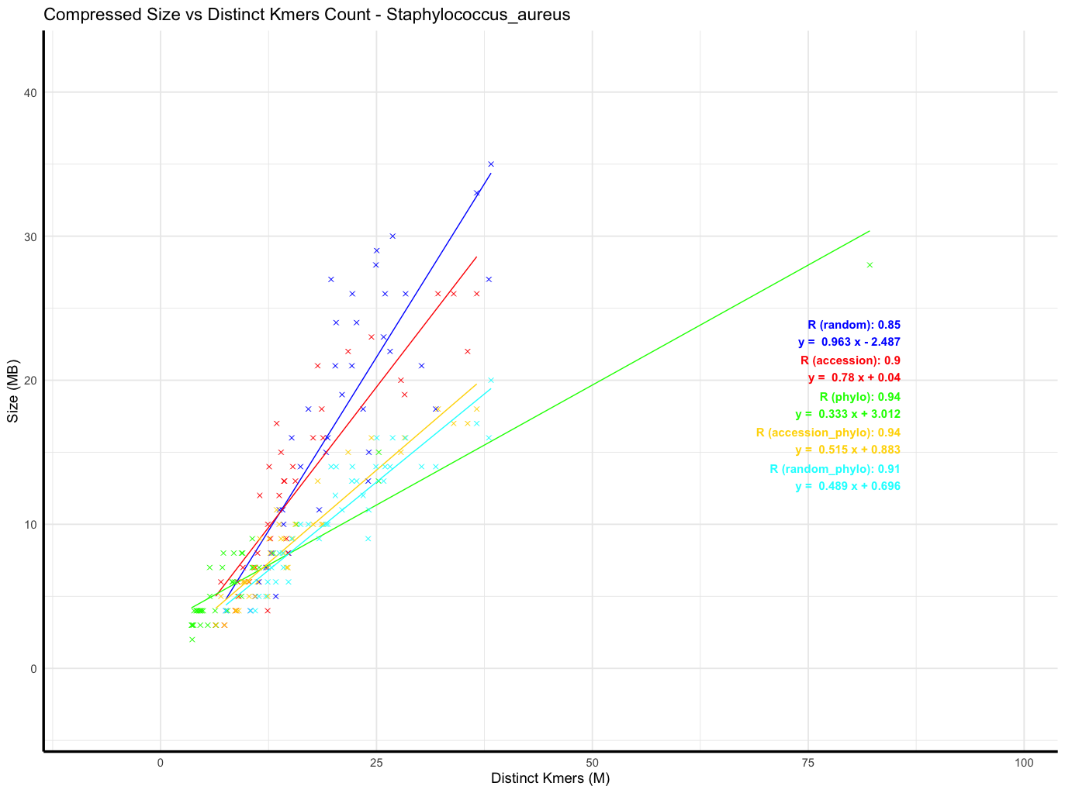
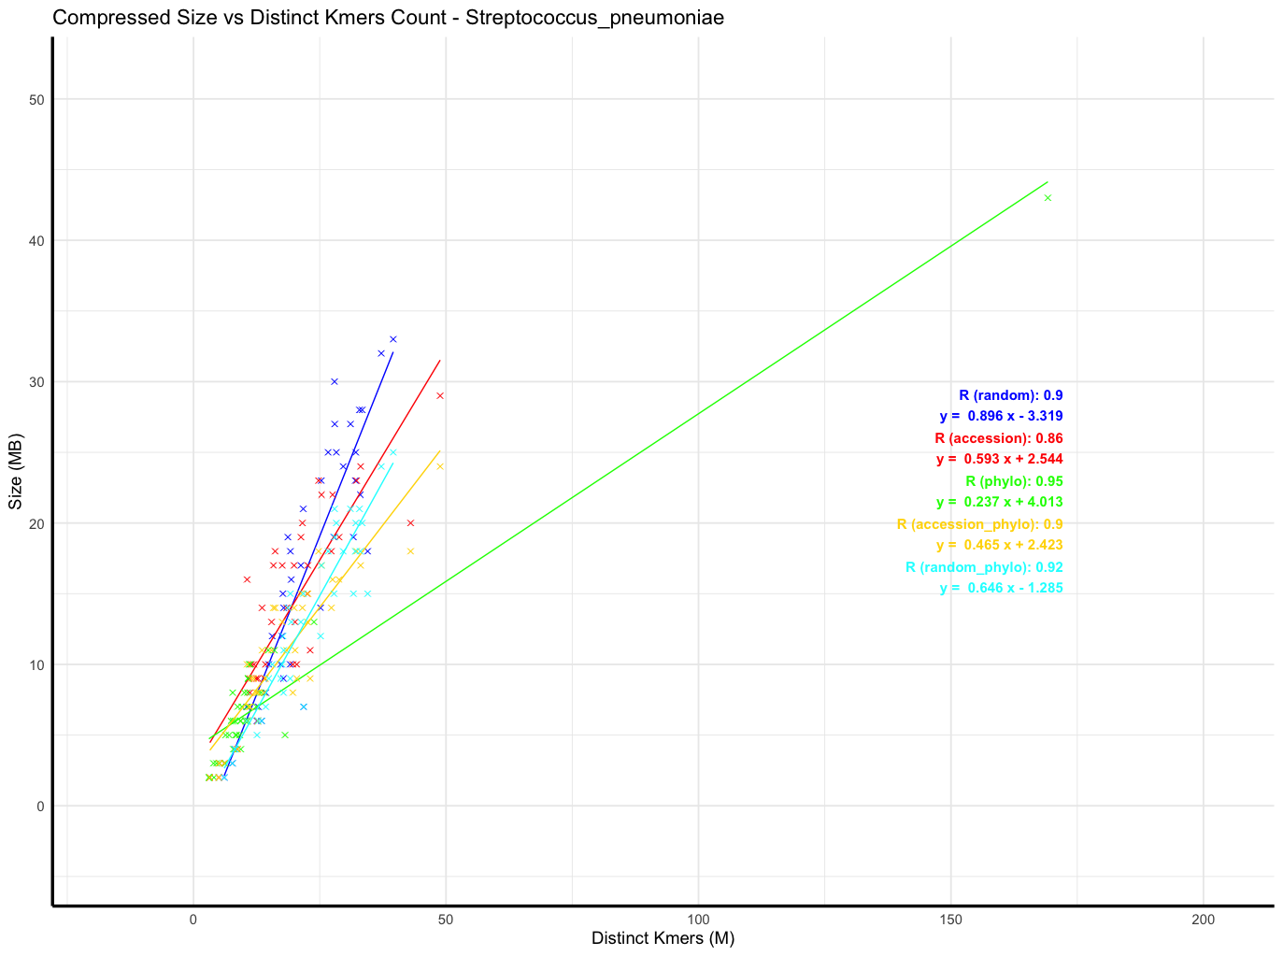
Phylogenetic trees last batch behaviors other species
When we do phylo order, we put the “bad” genomes aside?

Slide 23
Scaling up
10k is trivial (with my Mac M4 best in the market), 20k is doable, how about 100k?
My 2 current strategy:
Attotree with smaller sketch size (current 10000, test with 1000).
A heuristic strategy: quasi-phylogenetic order

Slide 24
Attotree with smaller sketch size (current 10000, test with 1000).
Attotre’s been running since 02 Apr :)
Mash finished in about 3 hours. Quick tree’s still running
=> What orders can we derive from just Mash distance?

Slide 25
Quasi-phylogenetic:
Step 1: Build a phylo tree for 10k randomly sampled genomes (reference tree)
Step 2: For each of the remaining genomes, find the most similar genome from reference tree
Step 3: infer sub-trees locally
10k reference genomes tree order
Infer subtree

Slide 26
Really understand the data
Paper on bacterial genomes for different species, bacterial pangenomes

