Slide 1
Distinct Kmers Count, Compression size and Compression Ratio Across Genome Orders
14 Apr 2025

Slide 2
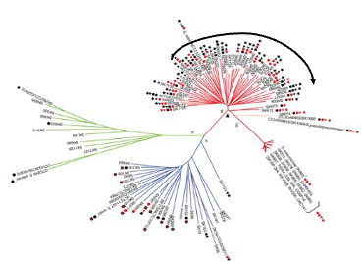
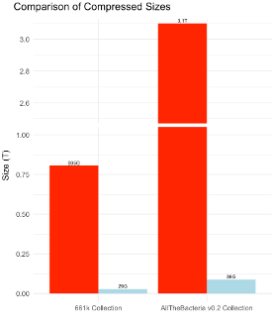
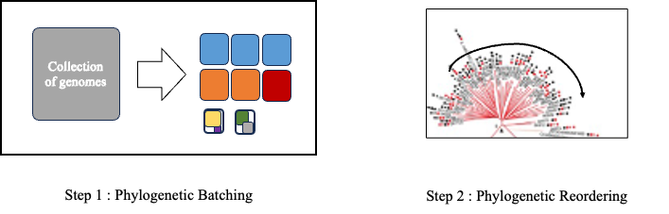

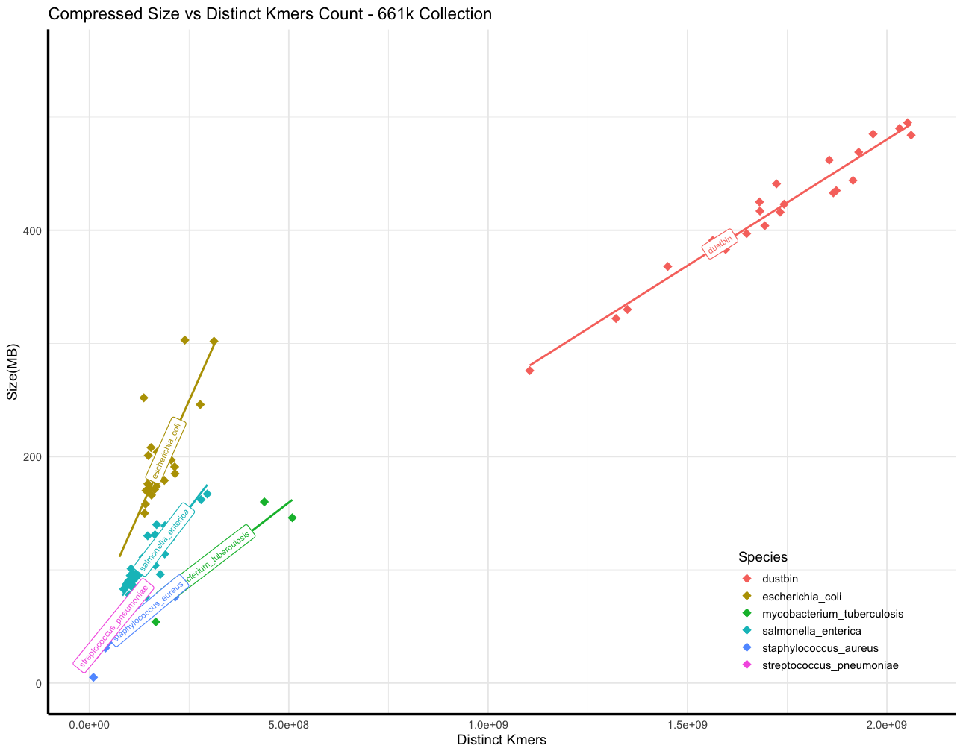
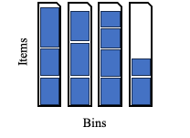

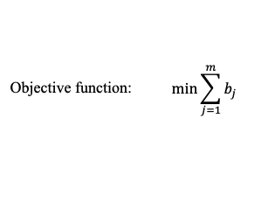
Phylogenetic compression and 3 ingredients for balancing batches
1: Innovation for compressing steadily growing bacteria database
2: Key steps of phylogenetic compression
Reordering genomes based on evolutionary history
3: Current limitation and out objective
4: First approach using distinct kmers count
Fast distinct kmers counting:
HyperLogLog sketching
Current batches compressed size: non-uniform
y = ax + b
Threshold
GOAL: balancing batches
A deeper look into this ingredient

Slide 3
Does this phenomenon still hold for different ordering of genomes?
Experiment setup:
Salmonella enterica
Escherichia coli
Dataset: 661k collection
Strep. pneumoniae
M. tuberculosis
Staph. aureus
C_D jejuni
Select 6 species (gtdbtk classification) with over 20,000 genomes
Sample randomly 20,000 genomes per species
661,405 genomes
444,507 genomes
120,000 genomes
~70%
~20%
Side note: the same experiment is also done with 13 species with over 10k genomes

Slide 4

Orders: Random, Accession, Phylogenetic, Accession+Phylo, Random+Phylo
genome_1
genome_2
genome_3
genome_4
…
genome_20000
shuffle
sort
phylo
genome_113
genome_192
genome_4512
genome_6789
…
genome_19091
SAMN00001
SAMN00011
SAMN00013
SAMN00300
…
SAMN20000
genome_2
genome_1
genome_4
genome_3
…
genome_20000
Random:
bash function shuf
Sorted by Accession number:
bash function sort
Reordering with Phylo tree (mash+quicktree)

Slide 5
Orders: Random, Accession, Phylogenetic, Accession+Phylo, Random+Phylo
Random
Accession
Phylo
genome_1
genome_2
genome_3
genome_4
…
genome_20000
genome_113
genome_192
genome_4512
genome_6789
…
genome_19091
SAMN00001
SAMN00011
SAMN00013
SAMN00300
…
SAMN20000
genome_2
genome_1
genome_4
genome_3
…
genome_20000
Cut each of the 3 sets into 40 disjunctive and different size subsets.
random_subset_1
accession_subset_1
phylo_subset_1
random_subset_2
accession_subset_2
phylo_subset_2
…
…
…
Random+Phylo
Accession+Phylo

Slide 6
Orders: Random, Accession, Phylogenetic, Accession+Phylo, Random+Phylo
Random
Accession
Phylo
Cutting how?
genome_1
genome_2
genome_3
genome_4
…
genome_20000
genome_113
genome_192
genome_4512
genome_6789
…
genome_19091
SAMN00001
SAMN00011
SAMN00013
SAMN00300
…
SAMN20000
genome_2
genome_1
genome_4
genome_3
…
genome_20000
Subset 1
Set of genomes
Subset 2
Subset 3
Cut each of the 3 sets into 40 disjunctive and different size subsets.
Subset 4
random_subset_1
accession_subset_1
phylo_subset_1
random_subset_2
accession_subset_2
phylo_subset_2
Subset 5
…
…
…
Random+Phylo
Accession+Phylo

Slide 7
Orders: Random, Accession, Phylogenetic, Accession+Phylo, Random+Phylo
Random
Accession
Phylo
Cutting how?
genome_1
genome_2
genome_3
genome_4
…
genome_20000
genome_113
genome_192
genome_4512
genome_6789
…
genome_19091
SAMN00001
SAMN00011
SAMN00013
SAMN00300
…
SAMN20000
genome_2
genome_1
genome_4
genome_3
…
genome_20000
Subset 1
Set of genomes
Subset 2
Subset 3
Cut each of the 3 sets into 40 disjunctive and different size subsets.
Subset 4
random_subset_1
accession_subset_1
phylo_subset_1
random_subset_2
accession_subset_2
phylo_subset_2
Subset 5
…
…
…
Reorder 1 more time on individual subset with phylo tree
random_phylo
subset_1
accession_phylo
subset_1
…
…
Random+Phylo
Accession+Phylo

Slide 8
Orders: Random, Accession, Phylogenetic, Accession+Phylo, Random+Phylo
Random
Accession
Phylo
Cutting how?
genome_1
genome_2
genome_3
genome_4
…
genome_20000
genome_113
genome_192
genome_4512
genome_6789
…
genome_19091
SAMN00001
SAMN00011
SAMN00013
SAMN00300
…
SAMN20000
genome_2
genome_1
genome_4
genome_3
…
genome_20000
Subset 1
Set of genomes
Subset 2
Subset 3
Cut each of the 3 sets into 40 disjunctive and different size subsets.
Subset 4
random_subset_1
accession_subset_1
phylo_subset_1
Final:
40 subsets for each order.
random_subset_2
accession_subset_2
phylo_subset_2
Subset 5
…
…
…
…
…
…
Reorder 1 more time with phylo tree
random_phylo
subset_1
accession_phylo
subset_1
…
…
Random+Phylo
Accession+Phylo

Slide 9
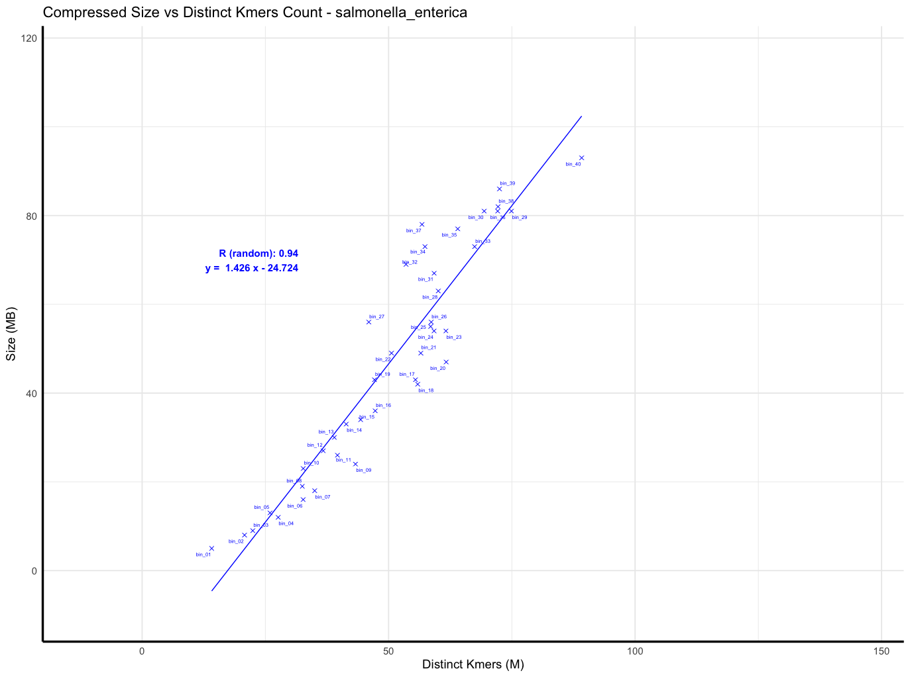
Result: Salmonella enterica - random order

Slide 10
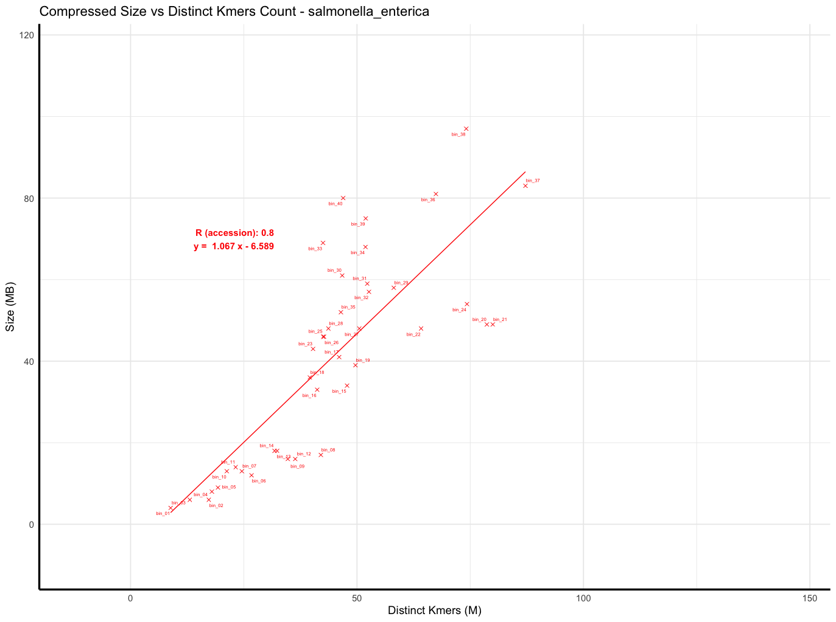
Result: Salmonella enterica - accession order

Slide 11
Result: Salmonella enterica - accession order
S. enterica in 661k: 178,585 genomes
Sampled: 20,000 (11% of the total)
This sampling broke the accession order.

Slide 12
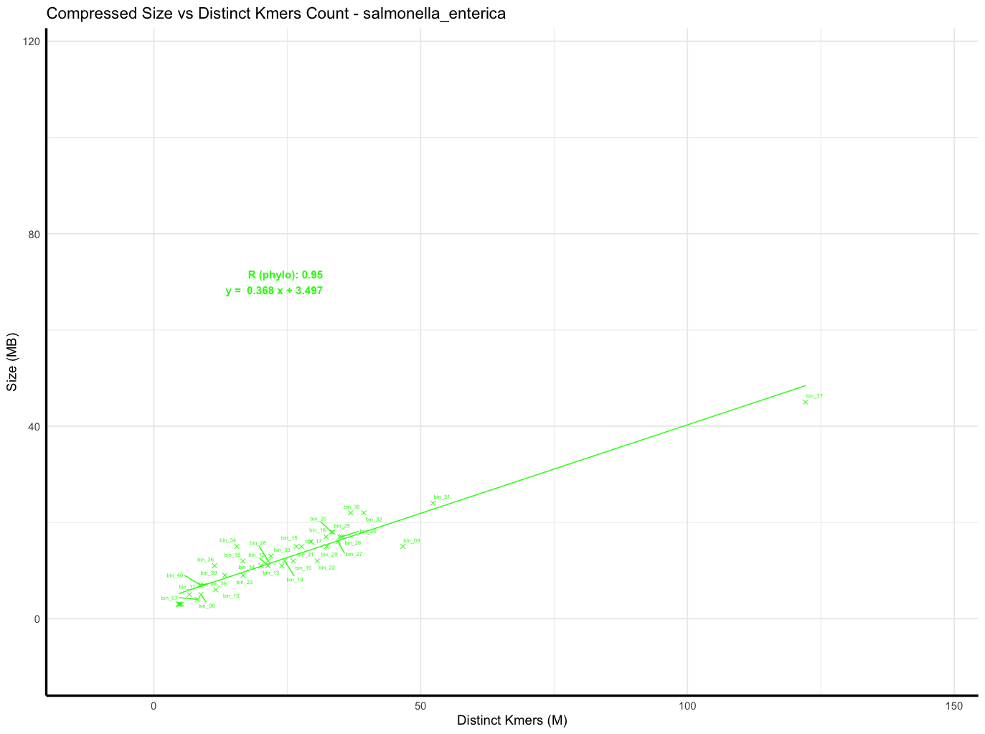
Result: Salmonella enterica - phylo order
Outlier
Hypothesis: low-quality/borderline genomes?

Slide 13
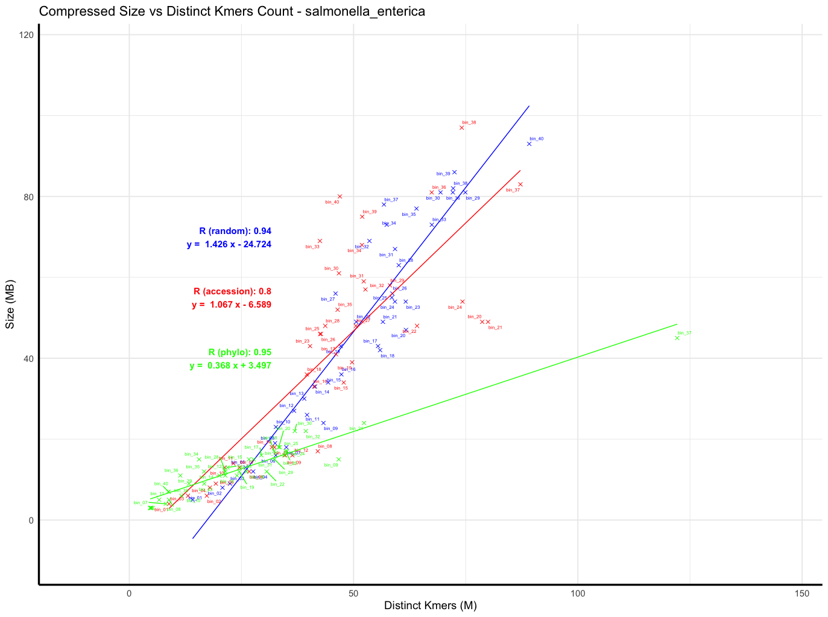
Result: Salmonella enterica - random, accession, phylo

Slide 14
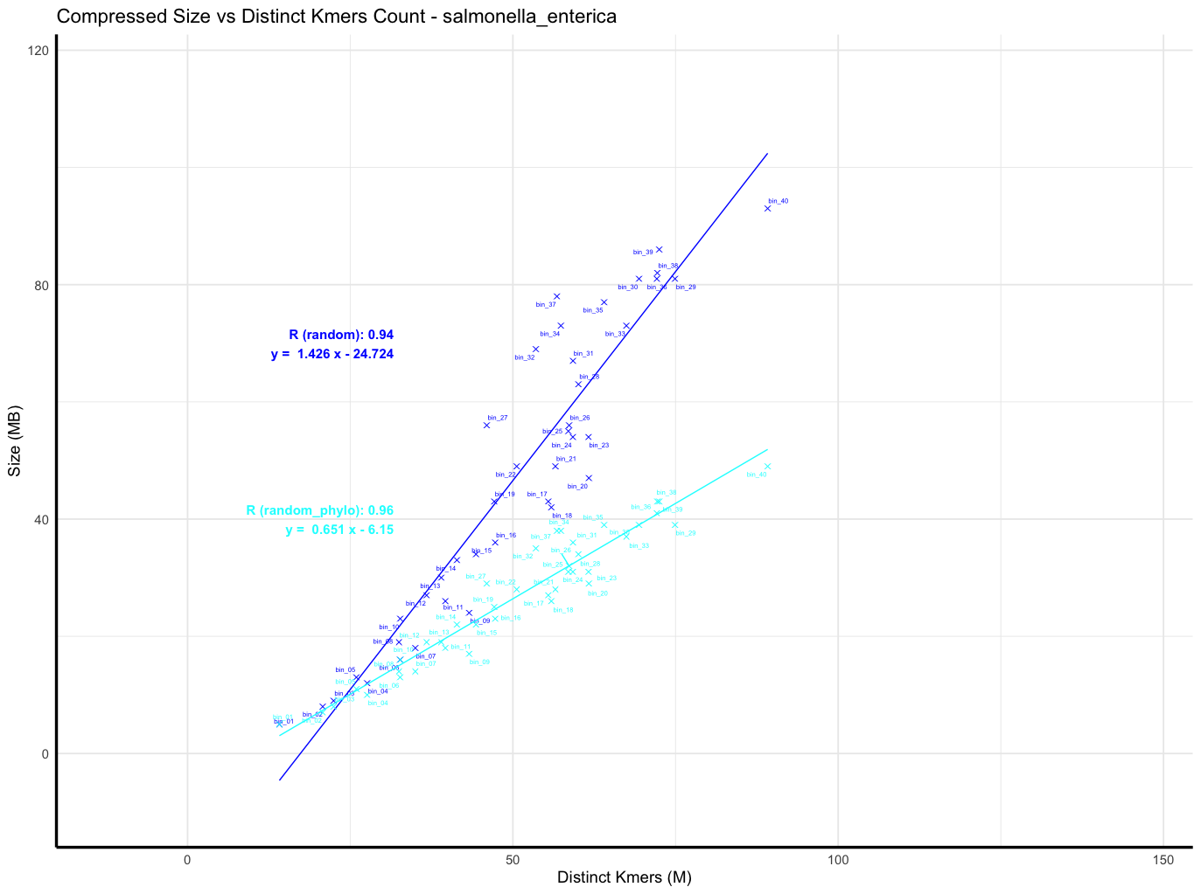
Result: Salmonella enterica - random, random + phylo

Slide 15
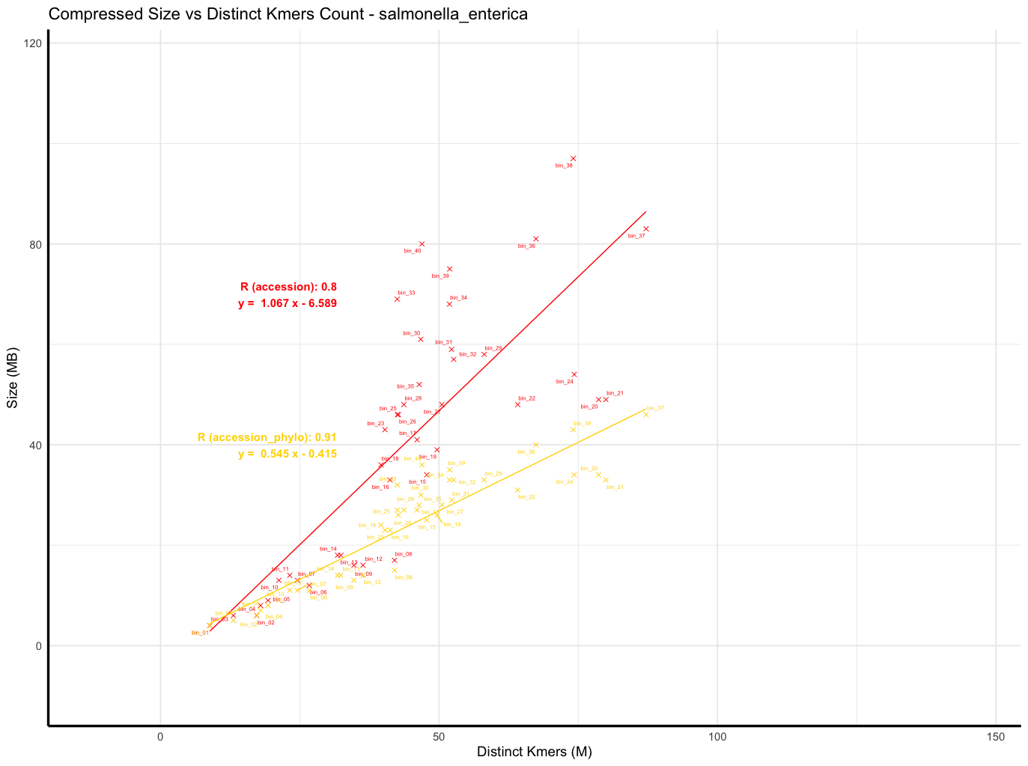
Result: Salmonella enterica - accession, accession + phylo

Slide 16
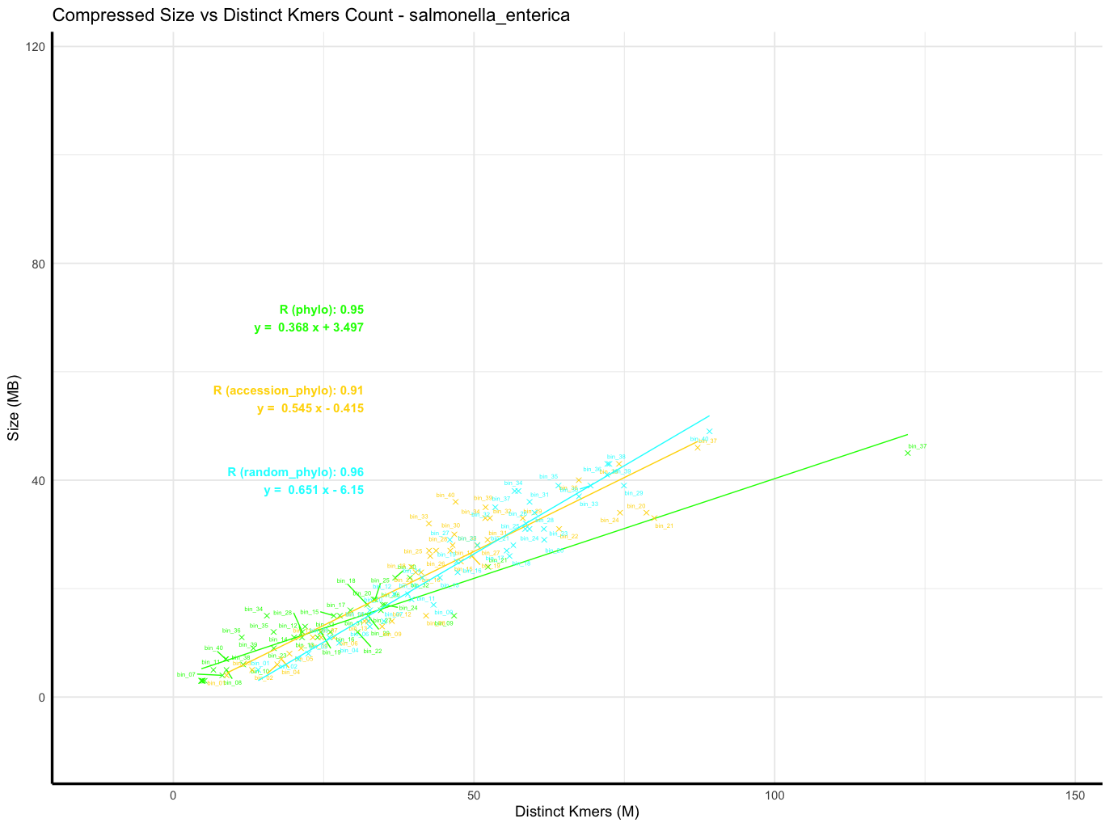
Result: Salmonella enterica - phylo, accession+phylo, random+phylo

Slide 17
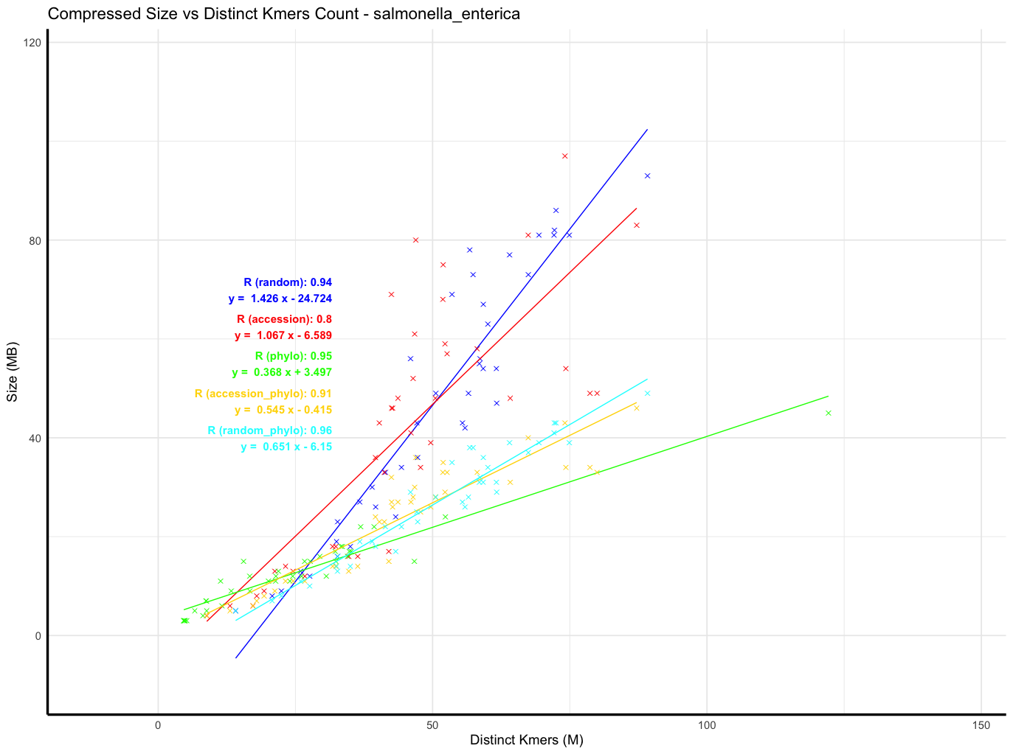
Result: Salmonella enterica - all orders
Order | Cpr ratio
phylo | 45.4 (0.5G)
a+phylo | 25.2 (0.9G)
r+phylo | 22.7 (1.0G)
accession | 15.1 (1.5G)
random | 12.6 (1.8G)
Original size: ~22,7G

Slide 18
Genome orders have strong impact on compression ratio.
Same observation on other species.
Phylogenetic order has the best compression ratio (as expected).
Overall, distinct kmers and compression size are correlated, particularly when involving phylogenetic orders.
Question:
Does accounting for genome orderings improve the approximation of post-compression sizes?

Slide 19
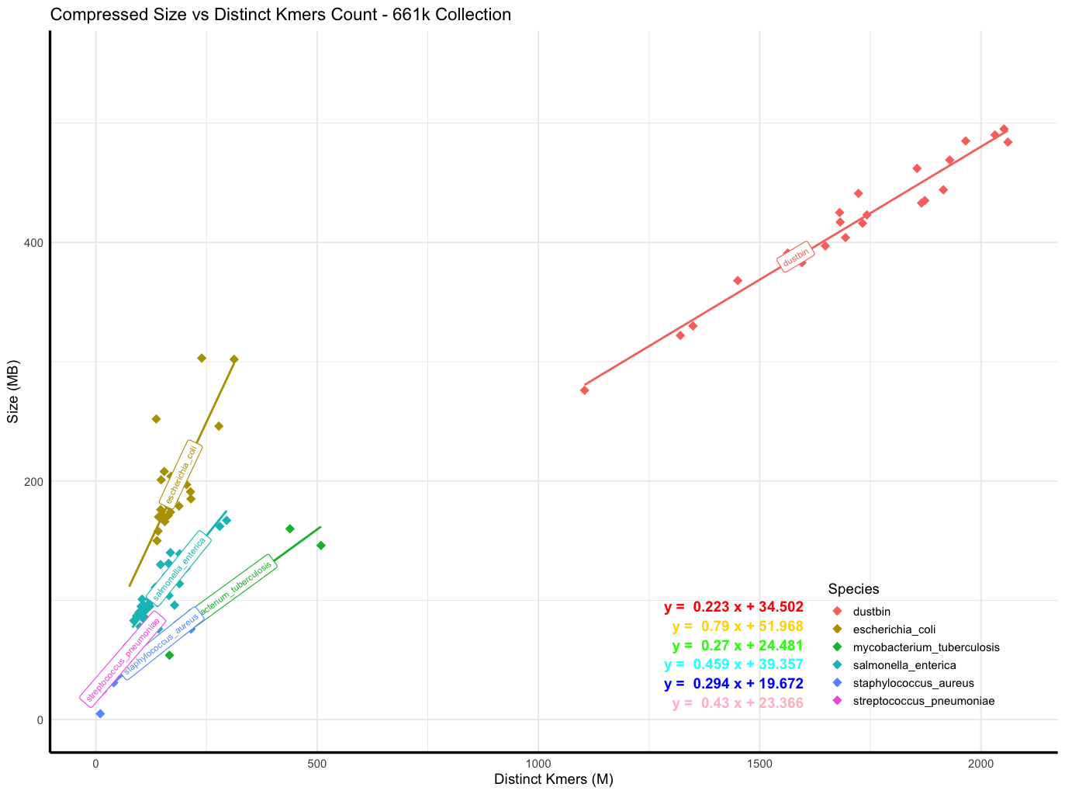
Back to 661k batches: Evaluating post compression sizes prediction
Test data:
10 randomly sampled batches from a single species,
Each with a varying number of genomes (100 => 1000).
Root Mean Squared Error is used in this presentation for ease of interpretation

Slide 20
Back to 661k batches: Evaluating post compression sizes prediction
Test data:
10 randomly sampled batches from a single species,
Each with a varying number of genomes (100 => 1000).
Salmonella enterica:
Root Mean Squared Error (RMSE): 34.850 MB
Escherichia coli:
Root Mean Squared Error (RMSE): 53.911 MB
Mycobacterium tuberculosis:
Root Mean Squared Error (RMSE): 26.651 MB
Not particularly good prediction
⇒ Possible reason: The batches in the 661k dataset are not random; they have a specific ordering.

Slide 21
Summarize: RMSE and Slope for S.enterica, E.coli and M. tuberculosis
 | S.enterica | E.coli | M. tuberculosis
Random | 45.623 | 53.375 | 20.590
Accession | 36.236 | 43.26 | 26.810
Phylo | 17.533 | 32.325 | 39.635
A+Phylo | 14.345 | 21.464 | 17.702
R+Phylo | 17.205 | 23.332 | 13.761
 | S.enterica | E.coli | M. tuberculosis
Random | 1.426 | 1.885 | 0.337
Accession | 1.067 | 1.422 | 0.348
Phylo | 0.368 | 0.699 | 0.283
A+Phylo | 0.545 | 0.813 | 0.294
R+Phylo | 0.651 | 0.952 | 0.296
Root Mean Squared Error
Slope
⇒ Accounting for genome orderings shows improvement
on the approximation of post-compression sizes on the studied species

Slide 22
Challenges:
Estimating a phylogenetic tree for 20,000 genomes is feasible—can we scale to 100,000 genomes or more?
Explain the outlier behavior in phylogenetic order.
Main bottleneck: compression time of large experiments.
(On pc): compression the previous experiment requires 4 days. (600k genomes)
Compression time: (nb_of_batches/nb_of_cores)*time_compression_biggest_batches
⇒ Before scaling up the experiments, compression time need to be greatly reduced.

Slide 23
Setting up MiniPhy2 workflow on Genouest Cluster
MiniPhy2 by itself currently only support compressing individual batch.
Goal: setting up an automatic workflow, to be able to run on the cluster

Slide 24
Setting up MiniPhy2 workflow on Genouest Cluster
MiniPhy2 by itself currently only support compressing individual batch.
Goal: setting up an automatic workflow, to be able to run on the cluster
Implementation:
Snakemake workflow:
https://github.com/karel-brinda/miniphy2/tree/workflow-implementation
Future developments:
create batches directly in rust instead of a python scripts
include tree reordering natively in MiniPhy2 instead of using attotree

Slide 25
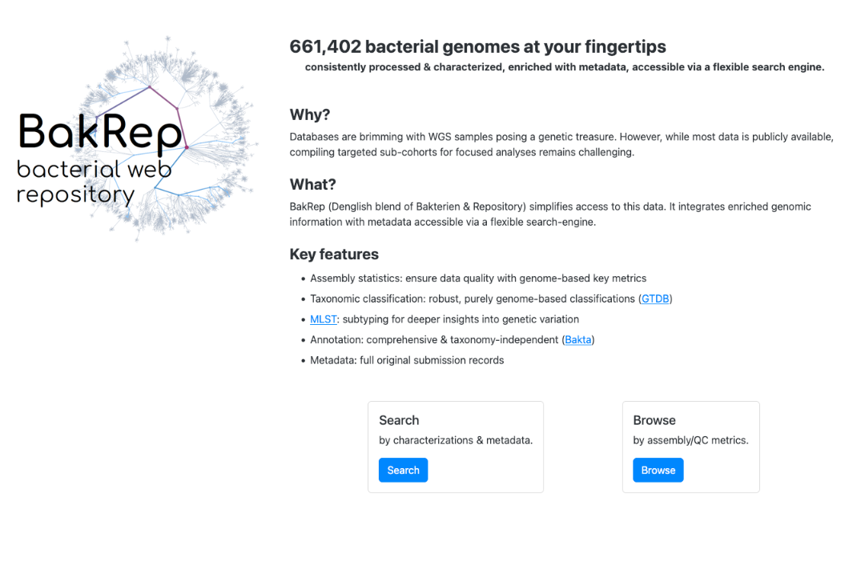
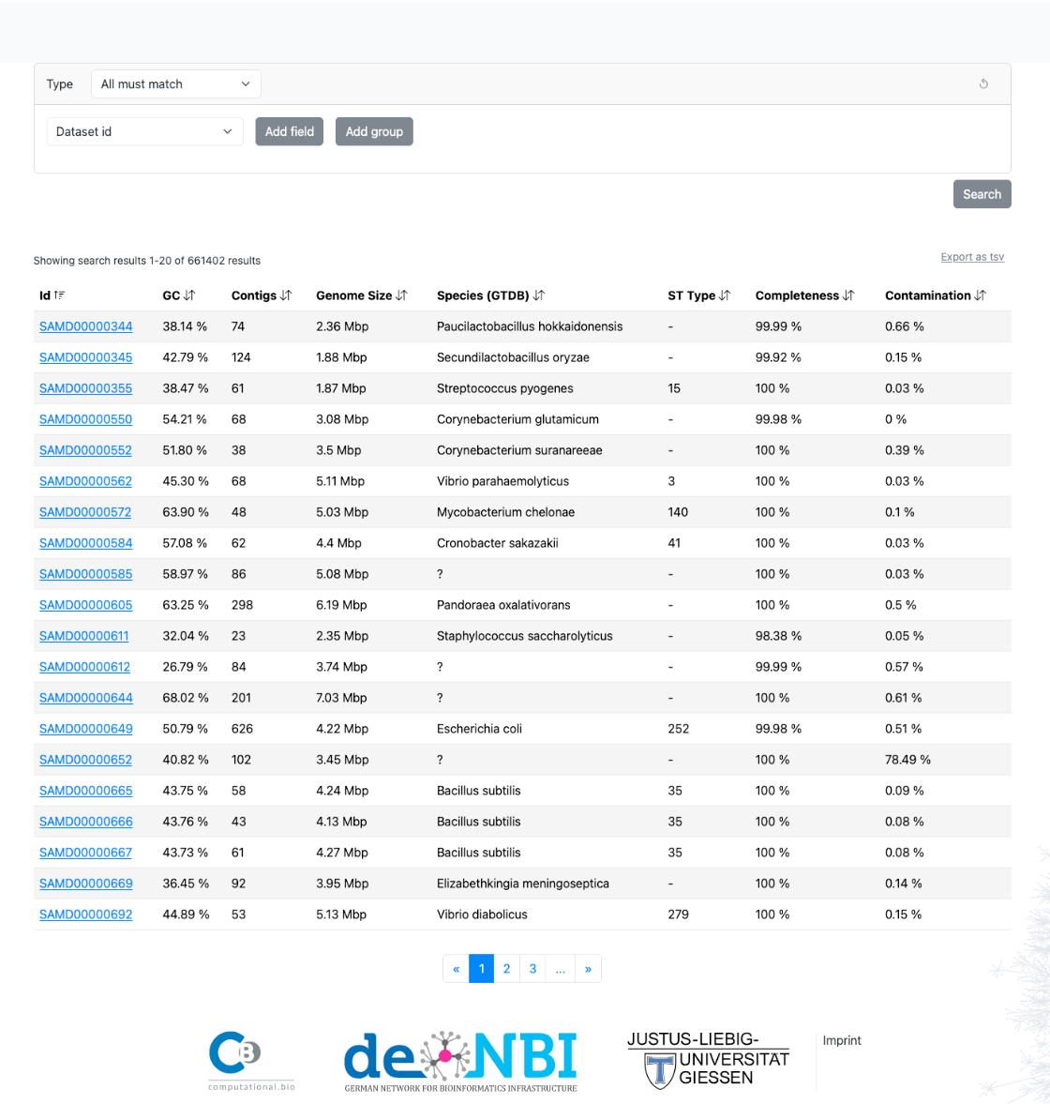
Recompression of the 661k collection with BakRep metadata and Miniphy2
Using the same original batching strategy:
Original number of batches
306 batches (22 dustbins)
BakRep metadata:
309 batches (30 dustbins)
Linda Fenske, Lukas Jelonek, Alexander Goesmann, Oliver Schwengers, Microbial Genomics 2024

Slide 26
Recompression of the 661k collection with BakRep metadata and Miniphy2
Using the same original batching strategy:
Original number of batches
306 batches (22 dustbins)
BakRep metadata:
309 batches (30 dustbins)
Compression time using 100 cores: ~15h
Total new compressed size: 28G (29G old)
Linda Fenske, Lukas Jelonek, Alexander Goesmann, Oliver Schwengers, Microbial Genomics 2024

Slide 27
Scaling up for Salmonella Enterica
Dataset: 100k genomes of salmonella enterica, disk size ~ 140,8G
3 orders:
Phylogenetic order with sketch size 1000
Phylogenetic order with sketch size 10000 (default)
Accession + phylo order (equivalent to the original batching strategy)
For each order, cut 100k genomes into disjunctive subset of 4000 genomes.
Question: Does smaller sketch size reduce the compression ratio for S. Enterica?

Slide 28
Result: phylogenetic order compression of 100k S. Enterica genomes
Phylogenetic tree estimation:
Sketch size: 1000
Mash: ~4h
Quicktree: ~4 days
Sketch size: 10000
Mash: ~14h
Quicktree: ~4 days
⇒ Not scalable
Compression sizes:
Phylo order s1k: 1.4G
Phylo order s10k: 1.4G
Accession+phylo: 2.5G
⇒ Increasing sketch size shows no improvement (further study on other species needed)

Slide 29
Result: phylogenetic order compression of 100k S. Enterica genomes
Phylogenetic tree estimation:
Sketch size: 1000
Mash: ~4h
Quicktree: ~4 days
Sketch size: 10000
Mash: ~14h
Quicktree: ~4 days
⇒ Not scalable
Compression sizes:
Phylo order s1k: 1.4G
Phylo order s10k: 1.4G
Accession+phylo: 2.5G
⇒ Increasing sketch size show no improvement (further study on other species needed)
How to quickly estimate phylogenetic order?

Slide 30
Quasi-phylogenetic:
Step 1: Build a phylo tree for 10k randomly sampled genomes (reference tree)
Step 2: For each of the remaining genomes, find the most similar genome from reference tree
Step 3: Infer sub-trees locally
10k reference genomes tree order
Infer subtree

Slide 31
Discussion and perspectives
Orders we can derive from just Mash distance matrix (Alix and Léo’s work):
Concorde (exact, slow)
Nearest-Neighbor (heuristic, fast)
Christofides/3-opt (in-between)
OR-Tools
Understand the data:
Bacterial genomes characteristics for different species, bacterial pangenomes
Quasi-phylogenetic implementation
Balance batching the whole 661k collection

