Slide 1
Maid for help
BY:-
ABHISHEK YADAV
YASH URADE
VAIBHAV WANERE
CHIRAG KESARWANI

Slide 2


Problem statement
In todays world it is very difficult to find a MAID for working people , bachelors etc.
MAIDS
REQUIREMENT
HIGH PRICING

Slide 3
SCOPE
To provide versatile services to the customers according to his convenience
Replacement policy
Weekly service
15 days service
Monthly service
Refund policy for monthly services
Extension policy

Slide 4
LITERATURE SURVEY
Different aggregators are:-bookmybai.com,kaamwalibai
Charge very high minimum of rs 6000
Charge for booking a maid through them
These apps are specific in nature and do not provide customized services
Charge 1000 for getting a call after our requirement query

Slide 5
LAYOUT OF APP
LOG IN AND SIGN UP PAGE
LOCATION
APPS DASHBOARD
SERVICES PROVIDED BY MAID FOR HELP
1.cleaning
2.cooking
3.cleaning and cooking
DATE and TIME INPUT PAGE
Price estimate and confirm booking
Booking information

Slide 6
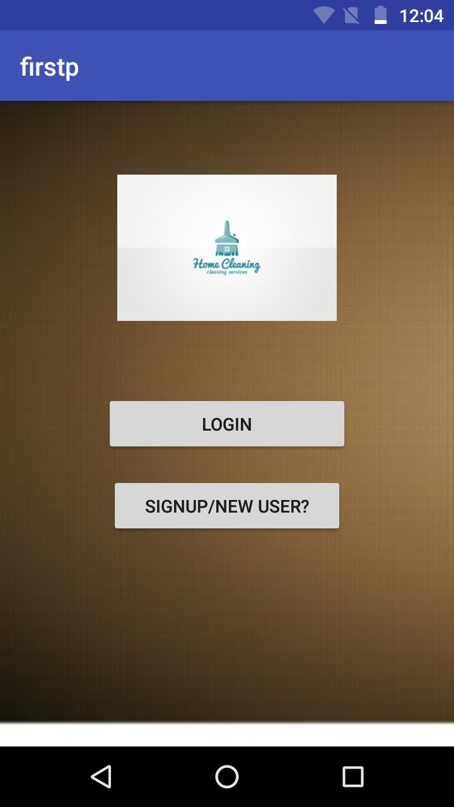
LOGIN/SIGN UP PAGE
This page lets the user sign up and proceed or if the user is already registered then lets the user to login into the app

Slide 7
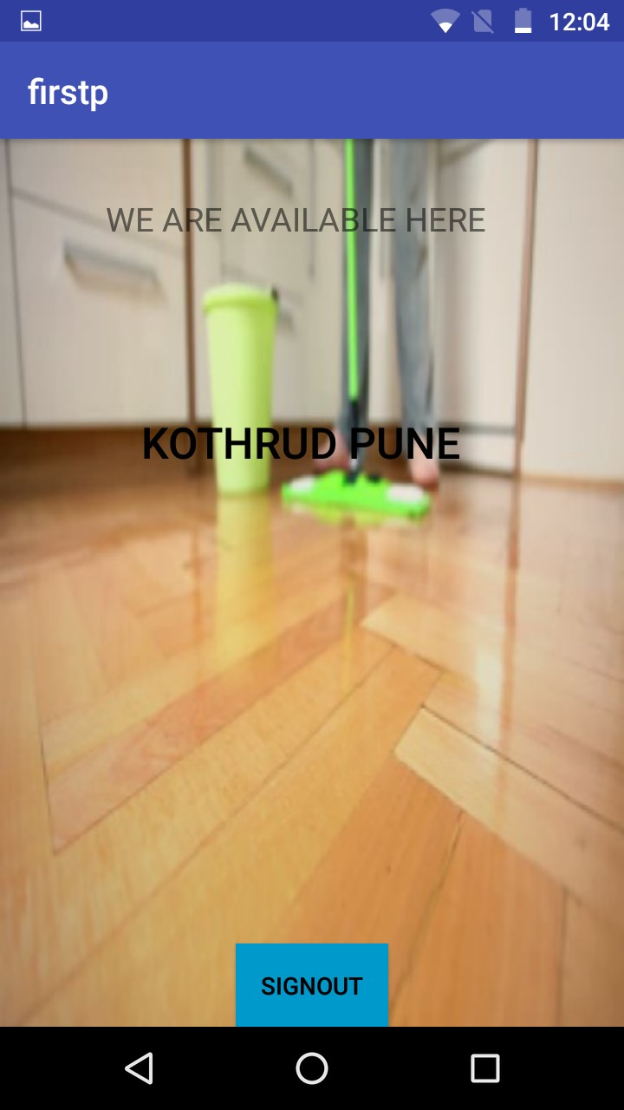
LOCATION UI PAGE
Lets the user known which area the services are currently provided and selecting lets the user procide

Slide 8
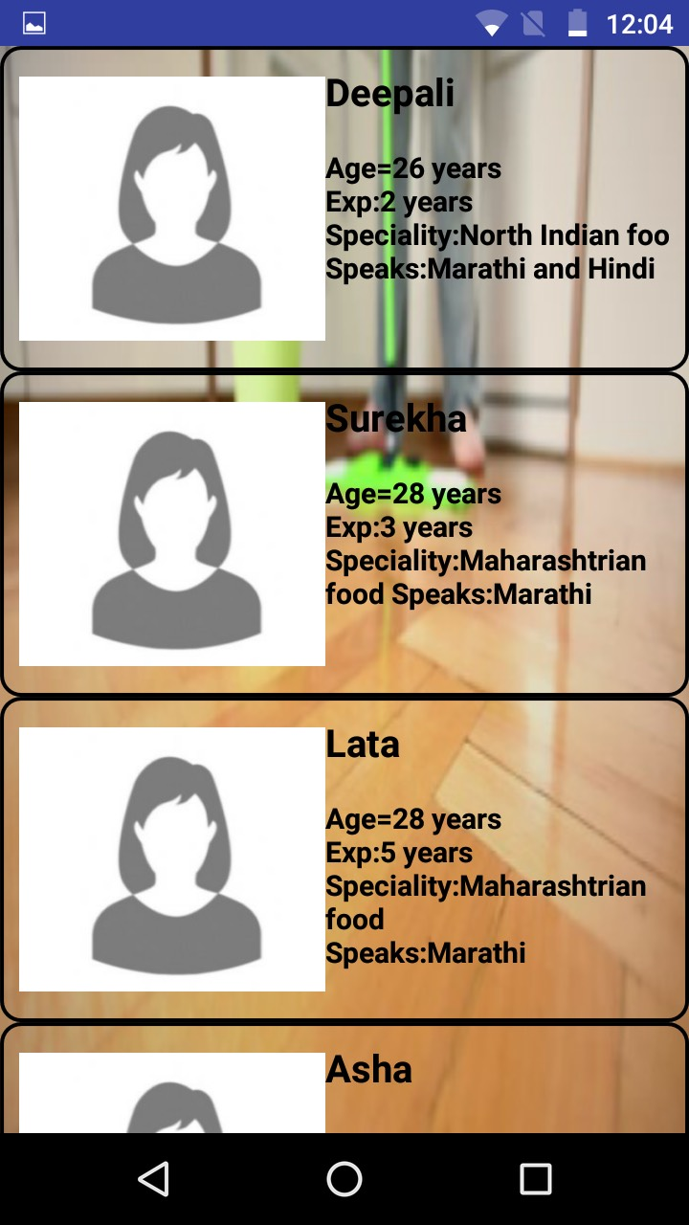
HOMEPAGE
Displays all the list of maids available with all there details like name,age,speciality in food and the languages they speak through which the user can select maid of his choice and procide further for booking

Slide 9
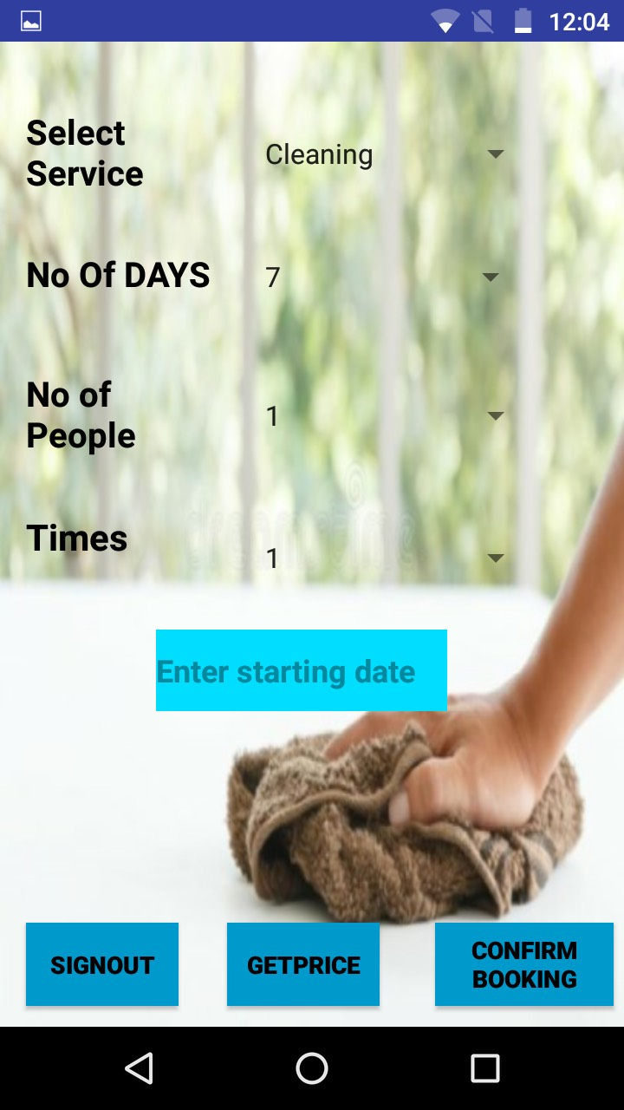
SERVICES PAGE
This page shows all information related to the services like cleaning,cooking and both the services it takes the input from user about no of people, start time ,services, how many times a day

Slide 10
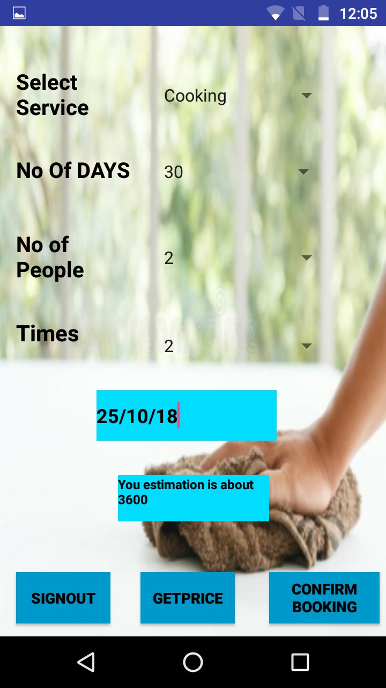
PRICE ESTIMATE PAGE
After selecting all the services and filling the start date of the service on clicking on get price we get a estimate price of how it will cost after getting the estimated price and after that we can confirm booking by selecting confirm booking button

Slide 11
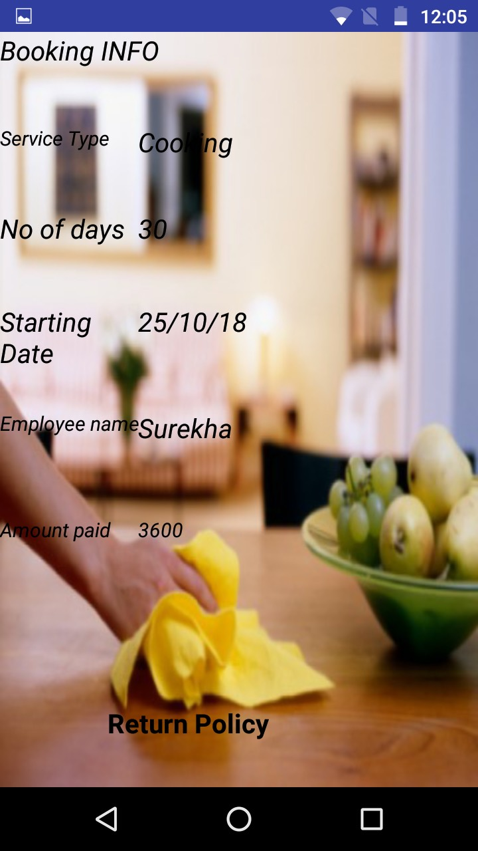
Booking confirmation page
This page gives all the information about the booking of the consumer it also displays the service type, no of days, starting date ,employee name and the total bill

Slide 12
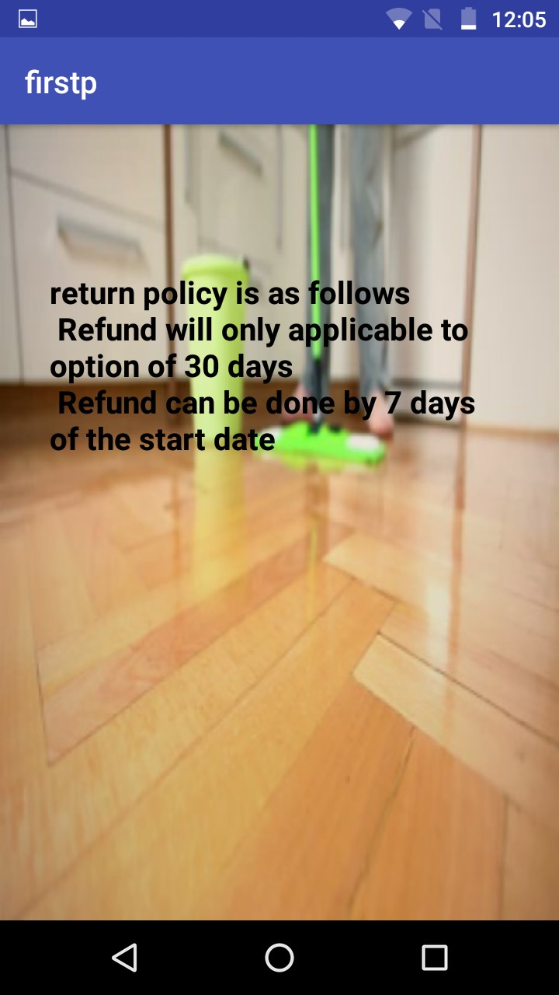
Return policy information
This page displays all the information of our return policy which is applicable for the monthly services

Slide 13
FUTURE SCOPE
Digitalization in house keeping sector
Ease for finding maid
Customization acc to users timing
Tracking of the booking and work

Slide 14
MAID FOR HELP
THANK YOU

