Slide 1
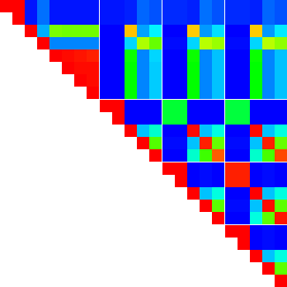
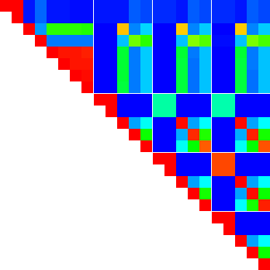

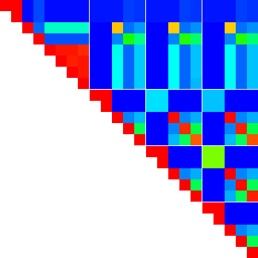
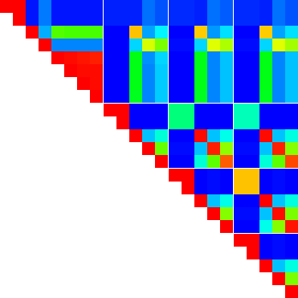
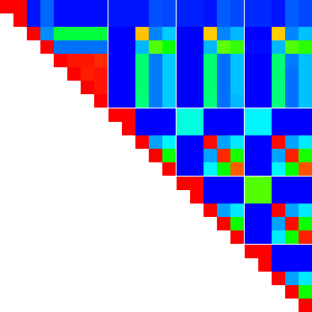
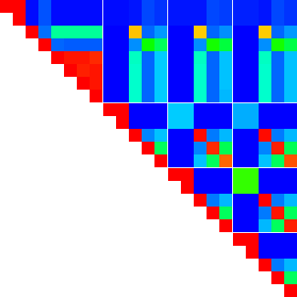
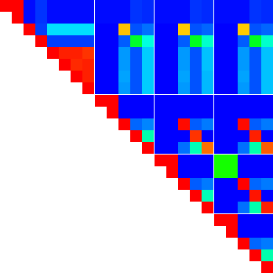
Hungarian
bzip2 (clang)
bzip2 (gcc)
bzip2go (go)
bzip2go (tinygo)
bzip2rs (sys, debug)
bzip2rs (sys, release)
bzip2rs (pure, debug)
bzip2rs (pure, release)
factorize (clang)
factorize (gcc)
factorize (go)
factorize (tinygo)
factorize (rust)
md5 (clang)
md5 (gcc)
md5 (go)
md5 (tinygo)
md5 (rust)
Dice index
Jaccard index
Simpson index
LCS
bzip2
Opcode Set
factorize
md5
sha256
Opcode Sequence
Cosine
Euclidean
Weighted Jaccard
Levenshtein
bzip2
factorize
Opcode Frequency
md5
sha256

Slide 2
Dice index
Jaccard index
Simpson index
bzip2
bzip2 (clang)
bzip2 (gcc)
bzip2go (go)
bzip2go (tinygo)
bzip2rs (sys, debug)
bzip2rs (sys, release)
bzip2rs (pure, debug)
bzip2rs (pure, release)
factorize (clang)
factorize (gcc)
factorize (go)
factorize (tinygo)
factorize (rust)
md5 (clang)
md5 (gcc)
md5 (go)
md5 (tinygo)
md5 (rust)
Opcode Set
factorize
md5
sha256
Cosine
Euclidean
Weighted Jaccard
bzip2
factorize
Opcode Frequency
md5
sha256
LCS
Levenshtein
bzip2
factorize
Opcode Sequence
md5
sha256

