Slide 1
Online Point of Sale
E-POS
Md. Sadakul Islam
Md. Zahidul Islam
Md. Mahbubur Rahman
Anwar Jahan

Slide 2
Presentation Agenda
Project Overview/Purpose
Project Deliverables
Software Development Model
System Design (Architectural and Detailed)
Difficulties Encountered and Lessons Learned
System Demonstration
Questions and Answers

Slide 3

Tools
Language: Java
Web: HTML5, CSS3, JSF, JSTL, EL, jQuery, Ajax, PrimeFace UI
IDE: Netbeans
Framework: EJB , JPA
Database: MySql
Repository: GIT
Visiting Des Moines for real life experiences
Combined our skills and strength

Slide 4
Project Deliverables
Documentation
  Project Management Plan Document
  Architectural (High-Level) Design Document
  UML Model
Software
  Java Source Code
  All Netbeans Project Related Files
  Database Structure

Slide 5
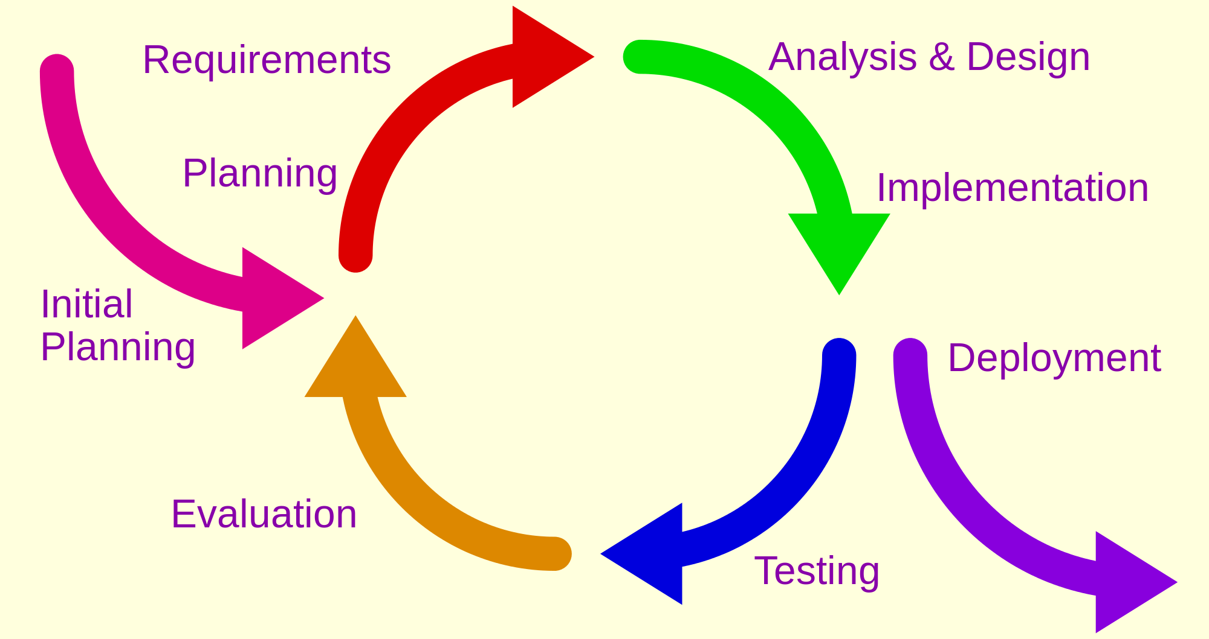
Software Development Model - SCRUM

Slide 6
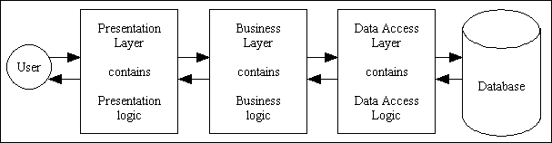
System Architecture Design

Slide 7
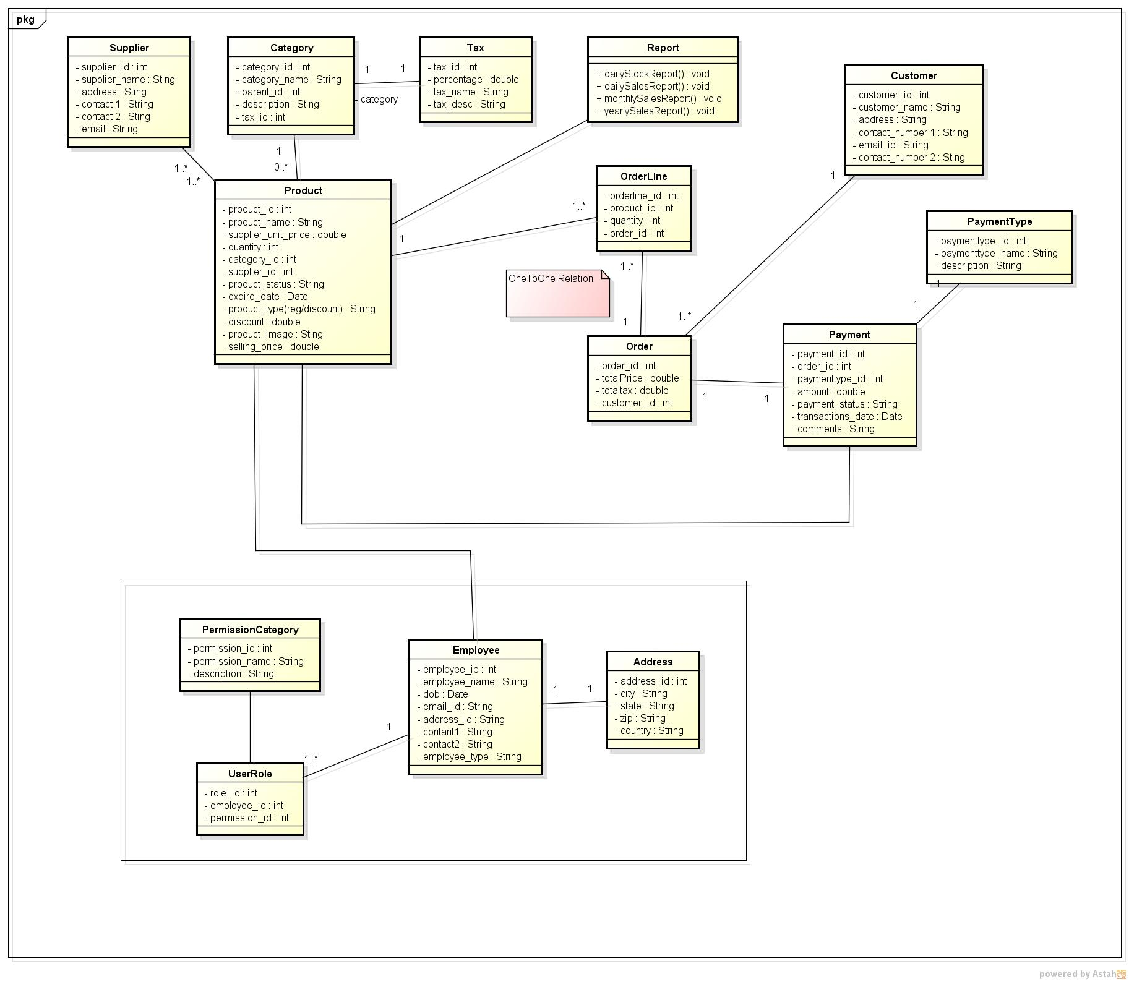
UML Diagram

Slide 8
Difficulties and Lessons Learned
Using Git allowed us to work effectively and efficiently to work in parallel.
Good team combination works
Undeploying from glassfish server, Build and Clean always works!!!

Slide 9
Demonstration Time!
Live execution of the resulting software application now demonstrated…

Slide 10
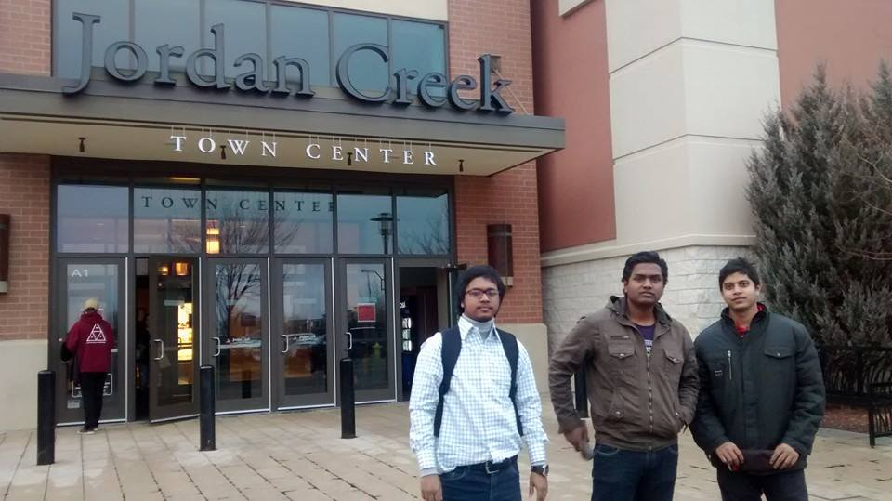
Questions/Comments?
Our team ready to answer ☺

Slide 11
Thanks to All
Merry Christmas!

