Slide 1
Critical Analysis : Collaborative geodesign and spatial optimization for fragmentation-free land allocation
Sagar Tamang and Bhupinder Juneja
CSCI 8715

Slide 2
Problem Statement
Knowledge gap:
Land management by farmers and conservation practices by environmental agencies isolated from each other.
Current optimization approaches either optimize space partitioning or land management practices but not both.
Geometric regularity and spatial contiguity constraint disregarded.

Slide 3
Problem Statement
Input:
A watershed with a set of spatial locations and unchangeable landscape boundary
Choices for land management practices (LMP)
Ecosystem objectives and their respective weights
A profit and cost value of each LMP at each location
Budget limit, minimum area and preferred shape
Output:
A fragmentation-free land allocation map with assigned LMP
Objective:
Maximize the overall profit
Constraints:
One location -- one LMP
Budget should not exceed the assigned budget limit
Each land allocation should satisfy minimum area and preferred shape requirement

Slide 4
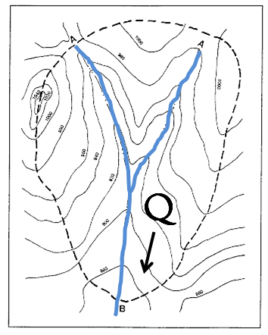
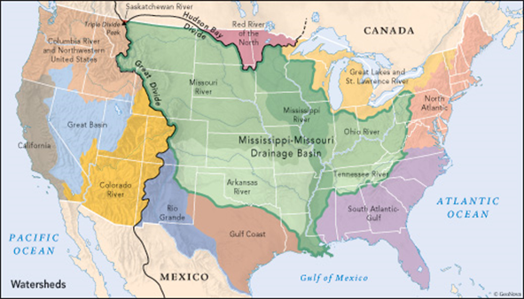
Key Concepts
Watershed - an area draining to a single point
Unchangeable landscape - Parts of watershed where land use/cover cannot be changed
Spatial location - a region eg. orthogonal land cover grid/hydrological response units
Land management practices - Practices for managing agricultural land
Spatial constraints - Constraints employed to avoid land fragmentation

Slide 5
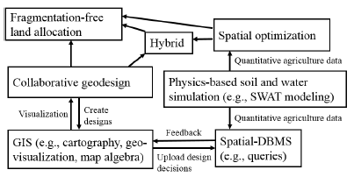
Major Contributions
Imposing shape constraints and spatial contiguity to avoid fragmentation in land allocation
Consideration of stakeholder design while performing spatial optimization
Propose three approaches to solve the Fragmentation-free land allocation plan:
Collaborative geodesign system for
stakeholders inclusiveness
(2) Spatial optimization approach to enforce
spatial constraints
(3) A hybrid approach of (1) and (2)

Slide 6
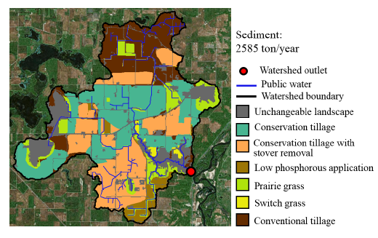
Validation Methodologies
Case Study conducted on Seven Mile Creek Watershed
Results demonstrated for both collaborative geodesign by stakeholders and spatial optimization in terms of water quality impact

Slide 7
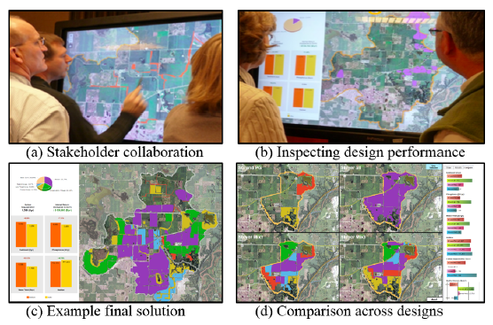
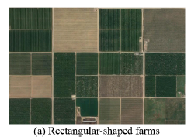
Assumptions/Limitations
Too many variables to be handled by stakeholders, geodesign not feasible.
Only rectangular shape constraint demonstrated.

Slide 8
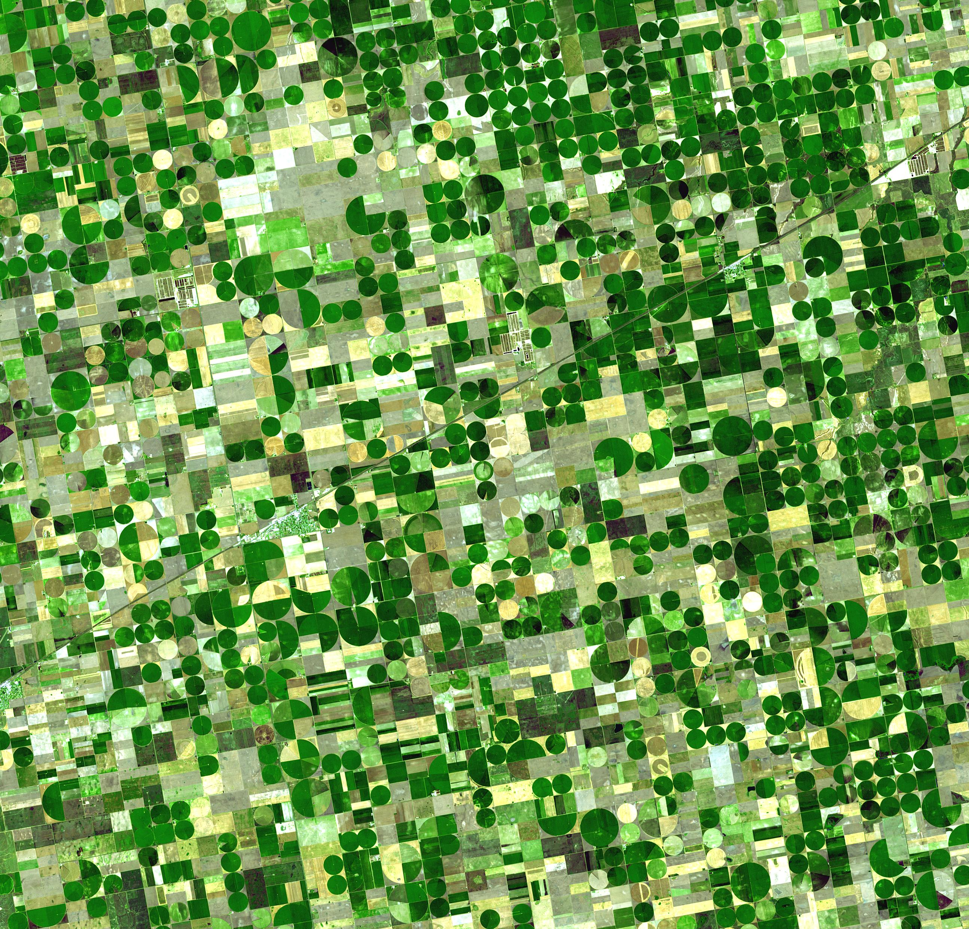
Revisions
FF-LA will intuitively favor big farms at expense of diversity. Is it possible to measure and include “maintaining diversity in farming” as a constraint in spatial optimization ?
The paper doesn’t seem to address two issues of subdivision and scattering prevalent in rural farms.

Slide 9
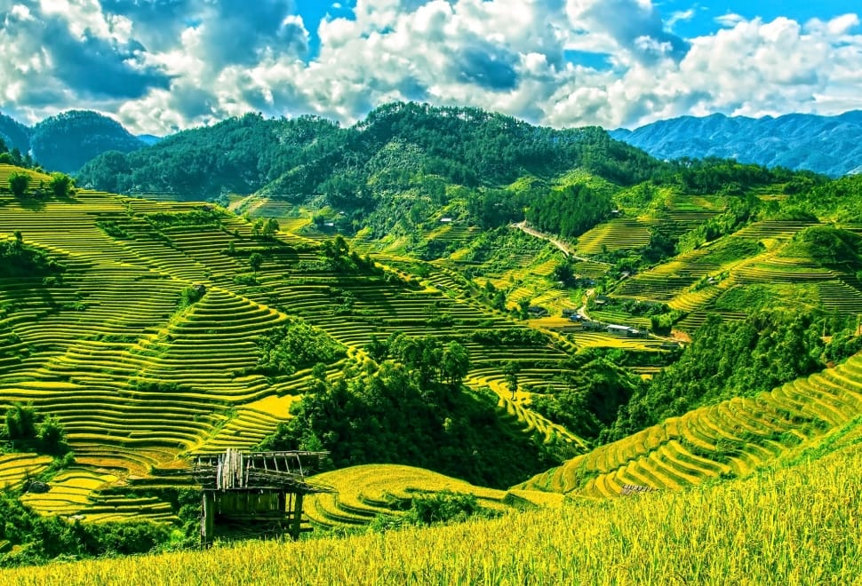
Revisions
Terrain may inherently favor small fragmented farms over large consolidated farms e.g. stepped farming prevalent in mountainous regions of rural India. Should terrain be included as a constraint in spatial optimization ?

