Slide 1

CSCI 8715 Proposal Presentation
Using Spatial Data Science Approaches to Estimate and Predict Buried Pipeline Failure Risk
Presenters
Sagar Tamang- PhD Student, Civil, Environmental, and Geo- Engineering
Bhupinder Juneja- Graduate Instructor, PhD Student, CSOM Supply Chain & Operations
Prof. Sehwon Kang, External Collaborator @ Tilburg School of Economics and Management
Notes:
Please especially check titles – I was guessing

Slide 2
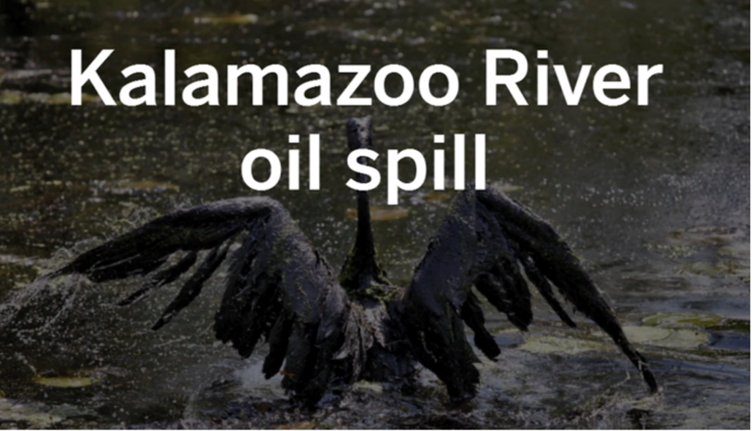
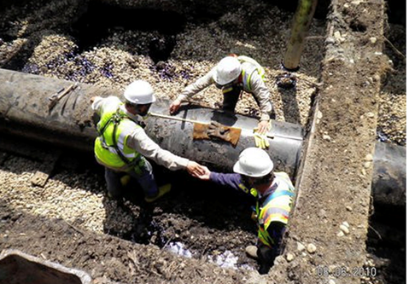
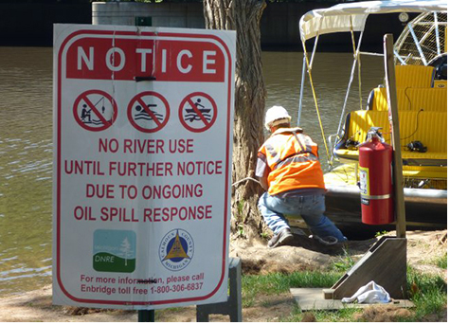
PROBLEM BACKGROUND AND MOTIVATION
Pipeline safety is vital because pipeline incidents threaten human health, biological life, and the environment. One single pipeline incident can result in a significant consequence.
Occurred in 2010, its considered to be largest oil spill in American history.
The oil spill caused by ruptured buried pipeline released 800,000 gallons of crude oil into wetlands near Marshall, Mich., and later into the Kalamazoo River.
Took 6 years in clean up effort and costed $1.2 billion.
Caused considerable environmental damage .
Can spatial data science be leveraged to predict potential hotspots of failure and estimate associated risk. so such disasters can be prevented ?

Slide 3
WHAT MAKES IT A HARD PROBLEM TO SOLVE ?
Total pipeline mileage in the United States are more than 2 million miles.
Pipeline incidents are low-probability high-consequence events.
Buried pipelines are subject to multiple stresses including but not limited to potentially unstable soil movements, seismic shocks, terrain topography , hydrography, population characteristics etc. These stresses can be broadly classified as Structural and Operational stresses.
Manual monitoring of deformations is expensive and time consuming intervention.
Sensor placement is often error prone due to inaccurate information on hotspots of failure.
General mindset has been “Out of Sight, Out of Mind, Until It Leaks”
Multiple contributors of stresses need to be investigated together vis-à-vis their interaction with buried pipelines in order to predict potential hotspots of failure and estimate associated risk.

Slide 4
HOW IS IT SOLVED TODAY?
Most approaches take a compartmentalized view of problem, they focus on limited set of variables belonging to structural or operational categories [1,2].
Traditional statistical or Machine Learning approaches are not well suited to deal with nuances of high dimensional data comprising of spatial and temporal characteristics of geographical data including hydrography, waterway, land cover, pipeline network shape etc. [3,4,5,6].
Most approaches treat prediction of failure hotspots and associated estimation of downside risk to rank pipelines according to their failure likelihood as two separate and independent problems when in reality they are interlinked.
Given vast pipeline network spanning 2 million miles in US, a prioritization scheme based on prediction of failure hotspots associated with estimates of downside risk is needed to reduce costs and focus efforts.

Slide 5
A NEW APPROACH:
AIM1 : An Integrative framework to empirically explore association between structural and operational stress factors related to buried pipeline failure risk using Spatial Regression.
(Note: The stress factors comprise of both spatial features such as GIS imagery data and non spatial features such as demographic and incidence data).
AIM 2: Failure hotspot prediction using Spatio-Temporal Data Mining

Slide 6
PROPOSED FRAMEWORK FOR AIM 1
Structural Risk Factors
Terrain, Hydrography, soil movement, seismic shocks, Land Cover etc.
H2a
Already established in earlier studies
Socio-economic and Demographic Factors
H3
Buried Pipeline Failure Risk
H2b
H1
Operational Risk Factors
Past Incidence reports, Political Stability etc.

Slide 7
Hypotheses FOR AIM 1
H1: Ceteris paribus, There exists positive association between operational risk factors and risk of buried pipeline failure.
H2a: Ceteris paribus, Socio-economic and demographic factors associated with population living in the vicinity of buried pipeline network significantly accentuates the relationship between structural risk factors and risk of pipeline failure.
H2b: Ceteris paribus, Socio-economic conditions of population living in vicinity of buried pipelines significantly moderate the association between operational factors and risk of buried pipeline failure.
H3: Ceteris paribus, Structural risk factors positively moderate the relationship between operational risk factors and pipeline failure risk.

Slide 8
Datasets identified for aim 1
Name | Description
Pipeline Incident Data (2010 – 2017) | -Time: incident time, incident identified time, reported time -Consequence: Volume: released commodity type, intended release, unintended release, recovered, Cost and other: fatality, injury, property damage, env. cost, total cost, commodity lost cost Ecological: wildlife impact (Y/N), soil contamination, water contamination. -Location: incident Longitude/Latitude, (Under Soil) - Pipeline Operator: id, name, address, (incident – pipe facility name, segment name) - Pipeline characteristics: intra/inter state, system part involved incidents, item involved incidents, pipeline thickness, pipeline diameter, seam type, material type, installed year, pipeline pressure - incident cause: external corrosion, internal corrosion, natural force (earth movement, floods, lightning, temperature, high winds, other), excavation damage, other (car, boat, fishing, …), material failure, equipment failure, incorrect operation
Pipeline system: image/GIS | - Petroleum product terminal: All operable bulk petroleum product terminals located in the 50 States company name, city, state, long-lat. - border crossing liquids: Border crossings of liquids pipelines- Petroleum product pipeline: operator name, pipeline name - HGL pipeline: operator name, pipeline name - Crude oil pipeline: operator name, pipeline name
Population: image/GIS | - high populated area: a population density of at least 1,000 people per square mile - other populated area: area contains a concentrated population, such as an incorporated or unincorporated city, town, village, or other designated residential or commercial area
Other data sets include Hydrography data (GIS), Land Cover data (Images) , Census Population data, Highly Sensitive Area (SGML data)

Slide 9
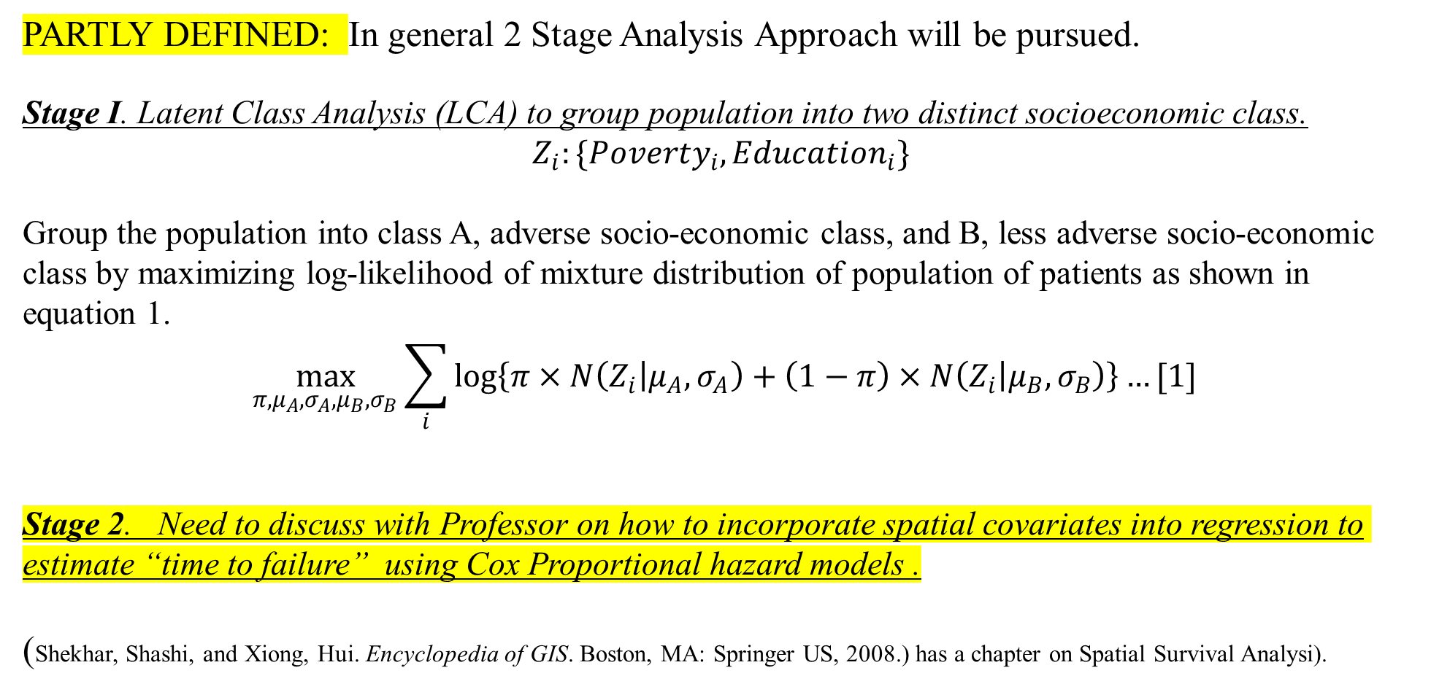
EMPERICAL STRAGTEGY FOR AIM 1 : SPATIAL REGRESSION
PARTLY DEFINED: In general 2 Stage Analysis Approach will be pursued.
Stage I. Latent Class Analysis (LCA) to group population into two distinct socioeconomic class.
$$Z_{i}:\{Poverty_{i}, Education_{i}\}$$
Group the population into class A, adverse socio-economic class, and B, less adverse socio-economic class by maximizing log-likelihood of mixture distribution of population of patients as shown in equation 1.
$$\max_{π,μ_{A}, σ_{A}, μ_{B},σ_{B}}{\sum_{i}{\log\left\{π×N\left(Z_{i} | μ_{A}, σ_{A}\right)+\left(1−π\right)×N\left(Z_{i} | μ_{B}, σ_{B}\right)\right\}}}…[1]$$
Stage 2. Need to discuss with Professor on how to incorporate spatial covariates into regression to estimate “time to failure” using Cox Proportional hazard models .
(Shekhar, Shashi, and Xiong, Hui. Encyclopedia of GIS. Boston, MA: Springer US, 2008.) has a chapter on Spatial Survival Analysi).

Slide 10
AIM 2: FAILURE HOTSPOT PREDICTION USING SPATIO-TEMPORAL DATAMINING
TO BE ELABORATED LATER.

Slide 11
RESEARCH PROGRESS TIMELINE
MILESTONES | Due date | CURRENT STATUS
Identify and gather data set for analysis. | - | DONE
Prepare empirical model and get it validated from Professor. | MARCH 19 | IN PROGRESS
Perform Initial Spatial Regression in R/MATLAB | April 1 | NOT STARTED
REFINE ANALYSIS AND PREPARE FINAL REPORT FOR AIM 1 | April 10 | NOT STARTED
Make progress on Aim 2 and prepare preliminary results report for Same | April 26. | NOT STARTED
Long Term Goal(s): Submit Proposal for Publication to Special Issue of Production and Operations Management Journal Business Analytics: Emerging Practice and Research Issues” Get full paper ready for publication. | April 30, 2020 January 31 2021 | IN PROGRESS

Slide 12
REFERENCES
Makhlouf, Abdel Salam Hamdy, and Mahmood Aliofkhazraei. Handbook of Materials Failure Analysis : With Case Studies from the Oil and Gas Industry. Amsterdam: Elsevier, 2016.
Seismic risk assessment for oil and gas pipelines
A. Ouadah, "Pipeline Defects Risk Assessment Using Machine Learning and Analytical Hierarchy Process," 2018 International Conference on Applied Smart Systems (ICASS), Medea, Algeria, 2018, pp. 1-6.
Pipeline condition prediction using Neural Network Models
Chinedu I. Ossai. "A Data-Driven Machine Learning Approach for Corrosion Risk Assessment—A Comparative Study." Big Data and Cognitive Computing 3, no. 2 (2019): 28.
Layouni, Mohamed, Sofiene Tahar, and Mohamed Salah Hamdi. "A Survey on the Application of Neural Networks in the Safety Assessment of Oil and Gas Pipelines." 2014 IEEE Symposium on Computational Intelligence for Engineering Solutions (CIES), 2014, 95-102.

