Slide 1

MASTER’S THESIS · INFORMATION SYSTEMS / INFORMATICS
Enhance Usability of the Educational Modeling Software Apollon
A reusable foundation for individual modeling, collaboration, teaching, assessment, and export
Fady Samaan · Ravi Tamang
Supervisor: Felix Dietrich, M.Sc.
Examiner: Prof. Dr. Stephan Krusche
Garching · 08 July 2026
1
Notes:
0:00–0:20. Introduce the thesis as an ecosystem-wide usability and integration effort, not as one isolated feature. Source: metadata.typ and content/introduction.typ.

Slide 2
PROBLEM
Apollon’s breadth exposed friction across the ecosystem
01
02
03
Editing friction
Limited awareness
Fragmented workflows
Edges, layout, navigation, and repeated actions diverted attention from modeling decisions.
Collaborators could edit together but could not easily see where others were working.
Standalone, mobile, Artemis, Athena, and VS Code depended on different editor behavior and model versions.
The same usability issue can surface in individual work, team modeling, assessment, and export.
Fady Samaan & Ravi Tamang | Master’s Thesis | Apollon
2
Notes:
0:20–1:20. Explain that the problem is systemic: one editor is reused across many contexts, while legacy and maintained versions had to coexist. Avoid listing every bug. Source: content/introduction.typ, Problem.

Slide 3
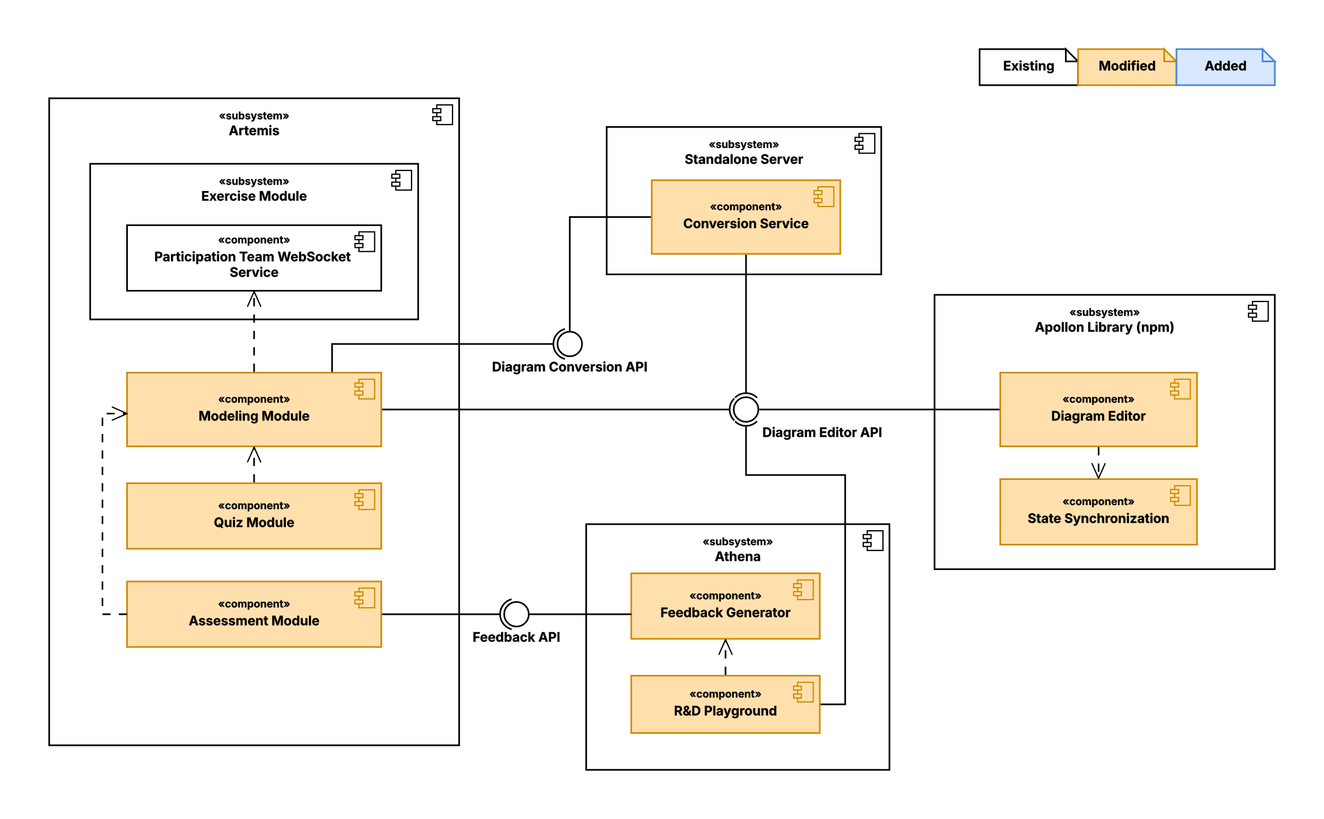
MOTIVATION
One editor foundation affects every learning context
Shared editor behavior
Modeling · rendering · callbacks · collaboration awareness
Host-owned workflows
Persistence · authentication · courses · assessment · deployment
Improve once—reuse consistently.
Fady Samaan & Ravi Tamang | Master’s Thesis | Apollon
3
Notes:
1:20–2:00. State the architectural thesis: reusable editor behavior belongs in the Apollon library; host-specific workflows remain outside. Source: content/system_design.typ.

Slide 4
OBJECTIVES
Four objectives guided the thesis
1
Improve modeling and application usability
Simplify diagram editing, navigation, mobile use, and export workflows.
2
Support collaborative modeling
Make collaborator activity visible in standalone shared modeling and Artemis team modeling.
3
Enhance Apollon for educational systems
Preserve exercises, quizzes, assessment, feedback generation, and existing diagram formats.
4
Improve diagram portability
Produce dependable visual representations and export artifacts across environments.
Fady Samaan & Ravi Tamang | Master’s Thesis | Apollon
4
Notes:
2:00–2:45. Read the four verb-led objectives. Say that the same wording will return on the status slide. Source: content/introduction.typ, Objectives.

Slide 5
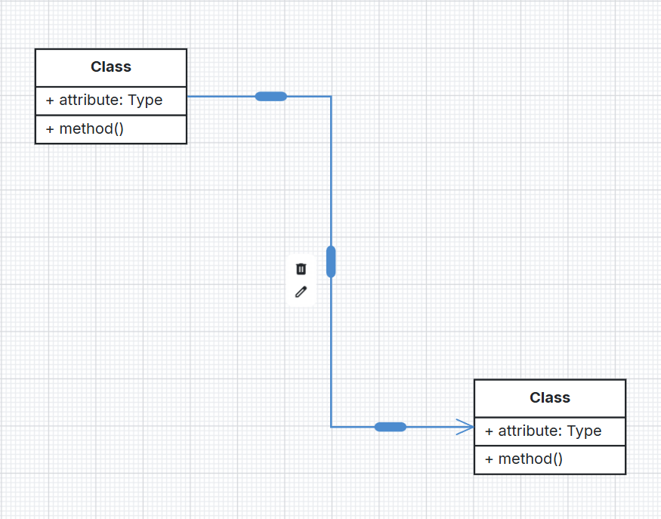
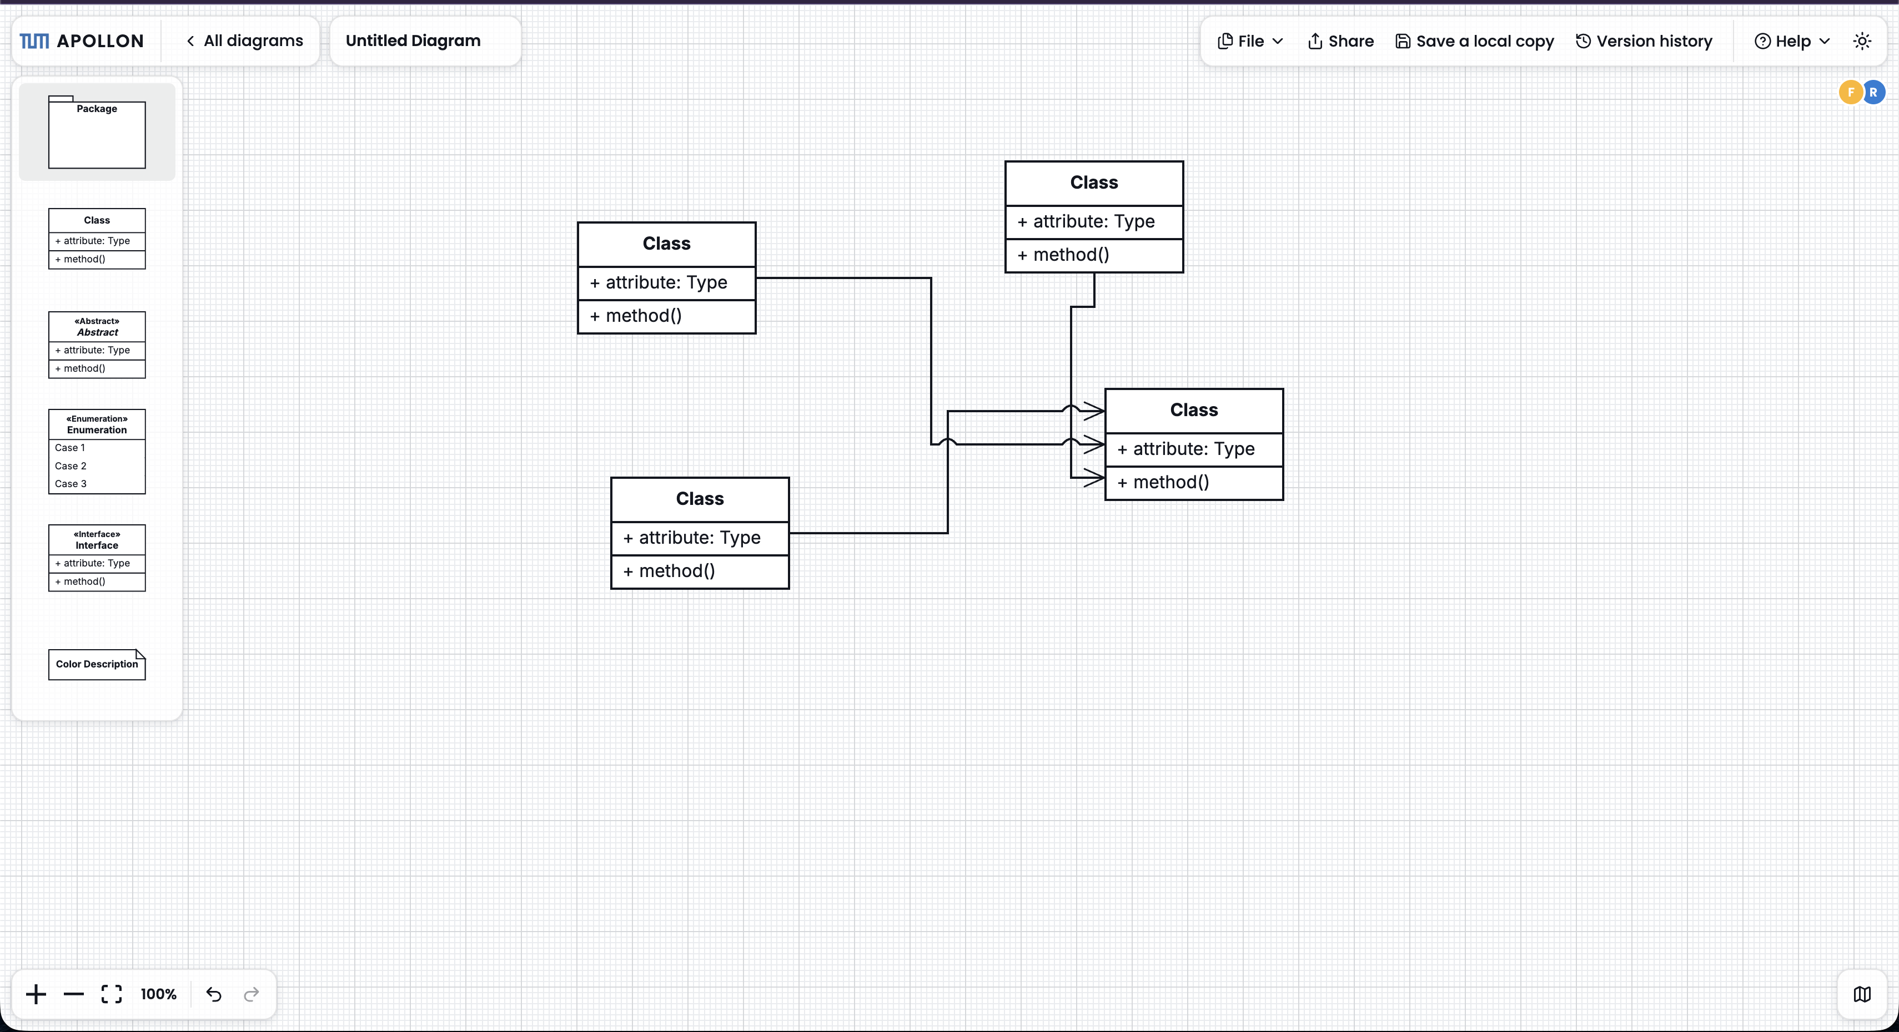
OBJECTIVE 1 · USABILITY
Editing improvements reduce repeated diagram work
Bend precisely
Read crossings
Waypoint dragging · reconnection · dynamic handles
Line jumps · compact routing · manual label placement
Fady Samaan & Ravi Tamang | Master’s Thesis | Apollon
5
Notes:
2:45–3:45. Use the two visuals to explain direct-manipulation improvements. Mention alignment guides, keyboard deletion, reordering, scroll lock, and larger selectable areas only verbally. Source: content/summary.typ and figures/edge-*.png.

Slide 6
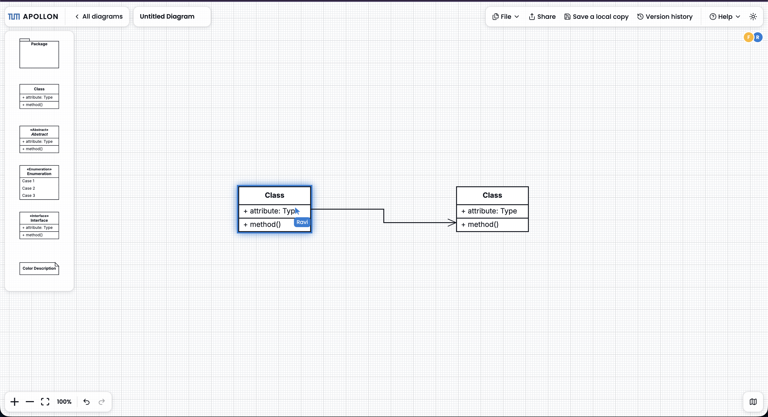
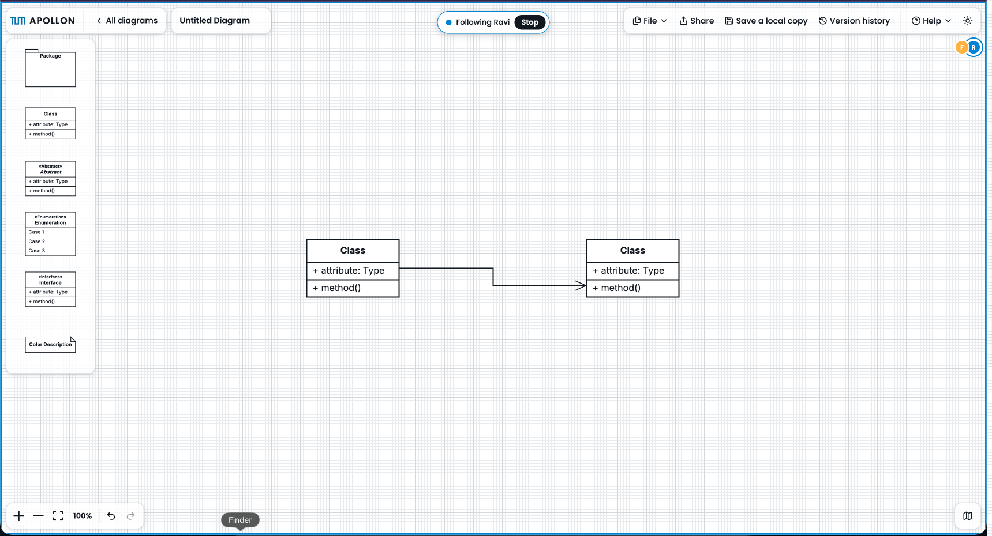
OBJECTIVE 2 · COLLABORATION
Collaboration awareness makes shared modeling legible
See who is active
Follow the work
Named cursors and selected or dragged elements expose activity in the shared workspace.
Viewport following helps participants coordinate without persisting awareness state in the diagram model.
Fady Samaan & Ravi Tamang | Master’s Thesis | Apollon
6
Notes:
3:45–4:45. Emphasize that awareness is transient session state and remains separate from persisted diagram content. Source: content/summary.typ and collaboration figures.

Slide 7
OBJECTIVE 1 · USABILITY
Standalone and mobile workflows became easier
01
Find diagrams
Home page and URL-based routing
02
Return safely
Local/shared lists and version history
03
Export anywhere
Mobile/iOS file and sharing support
Fady Samaan & Ravi Tamang | Master’s Thesis | Apollon
7
Notes:
4:45–5:30. Bridge from editor interactions to complete application workflows: create/open, distinguish local/shared, return through history, and export on mobile. The live demo shows the current interface. Source: content/implementation.typ and content/summary.typ.

Slide 8
LIVE DEMO
From model creation to an editable presentation export
1
2
3
Create
→
Edit together
→
Export
Open the standalone home page and create or import a realistic UML model.
Bend an edge, show line jumps, then reveal selection and viewport awareness.
Export the diagram as PPTX and show that elements remain separately animatable.
Demo target: a short modeling flow with realistic thesis diagrams
Fady Samaan & Ravi Tamang | Master’s Thesis | Apollon
8
Notes:
5:30–8:30 (3 minutes). Demo flow: import figures/requirements-editing-activity-model.json or create a small activity diagram; adjust one edge; open a shared/collaborative diagram to show awareness; export as 16:9 PPTX. Before presenting, record this exact flow as the backup screencast.

Slide 9
ARCHITECTURE · DATAFLOW
Reuse editor behavior across clients
1
The standalone editors reuse the maintained Apollon library through the editor API.
Existing
Modified
Added
«subsystem»
«subsystem»
Standalone Web Application
Standalone Server
«component»
«component»
Diagram Overview
Diagram API
Diagram Service
«subsystem»
Apollon Library (npm)
«component»
«component»
«component»
Diagram Editor
Apollon Editor API
Apollon Diagram Editor
WebSocket Relay
Collaboration WebSocket
«component»
State Synchronization
«component»
«component»
Version History
Version API
Version Service
«component»
Redis Stack
Fady Samaan & Ravi Tamang | Master’s Thesis | Apollon
9
Notes:
8:30–9:00. First build: client-side editor behavior is reusable. Point to the standalone application and Apollon library. Source: figures/apollon-standalone-decomposition.json exported through Apollon as native PPTX shapes.

Slide 10
ARCHITECTURE · DATAFLOW
Keep collaboration transport host-owned
2
Shared editing crosses the host boundary through APIs and a WebSocket relay.
Existing
Modified
Added
«subsystem»
«subsystem»
Standalone Web Application
Standalone Server
«component»
«component»
Diagram Overview
Diagram API
Diagram Service
«subsystem»
Apollon Library (npm)
«component»
«component»
«component»
Diagram Editor
Apollon Editor API
Apollon Diagram Editor
WebSocket Relay
Collaboration WebSocket
«component»
State Synchronization
«component»
«component»
Version History
Version API
Version Service
«component»
Redis Stack
Fady Samaan & Ravi Tamang | Master’s Thesis | Apollon
10
Notes:
9:00–9:30. Second build: collaboration transport is host-owned. The library presents awareness; the standalone server relays session events. The mask now reveals the server and WebSocket path.

Slide 11
ARCHITECTURE · DATAFLOW
Persist diagrams, not transient awareness
3
Diagram versions persist in Redis Stack; collaboration awareness remains transient.
Existing
Modified
Added
«subsystem»
«subsystem»
Standalone Web Application
Standalone Server
«component»
«component»
Diagram Overview
Diagram API
Diagram Service
«subsystem»
Apollon Library (npm)
«component»
«component»
«component»
Diagram Editor
Apollon Editor API
Apollon Diagram Editor
WebSocket Relay
Collaboration WebSocket
«component»
State Synchronization
«component»
«component»
Version History
Version API
Version Service
«component»
Redis Stack
Fady Samaan & Ravi Tamang | Master’s Thesis | Apollon
11
Notes:
9:30–10:00. Third build: current shared diagrams and complete versions persist; cursors, selections, and followed viewports do not. This preserves a clean diagram model and clear ownership boundaries.

Slide 12
OBJECTIVES 3 & 4
Apollon evolves without breaking educational workflows
Artemis
Maintained editor · modeling exercises · quizzes · assessment · team modeling
Athena
Earlier and current supported model formats remain consumable for feedback
Portability
Server-side PDF · SVG compatibility · flat SVG · PPTX-ready rendering
Fady Samaan & Ravi Tamang | Master’s Thesis | Apollon
12
Notes:
10:00–10:50. Explain that the maintained editor replaced legacy behavior without abandoning active educational workflows. Include the VS Code extension verbally. Source: content/summary.typ and figures/apollon-artemis-integration.*.

Slide 13
EVALUATION
Qualitative feedback supports the direction—within limits
Formative evidence
Perceived positively
Think-aloud walkthroughs
Teaching and integration feedback
GitHub issues and implementation findings
Collaboration awareness
Line jumps and edge readability
Export reliability
Standalone navigation and diagram management
Not a controlled comparative study
Remaining friction
No quantified claims about task time, errors, or satisfaction.
Precise layout control · shortcuts · selection · styling · sharing semantics · notation coverage
Fady Samaan & Ravi Tamang | Master’s Thesis | Apollon
13
Notes:
10:50–11:40. Be explicit about the evaluation limitation. The evidence is qualitative and formative. Then show that recurring feedback still supports the implemented direction. Source: content/evaluation.typ.

Slide 14
STATUS
All four objectives were realized
✓ 1
Improve modeling and application usability
Editing, navigation, mobile, and export workflows
✓ 2
Support collaborative modeling
Selections, cursors, viewport following, library reuse
✓ 3
Enhance Apollon for educational systems
Artemis, Athena, assessment, quiz, VS Code compatibility
✓ 4
Improve diagram portability
PDF, SVG, rendering fixes, visual export checks
Next: controlled usability evaluation · persistent ownership · broader UML support · PlantUML interoperability
Fady Samaan & Ravi Tamang | Master’s Thesis | Apollon
14
Notes:
11:40–12:30. Return to the exact objective wording. All four were realized; this does not mean every usability problem is solved. Name the four future directions in one sentence. Source: content/summary.typ.

Slide 15
A shared foundation makes every improvement travel further
Apollon now provides a more consistent basis for modeling across individual study, teamwork, teaching, assessment, and export.
Questions are welcome
15
Notes:
12:30–12:45. Resolve the opening: usability and integration are connected because the same editor foundation is reused across the ecosystem. Invite discussion.

