Slide 1

MASTER'S THESIS · INFORMATION SYSTEMS / INFORMATIK
Enhance Usability of the Educational Modeling Software Apollon
One maintained modeling foundation across standalone, iOS, Artemis, Athena, and VS Code
Fady Samaan · Ravi Tamang
Supervisor: Felix Dietrich, M.Sc.
Examiner: Prof. Dr. Stephan Krusche
Garching · 8 July 2026
1
Notes:
0:00-0:15. Introduce Apollon as an ecosystem rather than one screen. The thesis covers the library, standalone application, mobile/iOS, Artemis, Athena, VS Code, and export services. Source: metadata.typ and content/abstract_en.typ.

Slide 2
CONTEXT
Apollon is more than an editor
Standalone
Mobile / iOS
Artemis
Create, manage, share
Native file export
Exercises and assessment
Apollon library
Model · rendering · awareness
Athena
VS Code
Conversion service
Model-based feedback
Workspace editing
Server-side artifacts
Fady Samaan · Ravi Tamang | Master's Thesis · Apollon
2
Notes:
0:15-0:50. Name each environment. Stress that Artemis is the concrete learning platform; Athena consumes models; VS Code is an IDE host; iOS shares the standalone workflow through Capacitor. Source: content/background.typ and content/system_design.typ.

Slide 3
PROBLEM
Users fought the editor - and every host felt it
ON THE CANVAS
IN A SHARED SESSION
ACROSS THE ECOSYSTEM
Editing interrupted modeling
Collaboration was hard to read
Integrations had drifted apart
Correcting edge paths, arranging elements, and navigating larger diagrams demanded repeated manual work.
Shared state showed the result, but not who was active, what they selected, or where they were working.
Legacy and maintained editor behavior had to coexist across Artemis, Athena, mobile, VS Code, and exports.
A small editor change could become a migration problem in quizzes, assessment, feedback, or export.
Fady Samaan · Ravi Tamang | Master's Thesis · Apollon
3
Notes:
0:50-1:30. Tell the problem as three connected experiences: student editing friction, team coordination, and platform fragmentation. Avoid a bug catalogue. Source: content/introduction.typ, Problem.

Slide 4
MOTIVATION
A shared foundation removes friction once, everywhere
Improve the reusable editor
Reuse it in every host
One interaction or rendering improvement lives in the Apollon library.
→
Standalone
iOS
Artemis
VS Code
Keep host responsibilities separate
Persistence, authentication, courses, assessment, collaboration transport, and deployment stay with their host systems.
Fady Samaan · Ravi Tamang | Master's Thesis · Apollon
4
Notes:
1:30-2:00. State the architectural motivation: reuse common behavior without moving Artemis or standalone responsibilities into the editor library. Source: content/system_design.typ, Design Goals.

Slide 5
OBJECTIVES
Four objectives guided the thesis
Improve modeling and application usability
O1
Editing, navigation, standalone workflows, and mobile use
Support collaborative modeling
O2
Reusable awareness for standalone shared modeling and Artemis team modeling
Preserve Artemis, Athena, and VS Code workflows while adopting maintained Apollon
O3
Modeling, quizzes, assessment, feedback compatibility, and IDE editing
Improve diagram portability across web, server, and iOS
O4
Dependable SVG, PNG, PDF, PPTX, and JSON workflows
Fady Samaan · Ravi Tamang | Master's Thesis · Apollon
5
Notes:
2:00-2:35. Read the four verb-led objectives. The third objective makes the thesis phrase 'educational systems' concrete by naming Artemis, Athena, and VS Code. The status slide repeats these exact sentences. Source: content/introduction.typ, Objectives, tightened for presentation specificity.

Slide 6
SYSTEM MODEL
The thesis changes the editor and its workflows
1
Diagram user
Create or edit a diagram
Collaborate and follow
Create and collaborate
Instructor
Manage local and shared work
Create quizzes and assess
2
Prepare exercises and quizzes
Export and reuse the diagram across hosts
3
Assessor
Review submissions
New: follow collaborator
New: export editable PPTX
Fady Samaan · Ravi Tamang | Master's Thesis · Apollon
6
Notes:
2:35-3:05. This is a presentation simplification of the thesis use-case model. Point out the three human roles, then the added follow and PPTX use cases. The full formal use-case model is in the appendix. Source: figures/requirements-use-case-model.* and content/requirements.typ.

Slide 7
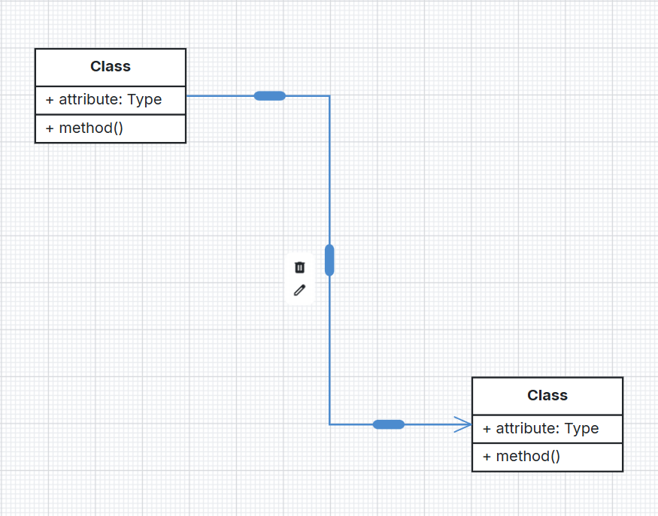
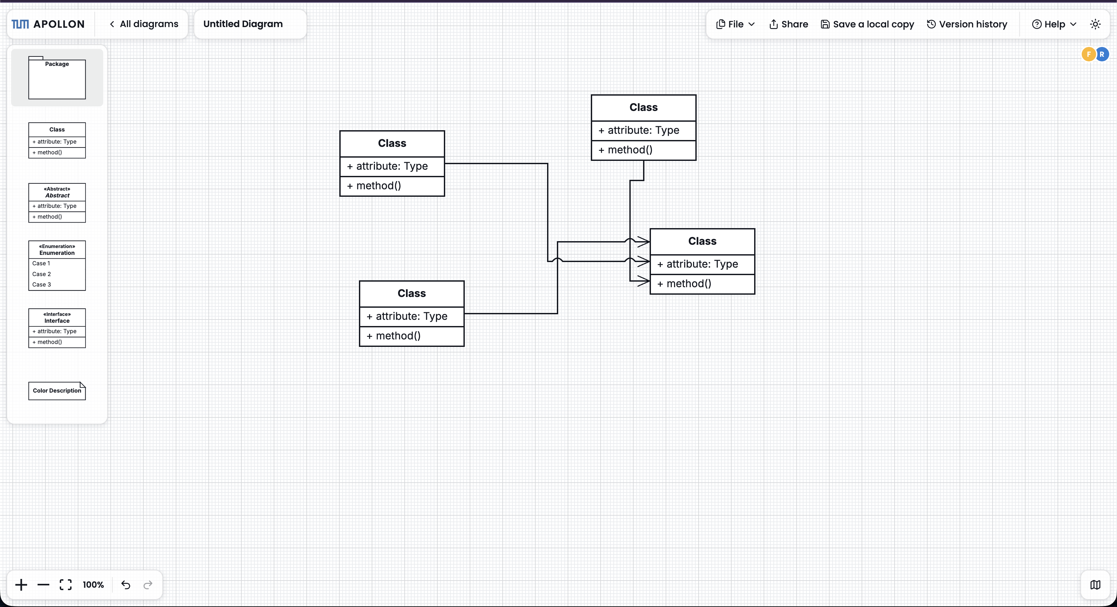
OBJECTIVE 1 · EDITING
Edges became directly manipulable
Bend, drag, reconnect
Read dense diagrams
Precise bend handles · waypoint dragging · React Flow reconnection
Line jumps · adaptive handles · compact routing · manual labels
Also: alignment guides, larger hit areas, keyboard deletion, class-member reordering, and scroll lock.
Fady Samaan · Ravi Tamang | Master's Thesis · Apollon
7
Notes:
3:05-3:45. Use the screenshots as proof, not decoration. Explain that the semantic edge remains while the path can be corrected. Mention the remaining improvements in one sentence. Source: content/implementation.typ, Edge Usability, and edge figures.

Slide 8
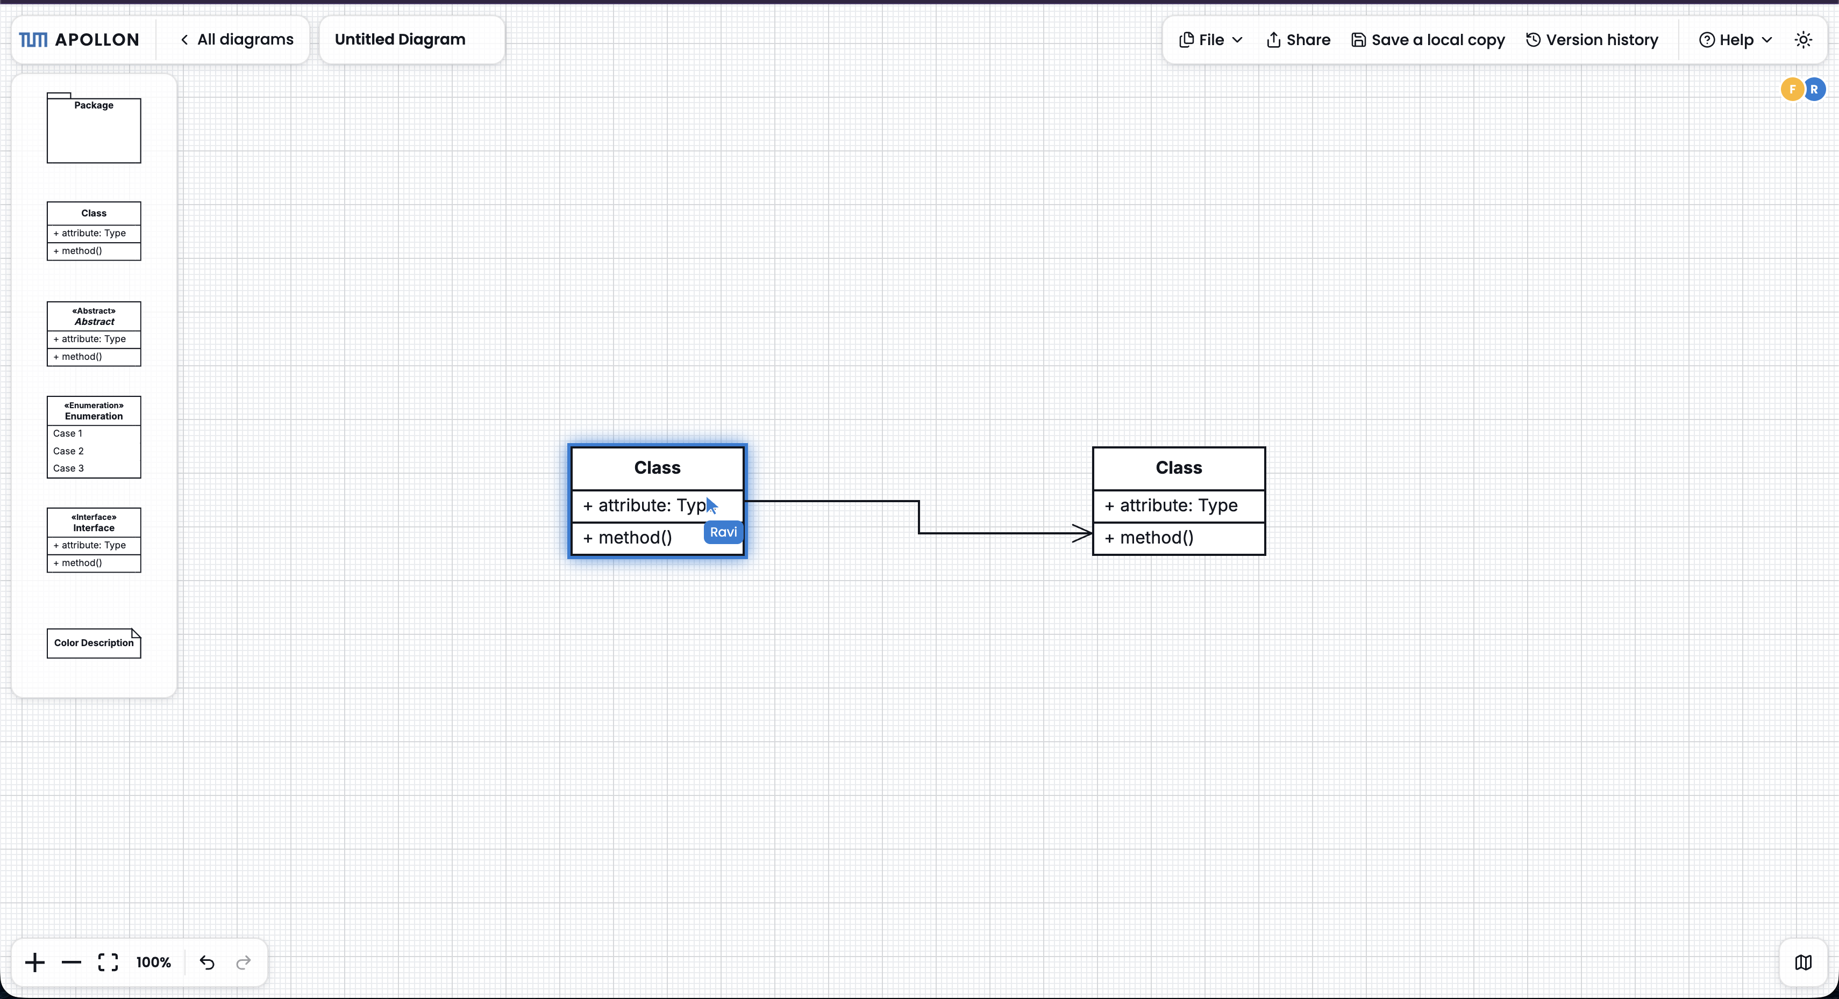
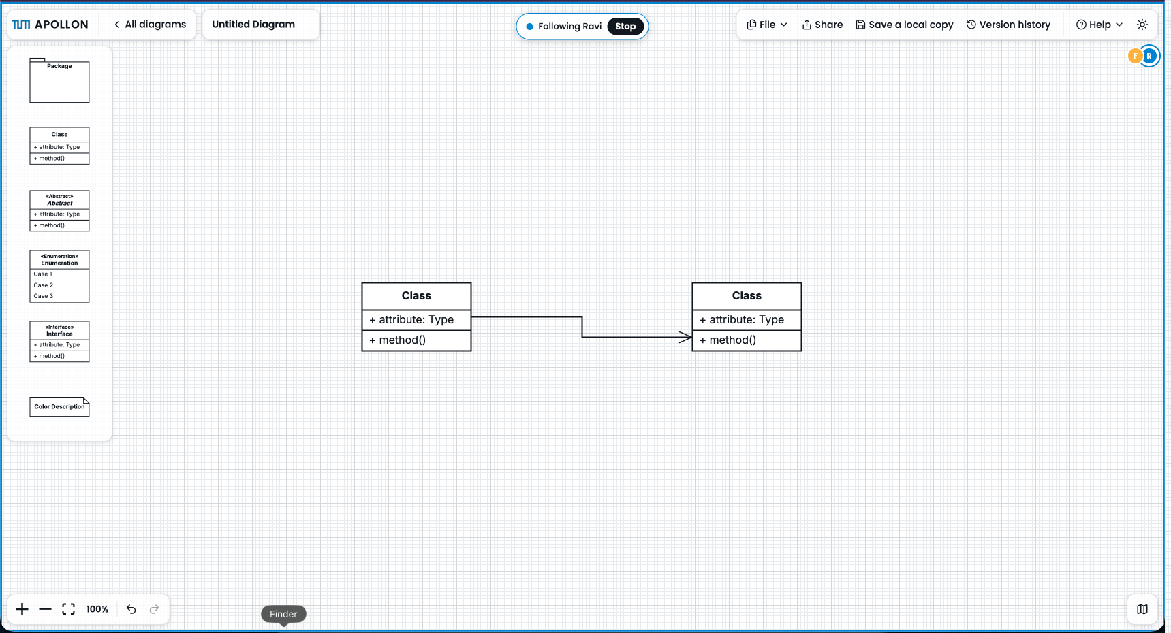
OBJECTIVE 2 · COLLABORATION
Collaboration now shows who is doing what
Named cursors and selections
Viewport following
Participants can see focus and movement before the final model change arrives.
A teammate or instructor can guide attention across a larger model.
Awareness is transient session state - it never becomes part of the persisted diagram.
Fady Samaan · Ravi Tamang | Master's Thesis · Apollon
8
Notes:
3:45-4:25. Describe the three iterations: selection/drag highlights, named live cursors, and viewport follow. Emphasize that awareness remains outside the diagram model and is reusable in standalone and Artemis. Source: content/implementation.typ, Collaboration Awareness.

Slide 9
OBJECTIVE 1 · STANDALONE
Standalone Apollon became a diagram workspace
1
2
3
4
5
Open home
→
Find
→
Manage
→
Share
→
Return
Start with existing work
Search · filter · sort
Favorite · duplicate · delete
Stable local/shared routes
History · retry · overview
Users return to existing work instead of starting from a blank editor.
Local and shared diagrams remain addressable through stable routes.
Fady Samaan · Ravi Tamang | Master's Thesis · Apollon
9
Notes:
4:25-4:55. Explain the shift from editor-first to diagram-management-first. Mention local/shared routes, gallery tools, sharing, thumbnails, versions, and error recovery. Do not show the outdated thesis screenshot. Source: content/implementation.typ, Standalone Home Page and Routing.

Slide 10
OBJECTIVE 4 · MOBILE
iOS exports the same diagram - including editable PPTX
One model, five export paths
APOLLON
MOBILE
PNG
PDF
JSON
Capacitor
SVG
PPTX
Native file handling
PPTX keeps diagram elements separately editable and ready for later animation.
Fady Samaan · Ravi Tamang | Master's Thesis · Apollon
10
Notes:
4:55-5:25. Explicitly name the mobile contribution: PNG, PDF, JSON, SVG, and animatable PPTX export through Capacitor file handling and app-local services. Source: content/requirements.typ, iOS Application, and content/implementation.typ, iOS Export.

Slide 11
MASTER'S THESIS · APOLLON
Live Demo
3 min
Home → edit → collaborate → export
current app
Current standalone application · realistic thesis diagram
11
Notes:
5:25-8:25 (3 minutes). Open the current standalone home page, import or open a realistic thesis diagram, demonstrate one edge interaction, show collaboration awareness if stable, then export PPTX and show editable elements. Record this exact sequence as the backup screencast.

Slide 12
ARCHITECTURE · STANDALONE
The library owns behavior; hosts own workflows and data
12
Existing
Modified
Added
«subsystem»
«subsystem»
Standalone Web Application
Standalone Server
«component»
«component»
Diagram Overview
Diagram Service
«subsystem»
Diagram API
Apollon Library (npm)
«component»
«component»
«component»
Diagram Editor
Apollon Diagram Editor
WebSocket Relay
Apollon Editor API
Collaboration WebSocket
«component»
State Synchronization
«component»
Version History
«component»
Version API
Version Service
«component»
Redis Stack
Notes:
8:25-9:00. This is the editable Apollon PPTX export of the standalone subsystem decomposition. It is translated downward only - there is no horizontal or vertical scaling, so the diagram is not stretched. Point out the library boundary, standalone UI, server, WebSocket relay, and Redis. Animation is intentionally deferred for later manual work.

Slide 13
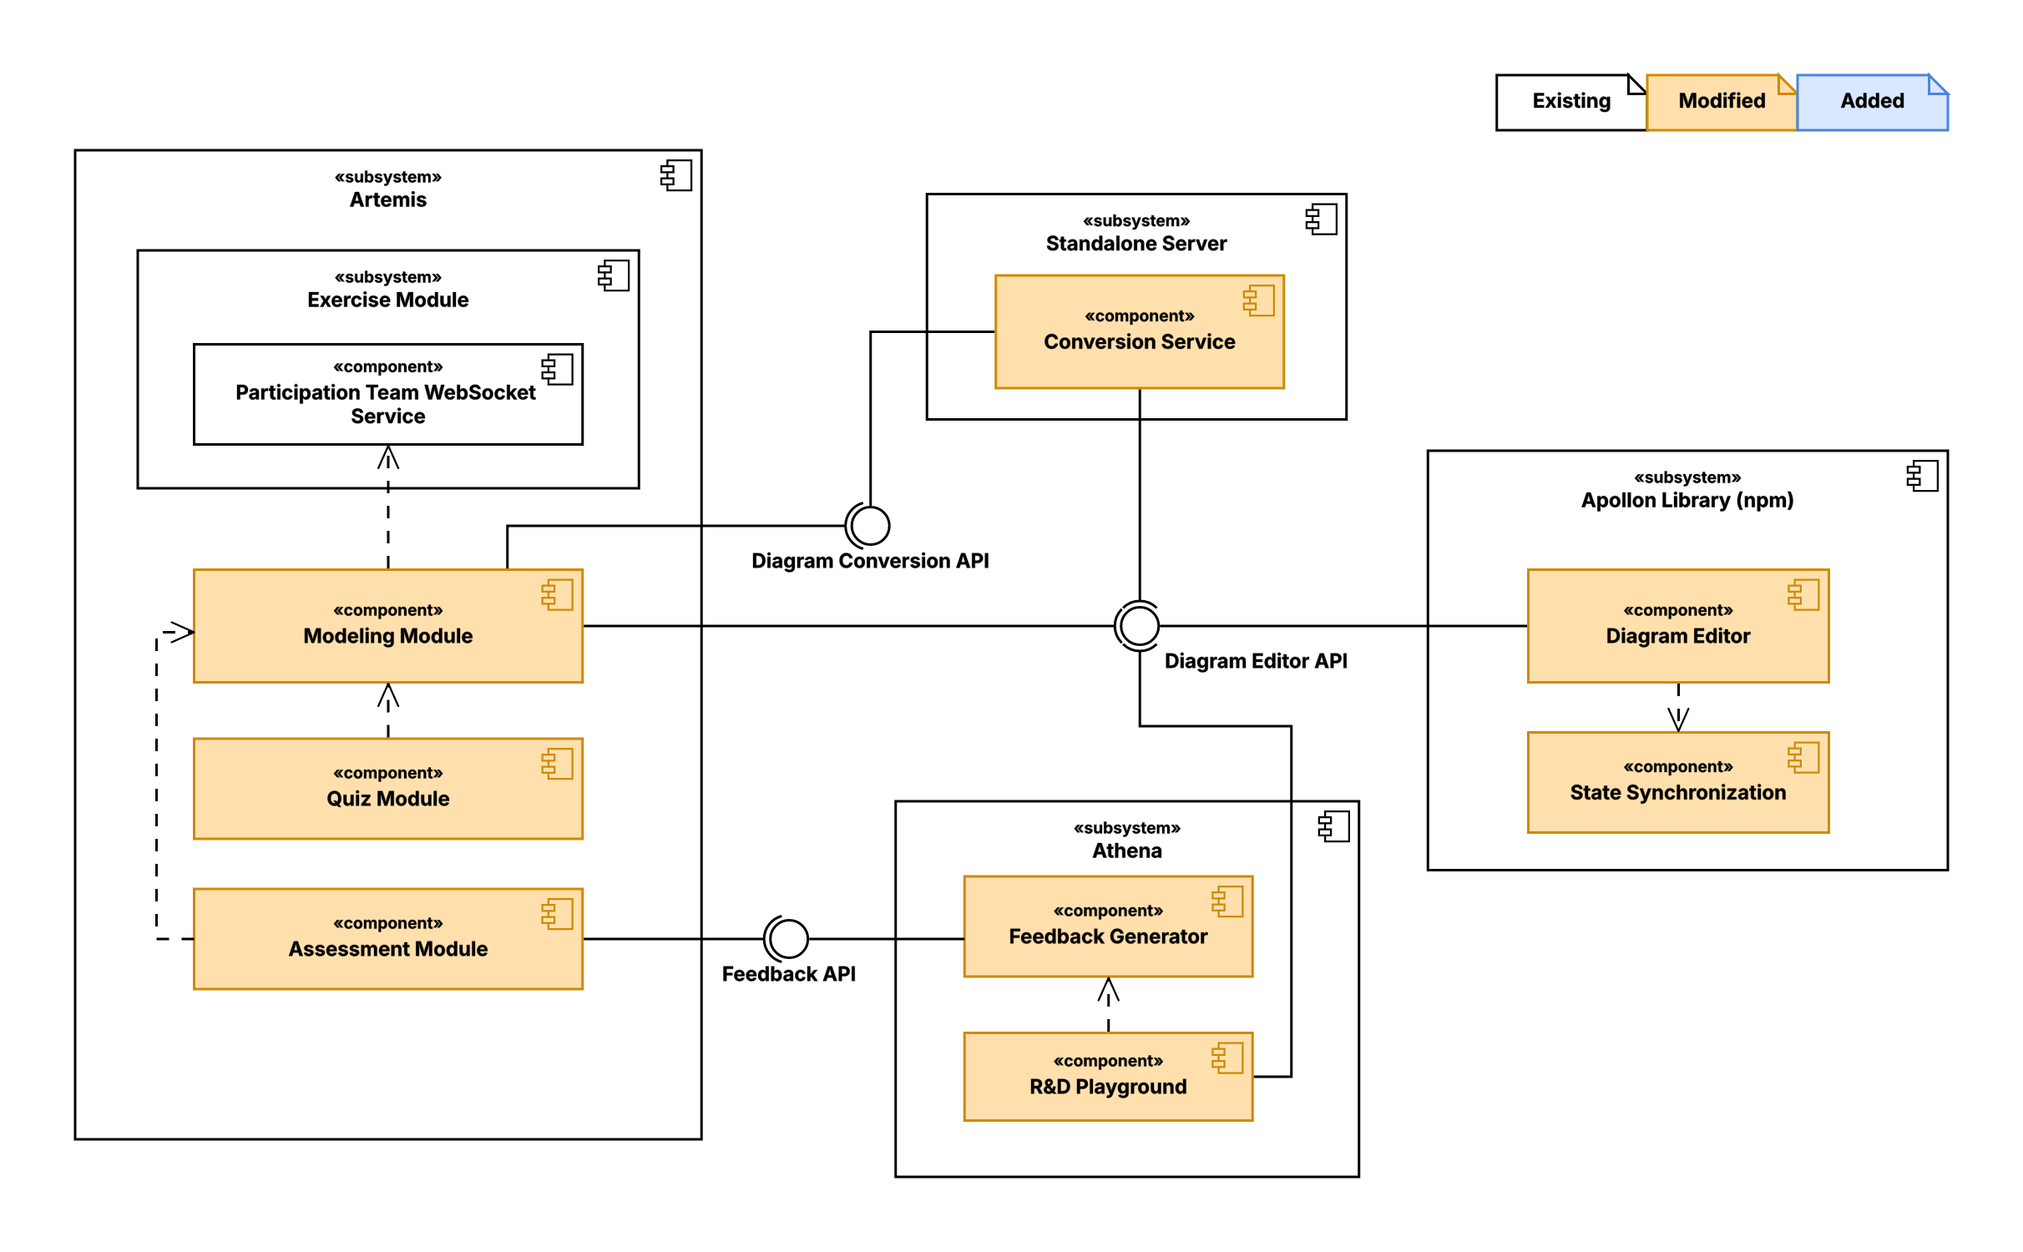
ARCHITECTURE · ARTEMIS
Artemis keeps the teaching workflow around the editor
Shared editor API
Fady Samaan · Ravi Tamang | Master's Thesis · Apollon
13
Notes:
9:00-9:35. Keep the diagram large. Artemis owns exercises, submissions, quiz data, assessment records, permissions, persistence, and team sessions. Apollon provides the editor and model interaction. Athena consumes serialized models. Source: content/system_design.typ and figures/apollon-artemis-integration.*.

Slide 14
OBJECTIVE 3 · ARTEMIS
Artemis adopted maintained Apollon without losing workflows
1
2
3
4
Model
Quiz
Assess
Collaborate
Modeling exercises use the maintained editor.
Selected and nested elements become aligned cut-outs and drop locations.
Element interaction and structured-grading compatibility remain intact.
Team modeling reuses the same awareness surface.
Migration constraint
Existing courses, exercises, serialized models, assessment, and feedback workflows had to continue working.
Fady Samaan · Ravi Tamang | Master's Thesis · Apollon
14
Notes:
9:35-10:15. Tell the migration through four preserved teaching workflows: modeling, quiz generation including nested class members, assessment, and team modeling. Source: content/implementation.typ, Artemis Migration and Quiz/Assessment.

Slide 15
OBJECTIVE 3 · INTEGRATIONS
Athena and VS Code stayed on the same model foundation
Athena
VS Code
Serialized model
→
Version-aware parser
.apollon file
→
Maintained renderer
Earlier and current supported Apollon formats remain usable for feedback generation.
The extension moved into the Apollon monorepo and now follows the maintained release path.
Same model definitions - different host responsibilities
Fady Samaan · Ravi Tamang | Master's Thesis · Apollon
15
Notes:
10:15-10:50. Athena does not embed the editor; it parses supported model versions. VS Code is a local IDE host that now uses the maintained renderer from the monorepo. Source: content/implementation.typ, Athena and VS Code sections.

Slide 16
OBJECTIVE 4 · PORTABILITY
Export now works beyond the browser
SVG
PNG
PDF
PPTX
JSON
Diagram model
Renderer
Server path
Editable source
Bounds · labels · shapes
JSDOM + React Flow
Compatibility work
Rendering correctness
Web/compat SVG modes · CSS variables · fallback colors
Text bounds · clipping · markers · class/SFC/Petri-net fixes · visual snapshots
Fady Samaan · Ravi Tamang | Master's Thesis · Apollon
16
Notes:
10:50-11:30. Explain the source-to-artifact path. The server-side PDF conversion no longer launches a browser; SVG compatibility and text-bound fixes make artifacts more dependable. Do not claim universal interoperability. Source: content/implementation.typ, Export and Rendering.

Slide 17
EVALUATION
Feedback supports the direction - not a measured gain
What users valued
What still interrupted the flow
Line jumps and edge readability
Collaboration awareness
Export reliability
Standalone navigation and diagram management
Precise layout control
Shortcuts and discoverability
Selection and styling flexibility
Sharing semantics and notation coverage
Qualitative and formative: no controlled comparison of task time, errors, or satisfaction.
Fady Samaan · Ravi Tamang | Master's Thesis · Apollon
17
Notes:
11:30-12:10. Be explicit about method and limitation. Sources included issues, developers, teaching contexts, integration feedback, tests, and think-aloud walkthroughs. The thesis does not quantify task time, error rate, or satisfaction. Source: content/evaluation.typ.

Slide 18
STATUS
All four objectives are realized within scope
Improve modeling and application usability
DONE
✓
Edges, editing controls, standalone management, and mobile use
Support collaborative modeling
DONE
✓
Named cursors, selections, viewport following, and library reuse
Preserve Artemis, Athena, and VS Code workflows while adopting maintained Apollon
DONE
✓
Exercises, quizzes, assessment, model compatibility, team modeling, and IDE editing
Improve diagram portability across web, server, and iOS
DONE
✓
Server PDF, SVG compatibility, visual fixes, and editable presentation export
Realized does not mean finished: the evaluation identifies the next product-level work.
Fady Samaan · Ravi Tamang | Master's Thesis · Apollon
18
Notes:
12:10-12:50. Return to the exact objective wording and ordering from slide 5. All four are realized within the defined thesis scope. Qualitative feedback and future work prevent overclaiming. Source: content/summary.typ, Realized Goals.

Slide 19
FUTURE WORK
The next gains are product-level
EVIDENCE
COLLABORATION
ECOSYSTEM
Measure usability
Strengthen ownership and review
Connect teaching and development
Test the feedback-driven edge and layout refinements systematically across diagram types, sizes, and user groups.
Add optional login, persistent shared diagrams, clearer sharing modes, local files, and review comments for supervision and assessment.
Extend Artemis workflows, PlantUML interoperability, UML notation, Git-friendly projects, VS Code continuity, and export hardening.
Keep the student workflow simple while making advanced controls discoverable.
Fady Samaan · Ravi Tamang | Master's Thesis · Apollon
19
Notes:
12:50-13:25. Select three directions rather than listing every feature: systematic evaluation, stronger persistence/ownership/review, and deeper teaching/development interoperability. Source: content/evaluation.typ and content/summary.typ, Future Work.

Slide 20
MASTER'S THESIS · APOLLON
One maintained Apollon now serves every workflow
Standalone · iOS · Artemis · Athena · VS Code · export services
Questions are welcome
20
Notes:
13:25-13:40. Resolve the opening: usability and integration are connected because the same maintained foundation is reused across every workflow. Invite questions. The remaining time is deliberate buffer for live-demo variability and transitions.

Slide 21
ADDITIONAL MATERIAL
Appendix
Requirements · models · deployment · timeline · contributions
21
Notes:
Appendix divider. Use only during questions.

Slide 22
APPENDIX · TRACEABILITY
The four objectives cover the full ecosystem
Objective
Requirement focus
Realized behavior
Primary environments
Usability
Edges · alignment · controls · standalone home and routing
Library · standalone · iOS
O1
Collaboration
Cursors · selections · drag highlights · viewport follow
Library · standalone · Artemis
O2
Compatibility
Migration · quiz · assessment · Athena parsers · VS Code
Artemis · Athena · VS Code
O3
Portability
Server PDF · SVG modes · rendering fixes · PPTX export
Web · server · iOS
O4
Fady Samaan · Ravi Tamang | Master's Thesis · Apollon
22
Notes:
Traceability reference from content/requirements.typ and content/summary.typ.

Slide 23
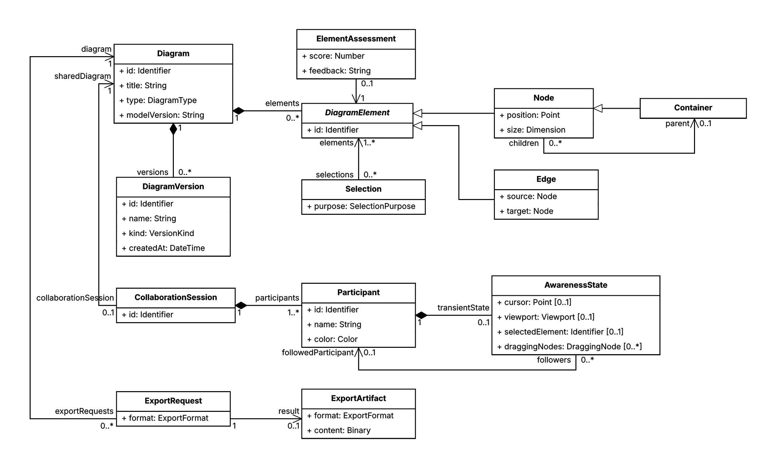
APPENDIX · SYSTEM MODEL
Diagram data and session awareness stay separate
Fady Samaan · Ravi Tamang | Master's Thesis · Apollon
23
Notes:
The model separates persisted diagram elements and versions from transient collaboration state. Export requests produce artifacts; Artemis owns exercises and assessments; Athena owns feedback requests. Source: figures/requirements-analysis-object-model.*.

Slide 24
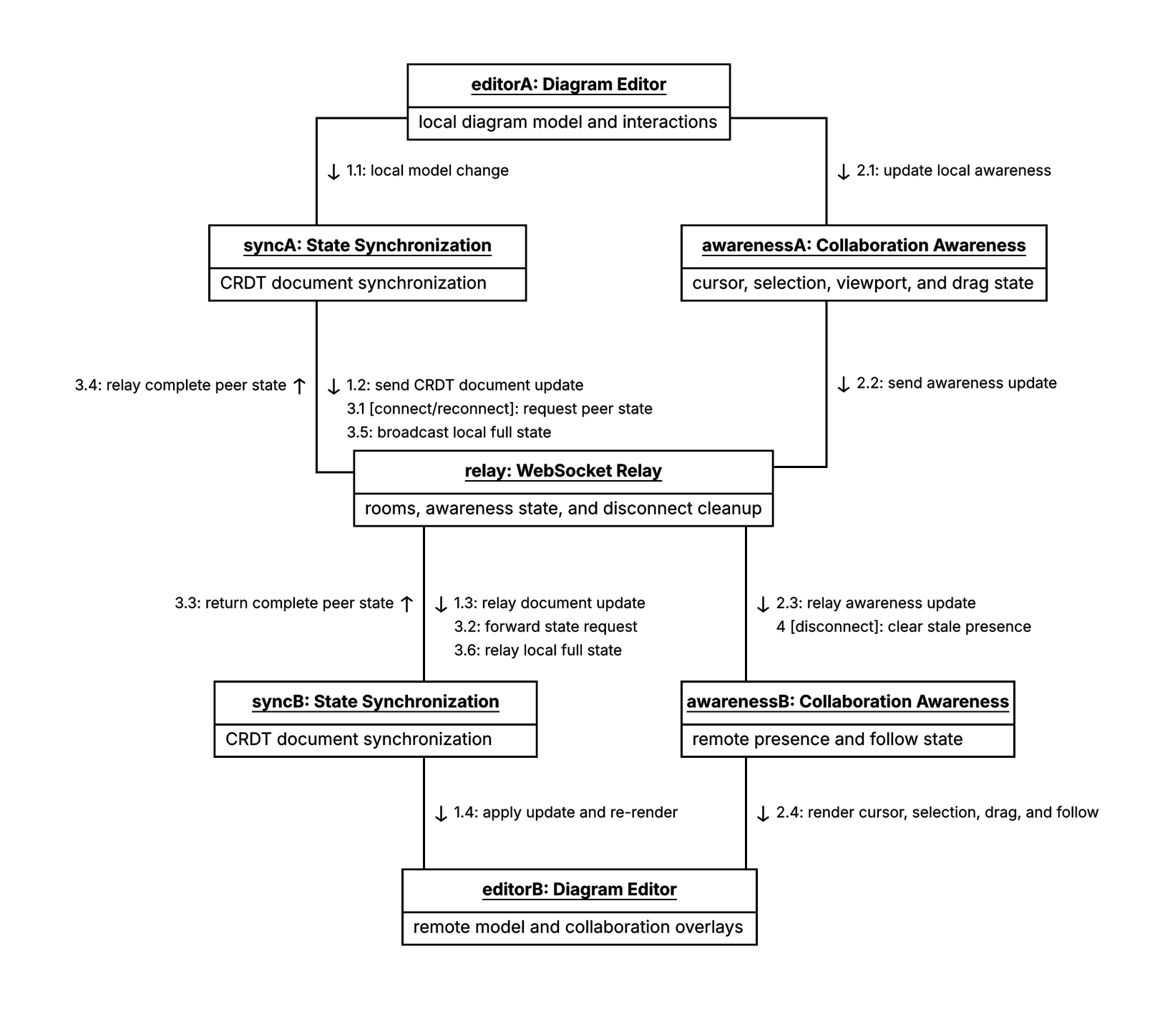
APPENDIX · COMMUNICATION MODEL
Model updates and awareness travel as separate flows
Persisted flow
CRDT document updates synchronize the diagram model and can be merged after reconnect.
Transient flow
Cursor, selection, drag, viewport, and presence updates disappear with the session.
One relay, two meanings
Fady Samaan · Ravi Tamang | Master's Thesis · Apollon
24
Notes:
Source: figures/standalone-collaboration-communication.* and content/implementation.typ, Collaboration Awareness.

Slide 25
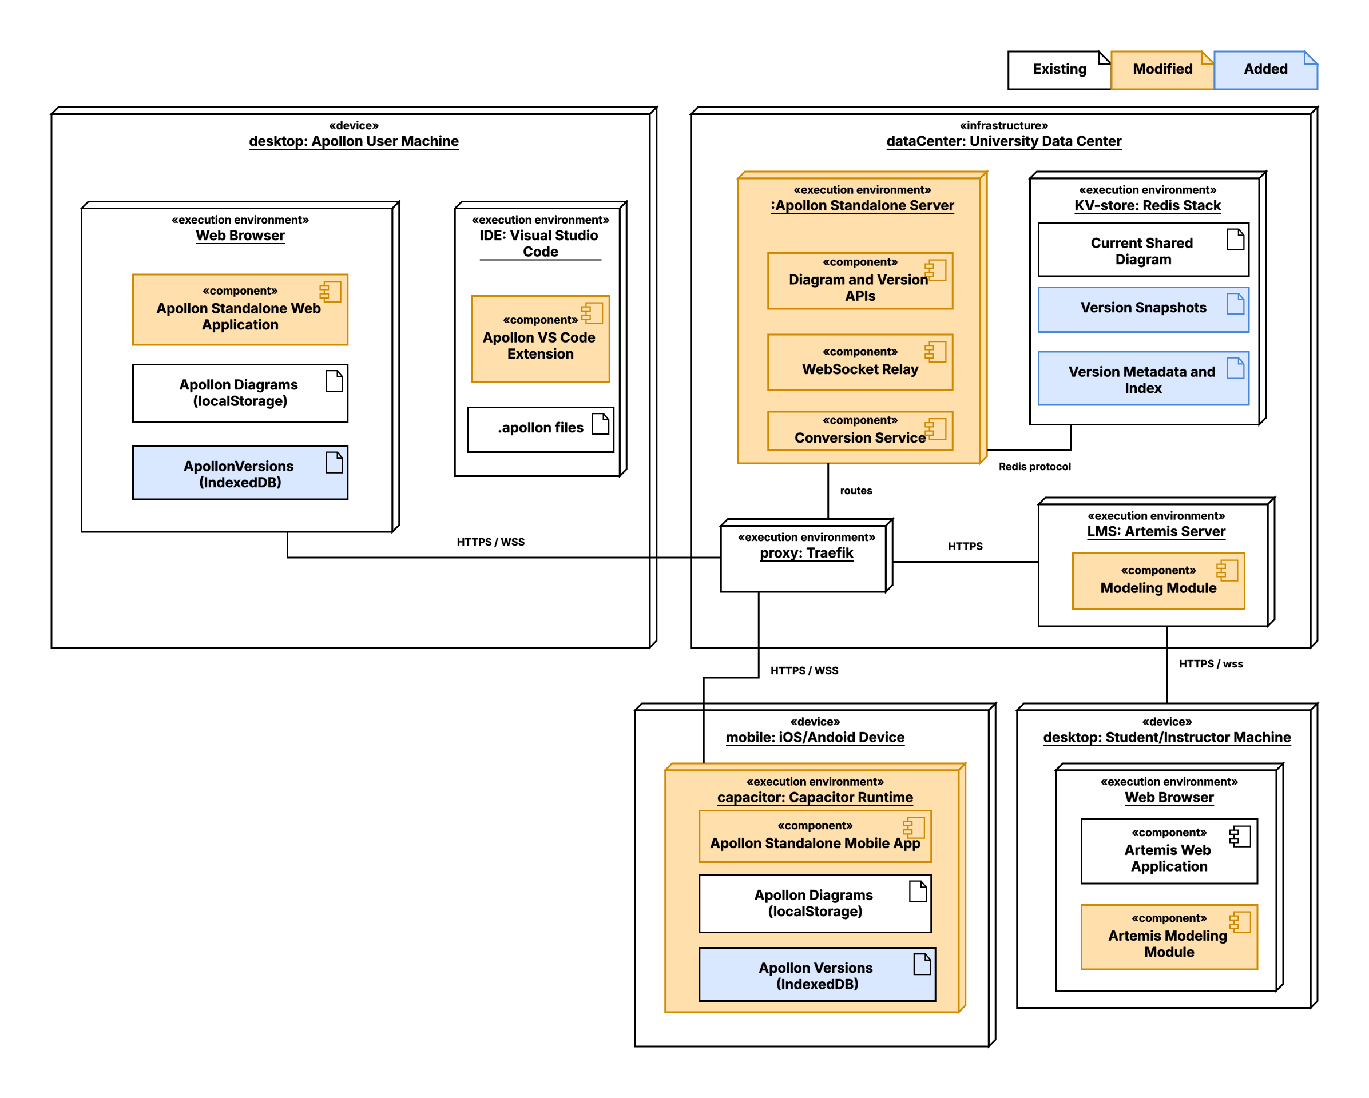
APPENDIX · DEPLOYMENT
Each host owns the data it persists
Browser / iOS
localStorage + IndexedDB
Standalone server
Redis Stack + in-memory presence
Artemis / VS Code
Artemis persistence / workspace files
Exports are derived artifacts, not the source model.
Fady Samaan · Ravi Tamang | Master's Thesis · Apollon
25
Notes:
This is a deployment diagram, not a component diagram. It maps execution nodes and storage ownership. Source: figures/apollon-deployment-and-persistence-architecture.* and content/system_design.typ.

Slide 26
APPENDIX · IMPLEMENTATION
The ecosystem work advanced in connected iterations
FEB
iOS export · VS Code migration · server PDF
MAR
Alignment · SVG compatibility · server conversion
APR
Artemis migration · Athena · quiz generation
MAY
Nested quiz selections · iOS PPTX · collaboration
JUN
Home page · team awareness · edge overhaul · UI modernization
Integration feedback created follow-up requirements instead of being postponed to the end.
Fady Samaan · Ravi Tamang | Master's Thesis · Apollon
26
Notes:
Source: content/implementation.typ, Implementation Timeline. The sequence shows why the process was iterative: migration exposed Athena and quiz gaps; collaboration moved into the library when Artemis needed it.

Slide 27
APPENDIX · CONTRIBUTIONS
Contribution ownership is documented for handoffs
Fady - documented inventory
Ravi - remaining thesis work
Edge interaction and usability
Standalone dashboard, routing, and UI modernization
Server PDF and SVG/export correctness
Artemis quiz generation and nested selections
Assessment fixes and migration contributions
Mobile/iOS support
Collaboration awareness and library reuse
Athena model compatibility
VS Code extension migration
Remaining joint ecosystem integration described by the thesis
Visible main slides tell the joint thesis story; this appendix supports detailed implementation questions.
Fady Samaan · Ravi Tamang | Master's Thesis · Apollon
27
Notes:
Attribution follows the user's rule: entries in Fady-contribution-history belong to Fady; the remaining thesis work belongs to Ravi unless shared. Source: Fady-contribution-history/fady-contribution-inventory.md and user instruction.

Slide 28
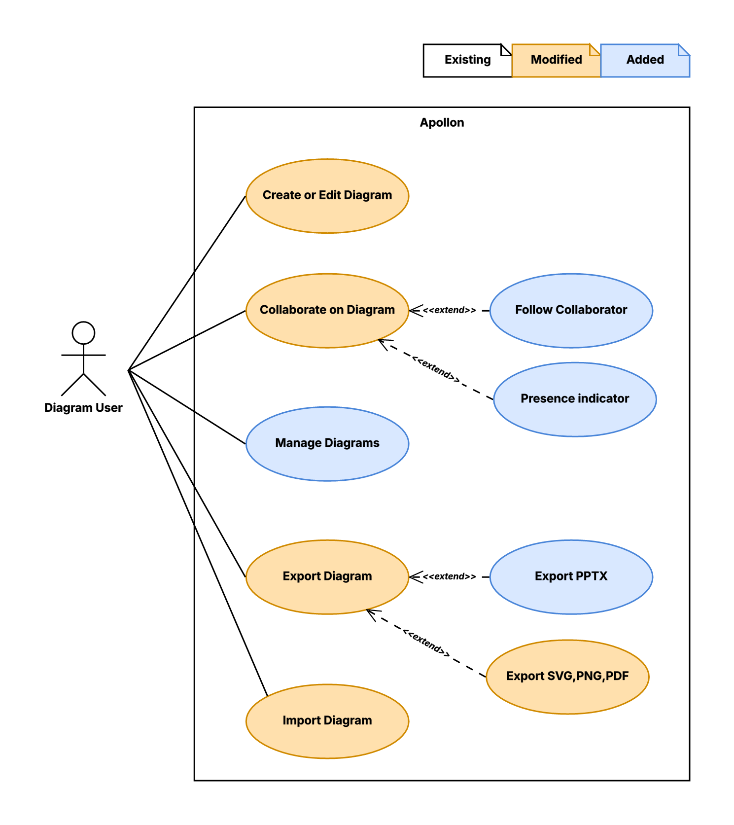
APPENDIX · USE-CASE MODEL
Added use cases make the new scope explicit
Legend
Existing
Modified
Added
New scope includes diagram management, collaborator following, and editable PPTX export.
Fady Samaan · Ravi Tamang | Master's Thesis · Apollon
28
Notes:
Full formal use-case model from figures/requirements-use-case-model.*. White existed, orange was modified, and blue was added.

