Slide 1

MASTER'S THESIS | INFORMATION SYSTEMS / INFORMATIK
Enhance Usability of the Educational Modeling Software Apollon
Collaboration-aware modeling and a maintained Artemis integration
with mobile and VS Code support, plus Athena model compatibility
Fady Samaan | Ravi Tamang
Supervisor: Felix Dietrich, M.Sc.
Examiner: Prof. Dr. Stephan Krusche
Munich | July 2026
1
Notes:
0:00-0:15. Open with the outcome: this thesis made collaboration visible and moved Artemis onto maintained Apollon while keeping teaching workflows intact. Mobile, VS Code, and Athena are supporting ecosystem results. Source: thesis metadata and abstract.

Slide 2
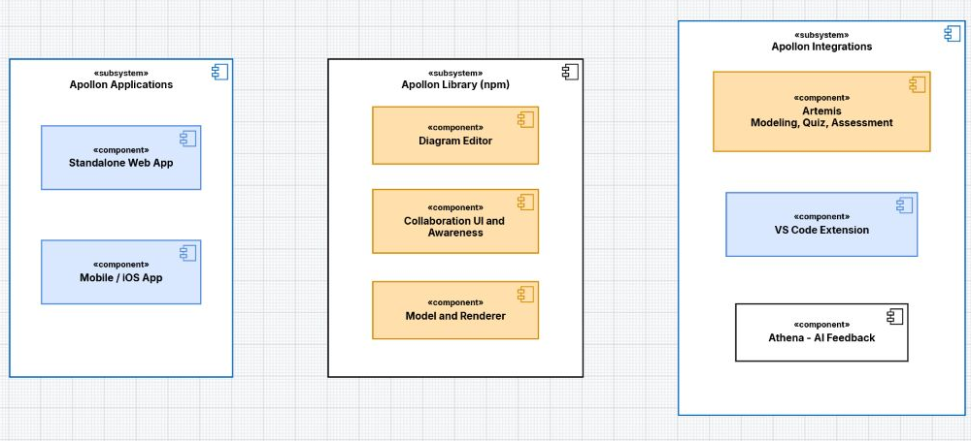
CONTEXT | COMPONENT MODEL
Two applications and three integrations reuse one Apollon library
Applications run Apollon. Artemis, VS Code, and Athena integrate it - in that order of importance here.
Fady Samaan | Ravi Tamang | Master's Thesis | Apollon
2
Notes:
0:15-0:50. Use the diagram's three columns. Standalone and mobile are Apollon applications. Artemis, VS Code, and Athena are integrations; Artemis is the primary one. The standalone conversion service is intentionally absent because it is an internal server component, not a peer environment. Apollon JSON: presentation-research/diagrams/apollon-products-and-integrations.json.

Slide 3
PROBLEM
Shared editing worked, but collaborators could not read intent
ON THE CANVAS
IN COLLABORATION
IN THE MAIN INTEGRATION
Editing demanded repair work
State sync was not enough
Artemis could not switch by import alone
Correcting edge paths, arranging elements, and navigating larger diagrams repeatedly interrupted the modeling task.
The final model arrived, but users could not reliably see who was active, what they selected, or where they were looking.
Modeling, quizzes, assessment, and team sessions depended on legacy behavior and serialized models.
The hard part was reusing improvements without breaking host workflows.
Fady Samaan | Ravi Tamang | Master's Thesis | Apollon
3
Notes:
0:50-1:30. Tell this as one connected problem. Editing friction affected individual modeling; missing awareness affected teams; Artemis migration turned shared-editor changes into compatibility work. Source: thesis introduction, requirements, and implementation chapters.

Slide 4
OBJECTIVES
Four objectives guided the thesis
Improve modeling and application usability
O1
Direct editing, clearer navigation, current standalone workflows, and mobile use
Support collaborative modeling
O2
Named cursors, remote selections, drag highlights, and viewport following
Migrate Artemis to maintained Apollon without breaking teaching workflows
O3
Modeling, quiz generation, assessment, and team modeling
Improve diagram portability across web, mobile, and integrations
O4
Reusable JSON and dependable SVG, PNG, PDF, and PPTX output
Fady Samaan | Ravi Tamang | Master's Thesis | Apollon
4
Notes:
1:30-2:05. Read the four verb-led objectives. The status slide repeats these sentences exactly. The third objective intentionally names Artemis rather than saying educational systems. Source: thesis objectives, made presentation-specific without changing scope.

Slide 5
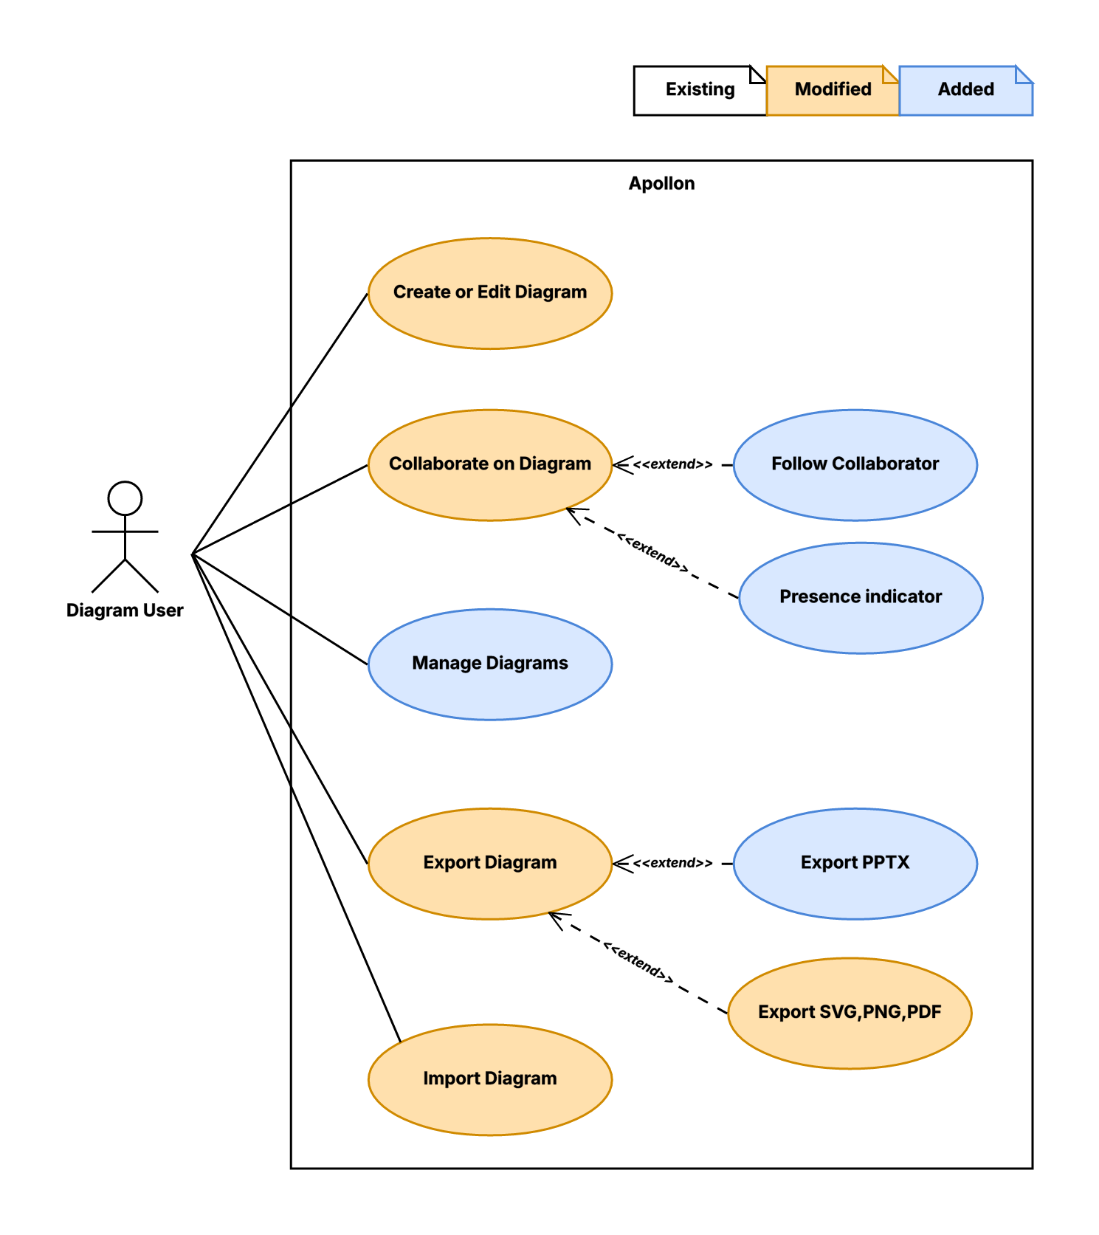
SCOPE | USE-CASE MODEL
The same model serves individual, collaborative, and teaching work
White: existing | Orange: modified | Blue: added
Fady Samaan | Ravi Tamang | Master's Thesis | Apollon
5
Notes:
2:05-2:35. Keep the full formal model large and point to only three areas: direct diagram editing, collaborator following, and Artemis teaching workflows. The model was authored in Apollon and has a JSON source at figures/requirements-use-case-model.json.

Slide 6
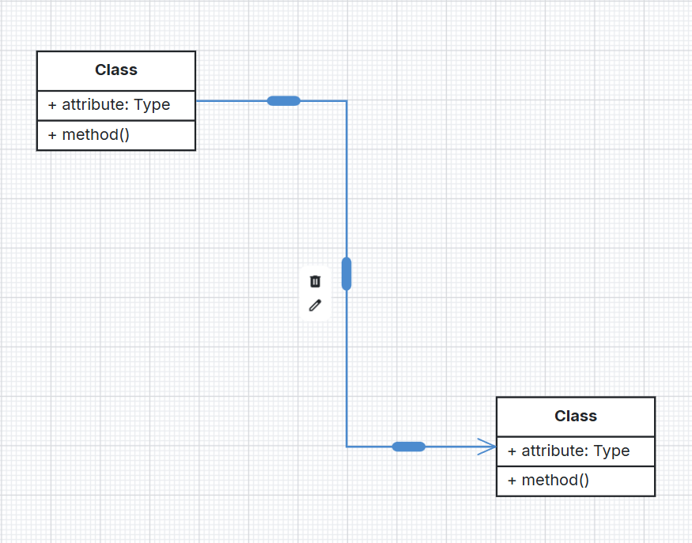
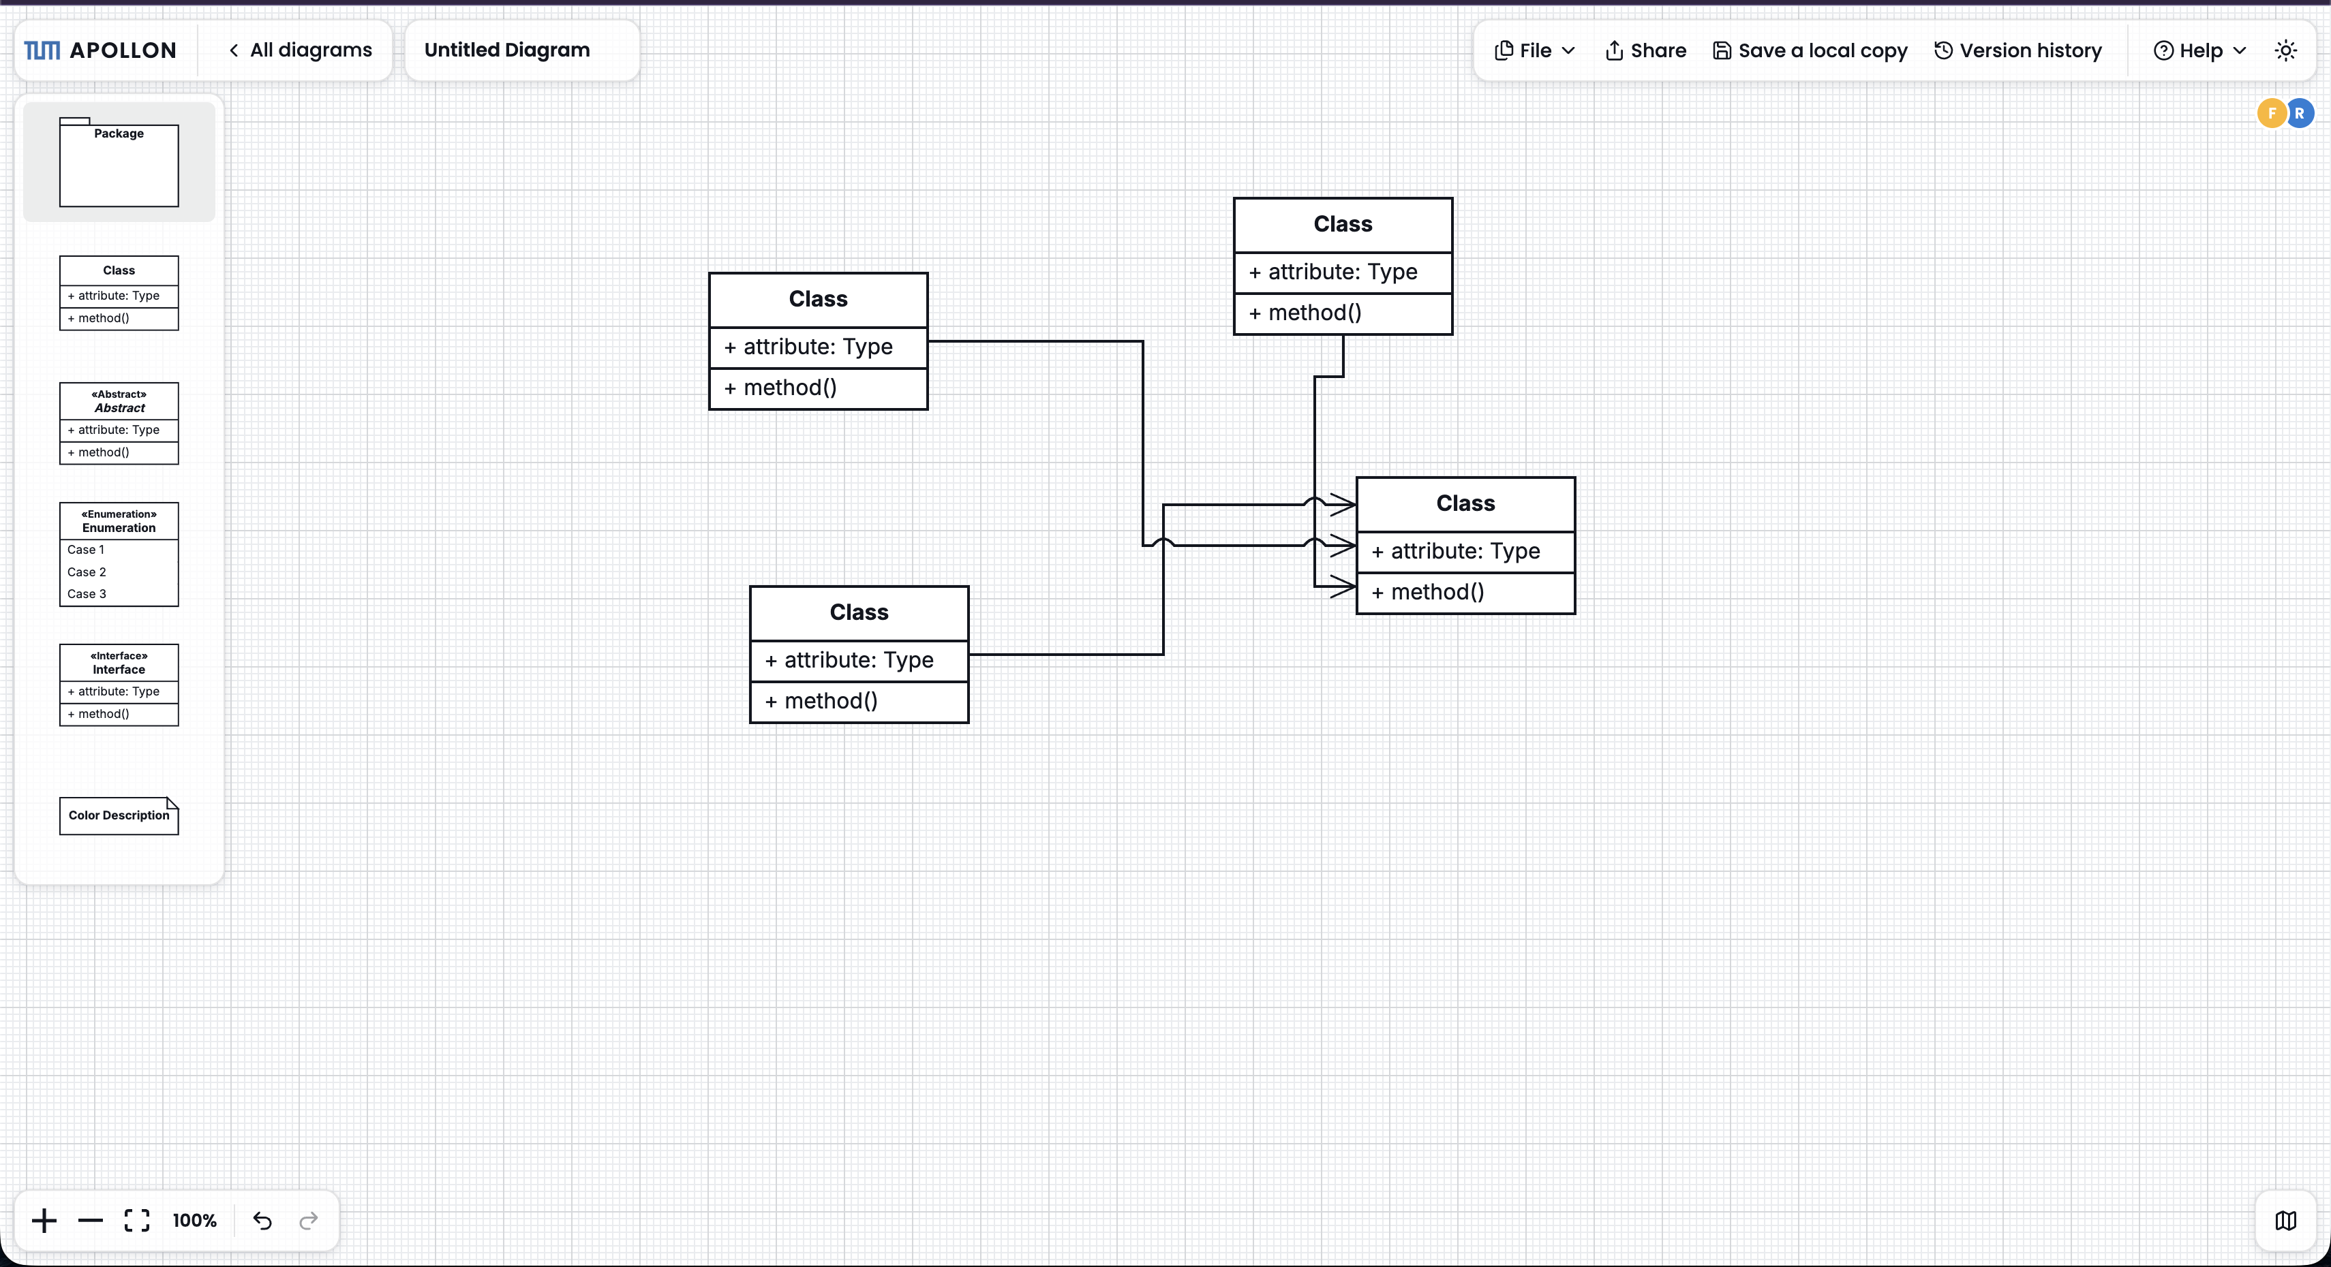
OBJECTIVE 1 | EDITING
Editing should change the diagram - not interrupt the thought
Bend, move, reconnect
Read crossings immediately
Keep the semantic edge while correcting its path and endpoints.
Line jumps and geometry-aware handles reduce visual ambiguity.
Also improved: alignment guides, hit areas, keyboard deletion, class-member ordering, labels, and scroll lock.
Fady Samaan | Ravi Tamang | Master's Thesis | Apollon
6
Notes:
2:35-3:15. Demonstrate the interaction principle: correct the geometry directly instead of deleting and recreating relationships. Mention the secondary improvements in one sentence. Source: thesis implementation chapter, edge usability and editor interaction sections.

Slide 7
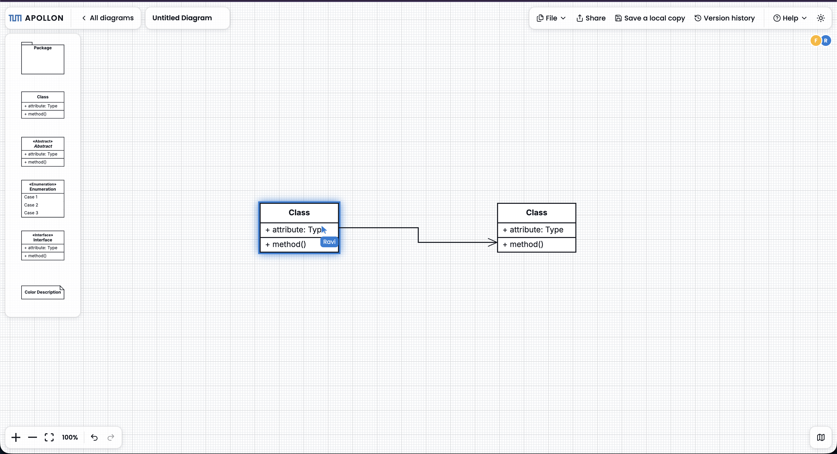
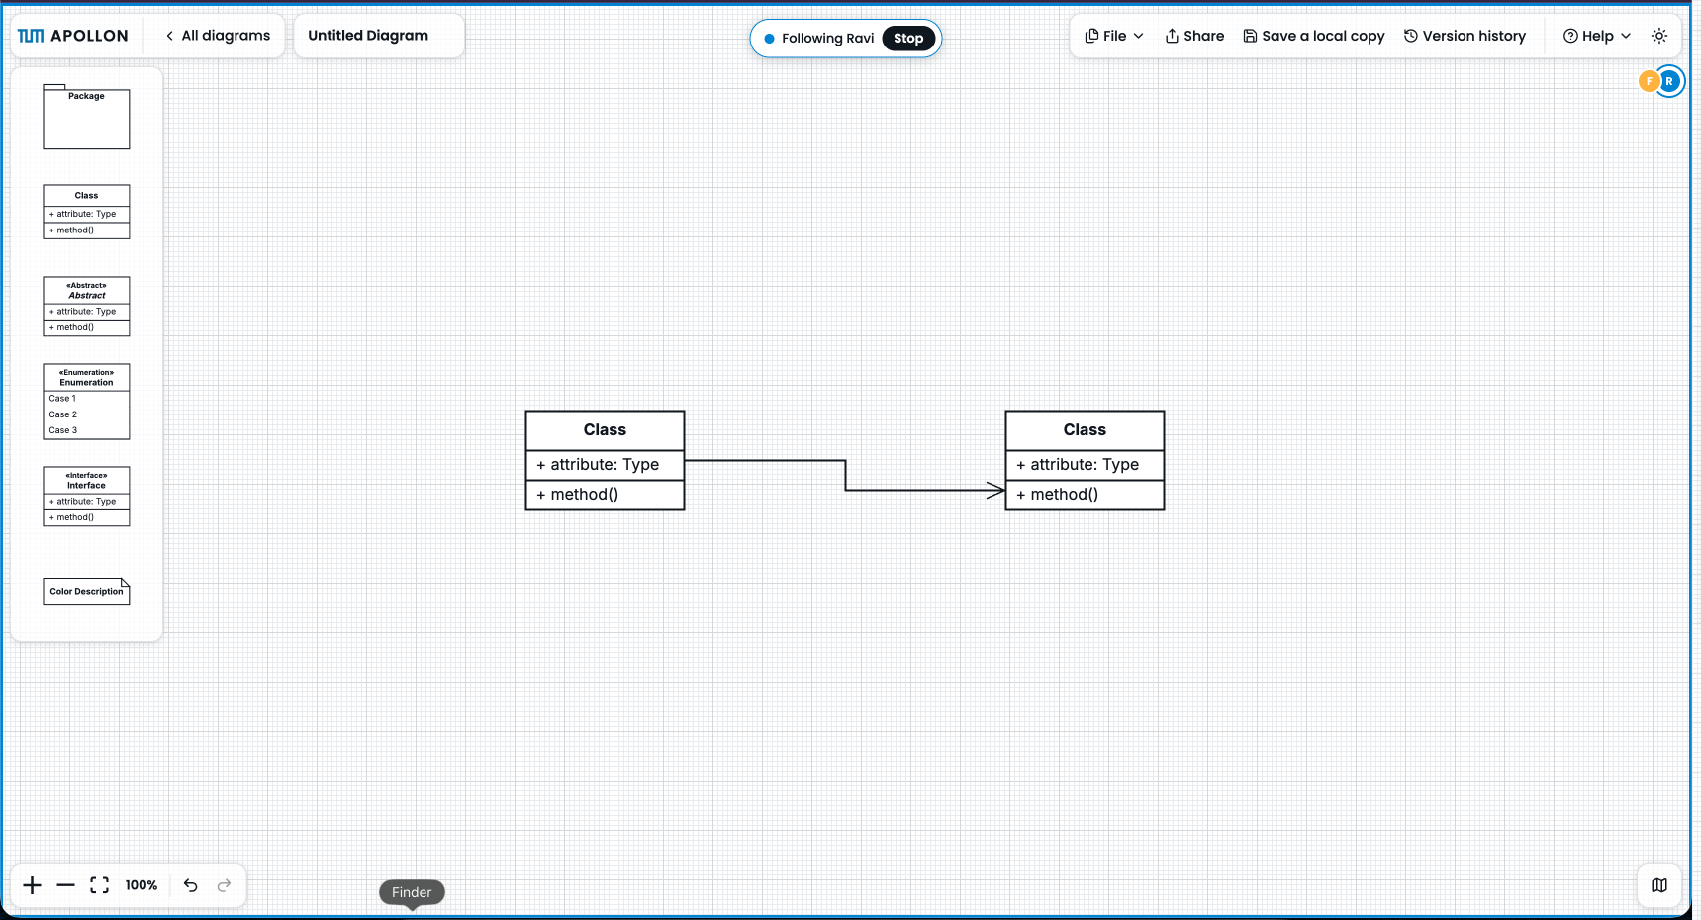
OBJECTIVE 2 | COLLABORATION
Collaboration UI moved from state sync to shared intent
1 SEE SELECTIONS AND DRAGS
2 RECOGNIZE NAMED CURSORS
3 FOLLOW A VIEWPORT
Awareness is transient session state; it never becomes part of the saved diagram.
Fady Samaan | Ravi Tamang | Master's Thesis | Apollon
7
Notes:
3:15-3:55. Tell the UI evolution in three steps: remote selection and drag highlights, named live cursors, then viewport following. These signals expose intent before the final model update arrives. The same awareness surface is reusable in standalone shared sessions and Artemis team modeling. Source: thesis collaboration implementation.

Slide 8
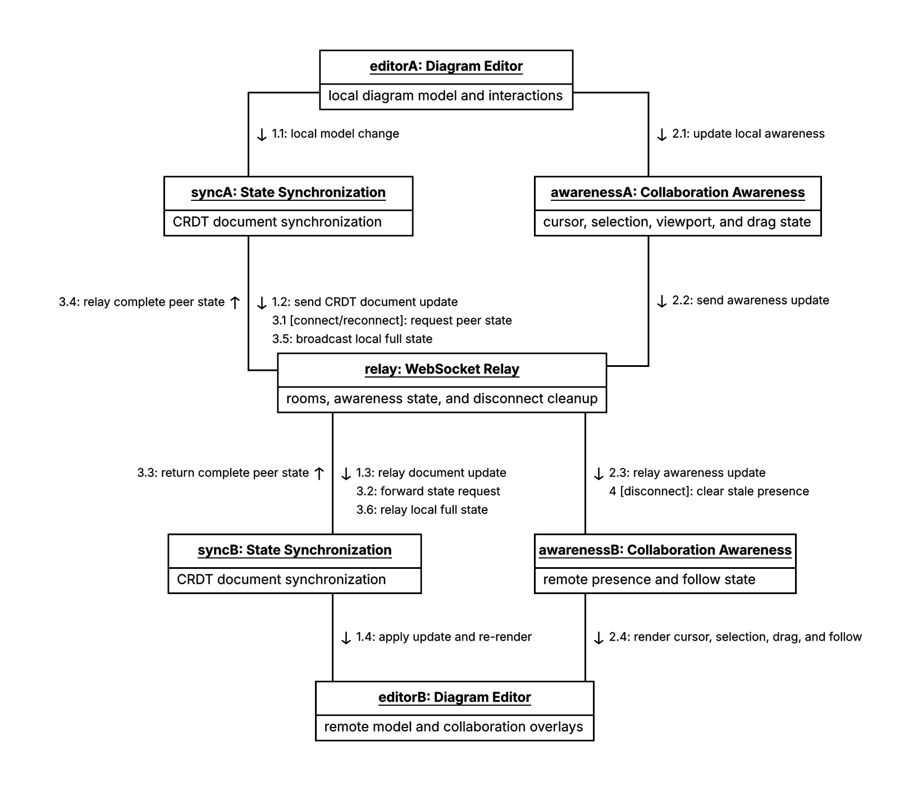
OBJECTIVE 2 | COMMUNICATION MODEL
One session carries two different kinds of change
Persisted model updates | Transient presence, cursor, selection, drag, and viewport awareness
Fady Samaan | Ravi Tamang | Master's Thesis | Apollon
8
Notes:
3:55-4:25. The communication model explains why awareness belongs beside, not inside, the diagram model. Yjs synchronizes model state; awareness messages describe the current session and disappear with it. Apollon JSON: figures/standalone-collaboration-communication.json.

Slide 9
MASTER'S THESIS | APOLLON
Live Demo
A current diagram, from JSON to editable presentation
Open
Edit
Collaborate
Export
3 min
1
2
3
4
Current home
One direct interaction
Awareness if stable
JSON + PPTX
backup cast ready
Current Apollon app | Realistic thesis diagram | Backup screencast available
9
Notes:
4:25-7:25. Open the current Apollon home, import a realistic JSON model, demonstrate one editing or collaboration interaction, then export PPTX and show separately editable elements. Use the prepared screencast if collaboration or export is unstable. Return to slide 10 for the architecture explanation.

Slide 10
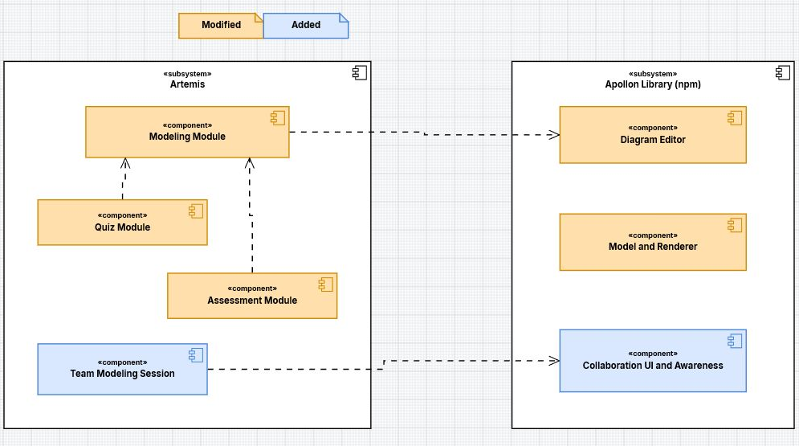
OBJECTIVE 3 | COMPONENT MODEL
Artemis owns teaching workflows; Apollon owns editor behavior
The boundary that matters: Artemis workflows reuse one maintained Apollon library.
Fady Samaan | Ravi Tamang | Master's Thesis | Apollon
10
Notes:
7:25-8:00. Artemis owns modeling exercises, quiz data, assessment records, permissions, persistence, and team sessions. Apollon provides the diagram editor, model and renderer, and collaboration-awareness UI. The conversion service is not a peer integration and is deliberately absent. Apollon JSON: presentation-research/diagrams/artemis-apollon-integration-focus.json.

Slide 11
OBJECTIVE 3 | ARTEMIS
Artemis kept four teaching workflows on maintained Apollon
1
2
3
4
Model
Quiz
Assess
Collaborate
Modeling exercises use the maintained editor and model behavior.
Selected and nested elements become aligned cut-outs and drop locations.
Element targeting and structured-grading compatibility remain intact.
Team modeling reuses the library's transient awareness surface.
Migration constraint
Existing courses, stored diagrams, quiz generation, assessment, and team sessions had to continue working.
Fady Samaan | Ravi Tamang | Master's Thesis | Apollon
11
Notes:
8:00-8:40. Present the migration through user-visible teaching workflows rather than package changes. Modeling is the base; quiz generation and assessment needed concrete compatibility fixes; team modeling reuses the new collaboration UI. Source: Artemis migration, quiz, assessment, and collaboration sections of the thesis.

Slide 12
OBJECTIVE 3 | ACTIVITY MODEL
One aligned pipeline turns diagram selections into a quiz
MODIFIED
ADDED
→
Select diagram
elements
→
Resolve nested
selections
→
Export background
without selections
→
Create cut-outs and
drop locations
→
Aligned drag-and-
drop quiz
→
The background, cut-outs, and drop locations share one coordinate system.
Apollon JSON source saved for re-import and later editing
Fady Samaan | Ravi Tamang | Master's Thesis | Apollon
12
Notes:
8:40-9:15. Walk left to right. Nested class members are resolved before export. The background excludes selected items; cut-outs and drop locations use the same coordinates, preventing drift. The model was validated in Apollon and saved as presentation-research/diagrams/artemis-quiz-generation-activity.json.

Slide 13
OBJECTIVE 3 | ARTEMIS
Compatibility fixes kept assessment and team modeling coherent
ARTEMIS FIX
SHARED IMPROVEMENT
Assessment compatibility
Team-modeling collaboration
Element targeting continued to work after the maintained-model migration. Structured-grading usage counts were repaired where flattened serialization had changed the expected structure.
Artemis reuses the library-level awareness UI for cursors, selections, drags, and viewport following while keeping session transport and persistence in Artemis.
These are compatibility fixes inside Artemis - not a second editor.
Fady Samaan | Ravi Tamang | Master's Thesis | Apollon
13
Notes:
9:15-9:55. Keep Athena out of this slide. Explain the two concrete Artemis fixes: assessment/structured-grading compatibility and library-level collaboration awareness reused by team modeling. Source: thesis Artemis assessment and collaboration implementation sections.

Slide 14
OBJECTIVE 3 | INTEGRATIONS
VS Code reuses the editor; Athena reuses the model
VS Code
Athena
SECONDARY INTEGRATION
AI-FEEDBACK INTEGRATION
.apollon workspace files
Maintained editor + renderer
Version-aware parser
The extension moved into the Apollon monorepo and release path, so workspace diagrams use the maintained rendering behavior next to the code they describe.
Earlier and current Apollon models remain readable so Athena can keep generating AI feedback suggestions through the Artemis workflow.
One model foundation; different host responsibilities.
Fady Samaan | Ravi Tamang | Master's Thesis | Apollon
14
Notes:
9:55-10:30. Give VS Code more space because it is the more important secondary integration. Athena is brief: it does not embed the editor; it reads versioned serialized models to support AI feedback suggestions in the Artemis ecosystem. Source: thesis VS Code and Athena sections; Athena project documentation.

Slide 15
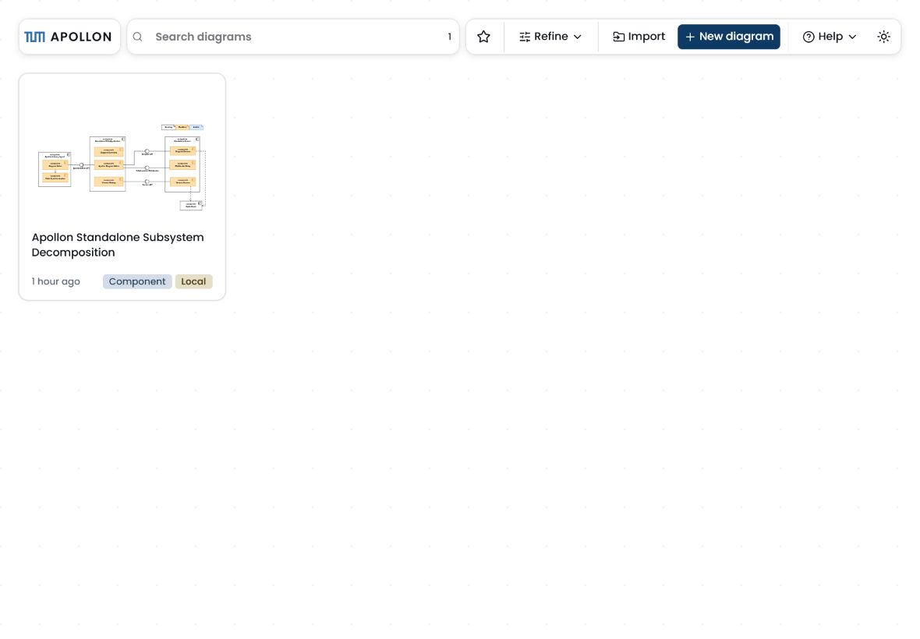
OBJECTIVE 4 | MOBILE
The same diagram also works on a landscape tablet
CURRENT HOME | LANDSCAPE
Mobile / iOS support
Capacitor connects the standalone workflow to native file handling.
PNG
PDF
JSON
SVG
PPTX
PPTX keeps diagram elements editable for presentation animation.
Fady Samaan | Ravi Tamang | Master's Thesis | Apollon
15
Notes:
10:30-11:05. This is a current screenshot, not the outdated home-page image in the thesis. Explain that the mobile app uses the standalone workflow inside a Capacitor shell and supports PNG, PDF, JSON, SVG, and PPTX export through platform file handling. Source: thesis mobile implementation and current Apollon app.

Slide 16
EVALUATION
Feedback supports the direction - not a measured usability gain
What users valued
What still interrupted the flow
Collaboration awareness
Line jumps and edge readability
Export behavior
Standalone navigation and diagram management
Precise layout control
Shortcuts and discoverability
Selection and styling flexibility
Sharing semantics and notation coverage
Qualitative and formative: no controlled comparison of task time, errors, or satisfaction.
Fady Samaan | Ravi Tamang | Master's Thesis | Apollon
16
Notes:
11:05-11:45. Be explicit about the evidence boundary. Feedback from developers, students, teaching contexts, integration work, tests, and walkthroughs supports the direction. The thesis does not statistically quantify task time, errors, or satisfaction. Source: thesis evaluation chapter.

Slide 17
STATUS
All four objectives are realized within the thesis scope
Improve modeling and application usability
DONE
OK
Direct editing, navigation, standalone management, and mobile use
Support collaborative modeling
DONE
OK
Named cursors, selections, drag highlights, viewport following, and reuse
Migrate Artemis to maintained Apollon without breaking teaching workflows
DONE
OK
Modeling, quiz generation, assessment, and team modeling preserved
Improve diagram portability across web, mobile, and integrations
DONE
OK
JSON round-trip plus dependable SVG, PNG, PDF, and editable PPTX
Realized does not mean finished: the evaluation defines the next product-level work.
Fady Samaan | Ravi Tamang | Master's Thesis | Apollon
17
Notes:
11:45-12:25. Return to the exact wording and order from slide 4. All four objectives are realized within the defined scope. Do not imply that the qualitative evaluation proves a quantified usability gain. Source: thesis summary and realized goals.

Slide 18
PRESENTATION WORKFLOW
Apollon makes presentation diagrams reusable, not disposable
1
2
3
Import JSON
→
Export PPTX
→
Retain JSON
Open the saved model in the web app
Keep elements editable for animation
Re-import and continue modeling later
All formal models in this deck
have an Apollon JSON source and were validated in the hosted editor.
Editable PPTX keeps diagram coordinates stable for the required dataflow animation.
Fady Samaan | Ravi Tamang | Master's Thesis | Apollon
18
Notes:
12:25-13:00. Make the workflow explicit for the audience: save the JSON model, import it into the hosted Apollon app, export PPTX for editable slide elements, and keep JSON for future changes. This is also how the presentation's formal models remain reproducible. Official Apollon documentation: https://ls1intum.github.io/Apollon/.

Slide 19
FUTURE WORK
The next gains are product-level
EVIDENCE
COLLABORATION
TEACHING
Measure usability
Strengthen ownership and review
Deepen Artemis support
Evaluate edge, layout, and collaboration refinements systematically across diagram types, sizes, and user groups.
Extend assessment collaboration, PlantUML interoperability, notation coverage, tutorials, and export hardening without cluttering the core workflow.
Add optional login, persistent shared diagrams, clearer sharing modes, local files, and review comments for supervision and assessment.
Keep advanced capabilities discoverable while preserving a simple student workflow.
Fady Samaan | Ravi Tamang | Master's Thesis | Apollon
19
Notes:
13:00-13:35. Select three directions: systematic evaluation, stronger persistence/ownership/review, and deeper Artemis teaching support. VS Code and export continuity fit under the product-level ecosystem work. Source: thesis future-work sections.

Slide 20
MASTER'S THESIS | APOLLON
One maintained Apollon makes
collaboration visible
and keeps Artemis teaching workflows intact
Mobile and VS Code reuse the same foundation; Athena keeps model-compatible AI feedback.
Questions are welcome
20
Notes:
13:35-13:50. Resolve the opening in one sentence: collaboration became visible and Artemis migrated without losing teaching workflows. Invite questions. The remaining time is buffer for the live demo and transitions.

Slide 21
ADDITIONAL MATERIAL
Appendix
Traceability | formal models | deployment | timeline | contributions | sources
21
Notes:
Appendix divider. Use only during questions.

Slide 22
APPENDIX | TRACEABILITY
The objectives map to concrete workflows and systems
Objective
Focus
Realized behavior
Primary systems
Usability
Edges | alignment | controls | standalone home | mobile use
Library | standalone | mobile
O1
Collaboration
Cursors | selections | drag highlights | viewport follow
Library | standalone | Artemis
O2
Artemis migration
Modeling | quiz | assessment | team modeling
Artemis | Apollon library
O3
Portability
JSON round-trip | SVG | PNG | PDF | editable PPTX
Web | mobile | VS Code | Athena
O4
Fady Samaan | Ravi Tamang | Master's Thesis | Apollon
22
Notes:
Traceability reference from the thesis requirements and summary chapters.

Slide 23
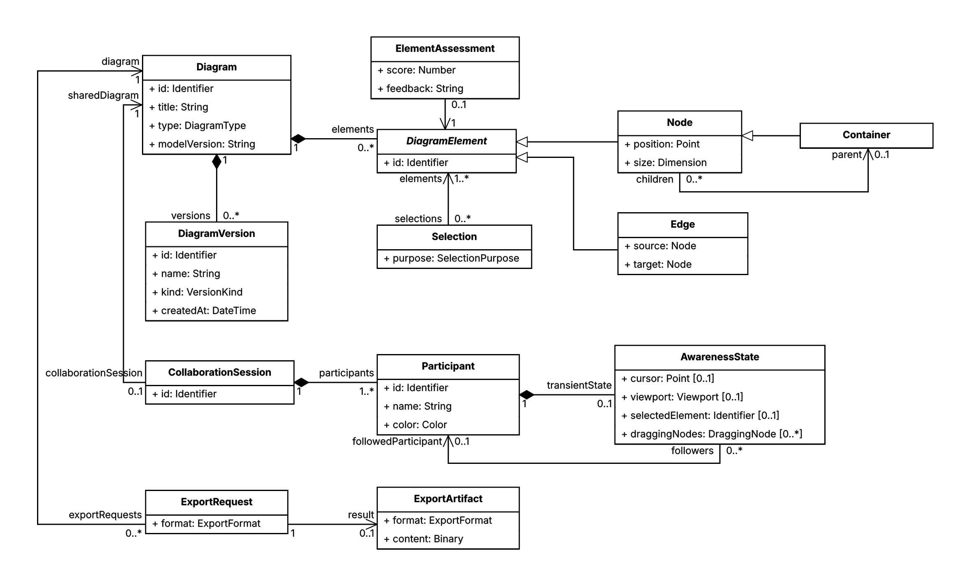
APPENDIX | ANALYSIS OBJECT MODEL
Diagram data and session awareness stay separate
Apollon JSON: figures/requirements-analysis-object-model.json
Fady Samaan | Ravi Tamang | Master's Thesis | Apollon
23
Notes:
The object model separates persisted diagram content and versions from transient collaboration state. Artemis owns exercises and assessments; Athena owns feedback requests. Apollon JSON source is stored beside the thesis figure.

Slide 24
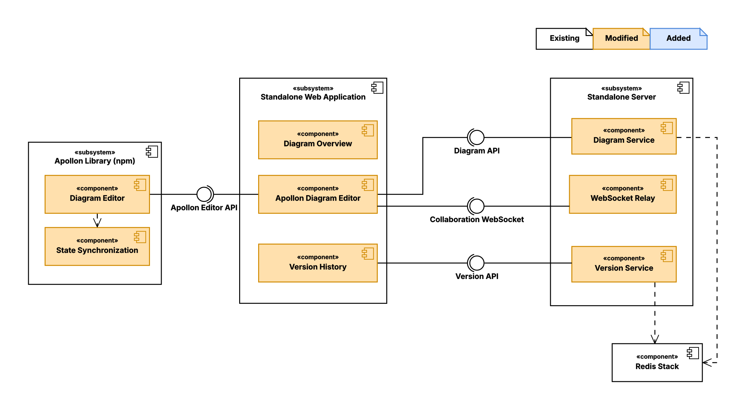
APPENDIX | COMPONENT MODEL
Standalone hosts the editor, collaboration, and persistence
Component responsibilities only - execution nodes are shown separately on the deployment slide.
Fady Samaan | Ravi Tamang | Master's Thesis | Apollon
24
Notes:
This is a component model, not a deployment model. It shows the reusable editor, application logic, server responsibilities, collaboration relay, and persistence components. Apollon JSON: figures/apollon-standalone-decomposition.json.

Slide 25
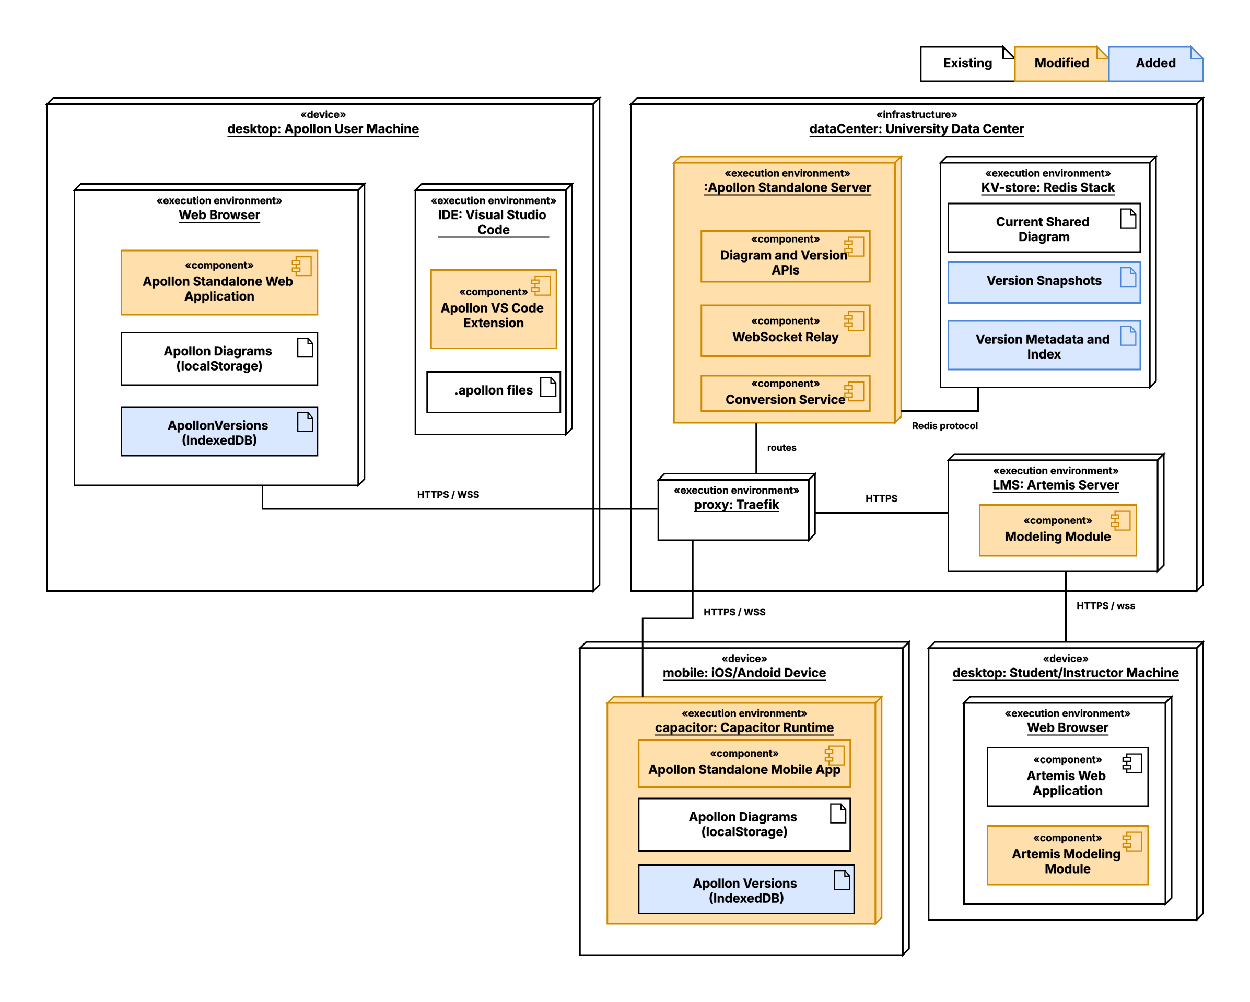
APPENDIX | DEPLOYMENT MODEL
Each host owns the data it persists
Browser and mobile | Standalone server | Artemis | VS Code workspace
Fady Samaan | Ravi Tamang | Master's Thesis | Apollon
25
Notes:
Use this slide to answer deployment questions without mixing component and deployment ideas. Local diagrams use browser storage; shared standalone diagrams use Redis; Artemis owns course and submission persistence; VS Code uses workspace files. Apollon JSON: figures/apollon-deployment-and-persistence-architecture.json.

Slide 26
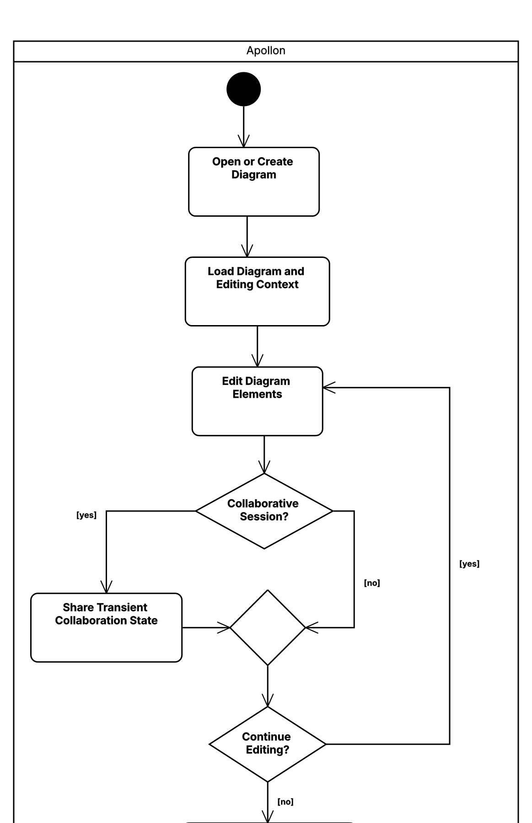
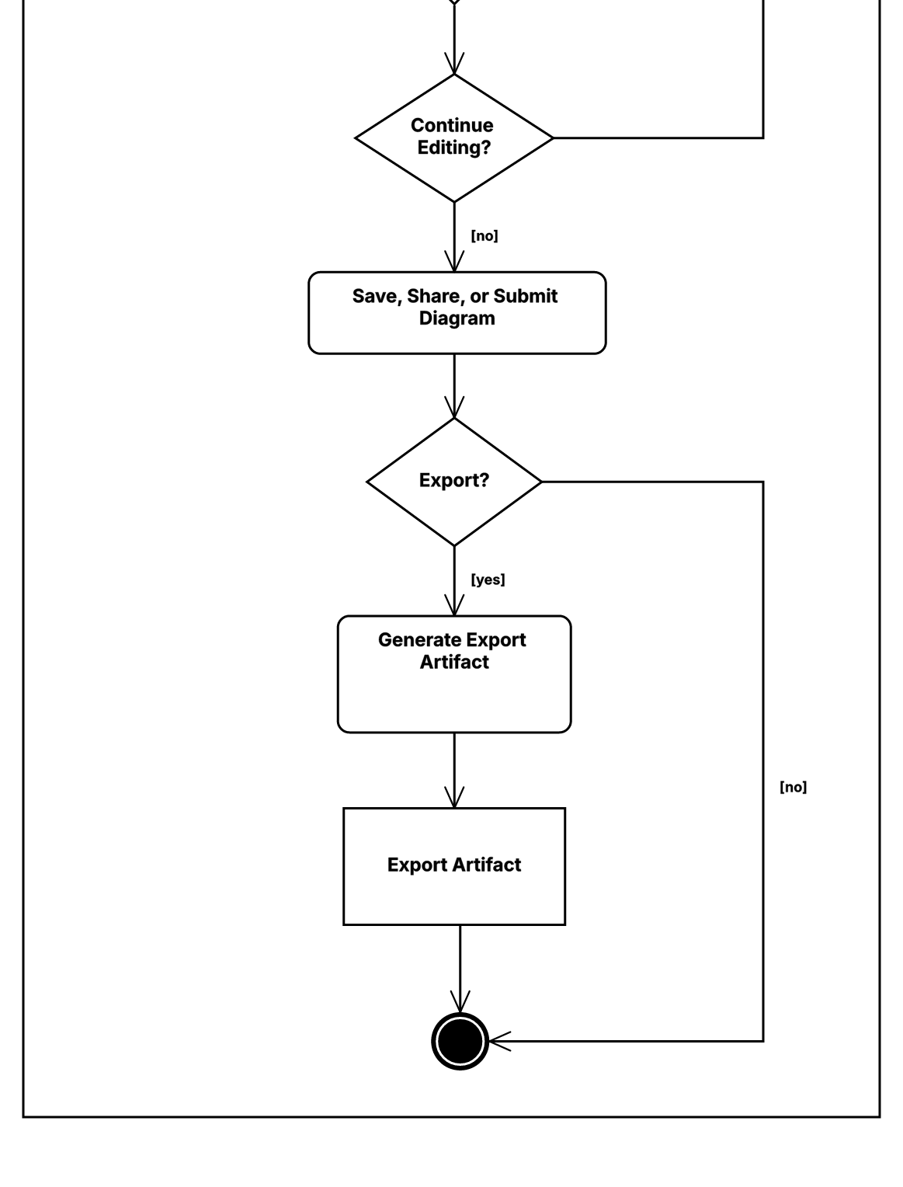
APPENDIX | ACTIVITY MODEL
Direct manipulation keeps correction inside the modeling flow
1 MODEL AND CORRECT
2 SAVE OR EXPORT
CONTINUES
→
One Apollon activity model, enlarged in two sequential views
Fady Samaan | Ravi Tamang | Master's Thesis | Apollon
26
Notes:
Use this activity model for detailed questions about the edit-correct-save-export flow. It is the same Apollon model shown in two enlarged sequential views for projector readability. Apollon JSON: figures/requirements-editing-activity-model.json.

Slide 27
APPENDIX | IMPLEMENTATION
Integration feedback shaped the next iteration
FEB
Mobile export | VS Code migration | server-side PDF begins
MAR
Editing and alignment | SVG compatibility | rendering
APR
Artemis migration | Athena compatibility | quiz generation
MAY
Nested quiz selections | assessment | mobile PPTX | collaboration
JUN
Standalone home | Artemis team awareness | edge overhaul | UI modernization
Artemis integration exposed quiz and assessment gaps; team modeling then pulled awareness into the reusable library.
Fady Samaan | Ravi Tamang | Master's Thesis | Apollon
27
Notes:
Source: thesis implementation timeline. The sequence explains why migration, collaboration, and usability could not be developed as isolated work packages.

Slide 28
APPENDIX | CONTRIBUTIONS
Contribution ownership is documented for handoffs
Fady - documented inventory
Ravi - remaining thesis work
Edge interaction and usability
Standalone dashboard, routing, and UI modernization
Server PDF and SVG/export correctness
Artemis quiz generation and nested selections
Assessment fixes and migration contributions
Mobile/iOS support
Collaboration awareness and library reuse
Athena model compatibility
VS Code extension migration
Remaining joint ecosystem integration described by the thesis
The main story is joint; this appendix supports detailed implementation questions and speaker handoffs.
Fady Samaan | Ravi Tamang | Master's Thesis | Apollon
28
Notes:
Attribution follows Fady-contribution-history/fady-contribution-inventory.md and the user's ownership rule. The main presentation remains a joint thesis narrative.

Slide 29
APPENDIX | DIAGRAM SOURCES
Every formal model has a saved Apollon source
Slide
Diagram type
Apollon JSON source
2
Component
presentation-research/diagrams/apollon-products-and-integrations.json
5
Use case
figures/requirements-use-case-model.json
8
Communication
figures/standalone-collaboration-communication.json
10
Component
presentation-research/diagrams/artemis-apollon-integration-focus.json
12
Activity
presentation-research/diagrams/artemis-quiz-generation-activity.json
23-26
Appendix models
figures/*.json (matching each rendered model)
Import JSON in the hosted app | Export editable PPTX | Keep JSON for the next revision
Fady Samaan | Ravi Tamang | Master's Thesis | Apollon
29
Notes:
Source map for reproducibility. The official Apollon application can import the JSON sources and export editable PPTX or other visual formats while JSON remains the editable model source.

