Slide 1
Unit 3
Logic Modeling

Slide 2
Components
Needs
Inputs
Activities
Outcomes

Slide 3
Developing a logic model helps us to
Design programs and initiatives
Identify external factors
Identify key process
1
2
3
4
5
6
Identify and express assumptions
Identify possible ways
Identify key results

Slide 4
Decision

Slide 5
Decision Table

Slide 6
A decision table is a scheduled rule logic entry
A decision table is a tabular representation of the logic of a decision

Slide 7
Parts in the decision table
Condition: Contains various condition that applies in the situation.
Rules: Contains the set of rules.
Action: Contains various actions for the required result.

Slide 8
Q. A Company sells merchandise to wholesale and retail outlets. Wholesale customers receive a two percent discount on all orders. The company also encourages both wholesale and retail customers to pay cash on delivery by offering a two percent discount for this method of payment. Another two percent discount is given on orders of 50 or more units. Each column represents a certain type of order.

Slide 9
Process Name |  | Rules
Condition | Less than 50 units ordered | Y | Y | Y | Y | N | N | N | N
 | Cash on Delivery | Y | Y | N | N | Y | Y | N | N
 | Wholesale Outlet | Y | N | Y | N | Y | N | Y | N
Actions | Discount Rate 0% |  |  |  | X
 | Discount Rate 2% |  | X | X |  |  |  |  | X
 | Discount Rate 4% | X |  |  |  |  | X | X
 | Discount Rate 6% |  |  |  |  | X
Table1: Decision Table

Slide 10
Decision Tree

Slide 11
Condition:
If the customer is registered and buys goods worth 10k+ then provide 20% discount.
If the customer is registered and buys goods less than 10k then provide 10% discount.
If customer is not registered and buys goods more than 10k then provide 5% discount.
If customer is not registered and buys goods less than 10k then no discount or 0% discount.

Slide 12
YES
20%
>10k
Customer registered
YES
10%
NO
YES
5%
<10k
NO
0%
NO
Fig1: Decision Tree

Slide 13
Structured
English
Structured English is the use of the English language with the syntax of structured programming to communicate the design of a computer program to non – technical users by breaking it down into logical steps using straight forward English words.

Slide 14
Syntax
Programming logic and natural language
Each step is described
It states rules
Structured English

Slide 15
How to develop a structured statements ?
Sequence Structure
Decision Structure
Iteration Structure

Slide 16
Operation statements written as English phrases executed from top to down.
Conditional blocks indicated by keywords such as IF, THEN, ELSE.
Repetition blocks are indicated by keywords such as DO, WHILE, UNTIL.
Elements

Slide 17
Points to remember while writing Structured English
Statements should be clear and unambiguous.
Statements should be written using sequential structure, decision structure, iteration structure.
Keywords should be capitalized.
Use one line per logical element
Underline phrases or words that has been defined in data dictionary

Slide 18
Advantages
Clarifying the logic and relationship found in human languages
An effective communication tool, and easy to teach and understand.

Slide 19
IF
Customer pays advance
THEN
Give 5% Discount
ELSE IF
Purchase amount >= 10,000
THEN
IF
The customer is regular customer
Fig2: Structured English 1

Slide 20
THEN
Give 5% Discount
ELSE
NO Discount
END IF
ELSE
NO Discount
END IF
END IF
Fig3: Structured English 2

Slide 21
Data Dictionary

Slide 22
What is Data Dictionary?
Data Dictionary is a collection of data to be captured and stored in the system.
A data dictionary contains metadata i.e. data about the database.

Slide 23

Example
Client_id | Client_name | Password | Contact no | Email
1 | Ram | 12345 | 111 111 111 | ram@email.com
2 | Hari | Abcde | 222 222 222 | hari@email.com
3 | Raju | 53421 | 333 333 333 | raju@email.com
4 | Mohan | 23234 | 444 444 444 | mohan@email.com
Table2: Data Table

Slide 24
Example
Field Name | Data type | Fiield Length | Constrains | Description
Client_id | Number | 10 | Primary key | Client id ,Auto generated
Client_name | Varchar | 20 | Not null | Name of client
Password | Varchar | 30 | Not null | Login Password
Contact no | Number | 10 | Not null | Contact of client
Email | varchar | 40 | Not null | Client email
Table4: Data Table

Slide 25
Types of data dictionary
Active
Passive

Slide 26
Well-structured
01
Advantages
Of
Analyze
02
DATA
Dictionary
Helpful
03
Valuable
04

Slide 27
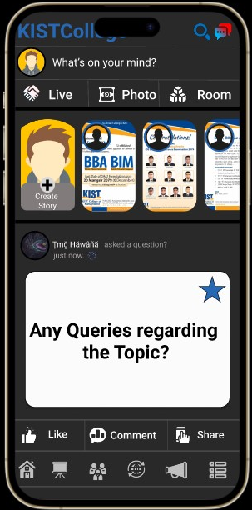
?

Slide 28
Thank You

