Slide 1
MUSIC PLAYER

Slide 2
TABLE OF CONTENTS
1.
Introduction
6.
System Flow
2.
Objectives
7.
Agile Methodology
3.
Features
8.
Use Case Diagram
4.
9.
Advantages
Future Scope
5.
Gantt Chart
Conclusion
10.

Slide 3
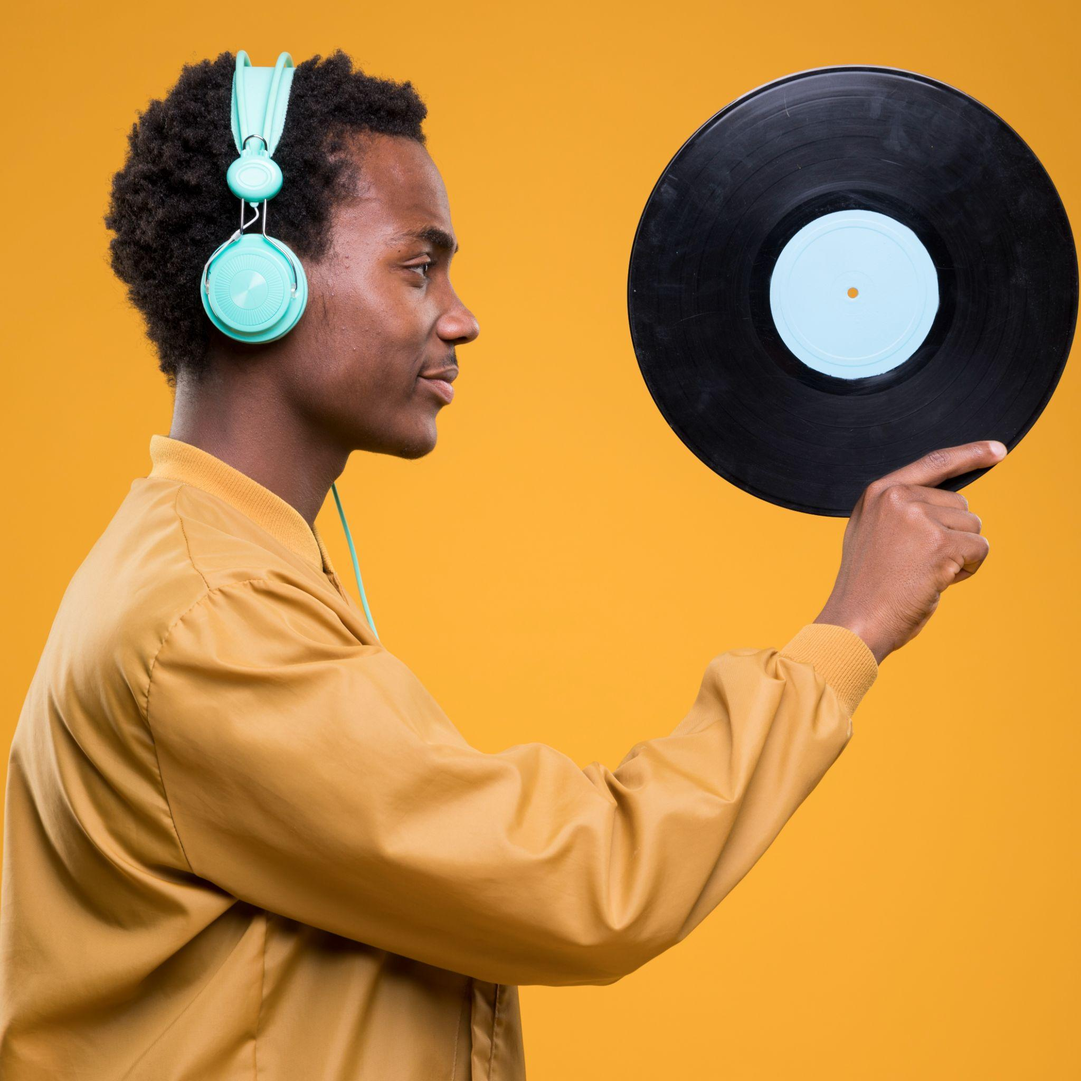
1
INTRODUCTION

Slide 4
INTRODUCTION
Our Music Player Project, a digital solution designed to make your music experience more enjoyable and convenient. It's like having your favorite music collection at your fingertips, with easy-to-use features that help you find, listen to, and share your cherished songs. Join us as we explore what makes our music player special and how it can enhance your musical journey. Let's dive into the world of music together!"

Slide 5
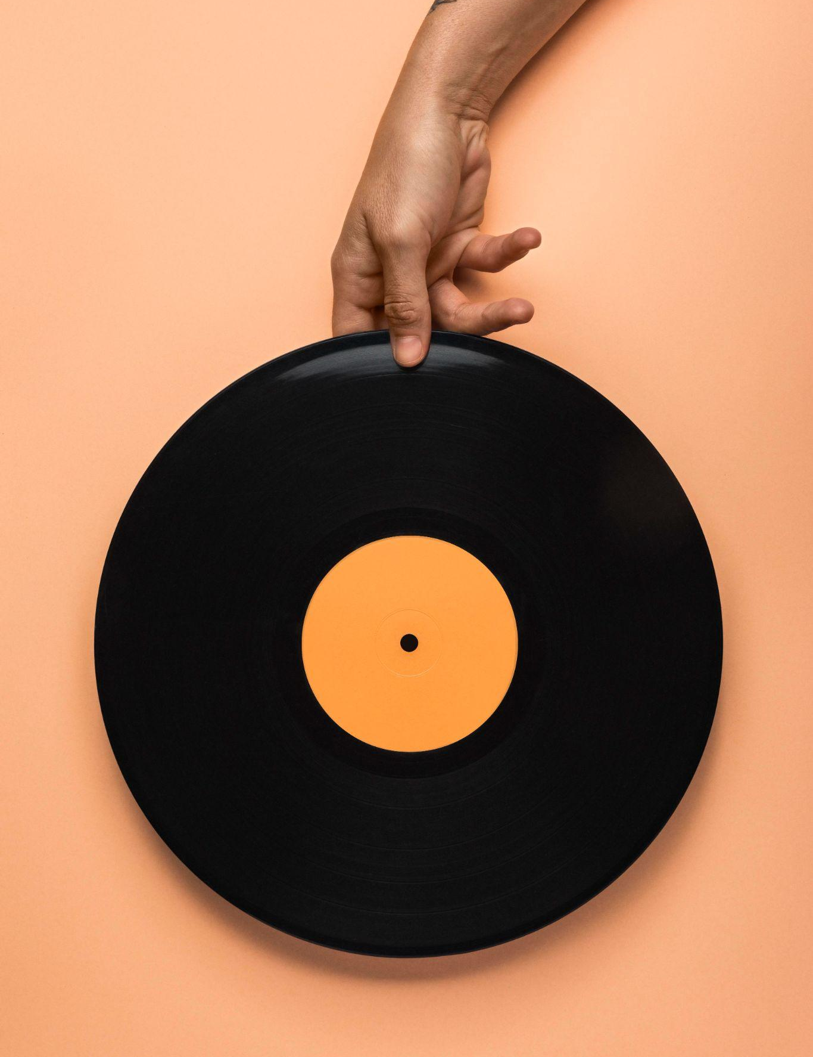

OBJECTIVES

Slide 6
OBJECTIVES
To provide a user-friendly search .
To maintain records of music tracks and their details.
To provide comprehensive song information, enhancing the listening experience.
To seamlessly log daily music interactions, ensuring accessibility and clarity.
To maintain organized records of songs, artists, albums, and playlists.

Slide 7
3
FEATURES

Slide 8
FEATURES
Login and Register
Playback Controls
Playlist Creation
Searching Song
Background Playback
Radio and Streaming

Slide 9
4
ADVANTAGES

Slide 10
ADVANTAGES
Easy to Use.
Good Quality of Sound.
Online and Offline Mode
User-Friendly Interfaces.

Slide 11
5
GANTT CHART

Slide 12
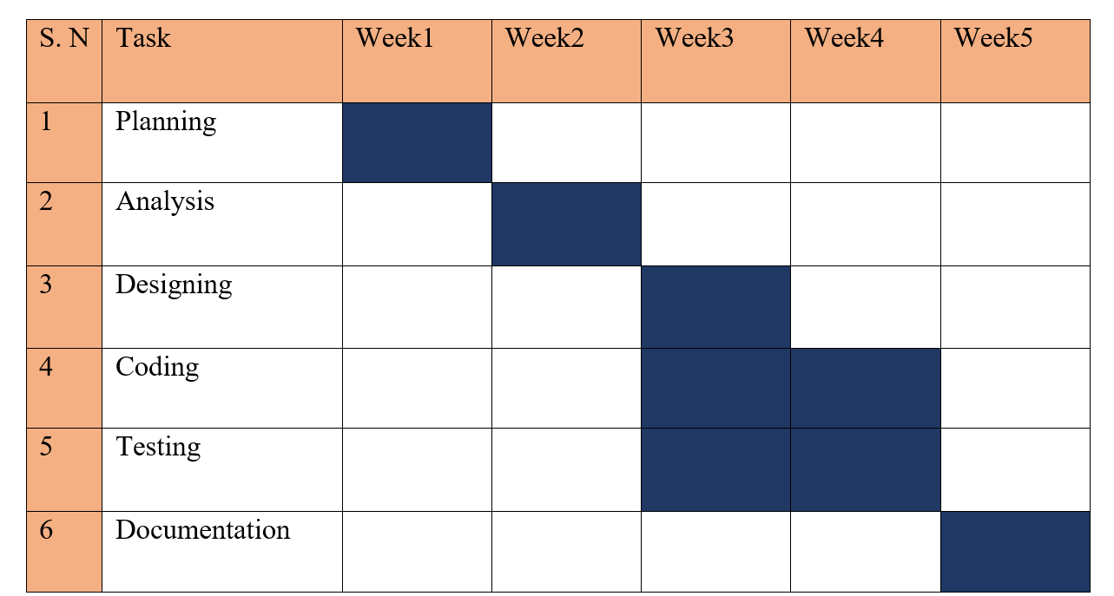
GANTT CHART

Slide 13
6
SYSTEM FLOW

Slide 14
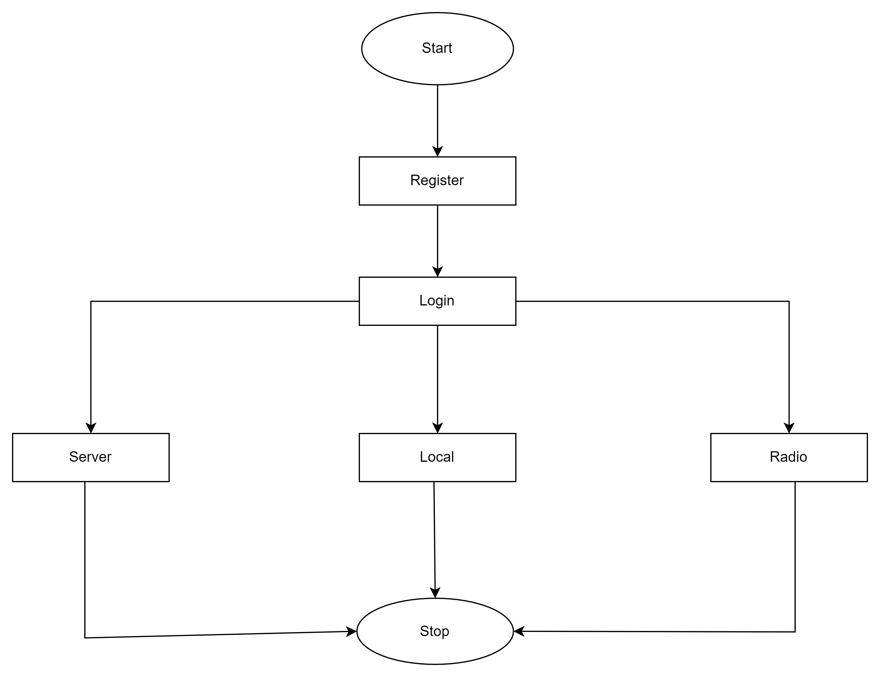

Slide 15

AGILE METHODOLOGY

Slide 16
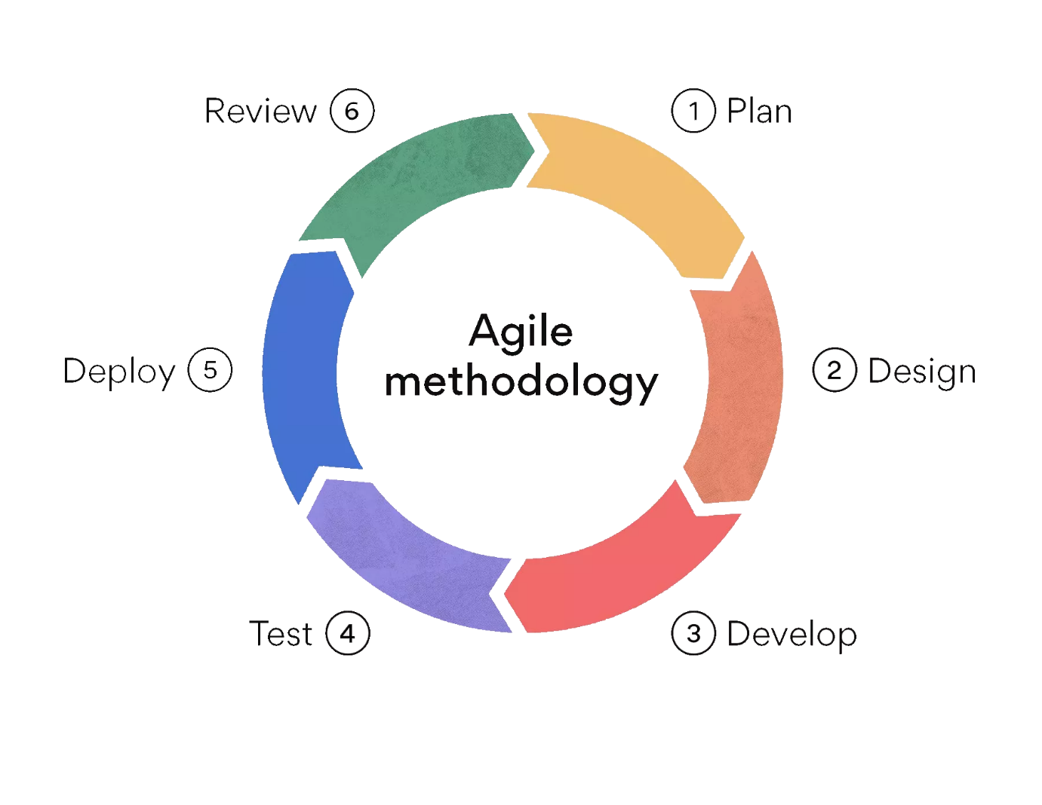
AGILE METHODOLOGY

Slide 17
8
USE CASE
DIAGRAM

Slide 18
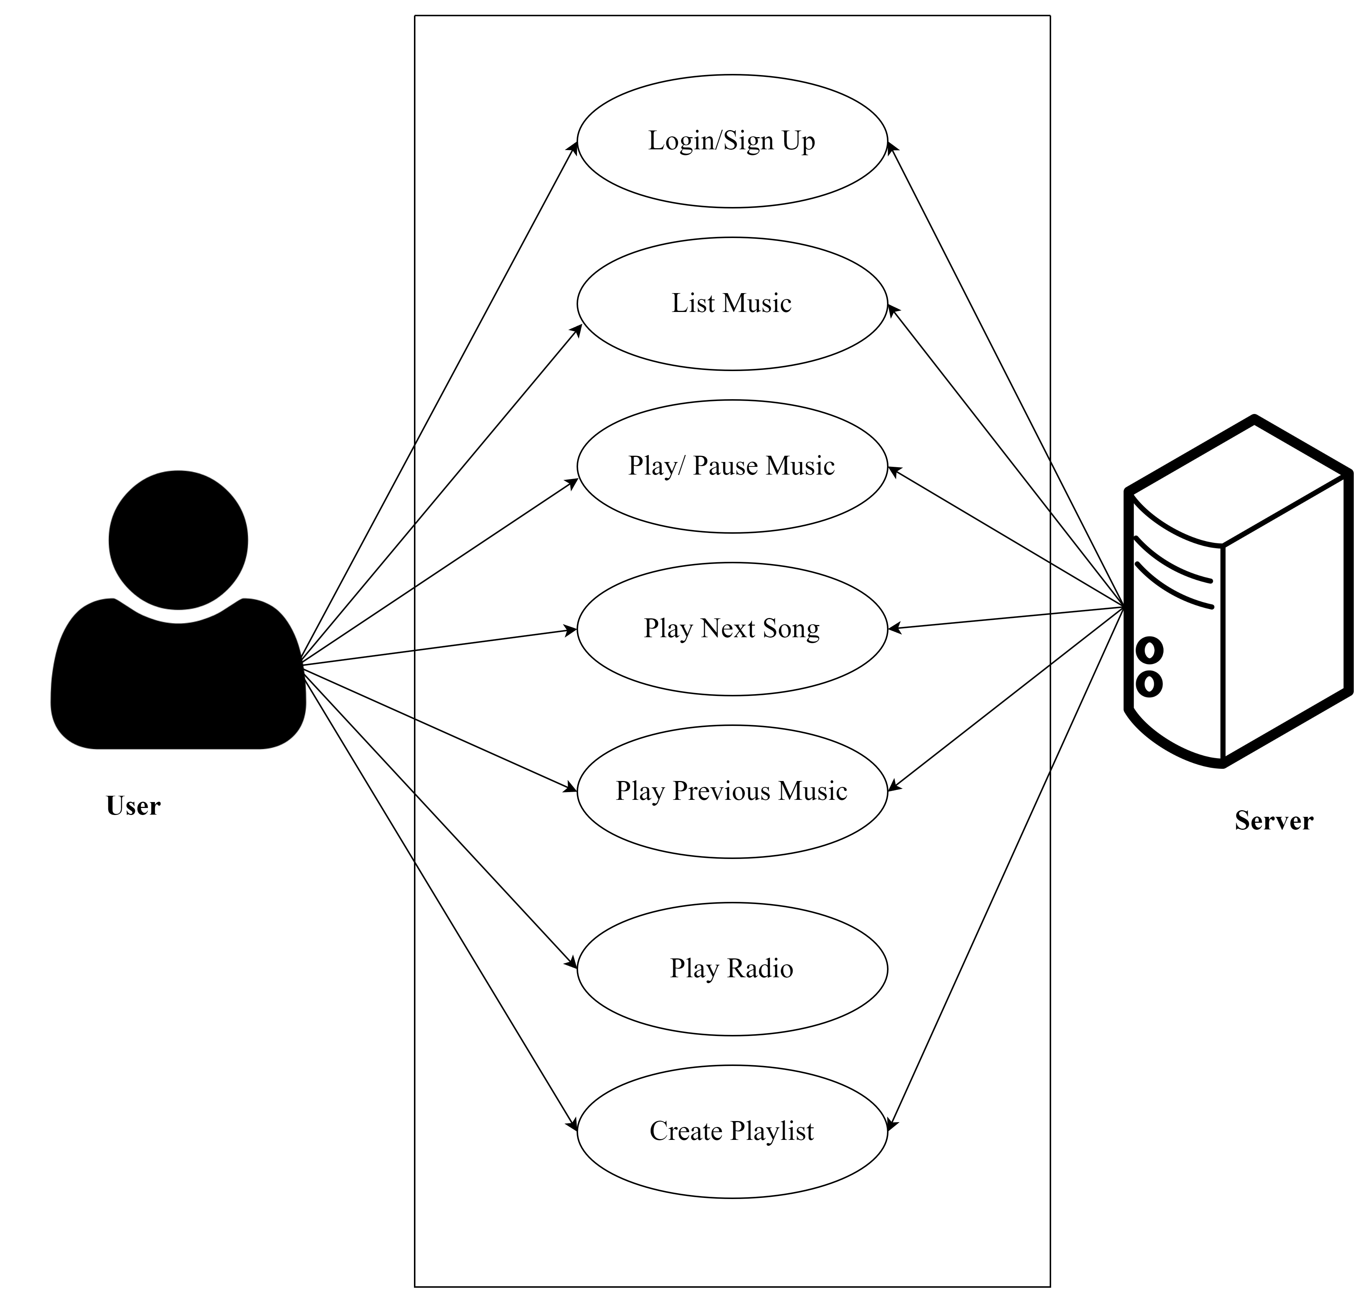
USE CASE DIAGRAM

Slide 19
9
FUTURE SCOPE

Slide 20
FUTURE SCOPE
In the future, we're planning to make our music player even better by doing a few key things. First, we'll make the sound quality even nicer by using better technology. Then, we'll make it easier for you to create, change, and share playlists. You'll be able to share your favorite songs and playlists on social media too. And, to make it even easier to use, we're thinking about adding voice control so you can tell the music player what to do without touching it. These improvements will make our music player more enjoyable and user-friendly.

Slide 21
CONCLUSION

Slide 22
THANK YOU!

