Slide 1
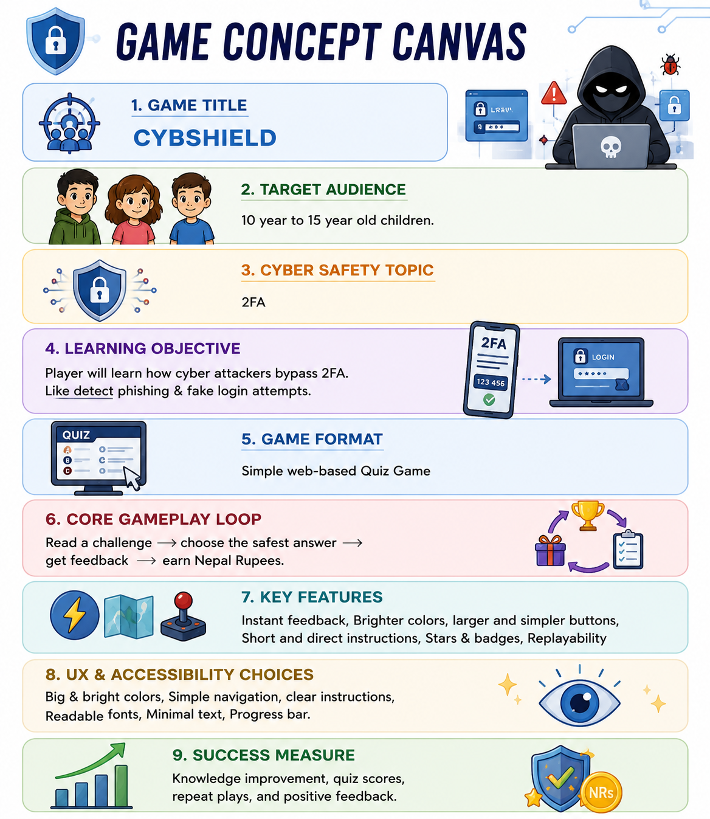
CybShield
Created by the team PKMPY……

Slide 2
1. Game Overview
• Web-based quiz game for children aged 10–15 years.
• Focused on cyber safety and 2FA awareness.
• Helps players identify phishing and fake login attempts.

Slide 3
2. Learning Objectives
• Understand how attackers bypass 2FA.
• Detect phishing messages and fake login pages.
• Build safe online habits and awareness.

Slide 4
3. Core Gameplay Flow
1. Read a cybersecurity challenge
2. Choose the safest answer
3. Receive instant feedback
4. Earn rewards, stars, and badges
5. Replay to improve score

Slide 5
4. Key Features
• Bright and engaging interface
• Large and simple buttons
• Short and direct instructions
• Reward system and replayability

Slide 6
5. UX & Accessibility
• Big and bright colors
• Simple navigation
• Readable fonts and minimal text
• Progress bar for tracking

Slide 7
6. Success Measures
• Improved cyber safety awareness
• Better quiz performance
• High engagement and replay rates

Slide 8
Thank You!
Cybshield makes cybersecurity learning fun, interactive, and accessible for children.

