Slide 1



Slide 2
Before The Interview
Research the potential employer
Review the job description and be able to match your experience and education with the duties of the position
Prepare a 1 to 2 minute script about yourself
Make sure you have the appropriate interview attire

Slide 3

Tips Regarding Attire (Men)
If possible, wear a suit to the interview
Belt and shoes should be same color
Avoid ties with elaborate patterns or too many colors
A wedding ring and/or watch is generally the only jewelry that should be worn
Head to Toe: Hair should be well groomed and shoes should be polished

Slide 4
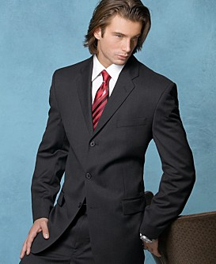
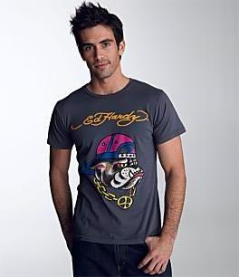
Who Would You Hire?

Slide 5

Tips Regarding Attire (Women)
A suit or dress is preferable
Skirts should meet at the top of the knee or longer
The amount of jewelry should be minimized
Make-up should be light
Avoid perfumes and scented powders

Slide 6
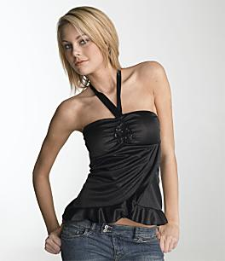
Stylish Look, But Not For An Interview

Slide 7

Stylish, And Ready To Interview

Slide 8

Starting The Interview
Be sure to arrive 10 to 15 minutes prior to the start of the interview
Greet the interviewer with a firm handshake
Maintain good eye contact and posture
Make sure you are energetic and enthusiastic
Speak clearly and articulate

Slide 9
Standard Interview Questions
Would you tell me about yourself?
What is your greatest strength?
What is your greatest weakness?
Where do you see yourself in 5 years?
What about this position do you find most appealing?
Why do you want to work for our company?
Why should we hire you?

Slide 10

Behavior-Based Questions
Can you describe the most valuable criticism you have received and what you did with it?
Can you tell me about an event that really challenged you?
Can you give me an example of a project that required attention to detail and how you handled the details?
Can you tell me about a difficult person with whom you have worked?
Can you describe the supervisor that you have liked the least?

Slide 11
Questions To Ask The Employer
What kind of training will I receive?
What type of advancement opportunities are available with your organization?
What is your time table for the remainder of the hiring process?
NOTE: Ask questions that demonstrate your knowledge of their company!

Slide 12

Follow-Up
Be sure to send a “thank you” after you have interviewed
A hand-written card is preferred
If you feel you have poor handwriting, then a typed letter may be a better option
Mail the card or letter on the same day as your interview

Slide 13

Need Additional Tips or Practice
Schedule an appointment with a career counselor by calling 618-650-3708 to further discuss interviewing or to set-up a mock interview

