Slide 1
Data Exercise
Using Microsoft Excel in a more effective and efficient way

Slide 2
Outline
Mindset
Livestock not pets
Project-oriented workflow

Slide 3
Mindset
As our skills as data analysts grow, the surrounding systems and infrastructure become crucial for ensuring the reproducibility and long-term preservation of our work. However, we often lack formal training or mentorship in managing such systems, leading us to either get lost amidst this technology or that we begin to explore these possibilities ourselves.

Slide 4
Mindset
With this short course, we hope to help you gracefully fall into this gap.
Don’t fret over past mistakes, but raise the bar for new work. Small but meaningful incremental changes add up over time, transforming your data quality of life.

Slide 5
Livestock not pets
Think of your data processes as livestock and not pets.
Notes:
Livestock is managed in herds and there is little fuss when individuals are lost or must be sacrificed. A pet, on the other hand, is unique and precious.
This is one of the limitations of spreadsheets in relation to creating a holistic data workflow. The tool combines the data, the code/steps, and the interface all in one software with an emphasis on just showing the end product/output to the user and the code/steps component hidden away.

Slide 6
Spreadsheets: save a source for your written functions
Use a text editor (rather than a word processor)
For Windows: Notepad++ - https://notepad-plus-plus.org/
For Mac: CodeEdit - https://www.codeedit.app/
Create a text file to associate with every spreadsheet project that you are working on.
Save the text file within the same directory as the associated spreadsheet.
Notes:
We will discuss the possible file organisation for this in a later slide

Slide 7
Project-oriented workflow
Organise work into projects.

Slide 8
File system discipline
Put all the files related to a single project in a designated folder.
This applies to data, code, figures, notes, etc.
Depending on project complexity, you might enforce further organization into subfolders.

Slide 9
File naming
File organisation and naming are powerful weapons against chaos.

Slide 10
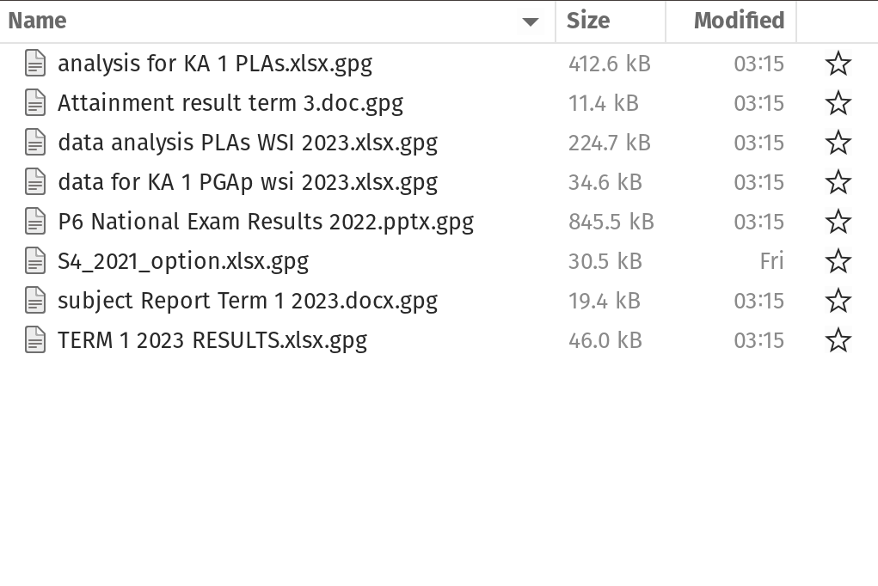
Three principles for file names
machine-readable
human-readable
plays well with default ordering

Slide 11
Machine-readable
avoid spaces, punctuation, accented, characters, case sensitivity.
deliberate use of delimiters/space-holders - "_" or "-"
general rule is that "_" to delimit units of metadata while "-" to delimit words so that they are more readable.

Slide 12
Machine-readable
easy to search for files later
easy to narrow file lists based on names
easy to extract information from file names

Slide 13
Human-readable
name contains info on content.
use the concept of a slug used in URLs.

Slide 14
Human-readable
Easy to figure out what something is based on its name

Slide 15
Plays well with default ordering
put something numeric first
use ISO 8601 standard for dates
add leading zeros to numbers

Slide 16
Three principles for file names
easy to implement now
payoffs accumulate as your skills evolve and projects get more complex

Slide 17
Exercise
The fem data is a dataset from 118 female students consulting at the university mental health/psychiatry clinic.

Slide 18
Data dictionary
ID | Patient ID
AGE | Age in years
IQ | IQ score
ANX | Anxiety (1=none, 2=mild, 3=moderate, 4=severe)
DEP | Depression (1=none, 2=mild, 3=moderate or severe)
SLP | Sleeping normally (1=yes, 2=no)
SEX | Lost interest in sex (1=yes, 2=no)
LIFE | Considered suicide (1=yes, 2=no)
WT | Weight change (kg) in previous 6 months

