Slide 1
Session 1
Global landscape of data governance institutions and frameworks Ernest Guevarra

Slide 2
Definitions
Notes:
In the next 4 slides, I will lay some proposed foundational concepts and definitions upon which the rest of the sessions for today will be built upon.

Slide 3
What is data?
“When we refer to data, we mean information about people, things and systems. … Data about people can include personal data, such as basic contact details, records generated through interaction with services or the web, or information about their physical characteristics (biometrics) - and it can also extend to population-level data, such as demographics. Data can also be about systems and infrastructure, such as administrative records about businesses and public services. Data is increasingly used to describe location, such as geospatial reference details, and the environment we live in, such as data about biodiversity or the weather. It can also refer to the information generated by the burgeoning web of sensors that make up the Internet of Things.”
- UK National Data Strategy
Notes:
Data refers to information about people, systems, and the world around us. It includes personal and population-level information about individuals, records about organisations and public services, and data describing locations and the environment. It also encompasses information generated by digital interactions and by connected technologies such as sensors and the Internet of Things.

Slide 4
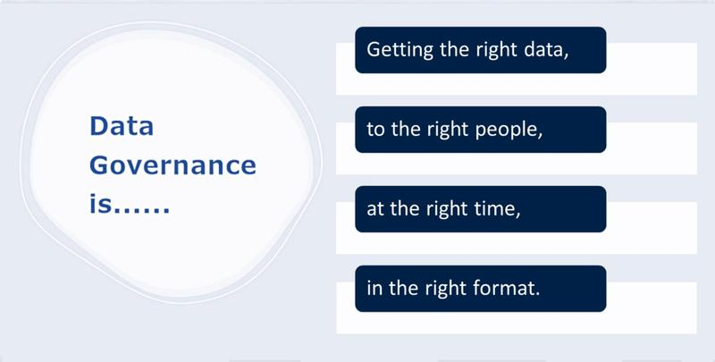
What is data governance?
A system of robust legal frameworks, ethical guidelines, standards, and processes that ensures an organisation’s data is accurate, consistent, secure, and compliant throughout its lifecycle.
Notes:
A system of robust legal frameworks, ethical guidelines, standards, and processes that ensures an organisation’s data is accurate, consistent, secure, and compliant throughout its lifecycle.
Getting the right data to the right people at the right time in the right format.

Slide 5
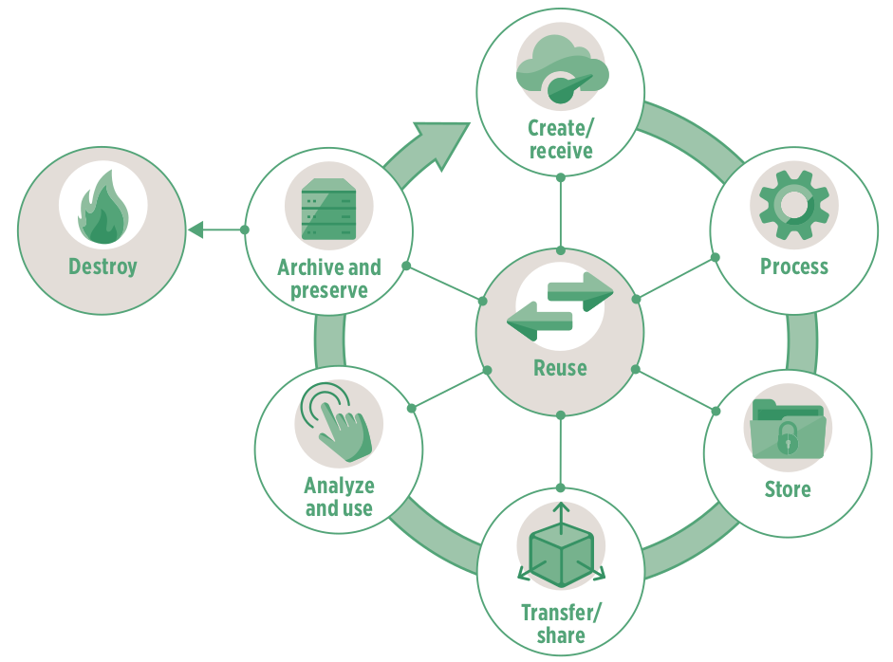
What is the data lifecycle?
Notes:
The data lifecycle describes the stages that data goes through from creation to disposal. While models vary, it typically includes these key phases:
Creation / Collection – Data is generated or gathered from sources such as people, systems, sensors, or surveys.
Processing – Data is cleaned, validated, organised, and transformed into a usable format.
Storage – Data is securely stored in databases, data warehouses, or other systems.
Use / Analysis – Data is accessed, analysed, and used to produce insights, support decisions, or deliver services.
Sharing / Publication – Data is shared with others, internally or externally, in line with legal, ethical, and security requirements.
Archiving / Retention – Data that is no longer actively used is retained for legal, historical, or reference purposes.
Disposal / Deletion – Data is securely destroyed or deleted when it is no longer needed.
Across all stages, governance, security, privacy, and quality management apply to ensure data is used responsibly and effectively.
The data lifecycle depicts the potential circularity of data use, reuse, and repurposing, as long as data can be made safely accessible across a wide array of users and unless explicit steps are taken to destroy the data. This demonstrates the inexhaustible/unrival nature of data – they can be used and reused repeatedly by companies and governments for different purposes without depleting them. Hence the potential to extract value from data is significant.

Slide 6
Public vs Private intent data
Notes:
We now will define and differentiate the concepts of public and private intent data.

Slide 7
Public intent data
Public intent data is data collected for public purposes.
Public intent data is a foundation of public policies and can play a transformative role in the public sector.
Private intent data
Private intent data is data collected by the private sector as part of routine business processes.
Private intent data can drive innovation, lower transaction costs, and improve productivity, competitiveness, and economic growth.
Notes:
Public intent data is data collected to support the public good, particularly for developing, implementing, and evaluating public policy. Governments are the main producers of this data through activities such as censuses, surveys, and administrative records, but it is also contributed by citizens, civil society, NGOs, academic and international organizations, and, in some cases, private firms.
Private intent data is data collected by the private sector as part of routine business processes. These are often referred to as digital footprints - like website visits, searches, content downloads, and social activity—that reveal a person’s or company’s specific interests, needs, and potential purchase intentions, helping businesses personalize marketing, identify high-value leads, and predict buying behaviour, though its collection and use raise privacy concerns and require careful ethical handling and consent.

Slide 8
Activity 1: Tell me about your data

Slide 9
Activty 1 - Mechanics
Move into the group assigned to you.
TAMRI Hanoi + TAMRI Ho Chi Minh City
Tam Anh Ho Chi Minh City
Tam Anh Hanoi
Eplus + SMART Research
VNVC + Calif
Department of Health (Hanoi and Ho Chi Minh City) + Department of Science and Technology Hanoi

Slide 10
Activity 1 - Mechanics
Individually, write keywords and/or key terms/concepts that describe any one or all data that you work with and/or are in charge of
write on the provided meta cards;
use keywords or key phrases and not sentences;
one keyword or key phrase in one meta card;
you can use as many meta cards as you want/need.

Slide 11
Activity 1 - Mechanics
Post your meta cards onto the assigned wall or table for your group.
Make sure that your meta cards are separate from everyone else’s in your group;
Make sure that your meta cards are posted in such a way that the text in each card is readable (don’t make the cards overlap).

Slide 12
Activity 1 - Mechanics
Within your group, find a partner and discuss and describe with each other the data that you work with and/or are in charge of
You will be given 5 minutes to share with your partner;
After 5 minutes, find a new partner and then discuss and describe with each other;
We will do three rounds of partner discussion within group.

Slide 13
Activty 1 - Mechanics
With another group, find a partner in that group and then ask them to discuss and describe to you the data they work with and/or in charge of
Specific groups will be chosen to approach another group;
The members of the visiting group will find a partner in the hosting group;
The members of the visiting group will ask their partner from the hosting group about the data they work with and/or are in charge of. They will have about 5 minutes for this discussion;
After five minutes, the members of the visiting group should find a new partner among the members of the hosting group and then start asking about the data they work with and/or are in charge of;
After three rounds, the hosting group will then be asked to visit another group and do the same steps while the visiting group will then host a different group.

Slide 14
Public intent data
Notes:
Now, we will dig deeper into public intent data.

Slide 15
Types of public intent data
Administrative data
Census data
Sample surveys
Citizen-generated data
Machine-generated data
Geospatial data
Notes:
Administrative - Administrative data are generated through official registration and record-keeping processes, typically by national authorities, and include records such as vital events, identification systems, and population, health, education, tax, and trade data. They also cover data used to manage government programs and services, with digital technologies creating new administrative data sources, such as information collected through smartphone applications used by inspectors.
Census data - Censuses systematically collect information on an entire population such as individuals, households, or businesses with population and housing censuses in particular providing comprehensive data on all residents and their key socioeconomic characteristics.
Surveys - Sample surveys collect detailed and frequent information from a representative subset of the population, often based on census data. They cover areas such as households, farms, businesses, labour, and health, and are a key source for official statistics like unemployment and national accounts, often used alongside administrative and census data.
Citizen-generated data - Citizen-generated data are created by individuals to address gaps or concerns in existing data and play an important role in monitoring, accountability, and problem-solving related to citizens’ needs.
Machine-generated data - Machine-generated data are automatically produced by sensors, applications, or computer processes without human input. They often come from connected devices, such as air pollution sensors, that form part of the Internet of Things.
Geospatial data - Geospatial data link different types of information to specific locations. Public intent geospatial data include satellite imagery, weather data, and property and land information.

Slide 16
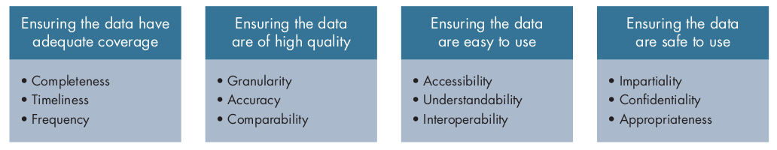
Maximising value of public intent data
Notes:
There are several conditions that should be in place to maximize the value of public intent data. The data need to be (1) produced with adequate spatial and temporal coverage (complete, timely, and frequent); (2) high in quality (granular, accurate, and comparable); (3) easy to use (accessible, understandable, and interoperable); and (4) safe to use (impartial, confidential, and appropriate). With these features, development-related data have the potential to transform development outcomes.

Slide 17
Three pathways for public intent data to add value
Improving service delivery
Prioritising scarce resources
Holding government accountable and empowering individuals
Notes:
For this potential of data to be realised, the data must be used explicitly to generate public good, including through the three pathways.
Improving service delivery
Increasing access to government services – this requires data representative of all residents. Using administrative data such as foundational identification systems like national IDs, civil registries, and digital IDs helps ensure comprehensive population coverage and equitable access.
Better preparing for and responding to emergencies
Generating useful knowledge
Prioritising scarce resources
Targeting - When public intent data is detailed and linked to specific individuals or locations, it can be used to better target resources and promote inclusion. For example, granular data from Demographic and Health Surveys has played a significant role in shaping public policy on issues such as HIV/AIDS and gender-based violence. Sex-disaggregated survey data have informed laws, education programs, and support services. For example, in Vietnam, survey findings on widespread gender-based violence prompted public debate, influenced the National Strategy on Gender Equality, and led to the creation of counselling, health, legal, and shelter services for affected women.
Saving resources – interoperability in administrative data and government records can be used to help government save resources through increase in taxation revenue (Tanzania) and increase efficiencies in the public welfare system (Argentina)
Monitoring progress
Holding government accountable and empowering individuals
Transparency - In China, media and watchdog organizations in Beijing noted inconsistencies between official government data on air quality and data from independent air quality monitoring systems. Heightened concerns about air quality have fuelled a dramatic expansion in publicly available, real-time data from thousands of air quality monitoring locations. The central government launched a US$275 billion plan to improve air quality throughout the country, and the Beijing municipal government promised an additional US$160 billion toward that goal.
Empowering individuals

Slide 18
Gaps in public intent data
Notes:
Even though public intent data have proven highly valuable, significant gaps remain in their availability, quality, and ease of use, especially in low-income countries.

Slide 19
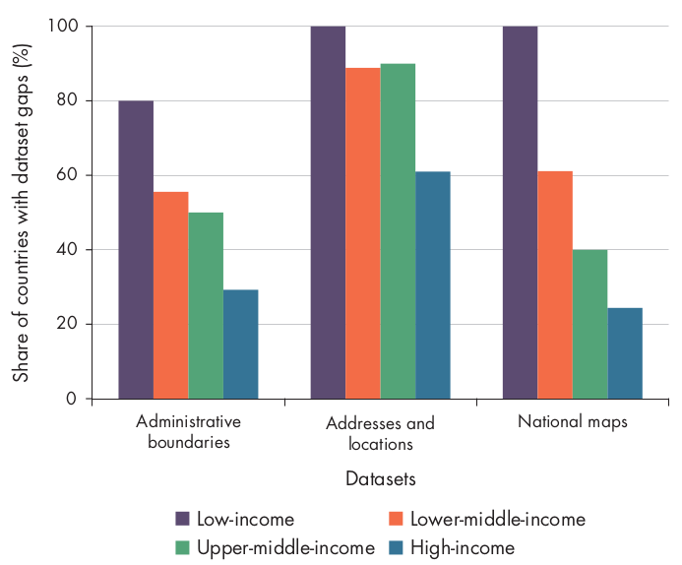
Coverage is inadequate
Lack of timeliness, frequency, and completeness.
Large gaps in geospatial data in lower-income countries
Notes:
Many areas still suffer from data that are not collected or released often enough across all types of public intent data. This problem is especially pronounced for surveys and censuses, where there are often long delays between data collection and publication. Half of low-income countries have not undertaken a population and housing census in the last 10 years, and 18 percent have not done so in the last 20 years.
Civil registration and vital statistics systems for recording births and deaths are incomplete in all low-income countries, while coverage is higher in wealthier countries—reaching about 22 percent in lower-middle-income countries, 51 percent in upper-middle-income countries, and 95 percent in high-income countries.
Lower-income countries often face significant gaps in geospatial data, particularly in core reference datasets such as administrative boundaries, addresses, and maps. Assessments show that these datasets are frequently incomplete in these countries.

Slide 20
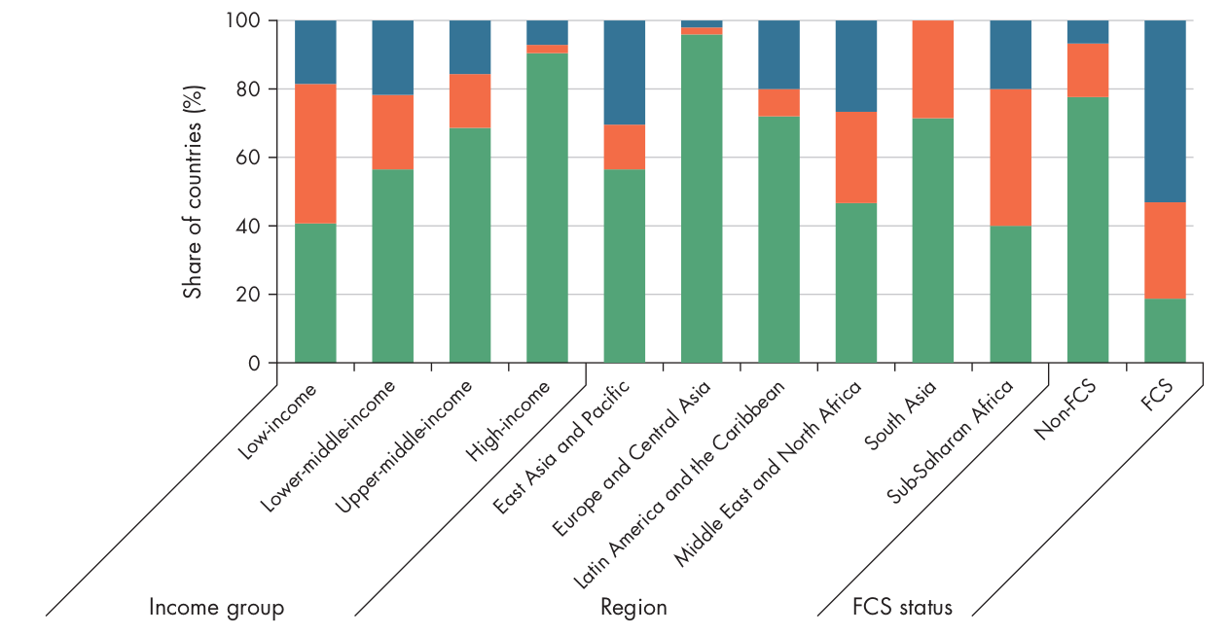
Data quality is poor
Lack of granularity, accuracy, and comparability.
Lack of data disaggregation
Lower-income countries have less comparable poverty data
Notes:
A lack of granularity arises when data are not available at the required level of detail or disaggregation.
Limited sex-disaggregated data
Individual level data are being proxied using household level data
Although geographically detailed data could greatly improve policy targeting, such data are rarely available. Most official statistics are not consistently reported at regional levels, and almost none are available at the district level.

Slide 21
Data not easy to use
Lack of accessibility, understandability, and interoperability.
Notes:
Limited data accessibility prevents effective data use. Lower-income countries trail significantly in data openness, and even high-income countries perform only moderately well. Very few countries especially low-income ones consistently publish data under open licenses, though openness increases with income level.
Data accessibility is often limited by fragmented public sector data systems. In sectors like health, multiple uncoordinated information systems often including private providers prevent data from being shared with central authorities. Administrative data are frequently siloed within and across government agencies, reducing their usefulness for monitoring and policy-making.
Even when data are accessible, a lack of clarity and usability can limit their value. Data need proper dissemination, metadata, user-oriented formats, and visualization to be useful. While many countries provide data portals and metadata, low-income countries still lag, particularly in using advance release calendars that ensure timely and predictable data publication.
Using shared standards, methods, and classifications across public intent data improves interoperability and integration. Consistent geographic identifiers and expanded georeferencing are especially needed at subnational levels, particularly in low-income countries. While unified personal identifiers could improve data linkage, they raise privacy and equity concerns and require strong data protection laws, public trust, and complete civil registration systems. Privacy-preserving options such as tokenized identifiers offer a possible alternative.

Slide 22
Data not safe to use
Data not immune to influence from stakeholders
Data not stored securely - too common in government and private sector databases
Data not properly de-identified
Notes:
Data safety gaps persist when data are vulnerable to manipulation, insecure storage, or inadequate deidentification. Past cases show risks from both intentional misrepresentation and data breaches, as well as the possibility of reidentifying individuals from supposedly anonymized data. To reduce these risks, data collection should focus on necessary, policy-relevant information and avoid excessive or intrusive data gathering, while recognizing that misuse remains possible even with safeguards.
Data not immune to influence from stakeholders
Example: Greece’s debt statistics appear to have deliberately misrepresented the country’s financial situation in the lead-up to the 2009 euro crisis
Data not stored securely - too common in government and private sector databases
Data not properly de-identified
Example: In the 1990s, Massachusetts released de-identified medical records of state employees for research. Despite removing names and addresses, a researcher was able to re-identify individuals, including the governor, by combining the data with other publicly available information.

Slide 23
Why gaps persist in public intent data
Deficiencies in financing
Deficiencies in technical capacity
Deficiencies in governance
Deficiencies in data demand
Notes:
Insufficient funding and poorly aligned investment priorities continue to sustain data gaps.
Data gaps persist due to shortages of skilled and adequately paid staff, limited workforce capacity, and insufficient technology and infrastructure.
Weak data governance alongside limited skills and funding hinders the effective use of public intent data. Clear mandates and strong coordination among data-producing agencies are essential but often lacking, resulting in poor data sharing, limited interoperability, delayed publication, and duplicated data collection efforts.
Even when data are high quality and accessible, their impact depends on being used effectively; a lack of data use remains a major barrier to development.

Slide 24
Private intent data
Notes:
Now we will focus on private intent data.

Slide 25
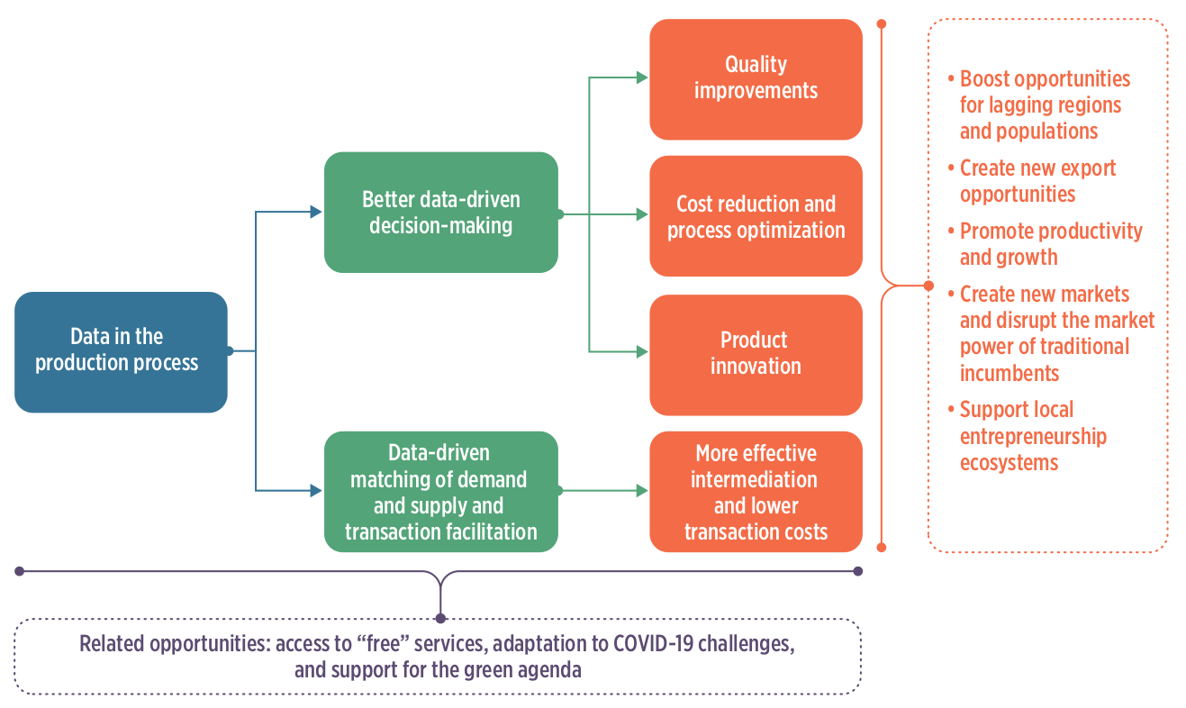
Data in the production process
Notes:
Data-intensive analytics help uncover new insights, improve decision-making, and streamline processes. Big data analytics usually rely on new methods and technologies to support more advanced and effective decisions.
Firms use data-driven technologies individually or together, with data-driven platforms being a key business model. These platforms combine data with analytics and AI to connect different user groups, reduce information gaps and search costs, facilitate market exchanges, and generate additional data on user behaviour.

Slide 26
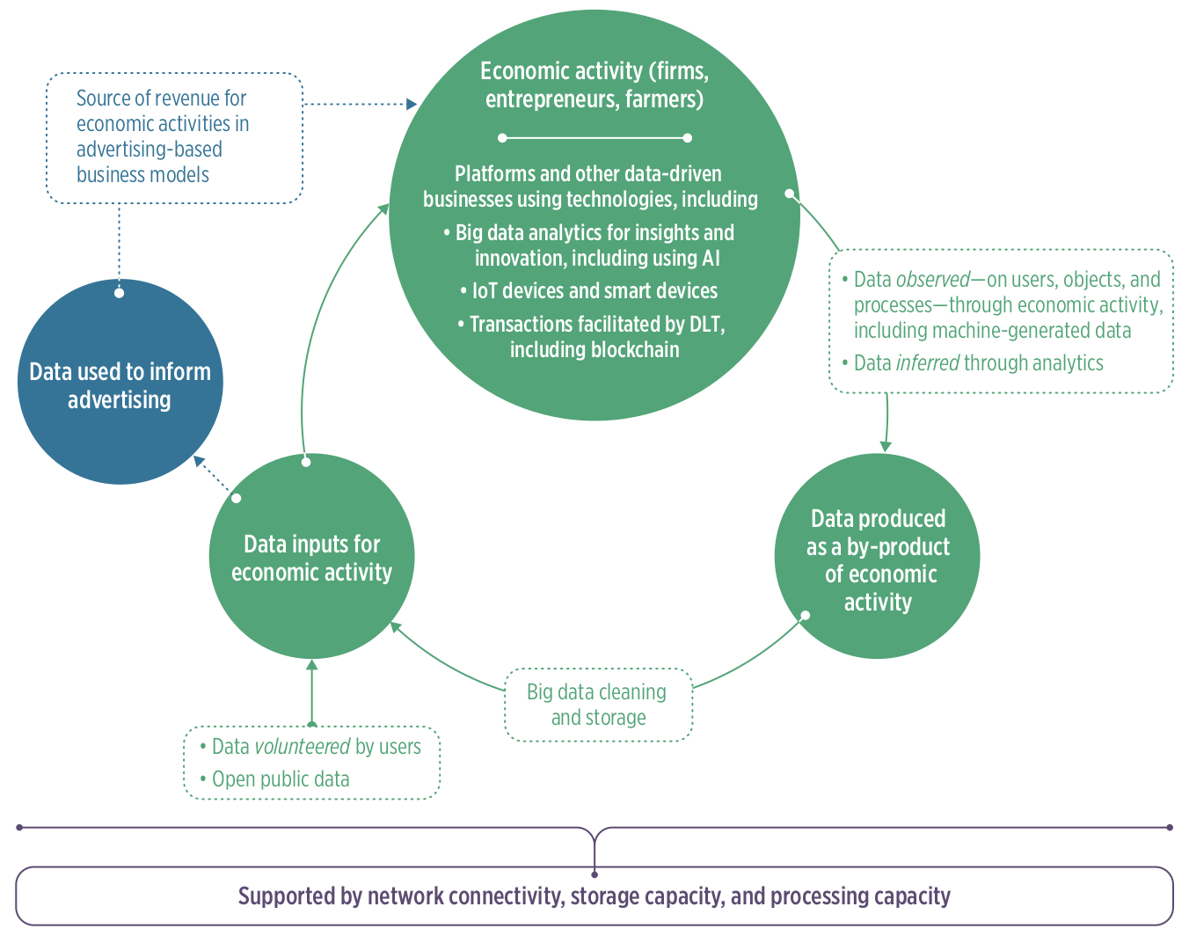
Role of data in economic activity
Notes:
The figure shows how data function both as an input to economic activity and as a by-product of it, highlighting how data generated from one activity can be reused to support the same or new economic activities.

Slide 27
Data inputs for economic activity
Data collection by firms - “digital footprint”
Use of public intent data by businesses
Notes:
Data collection by firms - “digital footprint”
Use of public intent data by businesse

Slide 28
Sectors transformed by use of data in the production process
Finance
Agriculture
Health
Education
Transport and logistics
Notes:
The following sectors have been transformed by use of data in the production process.

Slide 29
Finance sector
Alternative credit scoring algorithms - use of an individual’s digital footprint to train machine learning algorithms to identify, score, and underwrite credit.
Payment systems - digital payments; mobile payments.
Use of transaction data for product development - Mastercard’s Tourism Insights service allows leveraging big data to provide information on travellers’ preferences.
Distributed ledger technology - blockchain; eliminates financial intermediaries; embedding rules into smart contracts simplifies negotiation and verification processes.
Notes:
Alternative credit scoring algorithms - use of an individual’s digital footprint to train machine learning algorithms to identify, score, and underwrite credit.
Payment systems - digital payments; mobile payments.
Use of transaction data for product development - Mastercard’s Tourism Insights service allows leveraging big data to provide information on travellers’ preferences.
Distributed ledger technology - blockchain; eliminates financial intermediaries; embedding rules into smart contracts simplifies negotiation and verification processes.

Slide 30
Agriculture sector
Remote sensing and geographic information systems - analysis of these data provide insights into farming operations; smart farming
Internet-of-things (IoT) and embedded devices for monitoring farm and livestock conditions and farm operations
Use of data to provide a range of services along the agriculture value chain
Use of data to improve food traceability
Notes:
Remote sensing and geographic information systems - analysis of these data provide insights into farming operations; smart farming
Internet-of-things (IoT) and embedded devices for monitoring farm and livestock conditions and farm operations
Use of data to provide a range of services along the agriculture value chain
Use of data to improve food traceability

Slide 31
Education
video conferencing/video communication tools
digital supplemental learning platforms
intelligent adaptive education
Notes:
video conferencing/video communication tools
digital supplemental learning platforms
intelligent adaptive education

Slide 32
Transport and logistics sector
Digital freight matching
Digital courier logistics
IoT-enabled cold chain
Notes:
Digital freight matching
Digital courier logistics
IoT-enabled cold chain

Slide 33
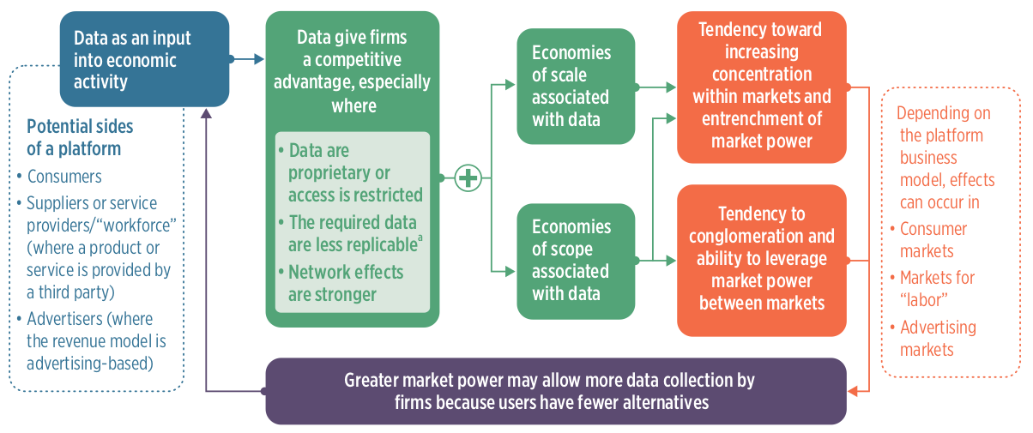
Risks to market structure from platform firms
Notes:
A platform business’s ability to gain market power depends on its business model, including the user groups it connects and how it generates revenue, which shape the types of data that provide competitive advantage.

Slide 34
Risks and adverse outcomes of data-driven businesses
Increase propensity of dominant firms emerging
Potential for exploitation of individuals
Potential to increase inequality within and among countries
Notes:
Proprietary data can give firms a strong competitive advantage because, after initial investment, additional data are inexpensive to generate. Improved targeting can attract more users, reinforcing network effects and creating scale advantages that can lead to winner-takes-most outcomes and high barriers for new entrants.
Potential exploitation of individuals via excessive data collection, insufficient governance of data held by private firms, pricing, discrimination, and algorithmic risks, and indirect management of the workforce through algorithms
Potential to increase inequality within and among countries

