Slide 1
Session 3
Case Study: Singapore’s Smart Nation, Open Government Products, and Singapore Government Tech Stack Ernest Guevarra

Slide 2


Slide 3
Smart Nation journey

Slide 4
Vision
Singapore’s Smart Nation initiative, led by the Ministry of Digital Development and Information (MDDI), aims to build a thriving digital future for everyone.
Launched in 2014, Smart Nation 1.0 sought to improve lives through seamless and meaningful use of technology.
Since its launch, Singapore has integrated digital technologies deeply into daily life, creating new opportunities while also needing to manage risks to well-being and social cohesion.
In 2024, Singapore introduced Smart Nation 2.0, a refreshed vision focused on using technology more effectively to transform the nation’s future.
The new phase shifts from primarily building digital capabilities to applying them strategically to shape Singapore’s long-term development.

Slide 5
Goals

Slide 6
Trust

Slide 7
Growth

Slide 8
Community

Slide 9
Smart City achievements
99% of all transactions between citizens and the government can be completed online.
High citizen and business satisfaction with Government Digital Services at 83% in 2023.
99% of resident households are connected to the internet, as of 2022.
95% of small and medium enterprises (SMEs) have adopted at least one digital technology from nine categories: cybersecurity, cloud, e-payment, e-commerce, data analytics, artificial intelligence, Internet of Things, blockchain, and immersive media.

Slide 10
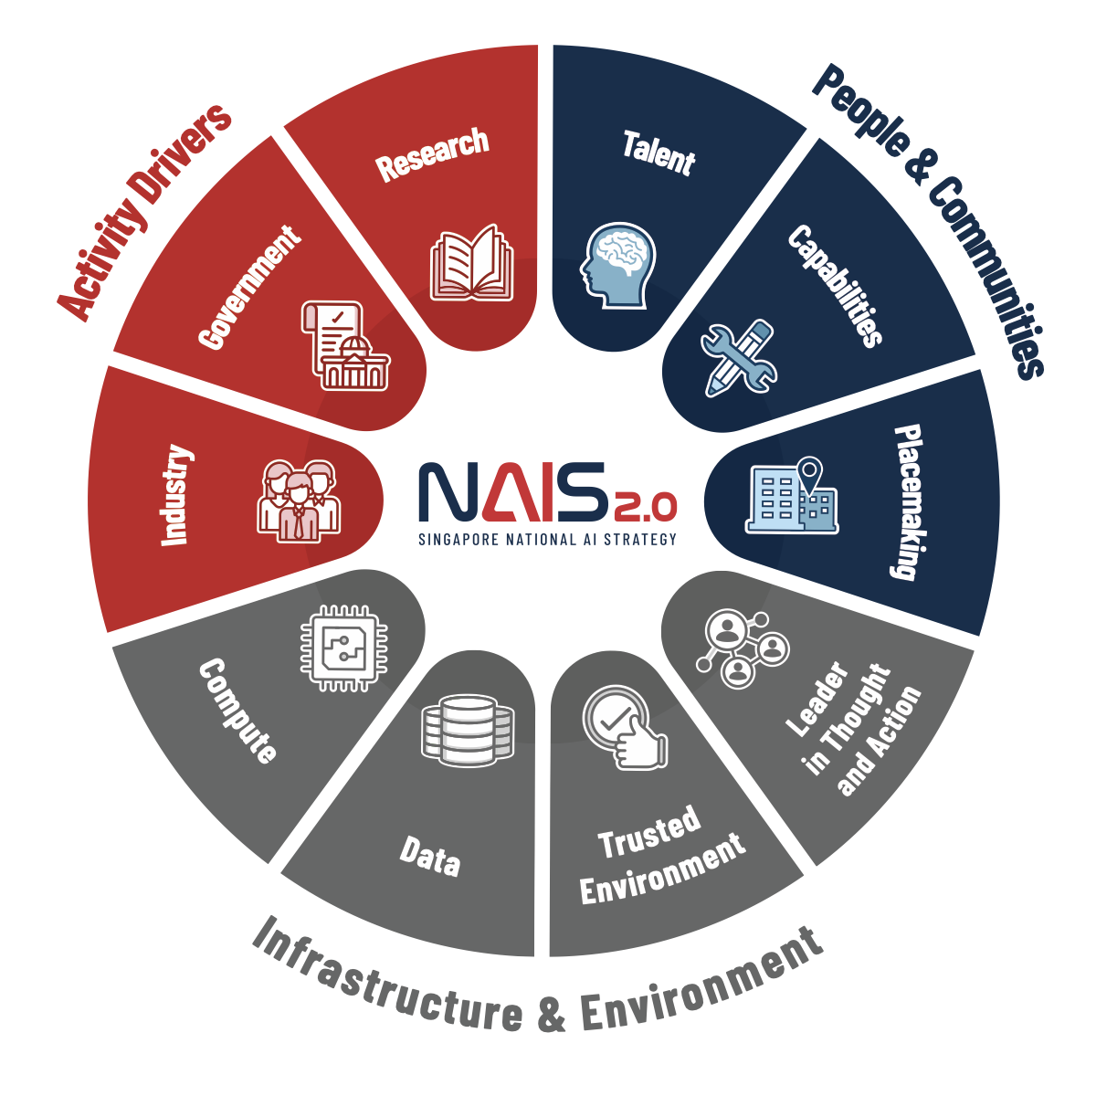
National AI Strategy

Slide 11
Open Government Products

Slide 12
Approach

Slide 13
Products
More than 40 products in progress
Use report cards mechanism to provide a transparent overview of the work being done on each of the products

Slide 14
Tackle real problems
Share why and how the product solves a problem with updates along the way.
Resource responsibly
Product costs are made open as possible to stay accountable to taxpayers and citizens.

Slide 15


Slide 16
ScamShield helps users detect, check, and report suspicious messages, calls, and links.
Reported scams are verified by authorities, helping them track and respond to new scam variants.

Slide 18
Paper voucher campaigns were slow to launch and difficult for residents to claim and use.
Merchants experienced long delays in receiving payments.
Existing digital alternatives were available but scattered across multiple complicated apps.
RedeemSG provides a unified platform for government agencies and non-profits to create, distribute, and monitor vouchers nationwide.
Citizens redeem vouchers and merchants accept them through the same system.

Slide 20
Paper-based tracking made it difficult for organisations to monitor distributions or adapt plans in real time.
This led to long waiting times, inaccurate records, and limited ability to reach more beneficiaries.
DistributeSG enables government agencies and non-profits to run and monitor distribution campaigns with real-time tracking.
It includes an admin portal for organisers to set up campaigns and a mobile app for on-the-ground tracking of distributed items.

Slide 21
Initiatives

Slide 22


Slide 23
Build for Good is a citizen engagement initiative by Open Government Products that encourages citizens to help improve Singapore.
People can participate through a hackathon, an accelerator for winning teams, or by joining the community.
The initiative aims to create a supportive space where individuals feel empowered to contribute positively, experiment, and build solutions that make the world better.

Slide 25
Hack for Public Good (HFPG) replaces top-down product development with a community-driven approach.
Instead of leadership setting the direction, tech teams engage directly with the community to identify public good problems in Singapore.
These teams then design and build solutions based on what they discover.

Slide 26
Singapore government tech stack

Slide 27
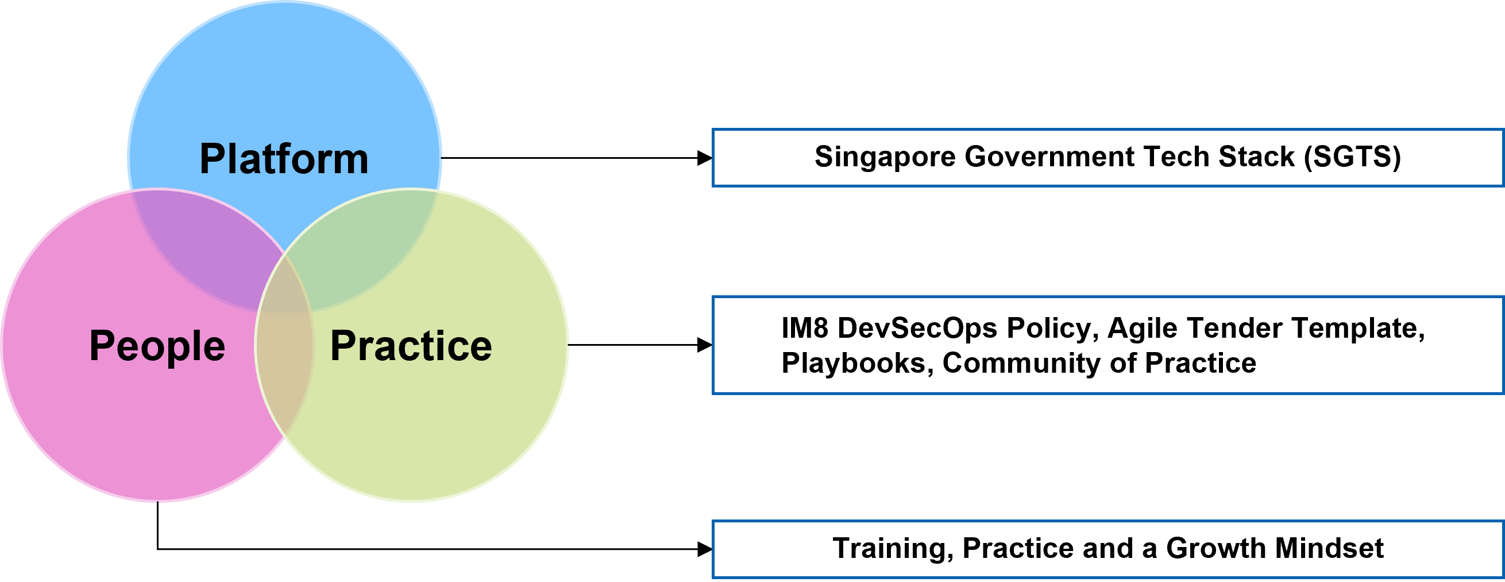
Overview
The Singapore Government Tech Stack (SGTS) modernises development practices across the whole government.
The goal is to support the creation of secure, responsive systems that keep up with evolving citizen and business needs.

Slide 28
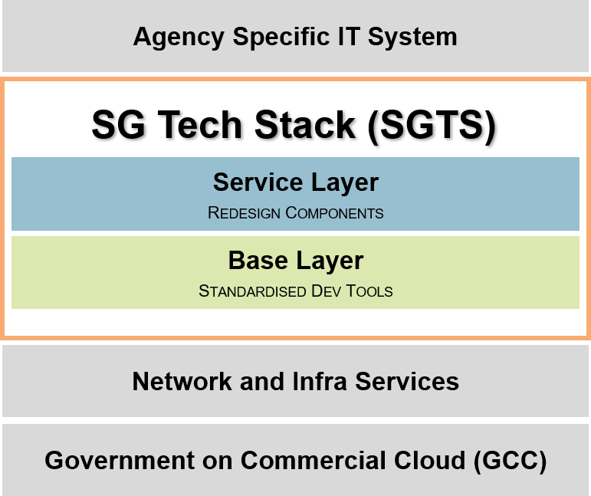
Architecture

Slide 29
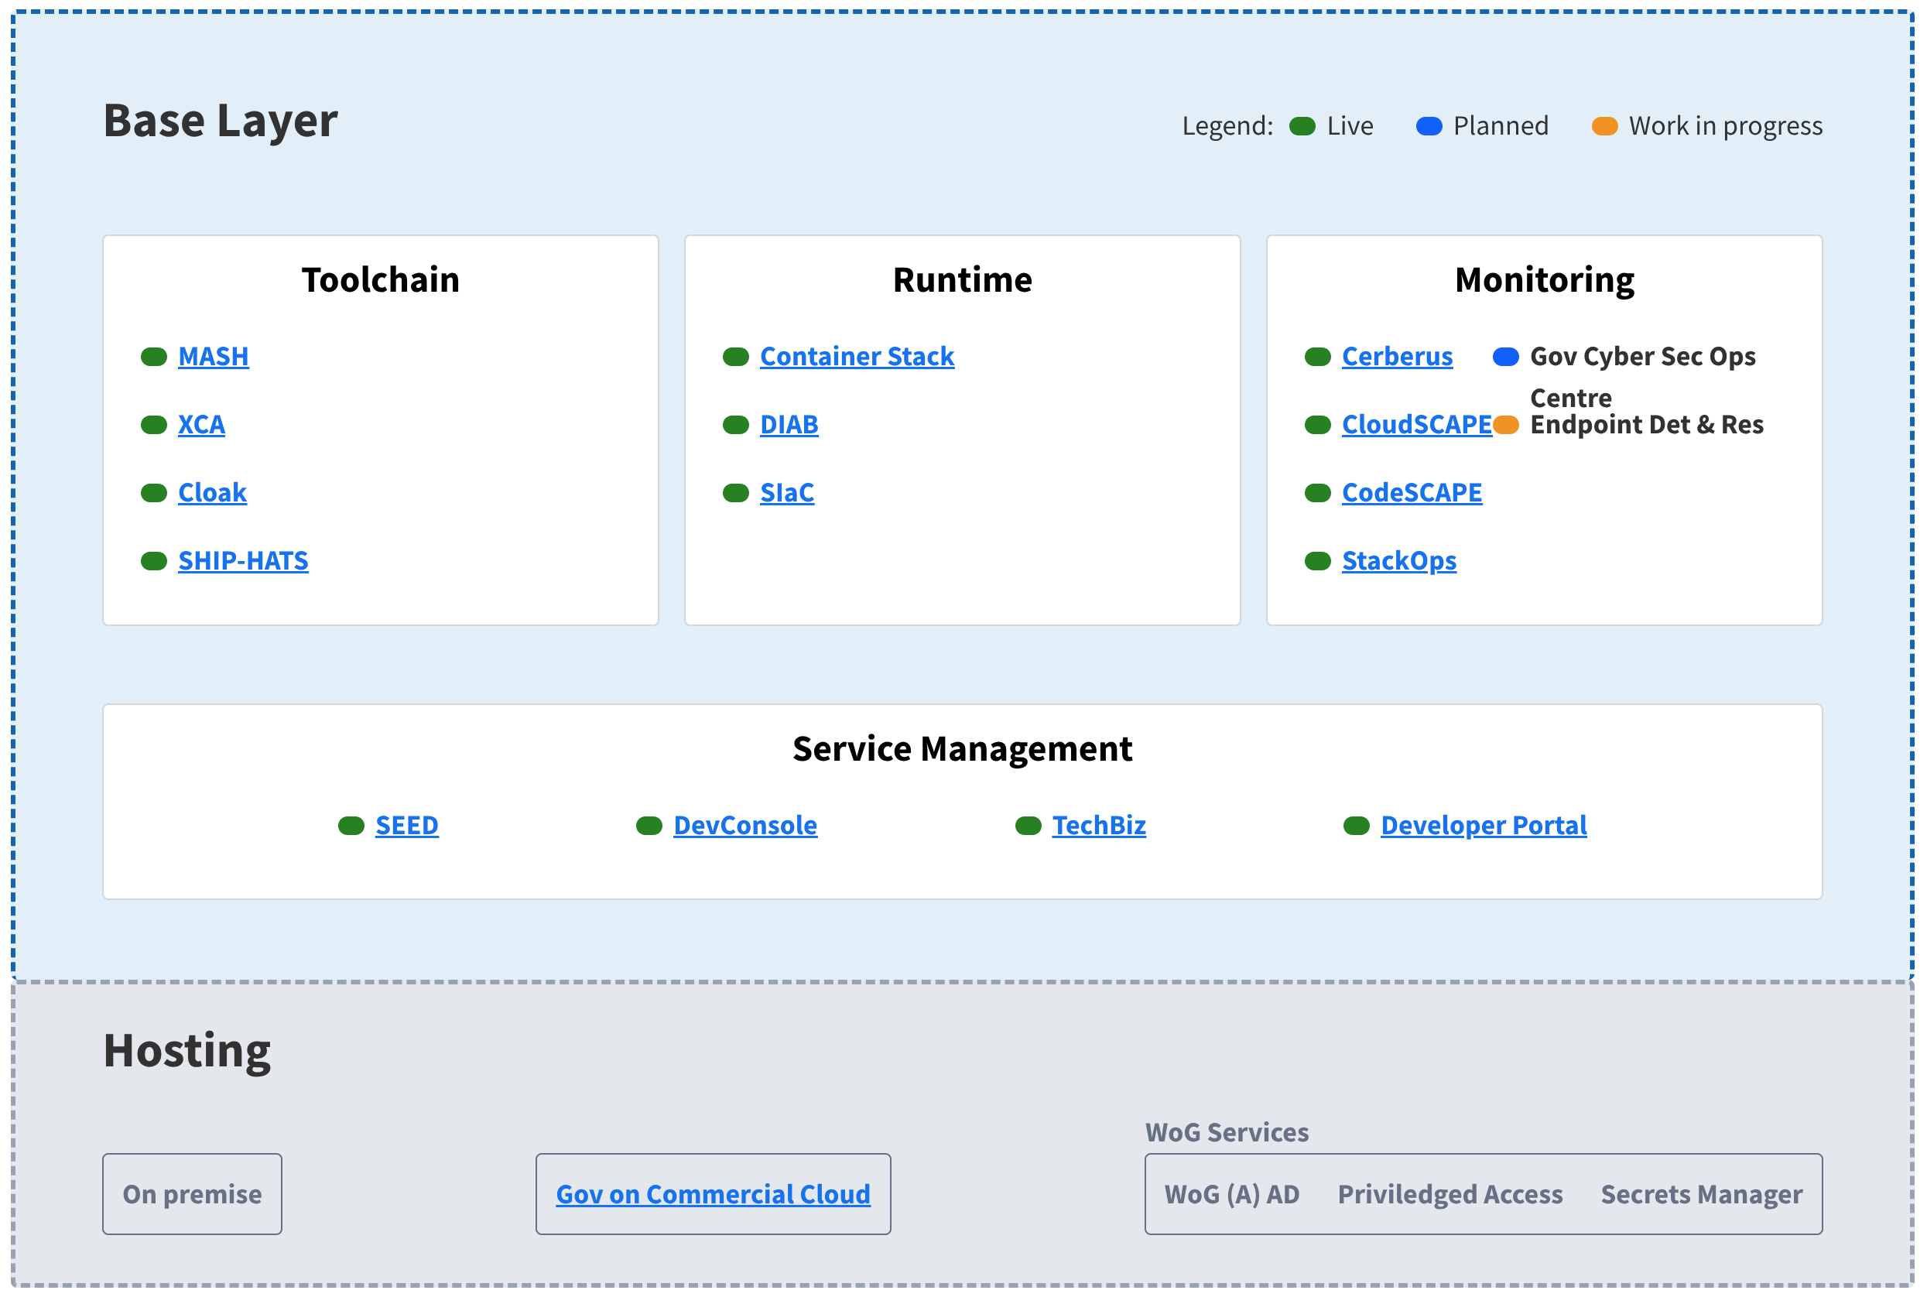
Architecture - base layer

Slide 30
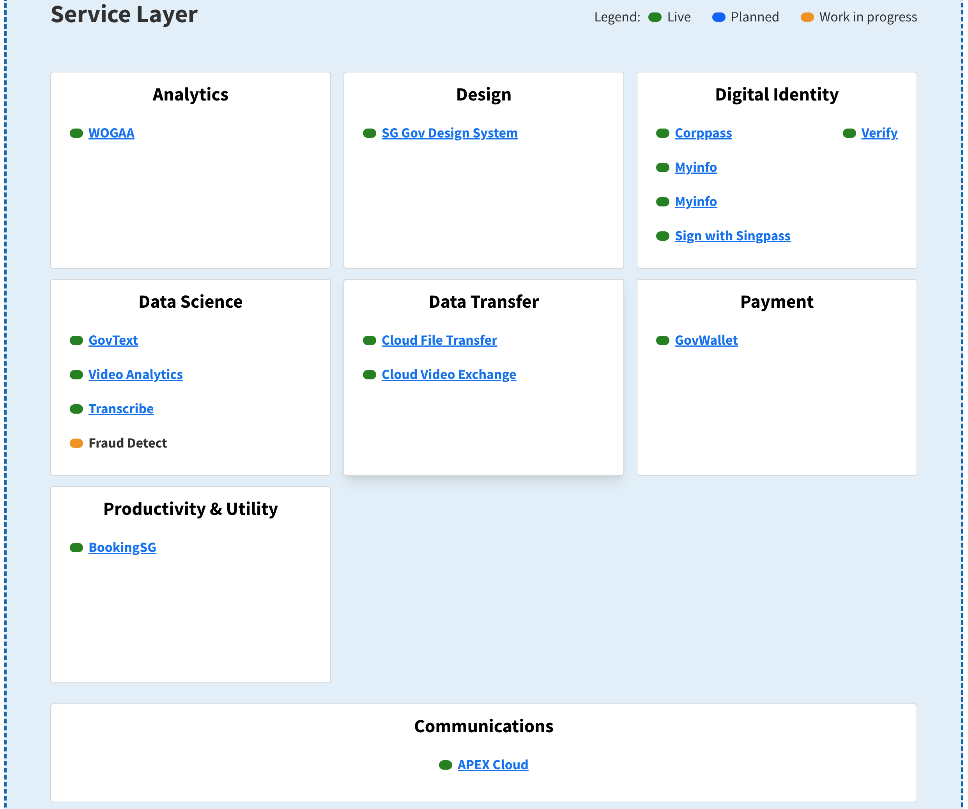
Architecture - service layer

Slide 31
Success story
Streamlining Payroll Submissions in Singapore: APEX’s Solution for Efficient Government Reporting

Slide 32
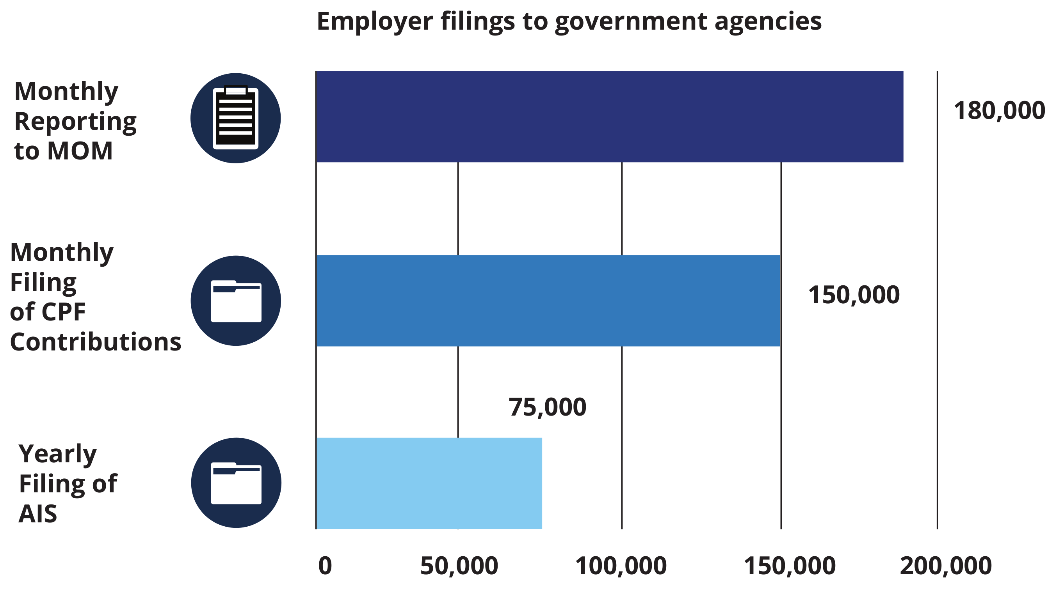
The Problem
Singapore-registered companies must regularly submit employee salary, workforce, and CPF contribution data to various government agencies (IRAS, MOM, CPFB).
All required data already exists within companies’ payroll or HR systems.
The challenge is to integrate government submissions with these systems to streamline processes, reduce manual work, and save employers time and resources.

Slide 33
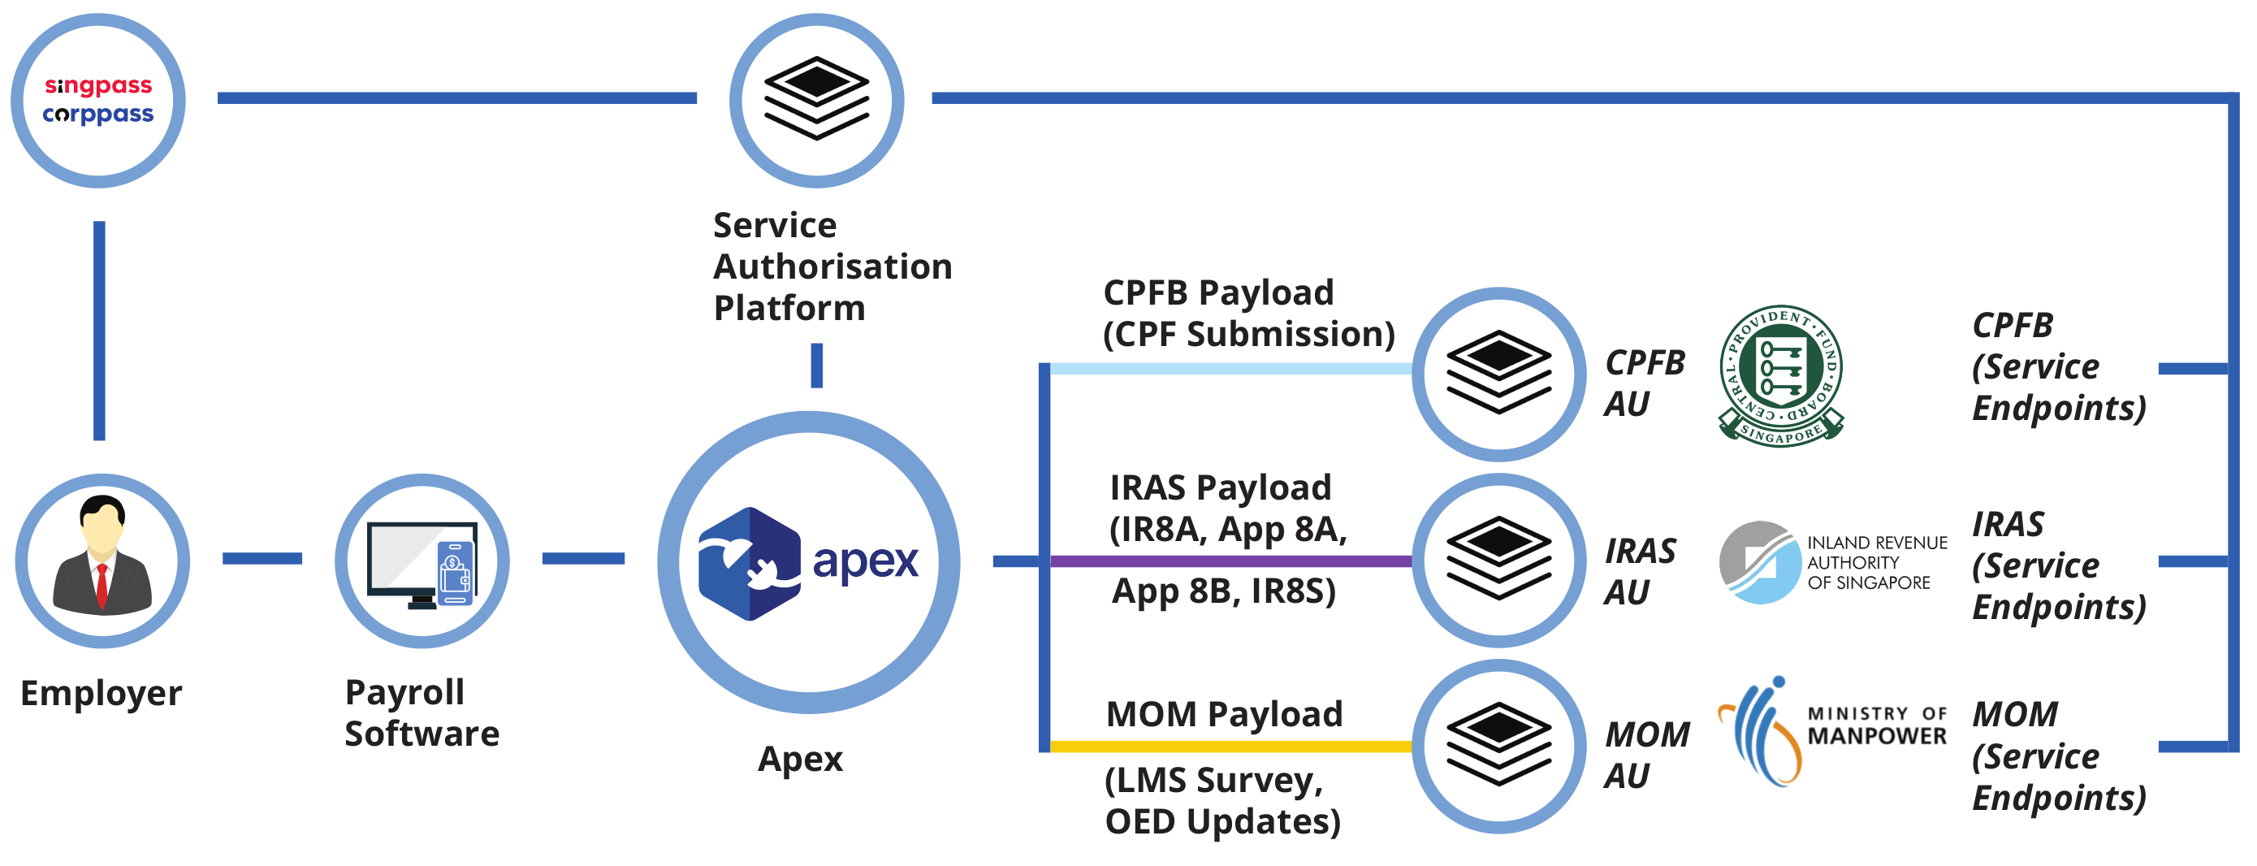
The solution
APEX unifies APIs from multiple government agencies on one secure platform.
It enables developers, including HR and payroll software providers, to integrate easily with these services.
APEX removes the need for manual filing reducing administrative burden and supports better compliance with payroll-related regulations.

