Slide 1
Session 12
Financing data governance Ernest Guevarra

Slide 2
Costs of data governance

Slide 3
Technology infrastructure costs
Data governance platforms: $50,000-$500,000+ annually
Metadata management tools: $40,000-$300,000 annually
Data quality and profiling tools: $30,000-$250,000 annually
Data catalog solutions: $50,000-$400,000 annually

Slide 4
Human resource expenses
Chief Data Officer salary: $175,000-$350,000+
Data governance managers: $120,000-$180,000
Data stewards: $85,000-$130,000 per resource
Compliance specialists: $90,000-$150,000

Slide 5
Implementation and consulting fees
Initial implementation consulting: $100,000-$500,000+
Strategy development: $50,000-$200,000
Program design: $75,000-$250,000
Training and change management: $30,000-$150,000

Slide 6
Compliance-driven governance requirements
Sector/industry-specific: healthcare regulations compliance; financial services compliance
General compliance requirements
for example, GDPR compliance costs average $1.4 million for mid-sized enterprises
Ongoing maintenance and updates add 30-40% annually to initial costs

Slide 7
Optimising data governance investment

Slide 8
Phased Implementation
Prioritise governance capabilities based on risk and compliance requirements
Start with high-risk data domains and expand systematically.

Slide 9
Cloud-Based Solutions
Cloud-based data governance platforms often provide lower initial costs and more predictable pricing models than on-premises alternatives.
Organisations can reduce total cost of ownership by 30-45% over five years through cloud-based governance solutions.

Slide 10
Integrated Governance Frameworks
Develop a unified approach addressing multiple compliance requirements simultaneously rather than creating siloed compliance programs.
This can reduce duplicative controls by 25-40%.

Slide 11
Automation and AI
Emerging AI-driven governance tools can reduce manual effort for data classification, monitoring, and remediation.
Automation can lower ongoing governance costs by 20-35%.

Slide 12
Funding data governance

Slide 13
Use data to improve free cash flow
Where does data cause cash flow pain?
Manual vs automated systems for repeated processes
Show how improved governance can increase efficiency

Slide 14
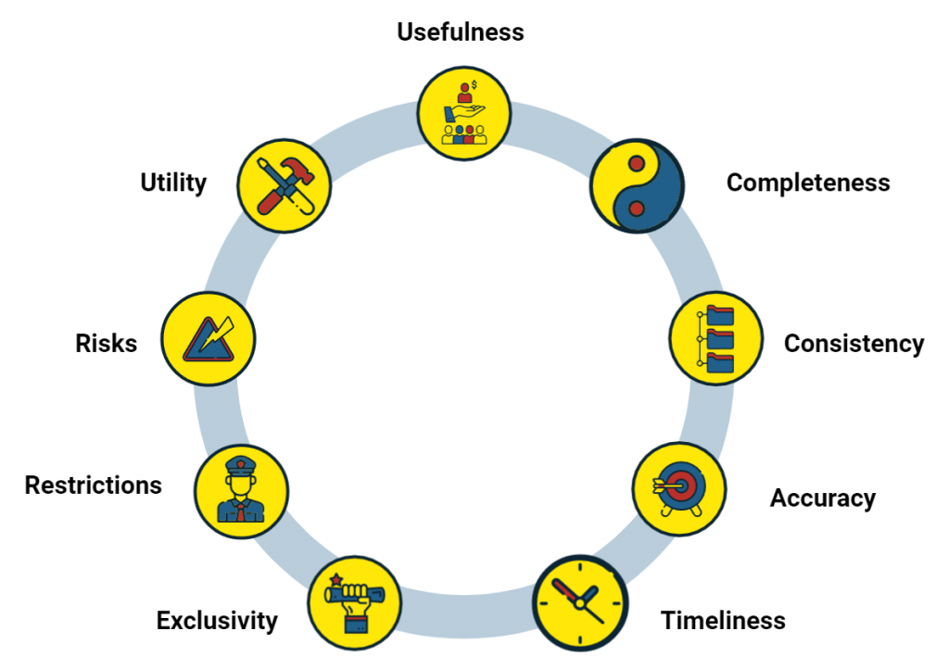
Increase revenues with data
Assess value of your data and leverage this value
Increase customer satisfaction with data

Slide 15
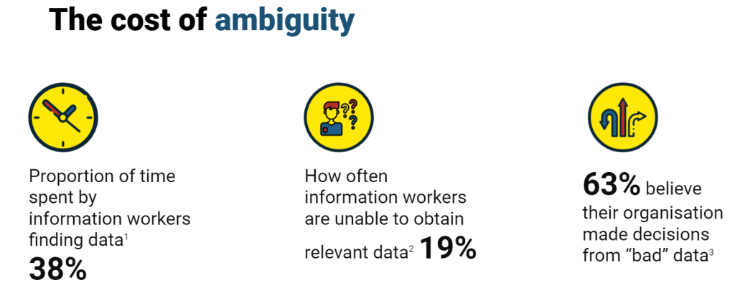
Cutting costs with data

Slide 16
About 530,000 days of managers’ time wasted by poor quality and undocumented data (equivalent to some $250 million in wages annually)
By just simply documenting your metadata can reduce data-related expenses by up to 97%

Slide 17
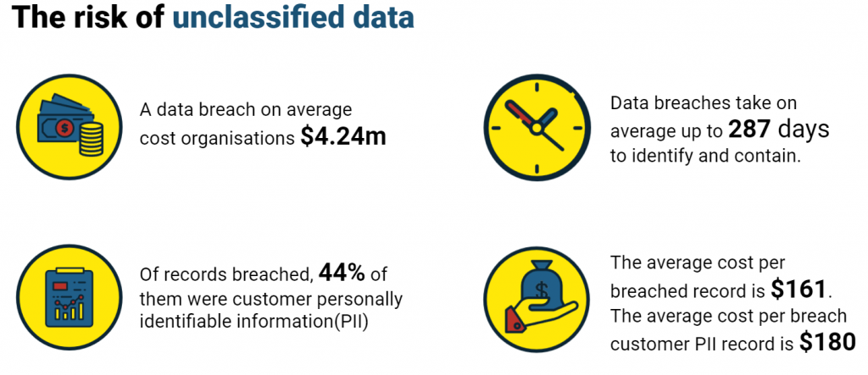
Reducing risk with data

Slide 18
Regulatory risk (GDPR fines, for example)
Cybersecurity risk (both costs of the response and erosion of customer trust)

Slide 19
Generating financial resources for data
Use data valuations to pinpoint parts of the business where data can increase revenue, unlock cash flow, or reduce costs and risk.
This gives you a concrete basis for discussions with leadership about investing in data improvements.
Instead of requesting budget without evidence, you approach the CFO with solid, data-driven justification.
Securing funding for data governance becomes much easier when the financial benefits are clearly understood.

