Slide 1
Session 4
Case Study: The United Nations and its technological and data challenges Ernest Guevarra

Slide 2


Slide 3
Costly and fragmented services, lagging in a digital age

Slide 4
The problem
The UN system’s technology infrastructure is fragmented, expensive, and not strong enough for today’s digital demands.
Digital advancements, including artificial intelligence, are reshaping the world, but the UN’s tech capabilities have not kept pace.
Over $2 billion is spent each year on software, cloud services, connectivity, and related support.

Slide 5
The problem (continued)
Much of this spending happens in isolation, without scale, leading to higher costs, duplication, and weak interoperability.
These inefficiencies slow the UN’s ability to modernise and build future-ready capabilities.
To remain credible and effective, the UN system must accelerate its digital adaptation.

Slide 6
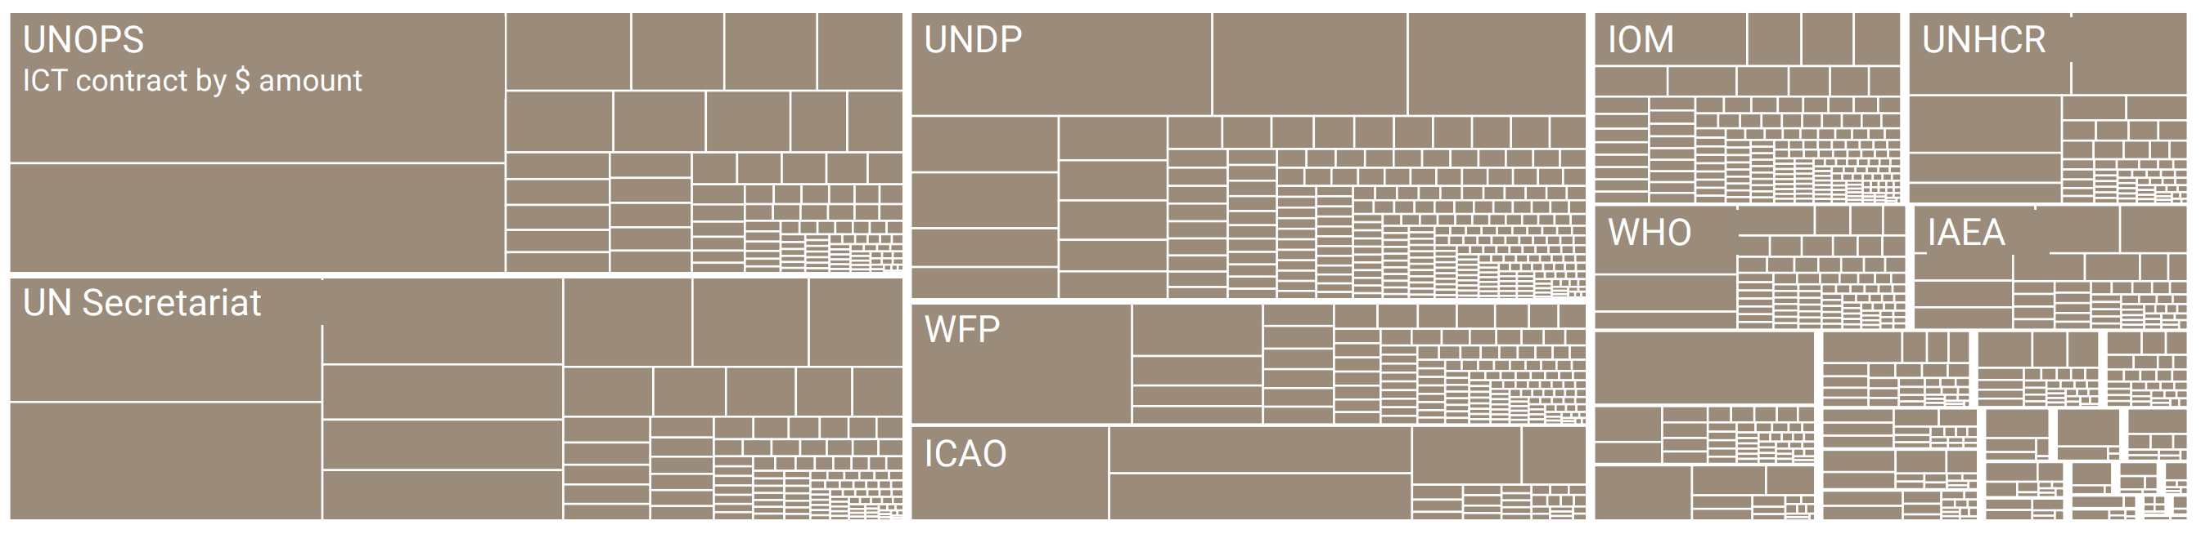
Costly and fragmented technology

Slide 7
The solution
The UN aims to harness technology responsibly to transform all aspects of its work.
Shared ICT services and the UN 2.0 Agenda will guide this transformation.
A new Technology Accelerator Platform will act as the system’s engine for change.
It will modernise internal UN operations.
It will also enhance the UN’s ability to support Member States in adopting digital and AI solutions effectively and responsibly.

Slide 8
Fragmented data, missed opportunities

Slide 9
The problem
The UN system serves as a major custodian of global public data, statistics, and insights on topics ranging from population trends to climate risks.
Despite this, its data platforms remain fragmented and duplicative, even as demand for faster and clearer information grows.
Individual UN entities have built separate systems, resulting in parallel capacities that rarely connect.

Slide 10
The problem (continued)
Without interoperability, data cannot be shared effectively across entities, leading to blind spots, wasted effort, and missed opportunities to address interconnected global challenges.
Data becomes far more useful when it is connected, but the capabilities needed to achieve this are limited, under-incentivised, and often hindered by entities’ reluctance to collaborate.

Slide 11
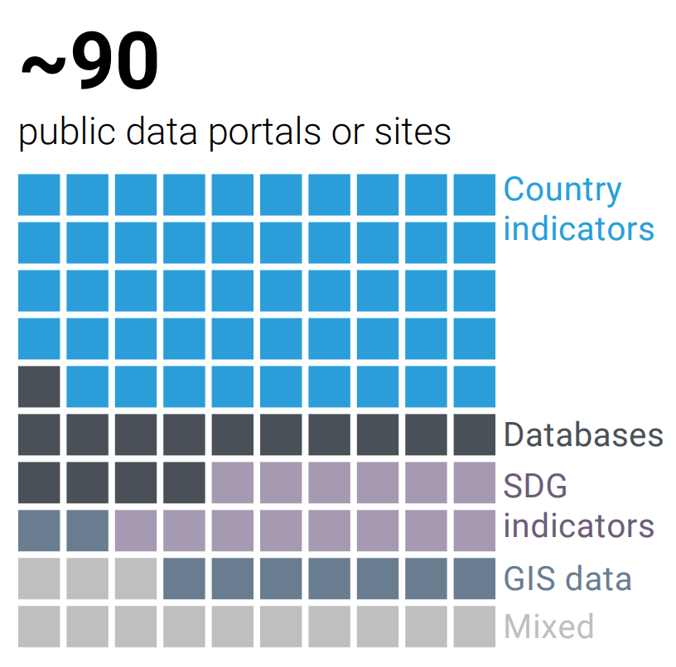
Multiple public portals

Slide 12
The solution
New data initiatives will be developed across all UN pillars integrated into a UN System Data Commons built on shared data infrastructure.
The shared backbone will be designed for full interoperability and able to generate insights at local, regional, and global levels.
Entities will retain only the data that must remain separate, while all shareable data will be openly shared.

Slide 13
The solution (continued)
To make this transformation sustainable, interoperability will be supported by collective financing and clear governance incentives.
This approach will help connect resources and systems more effectively, increase impact, and reduce overall costs.

