Slide 1
Session 5
Guiding principles on policymaking on national level data governance frameworks Ernest Guevarra

Slide 2
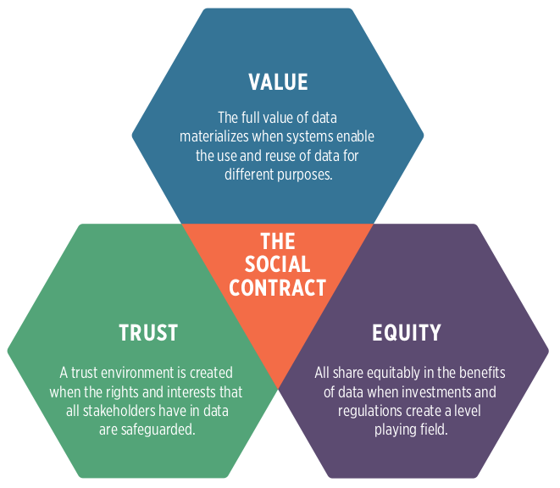
Social contract for data

Slide 3
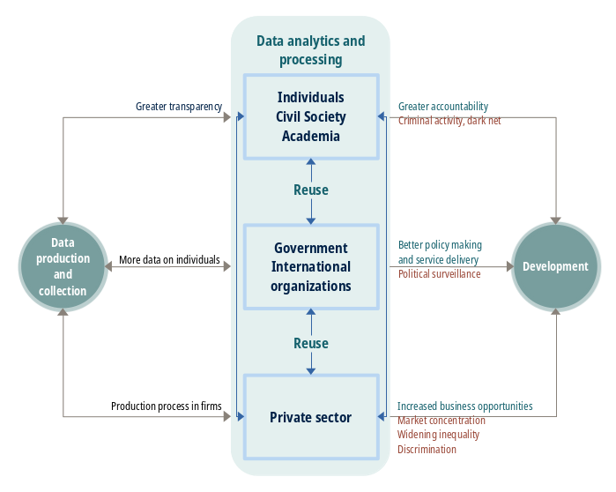
Theory of change: data for development

Slide 4
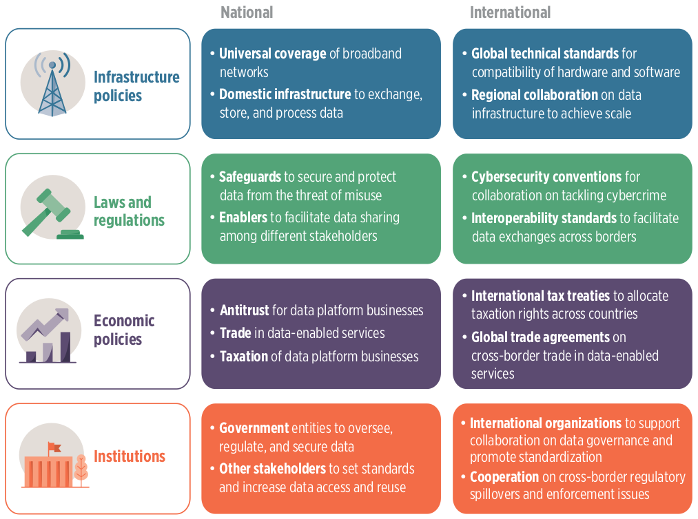
Data governance layers

Slide 5
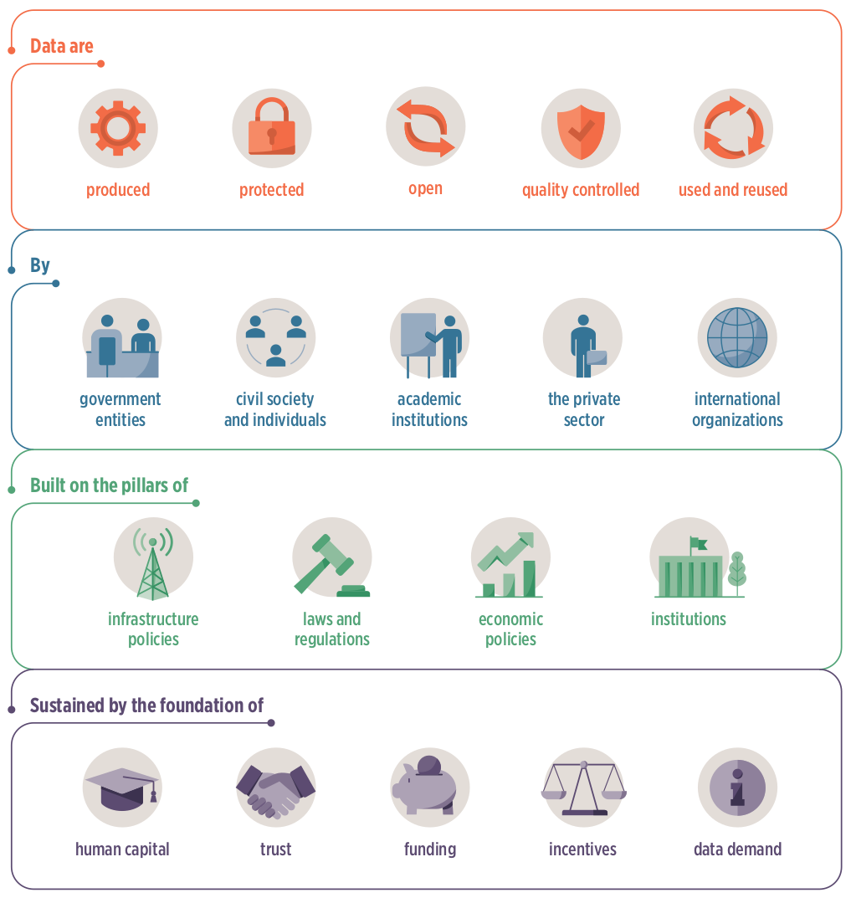
Integrated national data system

Slide 6
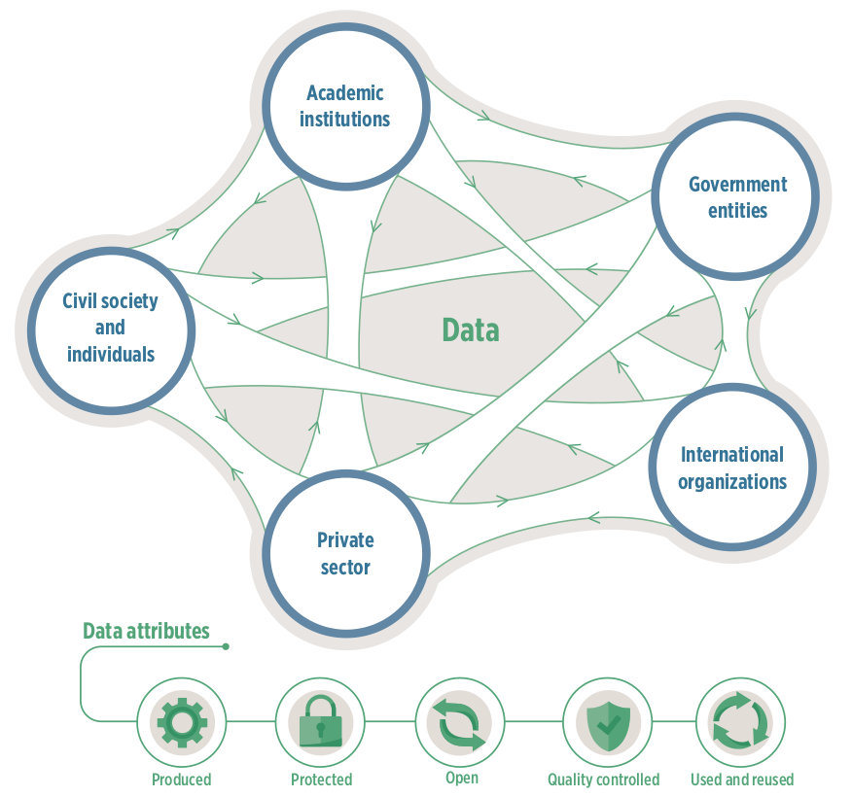
Data flow

Slide 7
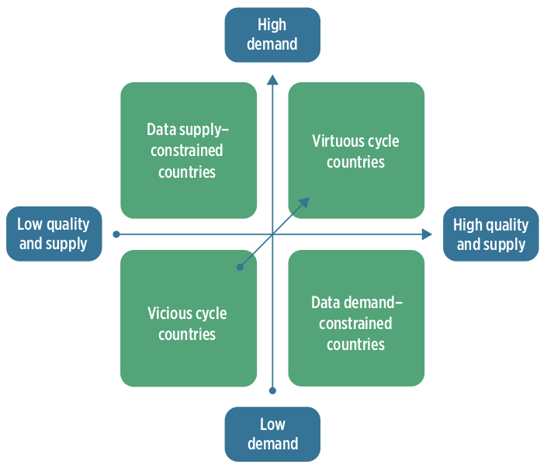
Data supply and demand

Slide 8
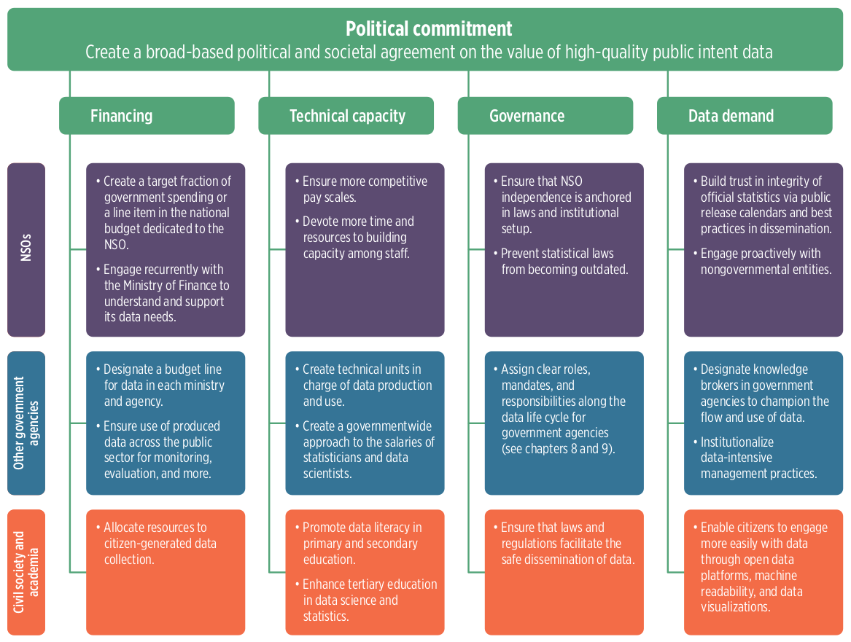
Data policies

