Slide 1
Session 7
Global landscape of available technologies for data Ernest Guevarra

Slide 2
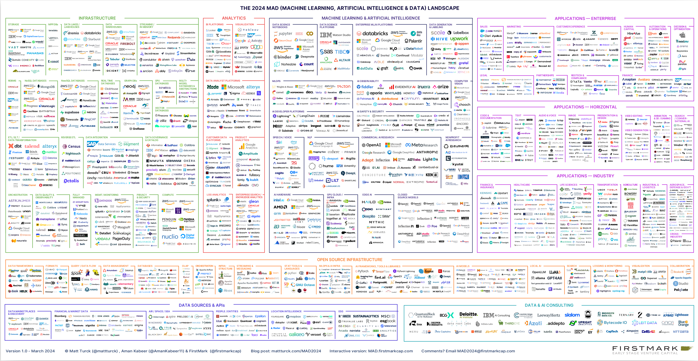

Slide 3
Number of data tools and technologies
In 2012, there were about 139 apps/tools/platforms relevant to data.
In 2023, there were about 1416.
By 2024, this number increased to 2000+.

Slide 4
Technologies and methods that support data-driven decision-making
Technology that supports data-intensive analytics: artificial intelligence, including machine learning
Technology that collects data and actions insights from analytics: smart devices and devices connected through the Internet of Things (IoT)
Technology that creates transparency and trust in data records: distributed ledger technology, including blockchain

Slide 5
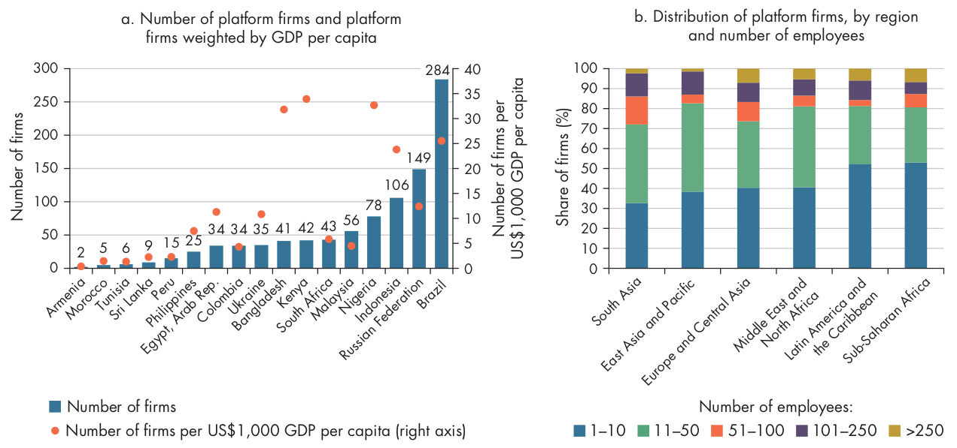
Platform firms in low and middle-income countries

Slide 6
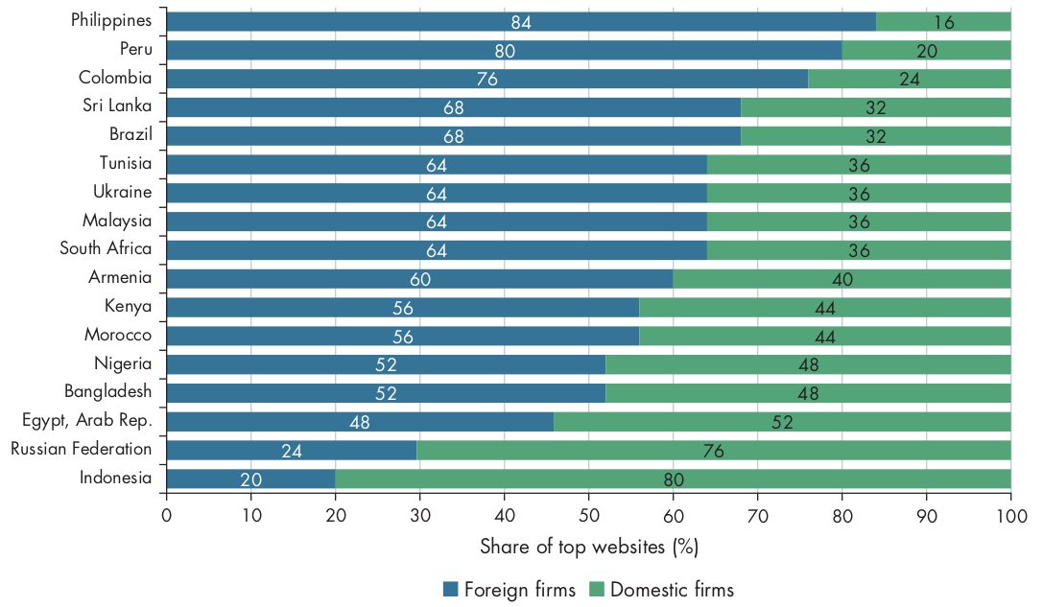
Domestic vs Foreign-based firms

Slide 7
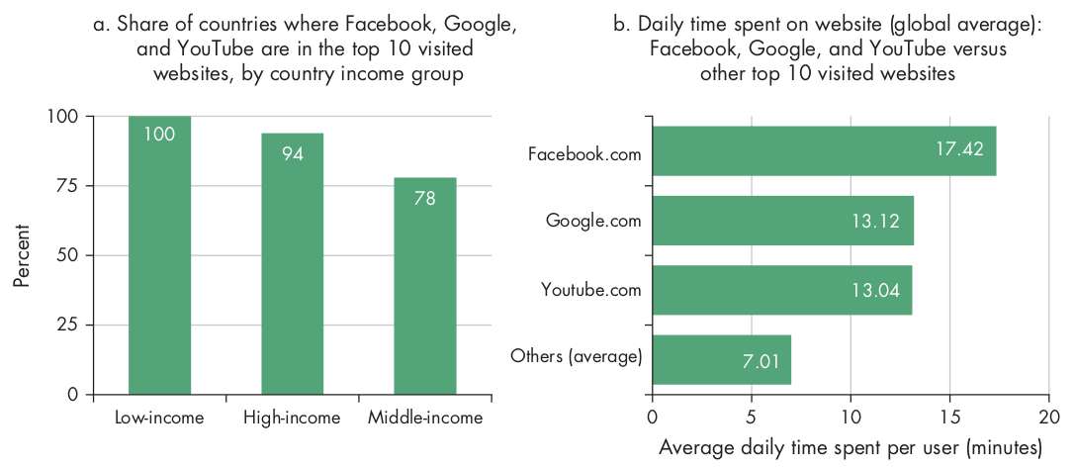
Users spend more time on Facebook, Google, and YouTube

Slide 8
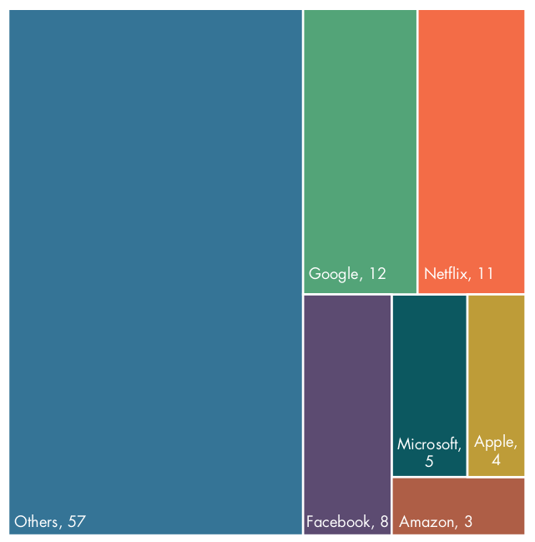
Internet traffic in low and middle income countries

Slide 9
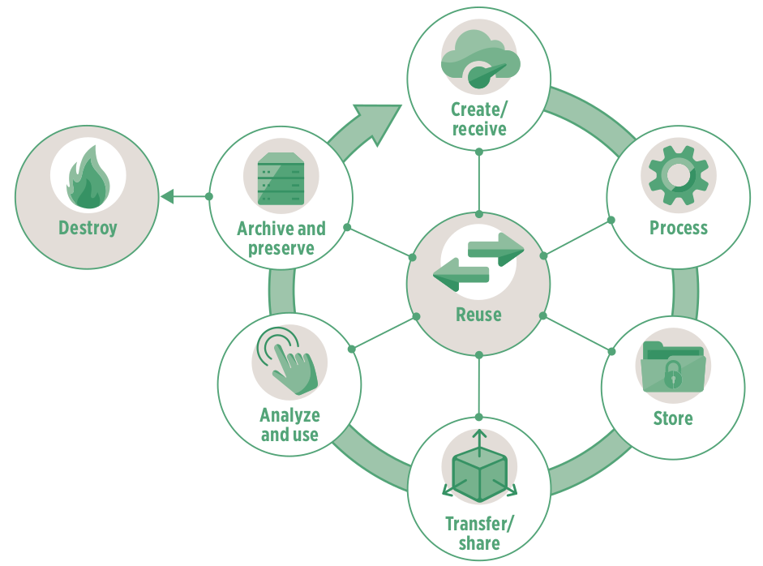
Data lifecycle

Slide 10
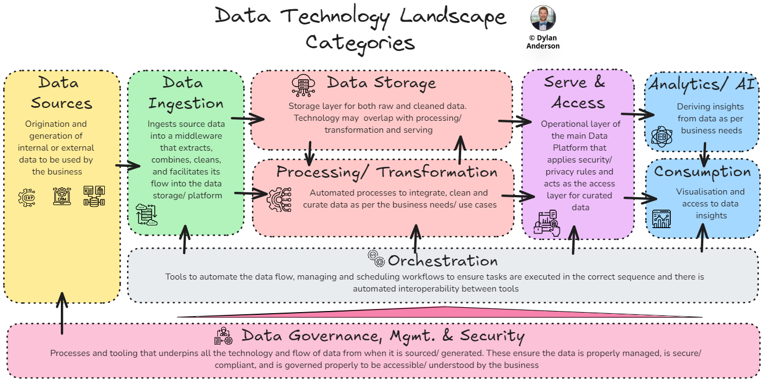
Data technology landscape

