Slide 1
Session 11
Guiding principles and best practices for data capacity building Ernest Guevarra

Slide 2
Building data capacity
Not everyone needs to be a data scientist.
Data capacities in policymaking refer to how well infrastructure, systems, and people can use data effectively for decisions.
Strengthening these abilities across different teams is essential.
Complementary skill sets help reinforce the entire data value chain and improve overall decision-making.

Slide 3
1. Identify gaps in data skills and statistical capacities

Slide 4
Types of skills

Slide 5
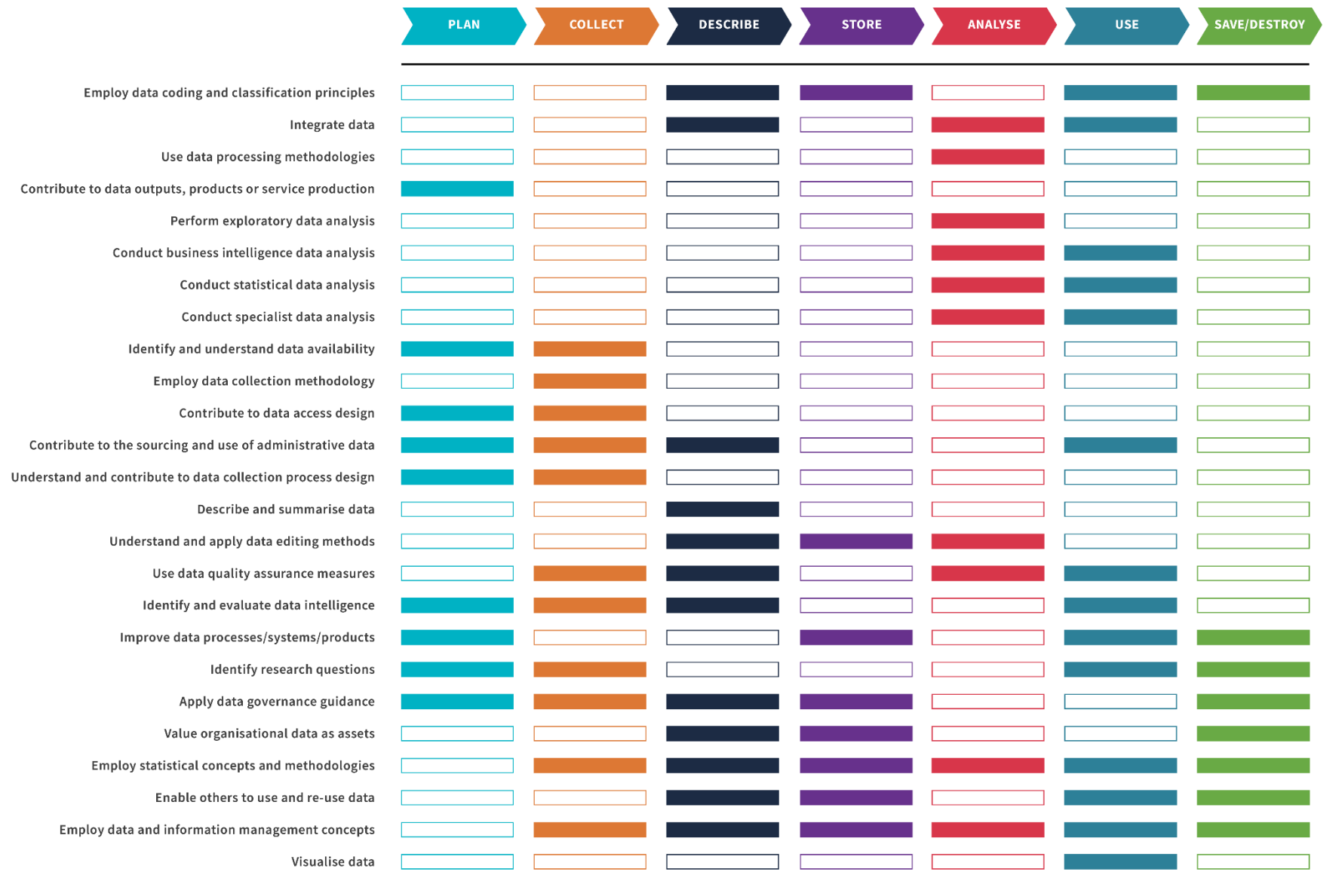
Data Capability Framework

Slide 6
Data Capability Framework - example
Capability: Employ data coding and classification principles
Catgory: Describe, Store, Use, and Save/Destroy

Slide 7
New
Is aware of relevant data classifications and coding protocols, and their proper application to data in general.
Knows who to consult for expert knowledge.
Proficient
Has a comprehensive knowledge of data classifications and coding protocols.
Knows where to obtain expert advice about coding and classifications as needed.

Slide 8

Data Capability Framework Guide

Slide 9
Link

Slide 10
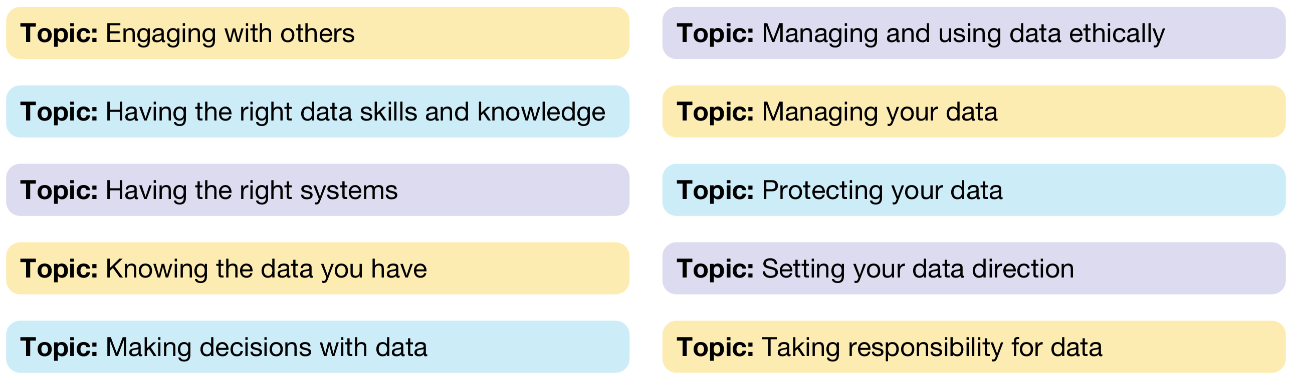
Data Maturity Assessment Framework

Slide 11
Data Maturity Assessment Framework
Themes: Uses, Data, Leadership, Culture, Tools, Skills
Maturity Levels: Beginning, Emerging, Learning, Developing, Mastering

Slide 12
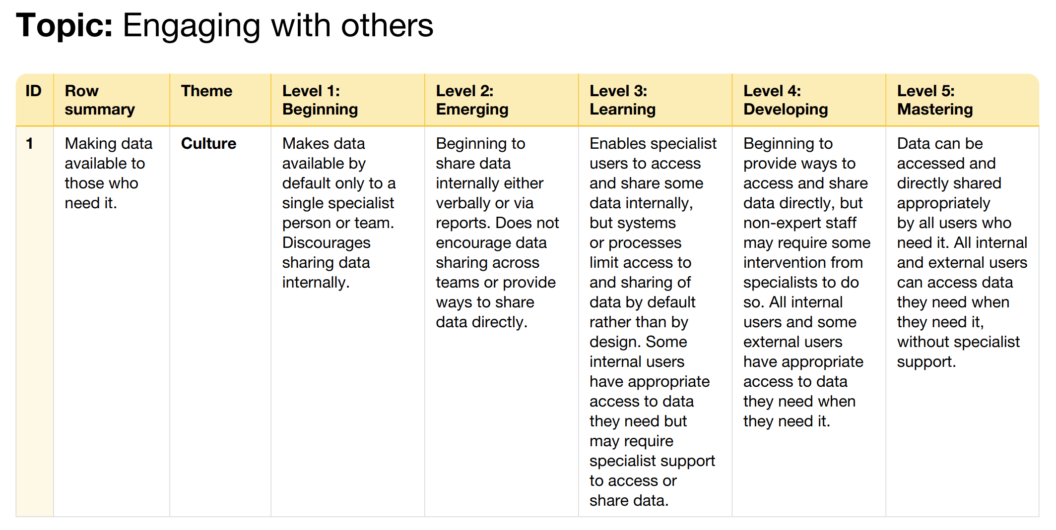
Data Maturity Assessment Framework - example

Slide 13

Data Maturity Assessment Framework Guide

Slide 14
Link

Slide 15
2. Build data capacities in your team

Slide 16
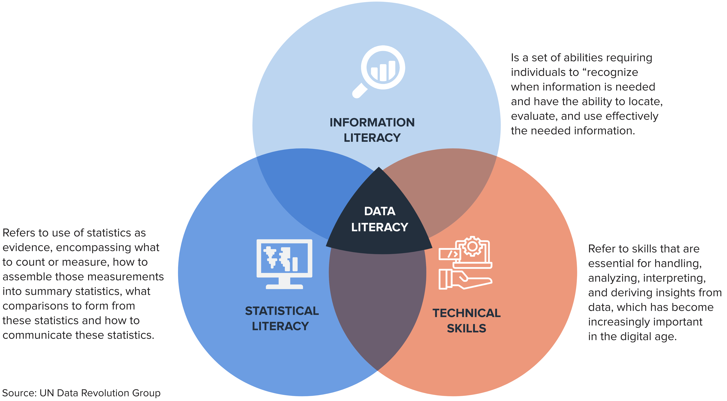
Data Literacy

Slide 17
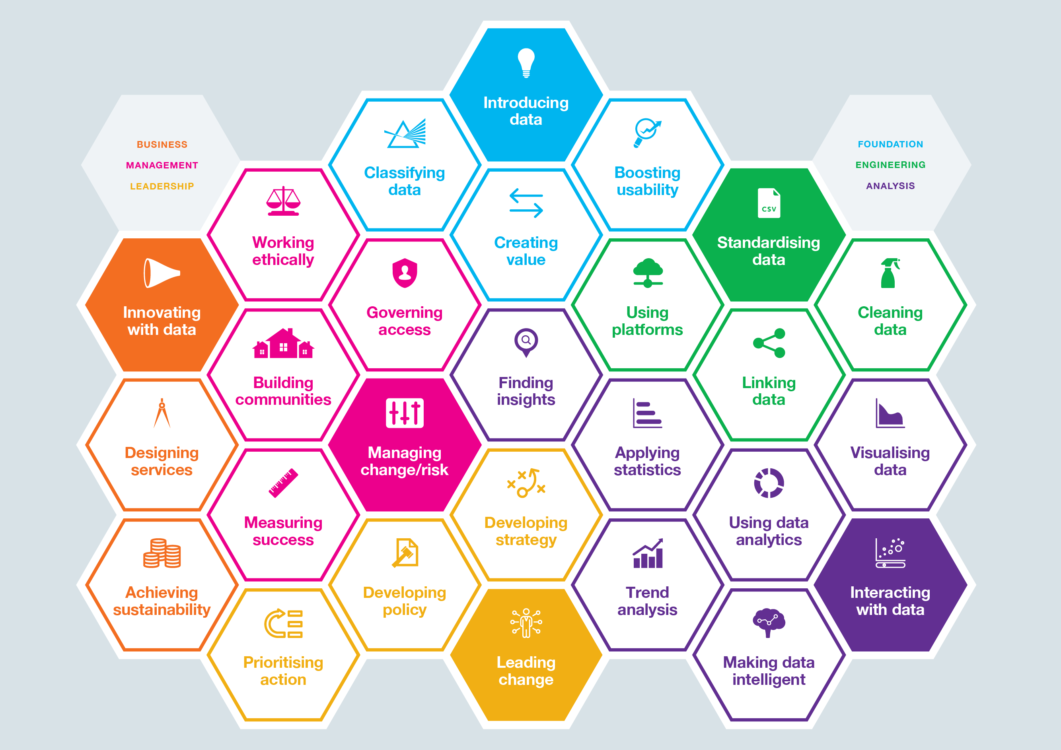
Data Skills Framework

Slide 18
3. Operationalise data capacity building

Slide 19
Short-term
Training workshops
Online training resources
Knowledge sharing on global innovations and use cases

Slide 20
Medium-term
Internal data champions
Periodic data skills training
‍Pilot data projects
‍Build complementary skills with other stakeholders
‍Build on local knowledge and capacities
‍Build network of data practitioners across your organization

Slide 21
Long-term
Embed data skills in job roles
Institutionalize data training programs
‍Partner with think tanks and external organizations
‍Partner with academia and local universities

