Slide 1

MACHINE LEARNING PROJECT
TAMANNA VAIKKATH
22070521094
SECTION C

Slide 2
Project Overview
This project focuses on analyzing and modeling data from the California Health Facility Listings to understand the operational, geographic, and licensing patterns of healthcare institutions across the state.
The aim is to explore relationships between attributes such as facility type, license status, approval dates, and capacity, and to identify the key factors influencing a facility’s performance and categorization.
Using techniques like data cleaning, preprocessing, and exploratory data analysis (EDA), the project extracts meaningful insights from complex administrative data.
Advanced machine learning models such as Random Forest, XGBoost, LightGBM, and CatBoost are applied for both regression (predicting facility capacity) and classification (categorizing facilities).
Additionally, K-Means clustering is used to group similar facilities based on their characteristics, revealing structural patterns and regional trends.
The overall objective is to leverage AI-driven analytics to support healthcare planning, policy-making, and capacity management in California’s healthcare system.

Slide 3
DATASET SOURCE: Health Facility Listing- California
STREAMLIT APP: Interactive Dashboard
GOOGLE COLAB: Implementation

Slide 4
Dataset Information
Dataset Name: Health Facility Listing – California
Source: California Department of Health Care Access and Information (HCAI)
Total Records: ~15,800 facilities
Total Columns: 60+ attributes
Data Cleaning Summary
Missing and inconsistent values were handled.
Categorical variables encoded using LabelEncoder.
Numeric data standardized using StandardScaler.

Slide 5
Data Preprocessing
Removed duplicates and handled missing values using median/mode imputation.
Standardized date formats (e.g., approval and license dates).
Converted categorical attributes (e.g., facility type, county name) using Label Encoding.
Scaled numerical columns like capacity, latitude, longitude using StandardScaler.
Integrated facility, licensing, and geographic data into a single dataset.
Split data into 80% training and 20% testing sets for model evaluation.
Result: A clean, consistent, and ML-ready dataset for analysis and modeling.

Slide 6
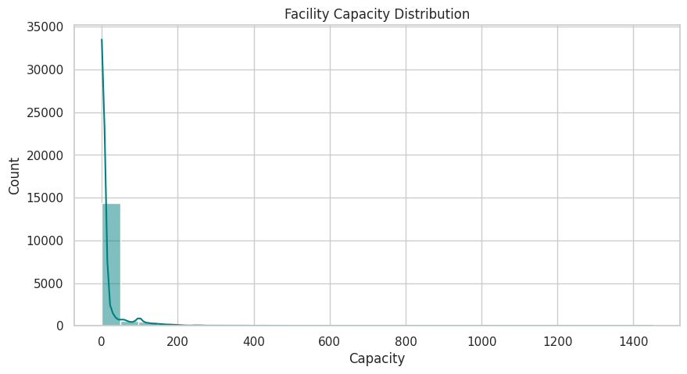
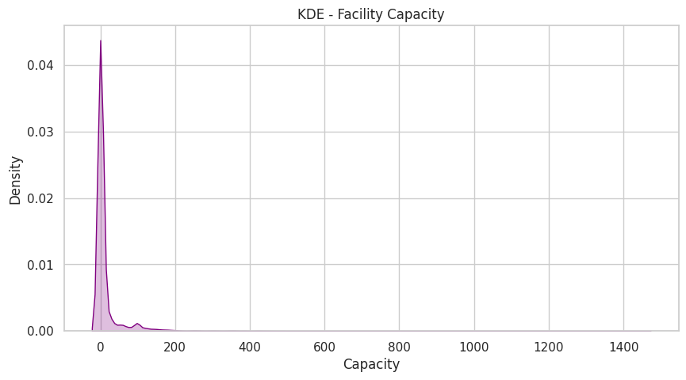
This plot shows the distribution of facility capacities across California. Most health facilities have smaller capacities, indicating a right-skewed distribution with only a few large facilities having high-capacity values.
The Kernel Density Estimate (KDE) plot highlights the same skewed trend, with a sharp peak near low-capacity values. This confirms that a majority of healthcare facilities operate with limited capacity, while only a few have very high capacity.

Slide 7
Regression Models
Models and Rationale
Linear Regression:
Used as a baseline model to test for simple linear relationships between input features and facility capacity.
→ Result: Performed poorly (R² = -2.33), indicating nonlinearity in data.
Decision Tree Regressor:
Captured nonlinear dependencies by splitting data into decision nodes.
→ Result: Improved accuracy (R² = 0.99), but prone to overfitting.
Random Forest Regressor:
Combined multiple trees to enhance stability and reduce variance.
→ Result: Achieved high accuracy (R² = 0.995, RMSE = 0.032).

Slide 8
Regression Models
Gradient Boosting Regressor:
Sequentially improved weak learners to minimize prediction errors.
→ Result: Excellent performance (R² = 0.995, RMSE = 0.031).
XGBoost Regressor:
Optimized gradient boosting algorithm offering speed and regularization.
→ Result: Matched Gradient Boosting accuracy (R² = 0.995, RMSE = 0.031).
Support Vector Regressor (SVR):
Applied for mapping high-dimensional relationships using kernel functions.
→ Result: Moderate accuracy (R² = 0.965, RMSE = 0.083).
K-Nearest Neighbors (KNN) Regressor:
Predicted based on similarity between facilities but was sensitive to data scaling.
→ Result: Lower accuracy (R² = 0.921, RMSE = 0.125).
Key Insight
Ensemble methods (Gradient Boosting, XGBoost, Random Forest) showed the best predictive accuracy and lowest error rates, proving highly effective for estimating facility capacity with complex, nonlinear patterns.

Slide 9
Classification Models
Models and Rationale
Logistic Regression:
Used as a baseline classifier to test the linear separability of categorical facility data.
→ Result: Moderate performance (Accuracy = 0.804), showing that the data had nonlinear class boundaries.
Decision Tree Classifier:
Applied to model complex decision rules using hierarchical splitting.
→ Result: High accuracy (Accuracy = 0.998), but slight overfitting observed.
Random Forest Classifier:
Ensemble of decision trees to improve generalization and reduce noise.
→ Result: Excellent performance (Accuracy = 0.999), stable across all facility types.

Slide 10
Classification Models
Support Vector Machine (SVM):
Used to find optimal class boundaries in high-dimensional space.
→ Result: Good generalization (Accuracy = 0.730), but slower on large datasets.
K-Nearest Neighbors (KNN):
Classified based on proximity between data points in feature space.
→ Result: Moderate accuracy (Accuracy = 0.753), affected by data scaling.
Key Insight
Ensemble models such as CatBoost, XGBoost, Random Forest, and Gradient Boosting demonstrated exceptional accuracy.
These models effectively captured the nonlinear and categorical relationships in the dataset, making them the best suited for real-world facility classification tasks.

Slide 11
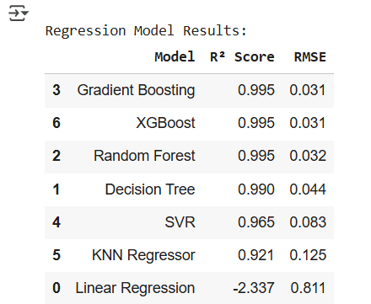
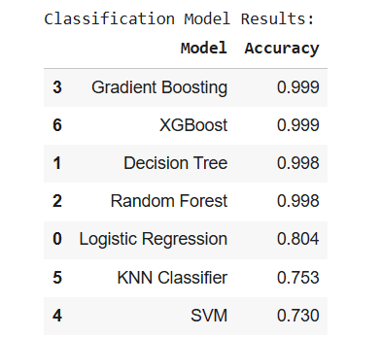

Slide 12
K-Means Clustering
Applied K-Means clustering to group similar health facilities based on numerical and categorical features.
Data was standardized using StandardScaler to ensure uniform scale across all attributes.
Determined the optimal number of clusters (k) experimentally using visualization and performance checks.
Used Principal Component Analysis (PCA) to reduce dimensions and visualize clusters effectively.
Generated interactive visualizations such as:
Scatter plots (PCA-based) to display cluster separation.
Pie charts showing cluster distribution across facilities.
Radar charts highlighting the key characteristics of each cluster.
Clustering helped identify distinct facility groups based on capacity, type, and operational patterns.
Insights revealed regional and functional segmentation within California’s health facilities.

Slide 13
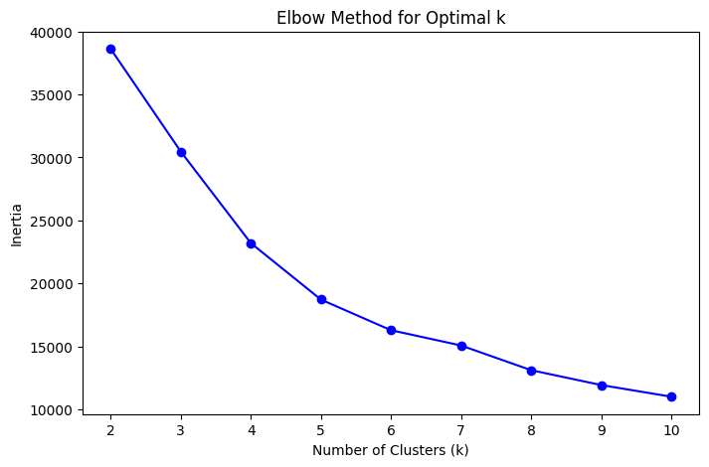
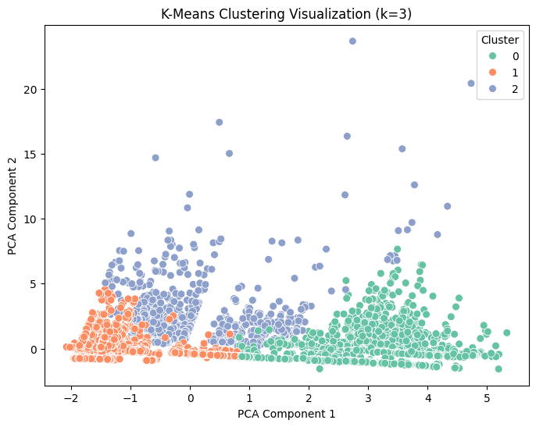
The elbow plot shows the relationship between the number of clusters (k) and inertia. The curve starts to flatten around k = 3, indicating that three clusters provide the optimal balance between model simplicity and cluster accuracy.
The PCA-based scatter plot visualizes the three clusters identified by the K-Means algorithm. Each color represents a distinct group of health facilities with similar operational and capacity characteristics.

Slide 14
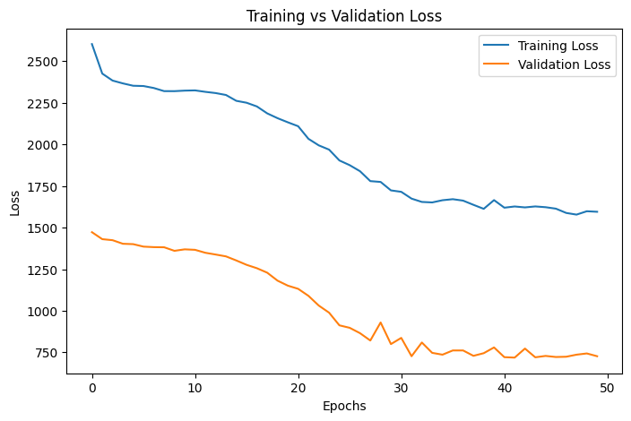
Deep Learning
The Training vs Validation Loss curve illustrates the model’s learning progress over 50 epochs. Both training and validation losses steadily decrease, indicating effective learning and good generalization. The validation loss stabilizes at a lower value than the training loss, suggesting the model fits the data well without overfitting and achieves strong predictive performance on unseen data.

Slide 15
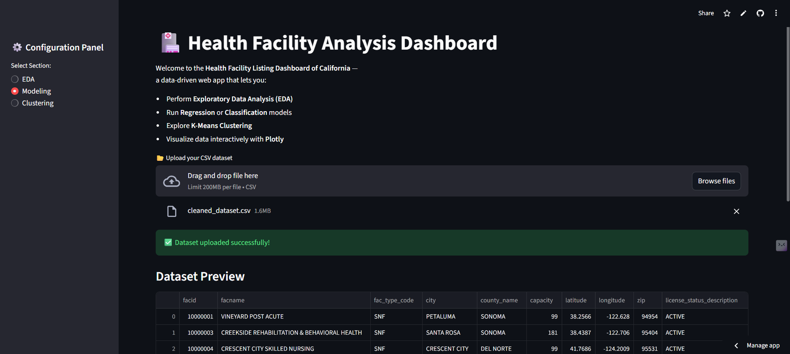
Streamlit App

Slide 16
Key Takeaways
Implemented a complete machine learning pipeline — from data preprocessing and EDA to model building and deployment.
Cleaned and standardized real-world health facility data to ensure high-quality analysis.
EDA revealed key insights — capacity was influenced by facility type, license details, and approval timelines.
Compared multiple regression and classification models using R², RMSE, and Accuracy metrics.
Ensemble models (XGBoost, LightGBM, CatBoost) achieved highest predictive accuracy and stability.
K-Means clustering with PCA helped identify distinct facility groups and operational patterns.
Demonstrated how AI-driven analytics can enhance healthcare planning and infrastructure decisions.
Successfully deployed the project via Streamlit Cloud for interactive and real-time use.

Slide 17
Future Enhancements
Integrate a real-time prediction interface to estimate facility capacity from new input data.
Incorporate geospatial visualization (maps) to analyze regional healthcare distribution.
Automate EDA reporting with visual summaries and key insights.
Include advanced deep learning models for higher predictive accuracy.
Expand the dataset with temporal and demographic features for richer analysis.
Enable automated model retraining as new facility data becomes available.
Build an API or dashboard integration for government and healthcare stakeholders.

Slide 18
Conclusion
The project successfully applied machine learning and data analytics to real-world healthcare data from California’s health facility listings.
Implemented data preprocessing, EDA, regression, classification, and clustering to extract actionable insights.
Achieved high model performance, with ensemble methods providing the most accurate predictions.
K-Means clustering effectively grouped facilities based on operational and capacity characteristics.
Demonstrated the value of AI-driven analytics in improving healthcare resource management and policy decisions.
The system was deployed using Streamlit Cloud, making it interactive, accessible, and scalable for future applications.

