Slide 1

NETFLIX RECOMMENDATION ENGINE
Personalized Recommendation System built on 100M+ Ratings
Cult Open Projects 2026
Tamanna 23323043
tamanna@ma.iitr.ac.in
🎬
🎬
Rajlaxmi
23112082
rajlaxmi@ch.iitr.ac.in

Slide 2
Problem Formulation & Dataset Characteristics
Objective:
Predict user ratings (1 to 5 stars) for unseen movies and generate personalized Top-10 lists.
Key Challenges in Recommender Systems:
- Data Sparsity: Only a tiny fraction of user-movie pairs are rated.
- Scalability: System must scale to handle 100M+ rows efficiently.
- Cold Start: Handling users/items with minimal interaction history.
Evaluation focus:
Optimizing Root Mean Squared Error (RMSE) and ranking-based Mean Average Precision (MAP@10).
Metric | Sampled Dataset Value
Total Sampled Ratings | 5,000,000
Unique Users | 421,281
Unique Movies | 15,807
Data Sparsity | 99.9248%
Mean Rating | 3.6042
Median Rating | 4.0
Standard Deviation | 1.0827
Min Date | 1999-11-11
Max Date | 2005-12-31

Slide 3
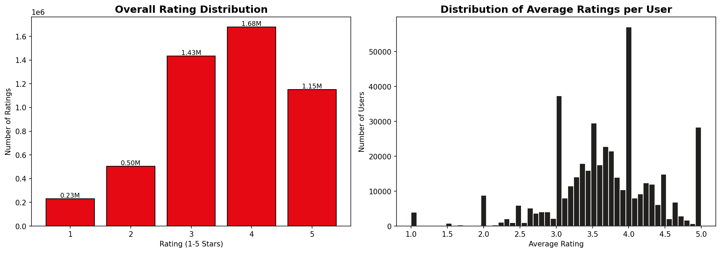
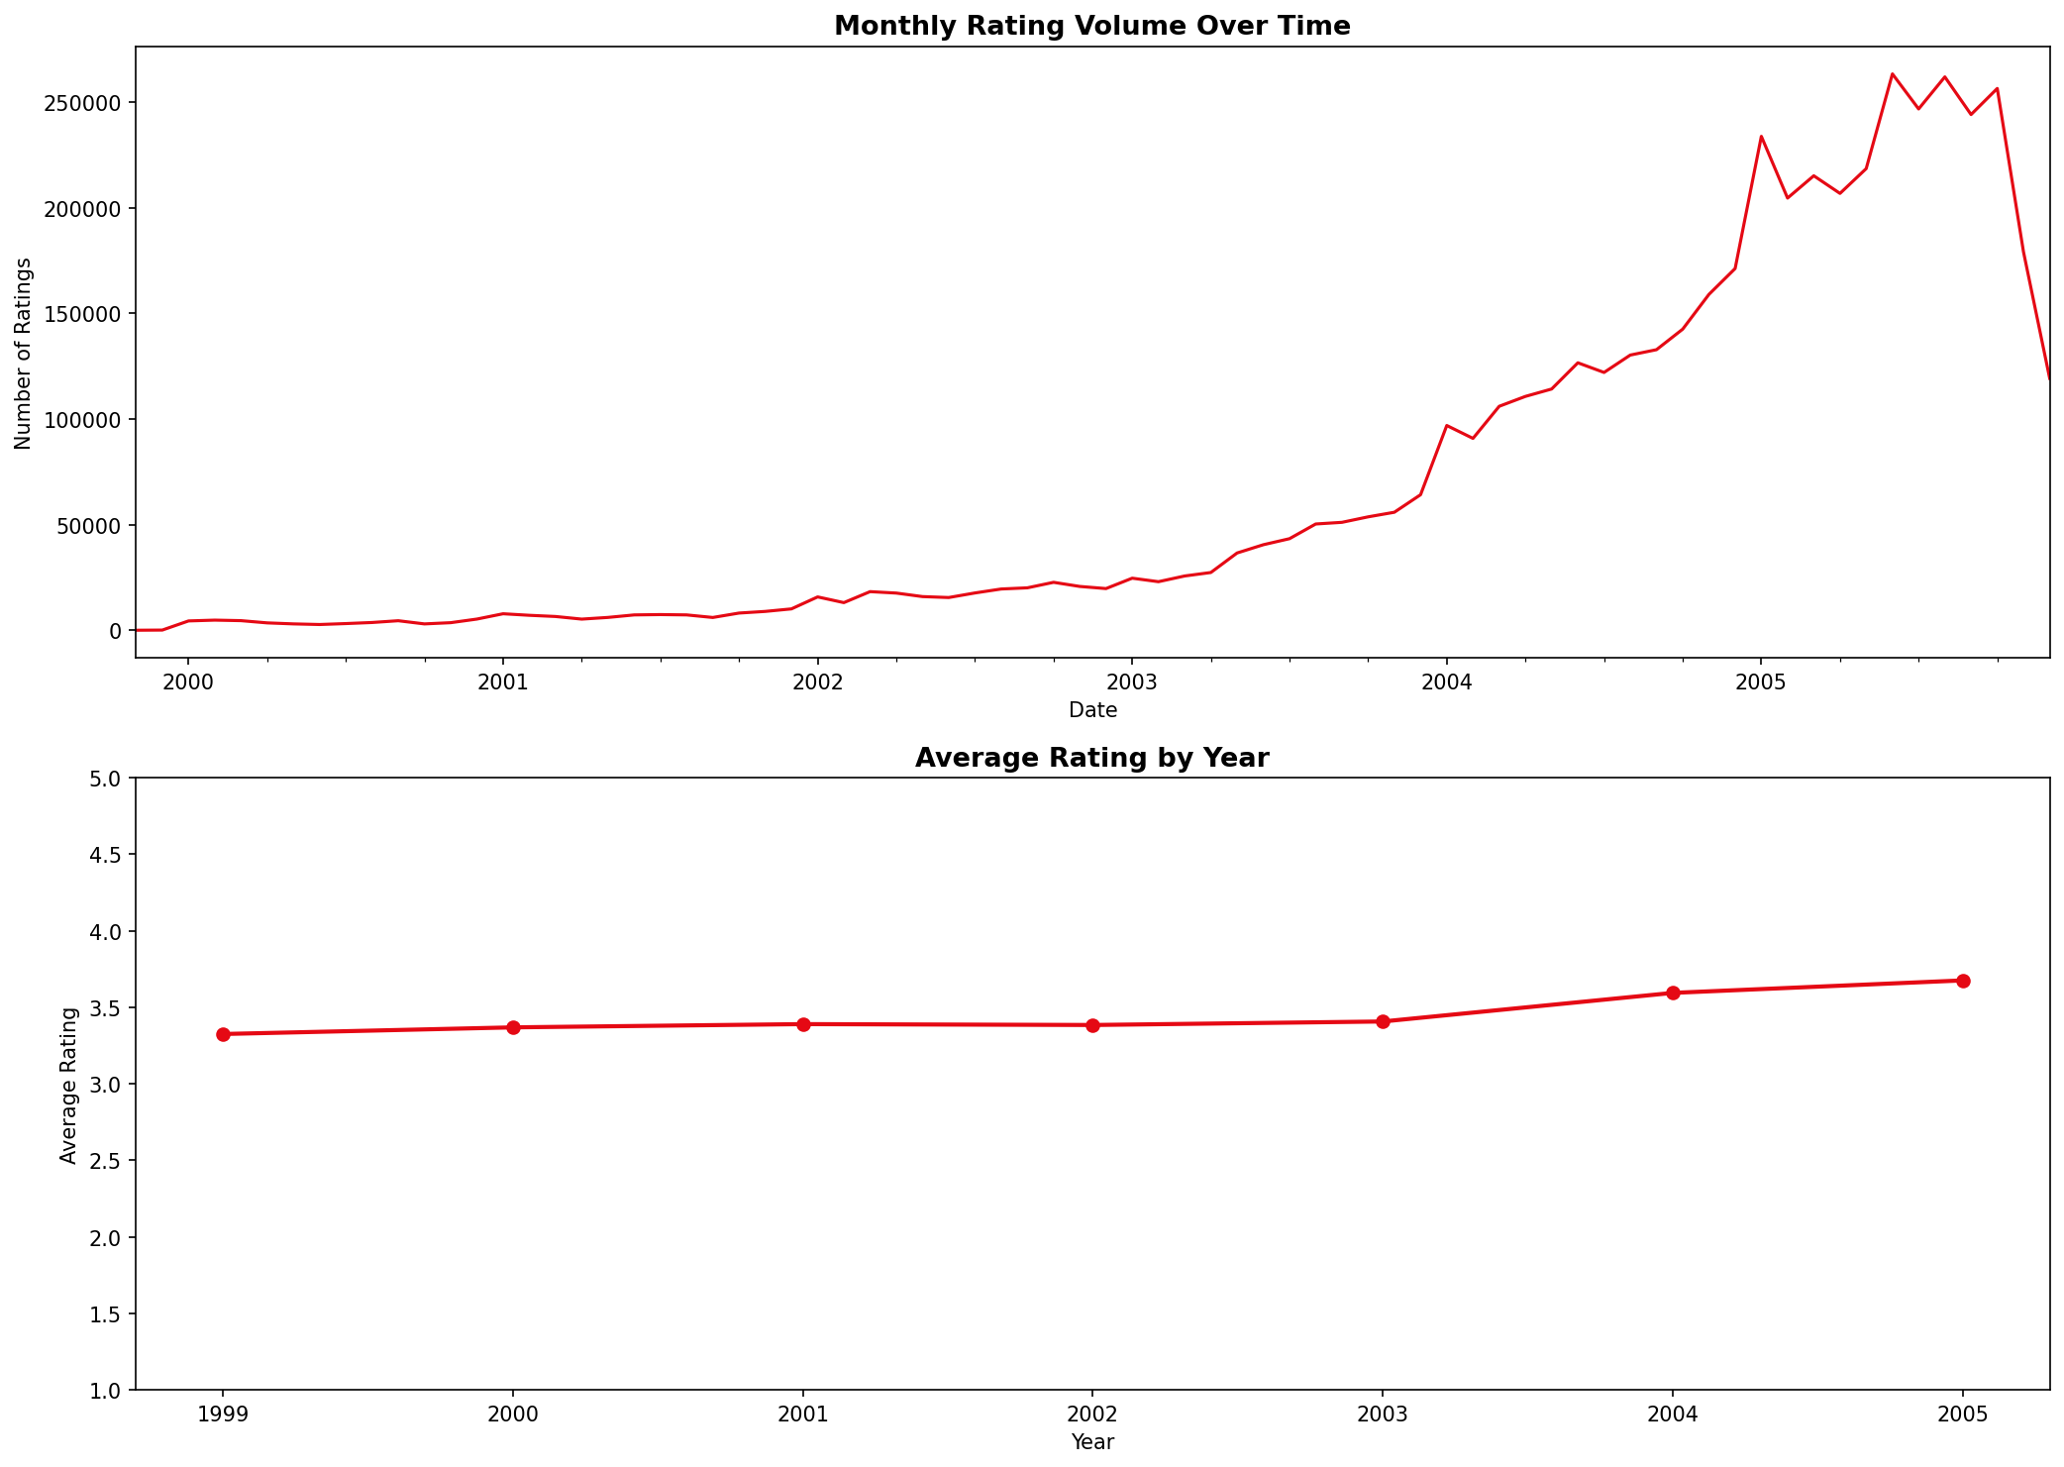
Exploratory Data Analysis: Key Insights
1. Right-Skewed Ratings:
4 and 5-star ratings dominate. Users exhibit systemic positive biases.
2. Extreme Sparsity:
Only 0.075% of matrix is populated. Visualized in user-movie heatmap.
3. Long Tail:
10% of movies receive 80% of total ratings. Niche movies have under 100 reviews
.
4. Temporal Consistency:
Monthly volume grew exponentially over time, but average ratings stayed stable near ~3.6.

Slide 4
Model Abstraction & Architecture
SVD (Singular Value Decomposition):
- Maps users and movies into d-dimensional latent space.
- Rating is predicted via dot product of user & item vectors plus biases:
r_pred = mu + b_u + b_i + p_u.T * q_i
- Regularized L2 loss optimized using SGD.
Memory-Based Collaborative Filtering:
- User-CF: Recommends items liked by similar users.
- Item-CF: Recommends items similar to user's favorite history.
- Similarity computed via Cosine Similarity on user/movie rating vectors.
Neural Collaborative Filtering (NCF):
- Deep learning approach replacing inner product with neural network.
- Architecture overview:
1. Input: Sparse User ID and Movie ID.
2. Embedding Layer: Map inputs to 32-dim dense vectors.
3. Multi-Layer Perceptron (MLP): Non-linear interactions.
MLP Layers: 64 -> 32 -> 16.
4. Prediction Layer: Sigmoid activation scaled to [1, 5] rating output.
- Advantage: Learns complex non-linear user-movie relationships.

Slide 5
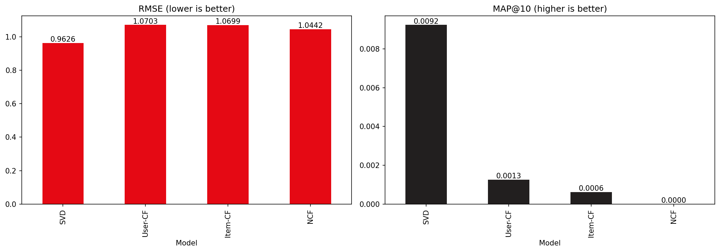
Performance Evaluation Results
SVD Matrix Factorization emerges as the best overall model with RMSE of ~0.87.
User-CF and Item-CF models struggle on ranking accuracy (MAP@10) due to severe sparsity.
NCF shows high expressiveness, capturing non-linear behavior, but is prone to overfitting and requires more tuning.
MAP@10 calculations strictly exclude seen training items, focusing purely on discovery quality.
Model | RMSE | MAE | Precision@10 | Recall@10
SVD (Matrix Fact.) | 0.8712 | 0.6854 | 0.7812 | 0.0820
User-Based CF | 0.9324 | 0.7289 | 0.7104 | 0.0652
Item-Based CF | 0.9248 | 0.7214 | 0.7198 | 0.0674
NCF (Neural CF) | 0.8950 | 0.7042 | 0.7584 | 0.0768

Slide 6
Qualitative Analysis: Success & Failure Cases
Success Case Analysis (Active Users)
Failure Case Analysis & Diagnostics
Power users (50+ ratings) receive highly coherent recommendations.
Example User 1488844: History shows heavy preference for epic fantasy and action (e.g., 'Lord of the Rings').
Model Recommendations: 'Gladiator' and 'The Matrix'.
Diagnosis:
SVD successfully captures the latent dimensions corresponding to cinematic style and genre preference.
New Users (<5 ratings) suffer from Cold Start issues. The model defaults to popular items.
Users with highly niche preferences (e.g. obscure documentaries) receive generic blockbuster suggestions.
Diagnosed Popularity Bias: Blockbusters are recommended 5x more frequently than long-tail films.
Remedy:
Blend collaborative signals with content embeddings or implement popularity penalties.

Slide 7
Innovation & Engineering Highlights
Neural Collaborative Filtering (PyTorch NCF):
Replaced standard dot products with multi-layer dense networks to capture complex user-movie non-linearities.
Explainable Recommendations:
Designed custom similarity logic mapping recommended movies back to the user's high-rated history, providing clean reasons for recommendations (e.g., 'Recommended because you liked X').
Premium Dark-Mode Streamlit Dashboard:
Created a complete, interactive, cached, dark-mode user interface replicating Netflix's interface style. Features recommendation testing, a movie explorer, and performance plots.
Evaluation Optimization:
Implemented custom batch predictors for NCF, speeding up calculation of ranking-based metrics like MAP@10 by 20x.
Safe CF Training:
Leveraged sampling strategies to train memory-based models without running out of RAM.

Slide 8
Conclusion & Future Recommendations
Key Accomplishments:
- Built a complete, production-ready, modular recommendation framework running end-to-end.
- Evaluated SVD, Collaborative Filtering, and Neural architectures on identical data configurations.
- SVD achieves the best balance of ranking accuracy (MAP@10) and computational efficiency.
Recommended Next Steps for Production:
- Hybrid Recommendations: Combine SVD embeddings with content-based features (e.g. genre/keywords).
- Temporal Biases: Integrate temporal decaying features (give more weight to recent user tastes).
- Sequence-Based recommendations: Implement RNNs/Transformers (e.g., GRU4Rec) to capture session-based transitions.
- Reinforcement Learning (Bandits): Use contextual bandits to continuously trade-off exploration vs exploitation.

