Slide 1
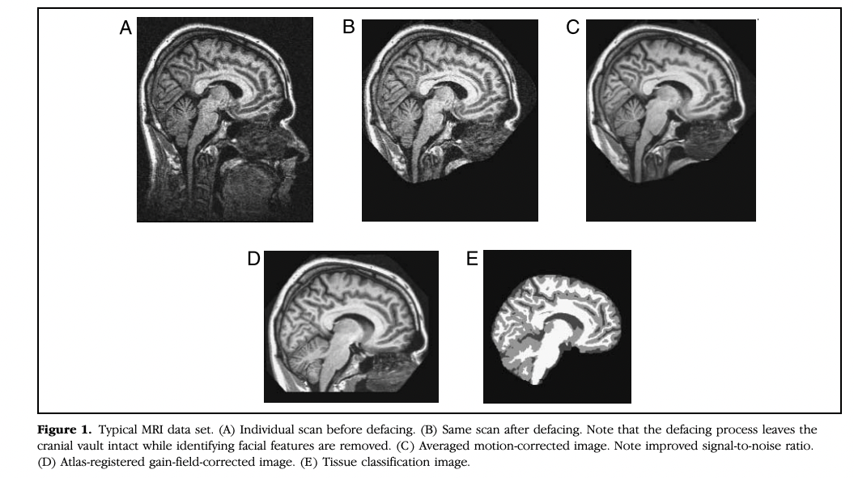

Slide 2
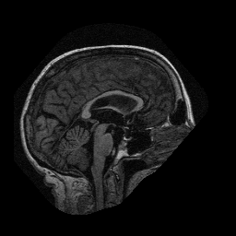
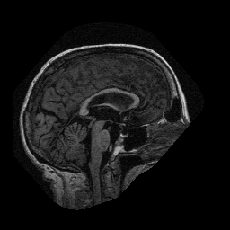


../RAW
OAS1_0001_MR1_mpr-1_anon_sag_66
OAS1_0001_MR1_mpr-2_anon_sag_66
“3-4 images corresponding to multiple repetitions of the same structural protocol within a single session to increase signal-to-noise”
OAS1_0001_MR1_mpr-3_anon_sag_66
OAS1_0001_MR1_mpr-4_anon_sag_66

Slide 3
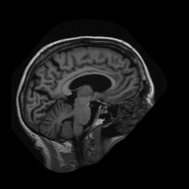
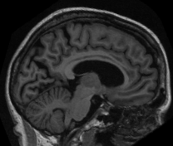
../PROCESSED/MPRAGE/SUBJ_111
OAS1_0001_MR1_mpr_n4 _anon_sbj_111_sag_88
“an average image that is a motion-corrected coregistered average of all available data”
../PROCESSED/MPRAGE/T88_111
“a gain-field corrected atlasregistered image to the 1988 atlas space of Talairach and Tournoux (Buckner et al., 2004)”
OAS1_0001_MR1_mpr_n4 _anon_111_t88_gfc_cor_110
“resulting transformation nonetheless places the brains in the same coordinate system and bounding box as the original atlas”

Slide 4
“resulting transformation places the brains in the same coordinate system and bounding box as the original atlas”

Slide 5
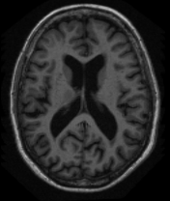
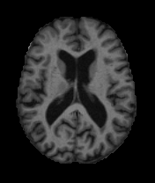
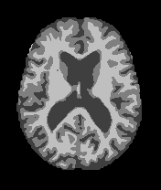
../PROCESSED/MPRAGE/T88_111
“a gain-field corrected atlasregistered image to the 1988 atlas space of Talairach and Tournoux (Buckner et al., 2004)”
OAS1_0001_MR1_mpr_n4 _anon_111_t88_gfc_tra_90
“a masked version of the atlas-registered image in which all non-brain voxels have been assigned an intensity value of 0”
OAS1_0001_MR1_mpr_n4 _anon_111_t88_masked_gfc_tra_90
../FSL_SEG
OAS1_0001_MR1_mpr_n4 _anon_111_t88_masked_gfc_fseg_tra_90
“a grey/white/CSF segmented image (Zhang et al., 2001)”

Slide 6
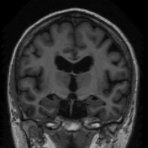
../PROCESSED/MPRAGE/T88_111
OAS1_0001_MR1_mpr_n4_anon_111_t88_gfc_sag_95

Slide 7
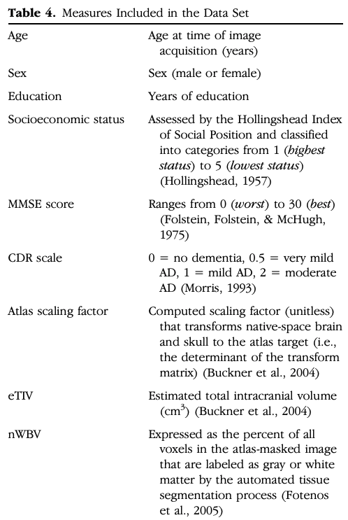

Slide 8
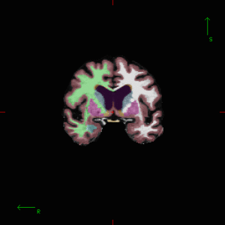
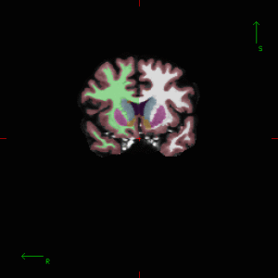
Freesurfer
Software used for 3D segmentation of MRI scans
folders contain even more files per patient (scripts etc)
colorized snapshots at specified locations
slice positions do not match perfectly
Patient1, Slice2
Patient2, Slice2

Slide 9
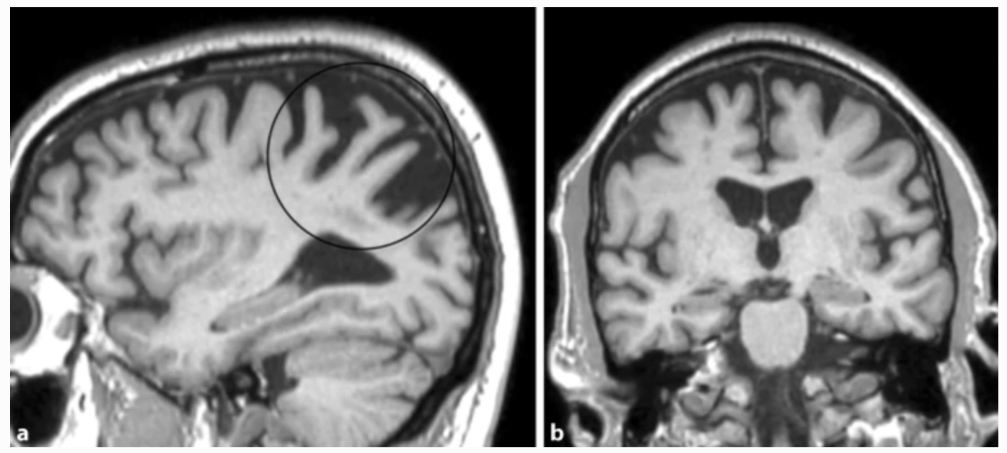
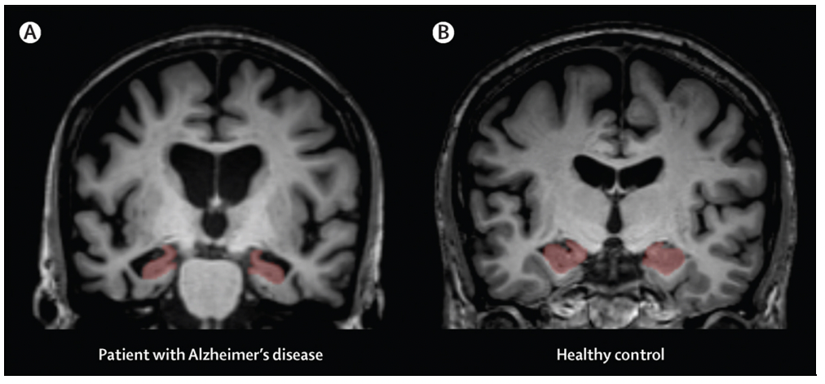
ImageJ script functionalities
Extract regions from side, front or top views
Extract single slices
Combine different slices in one image?
Potentially train models on several images per patient?
Separate models for each image, combine into meta-model?
Parietal lobe shrinkage
Hippocampal volume loss
Grey matter volume reduction?
Correlation of nWBV and CDR?

Slide 10
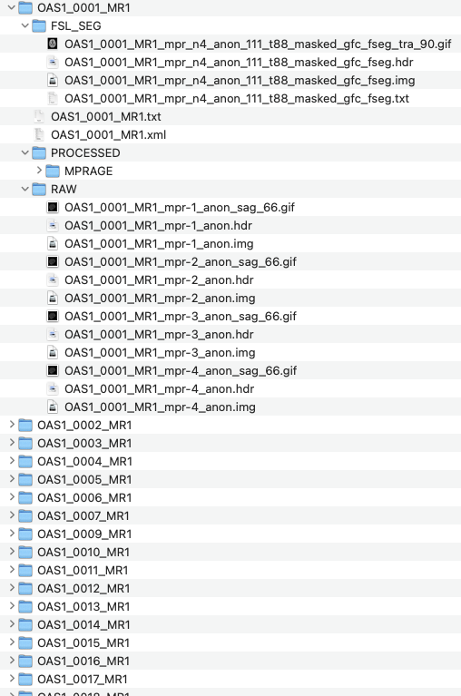
ImageJ script functionalities
Ask for correct directory structure
Ask what slices to extract from which side
Ask what regions to extract
IN
OUT
Extracts
> Hippocampus
> 0001_hippo.gif
> 0002_hippo.gif
> 0003_hippo.gif
> …
> Parietal_Lobe
> Ventricles
> Cortex
> Temporal lobe
Slices
> x_100
> 0001_x_100
> 0002_x_100
> 0003_x_100

Slide 11
ImageJ Script – First features
Get specific image from each folder
Save a subregion in a new folder

