Slide 1
KIDS TOYS STORE
Done by: 🧸Majd Albalawneh 🧸Samar alkhamis
🧸Taebah shlouh 🧸Tamara Alshabatat

Slide 2
Overview main idea
We offer phenomenal collections of kids’ toys online that encourage early development, promote learning, and stimulate the imagination.
Our website allows the customer to have an amazing shop experience, they can choose the products from different categories.

Slide 3
Project Description
Build E-commerce "KIDS TOYS store" for kids toys in 4 categories (dolls , creative , educational , electronic) website using using PHP and MYSQL. The user can add /delete product to carts and make payment, also can edit his data for the products and add them into the cart. Project contain admin dashboard; admin can add / update / delete : users, products, categories.

Slide 4




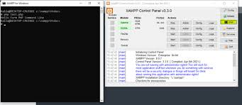



Languages used
Technologies used
Commend
Communication used

Slide 5
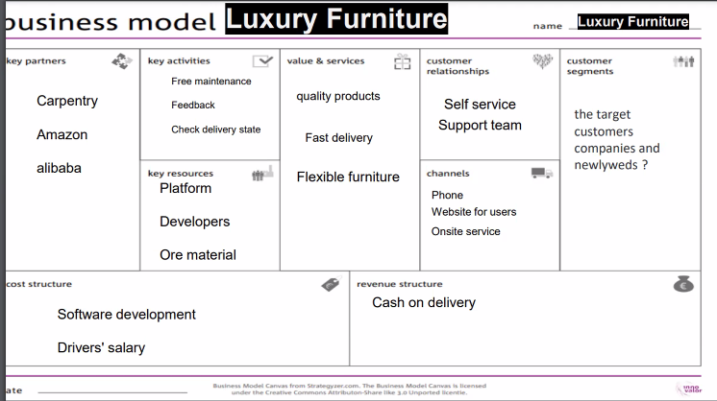

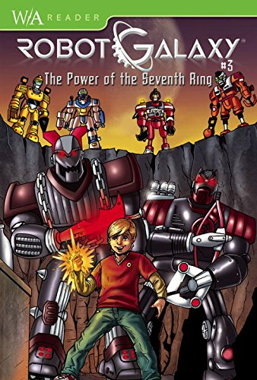
Kids Toys
Kids Toys
Electronic games maintenance,
Feedback
Its goal is customer satisfaction and continuing to provide what is new and useful for kids
Friendly toys
Games damaged during shipping

Slide 6
Demo
http://localhost/project5/index.html

Slide 7
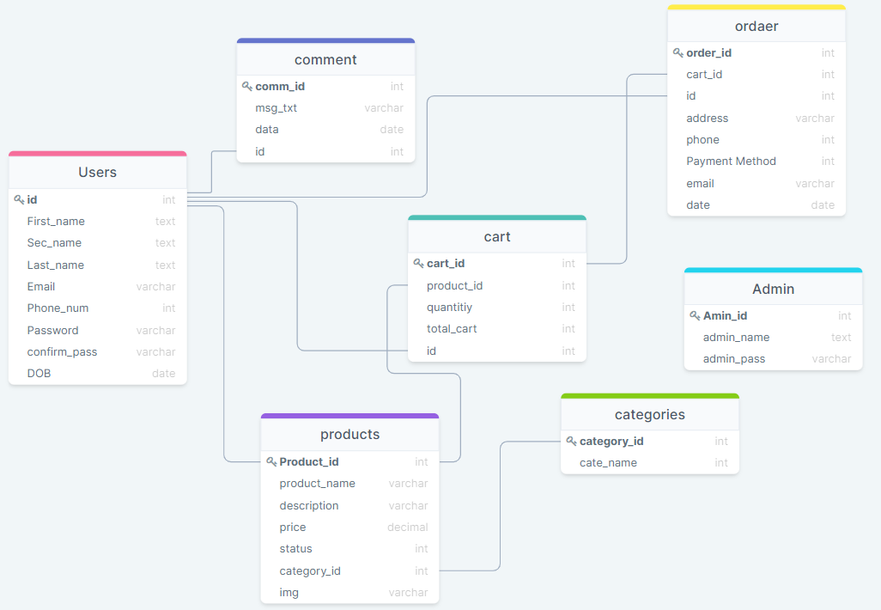
Kids Toys schema

