Slide 1
UPI Reliability Intelligence
Dashboard
Monitoring Transaction Activity Across Apps, Banks & Networks
Presented By
Mayank Aaswani
BCA

Slide 2
Introduction
UPI has transformed digital payments in India. Millions of users perform transactions every day.
Monitoring transaction activity helps organizations understand:
Usage patterns across platforms
Operational performance metrics
Transaction success and failure trends
Peak activity time windows
📱
Payment Apps
🏦
Banks
📡
Networks
💻
Devices

Slide 3
Problem Statement
Financial institutions process a large number of UPI transactions daily. Without monitoring tools, it becomes difficult to understand:
Peak Hours
App Usage
Bank Volume
When transaction activity is highest
Which payment apps are most used
Which banks handle the highest volume
Network Split
Outcomes
How transactions vary across networks
Overall success and failure distribution

Slide 4
Project Objective
Create an interactive Excel dashboard to monitor UPI transaction activity and outcomes
Key Questions Answered:
1
Which payment apps process the most transactions?
2
Which banks handle the highest transaction volume?
3
During which hours is transaction activity highest?
4
How are transactions distributed across networks?
5
What is the overall success and failure distribution?

Slide 5
Dataset Overview
Key Attributes
Dataset Size
Transaction ID
Timestamp
250,000
Payment App
Bank
UPI Transactions
Network Type
Device Type
Amount
Transaction Status

Slide 6
Data Preparation
🧹 Data Cleaning
⚙️ Feature Engineering
🛠 Tools Used
Removed duplicates
Checked missing values
Standardized categories
Month & Quarter fields
Amount Range buckets
Time-Based Analysis Fields
Microsoft Excel
Pivot Tables & Charts
Slicers
Dashboard Design

Slide 7
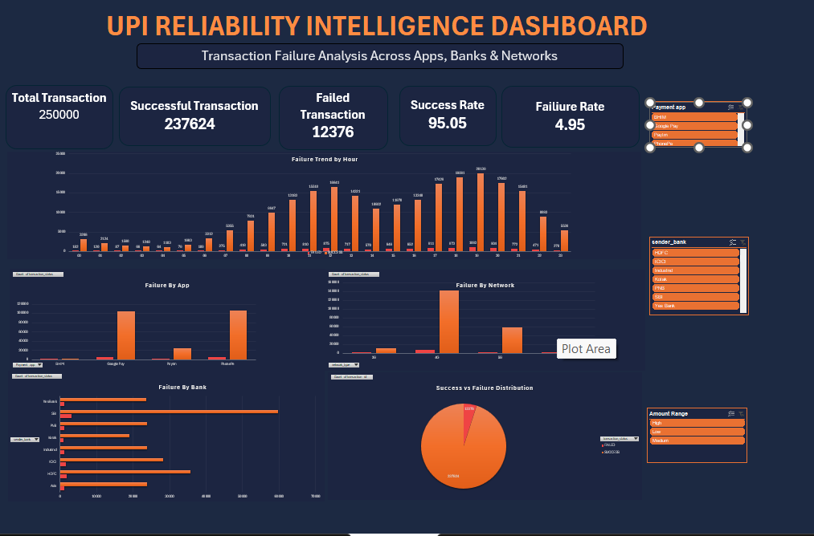
Dashboard Overview
[ Insert Dashboard Screenshot Here ]
KPI Cards
Total Transactions - 25,0000
Successful Txns - 237624
Failed Txns - 12376
Success Rate - 95.05%
Failure Rate - 4.95%
Visual Components
Txn Activity by Hour, App, Bank, Network
Success vs Failure Distribution

Slide 8
Key Insights
A total of 250,000 transactions were analyzed across all apps and banks.
Overall transaction success rate is approximately 95%.
1
2
Transaction activity peaks during evening hours — highest user engagement.
PhonePe and Google Pay account for the largest transaction volumes.
3
4
SBI handles the highest transaction volume among all banks in the dataset.
4G users account for the highest transaction activity among network types.
5
6

Slide 9
Business Value
This dashboard helps stakeholders:
📊
⚡
🧠
Monitor Transaction Activity
Track Operational Performance
Understand User Behavior
Real-time visibility into transaction volumes
KPI tracking for success and failure rates
Insights into app preferences and device usage
📈
🎯
Observe Transaction Trends
Data-Driven Decisions
Time-based patterns and peak hour analysis
Evidence-backed strategies for improvement

Slide 10
Future Improvements
Future versions of this project can include:
📉
🔐
🗺
Failure Rate Analysis
Fraud Detection
State-wise Analysis
🔮
📊
🤖
Predictive Analytics
Power BI Implementation
Machine Learning Models
💡 Acknowledging limitations shows analytical maturity and awareness of next steps

Slide 11
Conclusion
The dashboard successfully provides visibility into transaction activity across Payment Apps, Banks, Networks & Time Periods.
✅
📱
🏦
⏰
Transaction Monitoring
App-Level Insights
Bank Performance
Time-Based Trends
Complete visibility across all dimensions
App-wise volume and performance breakdown
Volume analysis by banking partner
Peak hour and period activity tracking
This project demonstrates how Excel dashboards can analyze large-scale digital payment data effectively.

Slide 12
Thank You
Mayank Aaswani | BCA
UPI Reliability Intelligence Dashboard

