Slide 1
Using a KNN Classifier to Predict Beach Closings
DS2500 Final Project
Tamara Hadzic

Slide 2
Background and Goals
Motivation came from trying to find beaches to swim at last summer, when many Massachusetts beaches were closed due to bacteria levels
We would like to be able to predict whether beaches would be open in a given week based on data from the past 3 weeks
To do this, we will use data from July 2023
We hope to train a K Nearest Neighbors classifier on week-by-week closures, precipitation data,

Slide 3
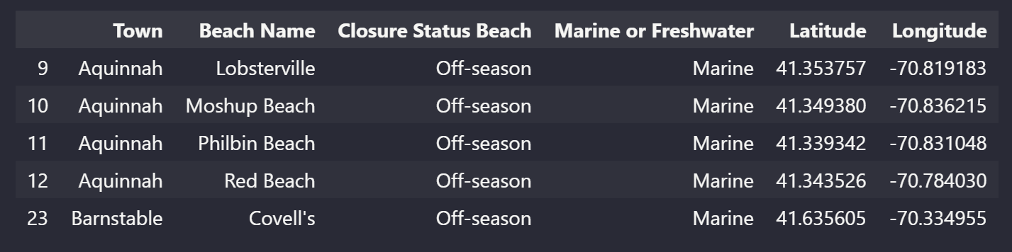
Current Postings for Public Beaches
https://www.mass.gov/info-details/interactive-beach-water-quality-dashboard

Slide 4
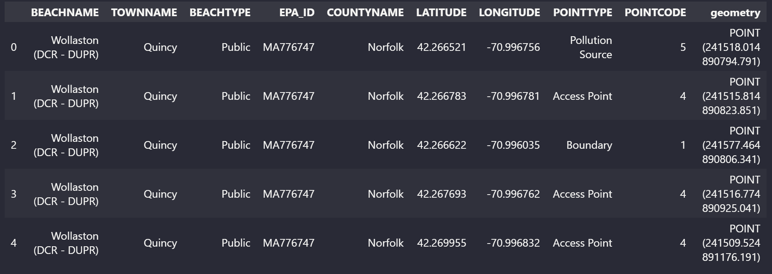
Shapefile for Massachusetts Beaches
https://www.mass.gov/info-details/massgis-data-marine-beaches

Slide 5
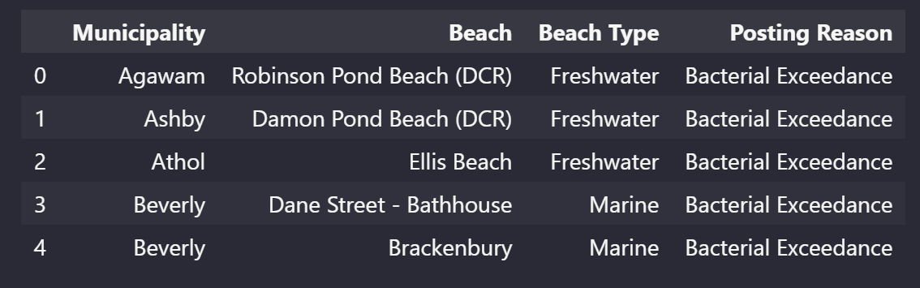
Archived Postings for One Timestamp
https://www.mass.gov/files/csv/2023-07/BeachPostingTbl-07-24-23.csv

Slide 6
Not all the beach closure data was available…
JULY
 |  |  |  |  |  | 1
2 | 3 | 4 | 5 | 6 | 7 | 8
9 | 10 | 11 | 12 | 13 | 14 | 15
16 | 17 | 18 | 19 | 20 | 21 | 22
23 | 24 | 25 | 26 | 27 | 28 | 29
30 | 31
= data available

Slide 7
To still provide week-to-week data, I used the percent of days each beach was closed as the features
JULY
 |  |  |  |  |  | 1
2 | 3 | 4 | 5 | 6 | 7 | 8
9 | 10 | 11 | 12 | 13 | 14 | 15
16 | 17 | 18 | 19 | 20 | 21 | 22
23 | 24 | 25 | 26 | 27 | 28 | 29
30 | 31
FEATURE: Closed ?/3 Days
FEATURE: Closed ?/4 Days
FEATURE: Closed ?/5 Days
LABEL: Was the beach closed at all during this week?

Slide 8
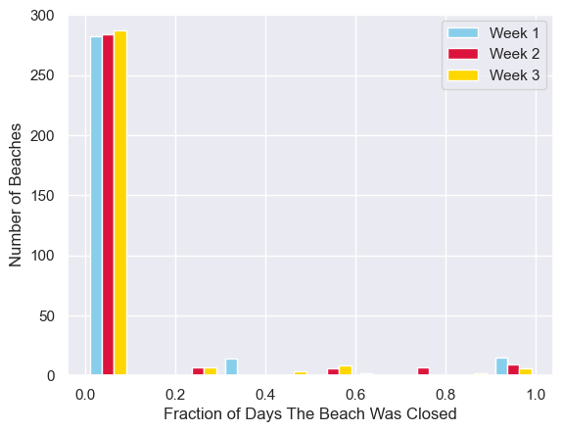

Slide 9



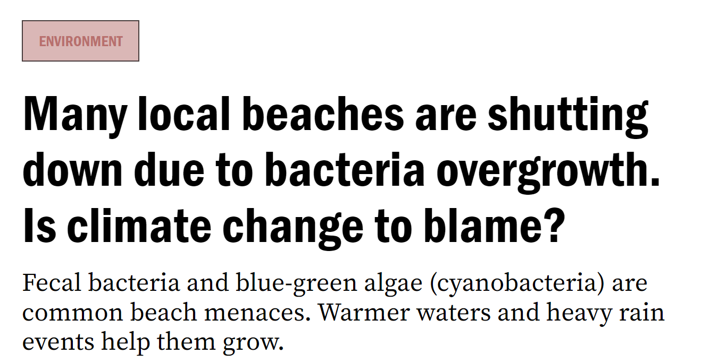

In addition to these three features, I considered the precipitation

Slide 10
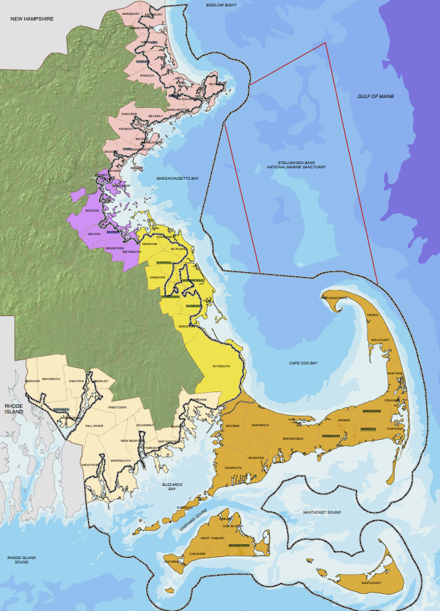
Cities Used to Represent Mass. Regions: - Ipswich - Beverly - Boston - Marshfield - Barnstable - Wellfleet - New Bedford - Edgartown

Slide 11
LABELS
FEATURES
Was the beach closed at any time in the last week of July?
Fraction of Days Closed During Week 1
Fraction of Days Closed During Week 2
Fraction of Days Closed During Week 3
Latitude
Longitude
Total Rainfall in First 3 Weeks of July
MODEL
K-Nearest Neighbors Classification
Test k from 4 to 18

Slide 12
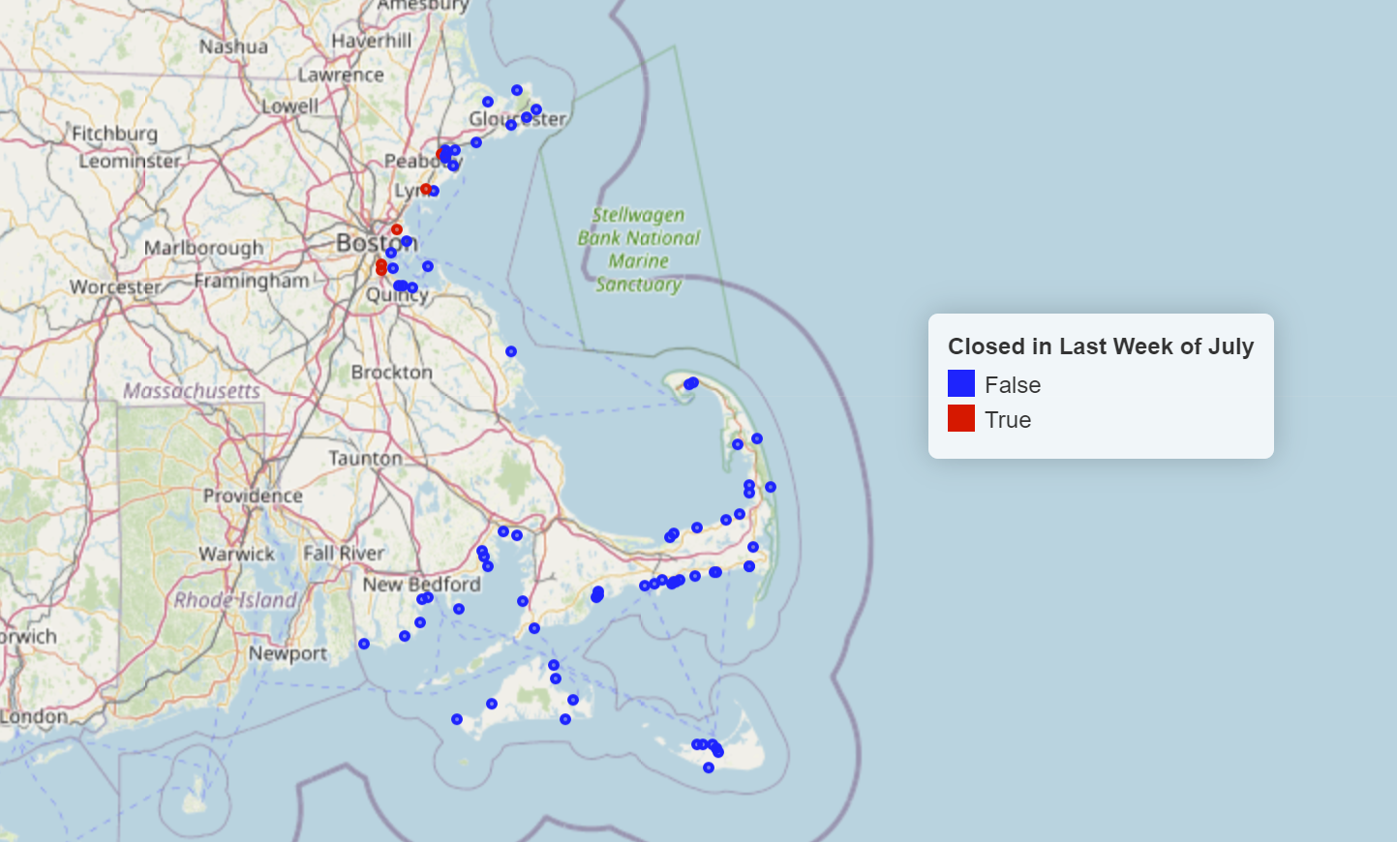

Slide 13
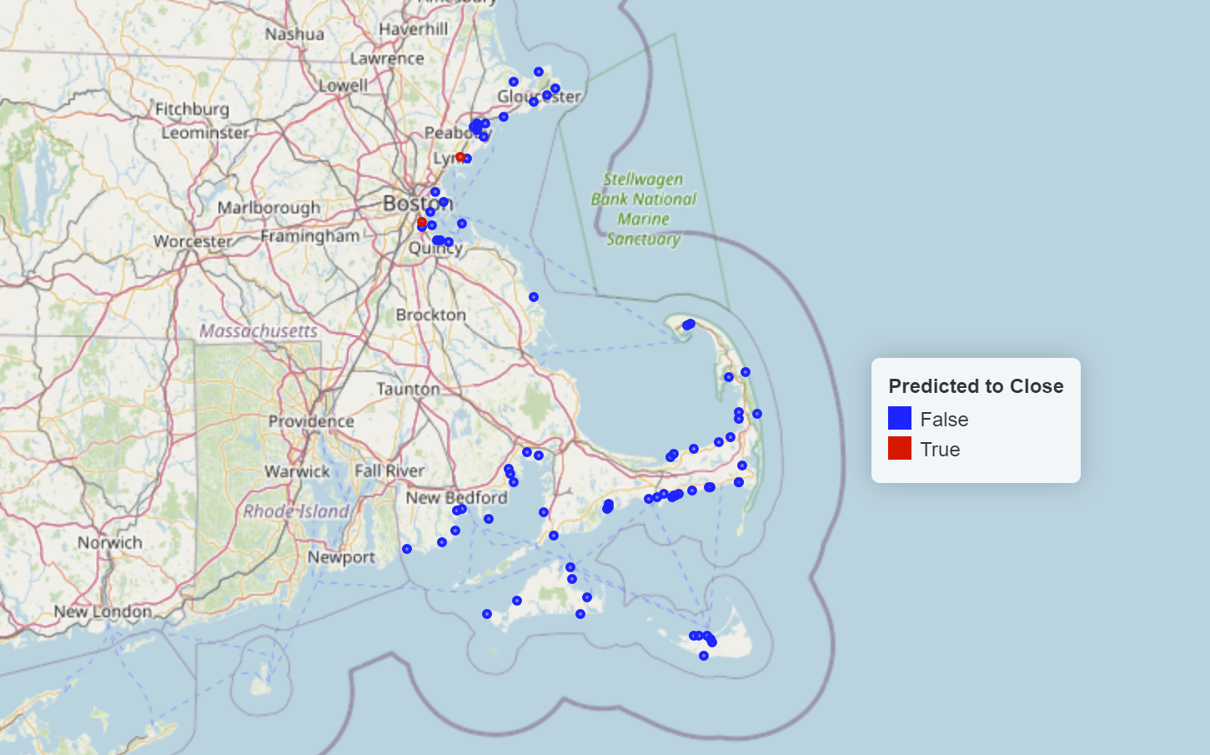

Slide 14
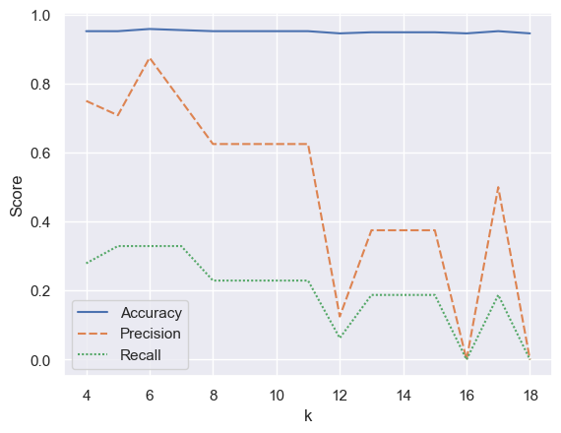

Slide 15
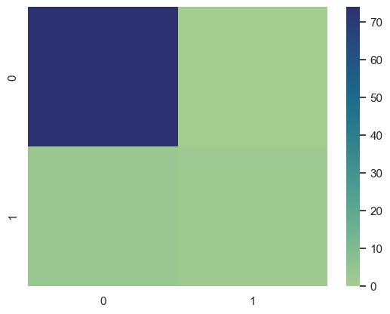
True Negatives
74
False Positives
0
The model predicted the beach would be closed at some point, but it remained open the whole week
The model predicted the beach would be open the entire week and it was
False Negatives
3
True Positives
2
The model predicted the beach would be open all week, but it closed at some point during the week
The model predicted the beach would close at some point during the week and it was

Slide 16
Conclusions and Future Work
Overall, our model was able to predict which beaches would be closed in a given week with accuracy 95.84%, precision 87.5%, and recall 32.92% in cross-fold validation
Using the optimal k of 6, the F1 score was 51.47%
The confusion matrix shows that there were 0 false positives and 3 false negatives, meaning it tended to predict that beaches were open when they were actually closed
In the future we would want to use a model that minimizes the false negative rate, even if that means increasing the false positive rate, since it is better for beachgoers to have an abundance of caution

