Slide 1

NEW LOCATION FOR OUTCOURCING IT SERVICES
Tamara Kirakosyan
08.02.2022

Slide 2

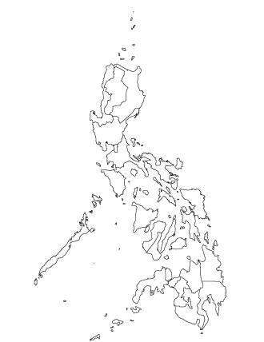
NEW LOCATION: PHILIPPINES
$25-$49 hourly software developer rate¹
190,000 developers²
> 92% speak English out of a population of 90 million³
> 700
Business Process Outsourcing Companies⁴
Tamara Kirakosyan

Slide 3
Potential-Evaluation of Philippines as a New Location for EPAM Anywhere
Cost-effectiveness
Digital Resonance
Region | Average software dev. hourly rate⁵
North America | $80
Western Europe | $75
Eastern Europe | $55
Latin America | $55
Asia Pacific | $28
Africa | $31
Country | Average software dev. hourly rate
Bangladesh | $28
China | $28
India | $29
Malaysia | $33
Nepal | $28
Pakistan | $25
Philippines | $28
Sri Lanka | $28
According to 2019 Kearney Global Services Location Index, Philippines is ranked 29th as a country with best digital resonance worldwide⁸
According to the 2021 Kearney Global Services Location Index Asian countries are among the top 10 outsourcing countries in the world that have completed work. Philippines ranks #9 in Global Services Location Index (GSLI) ⁸
The Global Innovation Index of Philippines has moved from 91th to 51th in the global ranking, reaching the 4th place among lower middle-income Economies⁹
Professional skills
Business Environment
Developers in Philippines ranked 36th as a country with best developers in the world (Only 3rd among countries in Asia Pacific Region, coming after Vietnam and India).⁶
According to PSIA (Philippine Software Industry Association), the Philippines has about 190,000 developers, and the number is expected to grow up to 210,000 by 2022. ²
Among common programming languages JAVA, C++, Python, SQL and Ruby are popular in Philippines. ⁷
Philippines has started incorporating severe educational reforms focusing on a specialized STEM high school system which will lead to the growth of yearly new software development professionals in the future.
Region | Ease of doing business, out of 100⁵
North America | 84
Western Europe | 80.3
Eastern Europe | 73.7
Latin America | 65.7
Asia Pacific | 65.5
Africa | 66.1
Country | Ease of doing business
Bangladesh | 45
China | 77.9
India | 71
Malaysia | 81.5
Nepal | 63.2
Pakistan | 61
Philippines | 62.8
Sri Lanka | 61.8
Although according to the ease of doing business index it might be challenging to do business, the other three metrics (cost-effectiveness, digital resonance and professional skills) show very promising potential for Philippines to become a new Anywhere program location.

Slide 4
Sources
¹ Offshore Developers — Rates in 2022: Best Countries and Best Platforms (youteam.io)
² TOP 5 Countries to Outsource Software Development | CustomerThink
³ Which Countries Have the Most English Speakers? (k-international.com)
⁴ Top 40 call centers in the Philippines | Outsource Accelerator
⁵ Offshore Developers — Rates in 2022: Best Countries and Best Platforms (youteam.io)
⁶ Best Developers In The World - IT Ranking | Pentalog
⁷ What Programming Language Does Your Country Like? (fossbytes.com)
⁸ The 2019 Kearney Global Services Location Index – Kearney
⁹ Global Innovation Index 2021 - Executive Summary (wipo.int)

